Slide 1
Chapter 2 Operating System Fundamentals
CPIT100

Slide 2
Operating System Basic
Every computer, from the smallest laptop to the largest supercomputer, has an operating system. Even cell phones, game consoles, cars, and some appliances have operating systems.
The role of the operating system is critical.
A computer can't operate without it.

Slide 3
Operating System Basic
What does the operating system do?
System software consists of two primary types of programs:
The operating system
Utility programs.
The operating system (OS) is a group of programs that controls how your computer functions.

Slide 4
Operating System Basic
The operating system has three primary functions:
It manages the computer's hardware, including the CPU, memory, and storage devices, as well as peripheral devices.
It provides a consistent means for application software to work with (CPU).
It responsible for the management, scheduling, and coordination of tasks.

Slide 5
Operating System Basic
You interact with your OS through the user interface.
User interface: desktop, icons, and menus that let you communicate with your computer.
A utility program: is a small program that performs many general housekeeping tasks for your computer, such as system maintenance and file compression.
A set of utility is bundled with each OS, but you can also buy standalone utility programs that often provide more features.

Slide 6
Operating System Basic
Are all operating system alike?
Laptops, tablet computers, and smartphones with Microsoft Windows operating systems designed to take advantage of their unique characteristics.
developers such as Microsoft and Apple are making operating systems that have similar functionality (such as OS X and iOS) or single operating systems (such as Windows 10) that can run on a variety of devices.

Slide 7
Operating System Basic
When operating systems were originally developed, they were single-user, single-task operating systems.
Modern operating systems allow a single user to multitask: to perform more than one process at a time.
Operating systems such as Windows and OS X provide networking capabilities as well.
Operating systems can be categorized by the type of device in which they're installed.

Slide 8
Operating System for Machinery, network and business
Why do machines with built-in computers need an OS?
Machinery that performs a repetitive series of specific tasks in an exact amount of time requires a real-time operating system (RTOS).
Also referred to as embedded systems require minimal user interaction.

Slide 9
Operating System for Machinery, network and business
RTOS: a program a specific purpose, and it must guarantee certain response times for particular computing tasks; otherwise, the machines useless and their functions.
There are no commercially available standard RTOS software programs.
The programs are written specifically for the needs of the device regimented tasks or record precise results such as measurement instruments found in the scientific, defense and aerospace industries –required RTOS.

Slide 10
Operating System for Machinery, network and business
You also encounter RTOSs every day in devices such as fuel injection system in car engines , automobile’’ infotainment’’ systems, and some common appliances.
RTOSs are found in many types of robotic equipment.
Television stations use robotic cameras with RTOSs that glide across a suspended cable system to record sports events from many angles.

Slide 11
Operating System for Machinery, network and business
What kind of operating systems do networks use?
A multiuser operating system (or network operating system) lets more than one user access the computer system at a time by handling and prioritizing requests from multiple users.
Networks: groups of computers connected to each other so that they can communicate and share resources.
Need a multiuser OS because many users simultaneously access the server: the computer that manages network resources such as printing and communications.

Slide 12
Operating System for Machinery, network and business
The latest versions of Windows and OS X can be considered network operating systems: They enable users to set up basic network in their homes and small businesses.
In larger networks, a more robust network OS is installed on servers and manages all user requests.
For example, on a network where users share a printer, the network OS ensures that the printer prints only one document at a time in the order the requests were made. Examples: Windows Server, LINUX, UNIX).

Slide 13
Operating System for Machinery, network and business
What is UNIX?
is a multiuser, multitasking OS that is used as a network OS, although it can also be found on PCs.
Developed in 1969 by Ken Thompson and Dennis Ritchie of AT&T's Bell Labs.
The UNIX code was initially not proprietary (no company owned it).
Any programmer was allowed to use the code and modify it to meet his or her needs.

Slide 14
Operating System for Machinery, network and business
UNIX is now a brand that belongs to the company The Open Group, but any vendor that meets the testing requirements and pays a fee can use the UNIX name.
Individual vendors then modify the UNIX code to run specifically on their hardware.

Slide 15
Operating System for Machinery, network and business
What other kinds of computers require a multiuser OS?
Mainframes and super computers also require multiuser operating Systems.
Mainframes routinely support hundreds thousands of users at time, and supercomputers are often accessed by multiple people working on complex calculations.

Slide 16
Operating System for Personal Use
What kind of OS dose a smartphone use?
Today's smartphone operating systems offer personal assistants with predictive search capabilities.
the ability to use a wide variety of apps, a search engine, a camera, and of course a phone, as well as texting and e-mail capabilities.
Some even enable note taking on their touch-screen displays.
Most smartphones support Bluetooth and WiFi as standard,
Introducing near field communication (NFC) for wireless transfers and mobile payments.

Slide 17
Operating System for Personal Use
What OS do tablets use?
Popular tablet operating system include IOS, Android and Windows.
iPad use IOS, whereas a number of different tablets (such as the Samsung Galaxy Tab and the Google Nexus) use versions of Android.
The Kindle Fire also runs a customized version of Android.
Until the release of Windows 8 in 2012, Microsoft didn't have a popular tablet OS.

Slide 18
Operating System for Personal Use
Do gaming consoles and iPods use an OS?
Gaming systems such as Microsoft's Xbox 360, the Nintendo Wii, and the Sony PlayStation, as well as personal media players such as the iPod, all require system software developed specifically for the particular device.
The system software controls the physical aspects of the device (such as game controllers) as well as other application programs that come with the device.
For example, the operating systems on gaming consoles control web browsing and file storage of media and photos as well as playing of DVDs and games.

Slide 19
Operating System for Personal Use
What are the most popular operating systems for personal computers?
Microsoft Windows, Apple OS X, and Linux (an open source OS) are the top three operating systems for personal computers.
Although they share similar features, each is unique.

Slide 20
Operating System for Personal Use
What's special about Windows?
Microsoft Windows is an operating environment that incorporates a user-friendly, visual interface like the one that was first introduced with Apple's OS.
improvements in Windows have concentrated on
Increasing user functionality
Friendliness
Improving Internet capabilities
Supporting home networks
Enhancing file privacy and security.
Microsoft's newest OS, Windows 10, provides an interface optimized for touchscreen devices and is designed to run across all devices: phones, tablets, laptops, and desktops.

Slide 21
Operating System for Personal Use
What's special about Mac OS?
In 1984, Mac OSs became the first commercially available OS to incorporate the ability to interact with the computer with user-friendly point-and-click technology.
With the release of the Mountain Lion version, Apple added many features such as messages reminders, notes, and a notification center.
The latest version, El Capitan, released in the fall of 2015, offers new features such as Split View (similar to Snap in Windows), touch-screen functionality, and natural language capabilities to Spotlight, OS X's search feature.
OS X uses the same desktop metaphors as Windows.
OS X is based on the UNIX operating system, which is exceptionally stable and reliable. But you still need to install updates.

Slide 22
Operating System for Personal Use
What is Linux?
Linux is an open source OS designed for use on personal computers and as a network OS.
Linux began in 1991 as a part-time project.
It has since been tweaked by scores of programmers as part of the Free Software Foundation GNU Project.
Linux has a reputation as a stable OS that is not subject to crashes or failures.
Linux can be modified or updated quickly by hundreds of programmers around the world.

Slide 23
Operating System for Personal Use
What is Linux?
Linux is available for download in various packages known as distributions or distros.
Distros include the underlying Linux kernel (the code that provides Linux's basic functionality) and special modifications to the OS, and may also include additional open source software (such as OpenOffice).
Distorswatch.com This site tracks Linux distros and provides helpful tips for beginners

Slide 24
Operating System for Personal Use
Does it matter what OS is on my computer?
An OS is designed to run on specific CPUs.
CPUs have different designs, which can require modifying the OS software to allow it to communicate properly with each CPU.
Computer's platform is the combination of an OS and a specific processor.
For user convenience, computers and other devices usually come with an OS already installed. Windows and Linux can run on most of the hardware being sold today.
Your choice of an OS in this case is mostly a matter of price and personal preference.
Most application software is OS dependent. You need to make sure you got correct version of the application for your OS.

Slide 25
Operating System for Personal Use
Can I have more than one OS on my computer?
Different operating systems offer different features.
In MAC, If you want to run windows or OS X both at the same time, you can create “virtual drives” using virtualization software such as Parallels or VMware Fusion.
In Windows, you can create a separate section of your hard drive (called a partition) and install another OS on it while leaving your original Windows installation untouched. After installing the second OS, when your computer starts, you're offered a choice of which OS to use.

Slide 26
Operating System for Personal Use
How do operating systems use the "cloud"?
Operating systems have features that are tied to cloud computing.
Windows 10:
It features tighter integration with the cloud.
Using your Microsoft account. Windows 10 stores your settings and keeps track of applications you've purchased from the Windows store online.
You can easily access and store files online in your OneDrive account.
You can also log in into your windows account from any windows-based machine and be able to see your familiar desktop and application.
OS X:
allows you to sign in with your Apple ID,which provides access to Apple's iCloud system. iCloud stores your content online and automatically pushes it out to all your Apple devices.

Slide 27
Operating System for Personal Use
Google Chrome OS:
Which is a web-based OS.
Virtually no files are installed on your computing device. Rather, the main functionality of the OS is provided by accessing the web through a web browser.
Chrome OS is only available on certain hardware from Google's manufacturing partners, and these devices are called Chromebooks.
The Chrome OS should not be confused with the Google Chrome browser. The browser is application software that can run in many different operating systems.

Slide 28
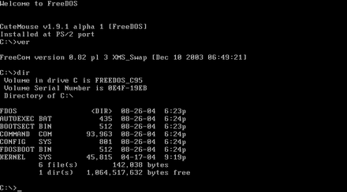
What Operating System DOES The User Interface
How dose OS control how I interact with my computer?
First personal computer used Microsoft Disk Operating System)MS-DOS or just DOS) which has a command driven interface.
Command driven interface: is one in which you enter commands to communicate with computer system.
The DOS commands were not easy to understand.
Interface too complicated for the average user.
Used in business by professional computer operators.

Slide 29
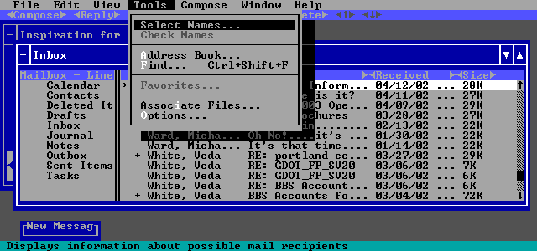
The User Interface
The command driven was later improved by incorporating a menu driven interface.
Menu driven interface: in which you chose a command from menus displayed on the screen.
Eliminated the need for user to know every command.
They were still not easy enough for most people to use.

Slide 30
The User Interface
What kind of interface operating system used today?
Current computer and mobile operating system, such as Microsoft and OS X use a graphical user interface (GUI).
GUI display graphic and use the point and click technology of the mouse.
User-friendly.
Linux-based operating system do not have a single default GUI. Instead, user free to choose among many commercially available and free interface, such as GNOME and KDE, each provide a different look and feel.

Slide 31
Hardware Coordination
Why does the OS need to manage the processor?
Although the CPU is powerful, it still needs the OS to arrange the execution of all these activities in a systematic way.
To do so, the OS assigns a slice of its time to each activity that requires the processor's attention.
The OS must then switch among different processes billions of times a second to make it appear that everything is happening seamlessly.

Slide 32
Hardware Coordination
How exactly does the OS coordinate all the activities?
Every keystroke, every mouse click (or touch on the screen), and each signal to the printer and from the Blu-ray drive creates an action, or event, in the respective device (keyboard, mouse, Blu-ray drive, or printer) to which the OS responds.
Sometimes these events occur sequentially (such as when you type characters one at a time ) but other events involve two or more devices working concurrently (such as the printer printing while you type and watch a movie).
The OS in fact switches back and forth among processes, controlling the timing of events on which the processor works

Slide 33
Hardware Coordination
An interrupt: a unique signal tells the OS that it's in need of immediate attention.
For example, assume you're typing and want to print a document. When you tell your computer to print your document. the printer generates an interrupt signal.
Every device has its own type of interrupt, which is associated with an interrupt handler, a special numerical code that prioritizes the requests.
These requests are placed in the interrupt table in the computer's primary memory (RAM).

Slide 34
Hardware Coordination
preemptive multitasking: The OS processes the task assigned a higher priority before processing a task assigned a lower priority.
For example: when the OS receives the interrupt from the printer, it suspends the CPU's typing activity and Blu-ray activity and puts a "memo" in a special location in RAM called a stack. The memo is a reminder of what the CPU was doing before it started to work on the printer request. The CPU then retrieves the printer request from the interrupt table and begins to process it. On completion of the printer request, the CPU goes back to the stack, retrieves the memo it placed about the keystroke or Blu-ray activity, and returns to that task until it is interrupted again, in a very quick and seamless fashion.

Slide 35
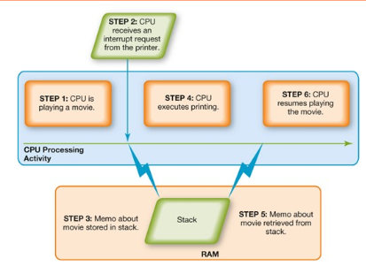
How preemptive multitasking works

Slide 36
Hardware Coordination
What happens if more than one document is waiting to be printed?
When the CPU receives a request to send information to the printer, it first checks with the OS to ensure that the printer is not already in use. If it is, the OS puts the request in another temporary storage area in RAM, called the buffer. The request then waits in the buffer until the spooler, a program that helps coordinate all print jobs currently being sent to the printer, indicates the printer is available. If more than one print job is waiting, a line (or queue) is formed so that the printer can process the requests in order.

Slide 37
Memory and Storage Management
Why does the OS have to manage the computer's memory?
As the OS coordinates the activities of the processor, it uses RAM as a temporary storage area for instructions and data the processor needs.
The processor then accesses these instructions and data from RAM when it's ready to process them.
The OS is, therefore, responsible for coordinating the space allocations in RAM to ensure there is enough space for all the pending instructions and data.
The OS then clears the items from RAM when the processor no longer needs them.

Slide 38
Memory and Storage Management
Can my computer ever run of RAM?
RAM has limited capacity.
Most computers sold for home use have between 4 and 16 GB of RAM.
If you have an older computer system with less RAM, it might be time to consider buying a new computer or add more RAM.

Slide 39
Memory and Storage Management
What happens if my computer runs out of RAM?
The OS borrows from the more spacious hard drive.
This process of optimizing RAM storage by borrowing hard drive space is called virtual memory.
When more RAM is needed, the OS swaps out from RAM the data or instructions that haven't recently been used and moves them to a temporary storage area on the hard drive called the swap file (or page file).
If the data or instructions in the swap file are needed later , the OS swaps them back into active RAM and replaces them in the hard drive's swap file with less active data or instructions.
This process of swapping is known as paging

Slide 40
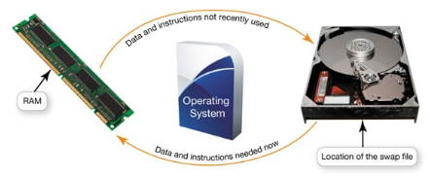
Memory and Storage Management

Slide 41
Memory and Storage Management
Can I ever run out virtual memory?
Only a portion of hard drive is allocated to virtual memory.
You can increase amount of hard drive space allocated.
Computer will become sluggish as it is forced to page more often.
Thrashing: the condition of excessive paging.
The solution is to increase RAM or buy a new computer.

Slide 42
Memory and Storage Management
How does the OS manage storage?
File management system that keeps track of the name and location of each file you save and the programs you install.

Slide 43
Hardware and Peripheral Device Management
How does the OS manage the hardware and peripheral devices?
Each device attached to your computer comes with a special program called a device driver that facilitates communication between the device and the OS.
Devices wouldn't function without the proper device drivers.

Slide 44
Hardware and Peripheral Device Management
Do I always need to install drivers?
Most devices such as flash drives, mice, keyboards, digital cameras, come with the driver already installed in Windows.
Called Plug and Play devices.
Plug and Play: is a software and hardware standard designed to facilitate the installation of new hardware in PCs by including in the OS the drivers these device need in order to run.
PNP let you plug a new device into your computer, run it and immediately play(use) it.

Slide 45
Hardware and Peripheral Device Management
What happens if the device is not PnP?
You'll be prompted to install or download from the Internet the driver that was provided with the device.
you can often download the necessary driver from the manufacturer's website or Driverzone.com

Slide 46
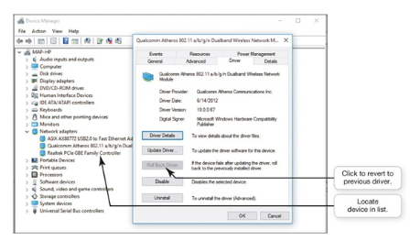
Hardware and Peripheral Device Management
Can I damage my system by installing a device driver?
Occasionally, when you install a driver, your system may become unstable.
to remedy the problem, Windows has a Roll Back Driver feature that removes a newly installed driver and replaces it with the last one that worked.

Slide 47
Software Application Coordination
How does the OS help application software run on the computer?
Every computer program needs to interact with the CPU using computer code.
For programs to work with the CPU they must contain code the CPU recognizes.
Rather than having the same blocks of code for similar procedures in each program, the OS includes the blocks of code-each called an application programming interface (API)-that application software needs in order to interact with the CPU.
Microsoft DirectX is a group of multimedia APls built into the Windows OS that improves graphics and sounds when you're playing games or watching videos on your PC.

Slide 48
Software Application Coordination
What are the advantages of using APIs?
APls not only prevent redundancies in software code, they make it easier for software developers to respond to changes in the OS.
Software companies make applications in software suites (such as Microsoft Office) that have a similar interface and functionality. And since these applications share common APls, data exchange is facilitated between two programs, such as inserting a chart from Excel into a Word document.

Slide 49
What are the steps involved in the boot process?
The boot process consists four basic steps.
Step 1: Activating BIOS.
Step 2: Performing the Power-On Self-Test.
Step 3: Loading the OS.
Step 4: Checking Further Configurations and Customizations.
The term boot, from bootstrap loader (a small program used to start a larger program).

Slide 50
What are the steps involved in the boot process?
Step 1: Activating BIOS
What's the first thing that happens after I turn on my computer?
In the first step of the boot process, the CPU activates the basic input/output system (BIOS).
BIOS is a program that manages the exchange of data between the OS and all the input and output devices attached to the system.

Slide 51
What are the steps involved in the boot process?
BIOS is also responsible for loading the OS into RAM from its permanent location on the hard drive.
BIOS itself is stored on a read-only memory (ROM) chip on the motherboard. Unlike data stored in RAM, data stored in ROM is permanent and is not erased when the power is turned off.

Slide 52
What are the steps involved in the boot process?
Step 2: Performing the Power-On Self-Test How does the computer determine whether the hardware is working properly?
The first job BIOS performs is to ensure that essential peripheral devices are attached and operational-a process called the power-on self-test (POST).
The BIOS compares the results of the POST with the various hardware configurations permanently stored in CMOS (pronounced "see-moss").

Slide 53
What are the steps involved in the boot process?
CMOS, which stands for complementary metal-oxide semiconductor, is a special kind of memory that uses almost no power.
A small battery pro- vides enough power so that the CMOS contents won't lost after the computer is turned off.
CMOS contains information about the system's memory, types of disk drives, and other essential input and output hardware components.
If the results of the POST compare favorably with the hardware configurations stored in CMOS, the boot process continues.

Slide 54
What are the steps involved in the boot process?
Step 3: Loading the OS
How does the OS get loaded into RAM? Next, BIOS goes through a preconfigured list of devices in its search for the drive that contains the system files, the main files of the OS.
When it is located, the OS loads into RAM from its perma- nent storage location on the hard drive.
Once the system files are loaded into RAM, the kernel or supervisor program) is loaded.
The kernel is the essential component of the OS.

Slide 55
What are the steps involved in the boot process?
It's responsible for managing the processor and all other components of the computer system.
Because it stays in RAM the entire time your computer is powered on, the kernel is said to be memory resident.
Other, less critical, parts of the OS stay on the hard drive and are copied over to RAM on an as-needed basis so that RAM is managed more efficiently.
These programs are referred to as nonresident. Once the kernel is loaded, the OS takes over control of the computer's functions.

Slide 56
What are the steps involved in the boot process?
Step 4: Checking Further Configurations and Customizations.
Is that it? Finally, the OS checks the registry for the configuration of other system components.
The registry contains all the different configurations (settings) used by the OS and by other applications.
It contains the customized settings you put into place, such as mouse speed, as well as instructions as to which programs should be loaded first.

Slide 57
What are the steps involved in the boot process?
Why do I sometimes need to enter a login name and password at the end of the boot process?
The verification of your login name and password is called authentication.
The authentication process blocks unauthorized users from entering the system.
You may have your home computer set up for authentication, especially if you have multiple users accessing it. All large environments, like your college, require user authentication for access.

Slide 58
What are the steps involved in the boot process?
On a Windows 10 computer, after your computer has completely booted up, you are brought to the Lock Screen where you are to log into your Microsoft account.
Your Microsoft account is a combination of an e-mail address and a password. Because configuration settings are stored online and associated with a particular Microsoft account, it is easy for multiple people to share any Windows 10 computer and have access to their individual settings and preferences.

Slide 59
What are the steps involved in the boot process?
How do I know if the boot process is successful? The entire boot process takes only a few minutes to complete.
If the entire system is checked out and loaded properly, the process completes by displaying the lock screen.
After logging in, the computer system is now ready to accept your first command.

Slide 60
What are the steps involved in the boot process?
What should I do if my computer doesn't boot properly?
Sometimes problems occur during the boot process. Here are some suggestions for solving a boot problem
If you've recently installed new software or hardware, try uninstalling it. (Make sure you uninstall through Apps & features in System Settings to remove the software.) If the problem no longer occurs when rebooting, you can reinstall the device or software

Slide 61
What are the steps involved in the boot process?
Try accessing the Windows Advanced Options Menu (accessible by pressing the F8 key during the boot process). If Windows detects a problem in the boot process, it will add Last Known Good Configuration to Windows Advanced Options Menu. Every time your computer boots successfully, a configuration of the boot process is saved When you choose to boot with the Last Known Good Configuration, the OS starts your computer by using the registry information that was saved during the last shut down.
Try resetting your computer (in Update & Security Settings).

Slide 62
What are the steps involved in the boot process?
What happens when a PC is "reset"?
Sometimes Windows does not boot properly or the system does not respond properly.
You may even see messages related to fatal exceptions." Reset this PC is a utility program in Windows 10 that attempts to diagnose and fix errors in your Windows system files that are causing your computer to behave improperly.

Slide 63
What are the steps involved in the boot process?
When a PC is reset, the following occurs
Your data files (documents, music, videos, etc.) and personalization settings are not removed or changed.
Apps that you have downloaded from the Windows Store are kept intact.
Apps that you have downloaded from the Internet or installed from DVDs ill be removed from your PC. There- fore, you'll need to reinstall them after the reset
It's recommended that you back up your PC prior to resetting it as a precautionary measure.
If all other attempts to fix your computer fail, try Go back to an earlier build to revert to a past configuration.

Slide 64
What are the steps involved in the boot process?
What should I do if my keyboard or another device doesn't work after I boot my computer?
Sometimes during the boot process, BIOS skips a device (such as a keyboard) or improperly identifies it.
Your only indication that this problem has occurred is that the device won't respond after the system has been booted. When that happens, try restarting the computer.
If the problem persists, check the OS's website for any patches (or software fixes) that may resolve the issue.
If there are no patches or the problem persists, you may want to try to update the device driver or get technical assistance.

Slide 65
Naming Files
Are there special rules I have to follow when I name files?
The first part of a file, or the file name, is generally the name you assign to the file when you save it.
For example, "bioreport" may be the name you assign a report you have completed for a biology class.
In a Windows application, an extension or file type, follows the file name and a period or dot (). Like a last name, this extension identifies what kind of family of files the file belongs to, or which application should be used to read the file.
For example, if "bioreport" is a spreadsheet created in Microsoft Excel 2016, it has an .xlsx extension and its name is "bioreport.xlsx" .

Slide 66
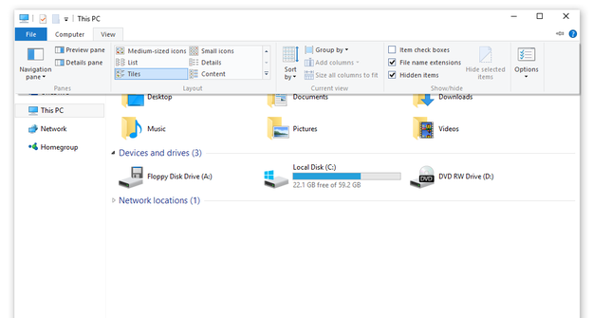
Naming Files
You can choose to display file extensions by checking or unchecking the File name extensions box in the Show hide group on the View tab in File Explorer.

Slide 67
Naming Files
lists some common file extensions and the types of documents they indicate.

Slide 68
Naming Files
Why is it important to know the file extension?
When you save a file created in most applications running under the Windows OS, you don't need to add the extension to the file name; it is added automatically for you.
Mac and Linux operating systems don't require file extensions. This is because the information as to the type of application the computer should use to open the file is stored inside the file itself.
However, if you're using the Mac or Linux OS and will be sending files to Windows users, you should add an extension to your file name so that Windows can more easily open your files.

Slide 69
Naming Files
Have you ever been sent a file by e-mail and couldn't open it?
Most likely, that was because your computer didn't have the program needed to open the file.
Sometimes, similar programs that you already have installed can be used to open the file, so it's helpful to know what the file extension is.
Sites such as FILExt (filext.com) can help you identify the source program.

Slide 70
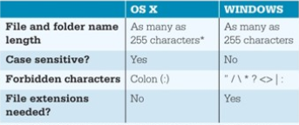
Naming Files
Are there things I shouldn't do when naming my files?
Each OS has its own naming conventions, or rules.
it's important that you name your files so that you can easily identify them.
A file name such as "BIO 101 Research Paper First Draft.docx" makes it very clear what that file contains.
All files must be uniquely identified,
unless you save them in different
folders or in different locations.
No two files stored in the same folder can
share both the same file name and
the same file extension.

Slide 71
Copying, Moving, and Deleting Files
How can I move and copy files?
Once you've located your file with File Explorer, you can perform many other file management actions such as opening, copying, moving ,renaming, and deleting files.
Where do deleted files go?
Recycle Bin is a folder on the desktop, represented by an icon that looks like a recycling bin where files deleted from the hard drive reside until you permanently purge them from your system.
files deleted from other drives don't go to the Recycle Bin but are deleted from the system immediately.
Files stored in the cloud are not cycled through the Recycle Bin.
When you delete a file from a thumb drive or a network drive, consider it gone forever!
Mac systems have something similar to the Recycle Bin, called Trash, which is represented by a wastebasket icon To delete files on a Mac, drag the files to the Trash icon

Slide 72
Copying, Moving, and Deleting Files
How do I permanently delete files from my system?
Files placed in the Recycle Bin or the Trash remain in the system until they're permanently deleted.
To delete files from the Recycle Bin permanently, select Empty Recycle Bin after right-clicking the desktop icon.
On Macs, select Empty Trash from the Finder menu in OS.

Slide 73
Copying, Moving, and Deleting Files
What happens if I need to recover a deleted file?
By Using one of two methods:
File History is a Windows 10 utility that automatically backs up files and saves previous versions of files to a designated drive (such as an external hard drive), If you're using File history.
FarStone's RestorelT or Norton Online Backup, When the Recycle Bin is emptied, only the reference to the file is deleted permanently, so the OS has no easy way to find the file. The file data actually remains on the hard drive until it's written over by another file. You may be able to use these programs to retrieve your files.

Slide 74
File compression
Why would I want to compress a file?
File compression makes a large file more compact
Making it easier and faster for you to send large attachments by e-mail. Upload them to the web, save them onto a flash drive or other storage medium.
File compression utility takes out redundancies in a file (zips it) to reduce the file size.
You can also obtain several standalone freeware and shareware programs, such as WinZip (for Windows) and Stuffit (for Windows or Mac) to compress your files.

Slide 75
File compression
How does file compression work?
Most compression programs look for repeated patterns of letters and replace these patterns with a shorter placeholder.
The repeated patterns and the associated placeholder are cataloged and stored temporarily in a separate file called the dictionary.
For example, in the following sentence, you can easily see the repeated patterns of letters.
The rain in Spain falls mainly on the plain.
Although this example contains obvious repeated patterns ( ain and the ) in a large document, the repeated patterns may be more complex.
The compression program's algorithm (a set of instructions designed to complete a solution in a step-by- step manner), therefore, runs through the file several times to determine the optimal repeated patterns needed to obtain the greatest compression.

Slide 76
File compression
How effective are file compression programs?
Current compression programs can reduce text files by 50 % or more depending on the file.
However, some files, such as PDF files already contain a form of compression, so they don't need to be compressed further.
Image files such as JPEG, GIF, and PNG files discard small variations in color that the human eye might not pick up. Likewise, MP3 files permanently discard sounds that the human ear can't hear. These graphic and audio files don't need further compression.

Slide 77
File compression
How do I decompress a file I've compressed?
In File Explorer, when you click on a Compressed (or zipped) folder, the Compressed Folders Tools tab displays.
Click Extract all to open the Extract Compressed (Zipped) Folders dialog box. Browse to locate where you want to save the extracted files, or just click Extract to accept the default location (which is generally the location of the zipped folder).

Slide 78
UTILITY PROGRAM
The main component of system software is the OS. However, utility programs-small applications that perform special functions on the computer are also an essential part of system software. Utility programs come in three flavors:
1. Those that are included with the OS (such as System Restore).
2. Those sold as stand-alone programs (such as Norton antivirus).
3. Those offered as freeware (such as antimalware software like Ad-Aware from Lavasoft). Figure 5.28 lists some of the various types of utility programs available within the Windows OS as well as some alternatives available as stand-alone programs.

Slide 79
UTILITY PROGRAM

Slide 80
UTILITY PROGRAM
In general, the basic utilities designed to manage and tune your computer hardware are incorporated into the OS. The standalone utility programs typically offer more features or an easier user interface for backup, security, or recovery functions. For some Windows programs, like Task Manager and Resource Monitor, no good standalone alternatives exist.

Slide 81
UTILITY PROGRAM
Windows Administrative Utilities
What utilities can make my system work faster?
Disk Cleanup is a Windows utility that removes unnecessary files from your hard drive.
These include files that have accumulated in the Recycle Bin as well as temporary files-files created by Windows to store data temporarily while a program is running.

Slide 82
UTILITY PROGRAM
Windows usually deletes these temporary files when you exit the program, but sometimes forgets to do this or doesn't have time because your system freezes or incurs a problem that prevents you from properly exiting a program.
Disk Cleanup also removes temporary Internet files (web pages stored on your hard drive for quick viewing) as well as offline web pages (pages stored on your computer so you can view them without being connected to the Internet).
If not deleted periodically, these unnecessary files can slow down your computer.

Slide 83
UTILITY PROGRAM
How can I control which files Disk Cleanup deletes?
When you run Disk Cleanup, the program scans your hard drive to determine which folders have files that can be deleted and calculates the amount of hard drive space that will be freed up by doing so. You check off which type of files you would like to delete.

Slide 84
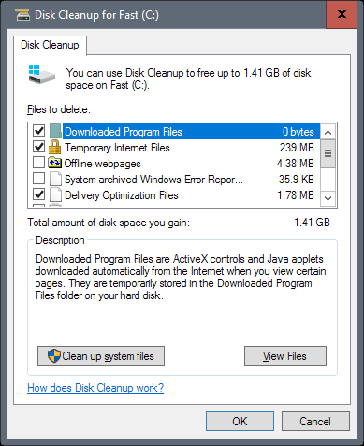
UTILITY PROGRAM

Slide 85
UTILITY PROGRAM
How can I check on a program that's stopped running?
If a program has stopped working, you can use the Windows Task Manager utility to check on the program or to exit the nonresponsive program. The Processes tab of Task Manager lists all the programs you're using and indicates their status. "Not responding" will be shown next to a program that stopped improperly. If the status section is blank, then the program is working normally. You can terminate programs that aren't responding by right-clicking the app name and selecting End Task from the shortcut menu

Slide 86
UTILITY PROGRAM

Slide 87
UTILITY PROGRAM
How can I improve my computer's performance?
After you have used your computer for a while, uploading, creating changing, and deleting content, the hard drive becomes fragmented: parts of files get scattered (fragmented) around the hard disk making the hard disk do extra work which can slow down your computer.

Slide 88
UTILITY PROGRAM
Disk defragmentation rearranges fragmented data so that related file pieces are unified. The Disk Defragmenter utility is found in the Windows Administrative Tools folder in All apps. Before you defragment your hard drive, you should first determine if the disk needs to be defragmented by selecting Analyze disk. If your disk is more than 10 % fragmented , you should run the disk defragmenter utility.

Slide 89
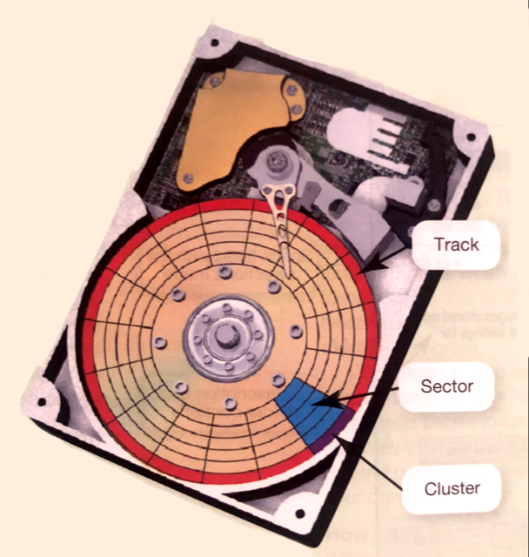
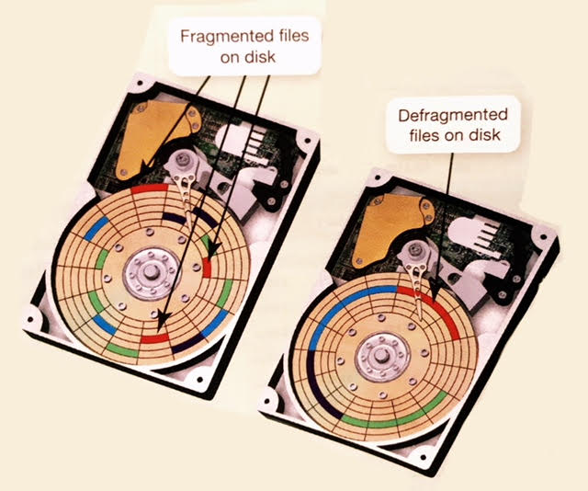
UTILITY PROGRAM

Slide 90
UTILITY PROGRAM
File and System Backup Utilities Objective
How can I protect my data in the event something malfunctions in my system? As noted earlier, when you use the File History utility, you can have Windows automatically create a duplicate of your libraries, desktop, contacts, and favorites and copy it to another storage device, such as an external hard drive. A backup copy protects your data in the event your hard drive fails or files are accidentally erased. File History also keeps copies of different versions of your files.

Slide 91
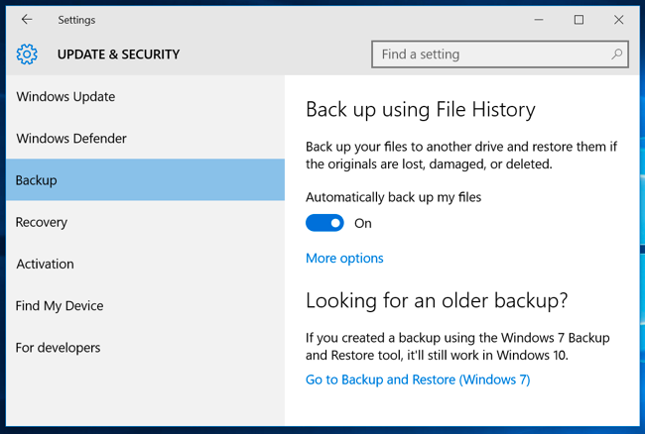
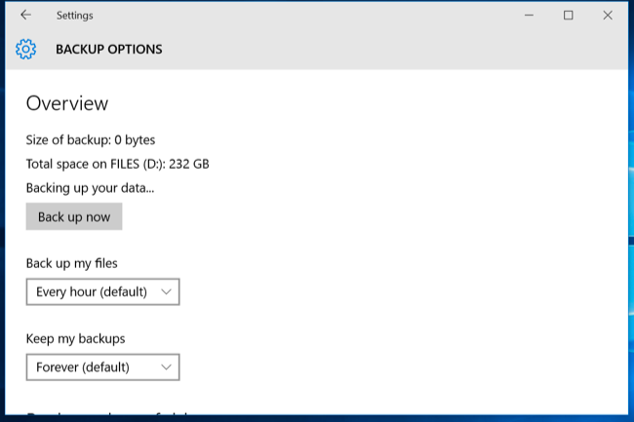
UTILITY PROGRAM
To modify back up setting, click More option

Slide 92
UTILITY PROGRAM
This means that if you need to go back to the second draft of your history term paper, even though you are now on your fifth draft, File History should allow you to recover it. File History needs to be turned on by the user and requires an external hard drive (or network drive) that is always connected to the computer to function. You can choose to backup all folders on the C: drive, or select certain ones that you use most often or contain the most sensitive files to backup. Windows 10 also includes recovery tools that allow you to complete backups of your entire system (system image) that you can later restore in the event of a major hard drive crash.

Slide 93
UTILITY PROGRAM
How can I recover my entire system?
Suppose you've just installed a new software program and your computer freezes. After rebooting the computer, when you try to start the application, the system freezes once again. You uninstall the new program, but your computer continues to freeze after rebooting.
What can you do now?
Windows has a utility called System Restore that lets you roll your system settings back to a specific date when everything was working properly.

Slide 94
UTILITY PROGRAM
A system restore point, which is a snap- shot of your entire system's settings, is generated prior to certain events, such as installing or updating software, or automatically once a week if no other restore points were created in that time. You also can create a restore point manually at any time. Should problems occur, if the computer was running just fine before you installed new software or a hardware device, you could restore your computer to the settings that were in effect before the software or hardware installation (see Figure 5.34). System Restore doesn't affect your personal data files (such as Word documents or e-mail), so you won't lose changes made to these files.

Slide 95
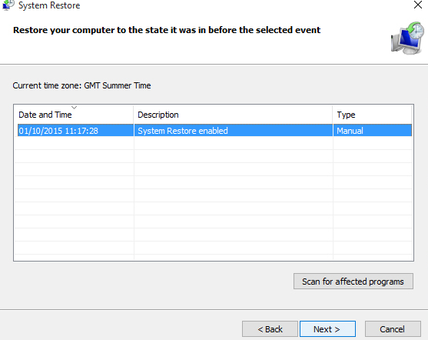
UTILITY PROGRAM

Slide 96
UTILITY PROGRAM
OS X includes a backup utility called Time Machine that automatically backs up your files to a specified location. Apple also offers backup hardware called Time Capsules, which are hard disk drives with wireless connectivity, designed to work with Time Machine and record your backup data. Because Time Machine makes a complete image copy of your system, it can also be used to recover your system in the case of a fatal error.

Slide 97
UTILITY PROGRAM
Accessibility Utilities Objective
What utilities are designed for users with special needs? Microsoft Windows includes an Ease of Access Center, which is a centralized location for assistive technology and tools to adjust accessibility settings. In the Ease of Access Center, which is accessible from Settings, you can find the tools to help users with disabilities, shown in Figure 5.35. The tools shown in the figure are just a sampling of the available tools. If you're not sure where to start or what settings might help, a questionnaire asks you about routine

Slide 98
UTILITY PROGRAM

Slide 99
UTILITY PROGRAM
tasks and provides a personalized recommendation for settings that will help you better use your computer Whether you use Windows, OS X, Linux, or another operating system, a fully featured OS is available to meet your needs. As long as you keep the operating system updated and regularly use the available utilities to finetune your system, you should experience little trouble from your OS.

