Slide 1

General Physics
(104 Phys)
Dr Nargis Bano

Slide 2
Chapter 24 Electric Flux
Chapter Outline
24.1 Electric Flux
24.2 Gauss’s Law
24.3 Application of Gauss’s Law to Various Charge Distributions
Equilibrium 24.4 Conductors in Electrostatic

Slide 3
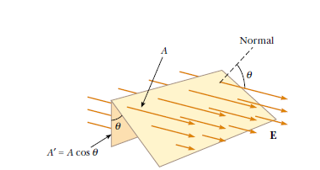
24.1 Electric Flux
* Electric flux is proportional to the number of electric
field lines that penetrate a surface
Φ_{E} = E.A
Φ_{E} has units of newton-meters squared per coulomb
* The field lines may make some angle θ with the perpendicular to the surface
Then Φ_{E} = EA cos θ
*The flux is a maximum when the surface is perpendicular to the field
* The flux is a minimum (zero) when the surface is (parallel) to the field

Slide 4
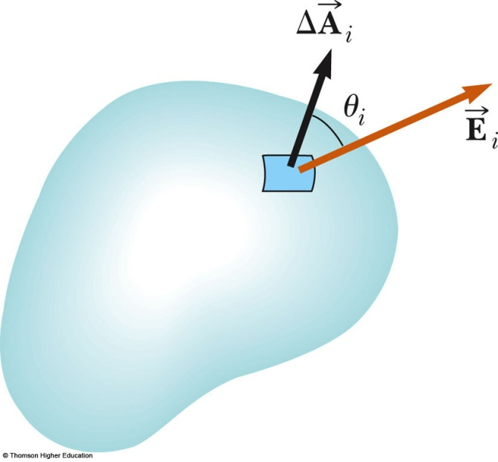
If the field varies over the surface, Φ = EA cos θ is valid for only a small element of the area
In the more general case, look at a small area element
In general, this becomes
The surface integral means the integral must be evaluated over the surface in question
The value of the flux depends both on the field pattern and on the surface
SI units: N.m²/C

Slide 5
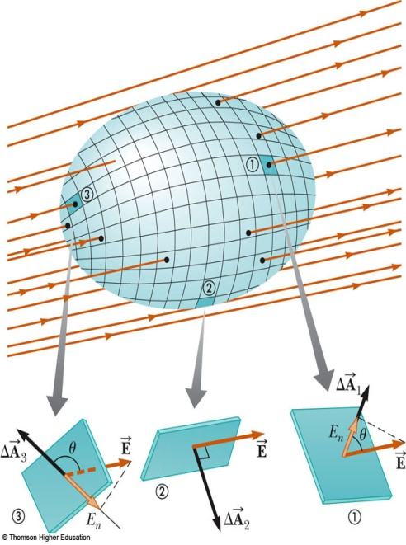
Electric Flux, Closed Surface
For a closed surface, by convention, the A vectors are perpendicular to the surface at each point and point outward
(1) θ < 90º, Φ > 0
(2) θ = 90º, Φ = 0
(3) 180º > θ > 90º, Φ < 0
So , The flux through an area element can be
positive (element 1), zero (element 2),
or negative (element 3).
The net flux through the surface is proportional to
the number of lines leaving the surface
minus the number entering the surface

Slide 6
Example 24.1 Electric Flux Through a Sphere
The magnitude of the electric field
Surface area
So the flux through the sphere

Slide 7

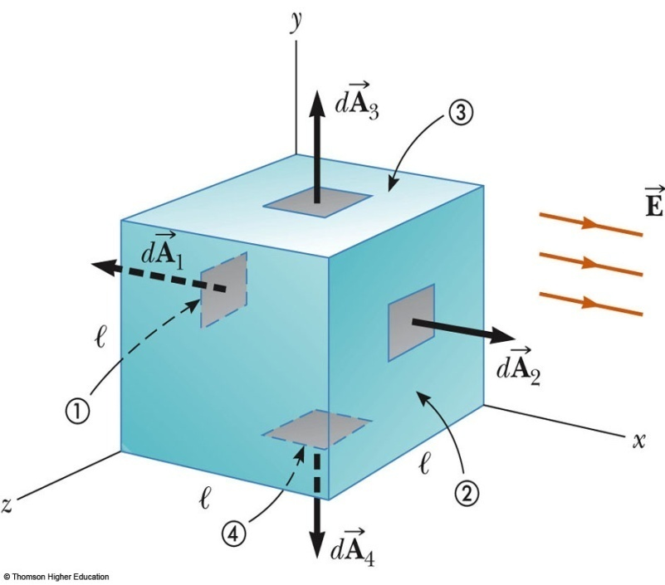
Example 24.2 Flux Through a Cube of a uniform electric field
The field lines pass through two surfaces perpendicularly and are parallel to the other four surfaces
For side 1, Φ_{E} = -El ²
For side 2, Φ_{E} = El ²
For the other sides,
Φ_{E} = 0
Therefore, Φ_{total} = 0

Slide 9
24.2 Gauss’s Law
Consider a sphere drawn around a positive point charge. Evaluate the net flux through the closed surface.
Net Flux =
For a Point charge
Gauss’ Law

Slide 10
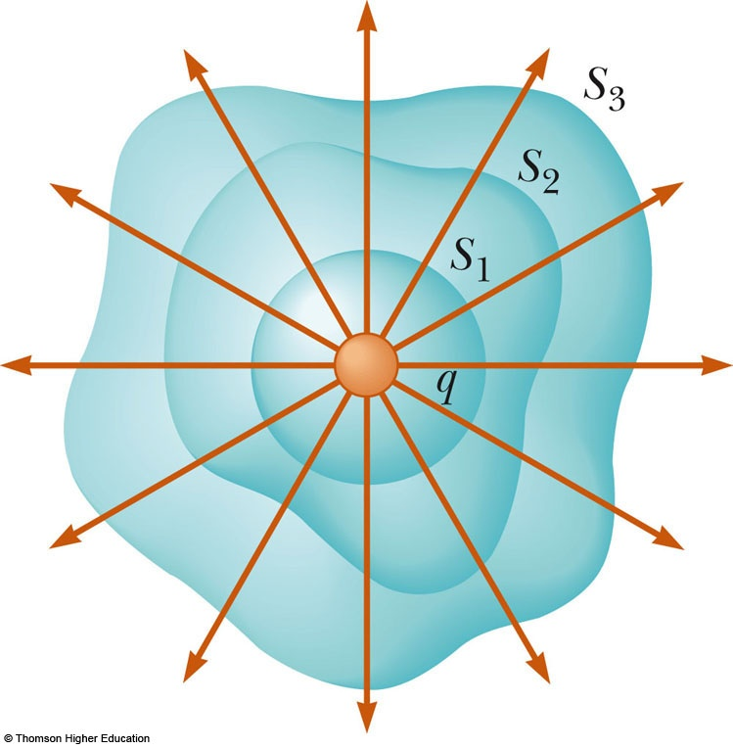
Gauss’ Law
The flux of electric field through a closed surface is proportional to the charge enclosed.
Gaussian surfaces of various shapes can surround the charge (only S₁ is spherical)
The electric flux is proportional to the number of electric field lines penetrating these surfaces, and this number is the same
Thus the net flux through any closed surface surrounding a point charge q is given by q/ε_{o} and is independent of the shape of the surface

Slide 11
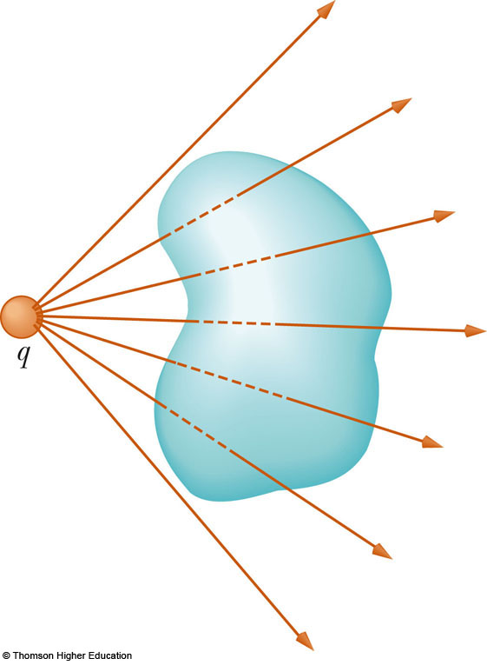
If the charge is outside the closed surface of an arbitrary shape, then any field line entering the surface leaves at another point
Thus the electric flux through a closed surface that surrounds no charge is zero

Slide 12
Since the electric field due to many charges is the vector sum of the electric fields produced by the individual charges, the flux through any closed surface can be expressed as
Although Gauss’s law can, in theory, be solved to find E for any charge configuration.
One should choose a Gaussian surface over which the surface integral can be simplified and the electric field determined.

Slide 13
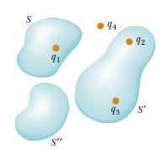
Example : Consider the system of charges shown in Figure, Find the net flux.
The net electric flux through any closed surface depends only on the charge inside that surface.
The flux through S due to charge q1 only
→ The net flux through surface S is
The flux through S’ due to charges q2 and q3
→ The flux through S’ is
Finally, the net flux through surface is zero because there is no charge inside this surface

Slide 14
Example 24.3 Flux Due to a Point Charge
A spherical Gaussian surface surrounds a point charge q. Describe what happens to the total flux through the surface if
(A) the charge is tripled,
(B) the radius of the sphere is doubled,
(C) the surface is changed to a cube, and
(D) the charge is moved to another location inside the surface.
The flux will triple.
The flux remains the same as it is not a function of r.
The flux will stay the same as it is not a function of surface shape.
It remains the same.

Slide 15
24.3 Application of Gauss’s Law to Various
Charge Distributions
The goal in this type of calculation is to determine a surface that satisfies one or more of the following conditions:
1. The value of the electric field can be argued by symmetry to be constant over the surface.
2. The dot product in Equation 24.6 can be expressed as a simple algebraic product E dA because E and dA are parallel.
3. The dot product in Equation 24.6 is zero because E and d A are perpendicular.
4. The field can be argued to be zero over the surface.

Slide 16
Problem solving guide for Gauss’ law
Use the symmetry of the charge distribution to determine the pattern of the field lines.
Choose a Gaussian surface for which E is either parallel to or perpendicular to dA.
If E is parallel to dA, then the magnitude of E should be constant over this part of the surface. The integral then reduces to a sum over area elements.

Slide 17

Charge Density
We will use a charge density to describe the distribution of charge.
This charge density will be different depending on the geometry

Slide 18

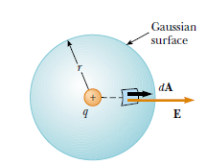


Example 24.4 The Electric Field Due to a Point Charge
Starting with Gauss’s law, calculate the electric field due to
an isolated point charge q.
Gauss’s law gives
The electric field

Slide 19
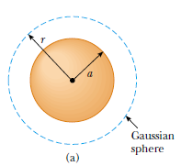

Example 24.5 A Spherically Symmetric Charge Distribution
An insulating solid sphere of radius a has a uniform volume
charge density ρ and carries a total positive charge Q
(A) Calculate the magnitude of the electric field at a point
outside the sphere.
select a spherical gaussian surface of radius r, where
For a uniformly charged sphere, the field in the region external to the sphere is equivalent to that of a point charge located at the center of the sphere.

Slide 20

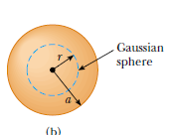


(B) Find the magnitude of the electric field at a point inside the sphere.
select a spherical Gaussian surface having radius r >a,
Here the charge q in within the Gaussian surface of volume V’ is less than Q

Slide 21
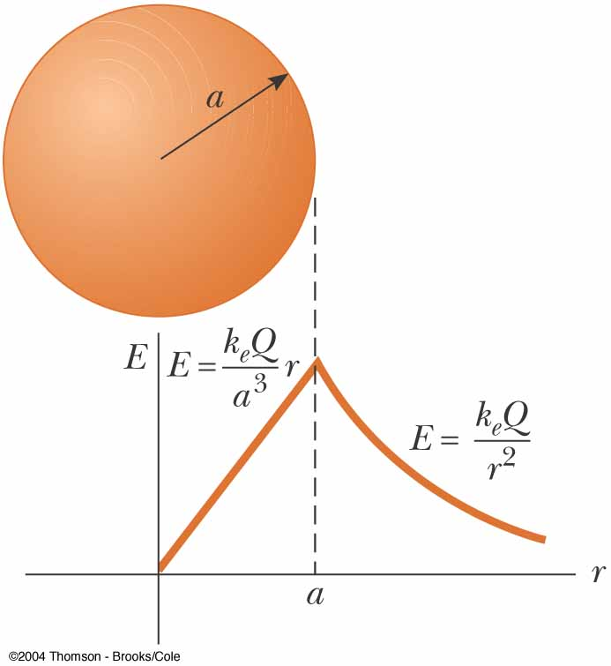
Field Due to a Spherically Symmetric Charge Distribution
Inside the sphere, E varies linearly with r (E → 0 as r → 0)
The field outside the sphere is equivalent to that of a point charge located at the center of the sphere
If r = a from inside the sphere and from outside. Do we measure the same value of the electric field from both directions? Yes

Slide 22
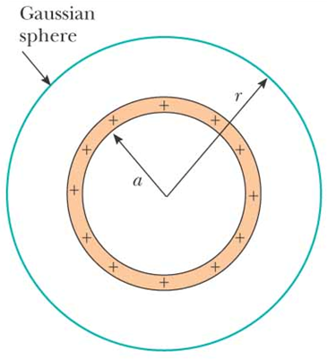
Example 24.6 The Electric Field Due to a Thin Spherical Shell
A thin spherical shell of radius a has a total charge Q distributed uniformly over its surface (Fig.). Find the electric field at points
(A) outside
Let’s start with the Gaussian surface outside the sphere of charge, r > a
so the electric field is

Slide 23
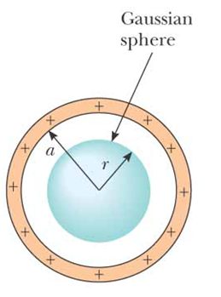
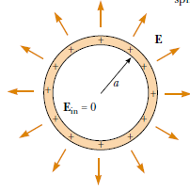
(B) inside the shell
We know that the enclosed charge is zero so
We find that the electric field is zero everywhere inside
spherical shell of charge
E=0
Thus we obtain two results
  The electric field outside a spherical shell of charge is the same as that of a point charge.
  The electric field inside a spherical shell of charge is zero.

Slide 24
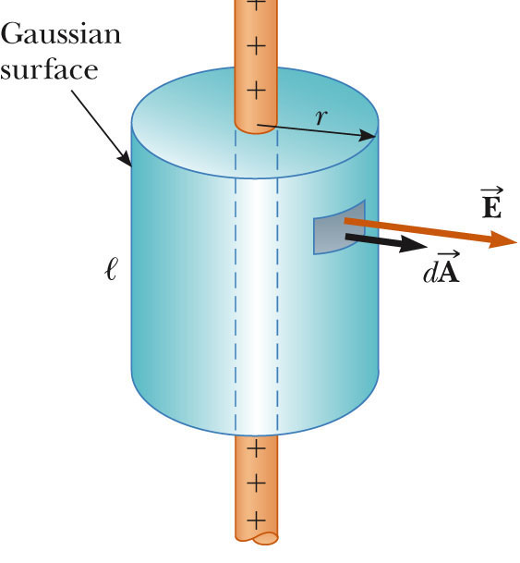



Example 24.7 A Cylindrically Symmetric Charge Distribution
Find the electric field a distance r from a line of positive charge of infinite length and constant charge per unit length λ
Select a cylinder as Gaussian surface. The cylinder has a radius of r and a length of ℓ
E is constant in magnitude and parallel to the surface (the direction of a surface is its normal!) at every point on the curved part of the surface (the body of the cylinder.

Slide 25
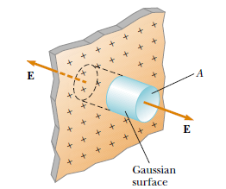
Example 24.8 A Plane of Charge
Find the electric field due to an infinite plane of positive
charge with uniform surface charge density σ
Assume that we have a thin, infinite non-conducting sheet of positive charge
The charge density in this case is the charge per unit area,σ
From symmetry, we can see that the electric field will be perpendicular to the surface of the sheet
To calculate the electric field using Gauss’ s Law, we assume a Gaussian surface in the form of a right cylinder with cross sectional area A, chosen to cut through the plane perpendicularly.
Because the electric field is perpendicular to the plane
everywhere, the electric field will be parallel to the walls of the cylinder and perpendicular to the ends of the cylinder.

Slide 26
Using Gauss’s Law we get

Slide 27
24.4 Conductors in Electrostatic Equilibrium
A conductor in electrostatic equilibrium has the following
properties:
The electric field is zero everywhere inside the conductor.
Because the charges in the conductor move creating an internal electric field that cancels the applied field on the inside of the conductor
2. If an isolated conductor carries a charge, the charge resides on its surface.
3. The electric field just outside a charged conductor is perpendicular to the surface of the conductor and has a magnitude , where σ is the surface charge density at that point.
4. On an irregularly shaped conductor, the surface charge density is greatest at locations where the radius of curvature of the surface is smallest.

