Slide 1
Chapter 14
Fluids

Slide 2
Outline
Fluid
Density
Pressure
Fluid at Rest
Pascal’s law
Buoyant Forces and Archimedes’s Principle
Continuity Equation
Bernoulli’s Equation

Slide 3
14-1 fluids, density and pressure
Fluids
A fluid, is a substance that can flow , like water or air, and conform to a container.
The term fluid refers to gases and liquids. Gases and liquids both have atoms/molecules that are free to move around.
Density
Is a mass per unit volume.
ρ = m/V
SI units: kg/m³
Mass is a Scalar quantity.

Slide 4
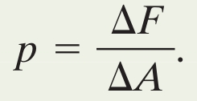
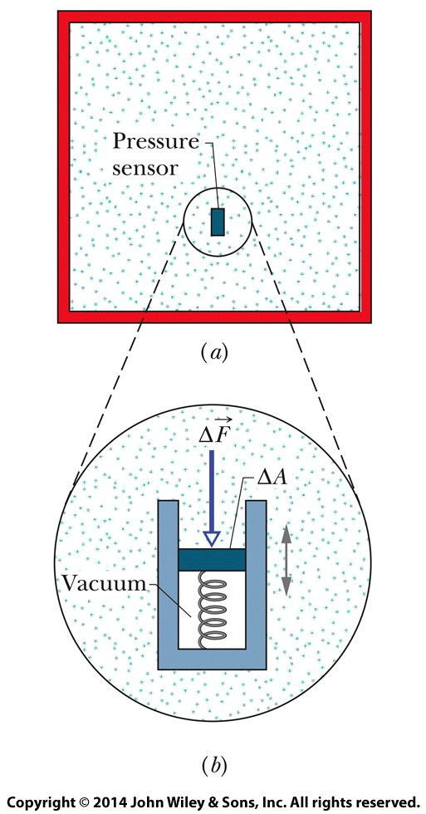
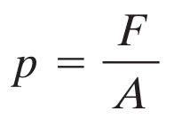
14-1 fluids, density and pressure
Pressure
The pressure, force acting on an area, is defined as:
We could take the limit of this for infinitesimal area, but if the force is uniform over a flat area A we write
Eq. (14-3)
Eq. (14-4)

Slide 5
14-1 fluids, density and pressure
Pressure is a Scalar quantity, but the Force is a Vector quantity.
The atmosphere is the average pressure of the atmosphere at the see level.
Units: the pascal (1 Pa = 1 N/m²) the atmosphere (atm) the torr (1 torr = 1 mm Hg) the pound per square inch (psi)

Slide 6
Example 14.01
A living room has floor dimensions of 3.5 m and 4.2 m and a height of 2.4 m.
Where ρair =1.21 kg/m³ , P=1.01×10⁵ N/m²
(a) What does the air in the room weigh when the air pressure is 1.0 atm?
(b) What is the magnitude of the atmosphere's force on the floor of the room?
Solution
(a)
W =mg= ρVg
= 1.21 kg/m³ × (3.5m× 4.2m × 2.4m) × 9.8m/s²
=418N
(b)
F=PA
=1.01×10⁵ × (3.5 m× 4.2m)
= 1.5×10⁶ N
F=P(L×W)

Slide 7
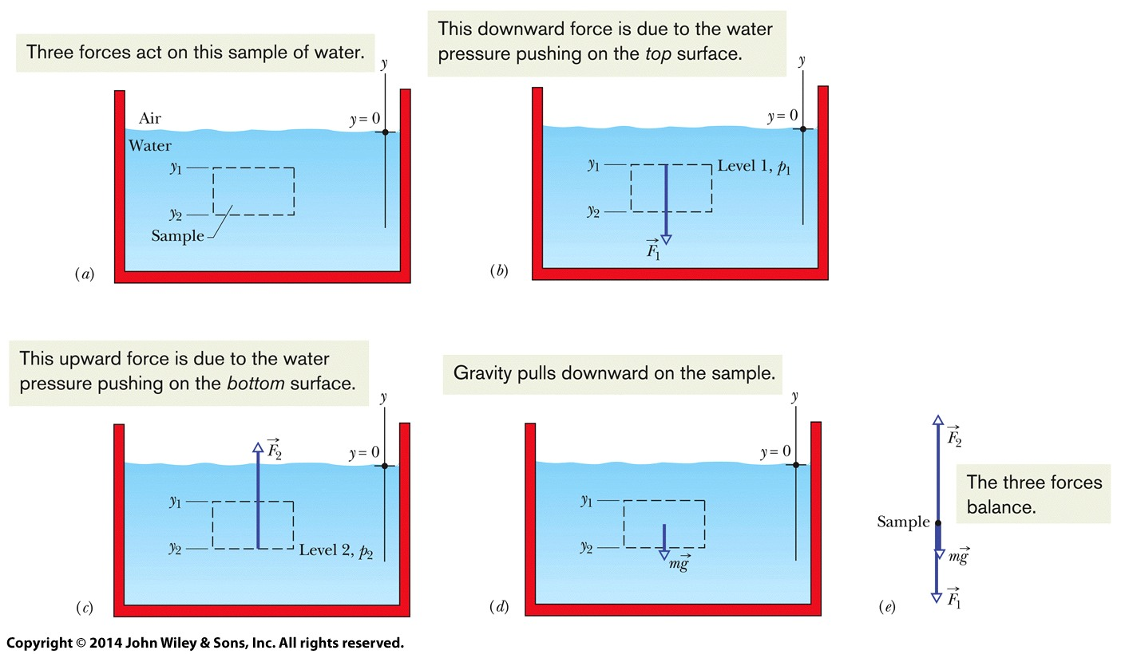
14-2 Fluids at Rest
Hydrostatic pressures are those caused by fluids at rest (air in the atmosphere, water in a tank)

Slide 8
14-2 Fluids at Rest
Write the balance of forces:
Rewrite: forces with pressures, mass with density
For a depth h below the surface in a liquid this becomes:
Eq. (14-5)
Eq. (14-7)
Eq. (14-8)

Slide 9
14-2 Fluids at Rest
The pressure P in equation 14-8 is the absolute pressure
The pressure p₀, the pressure due to the atmosphere, and the additional pressure from the fluid
The difference between absolute pressure and atmospheric pressure is called the gauge pressure because we use a gauge to measure this pressure difference.

Slide 10
Problem 21 , page 51
What gauge pressure must a machine produce in order to suck mud of density 1800 kg/m³ up a tube by a height of 2.0 m?
Solution:
ρ = 1800 kg/m³
h = 2.0 m
p = ρgh = 1800 ✕ 9.8 ✕ 2 = 35.28✕10³ N/m2

Slide 11
14-2 Fluids at Rest
Answer: All the pressures will be the same. All that matters is the distance h, from the surface to the location of interest, and h is the same in all cases.
Pressure Depends on Depth, not Shape
Pressure at a Given Depth is Constant

Slide 12
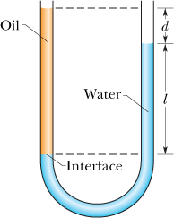
Example 14.03
The U-tube in Figure contains two liquids in static equilibrium: Water of density (ρw = 998 kg/m³) is in the right arm and oil of unknown density ρx is in the left. Measurement gives l = 135 mm and d = 12.3 mm. What is the density of the oil?
Solution
P_{int} = p₀ + ρ_{w}gl (right arm)
P_{int} = p₀ + ρ_{x}g(l+d) (left arm)
Equating these two expression:

Slide 13
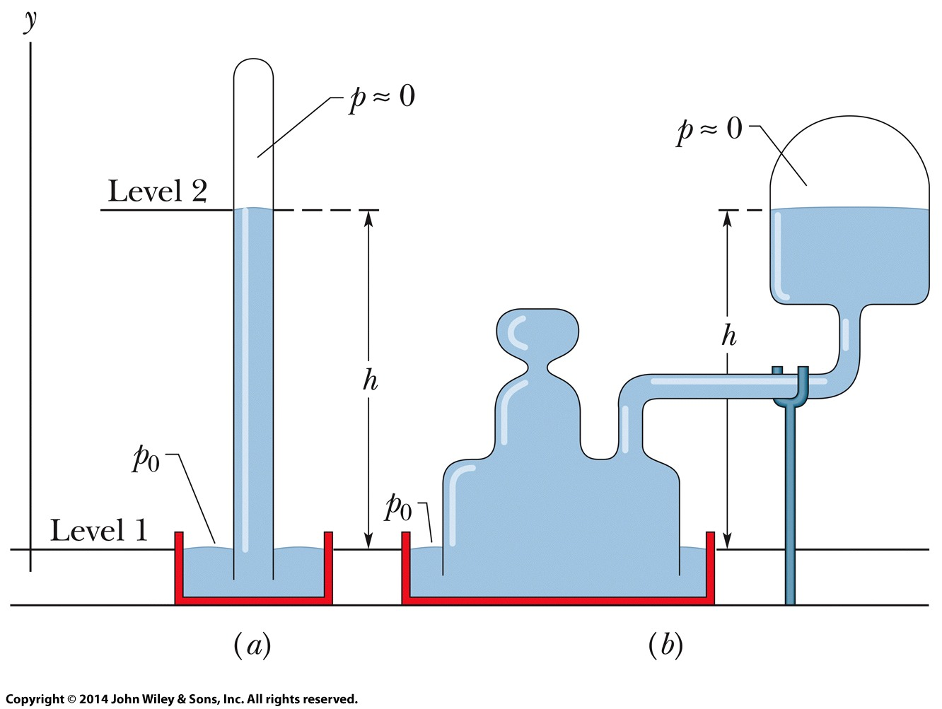
14-3 Measuring Pressure
Mercury barometers
Use to measure atmosphere pressure.
The height difference between the air-mercury interface and the mercury level is h:
Height of mercury column is numerically
equal to torr pressure only if:
Barometer is at a place where
g has its standard value
Temperature of mercury is 0°C
Eq. (14-9)
Figure 14-5

Slide 14
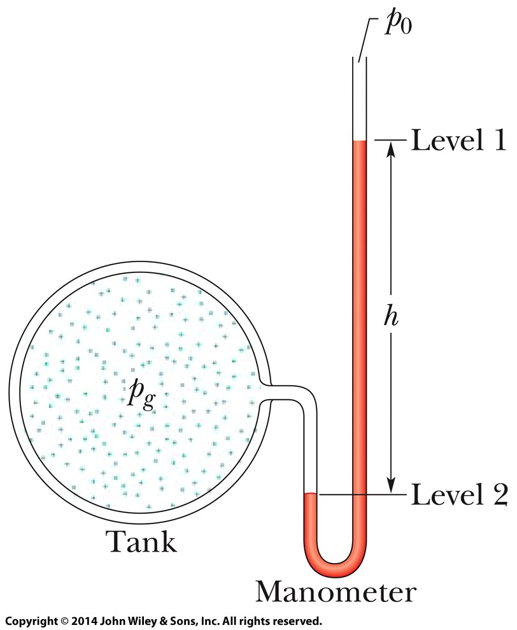
14-3 Measuring Pressure
Figure 14-6 shows an open-tube manometer
Open-tube Manometer
Use to measure gauge pressure.
The height difference between
the two interfaces, h, is related
to the gauge pressure:
The gauge pressure can be positive or negative, depending on whether the pressure being measured is greater or less than atmospheric pressure
Eq. (14-10)

Slide 15
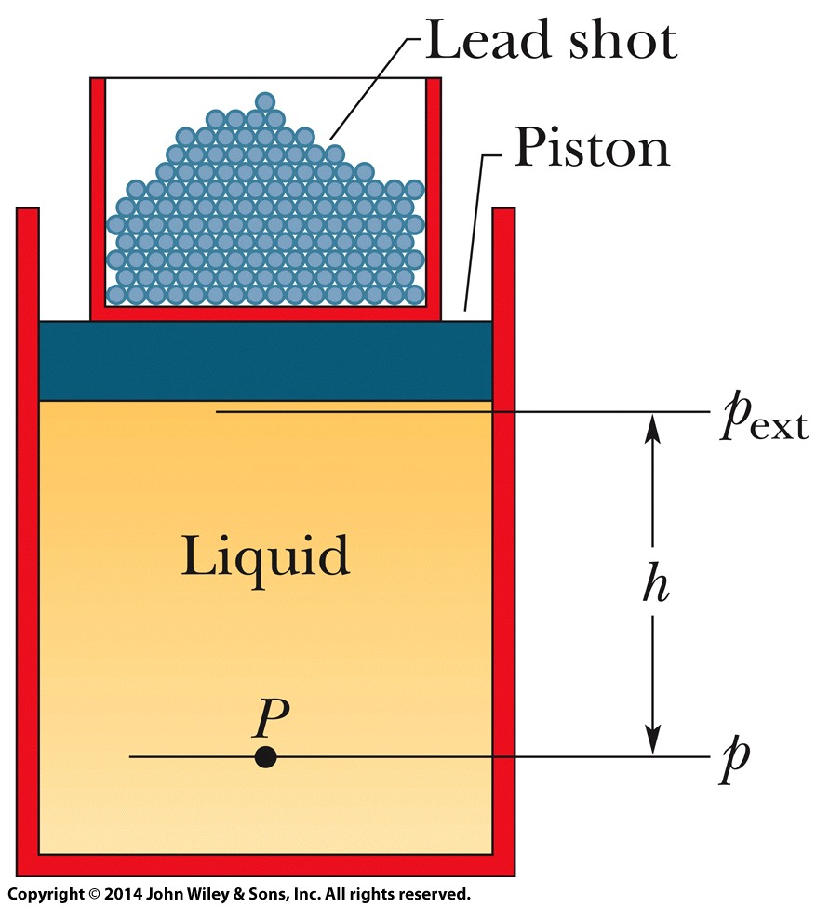
14-4 Pascal's Principle
Pascal's principle governs the transmission of pressure through an incompressible fluid:
Consider a cylinder of fluid (Figure 14-7)
The atmosphere, container, and shots exert
pressure p_{ext}, on the piston and thus on the liquid.
the p at any point in the liquid:
p = p_{ext} + ρgh
increasing p_{ext} by adding more shots will increase p at any point in the liquid by the same amount of p_{ext} .

Slide 16
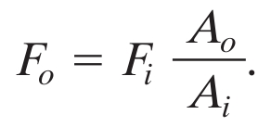
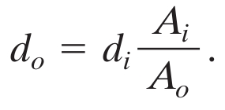
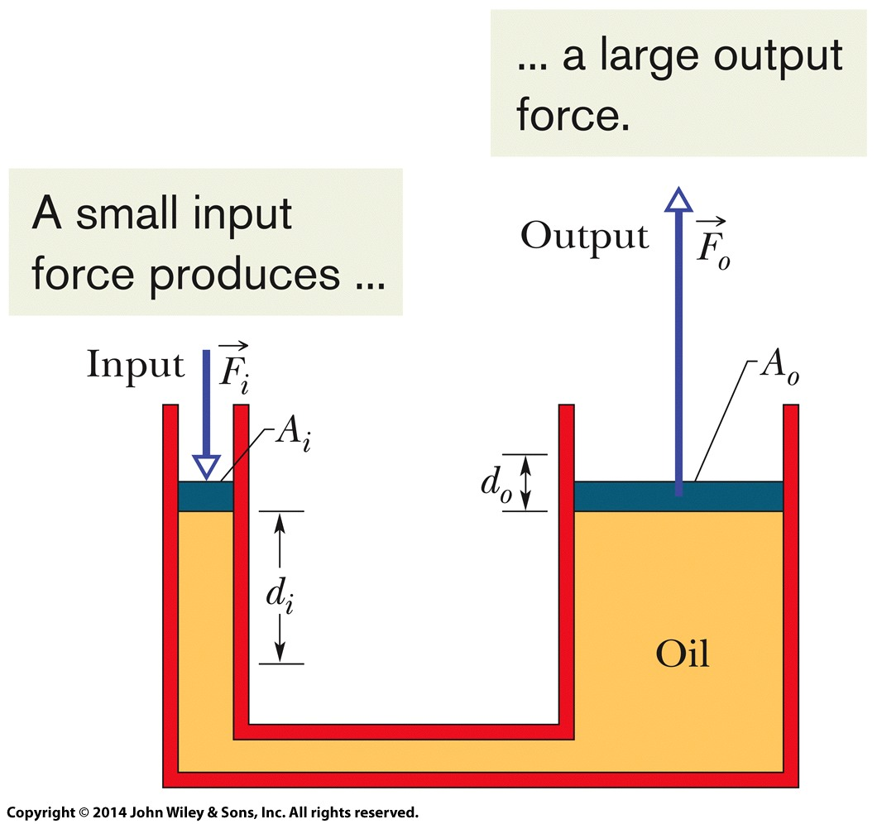
14-4 Pascal's Principle
Describes the basis for a hydraulic lever
Input and output forces related by:
The distances of movement are related by:
Eq. (14-13)
Eq. (14-14)
Figure 14-8

Slide 17
14-4 Pascal's Principle
So the work done on the input piston equals the work output
The advantage of the hydraulic lever is that:
Eq. (14-15)

Slide 18
Problem 24, page 51
Solution:
(a) According to Pascal’s principle,
F/A = f/a ➔ F = (A/a)f.
(b) We obtain

Slide 19
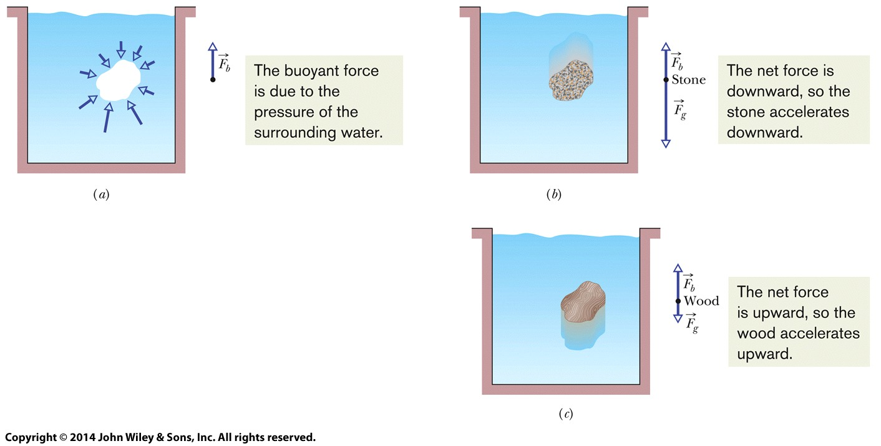
14-5 Archimedes’ Principle
The buoyant force is the net upward force on a submerged object by the fluid in which it is submerged
This force opposes the weight of the object , It comes from the increase in pressure with depth
(a) Floating: F_{b}=F_{g}
(b) Sinking: F_{b}<F_{g}
(c) Rising; F_{b}>F_{g}
Figure 14-10

Slide 20
14-5 Archimedes’ Principle
Archimedes' Principle states that:
The buoyant force has magnitude
Where m_{f} is the mass of displaced fluid
Then, we can write Archimedes’ principle as:
Eq. (14-16)
F_{b} = ρgV
Notes:
20

Slide 21
s' Principle
Floating
A block of wood in static equilibrium is floating:
This is expressed:
Because of Eq. 14-16 we know:
Which means:
Eq. (14-17)
Eq. (14-18)
Notes:
21

Slide 22
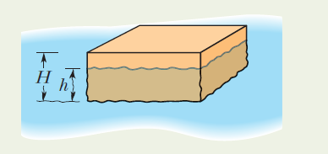
Sample problem 14.04 (a) Page 41
A block of density ρ= 800 kg/m³ floats face down in a fluid of density ρ_{f}= 1200 kg/m³ . The block has height H=6.0 cm.
(a) by what depth h is the block submerged?
Solution:
F_{b}= m_{f} g = ρ_{f} V_{f} g = ρ_{f} L W h g
F_{g}= m g = ρ V g = ρ L W H g
from floating equation:
F_{b} = F_{g}
ρ_{f} L W h g = ρ L W H g
ρ_{f} h = ρ H
h = ρ H / ρ_{f} h = (800) (6.0) / (1200) = 4 cm

Slide 23
14-6 Continuity Equation
We discuss motion of an ideal fluid
Steady flow: the velocity of the moving fluid at any fixed point does not change with time
Incompressible flow: The ideal fluid density has a constant, uniform value.
Nonviscous flow: Viscosity is, roughly, resistance to flow, fluid analog of friction. No resistive force here.
Irrotational flow: May flow in a circle, but a dust grain suspended in the fluid will not rotate about com
Notes:
23

Slide 24
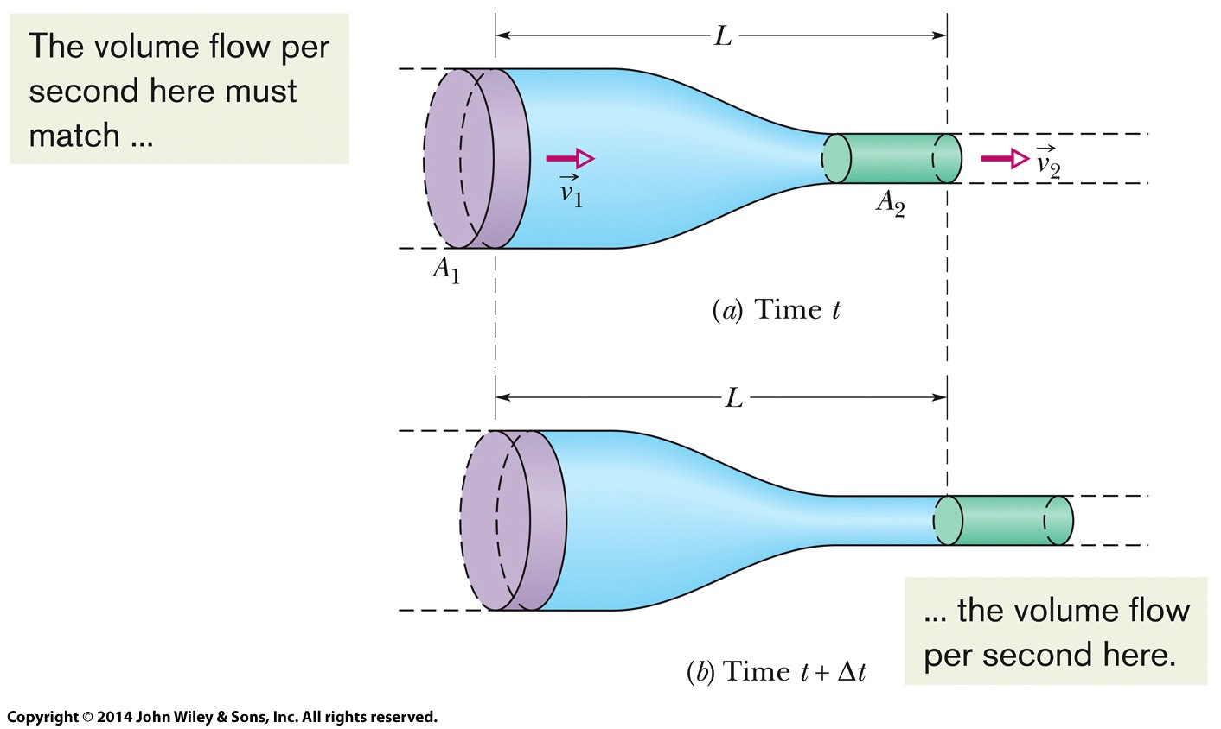
14-6 The Equation of Continuity
14-6 Continuity Equation
The flow speed (v) increases when we decrease the cross-sectional area (A) through which the fluid flows.
We write the equation of continuity:
A v = constant
The bigger the area, the slower the fluid speed.
Eq. (14-23)
Figure 14-15
Notes:
24

Slide 25
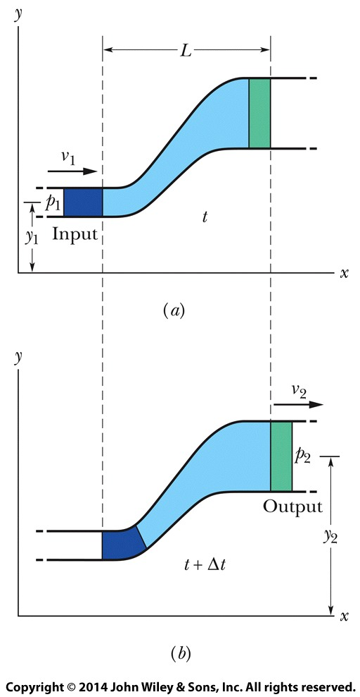
14-7 Bernoulli’s Equation
Applying the conservation of energy to the equal volumes of input and output fluid:
The ½ρv² term is called the fluid's kinetic energy density
Equivalent to Eq. 14-28, we can write:
Applying this for flow through a horizontal pipe
Eq. (14-28)
Eq. (14-29)
Figure 14-19
Eq. (14-30)
Notes:
25

