Slide 1
Computer skills
Computer Hardware

Slide 2
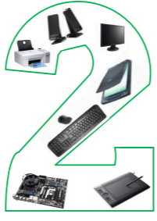
HARDWARE

Slide 3
Lecture objectives
After studying this lecture, the student is expected to master the following knowledge and skills:
1. Classifies the computer’s hardware components to internal and external.
2. Knows the CPU.
3. Shows the types of memory modules.
4. Learn about input and output units.
5. Learn about storage media.
6. Learn the components of the motherboard.
7. Learn how to measure computer performance.

Slide 4
Computer Hardware
Computer Hardware: or (hard components) is considered as one of the most important components of the computer system, and it means all units, devices and accessories that make up the computer.

Slide 5
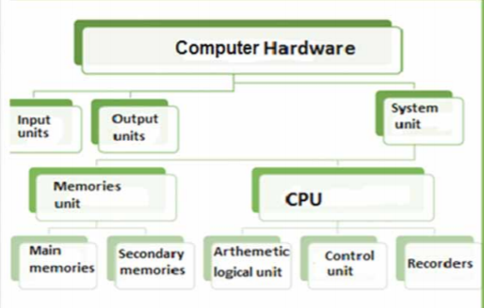
Computer hardware component

Slide 6
HARDWARE
INPUT UNIT

Slide 7
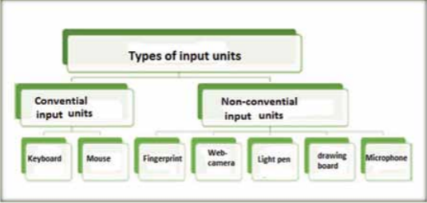
Input unit
INPUT UNIT DEFINITION
“Input Units” are the units responsible for entering data into the computer in its various forms.

Slide 8
Types of input devices
TRADITIONAL (Standard) input units
consist of the keyboard and the pointing device (Mouse).
A keyboard has a number of keys used for data entry.
A pointing device, which controls the cursor on the screen and enters orders by clicking or dragging.
Non-traditional (NON-STANDARD) input
Examples of recent input units such as microphone, drawing board, optical pen, fingerprint reader, and web camera, are known as non-conventional input units.

Slide 9
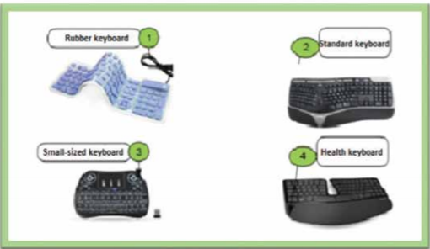
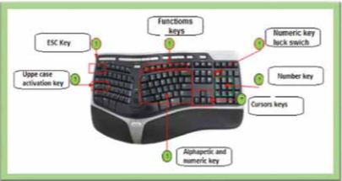
Traditional input
KEY BOARD

Slide 10
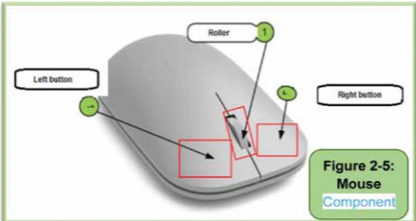
Traditional input
MOUSE
Left button: the most used button for controlling different icons, windows and multiple GUI objects..
Right button: Clicking on it displays a list of shortcut options,
Roller: used to move the text inside documents and internet pages open up or down, and it helps the user in browsing faster

Slide 11
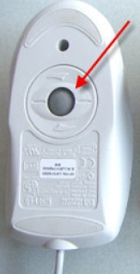
Types of Mouse:
1. Ball Mouse: contains a ball inside it, and when the mouse is moved, the ball moves and the cursor moves on the screen and was used in the past.

Slide 12
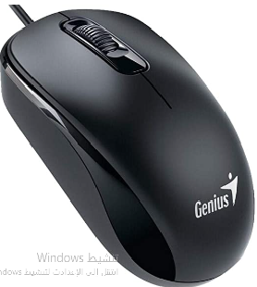
Types of Mouse:
2.Optical Mouse: contains an electronic chip inside it and emits a light beam from a bulb below it. The pointer moves according to moving the mouse on a smooth surface that touches the beam.

Slide 13
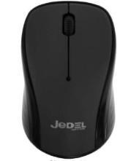
Types of Mouse:
3. Wireless Mouse: a modern mouse and works without wire and is connected to the computer by connecting an electronic piece to the USB port.

Slide 14
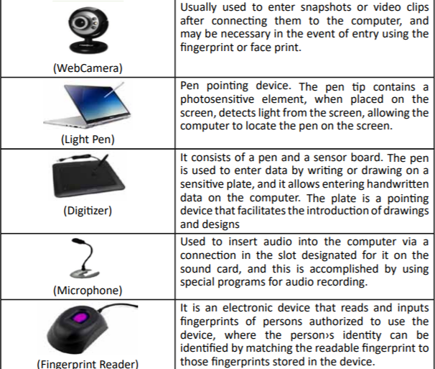
Non-traditional input

Slide 15
HARDWARE
OUTPUT DEVICES

Slide 16
OUTPUT DEFINITION
DEFINITION OF OUTPUT DEVICES
Output Units are used to display information stored on a computer. These units represent the means of computer communication with the outside world
TYPE OF OUTPUT DEVICES
Conventional output units include screen and printer.
Non-Conventional output units, including headphones, data projectors, and graphics.

Slide 17
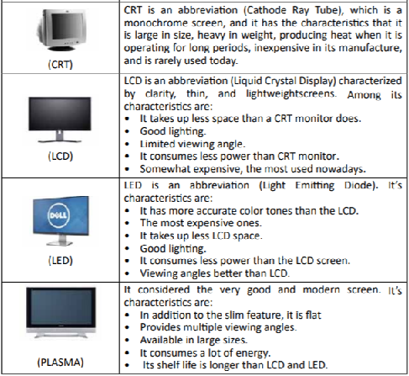
Traditional(Standard) Output Units
SCREEN

Slide 18
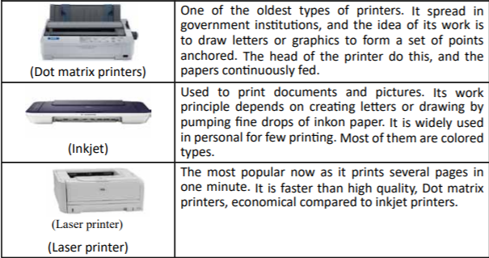
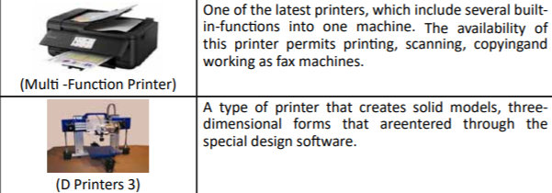
Traditional(Standard) Output Units
PRINTER

Slide 19
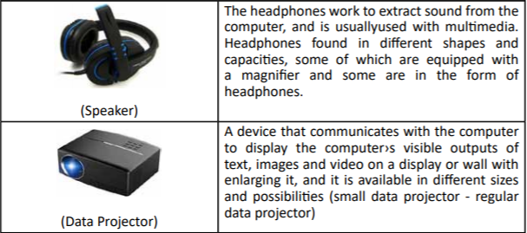
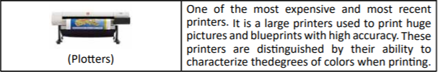
Non -conventional output units

Slide 20
HARDWARE
Units of input and output together

Slide 21
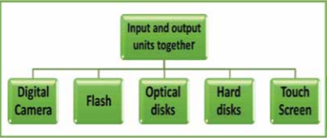
input and output together

Slide 22
HARDWARE
Central Processing unit

Slide 23
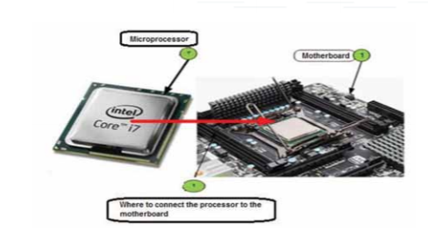
CPU
DEFENTION
The Central Processing Unit-Processor-CPU is the most important part of a computer. It considered the pulsed heart of the computer and is usually called a processor. It is a semiconductor chip on which millions of integrated circuits are placed.

Slide 24
Characteristics that distinguish the processor
Clock Speed
The computer’s speed is estimated at the processor speed and measured in MHz and Gigahertz. Today, the computer speed is measured in GHz, for example, if it’s 2GHz., that means it can perform a number of operations equivalent to two billion operations per second.
Core number
In the past, the processor contained only one core that does all the work alone, but with the development of applications and the need to perform many tasks at the same time, a number of the core was added to the processor, which increased the processor speed

Slide 25
Characteristics that distinguish the processor
Processor Memory (Cache)
A temporary memory similar to the RAM, but it is much smaller and fixed in the processor itself. The secret of its importance is that the processor accesses it much faster than the RAM, and it is one of the things that affect the speed of the processor when working with many multiple tasks at the same time.

Slide 26
CPU components
Control unit
Control Unit (CU) is a group of electronic circuits responsible for managing all the operations necessary to implement the various orders, it works to transfer data to and from the athematic logical unit (ALU) , registers, main memory and input and output units
Arithmetic logic unit (ALU)
is the unit responsible for all mathematical operations such as (addition, subtraction, multiplication, division, and raising of an exponent) and logical operations such as (positivity and negativity coefficients) within a computer

Slide 27
CPU components
Registers
Registers are special storage locations with very high speeds that are proportional to the speed of the processor and any malfunctions in them.
Registrars are divided into:
Data registrars: in which data are dealt with in terms of storage and logical and mathematical operations.
Address registrars: in which the different addresses are stored.
Cases Recorder: records the processor condition after executing a specific order
The function of recorders:
1- Control the implementation of the program.
2- Temporary retention of information and results.

Slide 28
CPU components
Buses
Bus is a set of electronic lines through which exchanges are made between computer components.
There are three buses inside and outside the processor, which are:
1. Address Bus: Used to assign addresses to different places in the memory or the input and output ports in order to transfer data from them, and the memory consists of a group of stores for each address.
2. Data Bus: is the data bus that transfers data from the processor to the units or vice versa.
3. Control Bus: Consists of a set of wires whose function is to synchronize events in a synchronous manner and control memory and I/O units from the processor end.

Slide 29
HARDWARE
STORAGE UNIT

Slide 30
STORAGE UNIT
STORAGE DEFINTION
A group of electronic circuits that are used to save data and programs.
STORAGE TYPES
MAIN MEMORY
SECONDARY MEMORY
RAM
ROM
FLOPPY DISC
HARD DISC
FLASH
MAIN MEMORY
OPTICAL DISC
STORAGE TYPE

Slide 31
RAM AND ROM

Slide 32
ROM Type
THERE ARE THREE TYPES OF ROM
1. One time programmed memory (ROM).
2. Programmable memory (PROM) which cannot be modified after programming it.
3. A programmable and erasable memory, that is, it can be erased and reprogrammed (EPROM).

Slide 33
RAM Type
THERE ARE TWO TYPES OF RAM
1. Static Random Access Memory (S-RAM): a type of random access memory called Static RAM, or SRAM. It is called this name because its contents do not change over time, as it keeps its contents as they are as long as they are continuously fed, and SRAM memory is characterized by high speed, but it is defective in high cost, compared to DRAM
2. Dynamic Random Access Memory (D-RAM): called Dynamic RAM or DRAM, it loses its contents gradually over time and needs to rewrite the contents periodically.

Slide 34
Secondary Memory Type
TYPE OF SECONDARY MEMORY
Internal Storage: Example of Hard Disks • External storage: Example of Flash memory and CDs.

Slide 35
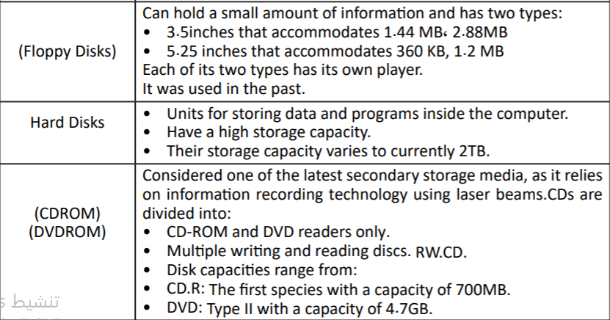
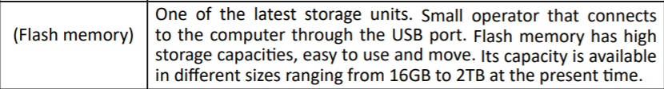
Secondary Memory Type

Slide 36
Hardware
Mother board

Slide 37
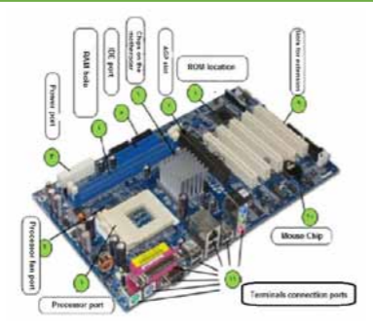
MOTHER BOARD
Motherboard DEFINITION
Motherboard is also known as the Main Board and System Board. The motherboard is called this title because it connects all the physical devices that make up the computer from input and output units, processing unit, memory, and others.

Slide 38
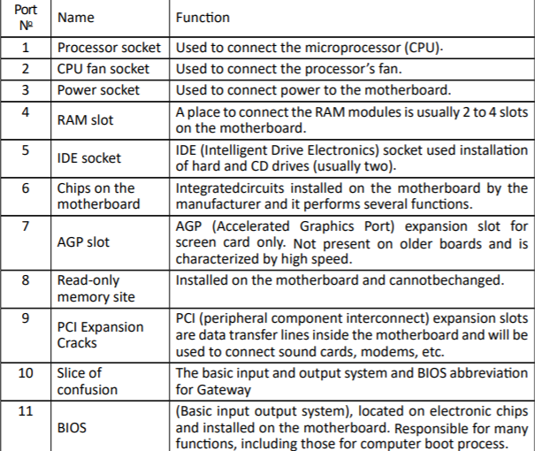
MOTHER BOARD COMPONENT

Slide 39
HARDWARE
PORTS

Slide 40
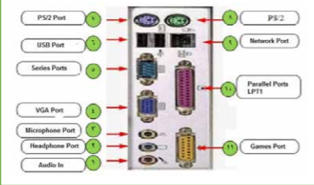
PORTS
DEFINITION
Ports are the places through which some external computer peripherals such as input or output units and some other devices are connected to the motherboard.

Slide 41
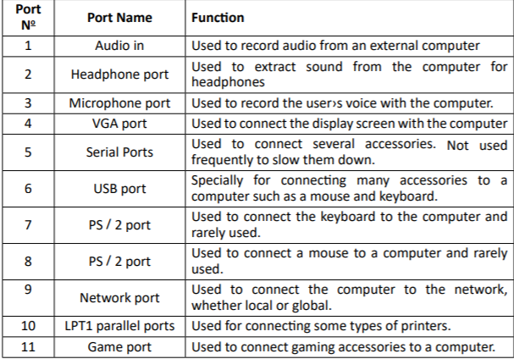
PORTS

Slide 42
HARDWARE
CARDS

Slide 43
Cards
CARDS DEFINITION
Cards are small electronic boards that are plugged into the expansion slots on the motherboard to connect various hardware accessories to the motherboard such as a screen card to link the screen, or a sound card to connect sound devices, etc., and the cards differ in type and performance

Slide 44
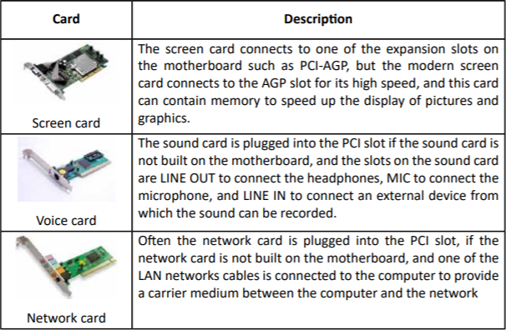
CARDS

Slide 45
HARDWARE
Measuring the Performance of Computers

Slide 46
Measuring the Performance of Computers
Processor Speed
Processor Speed: Control the speed of a computer. Speed is measured in a unit called GHz. The higher the speed, the better the performance.
Capacity and speed of random memory
Capacity and speed of random memory: It affects very much the performance of the computer and the memory capacity is measured in gigabytes and speed in Megahertz, the more memory capacity increases its speed, the performance of the computer improves.

Slide 47
Measuring the Performance of Computers
Speed and size of the hard disk
Both the speed and capacity of the hard disk affect the performance of the computer the higher the speed and capacity the larger the better the performance of the computer and vice versa.
SOFTWARE
Software: The programs running at the same time affect Computer performance. The more programs run at the same time, the less computer performance, especially programs that require more memory, such as multimedia programs.

Slide 48
Measuring the Performance of Computers
SCREEN CARD
Screen Card: The screen card affects multimedia programs such as video, pictures, and animation, and does not affect browsing other programs that need a fast screen card.
SSD storage disk
Is a disk for storing data of large and different capacities and overcomes the hard disk in terms of high speed in storing and retrieving data from it and the cost, and it is available in modern devices instead of the regular hard disk.

Slide 49
THE END OF LECTURE

