Slide 1
Chapter 5
Discrete Probability Distributions

Slide 2
Chapter 5 Overview
Introduction
5-1 Probability Distributions
5-2 Mean, Variance, Standard Deviation , and Expectation
5-3 The Binomial Distribution

Slide 3
Probability Distributions

Slide 4
5.1 Probability Distributions
A random variable is a variable whose values are determined by chance.
Classify as discrete and continuous
A discrete probability distribution consists of the values a random variable can assume and the corresponding probabilities of the values.
The sum of the probabilities of all events in a sample space add up to 1. Each probability is between 0 and 1, inclusively.

Slide 5
For example: tossed a coin S={T,H}
X= NUMBER OF HEADS
P(x=0) = P(T) =$\frac{1}{2}$
P(x=1) =P(H) =$\frac{1}{2}$
X | 0 | 1
P(X) | $$\frac{1}{2}$$ | $$\frac{1}{2}$$

Slide 6
Example 5-1: Rolling a Die
Construct a probability distribution for rolling a
single die.

Slide 7
For example: tossed 2 coins S={TT,HT,TH,HH}
X= NUMBER OF HEADS
P(x=0) = P(TT) =$\frac{1}{2}\frac{1}{2}$=$\frac{1}{4}$
P(x=1) =P(HT)$+$P(TH) =$\frac{1}{2}$. $\frac{1}{2}$+$\frac{1}{2}$. $\frac{1}{2}$= $\frac{2}{4}$
P(x=2)=P(HH)=$\frac{1}{2}\frac{1}{2}$=$\frac{1}{4}$
X | 0 | 1 | 2
P(X) | $$\frac{1}{4}$$ | $$\frac{2}{4}$$ | $$\frac{1}{4}$$

Slide 8
Example 5-2: Tossing Coins
Represent graphically the probability distribution for the sample space for tossing three coins.
.

Slide 9
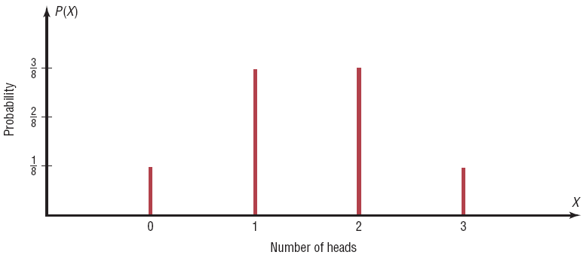

Slide 10
Mean, Variance, Standard Deviation, and Expectation

Slide 11
5-2 Mean, Variance, Standard Deviation, and Expectation
Mean :
Variance:
$σ^{2}$= $∑\left[X^{2}.P\left(X\right)\right]−μ^{2}$
$$μ=∑X.P(X)$$

Slide 12
Example 5-5: Rolling a Die
Find the mean of the number of spots that appear when a die is tossed.
.

Slide 13
Solution:

Slide 14
Example 5-8: Trips of 5 Nights or More
The probability distribution shown represents the number of trips of five nights or more that American adults take per year. (That is, 6% do not take any trips lasting five nights or more, 70% take one trip lasting five nights or more per year, etc.) Find the mean.
.

Slide 15
Solution :

Slide 16
Example 5-9: Rolling a Die
Compute the variance and standard deviation for the probability distribution in Example 5–5.
.

Slide 17
Solution:

Slide 18
Example 5-11: On Hold for Talk Radio
A talk radio station has four telephone lines. If the host is unable to talk (i.e., during a commercial) or is talking to a person, the other callers are placed on hold. When all lines are in use, others who are trying to call in get a busy signal. The probability that 0, 1, 2, 3, or 4 people will get through is shown in the distribution. Find the variance and standard deviation for the distribution.

Slide 19
Solution:

Slide 20
Expectation
The expected value, or expectation, of a discrete random variable of a probability distribution is the theoretical average of the variable.
The expected value is, by definition, the mean of the probability distribution.

Slide 21
Example 5-12: Winning Tickets
One thousand tickets are sold at $1 each for a color television valued at $350. What is the expected value of the gain if you purchase one ticket?
Solution :
Note: This PowerPoint is only a summary and your main source should be the book.

Slide 22
Solution :
 | Win | Lose
Gain(X) | $349 | -$1
Probability P(X)
An alternate solution :
Note: This PowerPoint is only a summary and your main source should be the book.

Slide 23
Example 5-13: Winning Tickets
One thousand tickets are sold at $1 each for four prizes of $100, $50, $25, and $10. After each prize drawing, the winning ticket is then returned to the pool of tickets. What is the expected value if you purchase two tickets?
Note: This PowerPoint is only a summary and your main source should be the book.

Slide 24
Solution :
Gain
X
$98
$48
$23
$8
-$2
Probability
P(X)
Note: This PowerPoint is only a summary and your main source should be the book.

Slide 25
An alternate solution :
Note: This PowerPoint is only a summary and your main source should be the book.

Slide 26
The Binomial Distribution

Slide 27
5-3 The Binomial Distribution
Many types of probability problems have only two possible outcomes or they can be reduced to two outcomes.
Examples include: when a coin is tossed it can land on heads or tails, when a baby is born it is either a boy or girl, etc.

Slide 28
The Binomial Distribution
The binomial experiment is a probability experiment that satisfies these requirements:
Each trial can have only two possible outcomes—success or failure.
There must be a fixed number of trials.
The outcomes of each trial must be independent of each other.
The probability of success must remain the same for each trial.

Slide 29
Notation for the Binomial Distribution
P(S)
P(F)
p
q
P(S) = p
n
X
Note that X = 0, 1, 2, 3,...,n
The symbol for the probability of success
The symbol for the probability of failure
The numerical probability of success
The numerical probability of failure
and P(F) = 1 – p = q
The number of trials
The number of successes

Slide 30
The Binomial Distribution
In a binomial experiment, the probability of exactly X successes in n trials is

Slide 31
Example 5-15: Tossing Coins
A coin is tossed 3 times. Find the probability of getting exactly heads.
Solution :
Note: This PowerPoint is only a summary and your main source should be the book.

Slide 32
Example 5-16: Survey on Doctor Visits
A survey found that one out of five Americans say he or she has visited a doctor in any given month. If 10 people are selected at random, find the probability that exactly 3 will have visited a doctor last month.

Slide 33
Solution:

Slide 34
Example 5-17: Survey on Employment
A survey from Teenage Research Unlimited (Northbrook, Illinois) found that 30% of teenage consumers receive their spending money from part-time jobs. If 5 teenagers are selected at random, find the probability that at least 3 of them will have part-time jobs.

Slide 35
Solution:

Slide 37
Mean, Variance and Standard deviation for the binomial

Slide 38
The mean , variance and SD of a variable that the binomial distribution can be found by using the following formulas:
Mean:
$$μ=np$$
Variance:
$$σ^{2}=npq$$
SD:
$$σ=\sqrt{npq}$$

Slide 39
Example 5-21: tossing a coin
A coin is tossed 4 times
Find the mean, variance and standard deviation of number of heads that will be obtained.

Slide 40
Solution:
With the formulas for the binomial distribution
n= 4,
p=0.5, q=0.5
$$μ=n.p=\left(4\right)\left(0.5\right)=2$$
$$σ^{2}=n.p.q=\left(4\right)\left(0.5\right)\left(0.5\right)=1$$
$$σ=\sqrt{1}=1$$

Slide 41
Example 5-22: Rolling a die
A die is rolled 360 times , find the mean , variance and slandered deviation of the number of 4s that will be rolled .

Slide 42
Solution:
n= 360,
p=$\frac{1}{6}$ , q=$\frac{5}{6}$
$$μ=n.p=\left(360\right)\left(\frac{1}{6}\right)=60$$
$$σ^{2}=n.p.q=\left(360\right)\left(\frac{1}{6}\right)\left(\frac{5}{6}\right)=50$$
$$σ=\sqrt{50}=7.07$$

Slide 43
Good Luck

