Slide 1
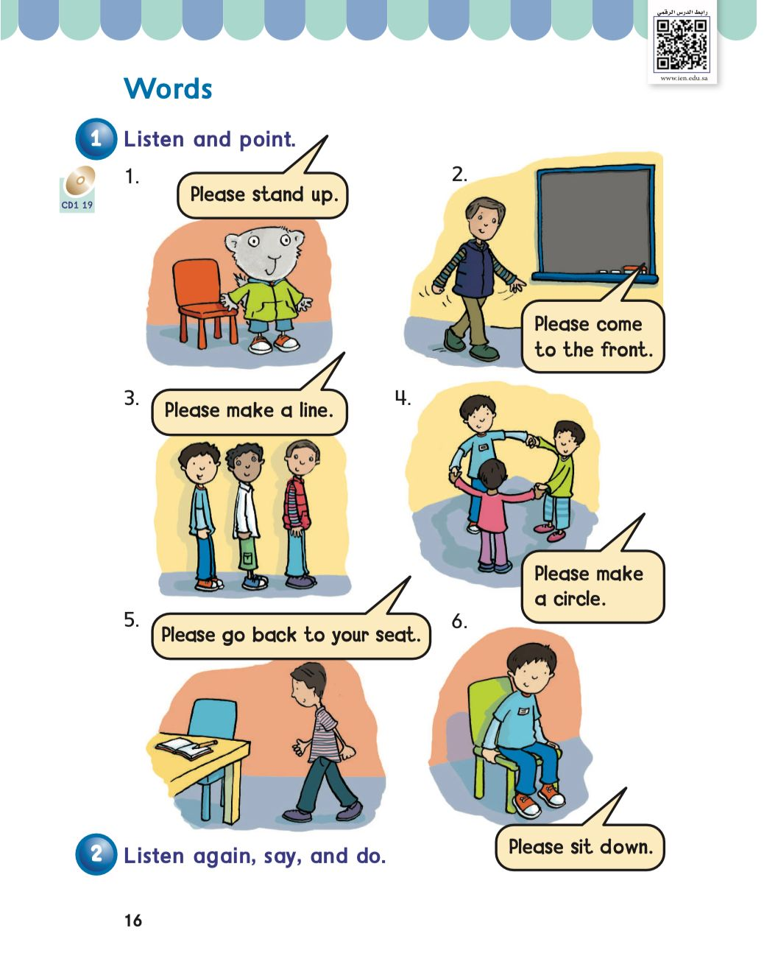
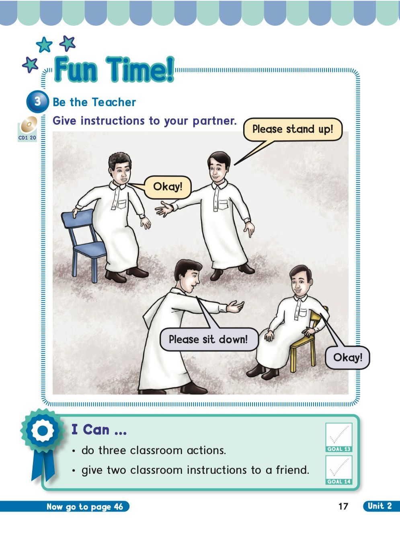
KSA National Anthem
Classroom Rules
Unit 2 : My body
Sunday
Warm Up
Lesson 3: Words
Main lesson
Fun Time
work book
Moral Goal
P: 16 / 17

Slide 2
KSA National Anthem
Classroom Rules
Warm Up
Main lesson
Fun Time
work book
Moral Goal

Slide 3
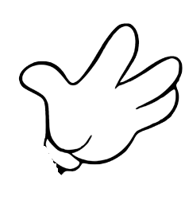
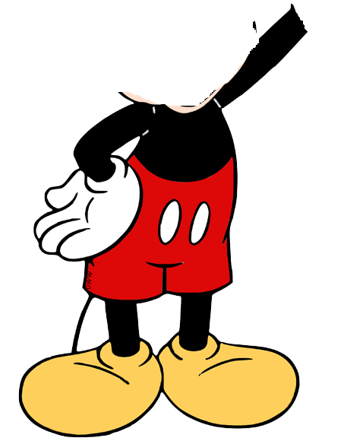
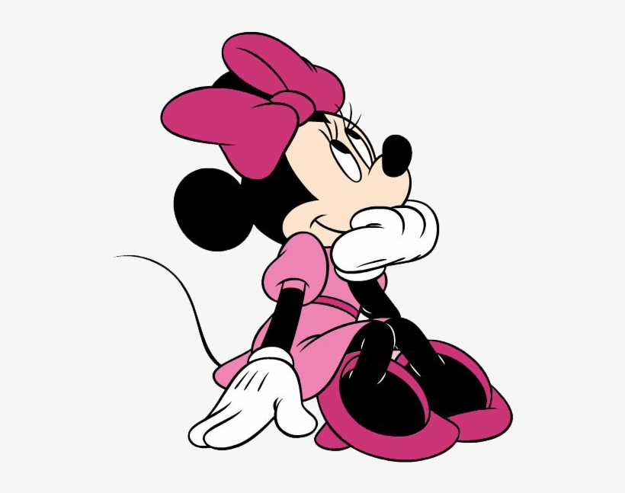
KSA National Anthem
Classroom Rules
Warm Up
Main lesson
Fun Time
work book
Moral Goal
Can you help me,please?

Slide 4
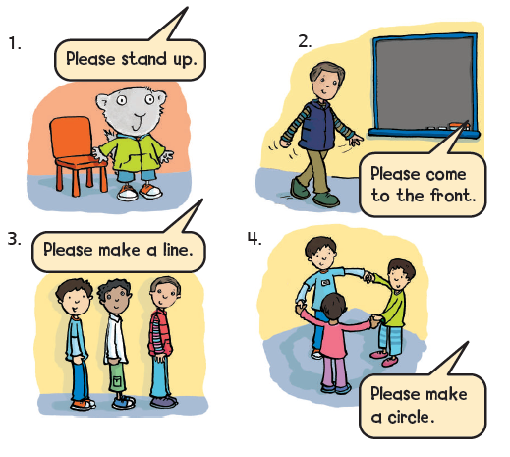
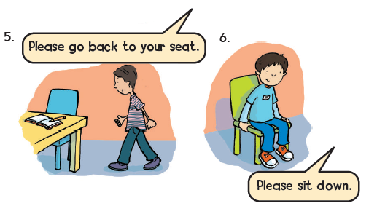
KSA National Anthem
Classroom Rules
Warm Up
Main lesson
Fun Time
work book
Moral Goal
Listen and point
استمع ثم تابع الكلمة والصورة
1

Slide 5
KSA National Anthem
Classroom Rules
Moral Goal
Warm Up
Main lesson
Fun Time
Work book
Moral Goal

Slide 6
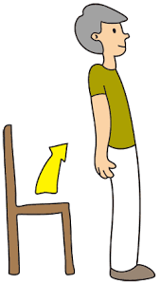
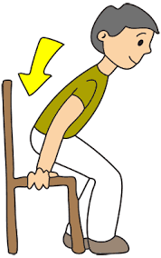
KSA National Anthem
Classroom Rules
Warm up
Main lesson
Fun Time
work book
Moral Goal
Stand up
Sit down

Slide 7
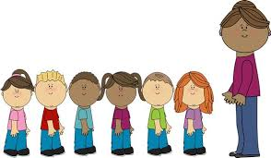
KSA National Anthem
Classroom Rules
Warm Up
Main lesson
Fun Time
work book
Make a line
Make a circle
Moral Goal

Slide 8
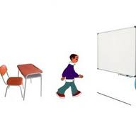
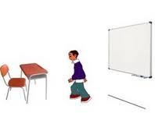
KSA National Anthem
Classroom Rules
Warm Up
Main lesson
Fun Time
work book
Come to the front
Go back to your seat
Moral Goal

Slide 9
KSA National Anthem
Classroom Rules
Warm Up
Main lesson
Stand up
Fun Time
work book
Sit down
Moral Goal

Slide 10
KSA National Anthem
Classroom Rules
Make a line
Warm Up
Main lesson
Fun Time
work book
Make a circle
Moral Goal

Slide 11
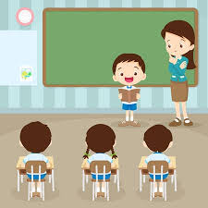
KSA National Anthem
Classroom Rules
Warm Up
Come to the front
Main lesson
Fun Time
work book
Go back to your seat
Moral Goal

Slide 12
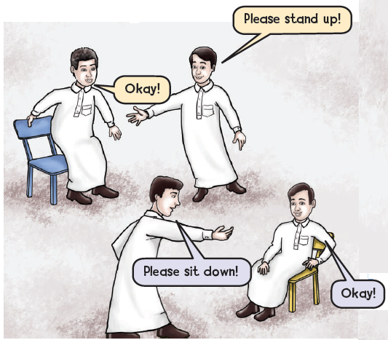
KSA National Anthem
Classroom Rules
Warm Up
Main lesson
Fun Time
work book
Moral Goal
3
Be the teacher كن المعلم
Give instructions to your partner . أعط الأوامر لزميلك

Slide 13
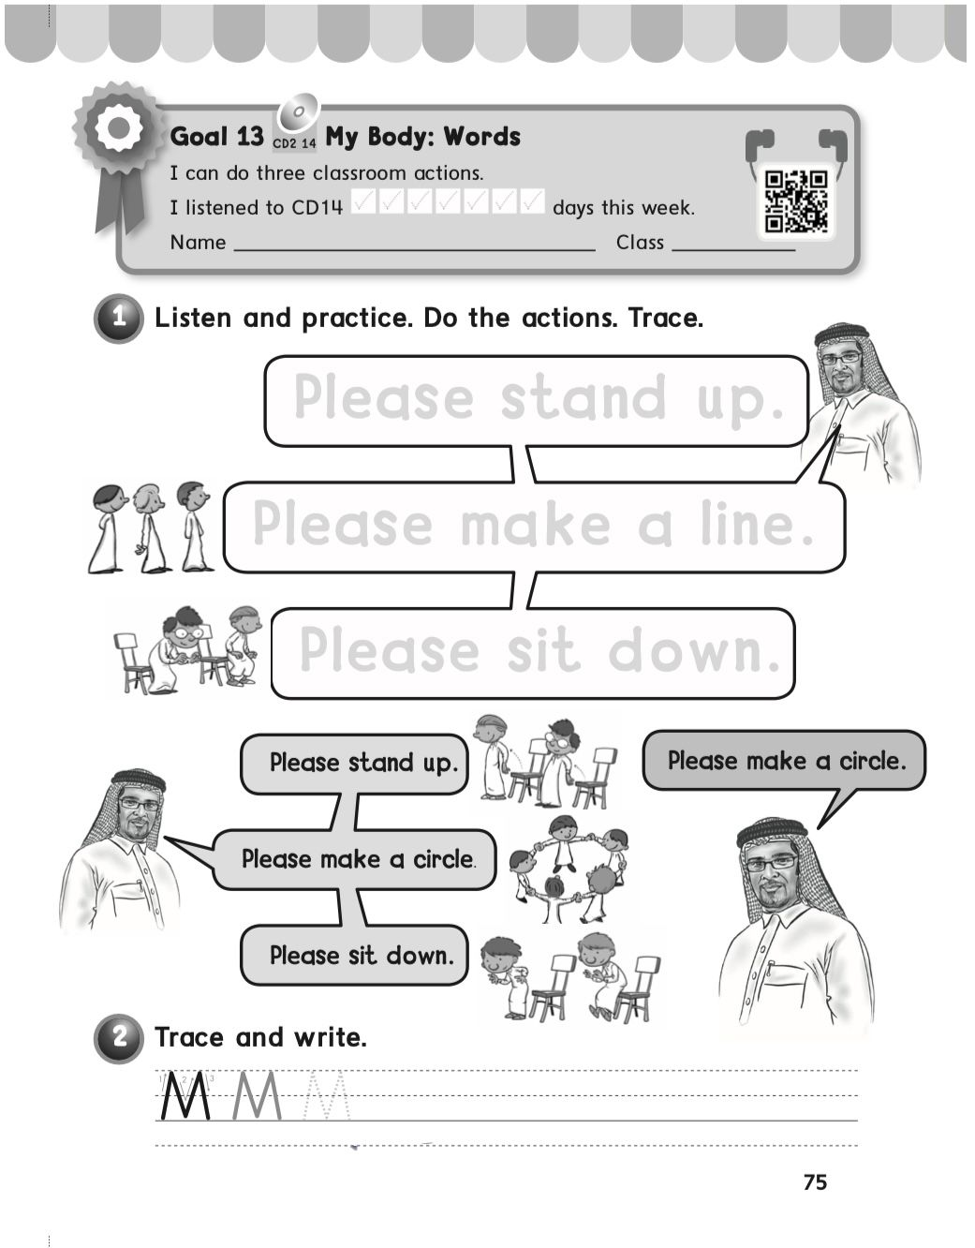
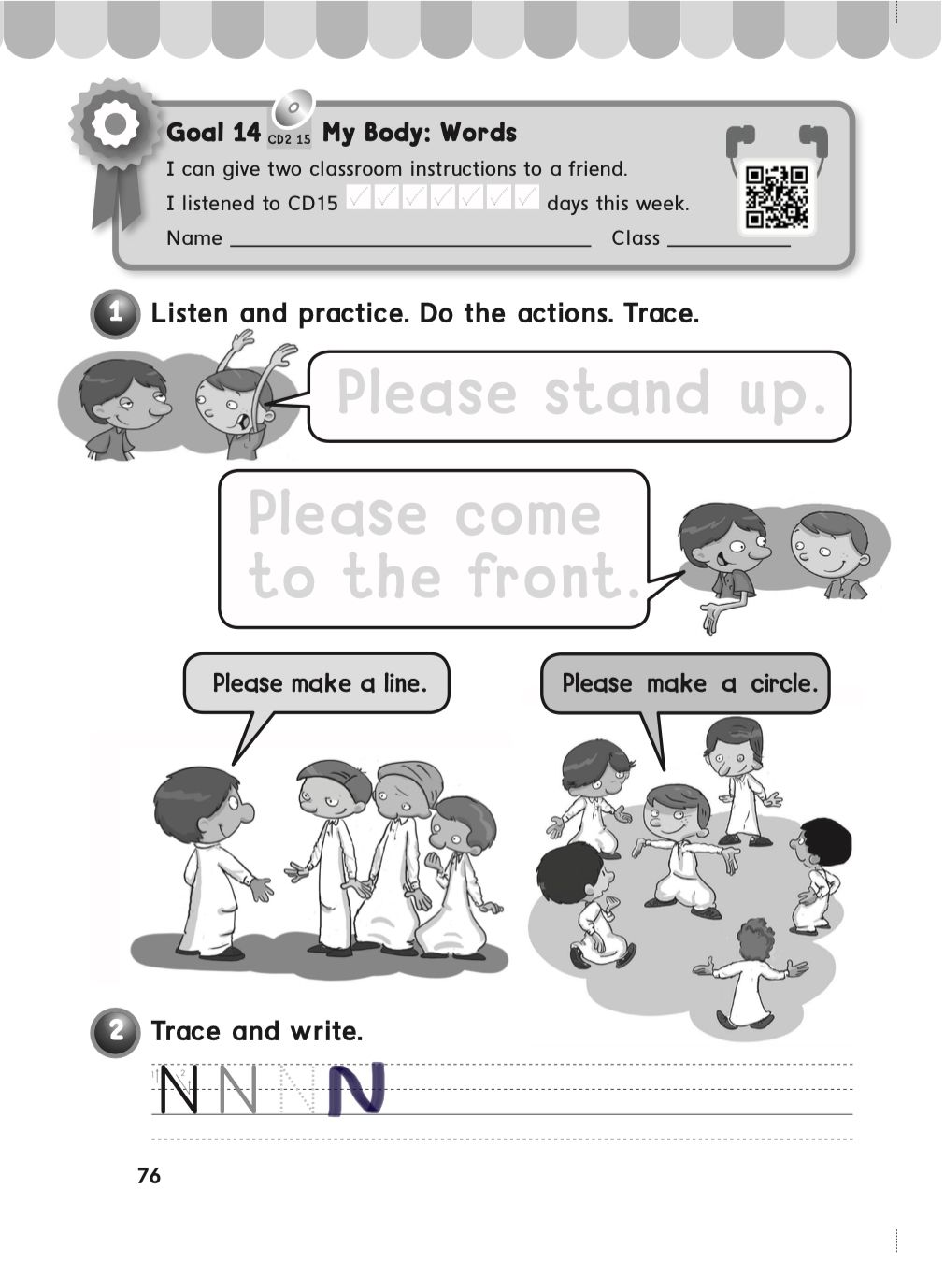
KSA National Anthem
Classroom Rules
Warm Up
Main lesson
Fun Time
work book
Moral Goal
P: 75 / 76

Slide 14
