Slide 1
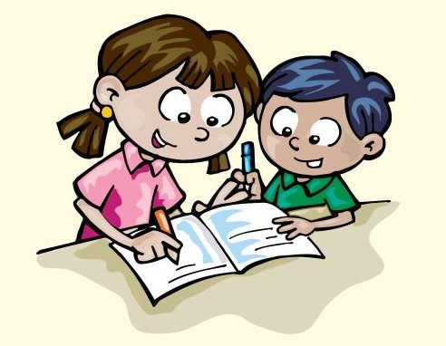
UNIT 8
Look at all the animals!
Family and Friends 3
Grade 3
Unit Practice
+ Review

Slide 2
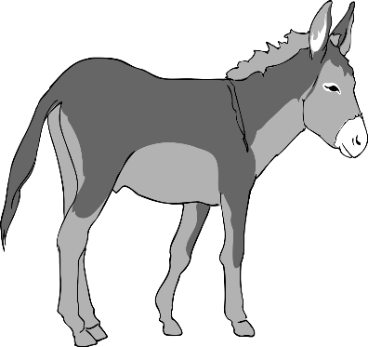
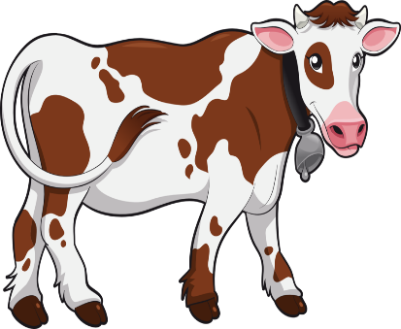
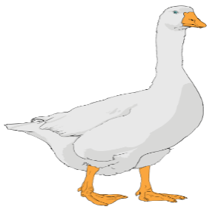
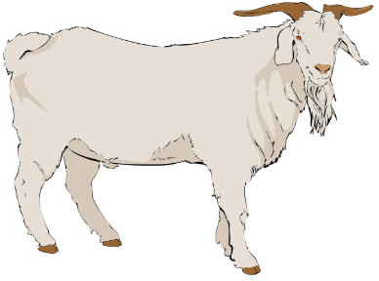
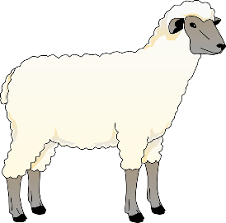
8
Lesson one
look at all the animal
Words
cow goat horse sheep donkey goose

Slide 3
8
Lesson one
look at all the animal
Words
goose
goat
cow
donkey
horse
sheep
cow goat horse sheep donkey goose

Slide 4
8
look at all the animal
Lesson one
Words
behind
on
in front of
Between
in
under
next to

Slide 5
8
look at all the animal
Lesson one
Words
behind
on
in front of
Between
in
under
next to
in
on
under
next to
behind
In front of
between

Slide 6
8
Lesson two Grammar
Write
1-Tall ………………
2-Small ………………
3-Short ……………..
4-Big ……………..
Shorter than bigger than taller than smaller than

Slide 7
8
Lesson two Grammar
Write
Tall taller than
Small smaller than
Short shorter than
Big bigger than
Shorter than bigger than taller than smaller than

Slide 8
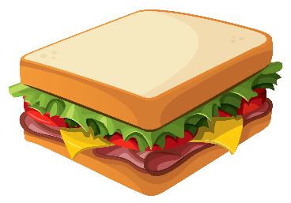
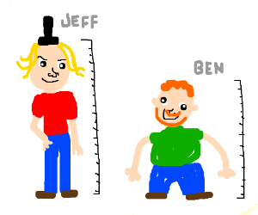
Lesson two Grammar
8
Write the opposites .Then write sentences.
A pizza is
a sandwich .
Jeff is
Ben .

Slide 9
Lesson two Grammar
8
Write the opposites .Then write sentences.
A pizza is
bigger than
a sandwich .
Jeff is
taller than
Ben .

Slide 10
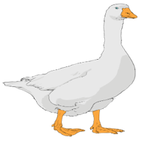
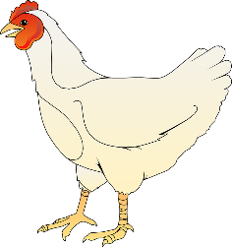
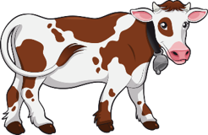
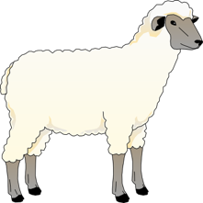
8
Lesson three words
1 find and circle the words
2 look and write
1-The goose is ..louder than.. the hen.
2-The sheep is …………………..…the cow.
3-The cow is ……………………….. The sheep.
4-The hen is ………………………….the goose.
Slow fast quiet loud
fastddloudsbquieteeSlow
Louder quieter slower faster
goose
hen
cow
sheep

Slide 11
8
Lesson three words
1 find and circle the words
2 look and write
1-The goose is ..louder than.. the hen.
2-The sheep is …faster than……the cow.
3-The cow is ……slower than…. the sheep.
4-The hen is ……quieter than...the goose.
Slow fast quiet loud
Fast dd loud sb quiet ee Slow
Louder quieter slower faster
goose
hen
cow
sheep

Slide 12
8
Lesson Four Phonics
1-Order the letters
Meoh sone peor nboe tosne
2-Write
The kitten has got my …rope……
The kitten is on a ………….
Hurry up, kitten.
I want to go ……..
Here is a ………..
Hurry up, kitten
home nose rope bone stone

Slide 13
8
Lesson Four Phonics
1-Order the letters
Meoh sone peor nboe tosne
home nose rope bone stone
2-Write
The kitten has got my …rope……
The kitten is on a …stone……….
Hurry up, kitten.
I want to go …home …..
Here is a …bone……..
Hurry up, kitten
home nose rope bone stone

Slide 14
Skills Time
8
Lesson Five Phonics
Read and circle
1-Circle two vegetables on the farm.
2- Circle two fruit trees on the farm.
3- Circle two animals on the farm.
4-How many donkeys are there on the farm?
5-How many cats are there on the farm?
carrots apples tomatoes
Sarah and Ahmed live on a farm. On the farm they grow vegetables: potatoes, carrots and tomatoes. They’ve got fruit trees too : mangos, apples and lemons. There are also animals on the farm :cows, hens, goats and sheep. They get eggs from the hens. They get yogurt and milk from the cows. They get milk and cheese from the goats. And they get meat from the sheep. There are also two donkeys on the farm and two cats. Sarah and Ahmed help their family on the farm.
figs mangos lemons
cows horses goats
one two three
one two three

Slide 15
Skills Time
8
Lesson Five Phonics
Read and circle
1-Circle two vegetables on the farm.
2- Circle two fruit trees on the farm.
3- Circle two animals on the farm.
4-How many donkeys are there on the farm ?
5-How many cats are there on the farm?
carrots apples tomatoes
Sarah and Ahmed live on a farm. On the farm they grow vegetables: potatoes, carrots and tomatoes. They’ve got fruit trees too : mangos, apples and lemons. There are also animals on the farm :cows, hens, goats and sheep. They get eggs from the hens. They get yogurt and milk from the cows. They get milk and cheese from the goats. And they get meat from the sheep. There are also two donkeys on the farm and two cats. Sarah and Ahmed help their family on the farm.
figs mangos lemons
cows horses goats
one two three
one two three

Slide 16
Skills Time
8
Lesson six
Writing
Circle and. Then write two sentences for each sentence.
1- Nada is seven and khalid is nine. Nada is seven .Khalid is nine.
2-This is a cow and these are hens …………………………………………..………
3-I like pears and he likes apples……………………………………………..………..
4-There is a house and there are cars. ………………………………………………..

Slide 17
Skills Time
8
Lesson six
Writing
Circle and .Then write two sentences for each sentence.
1- Nada is seven and Khalid is nine. Nada is seven .Khalid is nine .
2-This is a cow and these are hens. This is a cow .These are hens.
3-I like pears and he likes apples. I like pears .He likes apples.
4-There is a house and there are cars.There is a house .There are cars.

Slide 18
8
Review
Write sentences
1-donkey/big /goat
A donkey is bigger than a goat.
2-giraffe/tall/cow
3-Sheep/small/ cow
4-Hen/short/sheep

Slide 19
8
Review
Write sentences
1-donkey/big /goat
A donkey is bigger than a goat.
2-giraffe/tall/cow
3-Sheep/small/ cow
A sheep is smaller than a cow.
4-Hen/short/sheep
A giraffe is taller than a cow.
A hen is shorter than a sheep.

