Slide 1


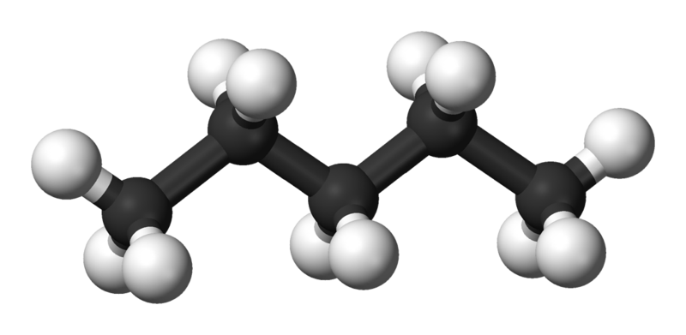
Saturated Hydrocarbons
Alkanes
1435-1436
2014-2015

Slide 2


Learning Objectives
Alkanes
Chapter one discusses the following topics and the student by the end of this chapter will:
Know the classification of hydrocarbon.
Know general formula of simple alkanes and their names from methane to decane.
Know the different methods of representing molecular formulas.
Know the different classes of carbon and hydrogen atoms.
know the hybridization and geometry of alkanes.
Know the rules for naming branched chain alkanes and how to use them and isomer.
Know the physical properties of alkanes and factors affecting them.
Know the different methods used for preparing alkanes.
Know the different reaction of alkanes.
Know why are cycloalkanes are special class of hydrocarbons.
Know the cis/trans isomerism in cycloalkanes.
Know the rules for naming cycloalkanes and how to use them.
know the halogenation reactions of different cycloalkanes.

Slide 3
Alkanes
Hydrocarbons ( C,H)
Saturated
i.e. contain only
single bonds
Unsaturated
i.e. contain multiple bonds (double or triple)
Opened chain
e.g. Alkanes
Cyclic
e.g. Cycloalkanes
Opened chain
e.g. Alkenes and Alkynes
Cyclic
e.g. Cycloalkenes and Aromatic compounds

Slide 4
Alkanes : C_{n}H_{2n+2}
Alkanes
Molecular Formula | Name
CH₄ | Methane
C₂H₆ | Ethane
C₃H₈ | Propane
C₄H₁₀ | Butane
C₅H₁₂ | Pentane
C₆H₁₄ | Hexane
C₇H₁₆ | Heptane
C₈H₁₈ | Octane
C₉H₂₀ | Nonane
C₁₀H₂₂ | Decane
4

Slide 5


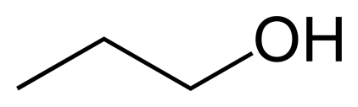
Representation Of Molecular Formulae
Alkanes
Ball and stick model dash formula
CH₃CH₂CH₂OH
Condensed formula Bond line formula
5

Slide 6
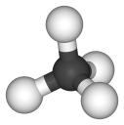
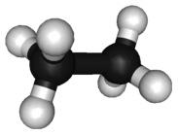
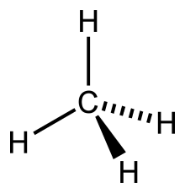
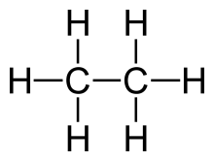
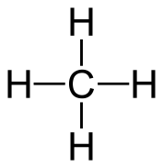
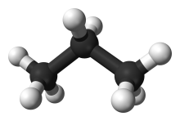
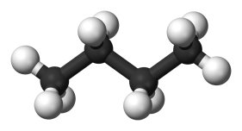
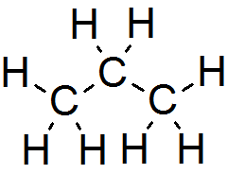
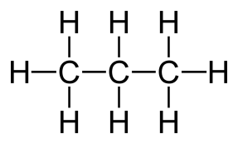
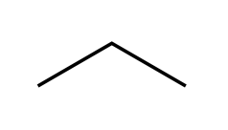
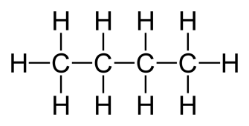

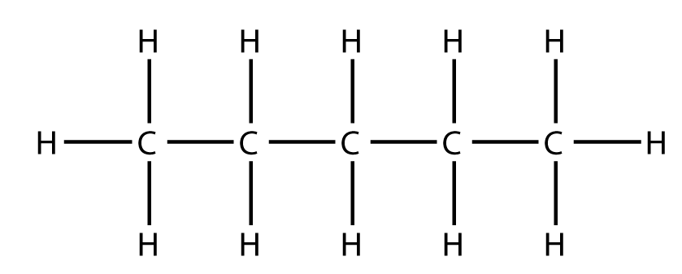

Drawing Alkanes
Alkanes
Methane
Ethane
CH₄
CH₃CH₃
Propane
butane
CH₃CH₂CH₃
CH₃CH₂CH₂CH₃
n-Pentane
CH₃CH₂CH₂CH₂CH₃
CH₃(CH₂)₃CH₃
6

Slide 7
Classes Of Carbons and Hydrogens
Alkanes
Primary carbon : CH₃-CH₂-CH₃
Secondary carbon : CH₃-CH₂-CH₃
Tertiary carbon : (CH₃)₂-CH-CH₃
Hydrogens are also referred to as 1º, 2º or 3º according to the type of carbon they are bonded to.
7

Slide 8
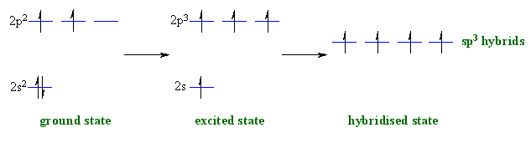
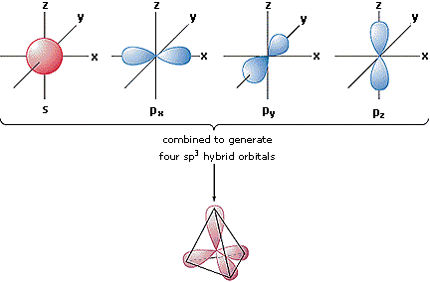
Alkanes
hybridization of carbon in alkane:
In the case of a carbon that has 4 single bonds, all of the orbitals are hybrids
4 Molecular orbital (Sp³)
Each orbital has
25% s, 75% p Character

Slide 9

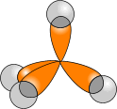
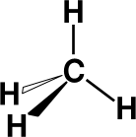
Alkanes
The Structure Of Alkanes
In ALKANES, the four sp³ orbitals of carbon repel each other into a TETRAHEDRAL arrangement with bond angles of 109.5º.
Each sp³ orbital in carbon overlaps with the 1s orbital of a hydrogen atom to form a C-H bond.
109.5º
9

Slide 10
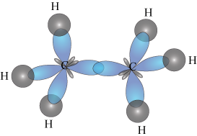
Alkanes
Ethane:
s orbital (hydrogen)
sp3 hybrids orbital
(carbon)
The length of the band: 1.54 A°
Angle: 109.5°

Slide 11
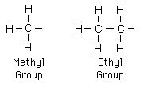
Alkyl groups
Alkanes
Alkyl groups are formed by loss of a hydrogen atom from the corresponding alkane
( e.g. CH₄ Methane – 1 H = -CH₃ Methyl group )
Alkyl groups are named by dropping the -ane suffix of the alkanes and adding the suffix -yl. Methane becomes a methyl group, ethane an ethyl group, etc.
11

Slide 12
Alkanes
Alkyl Groups
Propyl group C₃H₇
(can give two isomeric alky groups)
and
12

Slide 13
Alkanes
Butyl Group C₄H₉
(can give four isomeric alky groups)

Slide 14
IUPAC Nomenclature Of Branched-Chain Alkanes
Alkanes
1- Locate the longest continuous chain of carbon atoms; this chain determines the root name for the alkane.
Sometimes, you may need to go around corners and zigzag to find the longest (parent) chain. (the parent chain is in blue):
If the parent chain for example has 6 carbon atoms, therefore, it is a derivative of hexane and if it has 4 carbon atoms it is derivative of butane and so on .
14

Slide 15
Alkanes
2- Number the longest chain beginning with the end of the chain nearer to the substituent.
15

Slide 16
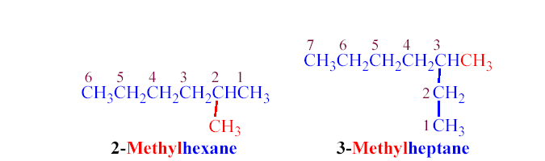
Alkanes
3- Use the numbers obtained by application of rule 2 to designate the location of the substituent group.
In writing the full name the root name is placed last; the substituent group, preceded by the number indicating its location on the chain, is placed first.
16
Notes:
16

Slide 17
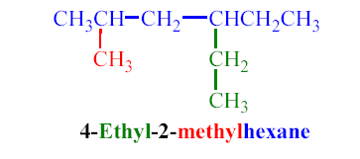
Alkanes
4- When two or more substituents are present, give each substituent a number corresponding to its location on the longest chain.
The substituent groups are listed alphabetically regardless of their order of occurrence in the molecule. Cl is called chloro, Br called bromo, I called iodo, F called fluoro, NO₂ called nitro, CN called cyano
17

Slide 18
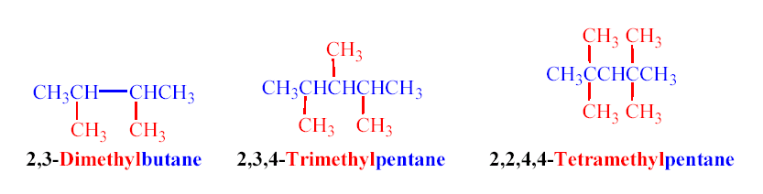
Alkanes
5- When two or more substituents are identical, indicate this by the use of the prefixes di-, tri-, tetra-, and so on.
In case of deciding alphabetical order of many substituent disregard multiplying prefixes such as “di”and “tri”, “tetra”, “penta”, ….
18

Slide 19
Alkanes
6- When two substituents are present on the same carbon, use the number twice.
19

Slide 20
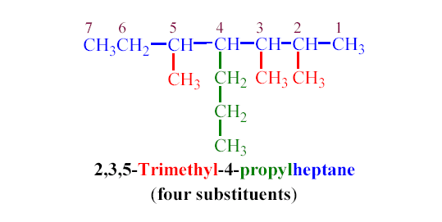
Alkanes
7- When two chains of equal length compete for selection as the parent chain, choose the chain with the greater number of substituents.
20

Slide 21
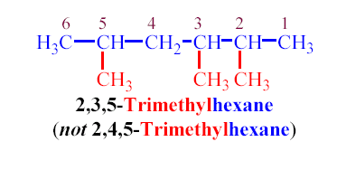
Alkanes
8- When branching occurs at an equal distance from both ends of the longest chain, choose the name that gives the lower number at the first point of difference.
21

Slide 22
Summary Of IUPAC System Of Nomenclature
Alkanes
Find and name the longest continuous carbon chain.
Identify and name groups attached to this chain.
Number the chain consecutively, starting at the end nearest a substituent group.
Designate the location of each substituent group by an appropriate number and name.
Assemble the name, listing groups in alphabetical order.
The prefixes di, tri, tetra etc., used to designate several groups of the same kind, are not considered when alphabetizing.
Halogen substituents are easily accommodated, using the names: fluoro (F-), chloro (Cl-), bromo (Br-) and iodo (I-).
22

Slide 23

Examples of The IUPAC Rules in Practice
Alkanes
By inspection, the longest chain is seen to consist of six carbons, so the root name of this compound will be hexane. A single methyl substituent (colored red) is present, so this compound is a methylhexane. The location of the methyl group must be specified, since there are two possible isomers of this kind. The IUPAC name is thus 3-methylhexane.
23

Slide 24
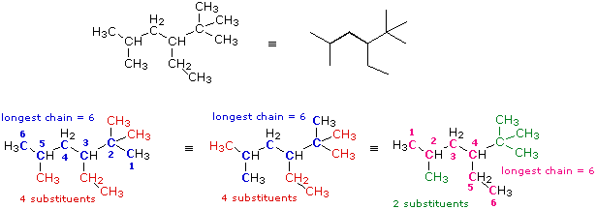
Alkanes
Thus the parent chain will be the one with 4 substituents and the correct IUPAc name of this compound is : 3-Ethyl-2,2,5-trimethylhexane
24

Slide 25
Important Notes
Alkanes
The common names isopropyl, isobutyl, sec-butyl, tert-butyl are approved by the IUPAC for the substituted groups.
Substituent groups are cited in the name in alphabetical order, regardless of their order of occurrence in the molecule. Multiplication prefixes di, tri, ect. and structural prefixes sec., tert. written in italics and separated from the name by a hyphen) are ignored, but prefixes iso and cyclo are not!
Thus “tert-butyl” precedes “ethyl”, but ethyl preceeds “isopropyl”
3-ethyl comes before 2,2-dimethyl
4-hexyl comes before 2,3-diisopropyl
3-Tert-butyl comes before 3-isopropyl
25

Slide 26
Alkanes
Isomerism
Molecules which have the same molecular formula, but differ in the arrangement of their atoms, are called isomers.
Types of Isomers:
Constitutional (or structural) isomers differ in their structural formulas.
Stereoisomers differ only in the arrangement of the atoms in space.
There are two types of stereoisomerism
  Geometrical isomerism
  Optical isomerism

Slide 27
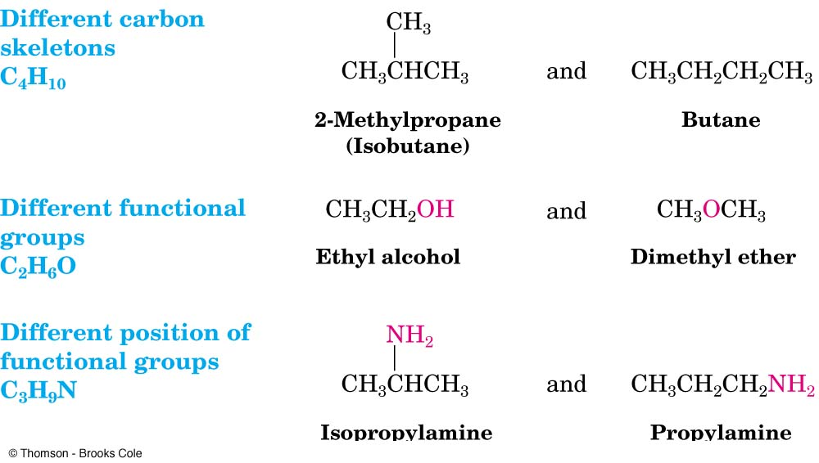
Alkanes
Structural Isomers
Butane and isobutane are isomers—two different compounds with the same molecular formula. Specifically, they are constitutional or structural isomers.

Slide 28
Alkanes
Geometrical isomers
Geometrical isomers occur in organic molecules where rotation around a bond is restricted
This occurs in cycloalkanes
This occurs most often around C=C
The most common cases are around asymmetric non-cyclic alkenes

Slide 29
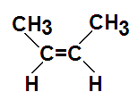
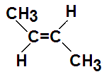
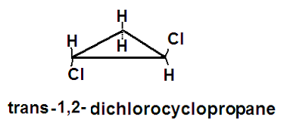
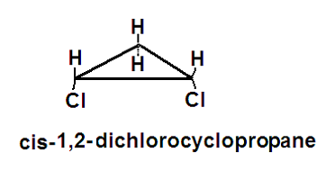
Alkanes
Geometric Isomers in alkenes
A cis isomer is one in which the substituents are on the same side of the C=C or cyclic alkane
A trans isomer is one in which the substituents are on the opposite sides of the C=C or cyclic alkane

Slide 30
Physical Properties
Alkanes
Methane, ethane, propane, and butane are gases; pentane through hexadecane are liquids; the homologues larger than hexadecane are solids.
The boiling points and melting points of alkanes increase with molecular weight.
Branching reduces the boiling point, the more branching the lower the boiling point.
Alkanes are non- polar so are immiscible with water , they are soluble in most organic solvents.
30

Slide 31
Preparation of alkanes
Give double or more number of carbons (start with one carbon might end with two or more carbon and so on)
Give the same number of carbons (start with one carbon will end with one carbon and so on)
Reaction with Na:
RX + Na
X= Cl,Br,F,I
Result: R-R
DOUBLE
Reaction with R2CuLi: R2CuLi+R¹X
X= Cl,Br,F,I
Result : R-R¹
INCREASED
Reaction of R-X
C=C + H₂/ Ni or Pd or Pt
Result : H-C-C-H
2H added + broke one bone
With Zn/H⁺
result: R-H
X= Cl,Br,F,I
With LiAlH₄
Result: R-H
X= Cl,Br,F,I
With Mg/H₃O⁺ (H₂O/H⁺)
Result: R-H
X: Br (only)

Slide 32
Preparation Of Alkanes
Alkanes
1- Hydrogenation of unsaturated hydrocarbon:
2- Hydrolysis of Grignard reagent
32

Slide 33
Alkanes
3- Reduction of alkyl halides
a) By metal and acid or by metal hydrides
b) By sodium metal (Coupling reaction) (Wurtz reaction)
c) By lithium dialkyl cuprate
33

Slide 34
Reactions Of Alkanes
Alkanes
Chemically alkanes are very unreactive and stable at room temperature towards acids , bases and most reactive metals.
Despite their relative inertness ( thus they known as paraffines i.e lacking affinity) , alkanes undergo several important reactions that are discussed in the following section.
1- Halogenation:
Halogenation is the replacement of one or more hydrogen atoms in an organic compound by a halogen (fluorine, chlorine, bromine or iodine).
The halogenation of an alkane appears to be a simple free radical substitution reaction in which a C-H bond is broken and a new C-X bond is formed; the reaction takes place in presence of heat or UV light ( no reaction in the dark)
34

Slide 35
Alkanes
Radical substitution reaction

Slide 36
Alkanes
If there is one type of the carbon atoms in the molecule (e.g. methane and ethane)
If there are different types of carbon atoms in the molecule (Selectivity issue)
When alkanes larger than ethane are halogenated, isomeric products are formed. The preferred order for the hydrogens to be substituted is 3° then 2° then 1° . Thus chlorination of propane gives both 1-chloropropane a s minor product and 2-chloropropane as major mono-chlorinated product.
36

Slide 37
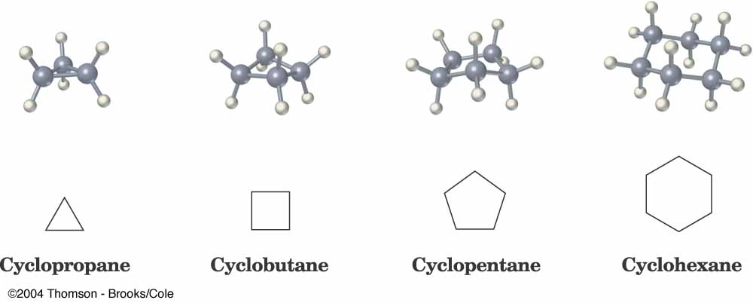
Cycloalkane
Alkanes
Cycloalkanes are alkanes that have carbon atoms forming rings (called
alicyclic compounds).
Simple cycloalkanes have the formula (CH₂)_{n}, or C_{n}H_{2n}
Nomenclature of Unsubstituted Cycloalkanes
1. Cycloalkanes with only one ring:
Ring strain
Bond angle
60°
90°
108°
109.5°
37

Slide 38
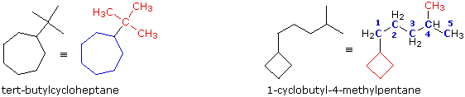
Naming Substituted Cycloalkanes
Alkanes
Count the number of carbon atoms in the ring and the number in the largest substituent chain. If the number of carbon atoms in the ring is equal to or greater than the number in the substituent, the compound is named as an alkyl-substituted cycloalkane i.e. use the prefix cyclo followed by the suffix indicate the number of carbon atoms.
For an alkyl- or halo-substituted cycloalkane, start at a point of attachment as C₁ and number the substituents on the ring so that the second substituent has as low a number as possible.
Number the substituents and write the name with the substituents in alphabetical order.
38
38
Notes:
38
38

Slide 39
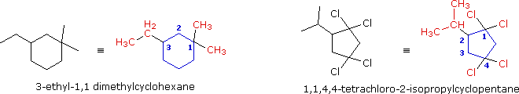
Alkanes
If the alkyl substituent is larger and/or complex, the ring is considered as a
substituent on alkane chain.
If a functional group (OH. CHO, COOH, CO , NH₂) is attached to the ring a suitable suffix is used to indicate their presence as appear in the following examples.
39

Slide 40
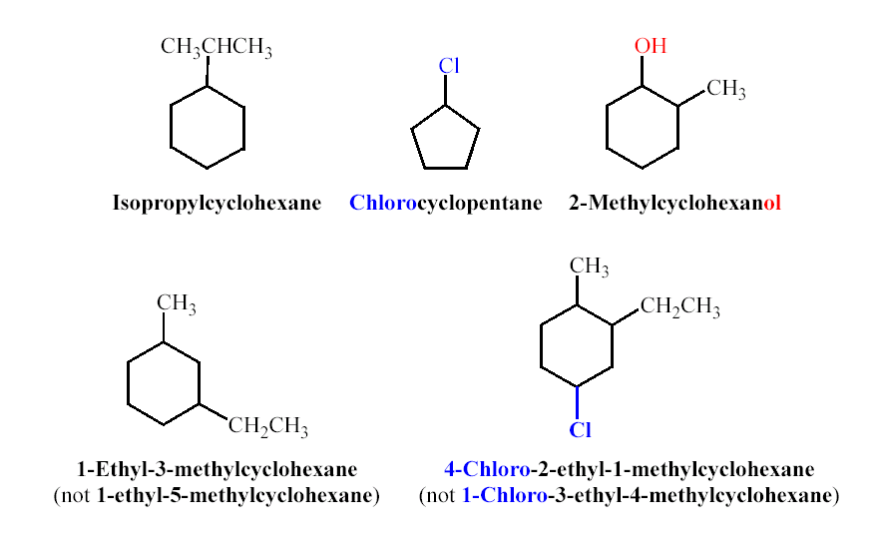
Alkanes
40

Slide 41
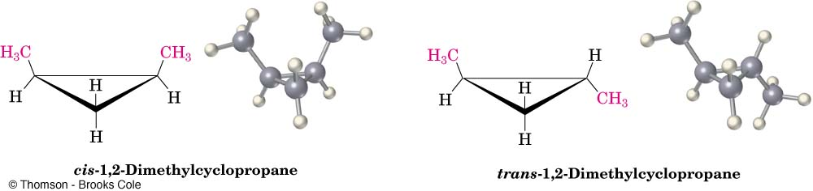
Cis-Trans Isomerism In Cycloalkanes
Alkanes
Rotation about C-C bonds in cycloalkanes is limited by the ring structure.
There are two different 1,2-dimethylcyclopropane isomers, one with the two methyls on the same side (cis) of the ring and one with the methyls on opposite sides (trans).
41
41
Notes:
41
41

Slide 42
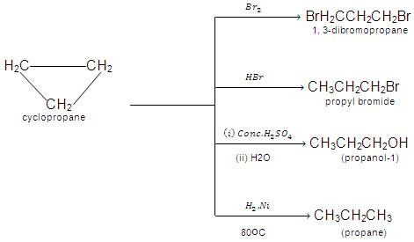
Reactions Of Cycloalkanes
Alkanes
Less stable rings
More stable 5 and 6 rings
42

Slide 43
Cyclobutan undergoes addition reactions less readily than cyclopropane
Conc.H₂SO₄ Br₂/CCl₄
H₂O
HX H₂/Ni
X=Cl,Br,F,I
OH
Br
Br
X

Slide 44
Question
1- Write the expected product for the following reaction
2- Name the Molecule shown below and Label the 3º carbon.
3- Design the type of hybridization for each carbon

Slide 45
Thank You for your kind attention !
Alkanes
Questions?
Comments

