Slide 1
Family and Friends 2-Grade 2
Unit 8
Tidy up!
Lesson 6
P 77

Slide 2
Objectives
1- Identify the use of (. - ?).
2- Use (. - ?) in sentences.
_________________________________________________________________________________________________________________________________________________
Ministry of Education-2020

Slide 3
How to use them ?
.
(full-stop)
There are many plates in the cupboard.
We use full-stops at the end of sentences.
_________________________________________________________________________________________________________________________________________________
Ministry of Education-2020

Slide 4
How to use them ?
?
(question mark)
What’s in the cupboard?
We use question marks at the end of questions.
_________________________________________________________________________________________________________________________________________________
Ministry of Education-2020

Slide 5
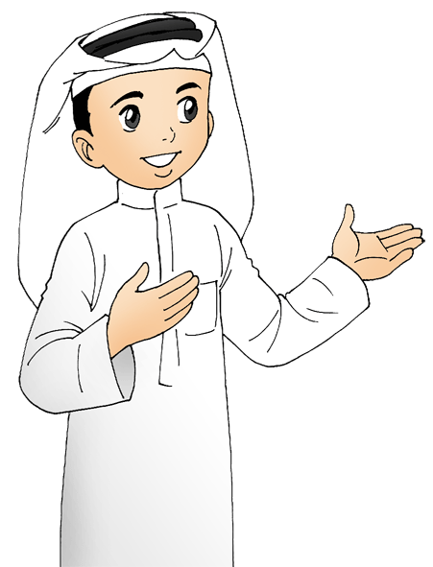
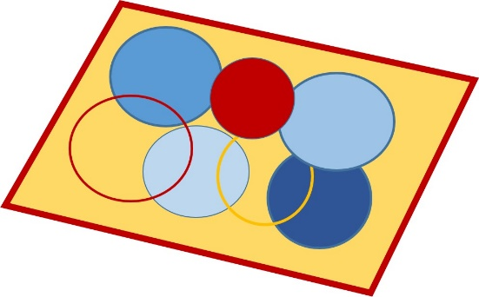
There is a brown chair on the rug
.
There are books on the shelf
.
_________________________________________________________________________________________________________________________________________________
Ministry of Education-2020

Slide 6
?
What is your name
?
Where is my plate
_________________________________________________________________________________________________________________________________________________
Ministry of Education-2020

Slide 7
Let’s practice
Read and point at (.) and (?)
Ex: Can you see my doll?
1- There’s a doll under my bed.
2- What’s under the rug?
3- I’ve got lots of English books on the shelf.
4- Where’s my pen?
_________________________________________________________________________________________________________________________________________________
Ministry of Education-2020

Slide 8
Model Answer
1- There’s a doll under my bed.
2- What’s under the rug?
3- I’ve got lots of English books on the shelf.
4- Where’s my pen?
_________________________________________________________________________________________________________________________________________________
Ministry of Education-2020

Slide 9
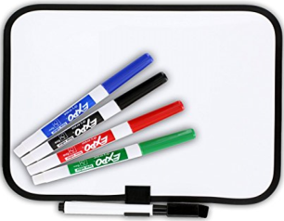
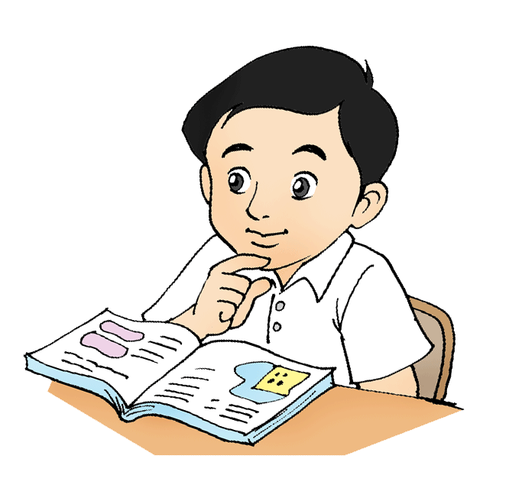
Let’s practice
Write (.) or (?)
1- There’s a blanket on my bed
2- Where’s the pillow
3- Is it in the Kitchen
4- What’s in my bedroom
5- There are lots of toys
6- His name’s Ismail
_________________________________________________________________________________________________________________________________________________
Ministry of Education-2020

Slide 10
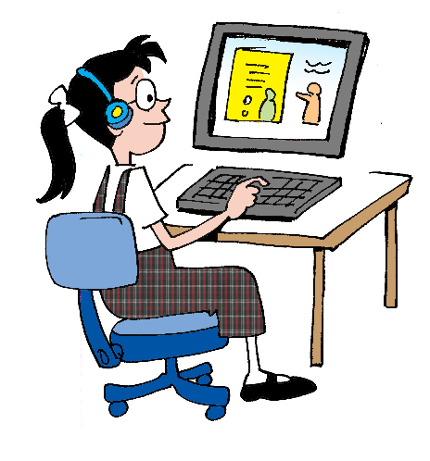
Model Answer
1- There’s a blanket on my bed
2- Where’s the pillow
3- Is it in the Kitchen
4- What’s in my bedroom
5- There are lots of toys
6- His name’s Ismail
.
?
?
?
.
.
_________________________________________________________________________________________________________________________________________________
Ministry of Education-2020

Slide 11
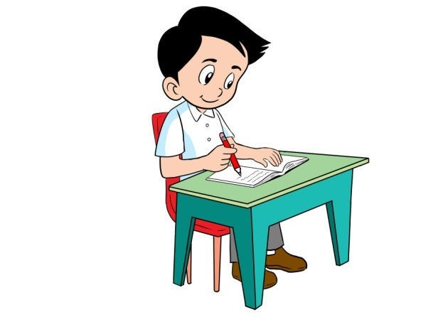
Let’s practice
In your notebook, write 4 sentences about what
is in your bedroom. Use (there’s\ there’re).
Don’t forget to answer the questions in the
practice PPT L6 + The Review.
_________________________________________________________________________________________________________________________________________________
Ministry of Education-2020

Slide 12
Take Unit 8 quiz.
_________________________________________________________________________________________________________________________________________________
Ministry of Education-2020

Slide 13
End of lesson 6
Good job dear !
_________________________________________________________________________________________________________________________________________________
Ministry of Education-2020

