Slide 1
Lab Exercise # 5
Zoo- 145
HISTOLOGY
Study the Histological
Features of Some of the Digestive Organs

Slide 2
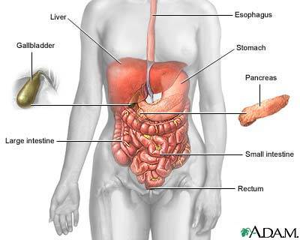
Lab Exercise # 5
Zoo- 145
The Digestive System
The digestive system is a collection of organs that work together to digest and absorb food.
Digestion is the process the body uses to break down foods into molecules that the body can use for energy and nutrients
Organs of the digestive system

Slide 3
Lab Exercise # 5
Zoo- 145
The digestive system consist of oral cavity with its accessories parts and the
digestive tract with its accessories glands
The digestive tract or Gastro Intestinal Tract (GIT) includes:
Oesophagus
Stomach
Small intestine
Large intestine
Every section through the digestive tract shows that each of the part is composed of four different layers
Serosa
Musculature (Muscularis)
Submucosa
Mucosa

Slide 4
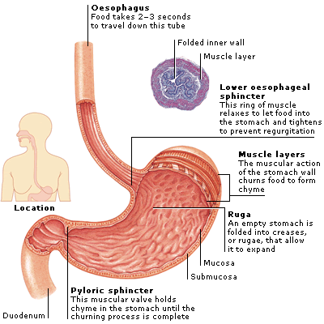
Esophagus
The esophagus is a hollow muscular tube that transports saliva, liquids, and foods from the mouth to the stomach. It is Located in throat near trachea (windpipe), the esophagus receives food from your mouth when you swallow. By means of a series of muscular contractions called peristalsis, the esophagus delivers food to your stomach.

Slide 5
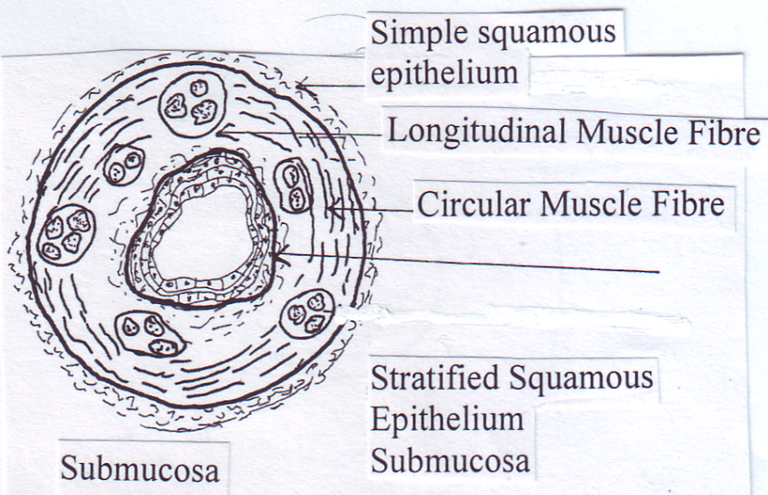
Lab Exercise # 5
Zoo- 145
The Oesophagus
Oesophagus is a muscular tube connects the pharynx with the stomach
Its wall consist of four layers
Serosa: Outermost layer is composed of Simple Squamous Epithelium
Musculature: Three layer thick, two layers of Longitudinal Muscle Fibers and a layer in between is composed of Circular Muscle Fiber
Submucosa: It is composed of Connective tissue
Mucosa: It is composed of stratified squamous epithelial

Slide 6
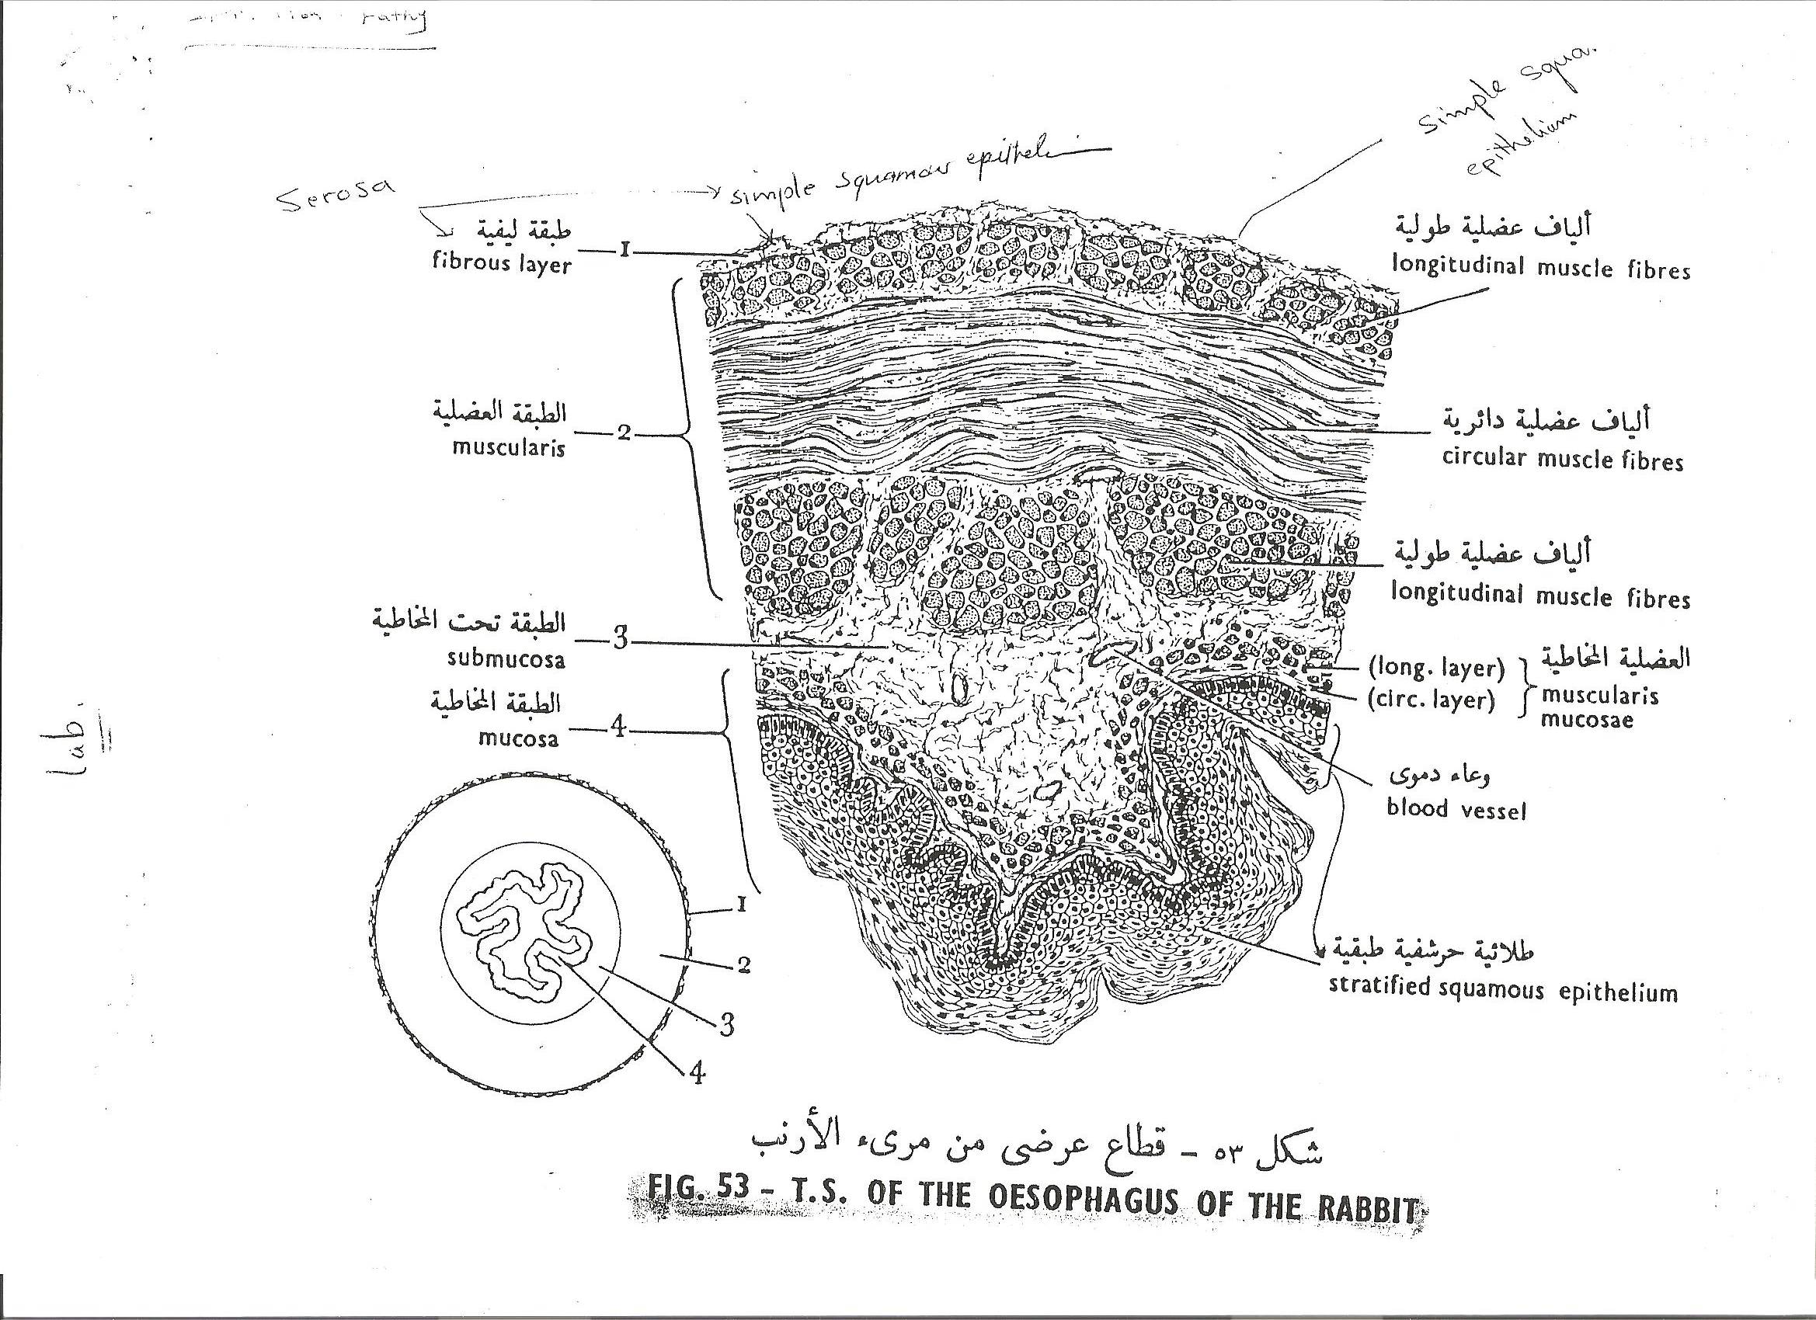
Lab Exercise # 6
Zoo- 145

Slide 7
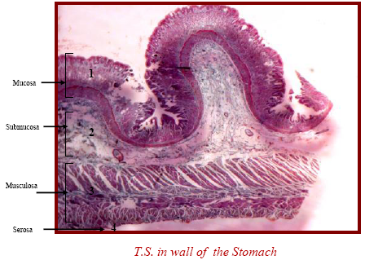
Lab Exercise # 6
Zoo- 145
The Stomach
Stomach is the dilated segment of the digestive tract
The wall of the stomach is formed of four layers:
Serosa: It is composed of connective tissue and squamous epithelium
Musculature: Two layers, one each from longitudinal (LMF) and circular muscle fibers (CMF)
Submucosa: It is composed of connective tissue
Mucosa: It is thick and lined marginally with simple squamous epithelium and peptic and oxyntic cells. Peptic cells are secreting peptic enzymes and oxyntic cells secrete HCL acid

Slide 8
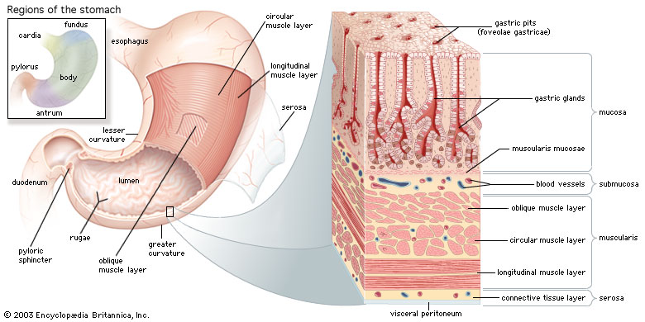
Stomach
The stomach is a hollow organ, or "container," that holds food while it is being mixed with enzymes that continue the process of breaking down food into a usable form. Cells in the lining of the stomach secrete a strong acid and powerful enzymes that are responsible for the breakdown process. When the contents of the stomach are sufficiently processed, they are released into the small intestine.

Slide 9
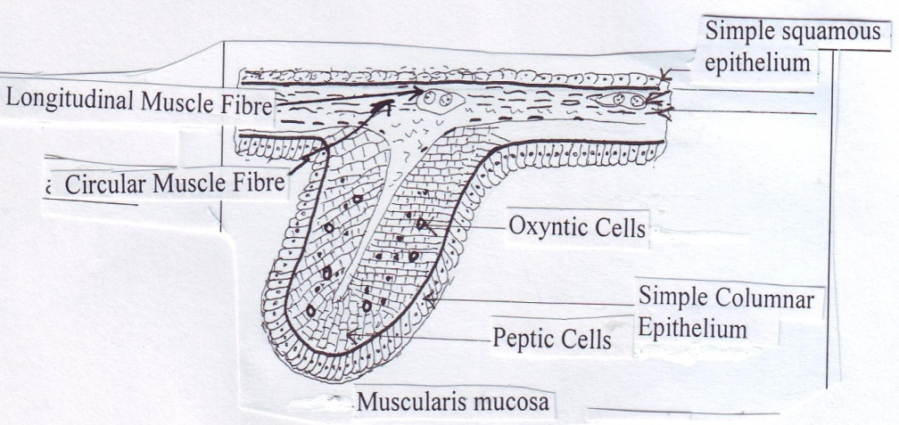
Lab Exercise # 5
Zoo- 145

Slide 10
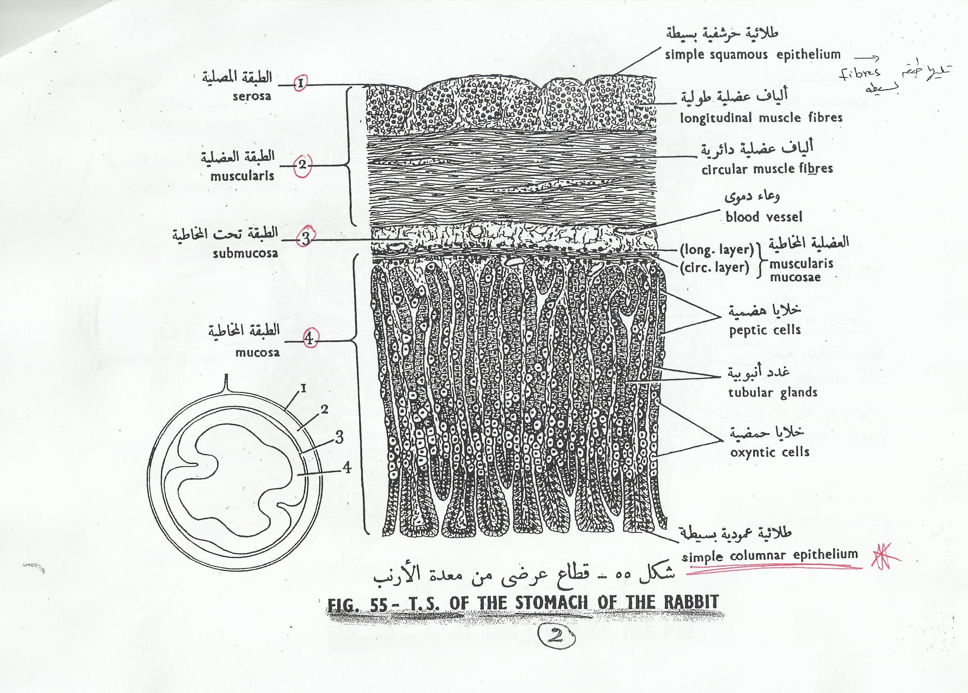

Slide 11
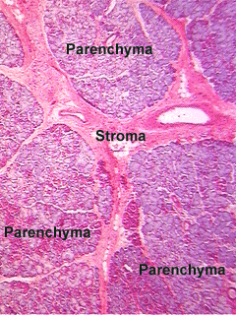
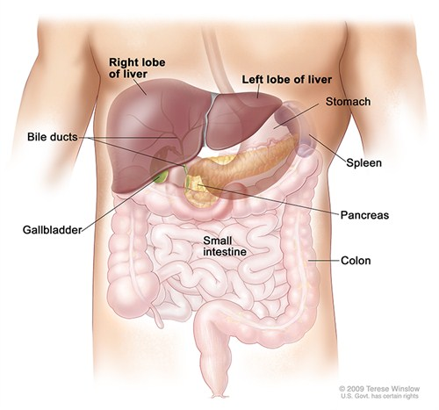
Lab Exercise # 5
Zoo- 145
The Liver
Liver Is the largest metabolic organ in the body
the liver formed of a stroma of connective tissue and parenchyma of liver cells (hepatocytes)
All of the cells in the liver are called hepatic cells and these are arranged in lines in the unit of liver called hepatic lobules (Hexagonal shape).
Each such line of the hepatic cells is called hepatic strand. The space in between hepatic strands is filled with blood and it is called hepatic sinusoid. In the centre of each hepatic lobule there is hole called central vein

Slide 12
Lab Exercise # 6
Zoo- 145
The Liver
The connective tissue septa cornered between 3 hepatic lobules is called portal space
or area, which contains the following structures:
1- Branch of hepatic artery
2- Branch of portal vein
3- Bile ductule
4- Lymph vessel
Functions of Liver
The liver has multiple functions, but its main function within the digestive system is to process the nutrients absorbed from the small intestine. Bile from the liver secreted into the small intestine also plays an important role in digesting fat. In addition, the liver is the body’s chemical "factory." It takes the raw materials absorbed by the intestine and makes all the various chemicals the body needs to function. The liver also detoxifies potentially harmful chemicals..

Slide 13
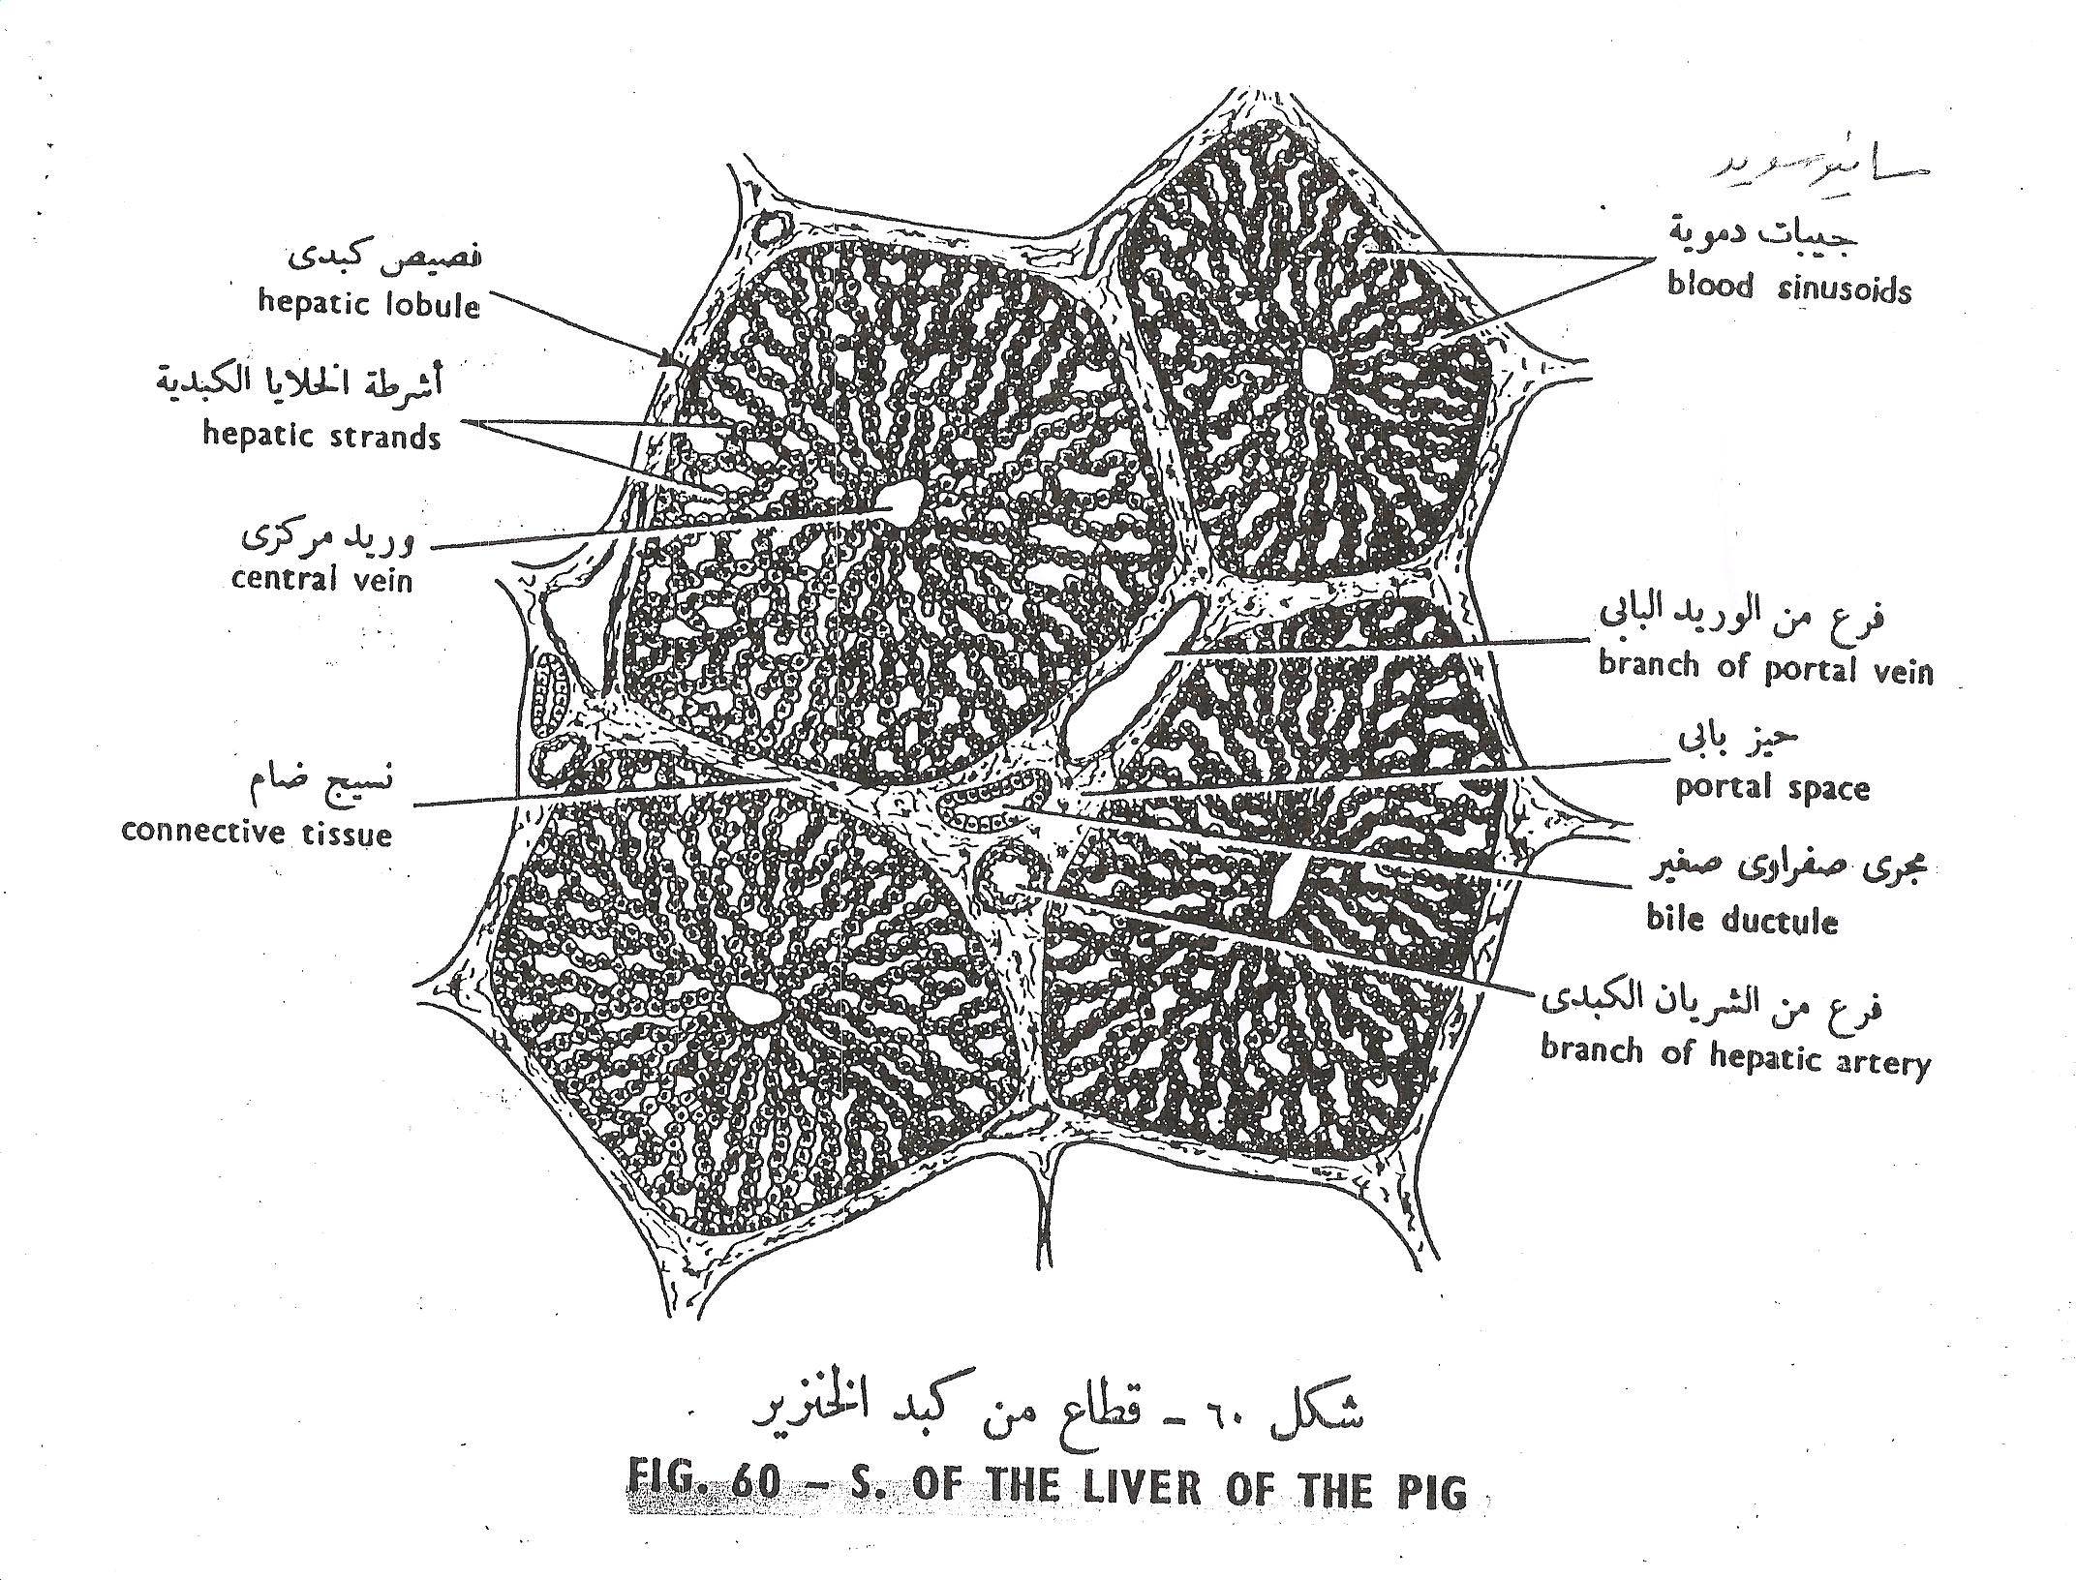
Lab Exercise # 5
Zoo- 145
T. S.

Slide 14
Lab Exercise # 5
Zoo- 145
Thank you

