Slide 1
Revision 1

Slide 2
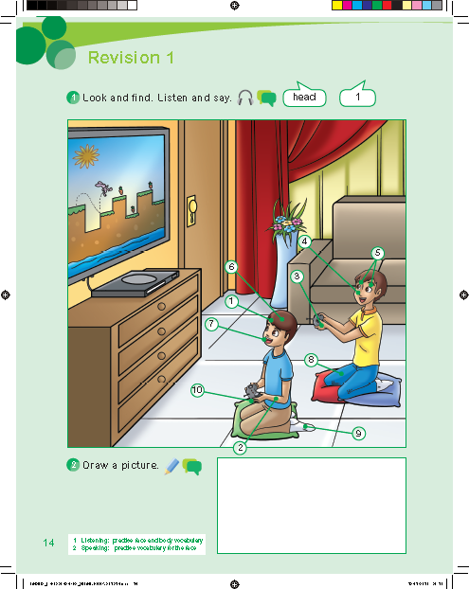

Slide 6
Work book p. 65

Slide 8
e
h
n
o
o
r
n
r

