Slide 1
U 1 the body
Lesson 2

Slide 3
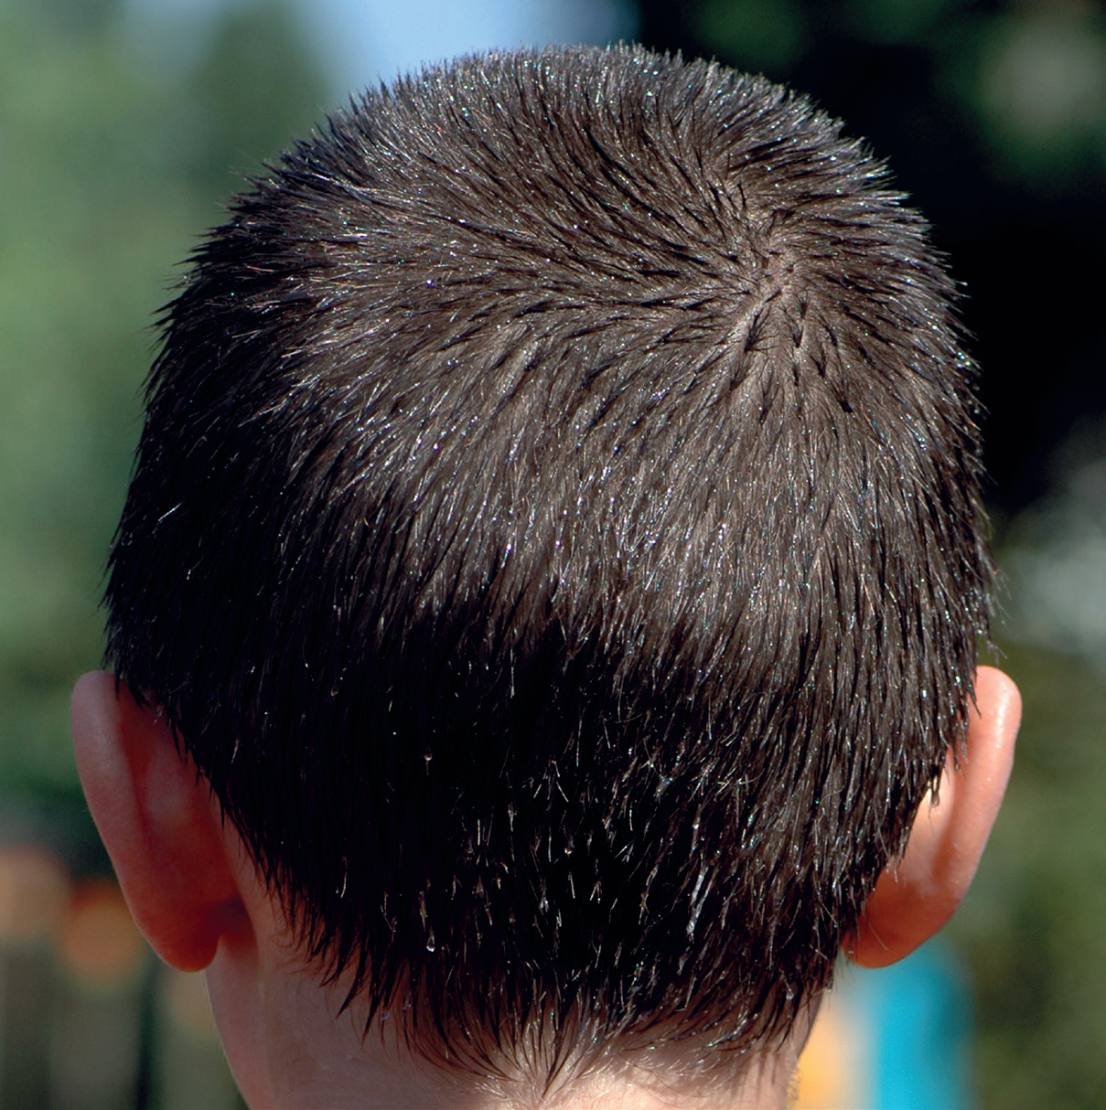
head

Slide 4
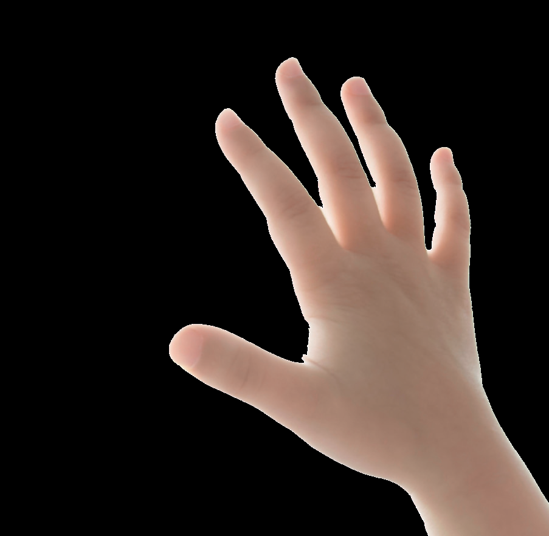
hand

Slide 5
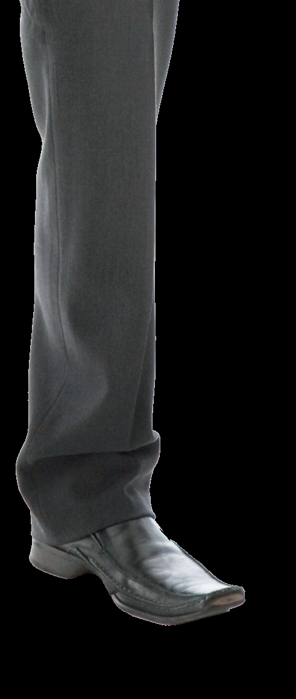
leg

Slide 6
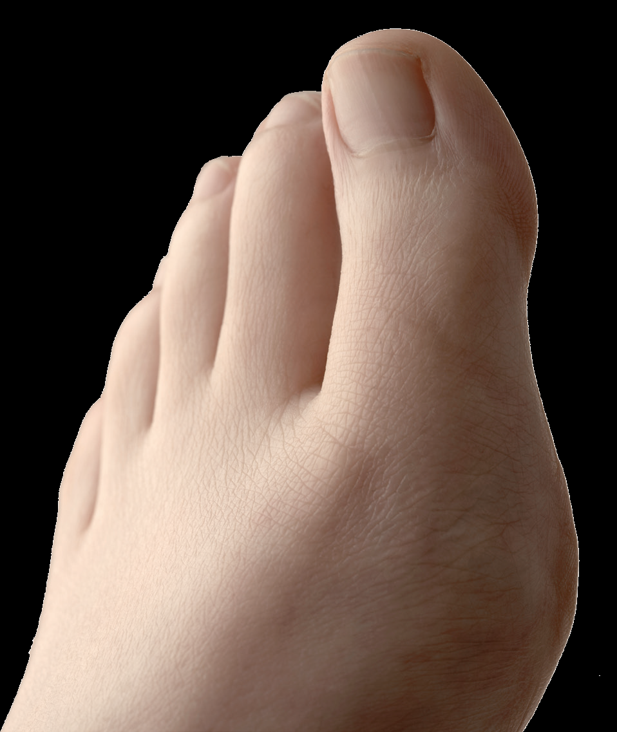
toe

Slide 7
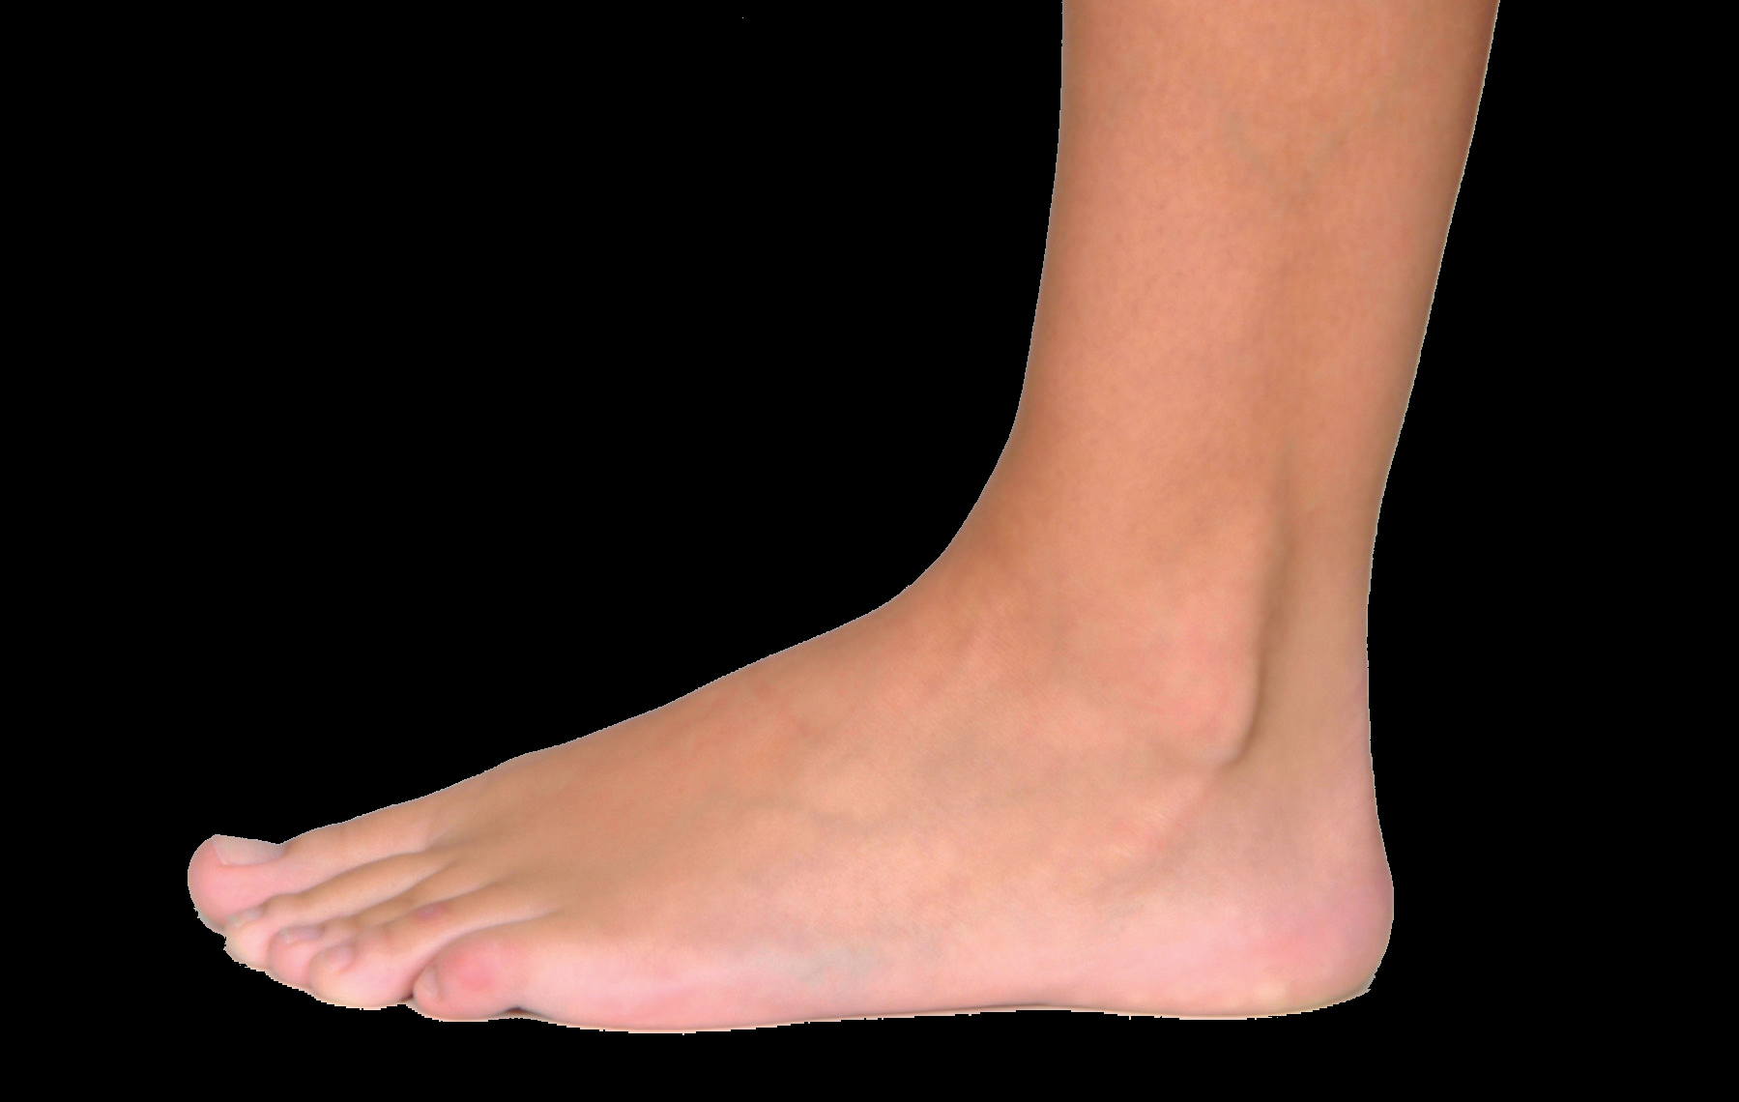
foot

Slide 8
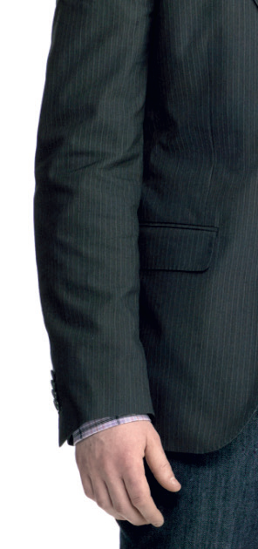
arm

Slide 9
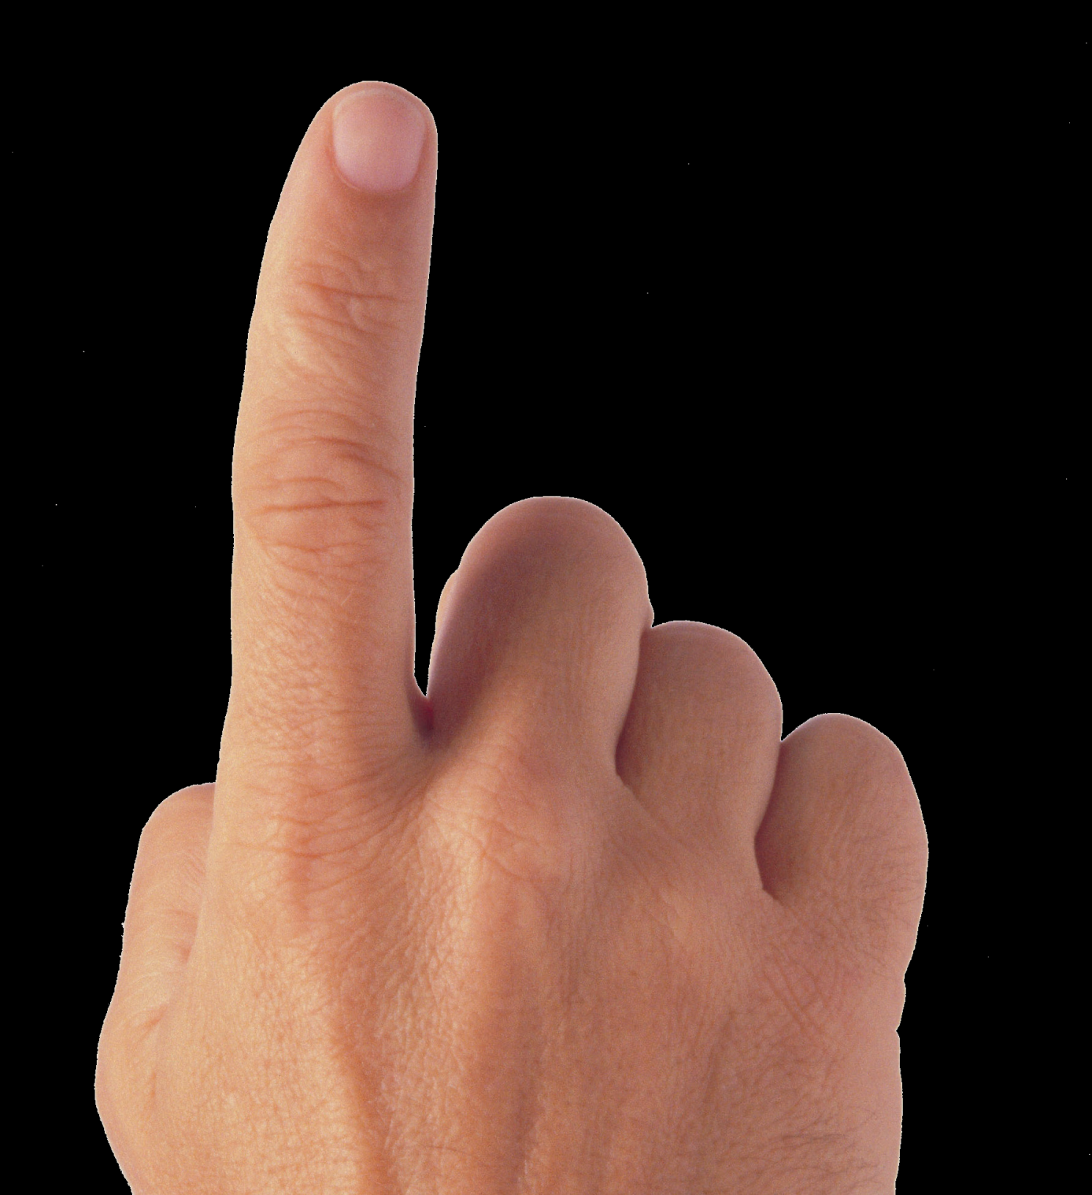
finger

Slide 10
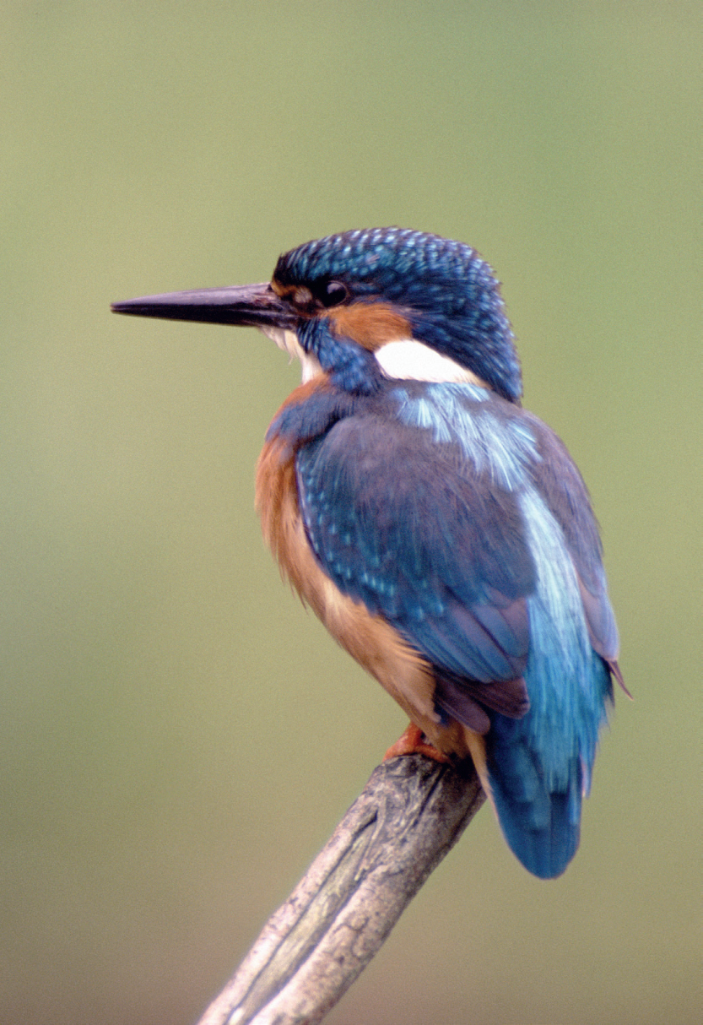
bird
B b

Slide 11
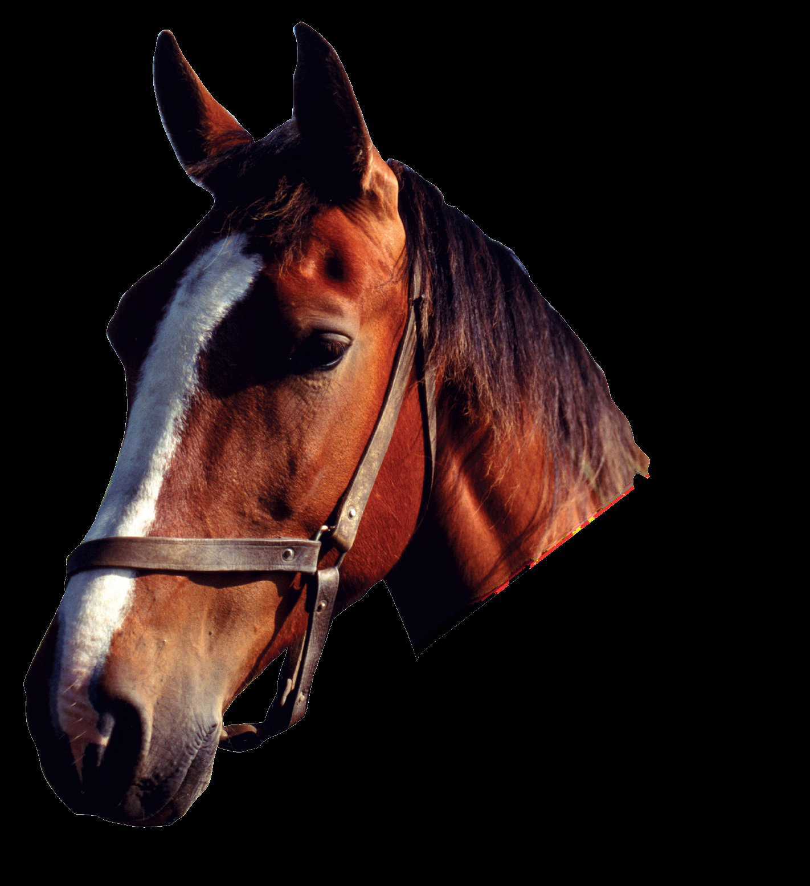
horse
H h

Slide 12
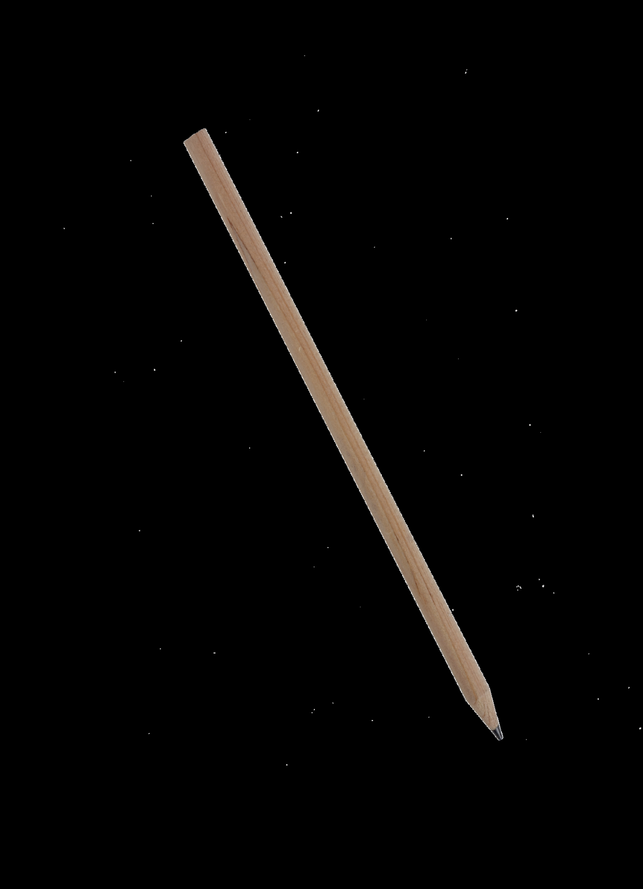
pencil
P p

Slide 13
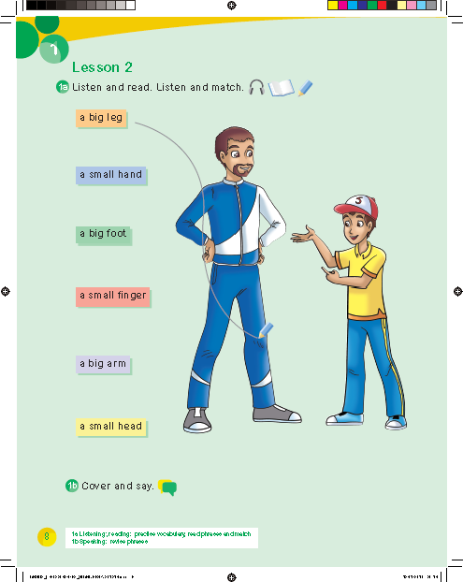

Slide 16
6
4
2
3
7
1
5

Slide 17
Work book p. 59

Slide 18
2
4
7
5
1
6
3

Slide 24
p
b
h

