Slide 1
The description of the Plane Curvilinear Motion by the normal-tangential (n-t) coordinates
Lecture V
Normal-Tangential coordinates

Slide 2
Plane Curvilinear Motion – Normal-Tangential (n-t) Coordinates
Here, the curvilinear motions measurements are made along the tangent (t) and the normal (n) to the path.
n-t coordinates are considered to move along the path with the particle.
The positive direction of the normal (n) always points to the center of curvature of the path; while the positive direction of the tangent (t) is taken in the direction of particle advance (for convenience).
e_{t} & e_{n} are the unit vectors in t-direction and n-direction, respectively.

Slide 3
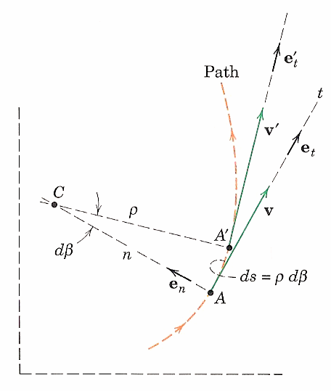
(n-t) Coordinates - Velocity
Note: ρ is the radius of curvature and dβ is the increment in the angle (in radians)
Note: as mentioned before that the velocity vector v is always tangent to the path; thus, the velocity has only one component in the n-t coordinates, which is in the t-direction. This means that v_{n} = 0.
Its magnitude is:
(after dt)

Slide 4
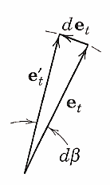
(n-t) Coordinates - Acceleration
Note: e_{t}, in this case, has a non-zero derivative, since it changes its direction. Its magnitude remains constant at 1.
(after dt)
?
Note: the vector de_{t} , in the limit, has a magnitude equal to the length of the arc |e_{t}|dβ=dβ. The direction of de_{t} is given by e_{n}.
Thus,

Slide 5
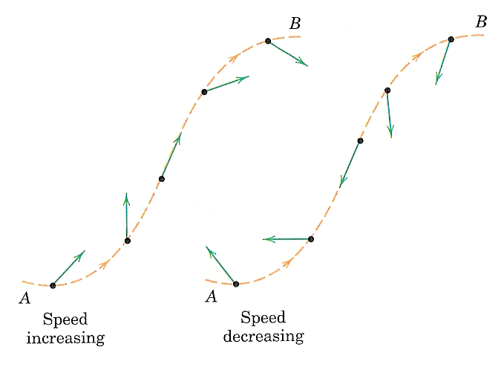
(n-t) Coordinates – Acceleration (Cont.)
Notes:
a_{n} always directed toward the center of curvature.
a_{t} positive if the speed v is increasing and negative if v is decreasing.
Its magnitude is:
ρ = ∞, thus a_{n} = 0
If the path is expressed as y = f(x), the radius of the curvature ρ at any point on the path is determined from:

Slide 6
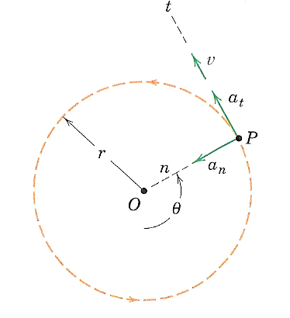
(n-t) Coordinates – Circular Motion
For a circular path: ρ = r

Slide 7
n-t Coordinates Exercises

Slide 8
Exercise # 1

Slide 9
Exercise # 2
Starting from rest, a bicyclist travels around a horizontal circular path, ρ = 10 m, at a speed of v = (0.09t² + 0.1t) m/s, where t is in seconds. Determine the magnitudes of his velocity and acceleration when he has traveled s = 3 m.

Slide 10
Exercise # 3
The design of a camshaft-drive system of a four-cylinder automobile engine is shown. As the engine is revved up, the belt speed v changes uniformly from 3 m/s to 6 m/s over a two-second interval. Calculate the magnitudes of the accelerations of points P1 and P2 halfway through this time interval.

Slide 11
Exercise # 4

Slide 12
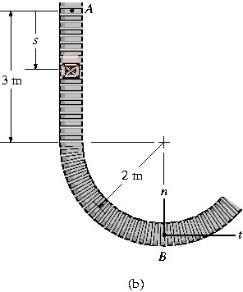
Exercise # 5
The boxes travels along the industrial conveyor. If a box starts from rest at A and increases its speed such that a_{t} = (0.2t) m/s², determine the magnitude of its acceleration when it arrives at point B.

Slide 13
Exercise # 6
If the roller coaster starts from rest at A and its speed increases at a_{t} = (6 – 0.06s) m/s², determine the magnitude of its acceleration when it reaches B where s_{B} = 40 m.

Slide 14
Exercise # 7
The race car travels around the circular track with a speed of 16 m/s. When it reaches point A it increases its speed at a_{t} = (4/3) v^{1/4} m/s², where v is in m/s. Determine the magnitudes of the velocity and acceleration of the car when it reaches point B. Also, how much time is required for it to el from A to B?

