Slide 1
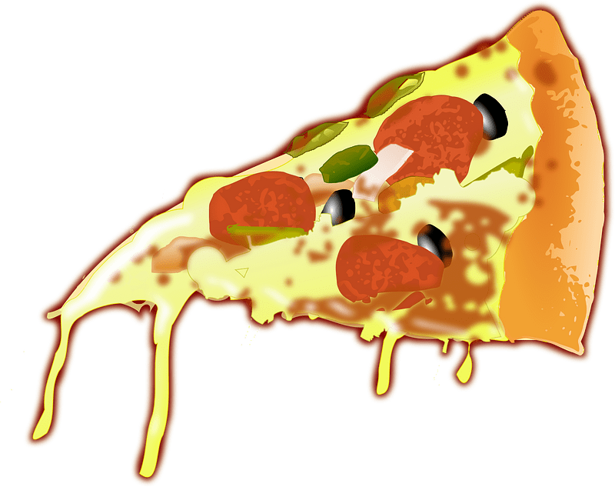
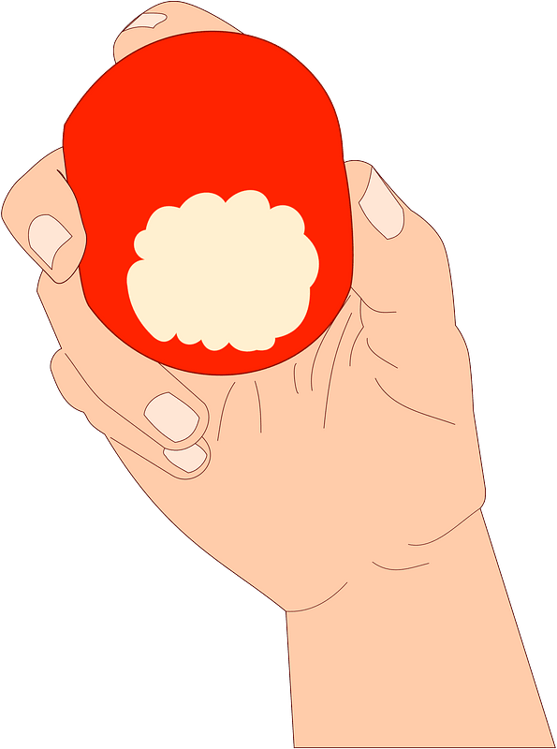
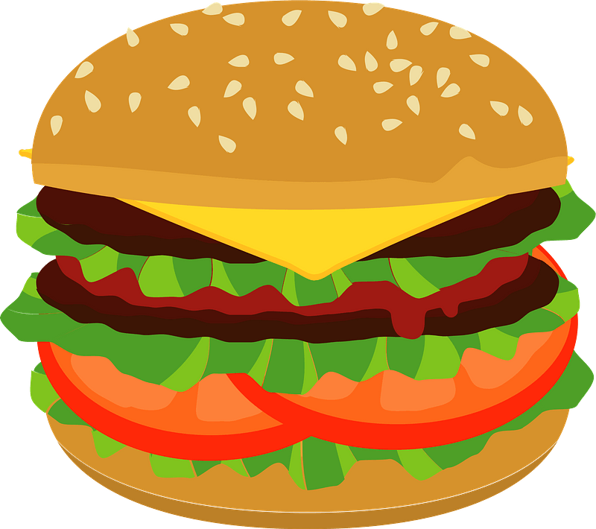
You are
what
you eat
Listen & discuss

Slide 3
Objectives
Name unusual food they eat .
analyze the saying ( you are what you eat)
Evaluate information about the text.

Slide 4
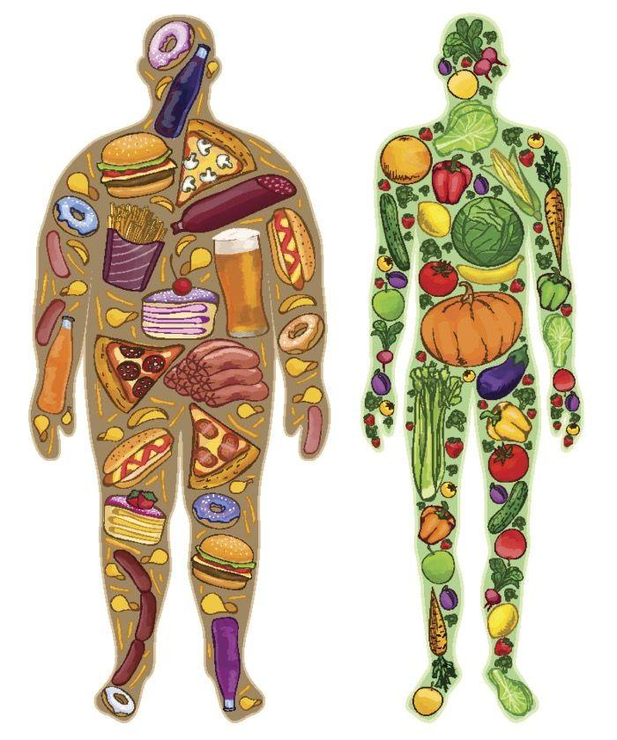
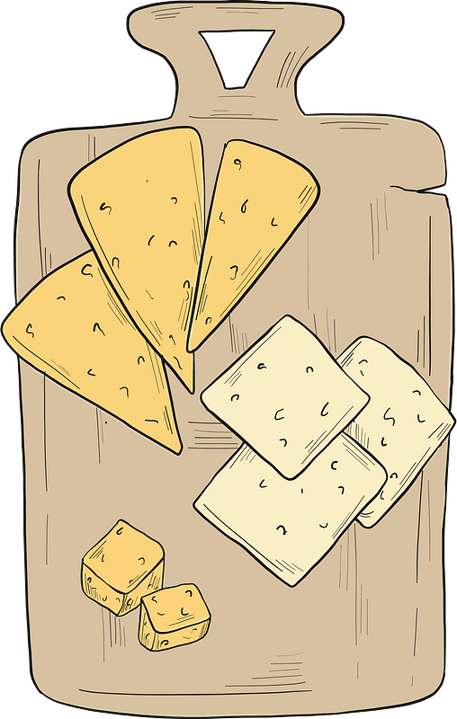
Do you agree?
What do you think the expression means ?
YOU ARE WHAT YOU EAT

Slide 5
Food that look like the
body part they benefit

Slide 6
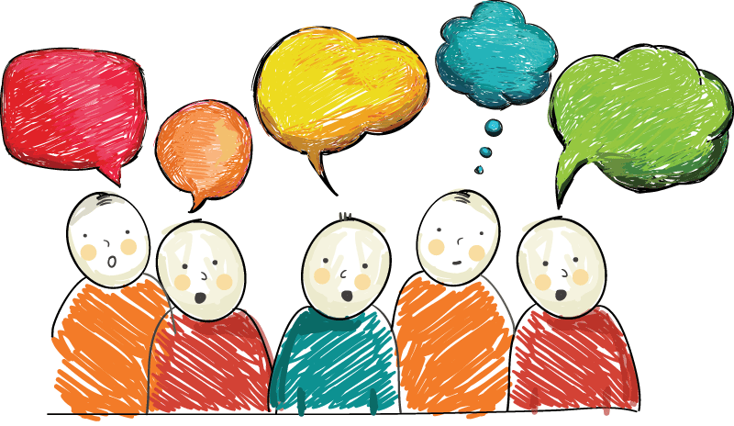
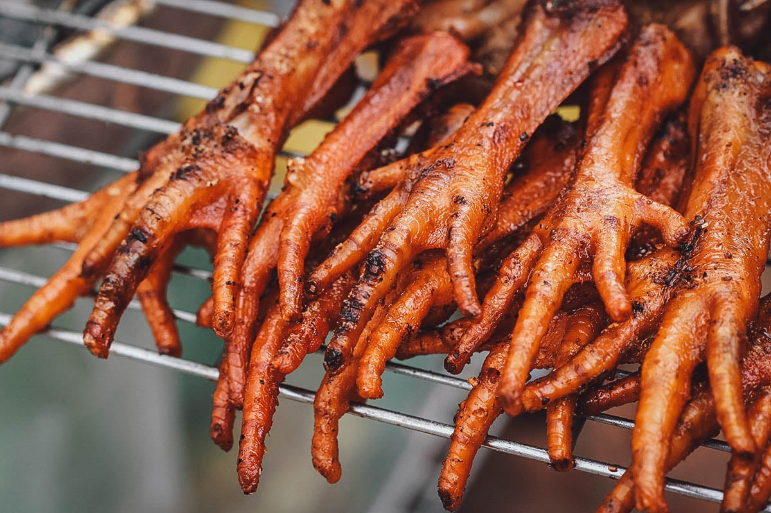
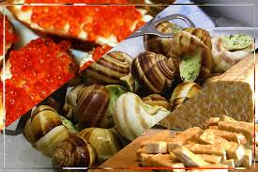
Have you eaten unusual food ?
What it tasted?
Do you prefer healthy or unhealthy food?
What it was?
. Are you careful about the kinds of foods you eat?
What is your favorite food ?

Slide 7
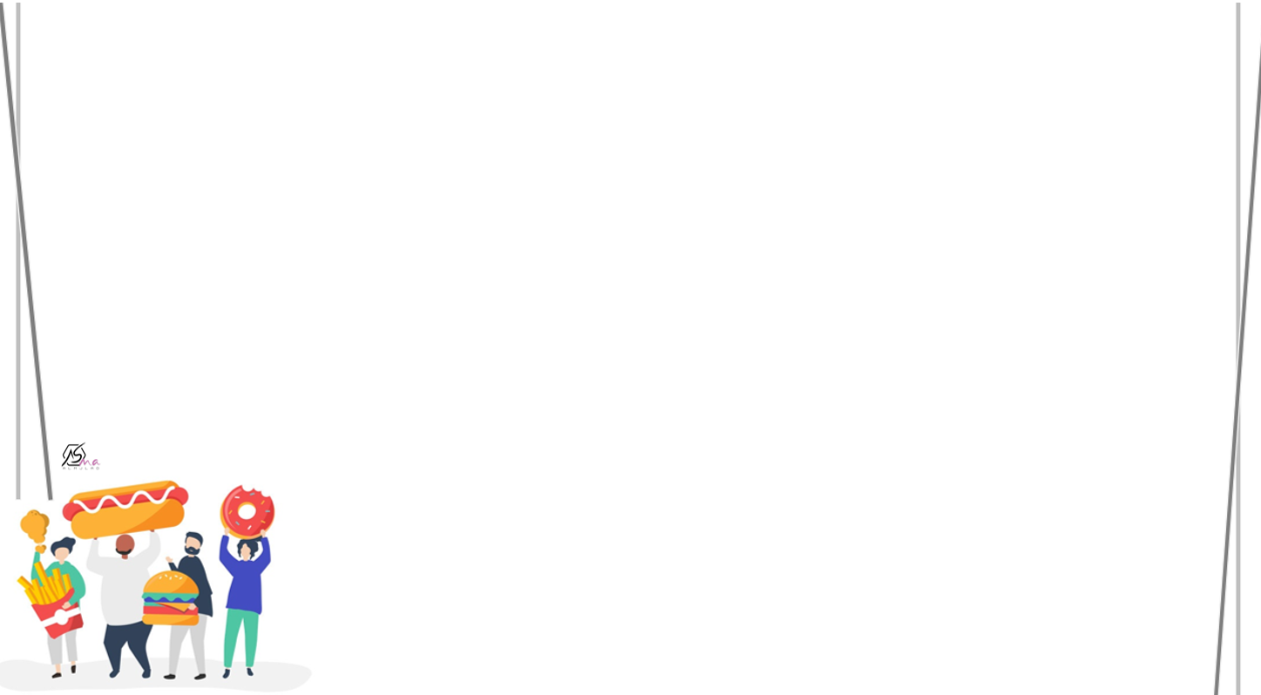
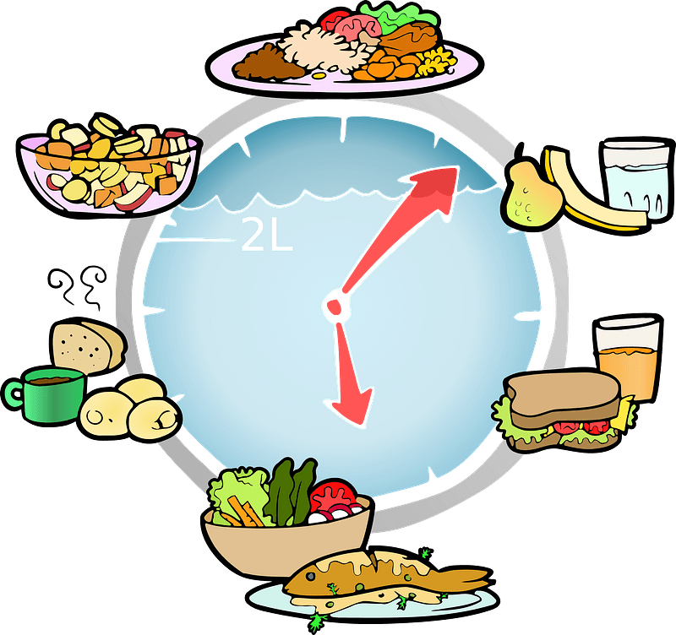
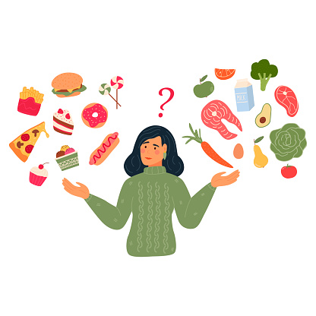
What do you prefer …?

Slide 8
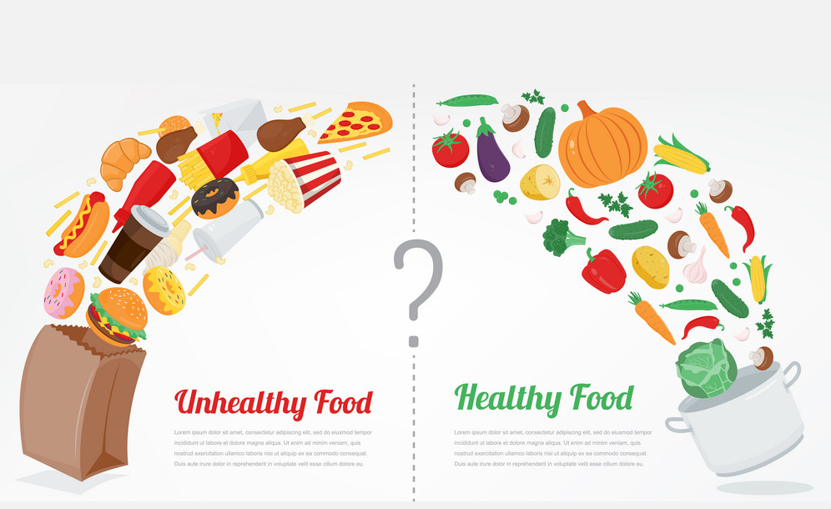
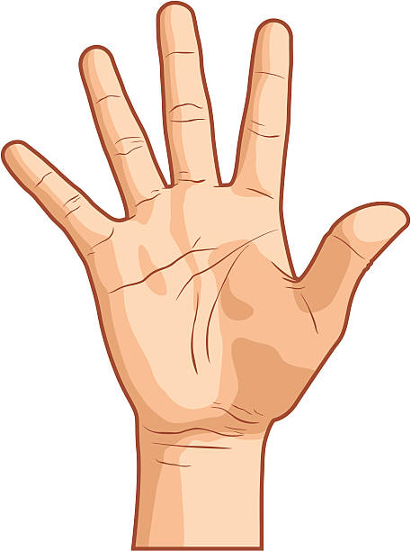
Name five kinds of healthy food
Name five kinds of health food

Slide 11
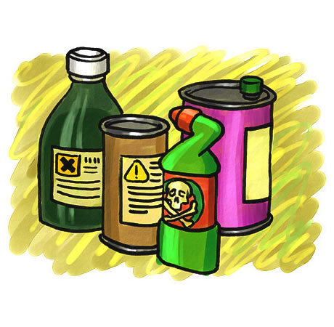
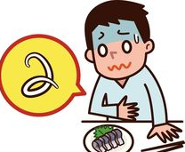
toxins
delicacy
poisoning
licensed

Slide 12
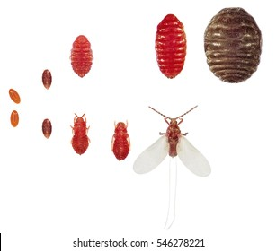
peck
aroma
cochineal insect
distinguish

Slide 14
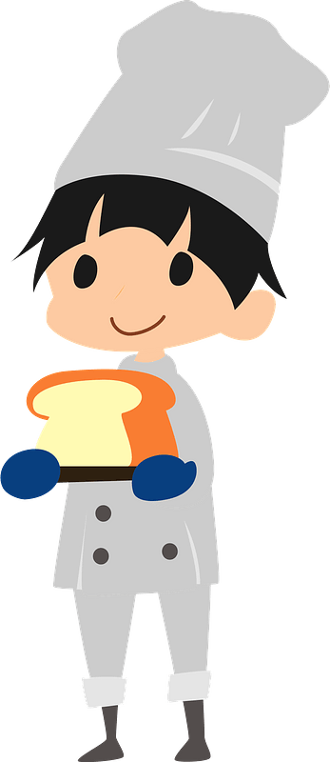
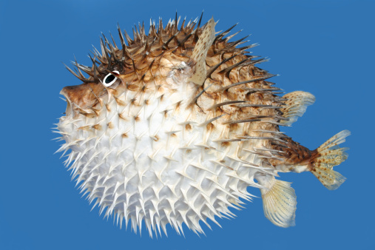
Would you eat blowfish if someone offered you an opportunity to try it?
Why do you think people want to eat such a dangerous food?

Slide 15
Do you like chocolate?
Have you tried dark chocolate? Do you like it?

Slide 16
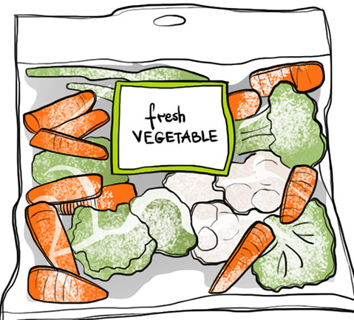
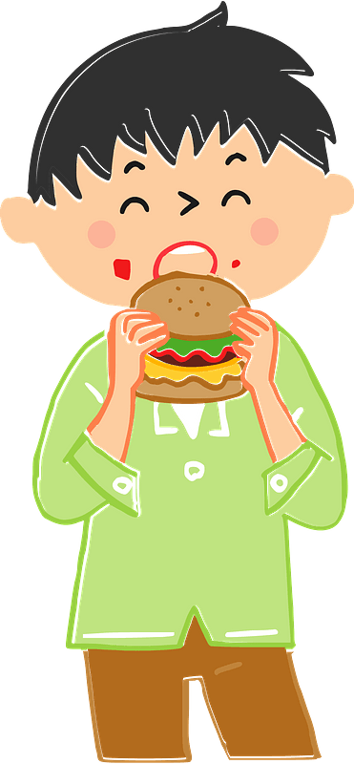
What frozen vegetables are available where you live?
Do you often use them in cooking?
Do you prefer fresh vegetables?
Where do you buy fresh vegetables?

Slide 17
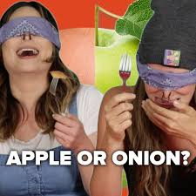
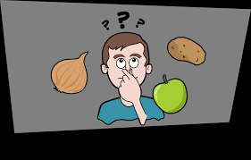
Did you know how important smell was for tasting?
Are there any foods that you dislike because of their smell?

Slide 18
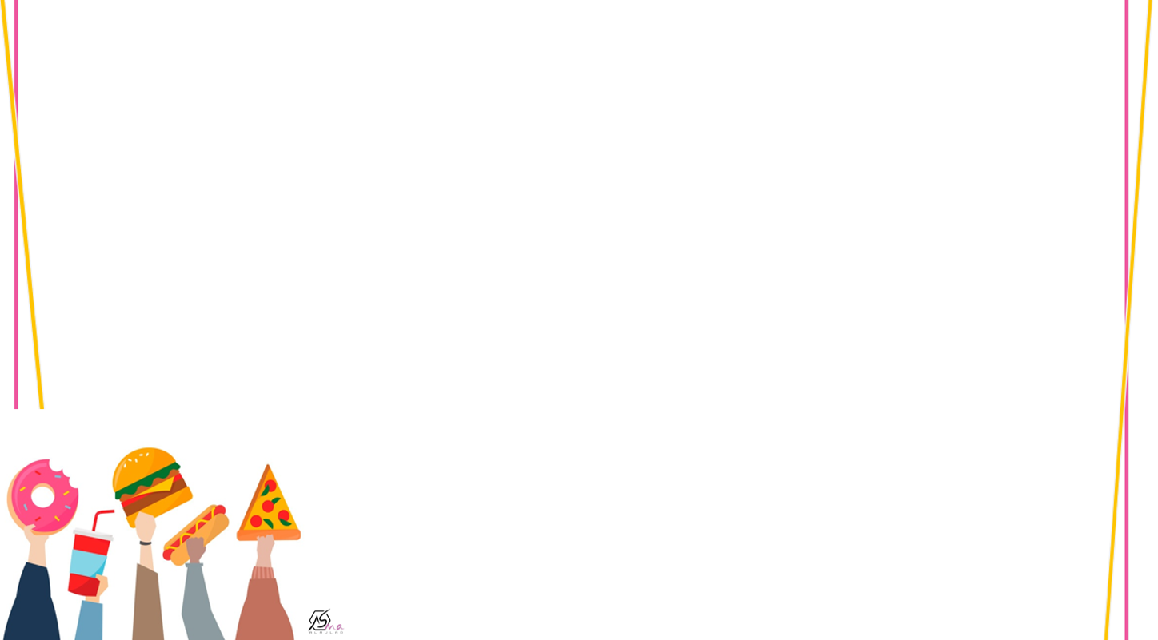
Get one
Give one
bitter
Salty
sweet

Slide 19
Had you heard of cochineal before?.
Check some food labels to see if cochineal or carmine are listed
Does this bother you?

Slide 20
Fruits
Vegetables
Sweets
fish
blueberries
carrots
chocolate
blowfish
Classify
blowfish
chocolate
blueberries
carrots

Slide 21
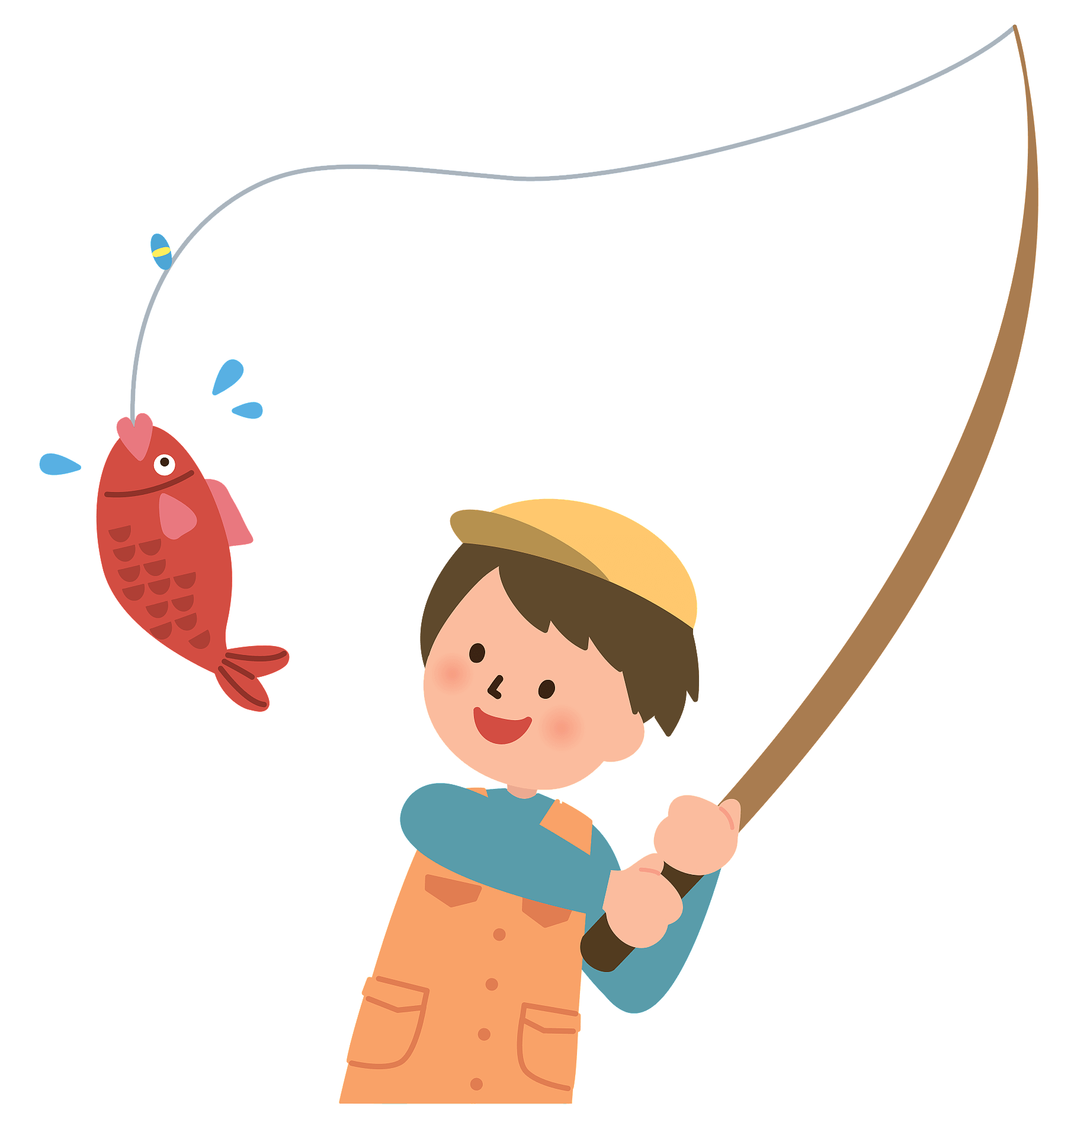
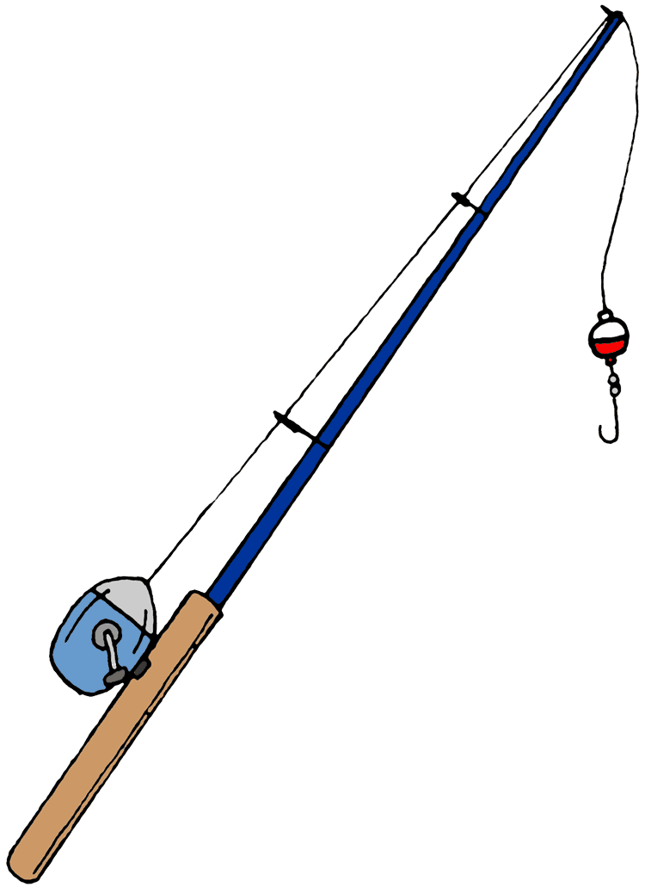
poisons
aroma
Toxins

Slide 22
Having legal permission to do something
licensed
disease

Slide 23
Fragrant smell
aroma
Delicacy

Slide 24
To be able to identify one from another
poisoning
Distinguish

Slide 25
1.delicacy 5. peak
2. toxins 6. aroma
3. licensed 7. distinguish
4. maintain

Slide 26
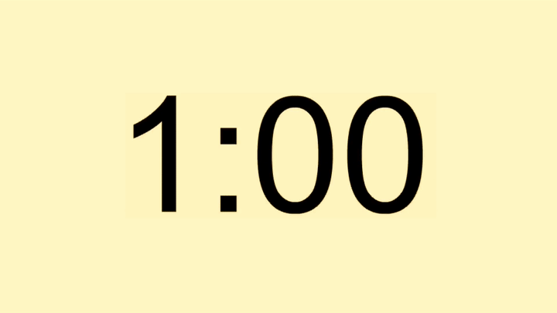
False
true
False
False
true
False

Slide 28
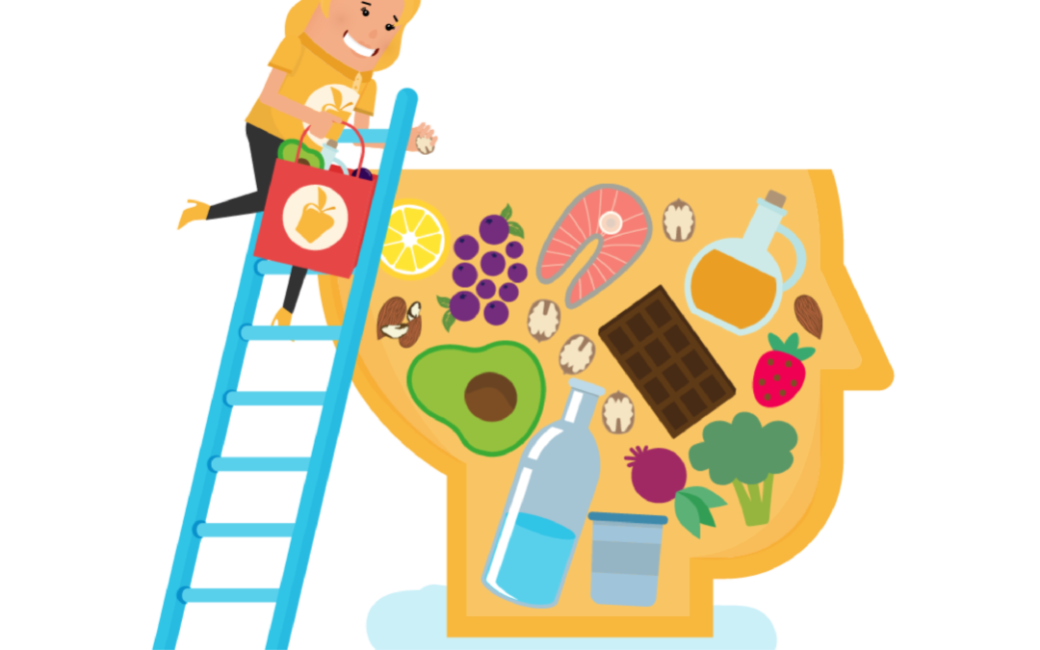
The best Comment

Slide 30
What do you do with extra food do you have every day ?
What do you know about
Food Recycling ?

