Slide 2
Unit 2
Heroes

Slide 4
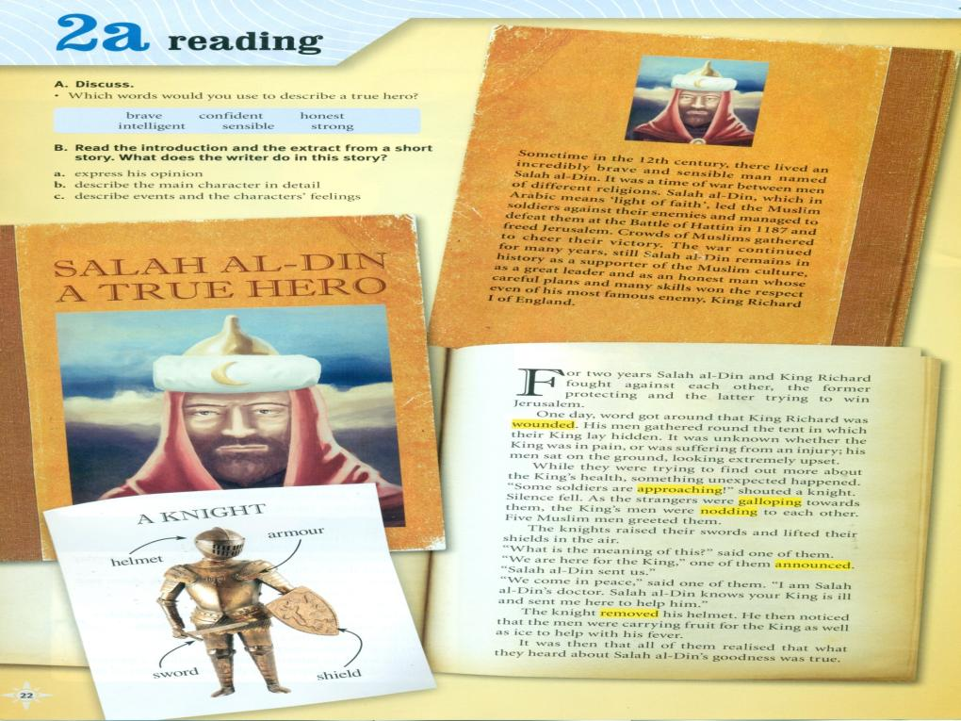

Slide 5
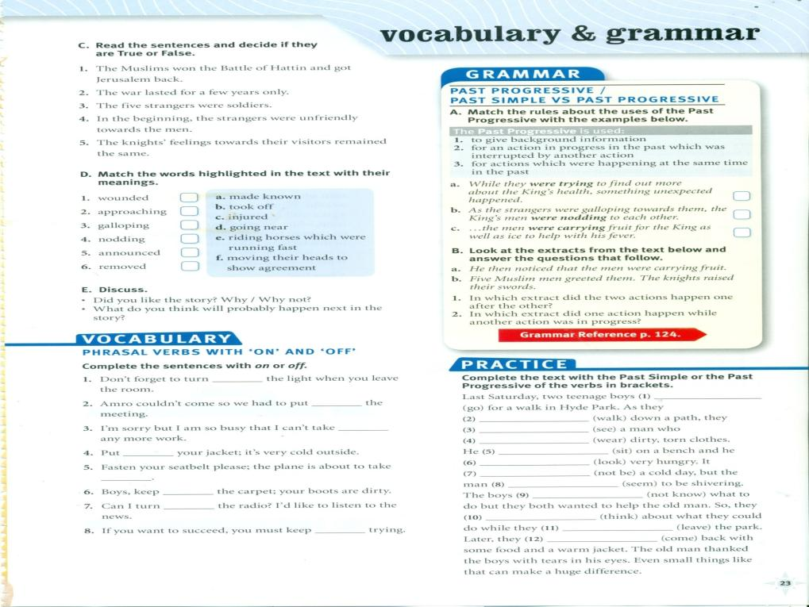
off
off
went
on
Were walking
saw
Was wearing
on
Was sitting
looked
off
Wasn’t
off
seemed
on
Didn’t know
thought
on
Were leaving
came

Slide 6
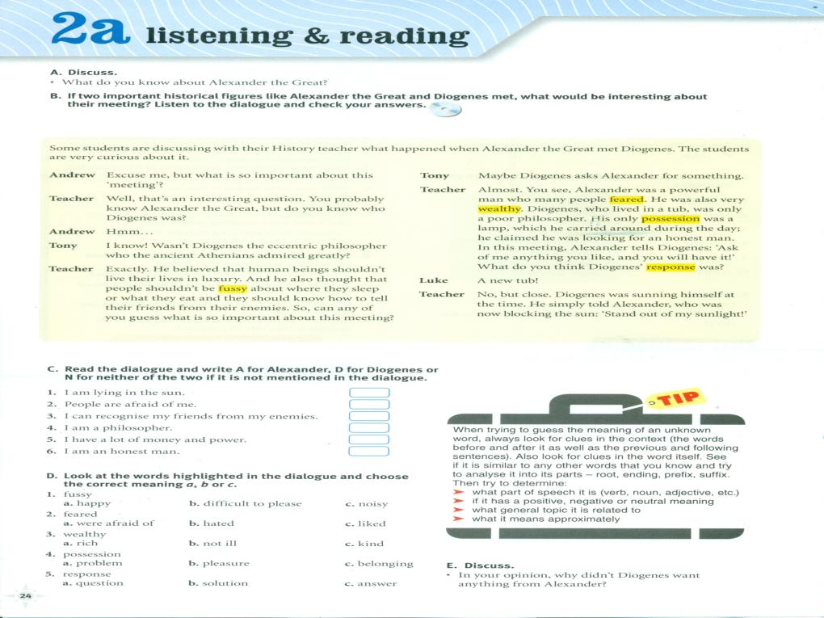

Slide 7
Say thank you
Tell a secret
Say so
Tell the time
Telling a story
Say hello
Tell the difference
Telling a lie
Tell the truth
Say sorry
who
that
which
that
Coffee is a drink which many people like to drink in the morning
Saeed Diab, who writes poetry books , is giving a talk at our collage.
My brother is moving to another city where he will work as a doctor.
Mrs. Huda whose son speaks English very well is my next door neighbour.
Emad who is captain of football team is a friend of mine.
Maths . is school subject, which many people find difficult.

Slide 8
p
F
P
F
F
R
R

Slide 9
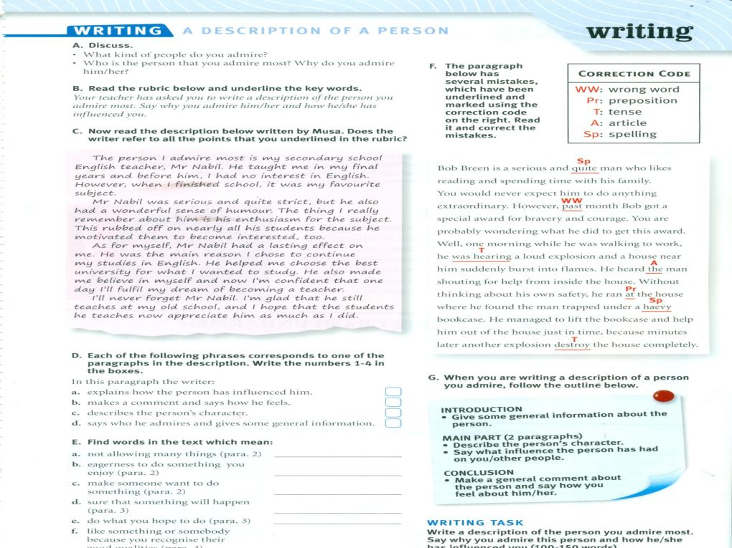
3
4
2
1

Slide 10
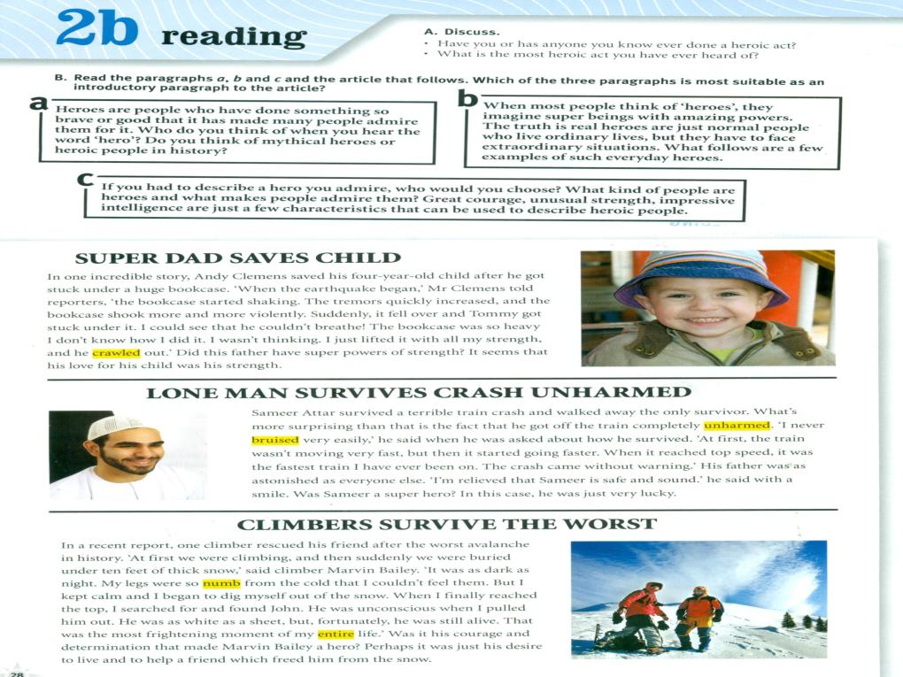

Slide 11
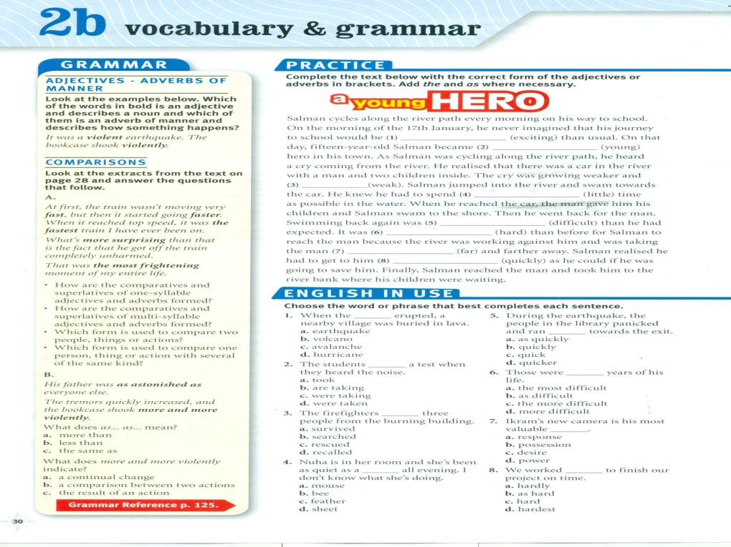
more exciting
the youngest
weaker
as little
more difficult
harder
farther
as quickly

Slide 12
T
F
T
F
T
F

Slide 13
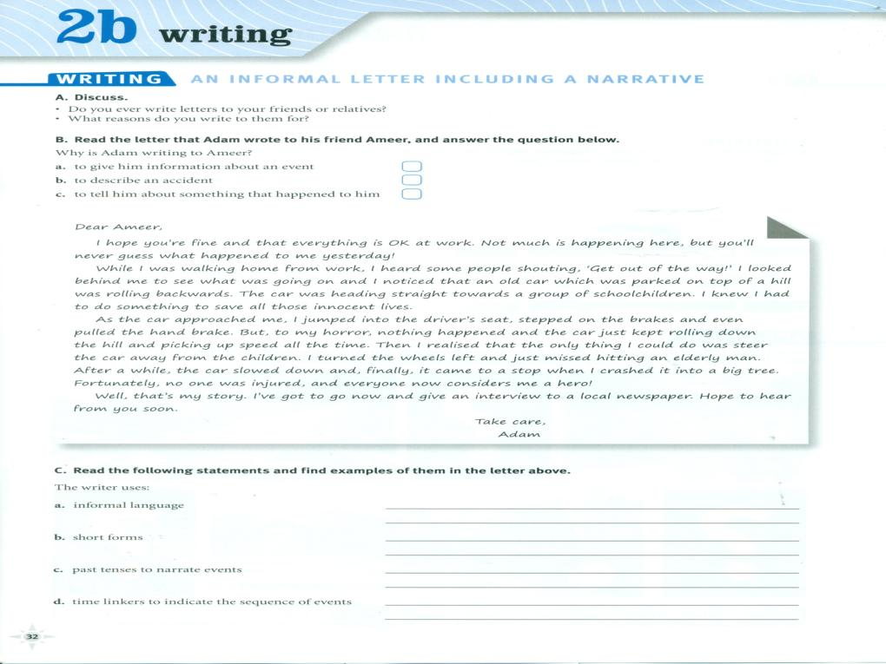
Informal language ..everything is Ok at work.; Not much is happening …;you will never guess …;
Get out of the way! Hope to hear from you soon …;
Short forms…you are fine …..;you will never guess …; that is my story
Past tense to narrate events;…was walking …;heard noticed…;was heading
Time linkers to indicate the sequence of events: while , then , after a while , finally

Slide 14
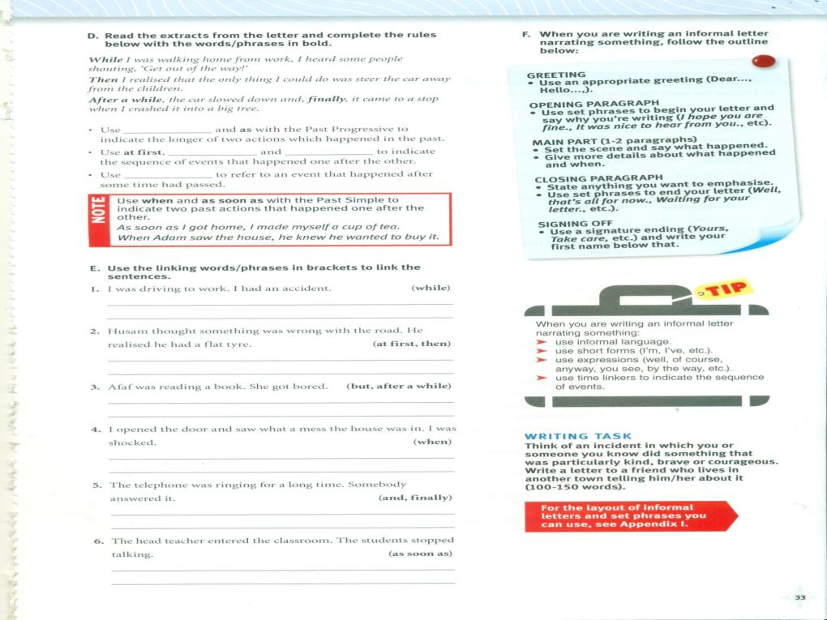
I had an accident while I was driving home
At first Husam thought something was wrong with the road then he realised that he had a flat tire
Afaf was reading a book, but after a while she got bored.
When I open the door and saw what a mess the house was in , I was shocked.
The telephone was ringing for a long time and ,finally, somebody answered it
As soon as the teacher entered the classroom the students stopped talking.

Slide 16
possessions
unselfish
unconscious
courageous
Intelligent
powerful
strength
calmness
most
whose
than
when
which
more
the
Were playing
Was working
started
went
broke
Was running
Were falling
saw
flew
moved
ran
helped
pulled
carried
destroyed

