Slide 1
University of Hail
Preparatory Year College
Medical Physics
PHYS121
Introduction to
Biological Physics
For The Health Life Science
Kirsten Franklin and others

Slide 2
III- Electricity and DC Circuits
Electricity in the cell

Slide 3
Objectives
To understand how to use Coulomb’s law .
To understand the nature of Potential difference and electrical capacitance, and the relationship between them.
To understand how to use Ohm’s law.
To be able to understand how capacitors in circuit can be combined In series and parallel.

Slide 4
Topics to be covered
Charge, Conductors and Insulators, Charging of Objects,
2. Polarization,Electric Field
3. The Heart and ECG.
4. The Capacitor, Electric current, Resistance and
Ohm’s Law,
5. Electricity in Cells.

Slide 5
1.1 Charge (Symbol is Q, Unit is Coulomb)
Electric charge comes in only two types; these types are positive and negative.
A proton has a positive charge, and an electron has a negative charge of exactly the same amount –they carry the same magnitude of charge. A particle that does not have an electric charge, such as a neutron, is said to be neutral.

Slide 6
The electric force between same charges, which may be both positive or both negative, is repulsive. The force between different charges (a positive and a negative charge) is attractive.
The SI unit of charge is the Coulomb, its symbol is C.
Coulomb is defined as the quantity of charge that has passed in 1s through the cross-section of an electrical conductor carrying one Ampere of current.

Slide 7
1.2 Conductors and Insulators
Materials may be classified according to how easily charged particles move through them. A conductor is a material through which charge flows easily, and an insulator is one through which charge does not flow freely.

Slide 8
Metals are generally very good conductors. In a metal, the outermost electrons of each atom are only loosely bound to the nucleus, so they are able to hop from atom to atom, and are thus essentially free to move about inside the metal.
Examples of conductors: Iron, Copper, and Aluminum.
In insulator, there are no loosely bound electrons, and charge can’t move around with the same ease.
Examples of insulators: glass, rubber and plastic.

Slide 9
1.3 Charging of Objects
There are several methods for creating an excess positive or negative charge on an object.
All of these methods involve moving charge from one object to another, and then separating the objects.
The simplest way to induce a charge on many common materials is to rub unlike materials together, as shown in following figure.

Slide 10
Charging of Objects
The process of supplying the electric charge (electrons) to an object or losing the electric charge (electrons) from an object is called charging. An uncharged object can be charged in different ways.
Charging by friction
Charging by conduction
Charging by induction

Slide 11
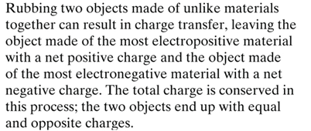
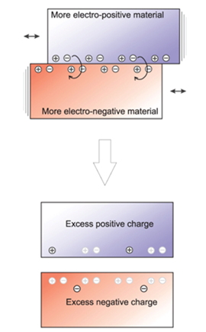

Slide 12
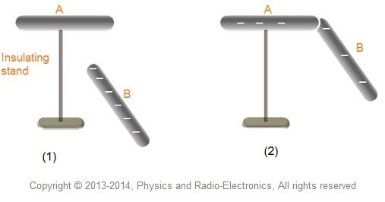
Ccharging by conduction
The process of charging the uncharged object by bringing it in contact with another charged object is called charging by conduction.

Slide 13
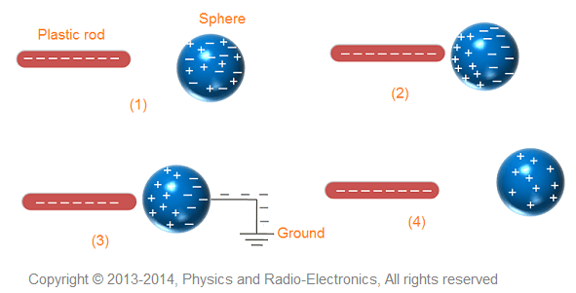
Charging by Induction
The process of charging the uncharged object by bringing another charged object near to it, but not touching it, is called charging by induction.

Slide 14
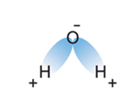
1.4 Polarization
It is possible to have a separation of charge within an object that, overall, has no net charge. This is called polarization.
Polarization can be (1) permanent, (2) induced or (3) instantaneous.
(1) Permanent Polarization: occurs when the molecular structure is such that one side of the molecule is more positive than the other. Such molecules are called polar molecules. See water molecule, H₂O, in the opposite figure.

Slide 15
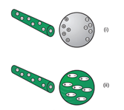
(2) Induced polarization is shown in the opposite figure for both a conductor and an insulator in the presence of a charged rod.

Slide 16
2- Coulomb’s Law
A force exists between two charged particles is depends on
the magnitude of each charge and
how far apart they are according to the following formula, known as Coulomb’s law
$$∣F1 on 2∣=∣F2 on 1∣ =K\frac{q1q2}{r2}$$
Where q₁ and q₂ are the magnitudes of the two charges, r is the distance separating the charges, and k is an experimentally determined constant of proportionality.

Slide 17
3- The Heart and ECG.
Electrocardiography (ECG) is the process of recording the electrical activity of the heart over a period of time using electrodes placed on the skin. These electrodes detect the tiny electrical changes on the skin that arise from the heart muscle's electrophysiologic pattern of depolarizing and repolarizing during each heartbeat. It is a very commonly performed cardiology test.

Slide 18
The Heart and ECG.
ECGs are quick, safe, painless, and inexpensive tests that are routinely performed if a heart condition is suspected.
doctor uses the ECG to:
Assess heart rhythm
Diagnose poor blood flow to the heart muscle (ischemia)
Diagnose a heart attack
Evaluate certain abnormalities of heart, such as an enlarged heart

Slide 19
We will give a very brief introduction to the electrical system of the heart and discuss how this system produces the signals seen in an electrocardiogram ( ECG).
1- When the heart is beating normally, an electrical signal is generated at the sinoatrial (SA node) of the heart which travels through the heart muscle (myocardium).
2- The electrical signal causes the contraction of the heart muscle (beating of the heart) (see the figure).

Slide 20
3- For efficient pumping of the blood without back flow, the atria contract first and after a delay the ventricles contract . This delay act by an electrical signal by the atrio-ventricular node ( AV node )
4- The pacemaking signal from the SA node occurs at rate of 60 – 100 beats / min. This known as normal sinus rhythm of the heart . When the impulse occurs at lower rate , called (sinus bradycardia) and when it happens more rapidly , called (sinus tachycardia)

Slide 21
5- In the cells of the outer membrane of the heart the potential difference around 90 mV between the inside and outside at the resting state.
6- The electrical potential differences that are seen on the surface of the skin are of a few millivolts. The measurement of these voltage by the placing of electrodes on the skin is called an electrocardiogram or ECG.

Slide 22
7- The ECG machines is the primary tool used for detecting abnormal heart rhythms and use measure the potential at the end of the arms and left leg, and six locations across the chest, mostly on the left side.
8- these signals can be plotted separately, but are usually combined in a single trace, see the figure.

Slide 23
9- The first bump (the P wave) is caused by the depolarization of the atria. The sharper feature in the middle (the QRS complex) show the depolarization of the ventricles (and masks the ropolarization of the atria)
10- The last bump is the T wave, caused by the repolarization of the ventricles.

Slide 26
4.1 The Capacitor
A capacitor is an electrical device that stores charge.
It consists of two conductors side by side, separated by some insulating substance called the dielectric.
The ability to store charge comes from the attraction that charges in one plate experience toward the charges in the other.
The ratio of the amount of charge transferred (Q) to the potential difference (V) resulting is defined to be the capacitance of the two conductors i.e.
Q α$V$

Slide 27
Q = C$V$
C $=\frac{Q}{ V}$
SI unit of capacitor is Farad (F)
The electric filed strength (E) is related to the area of each plate (A), and the magnitude of the charge on each plate (Q) i.e.
$$E \text{α} \frac{Q}{A}$$
$$E=\frac{Q}{εA}$$
where ε is the constant known as the permittivity of dielectric.
The potential difference between pleats is V=Ed; (d) is the distance separated.
$$E=\frac{V}{d}=\frac{Q}{εA}$$
$$\frac{Q}{ V}\text{ = }\text{C}=\frac{εA}{d}$$

Slide 28
For the case of plates separated by a vacuum:
The electric filed strength (E):
$$E=\frac{Q}{ε□A}$$
Where ε_{ο} is known as the permittivity of free space
The capacitance of free space (vacuum):
$$\text{C}=\frac{ε□A}{d}$$

Slide 29
In biological cell, the intracellular fluid and the extracellular fluid are both conducting electrolytes, separated by the cell membrane. The cell membrane is not a perfect insulator, but is still a much poorer conductor than the other media, so the biological cell acts like a leaky capacitor.

Slide 30
4.2 Electric current
The electric current, symbol (I), is a measure of the rate at which charge moves across sectional area
$$I=\frac{∆Q}{∆t}$$
The SI unit of current is the Ampere (A),
The direction of the current DC is defined to be the direction of the positive charges (But in reality negative electrons that are moving).

Slide 31
4.3. Resistance and Ohm’s Law
For many materials there is a linear relationship between the potential difference across the material and the current flow through an object.
i.e., V α I .
This relationship is know as Ohm’s low.
The opposition to the flow of electrical current through an object known as the electrical resistance (R)
The electrical resistance R, is defined as
$$R=\frac{V}{I}$$
Resistance is measured in ohm, symbol Ω.

Slide 32
Not all circuit elements obey Ohm’s law (see the below figure), and those for which I is not linearly proportional to V are known as non-Ohmic.

Slide 33
5-Electricity in Cells
The cell membranes itself consists of a phospholipid bilayer, that is a two-molecule thick membrane formed from a phosphate group and a hydrocarbon chain, a lipid.
The cell membranes are not perfect insulators, and the conductance per unit area is around 10⁻¹³ Ωm⁻² .
The cell membrane can maintain a separation of positive and negative charges, it has a capacitance. This capacitance is on the order of 10⁻² Fm⁻² .
Nerve cell’s electrical potential can be in one of the following cases:
(1) Inactive (passive or rest).
(2) Active.
(3) Na-Mg pumping (Inactive or rest again).

Slide 34
(1) Inactive or Rest Potential.
The resting membrane potential is on the order of (-70 to -90) mV, and the outside of the cell is positive with respect to the interior.
The extracellular fluid is high in sodium (Na⁺) and low in potassium (K⁺), while the intercellular fluid is high in potassium, low in sodium.
The exchange of substances between the cell interior and the environment is regulated by the cell membrane.
(2) Active.
In the presence of stimuli, the cell membrane becomes permeable to Sodium, diffusion due to a concentration difference would provide a means to push sodium into the cell.

Slide 35
On the other hand, Potassium would driven out of the cell by the concentration gradient.
An increase in the cell membrane’s permeability to potassium, and these ions subsequently move out of the cell. The cycle of changing potential is shown in this Figure.
The polarity of the charge across the membrane changes.
The action potential is a 1ms⁻¹ long increase in the cell membrane’s permeability to sodium ions to flood into the cell.

Slide 36
(3) Sodium-Potassium Pumping (Re-resting Again).
The establishment of this separation of electrical charge and electrical potential difference requires energy, and it is created and maintained by the action of Sodium-Potassium ions pump are actively pumped across the membrane, with sodium pumped out and potassium in.

Slide 37
Circuit Models of Cell and The Cell Membrane
The electrical properties of the axon of a nerve fiber can also be modeled by a resistor- capacitor network, as shown in this figure.

Slide 38
The velocity at which a signal can move along cell depends on the relationship between the resistance across the membrane and capacitance.
Higher resistance across the membrane and lower capacitance are associated with higher speed.
To allow fast signal conduction, either
a reduced resistance along the axon.
Lower axial resistance can be achieved with larger diameter axons.

Slide 39
Thank You
Questions?

