Slide 1
Unit 7
Old habits and new experiences

Slide 2
Lesson 1
Sami’s favourite sport

Slide 3
1
6
2
5
3

Slide 7
2. Drivers didn’t have to wear helmets before 1953 but they had to after that date .
3. Drivers must also now wear special clothes to give protection from and burns .
4. Safety walls to protect people watching must be one metre high .
5. Drivers and teams must follow special rules in F1 .
6. Drivers mustn’t start to race until race officials switch off the red start lights .

Slide 8
safety
crowd
medical
danger
protection

Slide 11
Lesson 2
Grandma used to like the area

Slide 14
First text : mother ( Grandma ) flat ( house ) : new ( modern ) : shop
( house ) : concrete ( bricks ) : plastic ( wood ) : frightened ( fond ) : worked ( lived ) : hate ( love ) : stones ( spices )
Sedond text : tired ( jealous) : afternoon ( morning ) : laugh ( cry ) : calm ( annoy ) : cake ( sandwich ) : taxi ( school bus ) : took ( brought ) sad ( happy ) : brothers ( sisters)

Slide 15
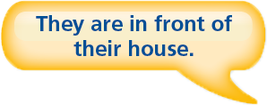

Slide 16
D
C
B
E
H
I
J
E
A
G

Slide 17
1. brick
2. paper
3. material
4. plastic
5. leather
6. metal
7. concrete
8. glass
9. wood

Slide 19
2. Ahmed used to walk to school . Now he goes by bus .
3. Rayyan used to play football every day but now he now has injured his leg ..
4. Sara didn’t use to understand maths but now she is very good at maths .
5. Leen and Shahad didn’t use to like computers but now they like them very much .

Slide 21
Lesson 3
Young achievers

Slide 24
2. She was 16 ( years old ) .
3. The journey took 17 days .
4. It was very cold – as low as minus 50 degrees .
5. She said , this journey has been the youngest person to walk to the North Pole .
6. In 2005 . Her sister , Alicia , became the youngest person to walk to the North Pole .

Slide 25
Europe
2008
6.200 m
4.900m
Asia
2011

Slide 26


Slide 27
2. He has became the youngest person to do this .
3. He has beaten the record of a 16 year boy from Britain .
4. In 2006 , he reached the top of Mount Kilimanjaro in Africa .
5. At the age of 12 , he climbed the youngest person to climb Mount Everst .
6. In 2010 , he become the youngest person to climb Mount Everest .

Slide 30


Slide 31
Had to
Didn’t have to
must
Mustn’t
Has to
Doesn’t have to

Slide 32
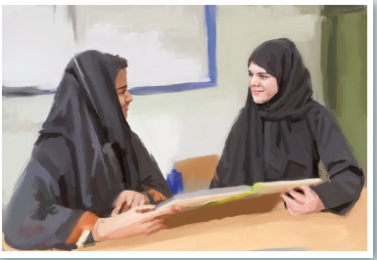

Slide 33
Dalal used to have no homework , Now she has homework everyday.
Waleed used to play football with friends , Now he plays football at a club
Ali didn’t use to like playing chess < Now he likes playing chess very much.
Kamal didn’t use to know how to swim , Now he works in Jeddah.
Rose didn’t use to speak Arabic , Now she speaks Arabic very well.
Yazeed used to like watching TV , Now he prefers computers .

Slide 37
C
d
b
a

Slide 38
started
ended
arrived
Have never driven
said

