Slide 1
Super goal 3

Slide 2
Unit 5

Slide 3
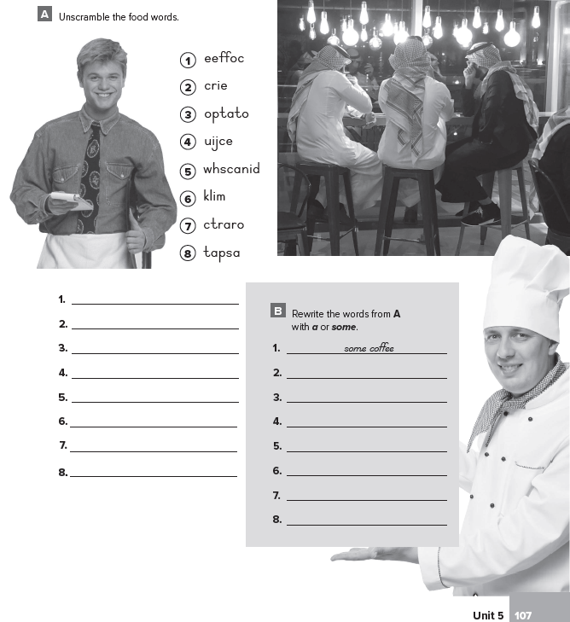
Coffee
Rice
Potato
Juice
Sandwich
Milk
Carrot
Pasta
1- some coffee
2- some rice
3- a potato
4- some juice
5- a sandwich
6- some milk
7- a carrot
8- some pasta

Slide 4
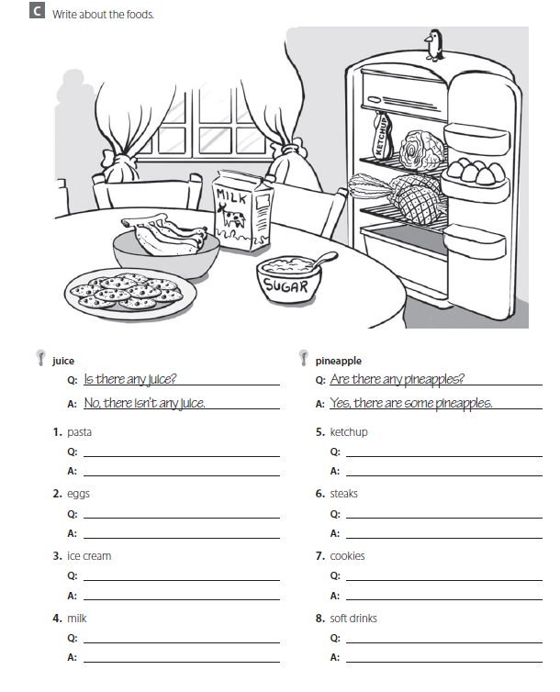
Is there any pasta ?
No , there isn’t any pasta
Is there any ketchup ?
Yes , there is some ketchup
Are there any eggs ?
Yes , there are some eggs
Are there any steaks ?
No , there aren’t any steaks
Is there any ice cream ?
No , there isn’t any ice cream
Are there any cookies ?
Yes , there some cookies
Is there any milk ?
Yes , there is some milk
Are there any soft drinks ?
No , there aren’t any soft drinks

Slide 5
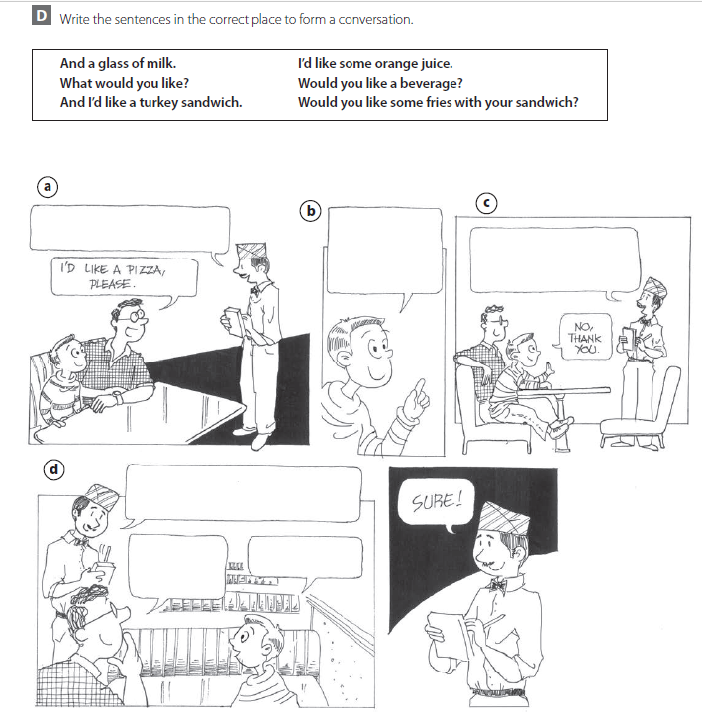
What would you like ?
And I’d like a turkey sandwich
Would you like some fries with your sandwich ?
Would like a beverage ?
I’d like some orange juice
And a glass of milk

Slide 6
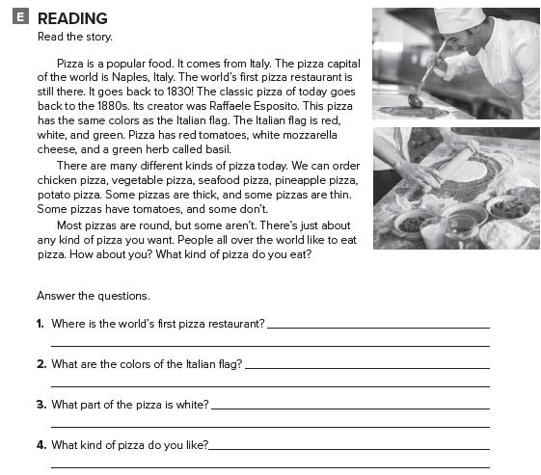
It is in Naples
Red , white and green
It is the cheese
I like the classic pizza

Slide 7
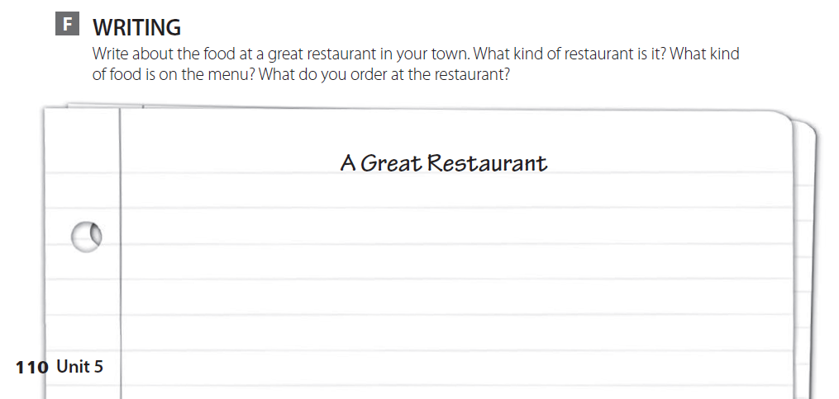
اكتب عن مطعم مشهور في بلدتك

Slide 8
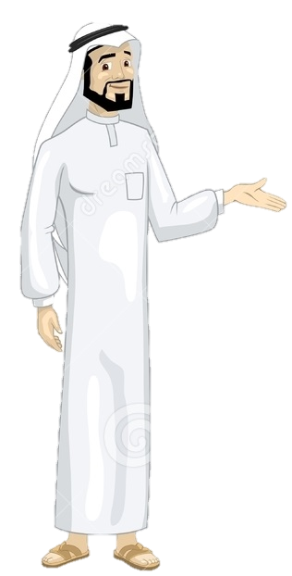
See you later
Take care
Teacher :
Badr Sayid Al-Shehri

