Slide 1
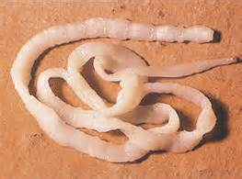
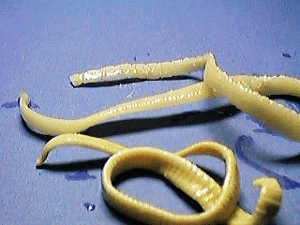
Taenia Lecture 8

Slide 2
Taenia
This class comprises the tapeworms, all of which are endoparasites and lack an alimentary canal throughout life.
They have a great power of reproduction, both asexual and sexual.
Kingdom:Animalia
Subkingdom:Eumetazoa
Class:Cestoda
Order:Cyclophllidea
Genus:Taenia
Species: Taenia saginata (beef tape­worm)
Taenia solium
(pork tapeworm)

Slide 3
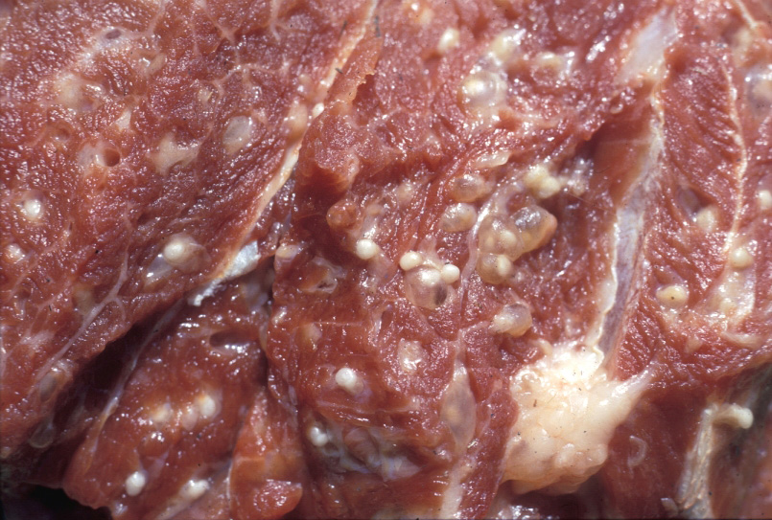
Infection acquired by the ingestion of raw or undercooked meat of infected animals.
Although many species exist, but the two species which infect man are T. saginata and T. solium

Slide 4
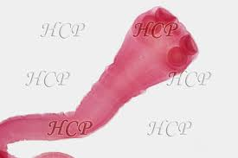
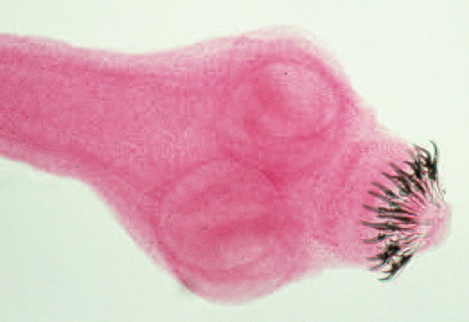
External Features
Taenia saginata
Taenia solium
Scolex has four large muscular suckers
No mouth or hooks exist.
SCOLEX IS RELATIVELY SMALLER
IT HAS A ROUNDED PROMINENT ROSTELLUM WITH A DOUBLE ROW OF CHITINOUS HOOKS.

Slide 6
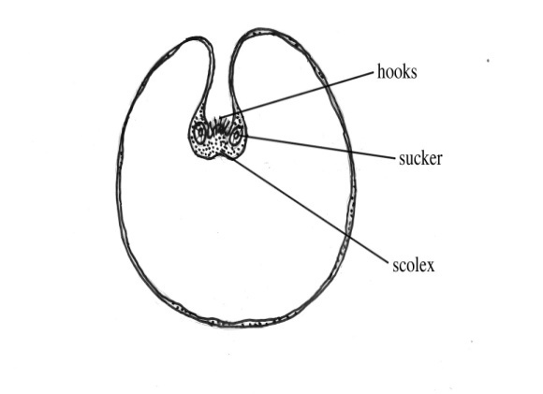
Morphology
T. solium | T. saginata
human | human | Definitive host
pig | cattle | Intermediate host
found in the muscles or subcutaneous tissues of their intermediate host | found in the cow after ingestion of the worm eggs. | Larvae

Slide 7
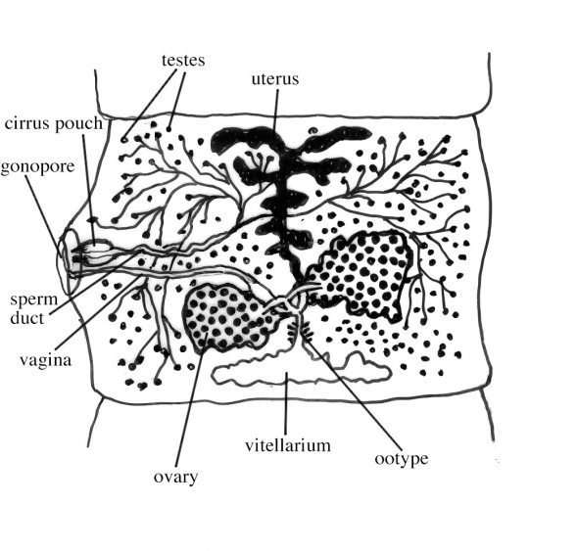
The Mature Proglottis: contains the uterus (unbranched), ovary, genital pore and testes.

Slide 8
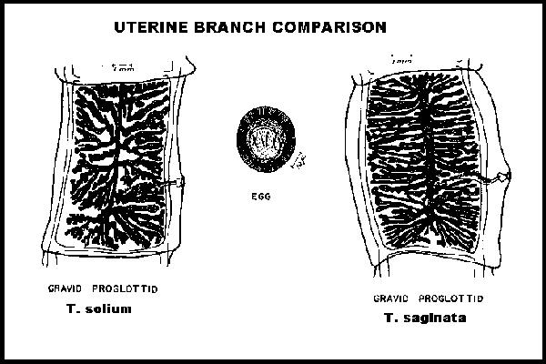
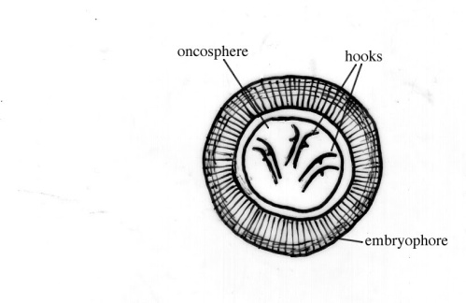
The Gravid Proglottids: the uterus in T. saginata is branched and is filled with eggs. (20-30 main branches on each side). T. solium uterus is less branched (7-to main branches on each side).
Eggs are similar

Slide 9
Incubation Period
It takes about 5 to 12 weeks for the worm to mature into adulthood in the human intestine.
Life Cycle
The life cycles of T. saginata and T. solium are very similar.
Life cycle differences include possible autoinfection route in T. solium, and the different intermediate hosts for each parasite.

Slide 10
Life Cycle of T.saginata
1.Faeces of humans contain the eggs of the tapeworm.
2.Egg is ingested by cattle.
3.Eggs hatch to release hexacynth (six-hooked) larvae in small intestine.
4.Larvae migrate through the intestinal and enters the blood, lymph system.
5.Larvae is carried to tissues such as heart and other muscles to develop cysticercus.
6.Man is infected by ingesting uncooked meat containing cysticercus.
7. Once ingested, the scolex of parasite attaches to the intestinal wall and grow into a mature tapeworm which sheds eggs in the faeces of the infected human.

Slide 11
Life Cycle of T.solium
1. Man ingests the larvae by eating uncooked contaminated pork containing the larvae in cysticerci.
2. Larvae develops into adult form the tapeworm.
3. Tapeworm attaches to the intestinal lining of human and sheds its eggs in human faeces.
4. Pigs come into contact with human faeces and ingest the tapeworm eggs that contain the eggs.
5. Eggs penetrate the small intestine of the pig, enter the hepatic portal vein, enter the general circulation system.
6. Eggs migrate to the skeletal or cardiac muscle where they form cysticerci.

Slide 12
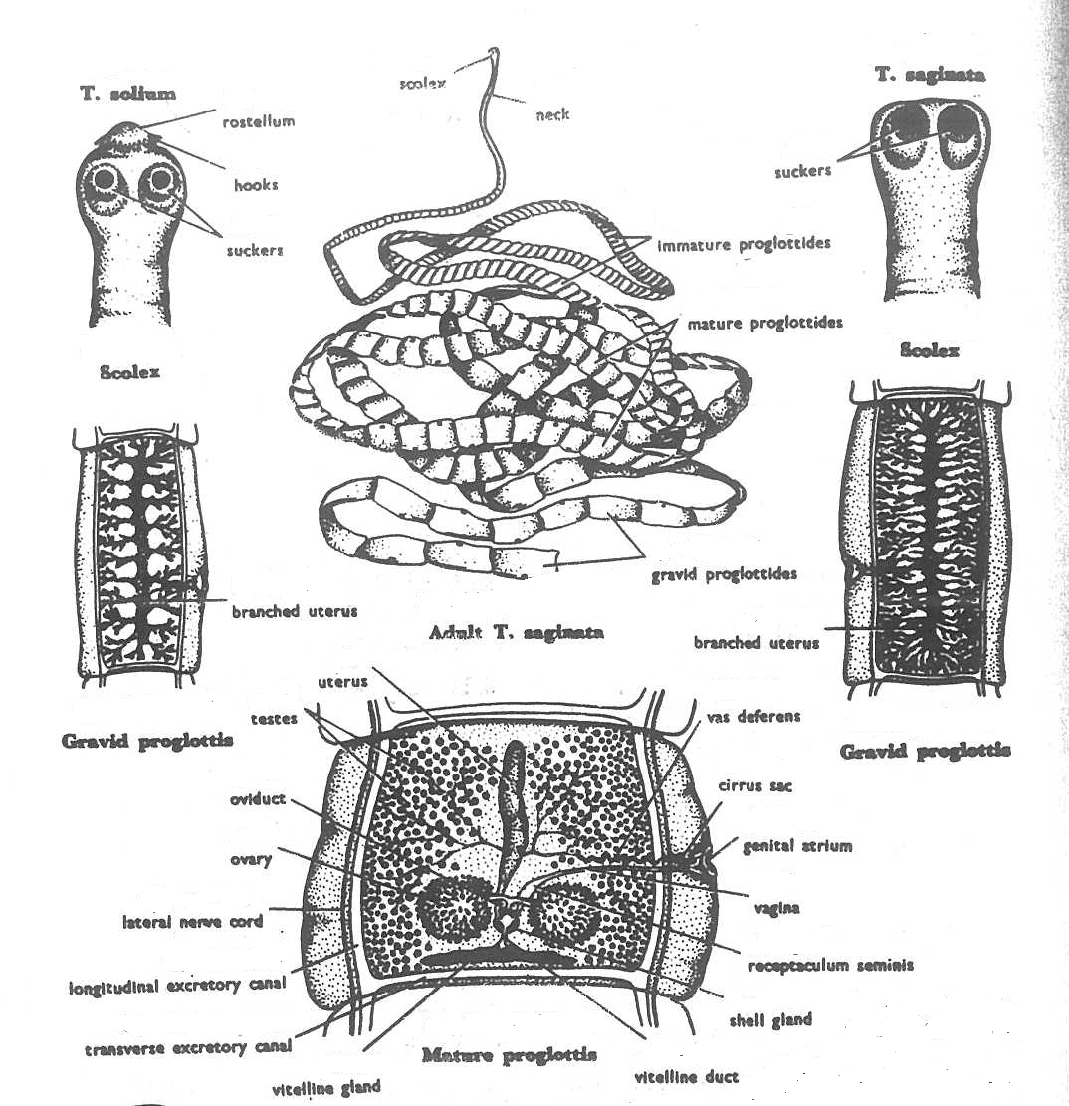

Slide 13
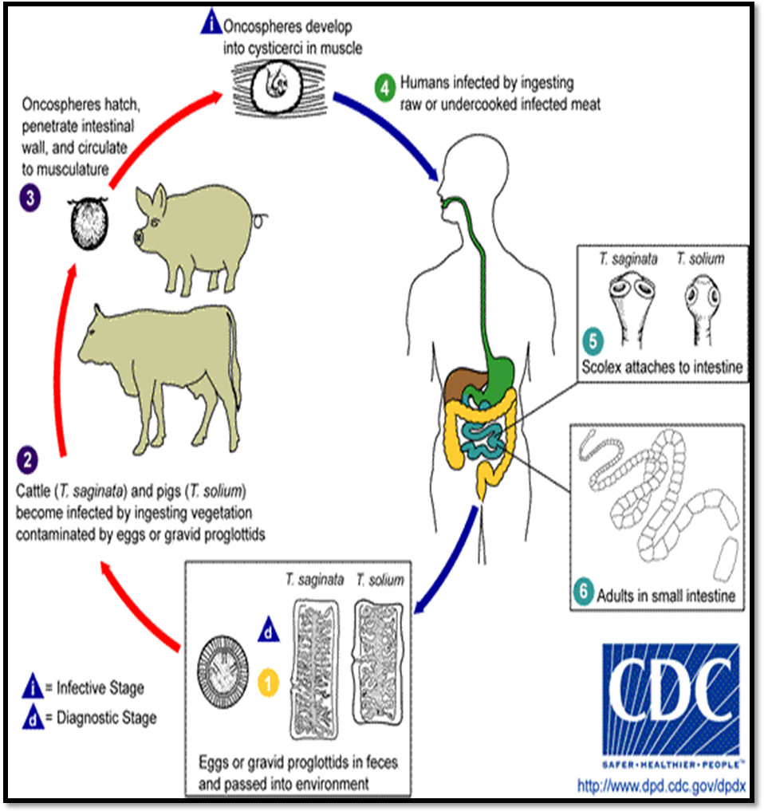

Slide 14
Under The microscope

Slide 20
The Lab exams for lab Zoo- 103 will be held on following dates:
Exam | Monday | Wednesday
Midterm exam | 16/11/2015 | 18/11/2015
 | 4/2/1437 | 6/2/1437
Final Exam | 30/11/2015 | 2/12/2015
 | 18/2/1437 | 20/2/1437

Slide 21
Thank you

