Slide 1
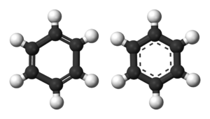
Aromatic compounds
1435-1436
2014-2015
1

Slide 2
Learning Objectives
Aromatic compounds
By the end of chapter four the students will:
Understand the resonance description of structure of benzene
Understand the hybridization in benzene
Understand the relation between the stability of benzene and resonance energy
Know the criteria of aromaticity and Huckel rule
Understand the nomenclature rules of aromatic compounds and know the Common names of some aromatic compounds
Understand the reactivity of aromatic compounds, know what are electrophiles and know the four types of electrophilic aromatic substitution reactions (halogenation, Freidel Crafts alkylation and acylation, nitration and Sulfonation).
Know the reactions of alkyl side chains of aromatic compounds (halogenation, oxidation)
Understand the orientation and reactivity of E.A.S reactions in monosubstituted benzene derivatives.

Slide 3
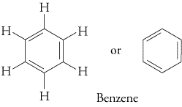
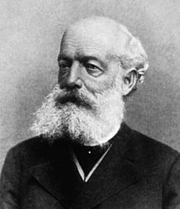
Benzene : Resonance Description
Aromatic compounds
Primary analysis revealed benzene had...
a molecular mass of 78
a molecular formula of C₆H₆
Structure:
Kekulé suggested that benzene was...
PLANAR
CYCLIC
Had Alternating Double And Single Bonds Thus These Double Bonds Are Described As Conjugated Bonds.

Slide 4
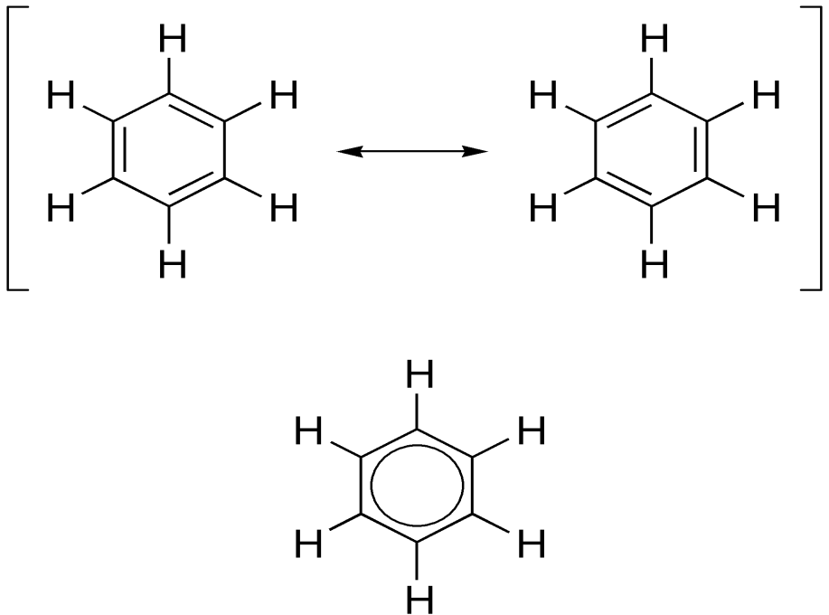
Aromatic compounds
However, all bond lengths in benzene to be equal and intermediate between single bond and double bond lengths (1.39 Å) and the ring is more stable than expected.
To explain the above, it was suggested that the structure oscillated between the two Kekulé forms but was represented by neither of them. It was a RESONANCE HYBRID ( average of two structures that differ only in the placement of the valence electrons).
The energy calculated for a resonance hybrid is lower than the energies of the two alternative structure.
Contributing Structures
4
Resonance hybride

Slide 5
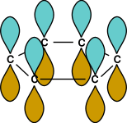
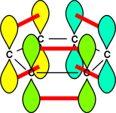
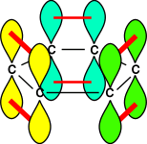
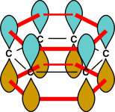
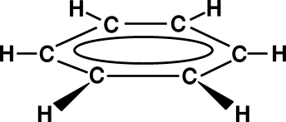
Aromatic compounds
6 single bonds
one way to overlap
adjacent p orbitals
another
possibility
delocalised pi
orbital system
5

Slide 6
Aromatic compounds
Characteristics of Aromatic Compounds
* π electron cloud delocalized all over the ring
* The resonance picture this helps to explain lack of reactivity of benzene (substitution not addition )
Aromatic compounds are compounds that resemble benzene in chemical behavior thus they tend to react by substitution rather than by addition and fulfill the aromaticity requirements.

Slide 7
Characteristics of Aromatic Compounds
Aromatic compounds
To be classified as aromatic, a compound must have :
Cyclic structure.
Coplanar structure.
Each atom of the ring must have a p orbital to form a delocalized π system i.e. no atoms in the ring can be sp³ hybridized instead all atoms must be sp² hybridized (N.B. carbocation and carbanions are sp² hybridized or an unshared pair electrons).
Fulfill Huckel rule i.e. the system must have 4n + 2 pi electrons :
thus by calculating n value it will be an integral number i.e. n=0, 1, 2, 3,

Slide 8
Aromatic compounds
Examples of aromatic compounds

Slide 9
Aromatic compounds
Examples of non aromatic compounds

Slide 10
Nomenclature of Aromatic Compounds
Aromatic compounds
1. Monosubstituted Benzenes
a. IUPAC Names
They are named as derivatives of benzene. One side group is named as a prefix in front of the word benzene.
No number is needed for mono-substituted benzene.

Slide 11
Aromatic compounds
Benzene ring has priority over :side chains with alkyl, alkoxy groups, halogens, double and triple bonds
In some cases the side chains on aromatic ring contain functional groups of higher priorities (NH₂, OH, CHO,C=O, COOH, COOR) thus in this case the aromatic ring will be considered as a substituent and the side chain will be used to give the root name. Two aromatic radials are known
11

Slide 12
Aromatic compounds
Any aryl group (Ar) is the aromatic group that remains after removal of hydrogen Atom from an aromatic ring. When the benzene ringis named as substituent, it is called aphenyl group (often abbreviated Ph).
A benzyl group is the seven carbonunit consisting of benzene ring and methylene (-CH₂-).
b. Common Names Of Monosubstituted Benzenes

Slide 13
Aromatic compounds
2. Nomenclature of Disubstituted and polysubstituted Benzenes
All disubstituted benzenes (two groups are attached to benzene), can give rise to three possible positional isomers.
When the substituents are different, they are of equal priorities they will should be listed in alphabetical order.

Slide 14
Aromatic compounds
If one of the substituents is part of a parent compound, then the disubstituted or polysubstituted benzene is named as a derivative of that parent compound i.e. priorities determine the root name and substituents.

Slide 15
Electrophilic Aromatic Substitution Reactions
Aromatic compounds
Reactions

Slide 16
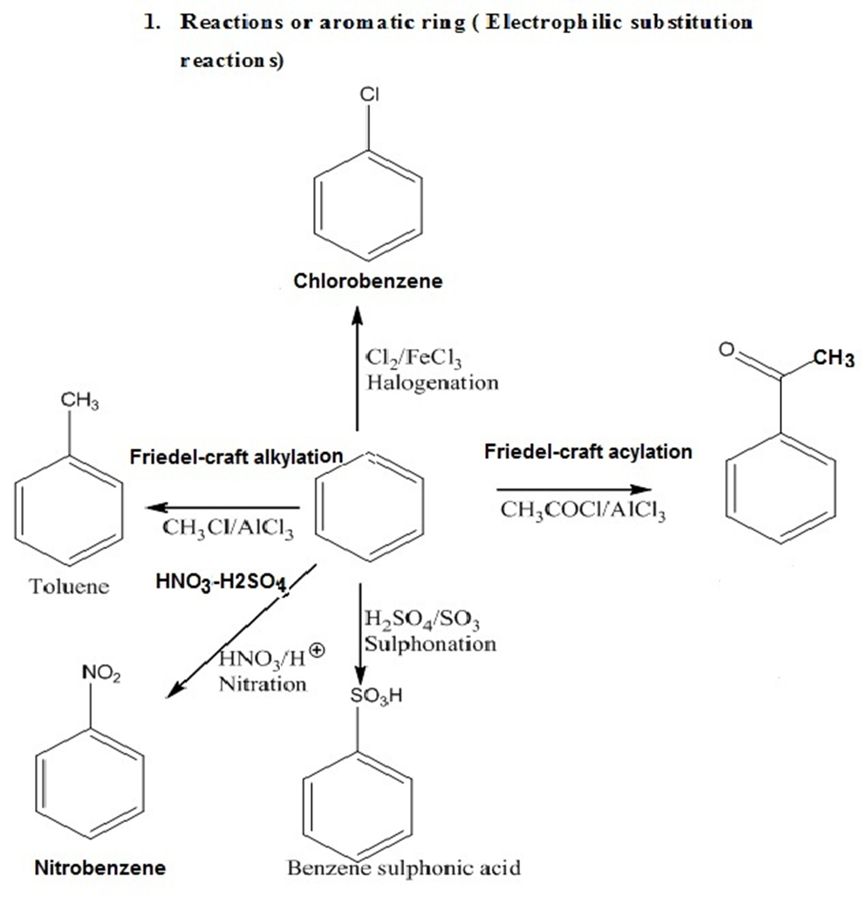
Aromatic compounds
acetophenone

Slide 17
Side-Chain Reactions of Aromatic Compounds
Aromatic compounds
1)Halogenation
a. Halogenation of an Alkyl Side Chain

Slide 18
Aromatic compounds
b. Oxidation of an Alkyl Side Chain

Slide 19
Aromatic compounds
Orientation effects of substituents in electrophilic aromatic substitution reactions of monosubstituted Benzenes
Alkyl groups and groups with lone pairs (electron donating groups) direct new groups to ortho-, para-positions and speed-up the reaction (i.e. o & p directors and activating groups).
Halogens direct new groups to ortho-, para- positions but they slow down the
reaction (i.e. halogens are o & p directors and deactivating groups).
Electron withdrawing groups such as nitro, nitrile, and carbonyl direct new
groups to the meta-position and slow the reaction down (i.e. i.e. m directors and deactivating groups).
Thus the order of reactivity of benzene and monosubstituted benzene derivatives in E.Ar.sub. is as in the following chart
Substituted benzene with o,p directors > Benzene > Halobenzene derivatives > Substituted
benzene with
m- directors

Slide 20
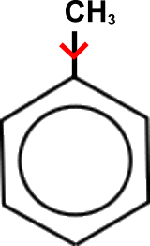
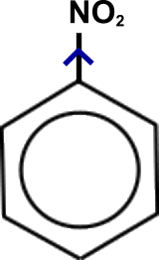
Orientation effects of substituents in electrophilic aromatic substitution reactions of monosubstituted Benzenes
Aromatic compounds
Meta directors | Ortho , para directors
-NO2 -SO3H -COOH, -COOR -CHO, -COR -CN | -OH, -OR -NH2, -NHR, -NR2 -C6H5 -CH3, -R (alkyl) -F, -Cl, -Br, -I

Slide 21
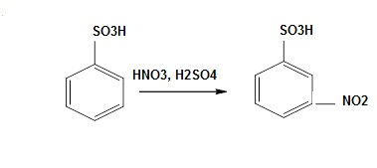
Aromatic compounds

Slide 22
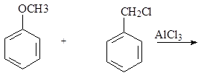
Aromatic compounds
Q1: What are the major products of the following reaction?
Q2: What is the empirical formula of the following compound: (p-methyl-Toluene):

Slide 23
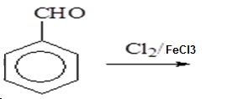
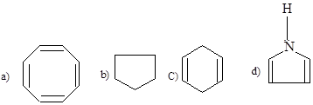
Aromatic compounds
Q3: What is the final product of the following reaction?
a) o-chlorobenzaldehyde b) m-chlorobenzaldehyde c) p-chlorobenzaldehyde d) a,c
Q4:Which one of the following compounds has aromatic character?

Slide 24
Thank You for your kind attention !
Aromatic compounds
Questions?
Comments

