Slide 1
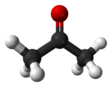
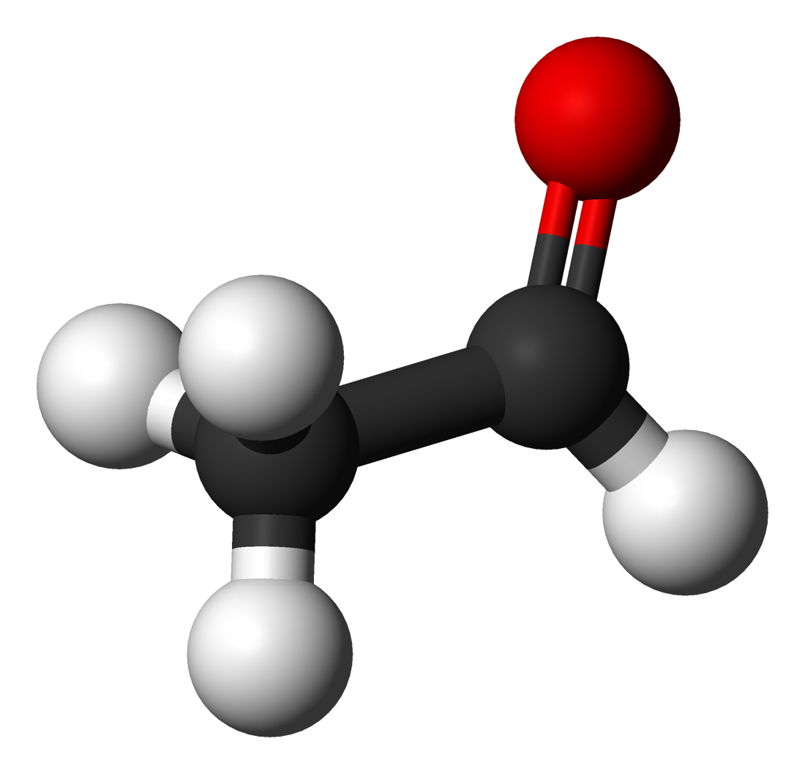
Aldehydes and ketones
1435-1436
2014-2015

Slide 2
Learning Objectives
Aldehydes and ketones
Chapter eight introduces carbonyl compounds and reactions that involve a nucleophilic attack at the carbonyl carbon in addition to the other topics.
By the end of this chapter the student will:
Know the structural differences between aldehydes and ketones
Know how to draw aldehydes and ketones
know the common and IUPAC nomenclature of aldehydes and ketones
Know the physical properties of aldehydes and ketones
Know how to synthesize an aldehyde or a ketone from a compound without that
functionality.
Know the different nucleophilic attack reactions at the carbonyl carbon and the specific products formed in each case.

Slide 3
ALDEHYDES: STRUCTURE AND NOMENCLATURE
Aldehydes and ketones
General formula: RCHO or
Bond line formula
The polarity of C=O
The aldehyde group is always (terminal)at the end of a chain
Common Nomenclature Of Aldehydes
Common name of aldehydes are derived from the common name of the correspounding acid
Some aliphatic aldehydes have common names which have to be memorized.
Formaldehyde Acetaldehyde Propionaldehyde Butyraldehyde
145 Chem.

Slide 4
Aldehydes and ketones
Some aromatic aldehydes have common names such as:
4
Salicylaldehyde (o-Hydroxybenzaldehyde) Anisaldehyde (p-methoxybezaldehyde)
IUPAC Nomenclature
Select the longest continuous carbon chain that contains the H-C=O group to get the name of the parent hydrocarbon, then replace the ending e by the suffix –al
The CHO group is assigned the local 1 and takes precedence over other functional groups that may present such as C=O(ketone),–OH, C=C, CΞC, OR
For cyclic aldehydes in which the –CHO group is attached to the ring, the suffix carbaldehyde is used.

Slide 5
Aldehydes and ketones
Methanal Ethanal Propanal Butanal
Cis-2-Hydroxy
cyclopentane
carbaldehyde
3-Chlorobutanal 3-Hydroxypropanal 2-Butenal
Aromatic aldehydes are usually designated as derivatives of the simplest aromatic aldehyde, Benzaldehyde.
Benzaldehyde 2-Hydroxybenzaldehyde
4-Nitrobenzaldehyde 4-Methoxybenzaldehyde

Slide 6
Aldehydes and ketones
KETONES:STRUCTUR AND NOMENCLATURE
General formula: RCOR’ (R and R’=alkyl or aryl)
Common names of ketones derived by listing the alkyl substituents attached to the carbonyl group in alphabetical order, followed by the word ketone.
In common names carbon atoms near the carbonyl group are often designated using Greek letters (α, ᵝ, ɣ , δ…..) beginning with carbon next the carbonyl group.
When a complex molecules contains more than one of functional groups, an order of precedence is used to determine the name.
The functional group priority order in nomenclature system is as following:
Acid and derivatives > aldehyde > ketone > alcohol > amine > alkene > alkyne > ether
6

Slide 7
Aldehydes and ketones
Acetone Acetophenone Benzophenone Dimethyl ketone Methyl phenyl ketone Methyl vinyl ketone Diphenyl ketone
IUPAC Nomencalture :
Select the longest continuous carbon chain that contains the C=O group to get the name of the parent hydrocarbon, then replace the ending e by the suffix –one
The chain is numbered in such a way as give the lowest number to the C=O group.
The prefix of oxo is used if there are higher ranking functional groups present.
7

Slide 8
Aldehydes and ketones
Propanone Phenyl ethanone 3-Buten-2-one Diphenylmethanone
Cyclopentylpropanone 3-Ethyl-2-hydroxycyclohexanone 5-Oxohexanal

Slide 9
Physical Properties OF Aldehydes And Ketones
Aldehydes and ketones
The carbonyl group is polar; with a partial negative charge on oxygen atom, and partial positive charge on carbon atom.
Because the polarity of the carbonyl group, aldehydes and ketones are polar compounds.
1) Boiling and melting points
Higher melting and boiling points compared to analogous alkanes due to they show dipole-dipole attractions.
These attractions although important, are not as strong as interactions due to hydrogen bonding as a result, the boiling points of aldehydes and ketones are higher than those of non polar alkanes, but lower than those of alcohols whose molecules are connected together by H-bonds.

Slide 10
Aldehydes and ketones
2) Solubility
Lower aldehydes and ketones are are more soluble than alkanes but less soluble than alcohols in aqueous media

Slide 11
Preparation Of Aldehydes And ketones: 1- Oxidation of Alcohols
Aldehydes and ketones

Slide 12
2- Ozonolysis of Alkenes: results in formation of aldehydes or ketones depending on structure of the alkene used.
Aldehydes and ketones

Slide 13
Aldehydes and ketones
3- Hydration Of Alkynes
4- Friedel Crafts Acylation
N.B: -COR group is m-director and deactivating towards electrophiles

Slide 14
Reactions Of Aldehydes And Ketones the most common reactions are :Nucleophilic addition reactions
Aldehydes and ketones
1- Reduction : Formation Of Alcohols
The reduction by NaBH₄ , LiAlH₄ ; the hydride ion H⁻ is serve as nucleophile.

Slide 15
Aldehydes and ketones
2-Nucleophilic addition of Grignard reagent (formation of alcohols)
Addition of RMgX to formaldehyde gives 1◦ alc.
Addition of RMgX to any other aldehyde gives 2◦ alc.
Addition of RMgX to ketones gives 3◦ alc.
3- Oxidation reaction
Only aldehydes can be oxidized ketones resist oxidation

Slide 16
Aldehydes and ketones
5-Addition of Hydrogen Cyanide: Formation Of Cynohydrins

Slide 17
Aldehydes and ketones
6- Addition Of Alcohols:

Slide 18
Aldehydes and ketones
7- Addition of Ammonia and Ammonia Derivatives
145 Chem.
18

Slide 19
Aldehydes and ketones
Exercises
1- The correct name of the following compound is:
A) 3-hydroxyhexanal
B) 3-hydroxy-4-hexenal
C) 4-hydroxy-5-hexenal
D)3-hydroxy-1-hexenal
2- The structure of Acetal is:
145 Chem.
19

Slide 20
Aldehydes and ketones
3- Reaction of phenyhydrazine with carbonyl compounds (aldyhydes or ketones) gives:
A) Oxime B) Phenylhydrazone C) Imine D) Hemiacetal
4 - Which of the following compounds has the highest boiling point?
145 Chem.
20

Slide 21
Thank You for your kind attention !
Aldehydes and ketones
Questions?
Comments

