Slide 1
Family and Friends 3
Grade 3
Unit 8
Lesson 4
P 75

Slide 2
Objectives
1- Recognise the sound /o-e/.
2- Review words with the sound /o-e/.
_________________________________________________________________________________________________________________________________________________
Ministry of Education-2020

Slide 3
Magic e
Sit
Site
www.
I sit on a chair.
The site is good.
The vowel (i) sounds short and weak.
The vowel (i) sounds LONG AND STRONG.
_________________________________________________________________________________________________________________________________________________
Ministry of Education-2020

Slide 4
Magic e
Makes the vowel long and strong!
Sit
Site
_________________________________________________________________________________________________________________________________________________
Ministry of Education-2020

Slide 5
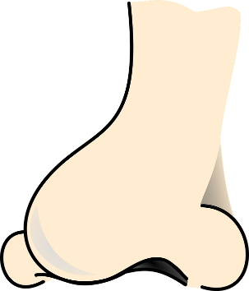
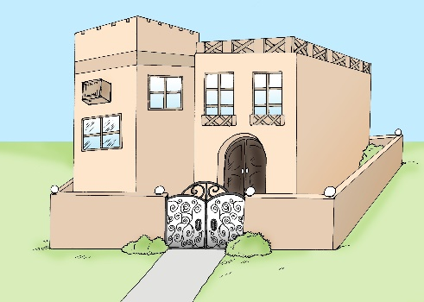
Listen, point and repeat
rope
nose
stone
bone
home
_________________________________________________________________________________________________________________________________________________
Ministry of Education-2020

Slide 6
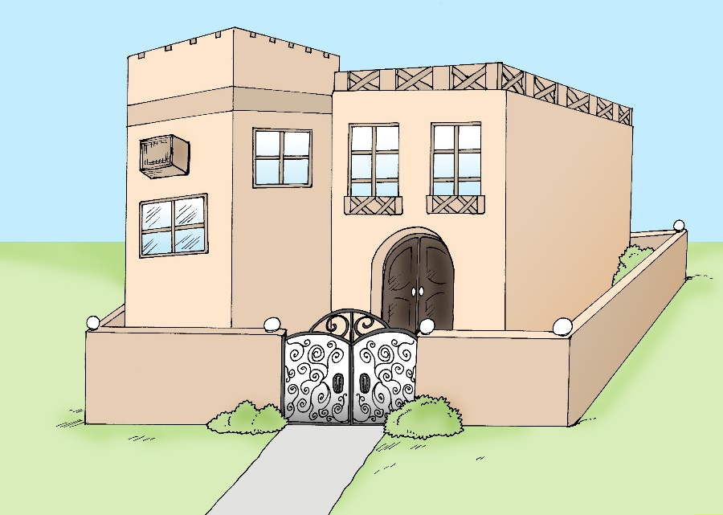
Read and point to the word with o-e
home
I like to go after school.
_________________________________________________________________________________________________________________________________________________
Ministry of Education-2020

Slide 7
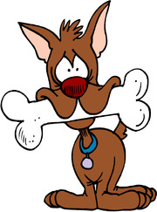
Read and point to the word with o-e
bone
The dog has a .
_________________________________________________________________________________________________________________________________________________
Ministry of Education-2020
Notes:
If you have got short hair stand up.

Slide 8
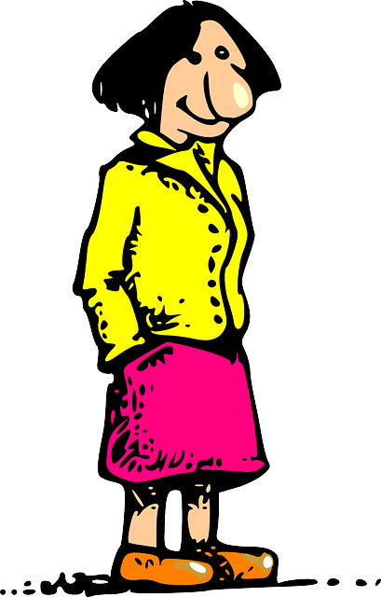
Read and point to the word with o-e
nose
She has a big .
_________________________________________________________________________________________________________________________________________________
Ministry of Education-2020

Slide 9
Read and point to the word with o-e
stone
It is a big .
_________________________________________________________________________________________________________________________________________________
Ministry of Education-2020

Slide 10
Read and point to the words with o-e
rope
He is skipping .
_________________________________________________________________________________________________________________________________________________
Ministry of Education-2020
Notes:
If you have got curly hair stand up.

Slide 11
Bring out your white boards and markers!
Let’s Play!
Read and write words with o-e.
I am a mole.
And I live in a hole.
The hole is my home.
Home, home, home.
_________________________________________________________________________________________________________________________________________________
Ministry of Education-2020

Slide 12
Let’s check!
Read and write words with o-e.
I am a mole.
And I live in a hole.
The hole is my home.
Home , home, home.
_________________________________________________________________________________________________________________________________________________
Ministry of Education-2020

Slide 13
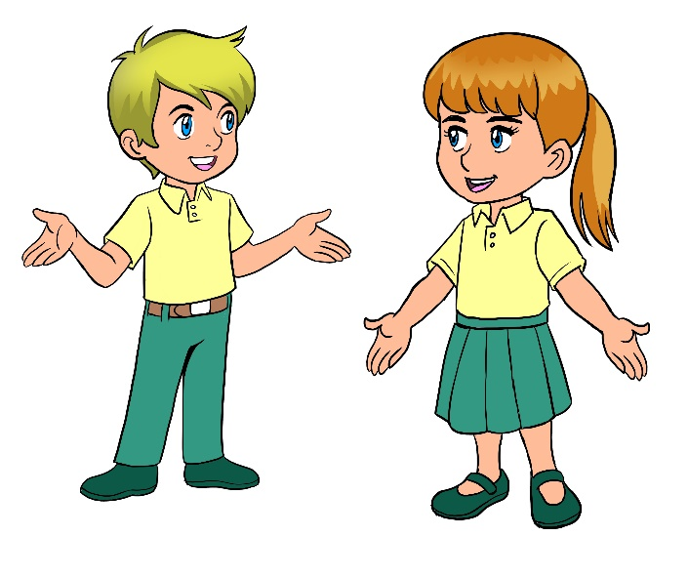
Let’s Play!
Read and write words with o-e.
My friend lives in Rome.
Rome is his home.
He has a small nose.
He smells a red rose with his small nose.
He has a dog with a big nose. The dog likes ice-cream cones.
He likes ice-cream cones more than bones.
_________________________________________________________________________________________________________________________________________________
Ministry of Education-2020

Slide 14
Let’s check!
Read and write words with o-e.
My friend lives in Rome.
Rome is his home.
He has a small nose.
He smells a red rose with his small nose.
He has a dog with a big nose. The dog likes ice-cream cones.
He likes ice-cream cones more than bones.
_________________________________________________________________________________________________________________________________________________
Ministry of Education-2020

Slide 15
Question 1
Let’s practice !
Open page 73 of your workbook. Answer the questions.
Question 2
Question 4
Question 3
_________________________________________________________________________________________________________________________________________________
Ministry of Education-2020

Slide 16
In your notebook, write three sentences with the words you have learned today.
_________________________________________________________________________________________________________________________________________________
Ministry of Education-2020

Slide 17
Open
Unit 8 practice PPT
and answer L 4.
______________________________________________________________________________________________________________________________________________________
Ministry of Education-2020

Slide 18
End of the
lesson!
_________________________________________________________________________________________________________________________________________________
Ministry of Education-2020

