Slide 1
Chapter 10
EXCRETION
الإخراج

Slide 2
Control of Body Temperature and Water Balance
التحكم في درجة حرارة الجسم والاتزان المائي

Slide 3
Control of Body Temperature and Water Balance as a part of homeostasis السيطرة على درجة حرارة الجسم و التوازن المائي جزء من الاتزان الحيوي
الاتزان الحيوي
Homeostasis means
Maintenance of steady internal conditions despite fluctuations in the external environment
القدرة على الحفاظ على ظروف وأحوال داخلية مستقرة بالرغم من التقلبات في البيئة الخارجية
Examples of homeostasis
Thermoregulation: the maintenance of internal temperature within narrow limits
التنظيم الحراري : القدرة على الحفاظ على درجة الحرارة الداخلية ضمن حدود ضيقة .
Osmoregulation: the control of the gain and loss of water and solutes
التنظيم الأسموزي : هو القدرة على التحكم باكتساب وفقدان الماء والمواد الذائبة.
Excretion: the disposal of nitrogen-containing wastes
الإخراج : هو عملية التخلص من المخلفات المحتوية على النيتروجين .
أمثلة على الاتزان الحيوي
3

Slide 4
Thermoregulation: An animal’s regulation of body temperature helps maintain homeostasis تنظيم الحيوان لدرجة حرارة جسمه يساعد على الحفاظ على الاتزان الحيوي
Thermoregulation التنظيم الحراري
The process by which animals maintain an internal temperature within a tolerable range
العملية التي يمكن بها للحيوان المحافظة على درجة حرارة الجسم الداخلية ضمن مدى يمكن تحمله
Ectothermic animals الحيوانات خارجية الحرارة
Absorb heat from their surroundings
تمتص الحرارة من البيئة المحيطة
Many fish, most amphibians, lizards, most invertebrates
العديد من الأسماك , معظم البرمائيات , السحالي, ومعظم اللافقاريات
Endothermic animals الحيوانات داخلية الحرارة
Derive body heat mainly from their metabolism
يستمد حرارة الجسم بصفة رئيسية من عملية الأيض
Birds, mammals, a few reptiles and fish, many insects
الطيور , الثدييات , القليل من الزواحف والأسماك, العديد من الحشرات
4
Notes:
Student Misconceptions and Concerns
1. The concept of homeostasis may be new to students, who have never considered how organisms must adjust to subtle changes in environmental conditions. Analogies to other systems that engage in self-regulation, such as the water regulation of a toilet or the temperature regulation of a furnace, may help.
2. One role of the circulatory system rarely discussed is the transport of heat. Blood vessels near the surface of the body expand when we are overheated, releasing some of this excess to the environment. Conversely, during periods of exposure to cold, blood is shunted away from the skin to conserve heat.
Teaching Tips
1. The terms warm-blooded and cold-blooded are less precise than endotherm and ectotherm. Encourage students to discuss why the latter two terms are preferable.
2. Ask your students to explain the adaptive advantages of endothermy and ectothermy. You might prompt the discussion by noting that endotherms consume about 10 times as many calories as ectotherms of equivalent body mass. What advantages might be worth this additional “cost” for endotherms?
3. The heat generated by aerobic metabolism is analogous to the heat generated by the engine of an automobile. In both cases, the heat is a by-product of the process. In the winter, this excess heat helps keep the body and the interior of the car warm. In the summer, both the body and the automobile’s engine must work to keep from overheating.

Slide 5
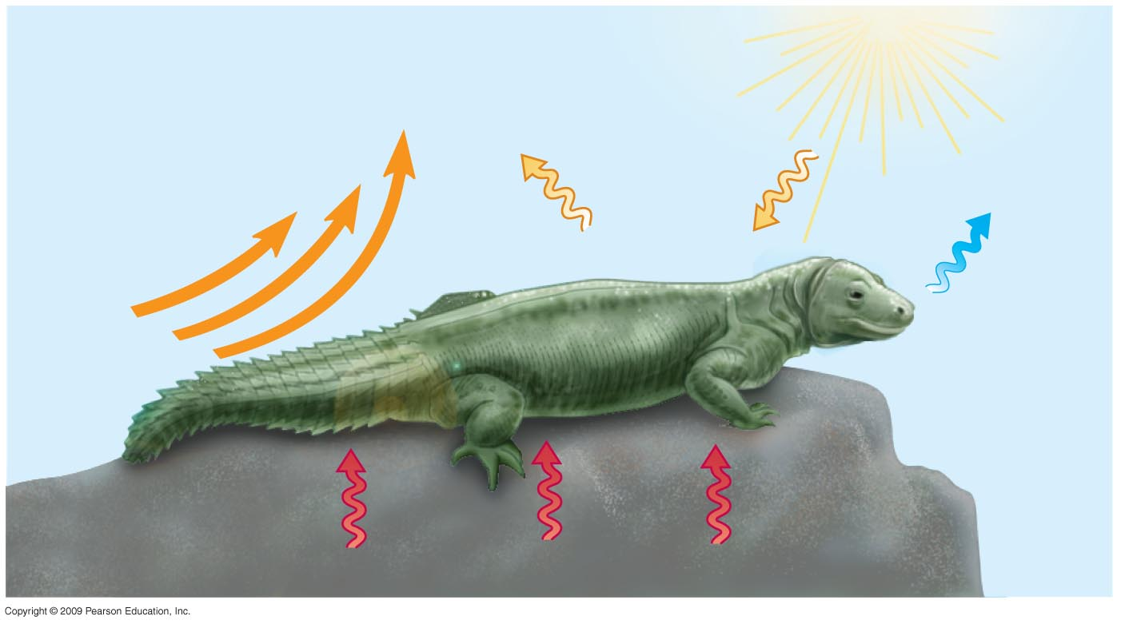
Heat is gained or lost in four ways يتم اكتساب أو فقدان الحرارة بأربع طرق
Heat exchange with the environment may occur by
قد يحصل تبادل الحرارة مع البيئة المحيطة من خلال
Conduction التوصيل
Convection الحمل الحراري
Radiation الاشعاع
Evaporation التبخير
Radiation
الإشعاع
Convection
الحمل الحراري
Evaporation
التبخير
Mechanisms of heat exchange
آليات تبادل الحرارة
Conduction
5

Slide 6
Adaptations that balance heat gain and loss التكيفات التي توزان بين اكتساب و فقد الحرارة
Five general categories of adaptations promote thermoregulation
هناك خمس فئات عامة من التكيفات التي تشجع على التنظيم الحراري
1- Increased metabolic heat production:
زيادة انتاج الحرارة الأيضية :
Hormonal changes boost metabolic rate in birds and mammals
تعمل التغيرات الهرمونية على رفع معدل الأيض في الطيور والثدييات
Shivering الارتجاف
Increased physical activity زيادة الأنشطة الجسدية
Honeybees cluster and shiver تزاحم نحل العسل والارتجاف
6
Copyright © 2009 Pearson Education, Inc.
Notes:
Student Misconceptions and Concerns
1. The concept of homeostasis may be new to students, who have never considered how organisms must adjust to subtle changes in environmental conditions. Analogies to other systems that engage in self-regulation, such as the water regulation of a toilet or the temperature regulation of a furnace, may help.
2. One role of the circulatory system rarely discussed is the transport of heat. Blood vessels near the surface of the body expand when we are overheated, releasing some of this excess to the environment. Conversely, during periods of exposure to cold, blood is shunted away from the skin to conserve heat.
Teaching Tips
1. Have students list the many factors that affect heat gain and loss during periods of physical activity, then have them identify which of the four physical processes for exchanging heat are involved. The factors include (a) the person’s physical condition, (b) the level of physical activity, (c) the age of the person (younger people tend to have higher metabolic rates), (d) the person’s level of hydration (which in turn affects the amount of sweating and evaporative cooling), (e) the external level of humidity (higher levels decrease evaporative cooling), (f) the intensity of the wind (greater intensity promotes evaporative cooling), (g) the intensity of sunlight, and (h) the color of the person’s clothing (which affects the amount of light energy the body absorbs).
2. You can extend the exercise above by challenging your class to identify environmental conditions when it would be too hot to play an outdoor sport. That is, when as a parent or coach would you want to prevent practice or a game because it is dangerously hot?
3. As an alternative to the above, challenge students to identify a human example of each of the four physical processes that involve heat exchange with the environment (Module 25.3) and that promote thermoregulation (Module 25.4). Or, to check student comprehension, describe such examples and challenge the class to match the examples to the correct terminology.
4. Some students will be familiar with the type of foam insulation wrap surrounding interior pipes. These forms of insulation are especially necessary when hot- and cold water pipes run parallel and in close proximity to each other. Without the insulation, heat would be easily transferred from hot-water to cold-water pipes, in a situation similar to countercurrent heat exchange systems in animals.

Slide 7
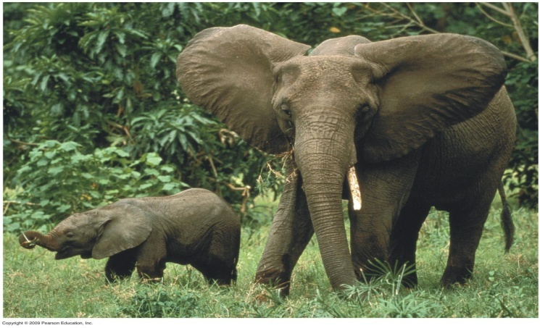
Thermoregulation involves adaptations that balance heat gain and loss يتضمن التنظيم الحراري التكيفات التي تعمل على الاتزان بين اكتساب وفقدان الحرارة
2- Insulation العزل
Hair الشعر
Feathers الريش
Fat layers الطبقات الدهنية
3- Circulatory adaptations التكيفات الخاصة بالدورة الدموية
Increased or decreased blood flow to skin by changing diameter of skin blood vessels
زيادة أو انخفاض تدفق الدم إلى الجلد عن طريق تغيير قطر الأوعية الدموية في الجلد
Large ears in elephants الاذان الكبيرة في الفيلة
Countercurrent heat exchange تبادل حرارة التيار المعاكس
7
Notes:
Student Misconceptions and Concerns
1. The concept of homeostasis may be new to students, who have never considered how organisms must adjust to subtle changes in environmental conditions. Analogies to other systems that engage in self-regulation, such as the water regulation of a toilet or the temperature regulation of a furnace, may help.
2. One role of the circulatory system rarely discussed is the transport of heat. Blood vessels near the surface of the body expand when we are overheated, releasing some of this excess to the environment. Conversely, during periods of exposure to cold, blood is shunted away from the skin to conserve heat.
Teaching Tips
1. Have students list the many factors that affect heat gain and loss during periods of physical activity, then have them identify which of the four physical processes for exchanging heat are involved. The factors include (a) the person’s physical condition, (b) the level of physical activity, (c) the age of the person (younger people tend to have higher metabolic rates), (d) the person’s level of hydration (which in turn affects the amount of sweating and evaporative cooling), (e) the external level of humidity (higher levels decrease evaporative cooling), (f) the intensity of the wind (greater intensity promotes evaporative cooling), (g) the intensity of sunlight, and (h) the color of the person’s clothing (which affects the amount of light energy the body absorbs).
2. You can extend the exercise above by challenging your class to identify environmental conditions when it would be too hot to play an outdoor sport. That is, when as a parent or coach would you want to prevent practice or a game because it is dangerously hot?
3. As an alternative to the above, challenge students to identify a human example of each of the four physical processes that involve heat exchange with the environment (Module 25.3) and that promote thermoregulation (Module 25.4). Or, to check student comprehension, describe such examples and challenge the class to match the examples to the correct terminology.
4. Some students will be familiar with the type of foam insulation wrap surrounding interior pipes. These forms of insulation are especially necessary when hot- and cold water pipes run parallel and in close proximity to each other. Without the insulation, heat would be easily transferred from hot-water to cold-water pipes, in a situation similar to countercurrent heat exchange systems in animals.

Slide 8
Thermoregulation involves adaptations that balance heat gain and loss يتضمن التنظيم الحراري التكيفات التي تعمل على الاتزان بين اكتساب وفقدان الحرارة
4- Evaporative cooling التبريد بالتبخر
Sweating التعرق
Panting اللهث
5- Behavioral responses الاستجابات السلوكية
Used by endotherms and ectotherms
وتستخدم من قبل الحيوانات داخلية الحرارة وخارجية الحرارة .
Examples: أمثلة
Moving to the sun or shade الانتقال نحو الشمس أو الظل
Migrating الهجرة
Bathing السباحة
8
Notes:
Student Misconceptions and Concerns
1. The concept of homeostasis may be new to students, who have never considered how organisms must adjust to subtle changes in environmental conditions. Analogies to other systems that engage in self-regulation, such as the water regulation of a toilet or the temperature regulation of a furnace, may help.
2. One role of the circulatory system rarely discussed is the transport of heat. Blood vessels near the surface of the body expand when we are overheated, releasing some of this excess to the environment. Conversely, during periods of exposure to cold, blood is shunted away from the skin to conserve heat.
Teaching Tips
1. Have students list the many factors that affect heat gain and loss during periods of physical activity, then have them identify which of the four physical processes for exchanging heat are involved. The factors include (a) the person’s physical condition, (b) the level of physical activity, (c) the age of the person (younger people tend to have higher metabolic rates), (d) the person’s level of hydration (which in turn affects the amount of sweating and evaporative cooling), (e) the external level of humidity (higher levels decrease evaporative cooling), (f) the intensity of the wind (greater intensity promotes evaporative cooling), (g) the intensity of sunlight, and (h) the color of the person’s clothing (which affects the amount of light energy the body absorbs).
2. You can extend the exercise above by challenging your class to identify environmental conditions when it would be too hot to play an outdoor sport. That is, when as a parent or coach would you want to prevent practice or a game because it is dangerously hot?
3. As an alternative to the above, challenge students to identify a human example of each of the four physical processes that involve heat exchange with the environment (Module 25.3) and that promote thermoregulation (Module 25.4). Or, to check student comprehension, describe such examples and challenge the class to match the examples to the correct terminology.
4. Some students will be familiar with the type of foam insulation wrap surrounding interior pipes. These forms of insulation are especially necessary when hot- and cold water pipes run parallel and in close proximity to each other. Without the insulation, heat would be easily transferred from hot-water to cold-water pipes, in a situation similar to countercurrent heat exchange systems in animals.

Slide 9
Osmoregulation and Excretion
التنظيم الأسموزي والإخراج
Osmoregulation is the active regulation of the osmotic pressure of an organism’s fluids to maintain the homeostasis of the organism's water content; that is, it keeps the organism's fluids from becoming too diluted or too concentrated.
التنظيم الأسموزي : هو التنظيم النشط للضغط الاسموزي للسوائل في الكائن الحي للحفاظ على التوازن من محتوى الماء الكائن الحي. وهذا هو، فإنه يحافظ على سوائل الكائن الحي من أن تصبح مخففة جدا أو مركزة جدا.
9

Slide 10
Animals balance the gain and loss of water and solutes through osmoregulation تعمل الحيوانات على الاتزان بين اكتساب وفقدان الماء والمواد الذائبة من خلال التنظيم الأسموزي
Osmoconformers الكائنات ذات التوافق الأسموزي
Have the same internal solute concentration as sea water
تمتلك نفس تركيز المواد الذائبة الداخلية كمياه البحر
Many marine invertebrates are osmoconformers
تعتبر العديد من اللافقاريات البحرية كائنات ذات توافق اسموزي
Osmoregulators control their solute concentrations
الكائنات ذات التنظيم الأسموزي لها القدرة على التحكم في تراكيز موادها المذابة
Freshwater fishes أسماك المياه العذبة
Gain water by osmosis تكتسب الماء بالخاصية الأسموزية
Excrete excess water تخرج الماء الفائض
Uptake salt across their gills تضخ الملح عبر الخياشيم
10
Notes:
Student Misconceptions and Concerns
1. The idea that a freshwater fish never drinks can be conceptually challenging, especially for students who have heard the old saying “drinks like a fish”! Consider introducing your discussion of osmoregulation with this remarkable and seemingly counterintuitive fact in order to generate interest.
Teaching Tips
1. Students may better understand the challenges of osmoregulation in freshwater fish if they are reminded of what occurs when humans soak their hands in water. Students will likely recall that this causes the skin on their hands to wrinkle, and some may have noticed that their skin wrinkles even faster in soapy water. Skin absorbs water by osmosis (just as a freshwater fish gains water). Oils on our skin reduce the influx of water. Soapy water, which washes away these oils, speeds up the process. The wrinkling occurs because the skin can expand only in certain areas, creating puckers.

Slide 11
EXCRETION الإخراج
هو العملية التي يتم التخلص من النفايات من عملية التمثيل الغذائي وغيرها من المواد غير المفيدة من كائن حي.
Excretion is the process by which waste products of metabolism and other non-useful materials are eliminated from an organism.
الإخراج : هو العملية التي يتم التخلص من النفايات من عملية التمثيل الغذائي وغيرها من المواد غير المفيدة من كائن حي.
In vertebrates this is primarily carried out by the kidneys and skin
في الفقاريات يتم هذا أساسا من قبل الكلى والجلد.
11

Slide 12
The Mammalian Excretory System النظام الاخراجي للثديات
The mammalian excretory system centers on paired kidneys, which are also the principal site of water balance and salt regulation
النظام الاخراجي للثدييات يركز على الكلى المقترنة، والتي هي أيضا الموقع الرئيسي لتوازن الماء وتنظيم الملح
Urine exits each kidney through a duct called the ureter يخرج البول من كل كلية من خلال قناة تسمى الحالب
Both ureters drain into a common urinary bladder, and urine is expelled through a urethra
كل الحالبين بفرغ الى المثانة البولية المشتركية ويطرح البول من خلال المجرى البولي
12

Slide 13
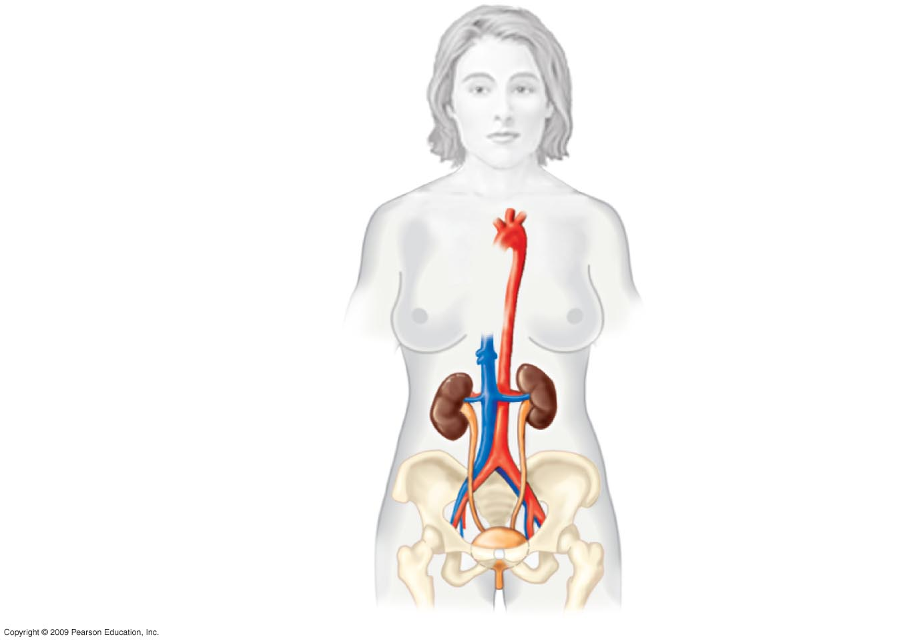
Anatomy of the human excretory system
تشريح الجهازالاخراجي في الانسان
Aorta
الاورطى
Inferior
vena cava
الوريدالاجوف السفلي
Renal artery and vein
الشريان والوريد الكلوي
Kidney
الكلية
Ureter
الحالب
Urinary bladder
المثانة البولية
Urethra
المجرى البولي
13
Notes:
.

Slide 14
The urinary system plays several major roles in homeostasis
يلعب الجهاز البولي عدة ادوار رئيسية في عملية الاتزان الحيوي
الجهاز الاخراجي
The excretory system
Expels wastes
Regulates water balance
Regulates ion balance
Nephrons
Functional units of the kidneys
الوحدات الوظيفية للكلى
Extract a filtrate from the blood
استخلاص المواد الراشحة من الدم
Refine the filtrate to produce urine
تنقية المواد الراشحة لإنتاج البول
يطرد المخلفات
ينظم الاتزان المائي
ينظم الاتزان الايوني
الوحدات البولية
14
Notes:
Student Misconceptions and Concerns
1. The kidney’s role in filtration and selective reabsorption may initially be confusing to many students. The process is a bit like cleaning up a closet by removing all the contents and then selectively returning to it what you wish to store.
2. Before addressing the human urinary system, challenge each student in your class to explain how a drink of water may end up as urine. Consider having each students write out their answer on a 3 × 5 card in class. This quick survey will likely reveal misunderstandings that would otherwise be concealed by quiet students’ reluctance to speak up. Students might suggest that some sort of tube transports fluid from the digestive tract to the kidneys or urinary bladder. Such surveys provide a useful means of gauging the initial assumptions of your students as they approach a new subject.
Teaching Tips
1. A moderately full human urinary bladder holds about 500 ml (or 1 pint) of fluid. The bladder’s maximum capacity may be up to double that volume, although if overdistended, it may burst!
2. Students must understand that blood consists of two main components, cells and plasma. If your course has not covered Chapter 23, consider assigning Module 23.12 to ensure that they have this important background knowledge.
3. During the production of urine, blood cells remain within blood vessels, and components of the plasma are filtered out and selectively reabsorbed. Students may appreciate your making this important distinction early on in the discussion of renal functions.

Slide 15
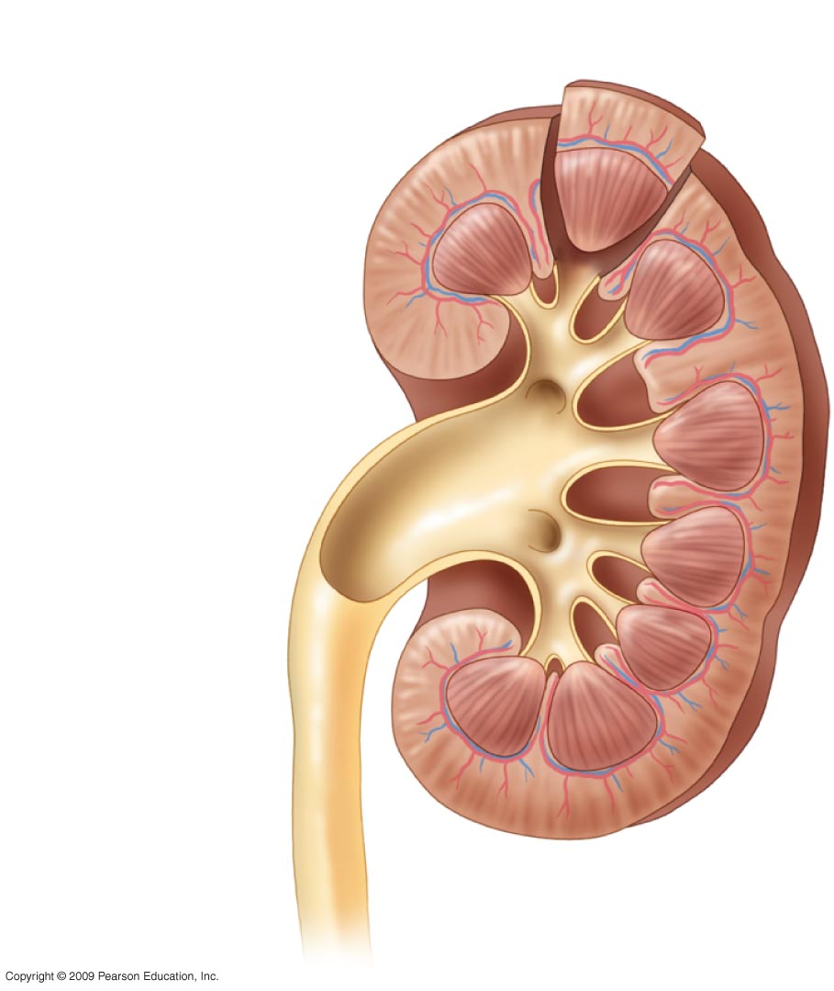
Renal cortex
قشرة الكلية
Renal medulla
نخاع الكلية
Renal pelvis
حوض الكلية
Ureter
الحالب
تشريح الجهاز الاخراجي في الانسان (قطاع طولي في الكلية)
Anatomy of the human excretory system (L.Sec. Kidney)
15

Slide 16
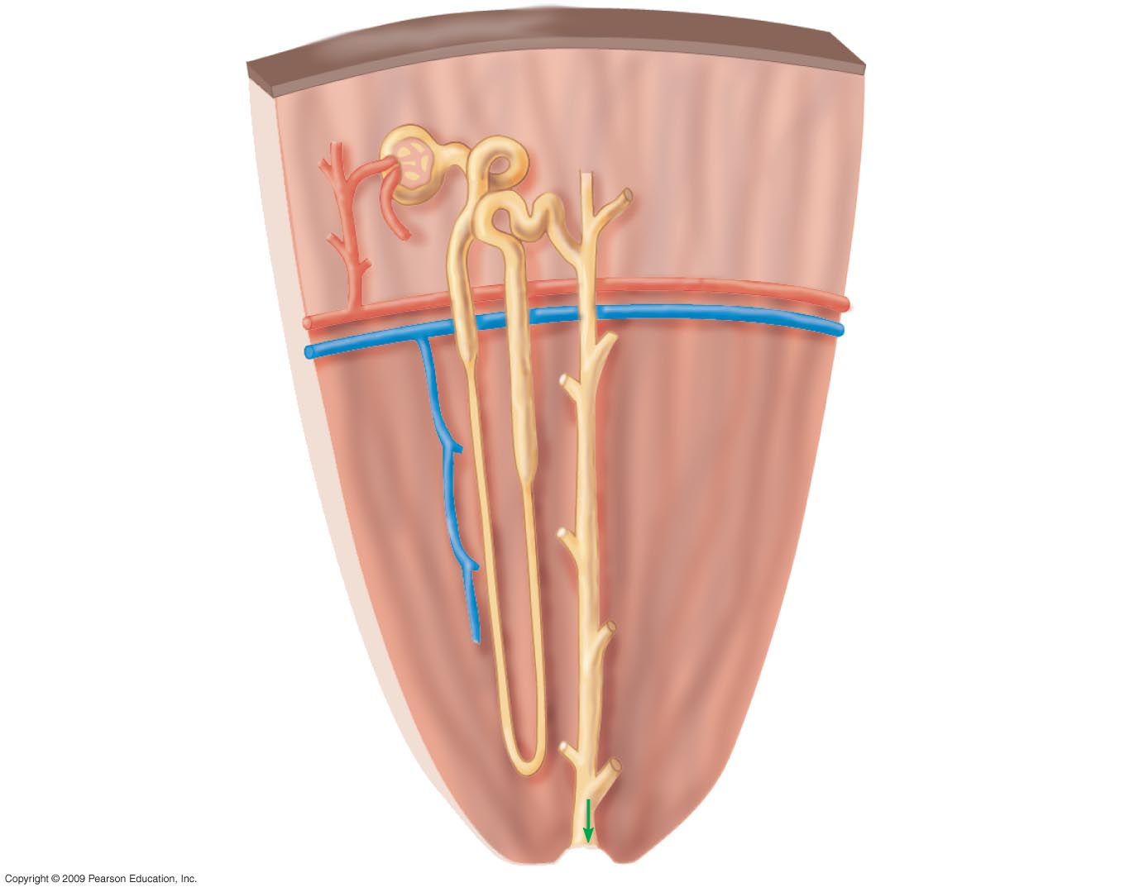
Bowman’s
Capsule
محفظة بومان
Tubule
انيبيبة
Renal cortex
قشرة الكلية
Renal artery
الشريان الكلوي
Renal vein
الوريد الكلوي
Collecting
Duct
انبوبة جامعة
Renal medulla
نخاع الكلية
To
renal
Pelvis
الي حوض الكلية
Anatomy of the human excretory system(C. Sec. Kidney)
تشريح الجهاز الاخراجي في الانسان(قطاع عرضي في الكلية)
16
Notes:
Figure 25.6 Anatomy of the human excretory system. قطاع عرضي في الكلية) ) تشريح الجهاز الاخراجي في الانسان

Slide 17
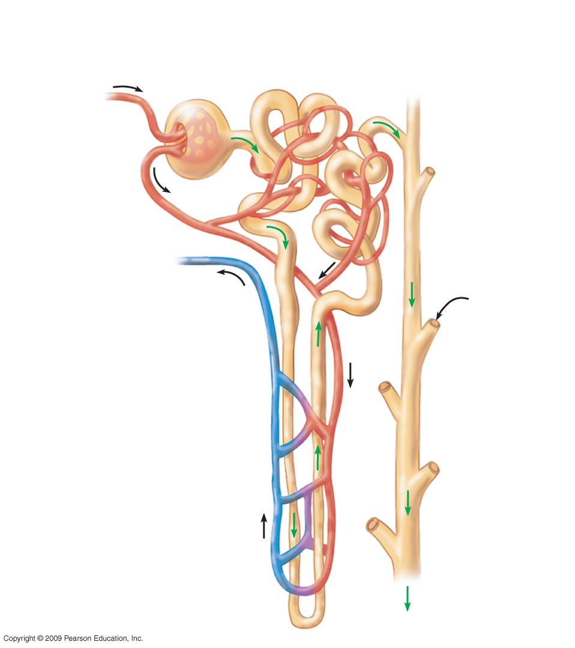
Bowman’s
Capsule
محفظة بومان
Proximal tubule
انيبيبة قريبة
Glomerulus
الكبة
1
Arteriole
from renal
Artery
شرين
متفرع عن الشريان الكلوي
Capillaries
شعيرات دموية
Arteriole
from
Glomerulus
شرين خارج من الكبة
3
Distal Tubule
انيبيبة بعيدة
From
another
Nephron
من وحدة بولية اخرى
Branch of
renal vein
فرع من الوريد الكلوي
Collecting
Duct
انبوبة جامعة
2
Loop of Henle
with capillary
Network
انشوطة التواء هنلي يكسوها
شبكة من الشعيرات الدموية
2
Anatomy of the human excretory system (Diagram of a Nephron)
17
Notes:
ا

Slide 18
عمليات الاخراج Excretory Processes
The key processes of the urinary system are filtration, reabsorption, secretion and excretion
العمليات الرئيسية للجهاز البولي للترشيح,اعادة الامتصاص,
الافراز و الاخراج
Filtration الترشيح
Blood pressure forces water and many small solutes into the nephron
Reabsorption اعادة الامتصاص
Valuable solutes are reclaimed from the filtrate
Secretion الافراز
Excess toxins and other solutes from the body fluids are added to the filtrate
4) Excretion
The final product, urine, is excreted
يدفع ضغط الدم الماء و العديد من المواد المذابة الصغيرة الى قنوات الوحدة البولية
يتم استعادة المواد الذائبة النافعة الى الدم من الراشح
تضاف السموم الزائدة وغيرها من المذاب من سوائل الجسم إلى الراشح
الاخراج
يتم اخراج المنتج النهائي وهو البول
18
Notes:
1. The kidney’s role in filtration and selective reabsorption may initially be confusing to many students. The process is a bit like cleaning up a closet by removing all the contents and then selectively returning to it what you wish to store.
Teaching Tips
1. Students must understand that blood consists of two main components, cells and plasma. If your course has not covered Chapter 23, consider assigning Module 23.12 to ensure that they have this important background knowledge.
2. During the production of urine, blood cells remain within blood vessels, and components of the plasma are filtered out and selectively reabsorbed. Students may appreciate your making this important distinction early on in the discussion of renal functions.
3. Some drugs are excreted in urine. This is the basis of drug testing using samples of a person’s urine. Making this simple connection can help generate interest and improve comprehension in your students.

Slide 19
Major Excretory Processes of the urinary system
العمليات الطرد الرئيسية من الجهاز البولي
انيبيبة الوحدة البولية
الترشيح
اعادة الامتصاص
الافراز
الاخراج
Filtration
Reabsorption
Secretion
Excretion
Nephron tubule
H₂O, other small
Urine
molecules
البول
الماء. وجزيئات صغيرة اخرى
Interstitial fluid
السائل البين نسيجي
Capillary
شعيرة دموية
19

Slide 20
Blood filtrate is refined to urine through reabsorption and secretion
يتم تنقية راشح الدم لتكوين البول من خلال اعادة الامتصاص والافراز
Reabsorption in the proximal and distal tubules removes Nutrients, Salt, Water
pH is regulated by
Reabsorption of HCO₃– اعادة امتصاص ايون البيكربونات
Secretion of H + افراز ايون الهيدروجين
High NaCl concentration in the medulla promotes reabsorption of water.
Antidiuretic hormone (ADH) regulates the amount of water excreted by the kidneys
استيعاب في الأنابيب القريبة والبعيدة يزيل العناصر الغذائية والملح والماء
يتم تنظيم الاس الهيدروجيني من خلال
ارتفاع تركيز كلوريد الصوديوم في النخاع يعزز امتصاص الماء
الهرمون المضاد للتبول- ينظم كمية الماء التي يتم التخلص منها عن طريق الكليتين
20
Notes:
Teaching Tips
1. Some drugs are excreted in urine. This is the basis of drug testing using samples of a person’s urine. Making this simple connection can help generate interest and improve comprehension in your students.
2. Students may be particularly interested in the diuretic effects of alcohol and caffeine. The text notes that the diuretic effects of alcohol may contribute to some of the symptoms of a hangover. However, the concentration of alcohol and caffeine are important factors. Higher urine output resulting from the high consumption of low-alcohol (1–5%) beer may largely be the consequence of increased water consumption. Drinks with higher alcohol levels, such as shots of hard liquor (gin, vodka, whiskey) or higher caffeine levels (espresso) and low fluid volume would be expected to better reveal the diuretic effects.

Slide 21
Dispose of nitrogenous wastes in animals
Nitrogenous wastes are toxic breakdown products of protein and nucleic acids (DNA and RNA)
تعتبر المخلفات النتروجينية نواتج سامة لتحليل البروتين والاحماض النووية
Animals dispose of nitrogenous wastes such as
تتخلص الحيوانات من المخلفات النتروجينية مثل
1) Ammonia (NH₃) امونيا (غاز النشادر)
Poisonous سامة
Soluble in waterالذوبان في الماء
Easily disposed of by aquatic animals تتخلص منها الحيوانات المائية
2) Urea البولينا
Less toxicاقل سمية
Easier to storeسهلة التخزين
Some land animals save water by excreting uric acid (dry waste) بعض حيوانات اليابسة تحتفظ بالماء عن طريق اخراج الحامض البولي وهو في الحقيقة مخلف جاف
يتطلب انتاج البولينا والحامض البولي بذل طاقة 3) Urea and uric acid take energy to produce
21
Notes:
Student Misconceptions and Concerns
1. The kidney’s role in filtration and selective reabsorption may initially be confusing to many students. The process is a bit like cleaning up a closet by removing all the contents and then selectively returning to it what you wish to store.
Teaching Tips
1. Student experience with osmoregulation not pertaining to their own bodies may be quite limited. However, many students are familiar with the pasty white color of bird droppings. Consider beginning your discussion of nitrogenous wastes by asking your class to explain why bird droppings are white.

Slide 22
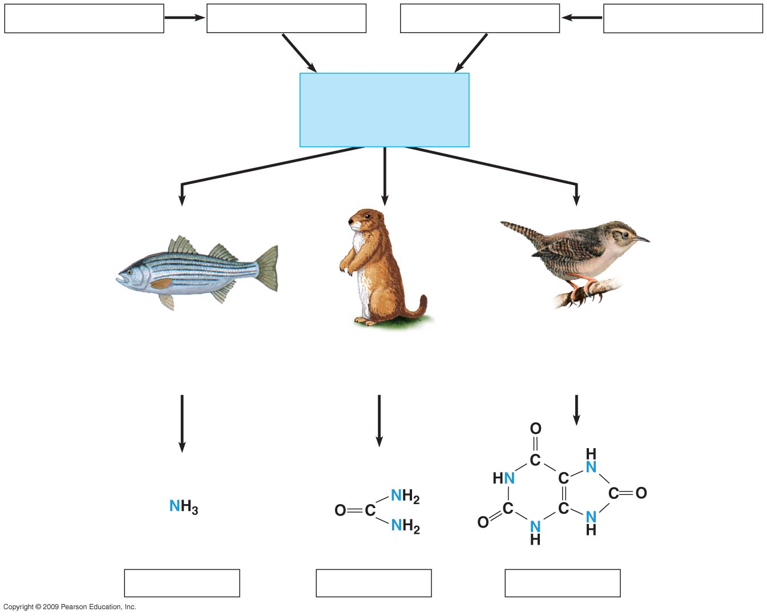
Proteins
Amino acids
Nitrogenous bases
Nucleic acids
البروتينات
احماض امينية
قواعد نتر وجينية
احماض نووية
Nitrogen-containing metabolic waste
Products
المخلفات الايضية المحتوية على النتروجين
—NH₂
Amino groups
مجموعة الامين
Most aquatic animals,
including most fishes
Mammals, amphibians,
sharks, some bony
fishes
Birds and many other
reptiles, insects, land
snails
معظم الحيوانات المائية
بما فيها معظم الاسماك
الطيور و العديد من
الزواحف الاخرى ,الحشرات
وحلزونات اليابسة
ثديات , البرمائيات , القروش
وبعض الاسماك العظمية
Ammonia
Urea
Uric acid
لبولينا
الحامض البولي
22
الامونيا
Notes:
Figure 25.5 Nitrogen-containing metabolic waste products.

Slide 23
Kidney dialysis can be a lifesaver
Compensating for kidney failure التعويض عن الفشل الكلوي
A dialysis machine جهاز غسل الكلى
Removes wastes from the blood ازاحة المخلفات من الدم
Maintains its solute concentration
المحافظة على تركيز المواد المذابة في الدم
23
Notes:
Student Misconceptions and Concerns
1. The kidney’s role in filtration and selective reabsorption may initially be confusing to many students. The process is a bit like cleaning up a closet by removing all the contents and then selectively returning to it what you wish to store.
Teaching Tips
1. It is well established that the loss of one kidney in a human results in enlargement of the remaining kidney, a process known as compensatory hypertrophy. As your time permits, this can provide material for a class discussion or for a special-topic assignment for students with a particular interest.
2. The unfortunate shortage of kidneys and other organs available for transplant is a major health issue. Consider discussing this problem with your class. Many state and federal organ donation organizations can by located by a quick Internet search. The National Kidney Foundation site www.kidney.org/atoz/atozTopic.cfm?topic=11, includes information on kidney donation.

Slide 24
خط من الشريان
الى الجهاز
Line from artery
to apparatus
نابيب مصنوعة من
اغشية لها خاصية
Pump
Tubing made of a
selectively permeable
membrane
مضخة
Dialyzing
solution
خط من
الجهاز
الى الوريد
Line from
apparatus
to vein
محلول الغسل المستعمل
به البولينا و فائض الايونات
محلول
الغسل
Fresh dialyzing
solution
Used dialyzing
solution
(with urea and
excess ions)
Kidney dialysis.
عملية غسل الكلى
محلول الغسل الطازج
24

Slide 25
Excretion in Plants الإخراج في النباتات
25
Notes:
25

Slide 26
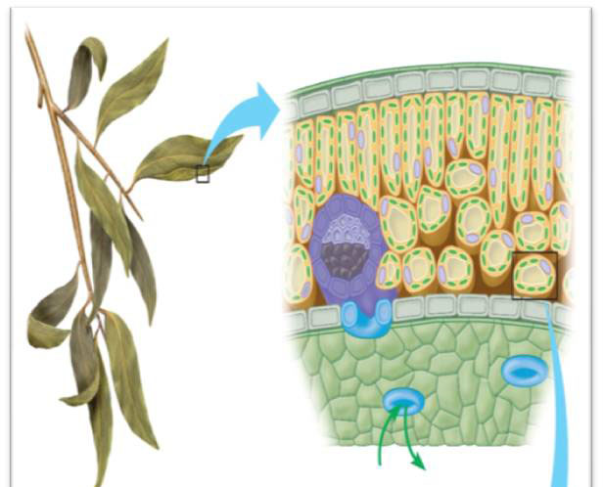
Excretion in Plants الإخراج في النبات
Excretion of Gases اخراج الغازات Excess of CO₂ or O₂ in the leaves exit through stomata to the air. فائض من CO_{2 او} O₂ للخروج من الأوراق من خلال الثغور الى الهواء
Or they are brought by phloem and xylem from anywhere in the plant body to where there are stomata to exit to the air
تجلب من قبل اللحاء وزيلم من أي مكان في الجسم النباتي الى الثغور للخروج للهواء
They can also penetrate external cell surfaces directly to the air
يمكن ان تخترق اسطح الخلايا الخارجية مباشرة الى الهواء
CO₂
O₂
26

Slide 27
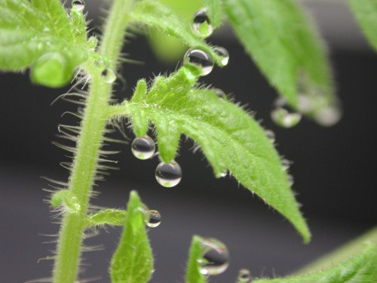
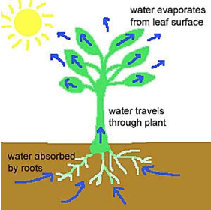
Excretion in Plants
Excretion of water اخراج الماء
Guttation تعرق النبات
Secretion of water and its solutes by hydathodes found in the leafs epidermis of some plants in hummed environment.
افراز الماء ومذيباته من قبل الثغور المائية وجدت في برعم الادمة من بعض النبات في بيئة خفية
Transpiration النتج عرق الورقه
Water evaporates from the surface of leaves through stomata
يتبخر الماء من سطح الورقة من خلال الورم
Water droplets
27

Slide 28
Excretion in Plants
Excretion of Nitrogenous Compounds اخراج المركبات النيتروجينية
Terrestrial plants convert excess amino acids into uric acid and Keto acids by deamination and deposited as crystals in the leafs
تحول النباتات الاحماض الأمينية الزائدة الى حمض اليوريك واحماض كيتو عن طريق إزالة الألغام وترسب كبلورات في الأوراق
In Aquatic plants the excess of amino acids are converted to ammonia and keto acids; ammonia exit outside the plant through stomata
في النباتات المائية يتم تحويل الفائض من الاحماض الامينيه الى الامونيا واحماض كيتو
28

Slide 29
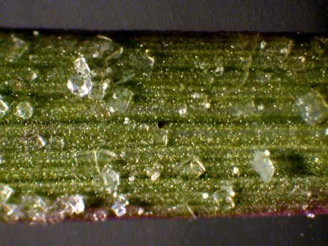
Excretion in Plants
Excretion by Salt glands اخراج بواسطة غدد الملح
Excretion of excess salts outside plant body by special salt glands as in halophytes (plants grow in waters of high salinity).اخراج الاملاح الزائدة خارج الجسم النباتي من قبل الغدد الملحية الخاصة كما هو الحال في النباتات الملحية (النباتات تنمو في المياه ذات الملوحة العالية
Salt crystals بلورات الملح
29

Slide 30
Control of Body Temperature and Water Balance
التحكم في درجة حرارة الجسم و الاتزان المائي
المصطلـــــــــــــــــــــــــــــــــح | تعريف المصطلــــــــــح
Homeostasis | الاتزان الحيوي
Maintenance Of Steady Internal Conditions | القدرة على الحفاظ على ظروف وأحوال داخلية مستقرة
Fluctuations | التقلبات
Thermoregulation | التنظيم الحراري
Osmoregulation | التنظيم الاسموزي
Excretion | لاخراج
Nitrogen-Containing Wastes | المخلفات المحتوية على النتروجين
Thermoregulation | التنظيم الحراري
Internal Temperature Within A Tolerable Range | المحافظة على درجة حرارة الجسم الداخلية ضمن مدى يمكن تحمله
Ectothermic | خارجية الحرارة
Endothermic | داخلية الحرارة
Conduction | التوصيل
Convection | الحمل الحراري
Radiation | الاشعاع
Evaporation | التبخير

Slide 31
Control of Body Temperature and Water Balance
التحكم في درجة حرارة الجسم و الاتزان المائي
المصطلـــــــــــــــــــــــــــــــــح | تعريف المصطلــــــــــح
Mechanisms Of Heat Exchange | اليات تبادل الحرارة
Adaptations Promote Thermoregulation | التكيفات التي تشجع على التنظيم الحراري
Increased Metabolic Heat Production | زيادة انتاج الحرارة الايضية
Insulation | العزل
Circulatory Adaptations | التكيفات الخاصة بالدورة الدموية
Evaporative Cooling | التبريد بالتبخر
Sweating | التعرق
Panting | للهث
Behavioral Responses | الاستجابات السلوكية
Osmoregulation and Excretion | التنظيم الاسموزي والإخراج
Osmoconformers | الكائنات ذات التوافق الاسموزي
Same Internal Solute Concentration As Seawater | نفس تركيز المواد الذائبة الداخلية كمياه البحر
Marine Invertebrates Are Osmoconformers | اللافقاريات البحرية كائنات ذات توافق اسموزي

Slide 32
Control of Body Temperature and Water Balance
التحكم في درجة حرارة الجسم و الاتزان المائي
المصطلـــــــــــــــــــــــــــــــــح | تعريف المصطلــــــــــح
Osmoregulators Control Their Solute Concentrations | الكائنات ذات التنظيم الاسموزي لها القدرة على التحكم في تراكيز موادها المذابة
Saltwater Fish | اسماك المياه المالحة
Land Animals | حيوانات اليابسة
Nitrogenous Wastes | المخلفات النتروجينية
1-Ammonia (Nh3) | (امونيا (غاز النشادر
Urea | البولينا
Excretory System | الجهاز الاخراجي
Expels Wastes | يطرد المخلفات
Regulates Water Balance | ينظم الاتزان المائي
Regulates Ion Balance | ينظم الاتزان الايوني
Nephrons | (النفرونات) الوحدات البولية
Functional Units Of The Kidneys | الوحدات الوظيفية للكلى
Extract A Filtrate From The Blood | استخلاص المواد الراشحة من الدم
Refine The Filtrate To Produce Urine | تنقية المواد الراشحة لإنتاج البول
Urine | البول

Slide 33
Control of Body Temperature and Water Balance
التحكم في درجة حرارة الجسم و الاتزان المائي
المصطلـــــــــــــــــــــــــــــــــح | تعريف المصطلــــــــــح
Ureters Drain The Kidneys | يفرغ الحالبان الكليتين
Stored In The Urinary Bladder | يخزن في المثانة البولية
Expelled Through The Urethra | يطرح من خلال المجرى البولي
Filtration | الترشيح
Blood Pressure Forces Water And Many Small Solutes Into The Nephron | يدفع ضغط الدم الماء و العديد من المواد المذابة الصغيرة الى الوحدة البولية
Reabsorption | اعادة الامتصاص
Valuable Solutes Are Reclaimed From The Filtrate | يتم استعادة المواد الذائبة النافعة من الراشح
Secretion | الافراز
Excess H⁺ And Toxins Are Added To The Filtrate | يضاف الفائض من ايون الهيدروجين و السموم الى الراشح
Excretion | الاخراج
Final Product, Urine, Is Excreted | اخراج المنتج النهائي وهو البول
Reabsorption In The Proximal And Distal Tubules Removes Nutrients, Salt, Water | يزيح اعادة الامتصاص في الانيببات القريبة والبعيدة المواد المغذية والملح والماء
pH is regulated by | يتم تنظيم الاس الهيدروجيني

Slide 34
Control of Body Temperature and Water Balance
التحكم في درجة حرارة الجسم و الاتزان المائي
المصطلـــــــــــــــــــــــــــــــــح | تعريف المصطلــــــــــح
High Nacl Concentration | تركيز كلوريد الصوديوم العالي
Antidiuretic Hormone (ADH) | الهرمون المضاد للتبول
Regulates The Amount Of Water Excreted By The Kidneys | ينظم كمية الماء التي يتم التخلص منها عن طريق الكليتين
Compensating For Kidney Failure | التعويض عن الفشل الكلوي
A Dialysis Machine | جهاز غسل الكلى
Removes Wastes From The Blood | ازاحة المخلفات من الدم
Solute Concentration | تركيز المواد المذابة
Excretion In Plants | الإخراج فى النبات
Excretion Of Gases | إخراج الغازات
Exit | لخروجه
Penetrate External Cell Surfaces | النفاذ مباشرة عبر سطوح الخلايا الخارجية
Guttation | الإدماع

Slide 35
Control of Body Temperature and Water Balance
التحكم في درجة حرارة الجسم و الاتزان المائي
المصطلـــــــــــــــــــــــــــــــــح | تعريف المصطلــــــــــح
Secretion | إفراز
Hydathodes | الثغور المائية
Humid Environment. | البيئة الرطبة
Terrestrial Plants | النباتات الأرضية
Deamination | بعملية نزع الأمين
Aquatic Plants | النباتات المائية
Converted | تحويل
Salt Glands | بالغدد الملحية
Halophytes | غدد ملحية

