Slide 1
Unit 4 food
Lesson 1

Slide 3
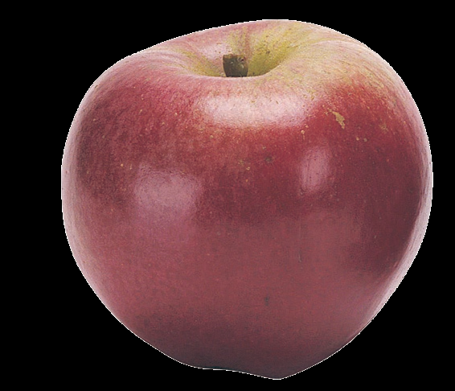
apple

Slide 4
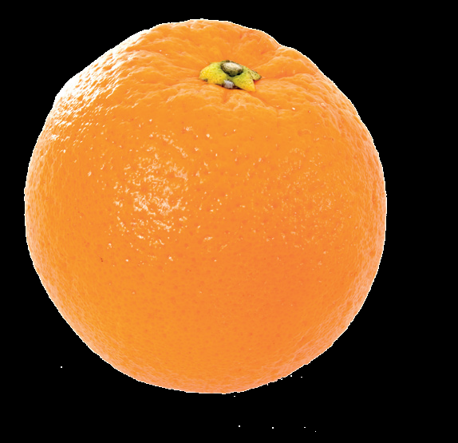
orange

Slide 5
egg

Slide 6
juice

Slide 7
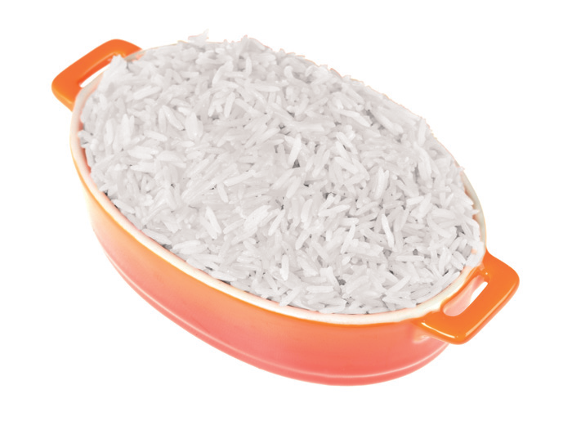
rice

Slide 8
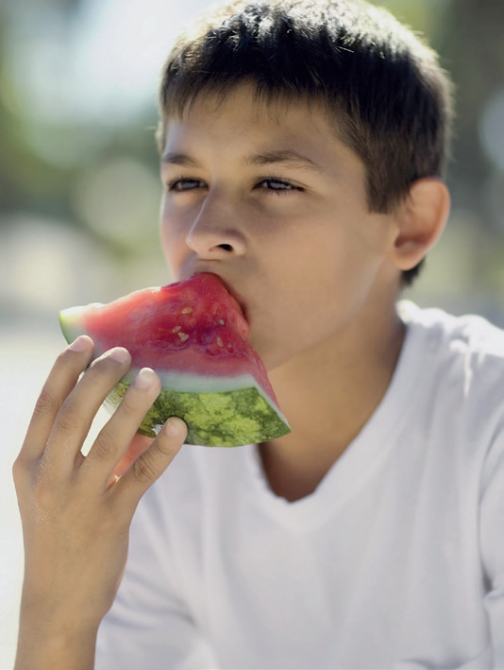
eat

Slide 9
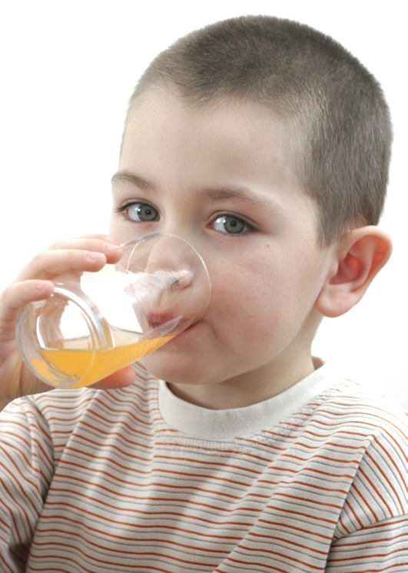
drink

Slide 10
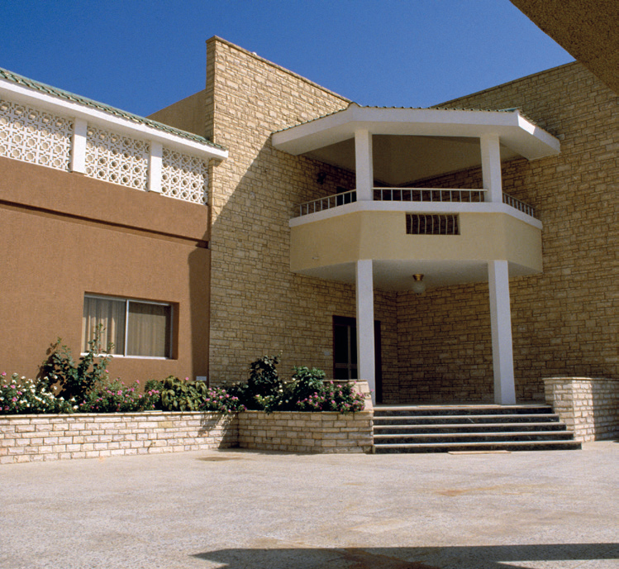
V v
villa

Slide 11
W w
window

Slide 12
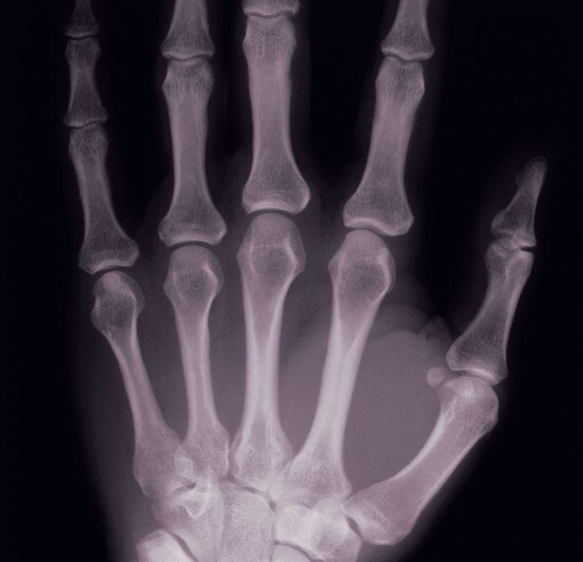
X x
x-ray

Slide 13
Write the new words & letters on the B.B apple – orange – egg – juice – rice – eat – drink V v – W w – X x

Slide 16
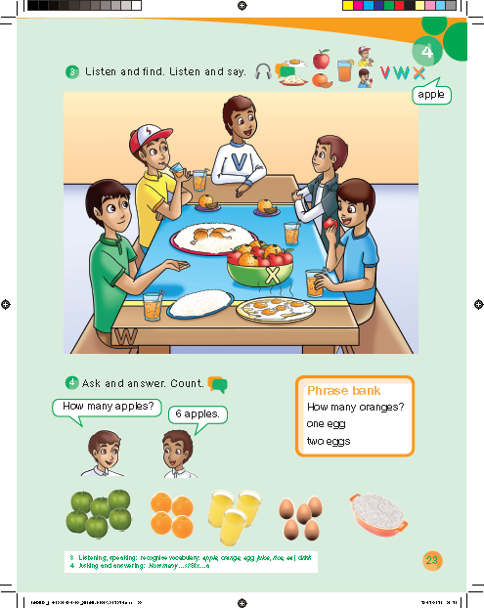

Slide 17
Explain ( how many )

Slide 19
Work book p. 70

Slide 20
i
a
o
j
e

Slide 21
orange
egg
apple
juice

Slide 24
v
w
x

