Slide 1
Chapter(1)
The Nature of Probability and Statistics
Lecturer : FATEN AL-HUSSAIN
Lecture (1)

Slide 2
Introduction
Statistics: is the science of conducting studies to
collect,
organize,
summarize,
analyze, and
draw conclusions from data.
Note: This PowerPoint is only a summary and your main source should be the book.

Slide 3
1-1 Descriptive and Inferential Statistics
A variables a characteristic or attribute that can assume different values.
Variables whose values are determined by chance are called Random Variables.
The values that a variable can assume are called Data.
A collection of data values forms A data set.
Each value in the data set is called A data value or a datum.
Note: This PowerPoint is only a summary and your main source should be the book.

Slide 4
For example: A data set in table
Variables
id gender age
1 male 20
2 male 25
3 female 30
4 male 23
5 female 30
Nationality
Saudi
Yemeni
Egypt
Jordanian
Lebanese
Data Set
Data
Data value
Note: This PowerPoint is only a summary and your main source should be the book.

Slide 5
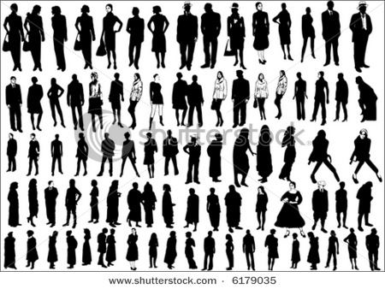
Sample
Population
Note: This PowerPoint is only a summary and your main source should be the book.

Slide 6
A population consists of all subjects (human or otherwise) that are studied.
A sample is a subset of the population( is a group selected from a population).
For example :
In order to study the response times for emergency 988 calls in Jeddah 50 calls are selected randomly over a six month period and the response times are recorded .
Population : all calls 988.
Sample : 50 calls .
Note: This PowerPoint is only a summary and your main source should be the book.

Slide 7
Branches of Statistics
Descriptive statistic
Inferential
statistic
consists of
the collection,
organization,
summarization,
and presentation of data.
consists of generalizing from samples to populations, performing estimations and hypothesis tests, determining relationships among variables, and making predictions.
For example :
-the average age of the student is 14 years.
-the median household income for people aged 25-34 is 35.888$.
For example:
the relationship between smoking and lung cancer.
probability .
Note: This PowerPoint is only a summary and your main source should be the book.

Slide 8
Variables and Types of Data
,Measurement Scales
Lecturer : FATEN AL-HUSSAIN
Lecture (2)

Slide 9
Variables and Types of Data
Variables
Qualitative
Categorical
Non numerical
Quantitative
Numerical
Discrete
Countable
5, 29, 8000, etc.
Continuous
Can be decimals
2.59, 312.1, etc.
Note: This PowerPoint is only a summary and your main source should be the book.

Slide 10
Types of Variables
Qualitative Variables:
Quantitative variables
are variables that can be placed
into distinct categories ,
according to some
characteristic or attribute.
For example: Gender ,Marital status ,Color……etc
are numerical and can be ordered or ranked.
For example: Age ,Height , Weight ,temperature …..etc
Note: This PowerPoint is only a summary and your main source should be the book.

Slide 11
Quantitative variables classified into two groups
Discrete Variables
Continuous Variables
assume values that can be counted .
For example:
Number of children in a family ,
Number of student in classroom,
Number of DVDs rented
each day ……etc
assume an infinite number of values between any two specific values.
For example:
Temperature ,
Height
Weight
Time …..etc
Note: This PowerPoint is only a summary and your main source should be the book.

Slide 12
Measurement Scales
Qualitative
Quantitative
Nominal
Ordinal
Interval
Ratio
Note: This PowerPoint is only a summary and your main source should be the book.

Slide 13
Measurement Scale of Qualitative
Nominal level
Ordinal level:
classifies data into mutually exclusive , exhausting categories in which no order or ranking can be imposed on the data.
For example:
Eye color ,Gender ,
Political party , blood types …etc
classifies data into categories can be ranked .
For example:
Grade of course (A,B,C) ,
Size( S,M,L)
Rating scale (Poor ,Good ,Excellent )
Ranking of tennis players …etc
Note: This PowerPoint is only a summary and your main source should be the book.

Slide 14
Measurement Scale of Quantitative
Interval
level
Ratio
level
possesses all the characteristics of interval
and there exist a true zero.
For example:
Height , Weight, Time,
Salary , Age …etc
ranks data and precise differences between units of measure do exist ,however there is no meaningful zero.
For example:
Temperature ,
IQ test…etc
0
+
0
-
+
Note: This PowerPoint is only a summary and your main source should be the book.

Slide 15
Data Collecting
and
Sampling Techniques
Lecturer : FATEN AL-HUSSAIN
Lecture (3)

Slide 16
Data collection
Survey
Observational
and
Experimental
Telephone surveys
Mailed questionnaire surveys
Personal interview
Note: This PowerPoint is only a summary and your main source should be the book.

Slide 17
To obtain samples that are unbiased ,statisticians use four methods of sampling:
Some Sampling Techniques
Random sampling
Stratified sampling
Systematic sampling
Cluster sampling
Note: This PowerPoint is only a summary and your main source should be the book.

Slide 18
Summer Term
1- Random sampling
are selected by using chance methods or random numbers
For example:
Note: This PowerPoint is only a summary and your main source should be the book.

Slide 19
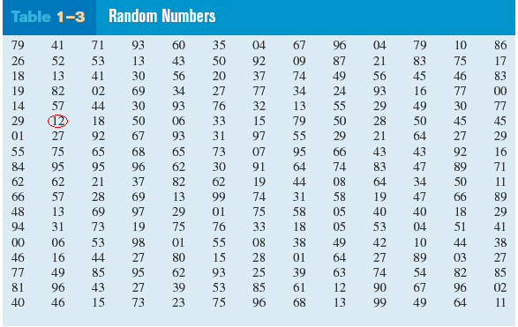
Summer Term
Q: Select random sample of 15 subjects out of 85 subjects:
A: 12, 27, 75, 62, 57, 13, 31, 06, 16, 49, 46, 71, 53, 41, 02
Note: This PowerPoint is only a summary and your main source should be the book.

Slide 20
Summer Term
2- Systematic sampling
are obtained by numbering each value in the population and then selecting the k^{th} value.
For example:
Note: This PowerPoint is only a summary and your main source should be the book.

Slide 21
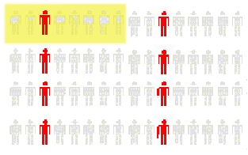
Decide on Sample Size: n
• Divide Frame of N individuals into Groups of k Individuals: k=N/n
• Randomly Select One Individual from the 1st Group
• Select Every k^{th} Individual Thereafter
Summer Term
First Group
N = 64
n = 8
k =64/8= 8
Note: This PowerPoint is only a summary and your main source should be the book.

Slide 22
Summer Term
3- Stratified sampling
are selected by dividing the population into groups (strata) according to some characteristic and then taking samples from each group.
For example:
Note: This PowerPoint is only a summary and your main source should be the book.

Slide 23
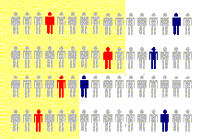
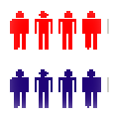
Summer Term
A researcher select a random sample from each gender to check their blood pressure
Female
male
Note: This PowerPoint is only a summary and your main source should be the book.

Slide 24
Summer Term
4- Cluster sampling
are selected by dividing the population into groups and then taking samples of the groups .
For example:
Note: This PowerPoint is only a summary and your main source should be the book.

Slide 25
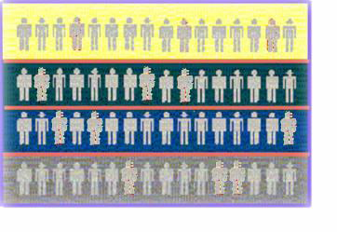
Summer Term
Randomly selected 2 clusters
Randomly selected 4 clusters
Note: This PowerPoint is only a summary and your main source should be the book.

Slide 26
Summary of sampling techniques
Summer Term
1) Random : random number generator.
2) Systematic :every k^{th} subject.
3) Stratified :divide population into group called “strata”.
4) Cluster :use intact groups.
Note: This PowerPoint is only a summary and your main source should be the book.

Slide 27
Types of Studies
,Uses and Misuses of statistics
Lecturer : FATEN AL-HUSSAIN
Lecture (4)

Slide 28
Types of Studies
Observational Study
Experimental
Study
The researcher merely observes what is happening or what has happened in the past and tries to draw conclusions based on these observations.
The researcher manipulates one of the variables and tries to determine how the manipulation influences other variables.
For examples:
Patients were randomly assigned to two groups was given drug A and the other group was given drug B to determine if the drug has an effect on patient’s blood pressure.
An Instructor has Three Teaching method ,he want to apply a best method by seeing students grades.
For example:
people who sleep 8 hours report better health.
A researcher counts the number of
people living in each house in specific a street .
Note: This PowerPoint is only a summary and your main source should be the book.

Slide 29
In a true experimental study, the subjects should be assigned to groups randomly. If this is not possible
and a researcher uses intact groups, then he is performing a quasi-experimental study.
group that received the special instruction is called The Treatment Group (specific treatment )while the other is called The Control Group (does not )
Note: This PowerPoint is only a summary and your main source should be the book.

Slide 30
Any Experiment has 2 Variables
Independent Variable
or
Explanatory Variable
Dependent Variable
or
Outcome Variable
(or input) variable is the one that is being manipulated by the researcher.
is the resultant variable
Note: This PowerPoint is only a summary and your main source should be the book.

Slide 31
For example
Independent | temperature of water | exercise
Dependent | time to cook an egg | health
Note :Statistical studies usually include one or more independent variables and one dependent variable.
For example:
exercise , diet ( independent )
Health (dependent)
Influence
Note: This PowerPoint is only a summary and your main source should be the book.

Slide 32
A confounding variable: is the variable that influences the dependent or outcome variable but cannot be separated from the independent variable.( variable that influence
with other variable)
For example:
confounding variable
age
cigarette
Influence
cigarette
health
health
Note: This PowerPoint is only a summary and your main source should be the book.

Slide 33
For Example :subjects on exercise program may improve their diet and perhaps that improve their health in other ways not due to exercise alone. Then diet becomes confounding variable.
confounding variable
exercise
diet
Influence
health
exercise
health
Note: This PowerPoint is only a summary and your main source should be the book.

Slide 34
Types of group
Treatment Group
Control Group
The group that received the special instruction .
The group that dose not received
the special instruction.
Note: This PowerPoint is only a summary and your main source should be the book.

Slide 35
Uses and Misuses of statistics
Suspect sample
Implied
connection
Ambiguous Averages
Misleading
Graphs
Faulty Survey Question
changing Subject
Detached Statistic
Note: This PowerPoint is only a summary and your main source should be the book.

Slide 36
Uses and Misuses of statistics
1- Suspect sample:
small samples ,convenience sample, volunteer sample
For example: if 4 doctors were surveyed from 100 doctors.
2- Ambiguous Averages: measures that are loosely called averages are the mean, median, mode and midrange. People who know this can without lying , select one of them to support their position.
Note: This PowerPoint is only a summary and your main source should be the book.

Slide 37
3- changing Subject : can occur when different values are used to represent the same data.
For example: if one political candidate say “ I will increase salaries a mere 3%”
And another one say “I will increase salaries a whopping 6,000,000 $”
And 3% =6,000,000
Note: This PowerPoint is only a summary and your main source should be the book.

Slide 38
4- Detached Statistic: it is the one in which no comparison is made.(Compared to what?)
For example, one may say that “Our cookies has one-third fewer calories” Here, fewer than what?
5- Implied connection : Usage of words such as may, suggest or some that imply connections but there is no guarantee
For example:
Eating fish may help to reduce your cholesterol.
Note: This PowerPoint is only a summary and your main source should be the book.

Slide 39
6-Misleading Graphs: if graphs are drawn inappropriately, they can misrepresent the data and lead to false conclusions.
7- Faulty Survey Question : should be sure that the questions are properly written since the way questions are phrased can influence the way people answer them .
Note: This PowerPoint is only a summary and your main source should be the book.

Slide 40
Chapter Definitions
1- Statistics 2- A variables 3-Random Variables. 4-Data. 5-A data set 6-A data value or a datum. 7-A population 8-A sample 9-Descriptive 10- Inferential | 11-Qualitative Variables: 12-Quantitative variables 13- Discrete Variables 14-Continuous Variables 15-Nominal level 16- Ordinal level 17-Interval level 18-Ratio level 19-Observational Study 20- Experimental Study
21-Independent Variable 22- Dependent Variable 23- A quasi-experimental study | 24- A confounding variable 25-Treatment Group 26- Control Group
Note: This PowerPoint is only a summary and your main source should be the book.

