Slide 1
General Statistics
Stat 110

Slide 2
Course Information:
Course name and number: General Statistics. STAT 110
Course website address:
http://stat. kau.edu.sa/Pages-stat-110-female-section.aspx

Slide 3

Textbook:
Elementary Statistics a Step by Step Approach, 9th Edition
by Allan Bluman, McGraw/Hill, 2009.

Slide 4
:COURSE SYLLABUS
Chapter 1: The Nature of Probability and Statistics
Chapter 2: Frequency Distributions and Graphs
Chapter 3: Data Description
Chapter 4: Probability and Counting Rules
Chapter 5: Discrete Probability Distributions
Chapter 6: The Normal Distribution
Chapter 10: Correlation and Regression + Chapter 13

Slide 5
CHAPTER 1
The Nature of Probability and Statistics

Slide 6
Statistics
is the science of conducting studies to collect , organize, summarize , analyze and drawing conclusions from data.

Slide 7
Introduction
A Variable: is characteristic or attribute that can assume different values.
Data: are the values (measurements or observations) that the variables can assume.
Random Variable: variables whose determined by chance.
Data set : Collection of data values .
Datum Or a data value Each value in the data set

Slide 8
A population: consists of all subjects (human or otherwise) that are being studied.
A sample : is a subset of the population (is a group of subjects selected from a population)
For example :
In order to study the response times for emergency 988 calls in Jeddah 50 calls are selected randomly over a six month period and the response times are recorded .
Population : all calls 988.
Sample : 50 calls .

Slide 9
(Variable , Data Set, Data value , Data)
B
gender age
male 20
male 25
female 30
male 23
female 30
Nationality
Saudi
Yemeni
Egypt
Jordanian
Lebanese
A
c
D

Slide 10
Branches of Statistics
Descriptive statistic
Inferential
statistic
consists of
the collection,
organization,
summarization,
and presentation of data.
consists of generalizing from samples to populations, performing estimations and hypothesis tests, determining relationships among variables, and making predictions.
For example :
-the average age of the student is 14 years.
-the median household income for people aged 25-34 is 35.888$.
For example:
the relationship between smoking and lung cancer.
probability .

Slide 11
Determine whether Descriptive or Inferential statistics were used:
The average jackpot for the top five lottery winners was $367.6 million.
A study done by the American Academy of Neurology suggests that older people who had a high caloric diet more than doubled their risk of memory loss.
In 2011,79% of U.S. adults used the Internet.
In 2011,there were 34 deaths from the avian flu.
Descriptive
Inferential
Inferential
Descriptive

Slide 12
Example:
A researcher asked 80 students at KAU about their weight. As a result of this information, the average weight of students at KAU was 59kg. Which branch of statistics was used in this survey?
Observational Experimental
Inferential Descriptive

Slide 13
Example:
"There is a relationship between IQ tests and the final score student" Which branch of statistics is
Observational Experimental
Inferential Descriptive

Slide 14
1-2:Variables and Types of Data
variables
Qualitative
Quantitative
Discrete
Continuous

Slide 15
Types of Variables
(Classify)
Qualitative Variables:
Quantitative variables
are variables that have distinct categories ,
according to some
characteristic or attribute.
For example:
Gender , Color……etc
are numerical and can be
ordered or ranked.
are variables that can be counted or measured.
For example: Age ,Height , Weight ,temperature …..etc

Slide 16
Quantitative variables classified into two groups
Discrete Variables
Continuous Variables
assume values that can be counted .
For example:
Number of children in a family ,
Number of student in classroom,
Number of DVDs rented
each day ……etc
assume an infinite number of values between any two
specific values . They are obtained measuring , they often Include fractions and decimals
For example:
Temperature , Height
Weight Time …..etc

Slide 17
Measurement Scales
Qualitative
Quantitative
Nominal
Ordinal
Interval
Ratio

Slide 18
Measurement Scale of Qualitative
Nominal level
Ordinal level:
classifies data into mutually exclusive , (nonover lapping) categories in which no order or ranking can be imposed on the data.
For example:
Eye color ,Gender ,
Political party, blood types …etc
classifies data into categories can be ranked .
For example:
Grade of course (A,B,C) ,
Size( S,M,L)
Rating scale (Poor ,Good ,Excellent )
Ranking of tennis players …etc

Slide 19
Measurement Scale of Quantitative
Interval
level
Ratio
level
ranks data and precise differences between units of measure do exist ,however there is no meaningful zero.
For example:
Temperature ,
possesses all the characteristics of interval
and there exist a true zero.
For example:
Height , Weight, Time,
Salary , Age …etc

Slide 20
Example:
1- Blood Type ,an example of which type of data?
Qualitative Ordinal
Continuous Discrete
2- Area of ​​the Kingdom of Saudi Arabia, is an example of which type of data?
Discrete Qualitative
Nominal Continuous

Slide 21
Example:
Number of stores represents a
Quantitative variable Discrete variable
Continuous variable Interval variable
Classify " Temperature in Jeddah":
Interval Qualitative
Continuous Discrete

Slide 22
Example:
If you classified the fruit in a basket as apple, orange and banana , this would be an example of which level of measurement?
Ordinal Ratio
Nominal Interval

Slide 23
Example
Which of the following represents ordinal level of measurement?
Rating scale IQ score
Age Marital status
Which one of the following variables is Qualitative?
Amount of fat in a piece of cheese
Salary of college professors
Favorite TV program
Age of a person

Slide 24
1-3
Data collection and sampling techniques

Slide 25
Data collection
Survey
Studies
Telephone surveys
Mailed questionnaire surveys
Personal interview

Slide 26
Some Sampling techniques
Random Sampling
Stratified Sampling
Systematic Sampling
Cluster Sampling

Slide 27
1-Random Sampling :
A random sample is a sample in which all members of the population have an equal chance of being selected.
Are selected by using chance methods or random numbers.

Slide 28
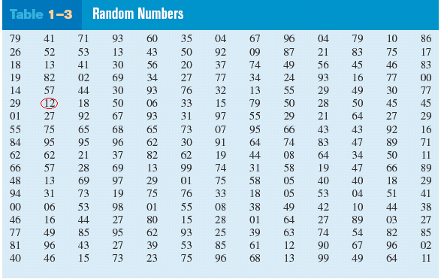
For example: Select random sample of 15 subjects out of 85 subjects, each subject numbered from 1 to 85

Slide 29
2-Systematic Sampling
Are obtained by numbering each value in the population and then selecting the kth value.
is a sample obtained by selecting every kth member of the population where K is counting number.
K=N/n
n is the sample size, and N is the population size.

Slide 30
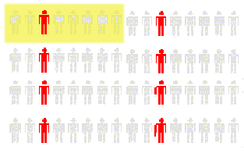
Decide on Sample Size: n
• Divide Frame of N individuals into Groups of k Individuals: k=N/n
• Randomly Select One Individual from the 1st Group
• Select Every k^{th} Individual Thereafter
First Group
N = 64
n = 8
k =64/8= 8

Slide 31
3-Stratified samples
is a sample obtained by dividing the population into subgroups or (strata ) according to some characteristic relevant to the study. Then subjects are selected from each subgroup.
For example: A researcher select a random sample from each gender to check their blood pressure.

Slide 32
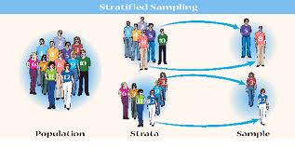

Slide 33
4-Cluster samples
is obtained by dividing the population into sections or clusters and then selecting one or more clusters and using all members in the cluster(s) as the members of the sample
For example : In a large school district ,all teachers from two building are interviewed to determine whether they believe the students have less homework to do now than in previous years.

Slide 34
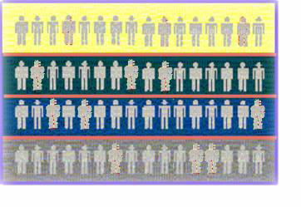
Population divided into 4 clusters Randomly
Randomly selected 2 clusters

Slide 35
Summary of sampling techniques
Random : random number generator.
Systematic :every kth subject.
Stratified :divide population into group called “strata”.
Cluster :use intact groups.
Convenient : a researcher uses subjects that are convenient.
Exp.: (a researcher in the mall…..).

Slide 36
* Exercises:
1- A researcher wanted to do a study about doctor’s income in Jeddah. He divided hospitals into two sectors (private and public) then he took a sample from each sector.

Slide 37
* Exercises:
2- A researcher wanted to know doctors opinion about herbal therapy in Jeddah. For this study he choose randomly 3 hospitals out of 20 hospitals in Jeddah, and all doctors in the 3 hospital were asked.

Slide 38
1- What type of sampling if employees is divided into Education classes and a sample is chosen from each class to be surveyed?
2- Researcher select 10 devices from different labs to be tested , What type of sampling in that example ?
3- Every seventh customer entering a shopping mall is asked to select her or his favorite store. What type of sampling methods has been used in that example ?

Slide 39
1-4
Observational and Experimental Studies

Slide 40
Types of studies
Observational Studies
Experimental Studies

Slide 41
1-4: Observational and Experimental Studies
1- Observational Study: The researcher merely observes what is happening or what has happened in the past and tries to draw conclusions based on these observations.
For example:” if a researcher records how many students are wearing the Abaya in the Science building over a period of time “.

Slide 42
1-4: Observational and Experimental Studies
2- Experimental Studies: the researcher manipulates one of the variables and tries to determine how the manipulation influences other variables.
For example: patients were randomly assigned into 2 groups. The first one was given drug A and other was given drug B to determine if the drug has an effect patient’s blood pressure .

Slide 43
quasi-experimental study.
In a true experimental study, the subjects should be assigned to groups randomly. If this is not possible and a researcher uses intact groups, then he is performing a quasi-experimental study.

Slide 44
1-4: Observational and Experimental Studies
In the sit up study , there are two group:
1- Treatment group: was a group that received the special instruction .
2- Control group: didn't receive the special instruction .

Slide 45
Example:
Subject were randomly assigned to two groups, and one group was given drug A and the other group drug B .After 6 months, the mean of blood pressure for each group wear compared.
This is an example of what type of study?
  Outcomes study
  Independent study
  Observational study
  Experimental study

Slide 46
Example:
1- "If researcher observes and counts the number of cars in parking ". What type of study was this?
Independent study
Experimental study
Observational study
Quasi-experimental study

Slide 47
Any Experiment has 2 Variables
Independent Variable
or
Explanatory Variable
Dependent Variable
or
Outcome Variable
(or input) variable is the one that is being manipulated by the researcher.
is the resultant variable

Slide 48
1-4: Observational and Experimental Studies
Statistical studies usually include one or more independent variables and one dependent variable.

Slide 49
For example
Independent | temperature of water | exercise
Dependent | time to cook an egg | health

Slide 50
A confounding variable is the variable that influences the dependent or outcome variable but was not be separated from the independent variable.
( variable that influence with other variable)
For Example :
subjects on exercise program may improve their diet unbeknownst to the researcher and perhaps that improve their health in other ways not due to exercise alone. Then diet becomes a confounding variable.

Slide 51
Example:
Subject were randomly assigned to two groups, and one group was given drug A and the other group drug B .After 6 months, the mean of blood pressure for each group wear compared.
1-What is the dependent variable in the study?
2-What is the independent variable in the study?
6 month
Number of groups
Type of drug
Blood pressure

Slide 52
1-5: Uses and Misuses of statistics
1- Suspect sample:
2- Ambiguous Averages
3- changing Subject
4-Detached Statistic
5-Implied connection
6-Misleading Graphs
Faulty Survey Question

Slide 53
1- Suspect sample:
-small samples
-convenience sample
- volunteer sample
For example:” if 4 doctors were surveyed from 100 doctors”.
2- Ambiguous Averages: measures that are loosely called averages are the mean, median, mode and midrange. People who know this can without lying , select one of them to support their position .

Slide 54
3- changing Subject : can occur when different values are used to represent the same data.
For example: if one political candidate say “ I will increase salaries a mere 3%”
And another one say “I will increase salaries a whapping 6,000,000 $” And 3% =6,000,000
4-Detached Statistic: it is the one in which no comparison is made.
For example, one may say that “Our cookies has one-third fewer calories” Here, fewer than what?

Slide 55
5-Implied connection : Usage of words such as may, suggest or some that imply connections but there is no guarantee
For example:
” Eating fish may help to reduce your cholesterol”.
“studies suggest that using our machine will reduce your weight”
“ Taking calcium will lower blood pressure in some people”

Slide 56
6-Misleading Graphs: if graphs are drawn inappropriately, they can misrepresent the data and lead to false conclusions.
7- Faulty Survey Question : should be sure that the questions are properly written since the way questions are phrased can influence the way people answer them .
For example:
What is your opinion about WHO Organization

