Slide 1
Grade 3 Family and Friends 3 Page 63
Fluency time!

Slide 2
The Objectives
1- Practice reading for comprehension.
2- Practice asking using (Are you free on….?).
____________________________________________________________________________________________________________________________________________
Ministry of Education-2020

Slide 3
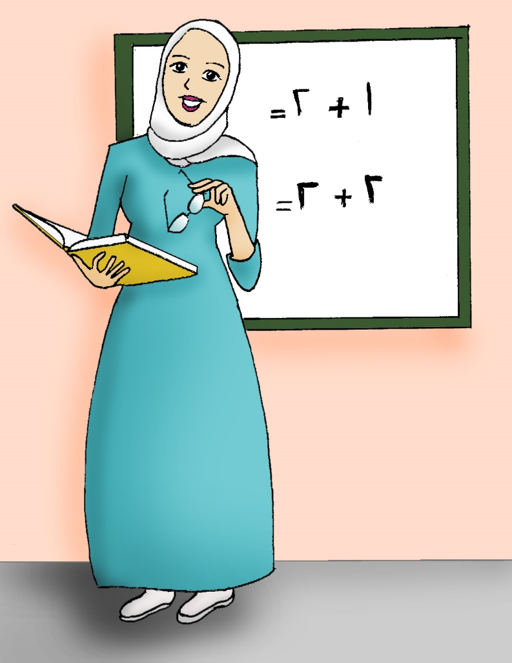
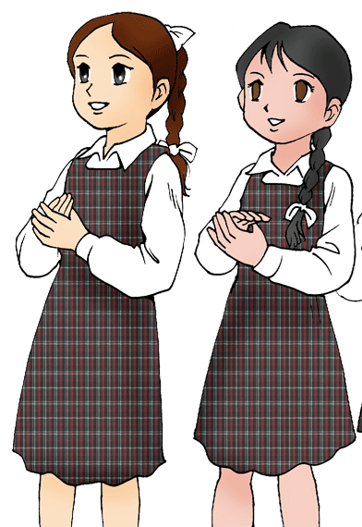
Read and act.
1
Jane: Are you free, today afternoon?
Sara: Sorry I’m not free today.
Jane: How about Sunday?
Sara: Yes, that’s fine.
Jane: We can play with my kitchen set.
____________________________________________________________________________________________________________________________________________
Ministry of Education-2020

Slide 4
Read and act.
2
Sara: Great. I'll ask my mum. Oops!
Mrs. Melanie: Oh! … Thank you Sara.
Sara: Sorry Mrs. Melanie.
____________________________________________________________________________________________________________________________________________
Ministry of Education-2020

Slide 5
Now let’s practice
Look at the picture. Read and choose.
Are you free on Tuesday?
Sorry. I’m not free on Tuesday.
Swimming
A
Yes, that’s fine.
B
click and check your answer
A
____________________________________________________________________________________________________________________________________________
Ministry of Education-2020

Slide 6
Now let’s practice
Look at the picture. Read and choose.
How about on Monday?
A
Sorry. I’m not free on Monday.
Swimming
Yes, that’s fine.
B
click and check your answer
B
____________________________________________________________________________________________________________________________________________
Ministry of Education-2020

Slide 7
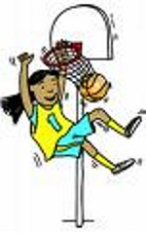
Now let’s practice
Look at the picture. Read and choose.
Are you free on Wednesday?
Sorry. I’m not free on Wednesday.
Playing
basketball
A
Yes, that’s fine.
B
click and check your answer
A
____________________________________________________________________________________________________________________________________________
Ministry of Education-2020

Slide 8
Now let’s practice
Look at the picture. Read and choose.
How about on Thursday?
Sorry. I’m not free on Thursday.
Playing
basketball
A
Yes, that’s fine.
B
click and check your answer
B
____________________________________________________________________________________________________________________________________________
Ministry of Education-2020

Slide 9
Now let’s practice
Look at the picture. Read and choose.
Are you free on Friday?
Sorry. I’m not free on Friday.
Visiting my grandma
A
Yes, that’s fine.
B
click and check your answer
A
____________________________________________________________________________________________________________________________________________
Ministry of Education-2020

Slide 10
Now let’s practice
Look at the picture. Read and choose.
How about on Saturday?
Sorry. I’m not free on Saturday.
Visiting my grandma
A
Yes, that’s fine.
B
click and check your answer
B
____________________________________________________________________________________________________________________________________________
Ministry of Education-2020

Slide 11
We write the days of the week with a capital letter !
Monday
monday
Friday
friday
____________________________________________________________________________________________________________________________________________
Ministry of Education-2020

Slide 12
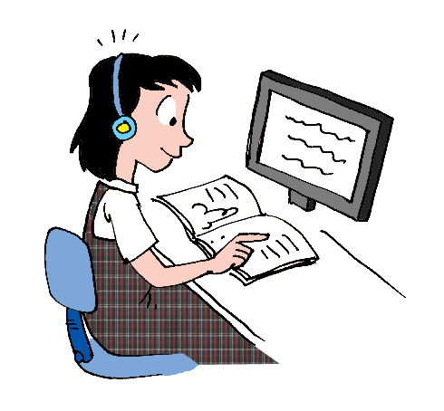
1. Open your Classbook
Page: 62 ex.3
2. Work with a partner.
3. Ask and answer using:
are you free on ….?
Sorry, I’m not free on ….
Yes, that’s fine.
____________________________________________________________________________________________________________________________________________
Ministry of Education-2020

Slide 13
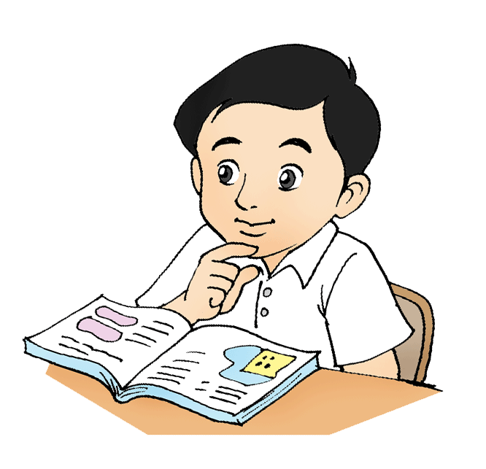
Now let’s practice
Answer the exercises in your workbook. P 62
____________________________________________________________________________________________________________________________________________
Ministry of Education-2020

Slide 14
End of the lesson
Good job dear !
____________________________________________________________________________________________________________________________________________
Ministry of Education-2020

