Slide 1
Principles of Microeconomics
Twelfth Edition, Global Edition
Chapter 9
Long-Run Costs and Output Decisions

Slide 2
Chapter Outline and Learning Objectives (1 of 2)
9.1 Short-Run Conditions and Long-Run Directions
Discuss how short-run conditions affect a firm’s short-run and long-run behavior.
9.2 Long-Run Costs: Economies and Diseconomies of Scale
Explain the causes and effects of diseconomies of scale.
9.3 Long-Run Adjustments to Short-Run Conditions
Describe long-run adjustments for short-run profits and losses.

Slide 3
Chapter Outline and Learning Objectives (2 of 2)
Output Markets: A Final Word
Appendix: External Economies and Diseconomies and the Long-Run Industry Supply Curve
Understand how external economies and diseconomies impact the slope of long-run industry supply curves.

Slide 4
Chapter 9 Long-Run Costs and Output Decisions
Output decisions in the long run are less constrained than in the short run:
Firms can choose their scale of plant and change any or all of its inputs.
Firms are free to enter and leave the industry.
Managers simultaneously make short-run and long-run decisions, making the best of the current constraints while planning for the future.

Slide 5
Short-Run Conditions and Long-Run Directions
We begin our discussion of the long run by looking at firms in three short-run circumstances:
Firms that earn economic profits
Firms that suffer economic losses but continue to operate to reduce or minimize those losses
Firms that decide to shut down and bear losses just equal to fixed costs
breaking even The situation in which a firm is earning exactly a normal rate of return.

Slide 6
Maximizing Profits (1 of 2)
Example: The Blue Velvet Car Wash
TABLE 9.1 Blue Velvet Car Wash Weekly Costs
 | TFC Total Fixed Cost |  | TVC Total Variable Cost (800 Washes) |  | TC Total Cost (800 Washes) | TR Total Revenue (P = $5)
 |  |  |  |  | TC = TFC + TVC
1. | Normal return to investors | $1,000 | Labor Soap | $1,000 600 | =$2,000 + $1,600 =$3,600 | TR = $5 × 800 = $4,000
2. | Other fixed costs (maintenance contract) | $1,000 |  | $1,600 |  | Profit = TR − TC = $400
 |  | $2,000

Slide 7
Maximizing Profits (2 of 2)
Graphic Presentation
A profit-maximizing perfectly competitive firm will produce up to the point where P* = MC.
Profit is the difference between total revenue and total cost.
Because average total cost is derived by dividing total cost by q, we can get back to total cost by multiplying average total cost by q.

Slide 8
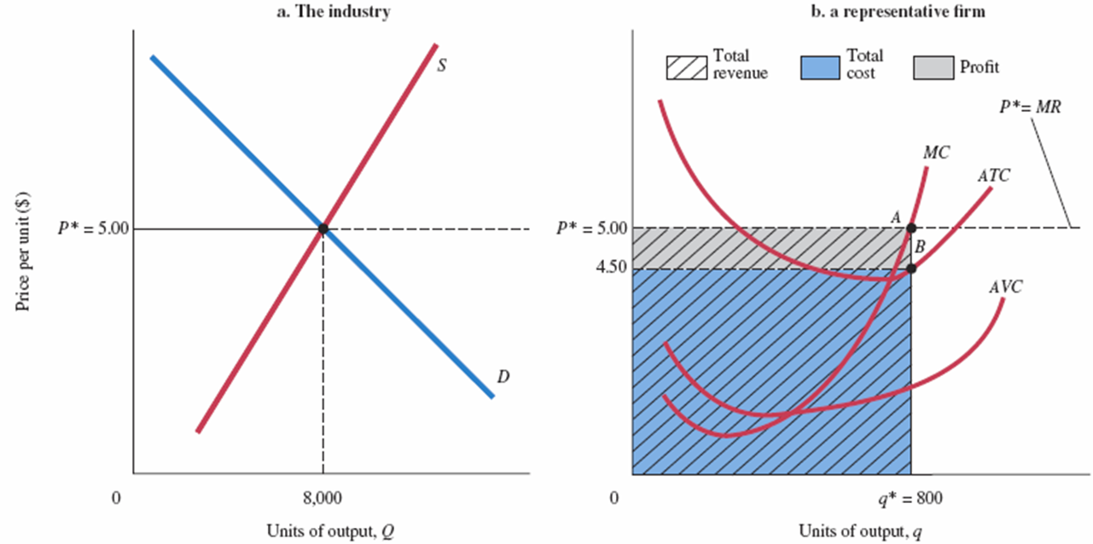
FIGURE 9.1 Firm Earning a Positive Profit in the Short Run
At q* = 800, total revenue is $5 × 800 = $4,000, total cost is $4.50 × 800 = $3,600, and profit is $4,000 − $3,600 = $400.

Slide 9
Minimizing Losses (1 of 2)
If total revenue exceeds total variable cost, the excess revenue can be used to offset fixed costs and reduce losses, and it will pay the firm to keep operating.
If total revenue is smaller than total variable cost, the firm that operates will suffer losses in excess of fixed costs. In this case, the firm can minimize its losses by shutting down.

Slide 10
Minimizing Losses (2 of 2)
Producing at a Loss to Offset Fixed Costs
shutdown point The lowest point on the average variable cost curve. When price falls below the minimum point on AVC, total revenue is insufficient to cover variable costs, and the firm will shut down and bear losses equal to fixed costs.

Slide 11
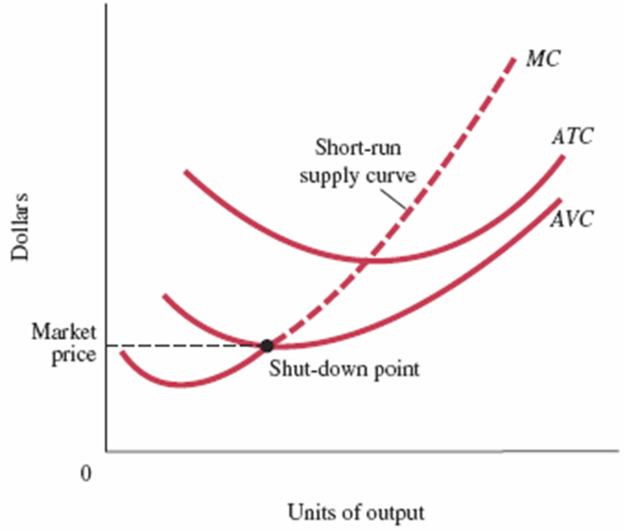
FIGURE 9.2 Short-Run Supply Curve of a Perfectly Competitive Firm
At prices below average variable cost, it pays a firm to shut down rather than continue operating.
Thus, the short-run supply curve of a competitive firm is the part of its marginal cost curve that lies above its average variable cost curve.

Slide 12
The Short-Run Industry Supply Curve
short-run industry supply curve The sum of the marginal cost curves (above AVC) of all the firms in an industry.

Slide 13
FIGURE 9.3 The Industry Supply Curve in the Short Run Is the Horizontal Sum of the Marginal Cost Curves (above AVC) of All the Firms in an Industry
If there are only three firms in the industry, the industry supply curve is simply the sum of all the products supplied by the three firms at each price.
For example, at $6 each firm supplies 150 units, for a total industry supply of 450.

Slide 14
Long-Run Directions: A Review
TABLE 9.2 Profits, Losses, and Perfectly Competitive Firm Decisions in the Long and Short Run
 |  | Short-Run Condition |  |  | Short-Run Decision |  |  | Long-Run Decision
Profits |  | TR > TC |  |  | P = MC: operate |  |  | Expand: new firms enter
Losses |  | 1. TR ≥ TVC |  |  | P = MC: operate |  |  | Contract: firms exit
 |  |  |  |  | (loss < total fixed cost)
 |  | 2. TR < TVC |  |  | Shut down: |  |  | Contract: firms exit
 |  |  |  |  | loss = total fixed cost

Slide 15
Long-Run Costs: Economies and Diseconomies of Scale
long-run average cost curve (LRAC) Shows the way per-unit costs change with output in the long run.
increasing returns to scale or economies of scale An increase in a firm’s scale of production leads to lower costs per unit produced.
constant returns to scale An increase in a firm’s scale of production has no effect on costs per unit produced.
decreasing returns to scale or diseconomies of scale An increase in a firm’s scale of production leads to higher costs per unit produced.

Slide 16
Increasing Returns to Scale
The Sources of Economies of Scale
Some economies of scale result not from technology but from firm-level efficiencies and bargaining power that can come with size.
Economies of scale have come from advantages of larger firm size rather than gains from plant size.
minimum efficient scale (MES) The smallest size at which the long-run average cost curve is at its minimum.

Slide 17
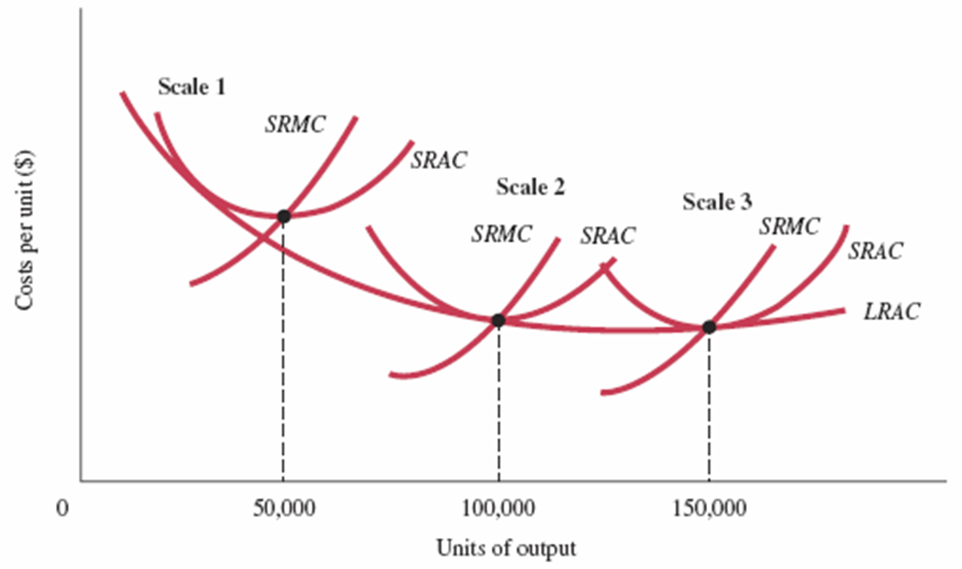
FIGURE 9.4 A Firm Exhibiting Economies of Scale
The long-run average cost curve of a firm shows the different scales on which the firm can choose to operate in the long run. Each scale of operation defines a different short run. Here we see a firm exhibiting economies of scale; moving from scale 1 to scale 3 reduces average cost.

Slide 18
ECONOMICS IN PRACTICE
Economies of Scale in the Search Business
Online search is a scale-driven business: The search behavior of one user can be used to improve the search of future users.
Google—the top search engine—has more than three times the searches of Microsoft’s Bing but employs only about twice as many engineers and spends less per search on its data centers.
THINKING PRACTICALLY
Google was an early pioneer in the search business. How did that early lead interact with the fact of scale economies in Google’s favor?

Slide 19
Constant Returns to Scale
Technically, the term constant returns means that the quantitative relationship between input and output stays constant, or the same, when output is increased.
Constant returns to scale means that the firm’s long-run average cost curve remains flat.

Slide 20
Diseconomies of Scale
When average cost increases with scale of production, a firm faces decreasing returns to scale, or diseconomies of scale.

Slide 21
U-Shaped Long-Run Average Costs
optimal scale of plant The scale of plant that minimizes long-run average cost.

Slide 22
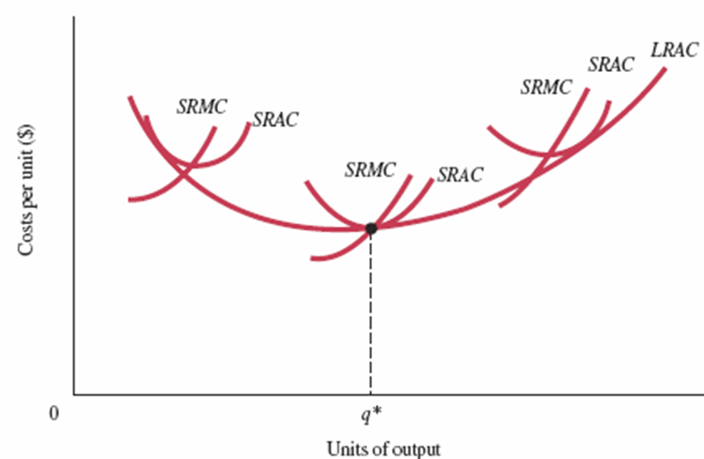
FIGURE 9.5 A Firm Exhibiting Economies and Diseconomies of Scale
Economies of scale push this firm’s average costs down to q*.
Beyond q*, the firm experiences diseconomies of scale; q* is the level of production at lowest long-run average costs, using optimal scale.

Slide 23
ECONOMICS IN PRACTICE The Long-Run Average Cost Curve: Flat or U-Shaped?
A long-run average cost curve was first drawn as the “envelope” of a series of short-run curves in 1931.
Jacob Viner drew the long-run curve through the minimum points of all the short-run average cost curves.
In 1986, Professor Herbert Simon of Carnegie-Mellon University explained that studies show that a firm’s cost curves are not U-shaped but instead slope down to the right and then level off.
THINKING PRACTICALLY
Some have argued that even if long-run AC curves do eventually slope up, we would not likely see many firms operating at this size. Why not?

Slide 24
Long-Run Adjustments to Short-Run Conditions
Short-Run Profits: Moves In and Out of Equilibrium
Suppose demand increases when the industry is in long-run equilibrium. What will happen?

Slide 25
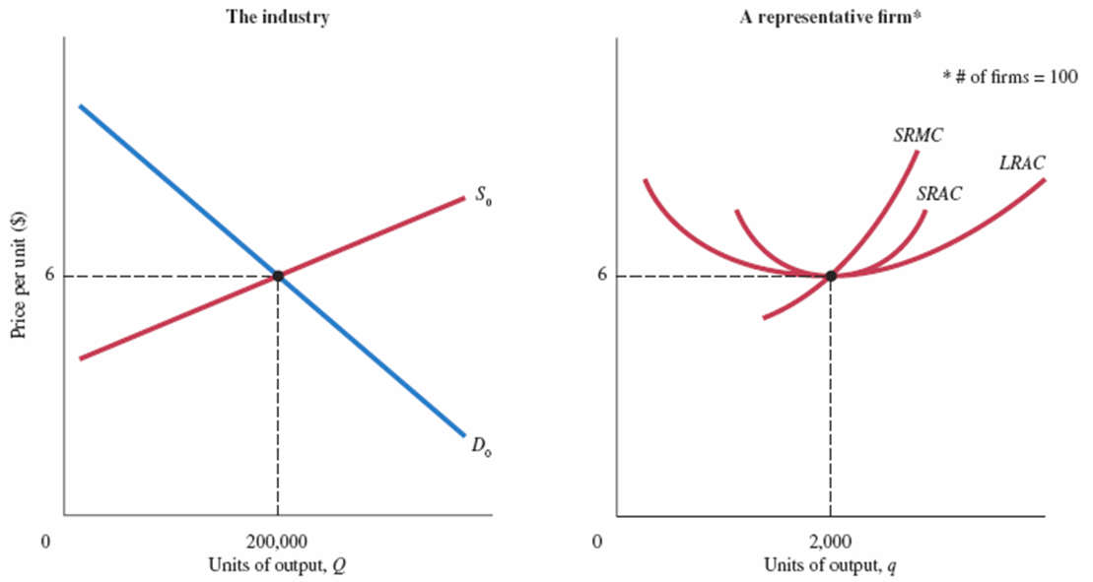
FIGURE 9.6 Equilibrium for an Industry with U-Shaped Cost Curves
The individual firm on the right is producing 2,000 units, and we also know that the industry consists of 100 firms.
All firms are identical, and all are producing at the uniquely best output level of 2,000 units.

Slide 26
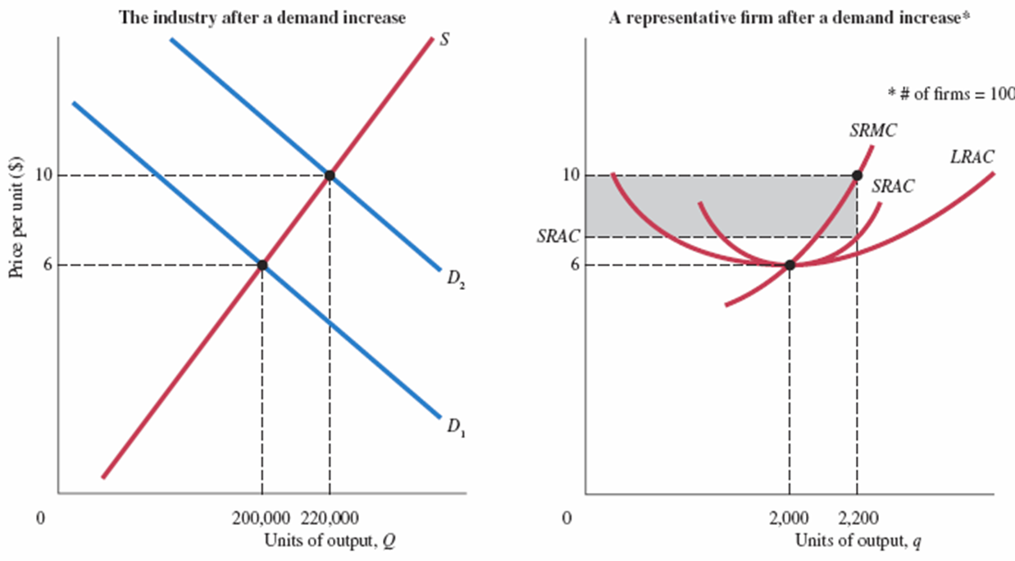
FIGURE 9.7 Industry Response to an Increase in Demand

Slide 27
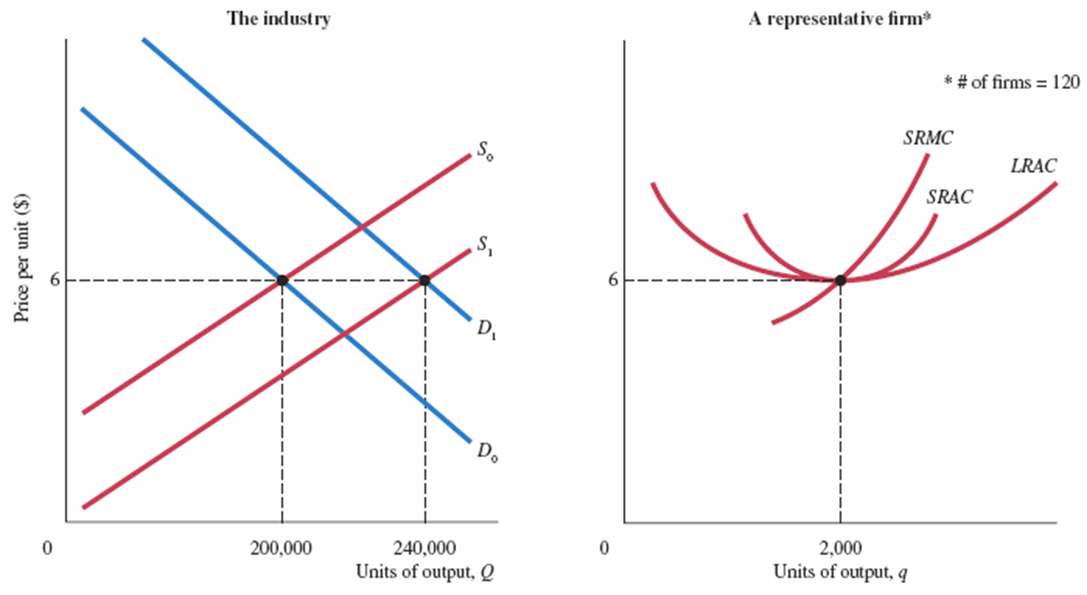
FIGURE 9.8 New Equilibrium with Higher Demand

Slide 28
Short-Run Profits: Moves In and Out of Equilibrium
In equilibrium, each firm has:
Firms make no excess profits so that:
and there are enough firms so that supply equals demand.

Slide 29
The Long-Run Adjustment Mechanism: Investment Flows toward Profit Opportunities (1 of 2)
The entry and exit of firms in response to profit opportunities usually involve the financial capital market.
In capital markets, people are constantly looking for profits. When firms in an industry do well, capital is likely to flow into that industry in a variety of forms.
long-run competitive equilibrium When

Slide 30
The Long-Run Adjustment Mechanism: Investment Flows toward Profit Opportunities (2 of 2)
Investment—in the form of new firms and expanding old firms—will over time tend to favor those industries in which profits are being made.
Also, over time, industries in which firms are suffering losses will gradually contract from disinvestment.

Slide 31
ECONOMICS IN PRACTICE Why is Food so Expensive at the Airport?
A sandwich or a latte at an airport is more expensive.
If airport A earns supernormal profits, free entry would lead to constructing another airport nearby, reducing the demand for everything in airport A, including the demand for food. Airport A would then have to charge a lower rent from food vendors, making food cheaper.
Research has shown that taking the costs and revenues of running an airport into account, that if no supernormal profit is earned by the airport, the food items cost just as much as they should.
THINKING PRACTICALLY
1. With the help of a graph, show how a higher rent increases the price of a café latte.

Slide 32
Output Markets: A Final Word (1 of 2)
In the last four chapters, we have been building a model of a simple market system under the assumption of perfect competition.
Changes in market price and thus profits are the basic signal that leads to a reallocation of society’s resources.
In the short run, producers are constrained by their scales of operation.

Slide 33
Output Markets: A Final Word (2 of 2)
In the long run, however, we would expect to see resources flow in to compete for these profits. What starts as a shift in preferences thus ends up as a shift in resources.
You have now seen what lies behind the demand curves and supply curves in competitive output markets.
The next two chapters complete the picture by taking up competitive input markets.

Slide 34
REVIEW TERMS AND CONCEPTS
breaking even
constant returns to scale
decreasing returns to scale or diseconomies of scale
increasing returns to scale or economies of scale
long-run average cost curve (LRAC)
long-run competitive equilibrium
minimum efficient scale (MES)
optimal scale of plant
short-run industry supply curve
shutdown point
Equation:
long-run competitive equilibrium,

Slide 35
CHAPTER 9 APPENDIX: External Economies and Diseconomies
When industry growth results in a decrease in long-run average costs, there are external economies.
When industry growth results in an increase in long-run average costs, there are external diseconomies.

Slide 36
TABLE 9A.1 Construction of New Housing and Construction Materials Costs, 2000–2005
Year | House Prices % over the Previous Year | Housing Starts (Thousands) | Housing Starts % Change over the Previous Year | Construction Materials Prices % Change over the Previous Year | Consumer Prices % Change over the Previous Year
2000 | — | 1,573 | — | — | —
2001 | 7.5 | 1,661 | 5.6% | 0% | 2.8%
2002 | 7.5 | 1,710 | 2.9% | 1.5% | 1.5%
2003 | 7.9 | 1,853 | 8.4% | 1.6% | 2.3%
2004 | 12.0 | 1,949 | 5.2% | 8.3% | 2.7%
2005 | 13.0 | 2,053 | 5.3% | 5.4% | 2.5%
Source: Based on Economy.com and the Office of Federal Housing Enterprise Oversight (OFHEO).

Slide 37
The Long-Run Industry Supply Curve (1 of 2)
long-run industry supply curve (LRIS) A graph that traces out price and total output over time as an industry expands.
decreasing-cost industry An industry that realizes external economies—that is, average costs decrease as the industry grows. The long-run supply curve for such an industry has a negative slope.

Slide 38
The Long-Run Industry Supply Curve (2 of 2)
increasing-cost industry An industry that encounters external diseconomies—that is, average costs increase as the industry grows. The long-run supply curve for such an industry has a positive slope.
constant-cost industry An industry that shows no economies or diseconomies of scale as the industry grows. Such industries have flat, or horizontal, long-run supply curves.

Slide 39
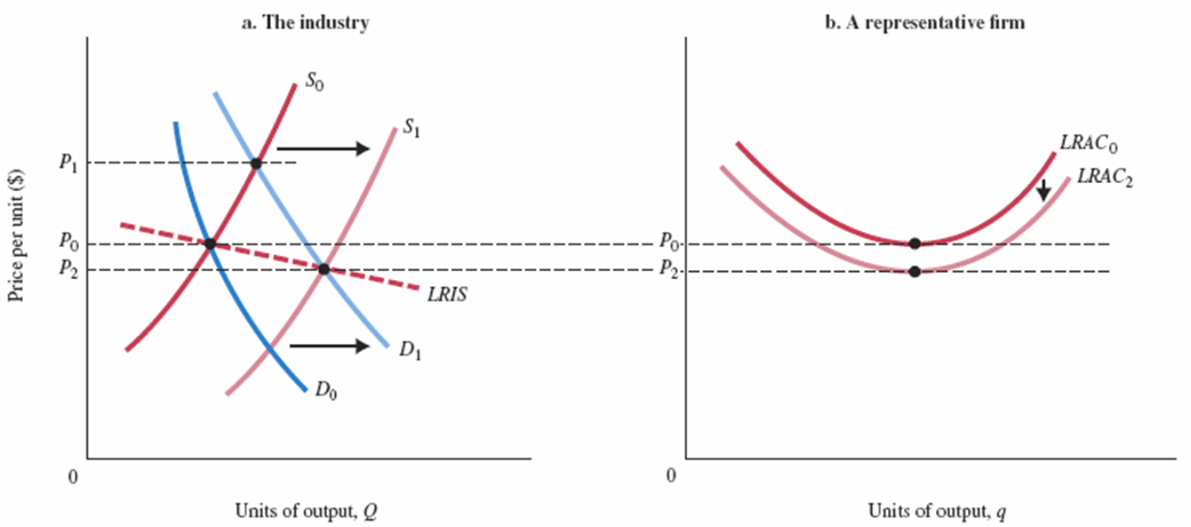
FIGURE 9A.1 A Decreasing-Cost Industry: External Economies
In a decreasing-cost industry, average cost declines as the industry expands.
As demand expands from D₀ to D₁, price rises from P₀ to P₁.
As new firms enter and existing firms expand, supply shifts from S₀ to S₁, driving price down.
If costs decline as a result of the expansion to LRAC₂, the final price will be below P₀ at P₂.
The long-run industry supply curve (LRIS) slopes downward in a decreasing-cost industry.

Slide 40
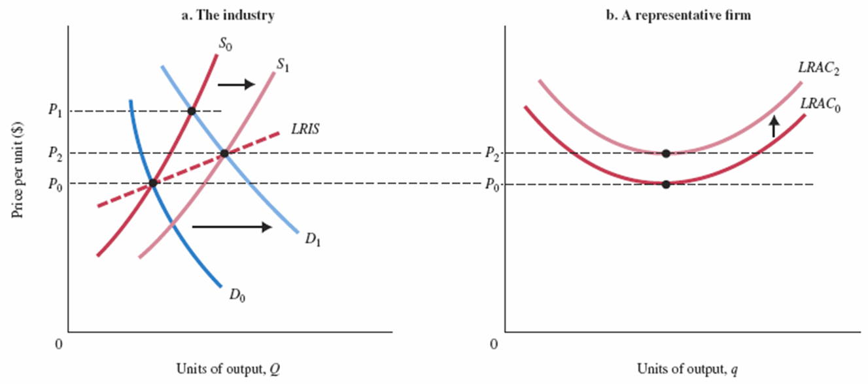
FIGURE 9A.2 An Increasing-Cost Industry: External Diseconomies
In an increasing-cost industry, average cost increases as the industry expands.
As demand shifts from D₀ to D₁, price rises from P₀ to P₁.
As new firms enter and existing firms expand output, supply shifts from S₀ to S₁, driving price down.
If long-run average costs rise, as a result, to LRAC₂, the final price will be P₂.
The long-run industry supply curve (LRIS) slopes up in an increasing-cost industry.

Slide 41
APPENDIX REVIEW TERMS AND CONCEPTS
constant-cost industry
decreasing-cost industry
external economies and diseconomies
increasing-cost industry
long-run industry supply curve (LRIS)

