Slide 1


Slide 2
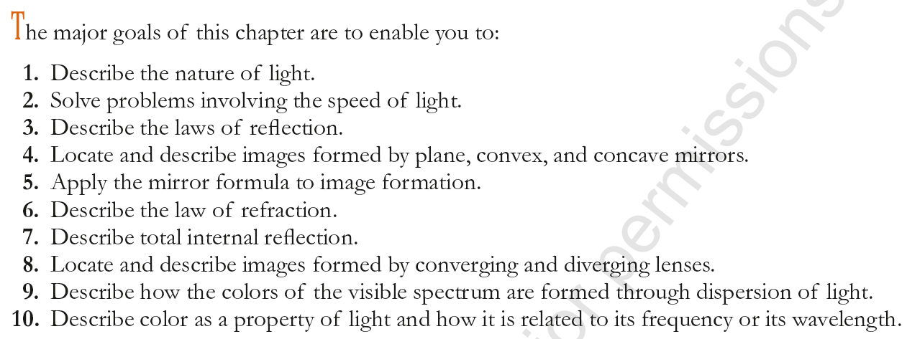

Slide 3

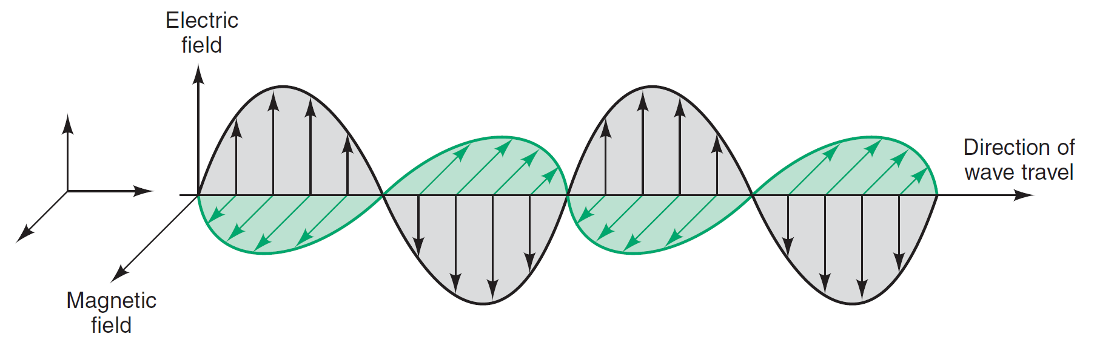
Light may be defined as radiant energy that can be seen by the human eye.
A new theory for the nature of light:
light is an oscillating disturbance of an electric field and a corresponding magnetic field
⇒ Light ≡ Electromagnetic wave.

Slide 4
Electromagnetic wave
are produced by accelerating electric charges
consists of two perpendicular transverse waves ; a vibrating electric field and vibrating magnetic field.
moves in a direction perpendicular to both electric and magnetic field components.
Electromagnetic waves do not need a medium to travel.
Light is a form of electromagnetic radiation.
The electromagnetic spectrum includes more than visible light.

Slide 5
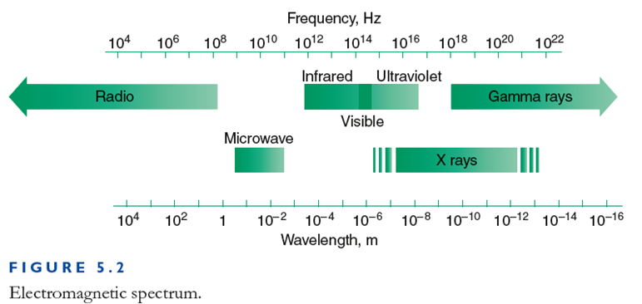
Electromagnetic waves vary depending on frequency and wavelength.
All electromagnetic waves move at the same speed in a vacuum (3.00×10⁸ m/s).
As the frequency increases to the right, the wavelength decreases.
No sharp boundary between regions

Slide 6

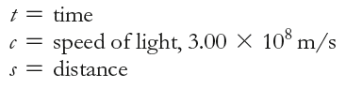
Electromagnetic wave speed (in vacuum) is
c = 299,792,458 m/s ≈ 3 × 10⁸ m/s
The distance travelled by any form of electromagnetic radiation is given by:
s = c t
A light-year is the distance travelled by light in one earth year, so 1 light-year equals 9.45 ×10¹⁵ m
⇒ Convenient for expressing distance between stars

Slide 7
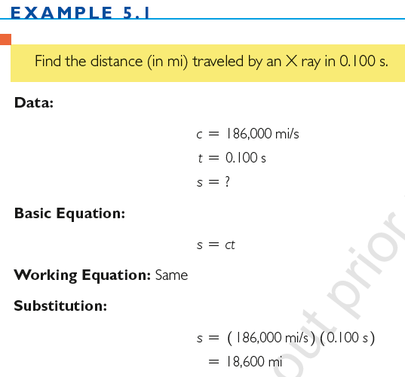

Slide 8

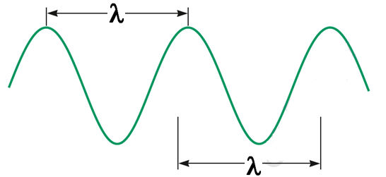
The wavelength, λ:
The distance between two successive corresponding points on the wave.
The wavelength of visible light ranges from about 4.0×10⁻⁷ m
to 7.6×10⁻⁷ m.
The longest visible wavelengths, which are also the lowest frequencies, are perceived as red.
The shortest visible wavelengths, which are the highest frequencies, are perceived as violet

Slide 9
The frequency, f :
The number of vibrations or cycles per second of a wave.
Unit: cycles/second = Hertz (Hz)
For all electromagnetic waves:
c = λ f
f = frequency
λ = wavelength
c = speed of light

Slide 10
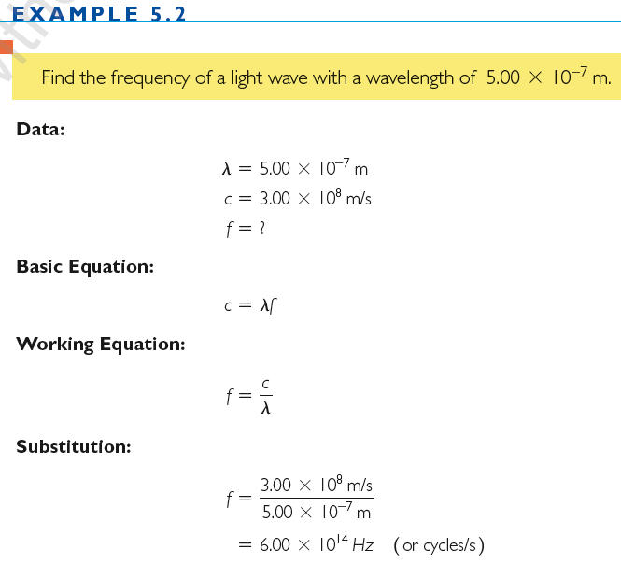

Slide 11
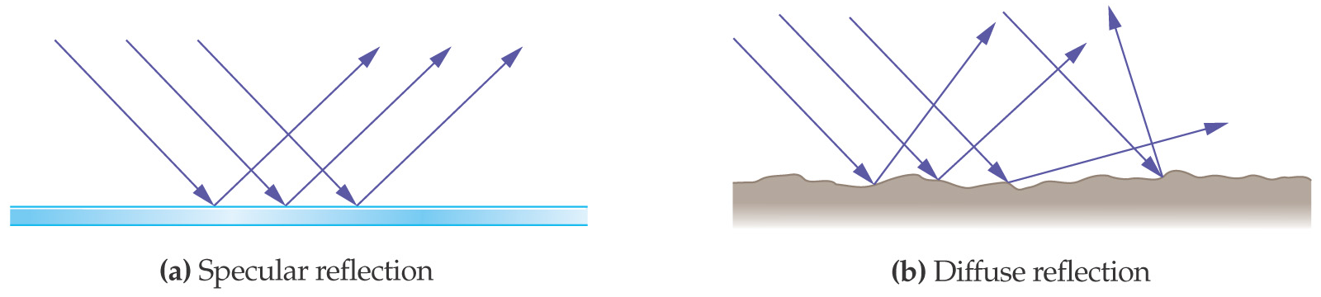
Reflection
Reflection The turning back of all or part of a beam of light as it strikes a surface.
Upon striking the surface, some of the light is reflected in all directions. This is called scattering.
Reflection with very little scattering is called regular (or specular) reflection
The scattering of light by uneven (rough) surfaces is called diffusion.
Regular reflection occurs when parallel or nearly parallel rays of light remain parallel after being reflected from a surface
Regular reflection (reflected rays are parallel).

Slide 12
Law of Reflection
Angle of incidence
  Angle made by the incoming ray and the perpendicular
Angle of reflection
  Angle made by the reflected ray and the perpendicular
Normal
  Imaginary line perpendicular to the plane of the reflecting surface
  Lies in the same plane as the incident and reflected rays

Slide 13
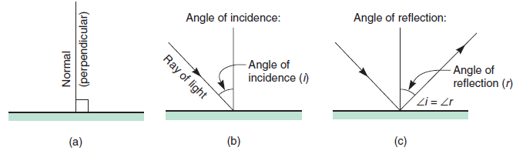
Law of Reflection
First Law of Reflection
The angle of incidence, i, is equal to the angle of reflection, r; that is,
This law of reflection apply to specular reflection and diffuse reflection.
Each ray obeys the law of reflection.

Slide 14
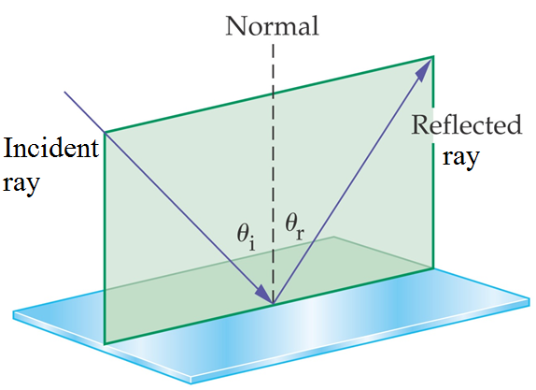
Second Law of Reflection
The incident ray, the reflected ray, and the normal (perpendicular) to the surface all lie in the same plane.
These laws of reflection apply not only to light, but to all kinds of waves.

Slide 15
Images
Real images (images formed by rays of light)
  are always inverted (by a single mirror or lens)
  may be larger than, smaller than, or the same size as the object.
  can be shown on a screen
virtual images (images that only appear to the eye to be formed by rays of light).
  are always erect
  may be larger than, smaller than, or the same size as the object.
  cannot be shown on a screen.

Slide 16
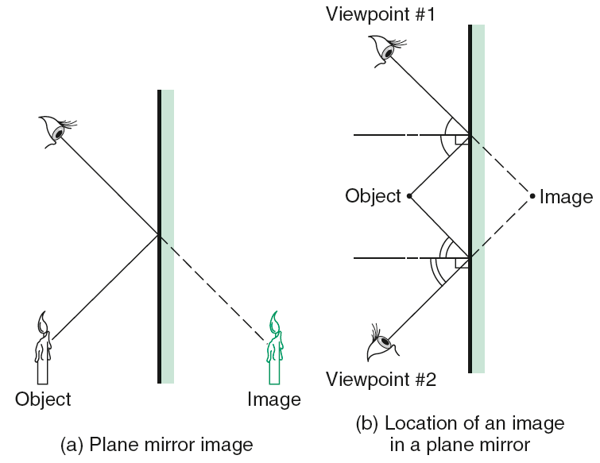
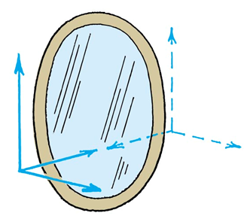
Images Formed by Plane Mirrors
are always erect and virtual
is same size as object
appear as far behind the mirror as the distance the object is in front of the mirror.
Plane mirrors also reverse right and left
The only axis reversed in an image is the front-back axis.

Slide 17
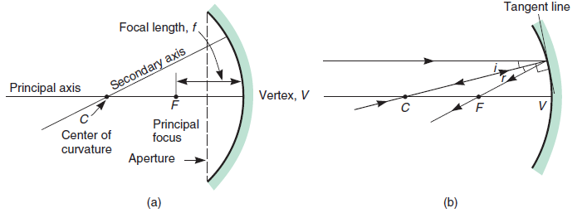
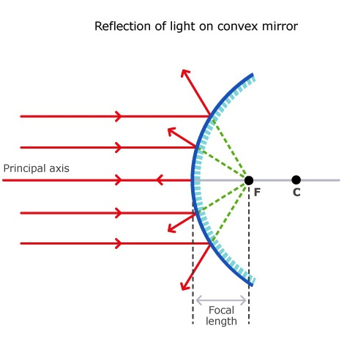
Images Formed by Concave Mirrors
The center of curvature, C, is the center of the sphere that forms a part of the spherical mirror.
The vertex, V, is the center of the mirror (sometimes called its optical center).
The principal axis is the line CV drawn through the center of curvature and the vertex.
The principal focus, F, is the point on the principal axis through which all rays parallel to the principal axis converge in a concave mirror or from which they diverge in a convex mirror.
The focal length is the distance between the principal focus of a mirror (or lens) and its vertex.

Slide 18
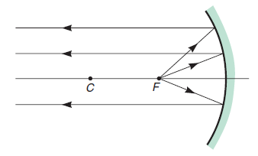
Images Formed by Concave Mirrors (Converging Mirrors)
An object is placed
outside the focal point,
  produces a real and inverted image.
inside the focal point,
  the resulting image is virtual, erect, and larger than the object
at the focal point,
  no image will be formed because the rays of light will be reflected parallel to the principal axis
Concave mirrors can produce both real and virtual images.
No image is formed if the object is located at the focal point.

Slide 19
Images Formed by Convex Mirrors (Diverging Mirrors)
The image is always virtual, erect, and smaller than the object (diminished).
Formation of images in convex mirrors

Slide 20

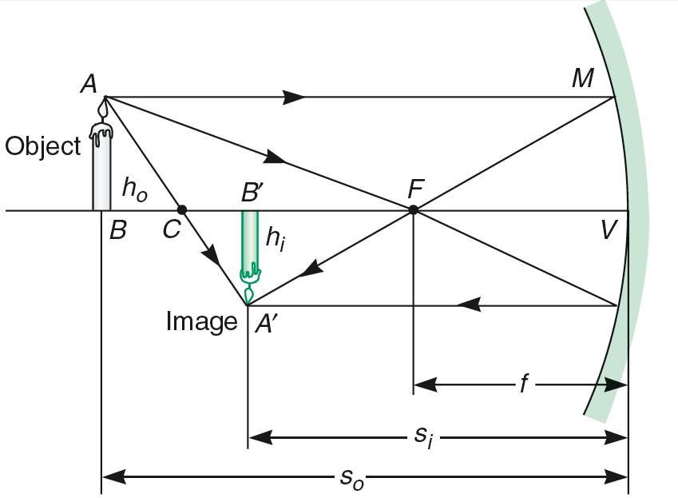
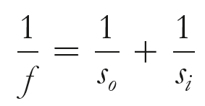
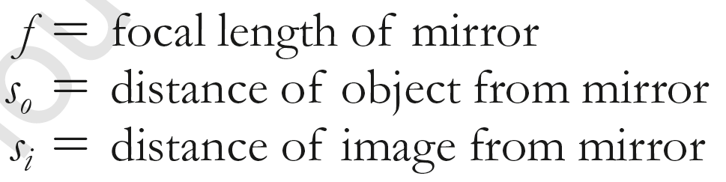
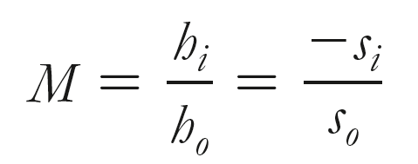
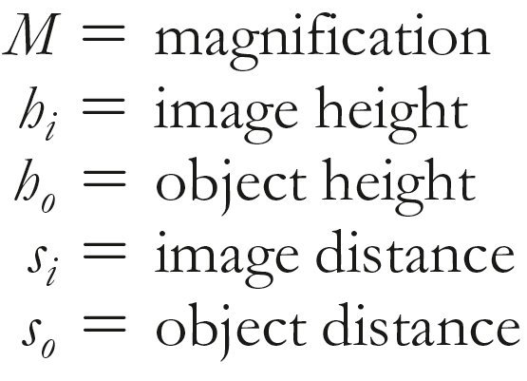
the distance to a virtual image is always negative;
the focal length of a convex mirror is also negative.
An inverted image (real) has a negative magnification
An erect image (virtual) has a positive magnification.

Slide 21
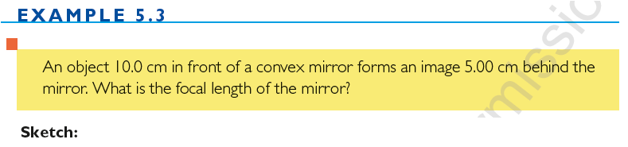
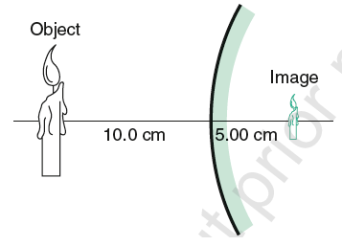
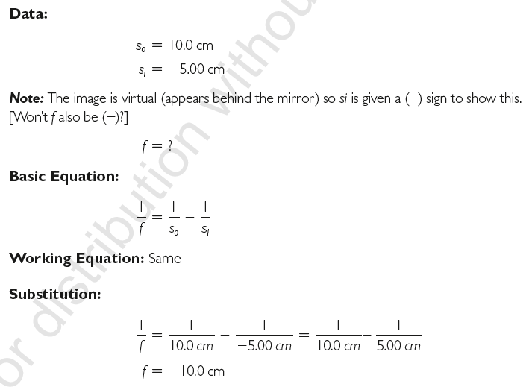
Remember that
f and s_{i} may be negative only when forming virtual images and/or using convex mirrors.

Slide 22
An object and its image in a concave mirror are the same height, yet inverted, when the object is 20.0 cm from the mirror. What is the focal length of the mirror?
Ans. f = 10.0 cm

Slide 23
An object 30.0 cm tall is located 10.5 cm from a concave mirror with focal length 16.0 cm. (a) Where is the image located? (b) How high is it?
Ans. s_{i} = -30.5 cm; h_{i} = 87.1cm
Notes:
Si = -30.5 cm; hi = 87.1cm

Slide 24
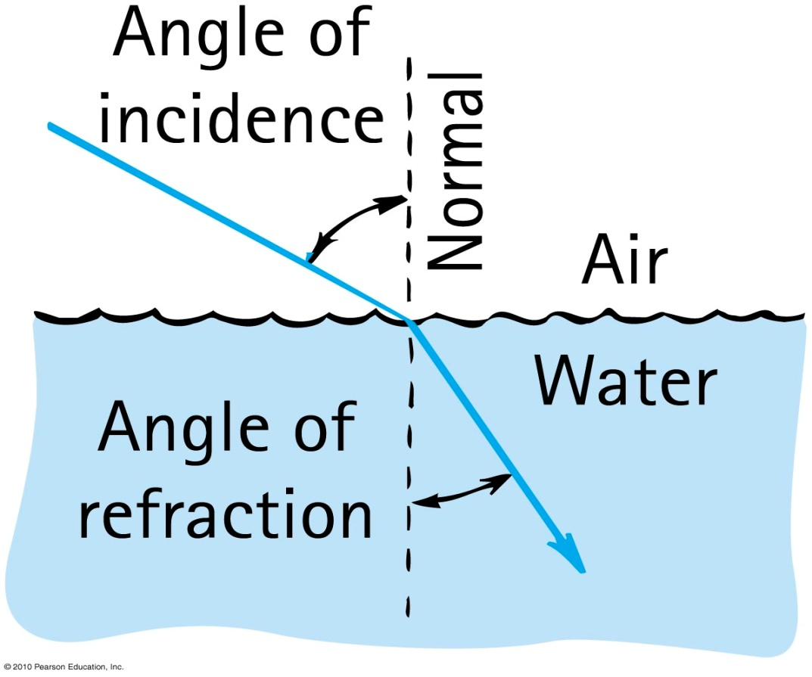
Refraction
Optical density is a property of a transparent material that is a measure of the speed of light through the given material.
  The speed of light is different in different media
Refraction
is the bending of light as it passes at an angle from one medium to another of different optical density.
Caused by change in speed of light
Water is optically denser than air and the speed of light in water is less than the speed of light in air.

Slide 25
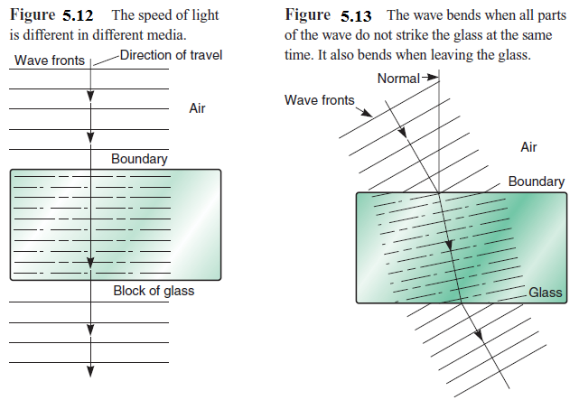
When passing from one medium to another perpendicular to the surface (called the interface), the wave is not bent, although the speed of the wave is slowed.
The wave bends when all parts of the wave do not strike the glass at the same time. It also bends when leaving the glass.

Slide 26
Refraction
Refraction of light makes objects under water appear to be closer to the surface

Slide 27
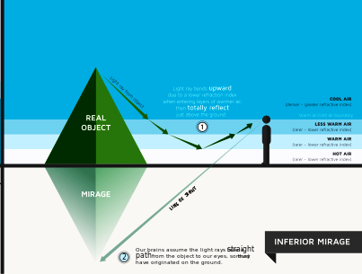
Mirage
A mirage is a good example of refraction
Light travels faster through the very hot and less dense air near a warm surface such as the ground on a hot day than through the cooler air above it.
As a result, the image appears to the observer to shimmer as if it had been reflected from the surface of water.
It is not reflected, however, but refracted, forming an image

Slide 28
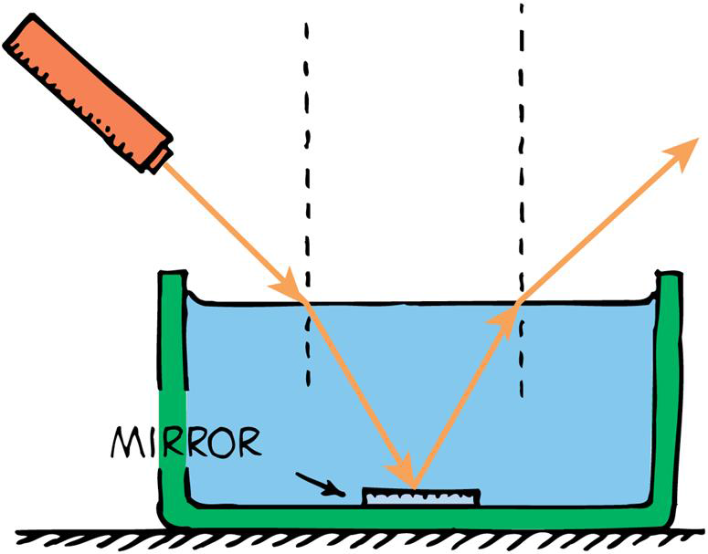
Refraction
LAW OF REFRACTION
When a beam of light passes at an angle from a medium of lower optical density to a denser medium (like from air to water), the light is bent toward the normal.
When a beam of light passes at an angle from a medium of greater optical density to one less dense (like from water to air), , the light is bent away from the normal.
When light slows down in going from one medium to another, like going from air to water, it refracts toward the normal.
When it speeds up in traveling from one medium to another, like going from water to air, it refracts away from the normal.

Slide 29
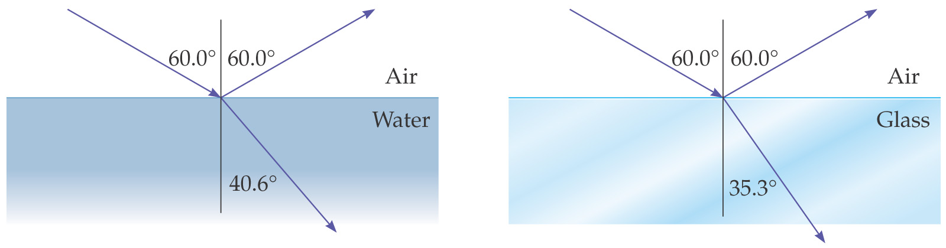
Refractive index:
Index of refraction, n, of a material
indicates how much the speed of light differs from its speed in a vacuum.
indicates the extent of bending of rays.
ratio of speed of light in a vacuum to the speed in a material.

Slide 30
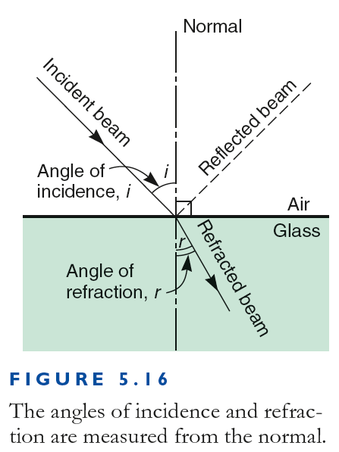
Refraction
Refractive index (continued):
In equation form:
Medium with a high index means high bending effect and greatest slowing of light.
Light always travels more slowly in a material than in vacuum, n > 1
For vacuum, n = 1.
Snell's law
speed of light in vacuum
n =
speed of light in material
n ₁ sin i = n ₂ sin r

Slide 31
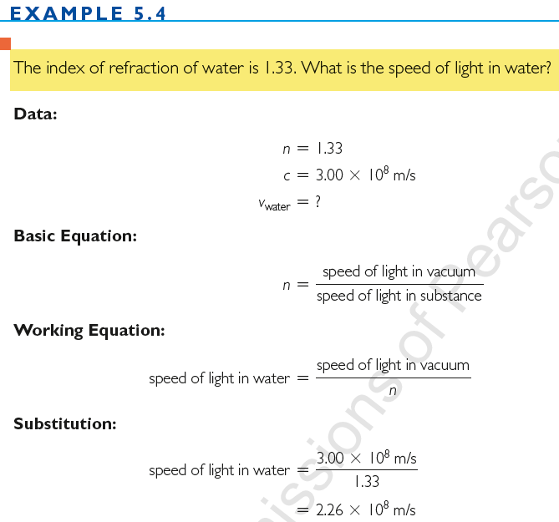

Slide 32
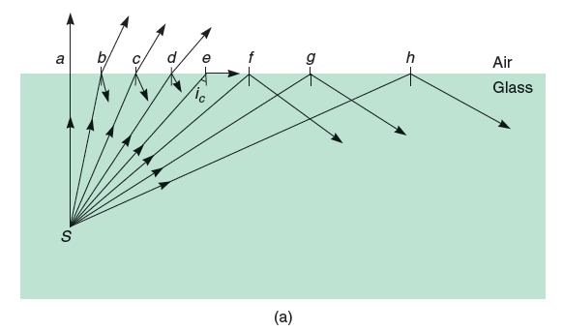
Total Internal Reflection (TIR)
Light propagating from a medium with a higher refractive index into one with a lower index is bent away from the normal,
If the angle of refraction is 90º or greater, a beam of light does not leave the medium but is reflected inside it. This is called total internal reflection.
Total internal reflection occurs when the angle of incidence is greater than the critical angle.

Slide 33
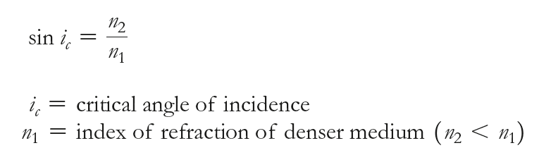

Total Internal Reflection
The critical angle is the smallest angle of incidence at which all light striking the surface is totally internally reflected
Total internal reflection occurs in materials in which the speed of light is less than the speed of light outside
When : n₂ = 1
the index refraction of air

Slide 34
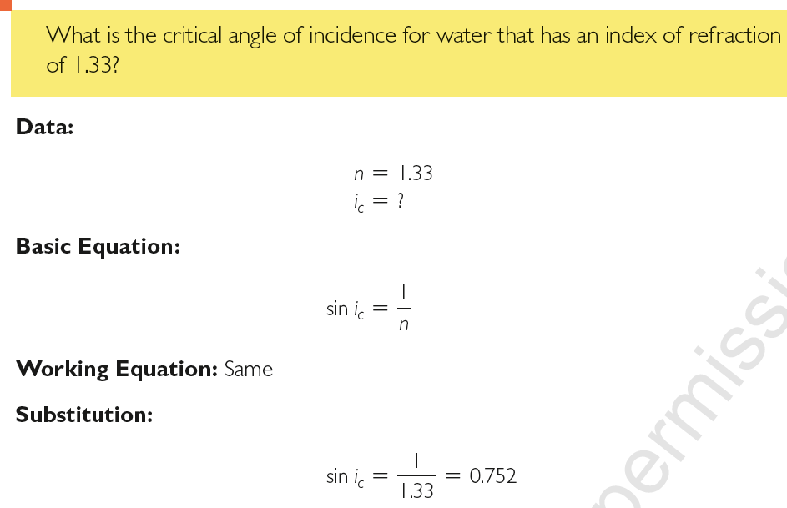

Slide 35
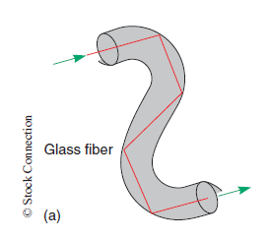
Total Internal Reflection
An example of the practical application of TIR is fiber optics.
Light may be transferred inside flexible glass or plastic fibers, which are transparent but keep nearly all the light inside because the light is reflected along the inside surface of the fibers.
Light travels inside an optical or glass fiber like a light pipe in which the light is always incident at an angle greater than the critical angle.
Thus, no light escapes the optical fiber by refraction.
Fiber optics is essential to light-wave communications systems.

Slide 36
Types of Lenses
A lens is a piece of transparent material that uses refraction to form images.
Lenses may be converging or diverging.
Converging lenses
  bend the light passing through them to some point beyond the lens.
  are always thicker in the center than on the edges ( convex lens).
Diverging lenses
  bend the light passing through them so as to spread the light.
  are thicker on the edges than at the center ( concave lens)

Slide 37
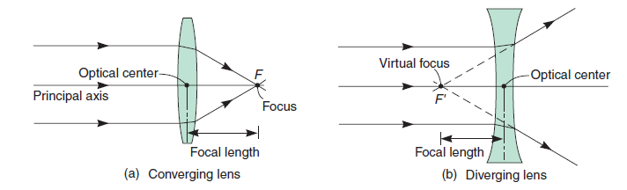
Images Formed by Converging Lenses
Every lens has a focal length—that distance from the lens center to the point where parallel beams directed through the lens come together if converging or appear to come together if diverging

Slide 38
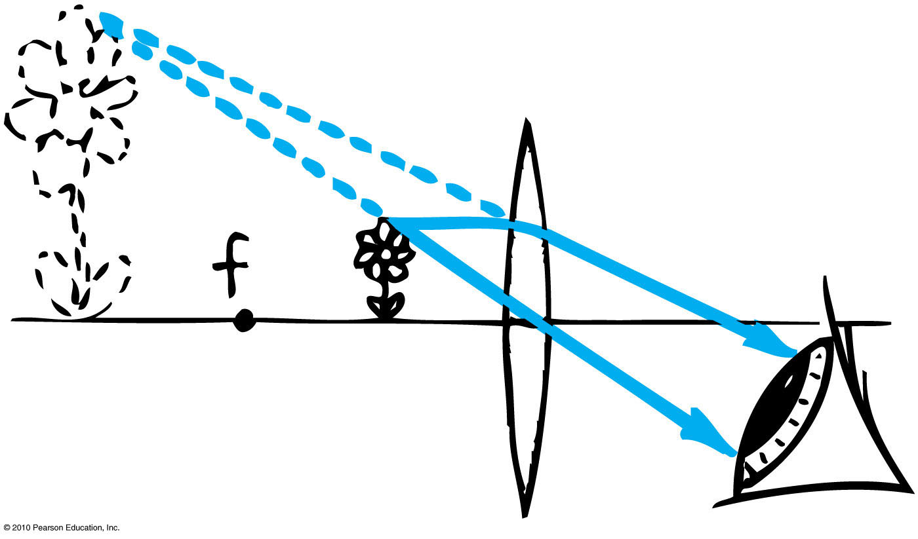
Images Formed by Converging Lenses (Convex Lens)
when the object is inside the focal point
  the resulting image is virtual, erect, larger than the object, and farther from the lens than the object
When an object is near a converging lens (inside its focal point f ), the lens acts as a magnifying glass to produce a virtual image. The image appears larger and farther from the lens than the object.

Slide 39
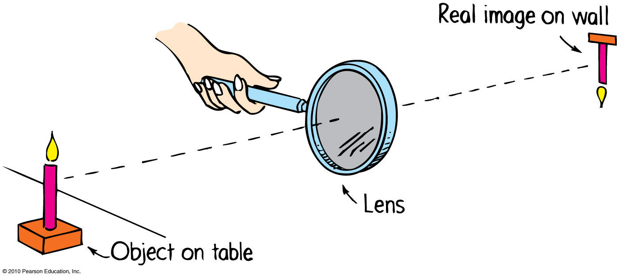
Images Formed by Converging Lenses (Convex Lens)
When the object outside the focal point,
  produces a real and inverted image.
When an object is far from a converging lens (beyond its focal point), a real inverted image is formed.

Slide 40
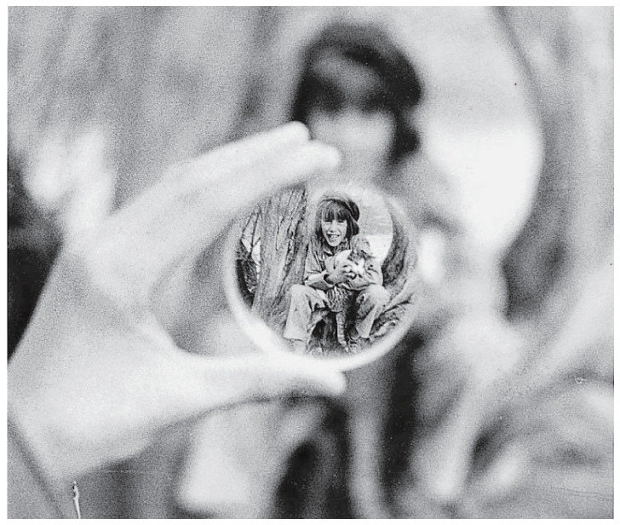
Images Formed by Diverging Lenses ( Concave Lens)
When a diverging lens is used alone, the image is always virtual, erect, and smaller than the object
A diverging lens forms a virtual, erect image
It makes no difference how far or how near the object is.

Slide 41

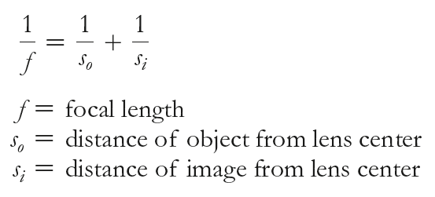
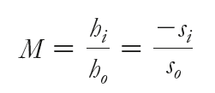
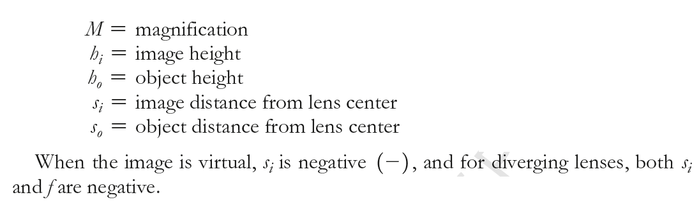

Slide 42
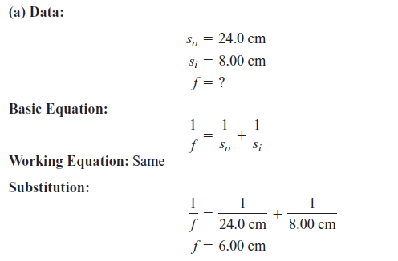
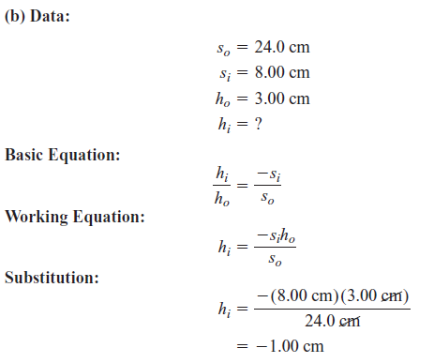
An object 3.00 cm tall is placed 24.0 cm from a converging lens. A real image is formed 8.00 cm from the lens.
(a) What is the focal length of the lens? (b) What is the size of the image?

Slide 43
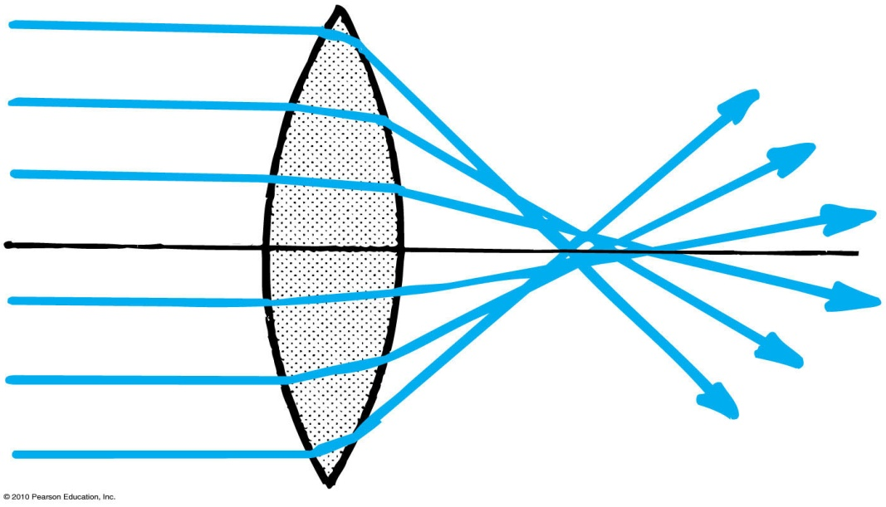
Lens Defects
Aberration
  No lens gives a perfect image
  distortion in an image
Types of aberrations
  Spherical aberration
  results from light that passes through the edges of a lens focusing at a slightly different place from where light passing near the center of the lens focuses
  Corrections:
    compound-lens systems;
    use only central part of lens.

Slide 44
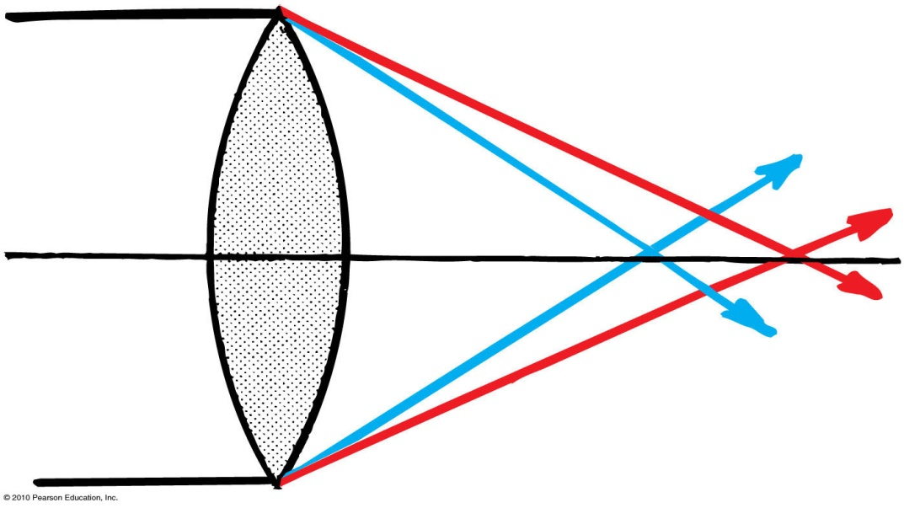
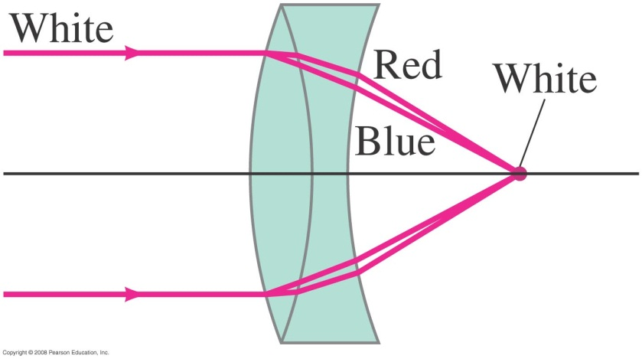
Lens Defects
Aberration (continued)
  Chromatic aberration
    result of various colors having different speeds and hence different refractions in the lens
    Achromatic lenses, which combine simple lenses of different kinds of glass, correct this defect.
Astigmatism
  results when the cornea is curved more in one direction than the other, i.e., front surface of the eyeball is unequally curved
  Because of this defect, the eye does not form sharp images
The remedy is eyeglasses with cylindrical lenses

Slide 45
The Color of Light
Color is a property of the light that reaches our eyes and is determined by its wavelength or its frequency.
Red light has lower frequency and longer wavelength, whereas at the opposite end of the spectrum Violet light has higher frequency and shorter wavelength.
Polychromatic light is light consisting of several colors.
Monochromatic light consists of only one color.

Slide 46
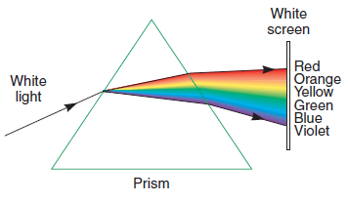
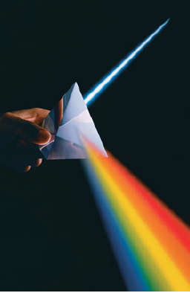

Dispersion
Dispersion
Process of separation of light into colors arranged by frequency
The refraction of the red light is less than that of the others
The refraction of the violet light is the greatest .
The shorter wavelengths are refracted more than the longer wavelengths

Slide 47
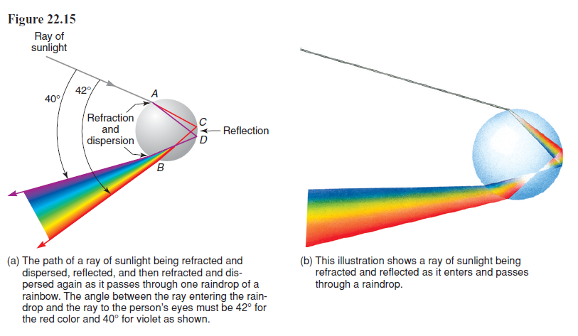
Why We See Rainbow ?
Rainbows are a result of dispersion by many drops.
A rainbow is a spectrum of light formed when sunlight strikes raindrops, refracts into them, reflects within them, and then refracts out of them.

Slide 48
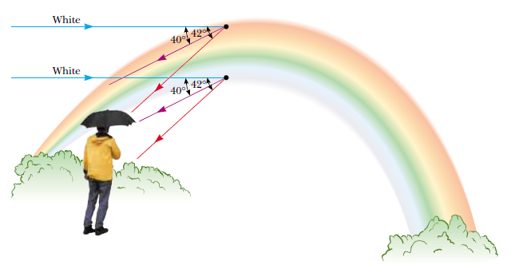
Why We See Rainbows ?
For a person to see a rainbow,
the person must be between the sun and the raindrops and
the angle between the sun to the raindrops and back to the person’s eyes must be between 40° and 42°.

Slide 49
Electromagnetic Waves
CHECK YOUR ANSWER
If an electron vibrates up and down 1000 times each second, it generates an electromagnetic wave with a
A. period of 1000 s.
speed of 1000 m/s.
wavelength of 1000 m.
None of the above.
Explanation:
The vibrating electron would emit a wave with a frequency of 1000 Hz, which is not in the list above

Slide 50
Law of Reflection
CHECK YOUR ANSWER
Light reflecting from a smooth surface undergoes a change in
A. frequency.
speed.
wavelength.
None of the above.

Slide 51
Refraction
CHECK YOUR ANSWER
Refracted light that bends toward the normal is light that has
A. slowed down.
sped up.
nearly been absorbed.
diffracted.

Slide 52
Refraction
CHECK YOUR ANSWER
Refracted light that bends away from the normal is light that has
A. slowed down.
sped up.
nearly been absorbed.
diffracted.
Explanation:
This question is a consistency check with the question that asks about light bending toward the normal when slowing

Slide 53
Refraction
CHECK YOUR ANSWER
When light travels from one medium to another and changes speed in doing so, we call the process
A. reflection.
interference.
dispersion.
refraction.

Slide 54
Dispersion
CHECK YOUR ANSWER
When white light passes through a prism, green light is bent more than
A. blue light.
violet light.
red light.
None of the above.

