Slide 1
بسم الله الرحمن الرحيم

Slide 2
مبادئ علم الحيوان - 103 حين Principles of general Zoology - Z00 103 ”الجزء العملي“

Slide 3
المجهر Microscope
Lab Exercise # 1
Zoo - 103
STRUCTURE, FUNCTION AND
OPERATION OF LIGHT MICROSCOPE

Slide 4
Types of Microscope
Lab Exercise # 1
Zoo - 103
Light Microscope
Electron Microscope
(Electron beam)
Simple Microscope Compound Microscope
(single lens) (2 sets of lenses)
Monocular Binocular
(With one eye piece) (With two eye pieces)

Slide 5
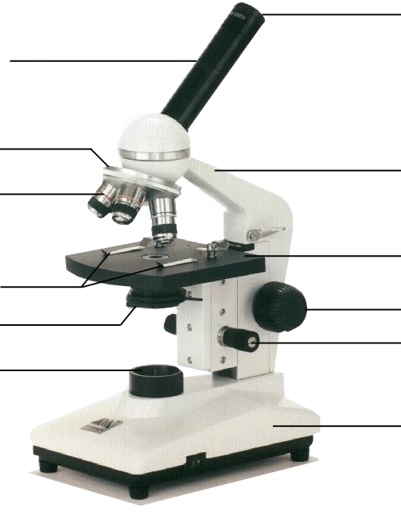
Lab Exercise # 1
Zoo - 103
The Parts of a Light Microscope
Eyepiece
Body Tube
Revolving Nosepiece
Arm
Objective Lens
Stage
Stage Clips
Coarse Focus
Diaphragm
Fine Focus
Light
Base
Notes:
This is the exact version of the microscope used in class. Students will be identifying the parts on the microscopes at their desks as we go along and what their functions are.

Slide 6
Lab Exercise # 1
Zoo - 103
Magnification Power
Magnification = Power of the eye piece X Power of objective lense
For example: 40X (objective lens) x 10X (ocular lens) = 400X magnification

Slide 7
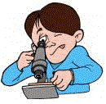
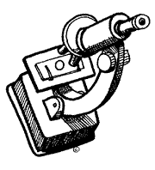
Lab Exercise # 1
Zoo - 103
Microscope Use and Care
Always carry with 2 hands
Only use lens paper for cleaning
Do not force knobs
Always Keep covered
Use Stage Clips
Click Nosepiece to the lowest (shortest) setting
Look into the 2 Eyepiece
Use the Coarse Focus first then use the objective
of higher magnification and use fine adjustment
to focus it

Slide 8
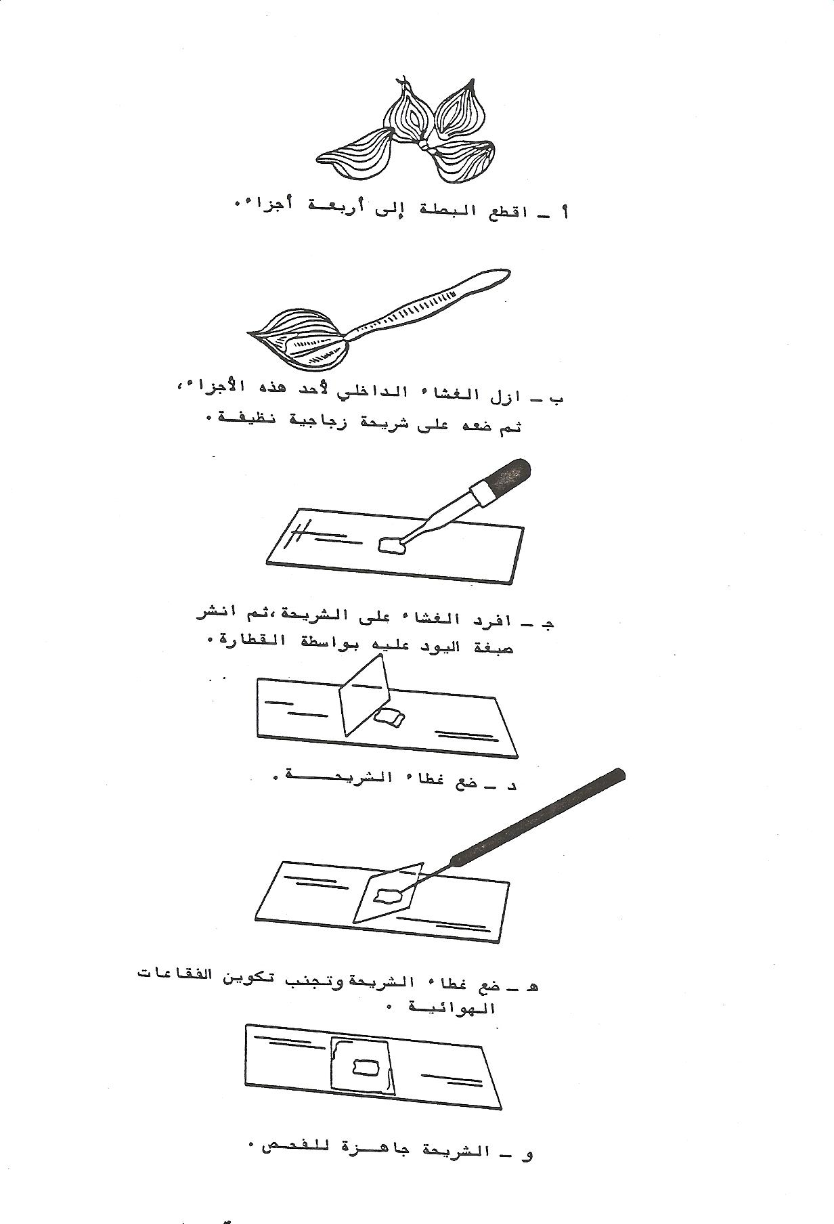
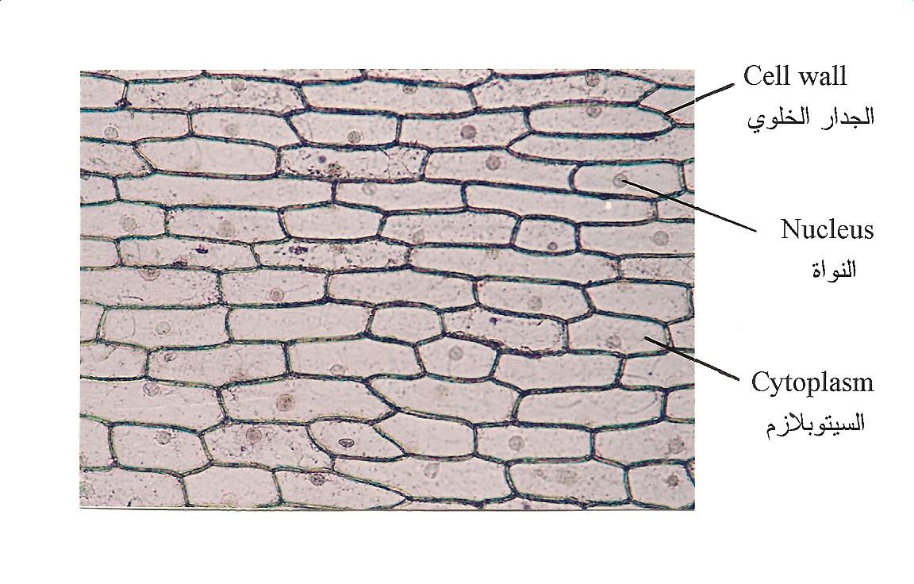
Lab Exercise # 1
Zoo - 103
For practice, Prepare a slide of epithelial cells of onion an stain it
Observe the cells under different magnification
Compare what you saw with the figure shown below
Simple Columnar Epithelium
(Onion Cells)

Slide 9
Thank you

