Slide 1
General Physics
(104 Phys)
Dr NARGIS

Slide 2
Chapter 26 Capacitance and Dielectrics
Chapter Outline
26.1 Definition of Capacitance
26.2 Calculating Capacitance
26.3 Combinations of Capacitors
26.4 Energy Stored in a Charged Capacitor
26.5 Capacitors with Dielectrics

Slide 3
26.1 Definition of capacitance
Capacitor: two conductors (separated by an insulator)
usually oppositely charged
The capacitance, C, of a capacitor is defined as a ratio of the magnitude of a charge on either conductor to the magnitude of the potential difference between the conductors
a
+Q
b
-Q

Slide 4
Note that by definition capacitance is always a positive quantity.
The charge Q and the potential difference ΔV are positive quantities. Because the potential difference increases linearly with the stored charge, the ratio Q / Δ V is constant for a given capacitor.
The charge, Q, on a capacitor is directly proportional to the potential difference, V, across the capacitor and the proportionality constant is C, the capacitance of the capacitor, so we have

Slide 5
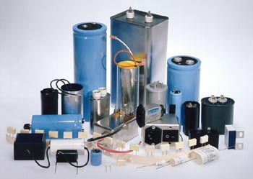
Units of capacitance
The unit of C is the farad (F), but most capacitors have values of C ranging from picofarads to microfarads (pF to μF).
Recall, micro ⇒10⁻⁶, nano ⇒10⁻⁹, pico ⇒10⁻¹²
If the external potential is disconnected, charges remain on the plates, so capacitors are good for storing charge (and energy).

Slide 6
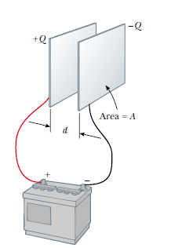
26.2 Calculating Capacitance
The capacitance of a pair of conductors depends on the geometry of the conductors.
The parallel-plate capacitor
Two parallel metallic plates of equal area A are separated by a distance d, One plate carries a charge Q , and the other carries a charge -Q .
where A is the area of one of the plates, d is the separation, ε₀ is a constant called the permittivity of free space, ε₀= 8.85×10⁻¹² C²/N·m²
the capacitance of a parallel-plate capacitor is proportional to the area of its plates and inversely proportional to the plate separation.

Slide 7
Example 26.1 Parallel-Plate Capacitor

Slide 8
26.3 Combinations of Capacitors
It is very often that more than one capacitor is used in an electric circuit
We would have to learn how to compute the equivalent capacitance of certain combinations of capacitors
C₂
C₁
C₅
C₃
C₁
C₃
C₂
C₄

Slide 9
a. Parallel combination
Connecting a battery to the parallel combination of capacitors is equivalent to introducing the same potential difference for both capacitors,
a
C₁
+Q₁
C₂
+Q₂
V=V_{ab}
−Q₁
−Q₂
A total charge transferred to the system from the battery is the sum of charges of the two capacitors,
b
By definition,
Thus, C_{eq} would be

Slide 10
Parallel combination: notes
Analogous formula is true for any number of capacitors,
(parallel combination)
It follows that the equivalent capacitance of a parallel combination of capacitors is greater than any of the individual capacitors

Slide 11
Problem : A 3 μF capacitor and a 6 μF capacitor are connected in parallel across an 18 V battery. Determine the equivalent capacitance and total charge deposited.
a
Given:
V = 18 V
C₁= 3 μF
C₂= 6 μF
Find:
C_{eq}=?
Q=?
C₁
+Q₁
C₂
+Q₂
V=V_{ab}
−Q₁
−Q₂
b
First determine equivalent capacitance of C₁ and C₂:
Next, determine the charge

Slide 12
b. Series combination
Connecting a battery to the serial combination of capacitors is equivalent to introducing the same charge for both capacitors,
a
C₁
+Q₁
−Q₁
A voltage induced in the system from the battery is the sum of potential differences across the individual capacitors,
V=V_{ab}
c
C₂
+Q₂
−Q₂
b
By definition,
Thus, C_{eq} would be

Slide 13
Series combination: notes
When this analysis is applied to three or more capacitors connected in series, the relationship for the equivalent capacitance is
(series combination)
It follows that the equivalent capacitance of a series combination of capacitors is always less than any of the individual capacitance in the combination

Slide 14
Problem : A 3 μF capacitor and a 6 μF capacitor are connected in series across an 18 V battery. Determine the equivalent capacitance and total charge deposited.
a
C₁
+Q₁
Given:
V = 18 V
C₁= 3 μF
C₂= 6 μF
Find:
C_{eq}=?
Q=?
−Q₁
V=V_{ab}
c
C₂
+Q₂
−Q₂
b
First determine equivalent capacitance of C₁ and C₂:
Next, determine the charge

Slide 15
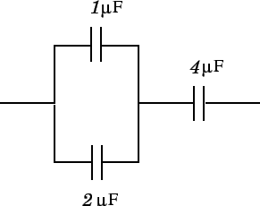
Question: A and a capacitor are connected in parallel, and this pair of capacitors is then connected in series with a capacitor, as shown in the diagram. What is the equivalent capacitance of the whole combination? What is the charge on the capacitor if the whole
combination is connected across the terminals of a V battery? Likewise, what are the charges
on the and capacitors?
Solution:
The equivalent capacitance of the and capacitors connected in parallel is
When a capacitor is combined in series with a capacitor, the equivalent capacitance of the whole combination is given by

Slide 16
and so
The charge delivered by the V battery is
This is the charge on the capacitor, since one of the terminals of the battery is connected directly to one of the plates of this capacitor.
The voltage drop across the capacitor is

Slide 18
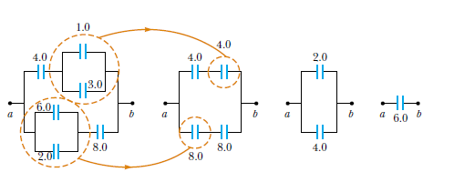
Example 26.4 Equivalent Capacitance
Find the equivalent capacitance between a and b for the combination of capacitors shown in Figure 26.11a. All capacitances are in microfarads.

Slide 19
26.4 Energy Stored in a Charged Capacitor
Energy
The energy (U) stored on a capacitor is given by:
Energy Density
The potential energy per unit volume between parallel-plate capacitor is

Slide 20
Example: stored energy
In the circuit shown V = 48V, C₁ = 9μF, C₂ = 4μF and C₃ = 8μF.
(a) determine the equivalent capacitance of the circuit,
(b) determine the energy stored in the combination by calculating the energy stored in the equivalent capacitance,
C₁
V
C₂
C₃
Given:
V = 48 V
C₁= 9 μF
C₂= 4 μF
C₃= 8 μF
Find:
C_{eq}=?
U=?
First determine equivalent capacitance of C₂ and C₃:
Next, determine equivalent capacitance of the circuit by noting that C₁ and C₂₃ are connected in series
The energy stored in the capacitor C₁₂₃ is then

Slide 21
26.5 Capacitors with Dielectrics
A dielectrics is an insulating material (rubber, glass, etc.)
Consider an insolated, charged capacitor
Notice that the potential difference decreases (k = V₀/V)
Since charge stayed the same (Q=Q₀) → capacitance increases
dielectric constant: k = C/C₀
Dielectric constant is a material property
−Q
−Q
Insert a dielectric
+Q
+Q
V₀
V

Slide 22
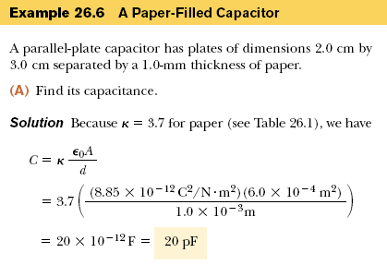
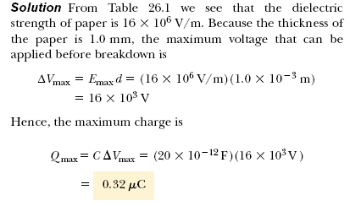

Slide 23
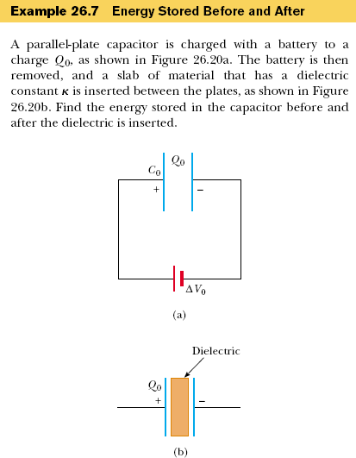
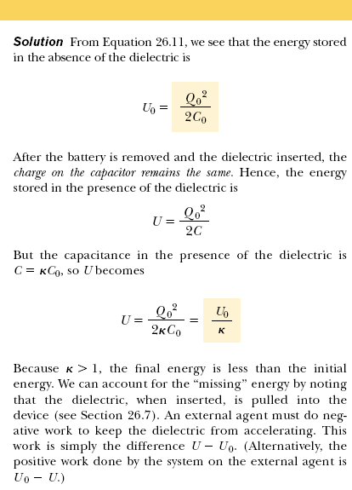

Slide 24
Problem : Take a parallel plate capacitor whose plates have an area of 2 m² and are separated by a distance of 1cm. The capacitor is charged to an initial voltage of 3 kV and then disconnected from the charging source. An insulating material is placed between the plates, completely filling the space, resulting in a decrease in the capacitors voltage to 1 kV. Determine the original and new capacitance, the charge on the capacitor, and the dielectric constant of the material.
Given:
ΔV₁=3,000 V
ΔV₂=1,000 V
A = 2.00 m²
d = 0.01 m
Find:
C=?
C₀=?
Q=?
k=?
Since we are dealing with the parallel-plate capacitor, the original capacitance can be found as
The dielectric constant and the new capacitance are
The charge on the capacitor can be found to be

