Slide 1
Chapter 10
EXCRETION

Slide 2
Control of Body Temperature and Water Balance

Slide 3
Control of Body Temperature and Water Balance as a part of homeostasis
Homeostasis means
Maintenance of steady internal conditions despite fluctuations in the external environment
Examples of homeostasis
Thermoregulation: the maintenance of internal temperature within narrow limits
Osmoregulation: the control of the gain and loss of water and solutes
Excretion: the disposal of nitrogen-containing wastes
3

Slide 4
Thermoregulation: An animal’s regulation of body temperature helps maintain homeostasis
Thermoregulation
The process by which animals maintain an internal temperature within a tolerable range
Ectothermic animals
Absorb heat from their surroundings
Many fish, most amphibians, lizards, most invertebrates
Endothermic animals
Derive body heat mainly from their metabolism
Birds, mammals, a few reptiles and fish, many insects
4
Notes:
Student Misconceptions and Concerns
1. The concept of homeostasis may be new to students, who have never considered how organisms must adjust to subtle changes in environmental conditions. Analogies to other systems that engage in self-regulation, such as the water regulation of a toilet or the temperature regulation of a furnace, may help.
2. One role of the circulatory system rarely discussed is the transport of heat. Blood vessels near the surface of the body expand when we are overheated, releasing some of this excess to the environment. Conversely, during periods of exposure to cold, blood is shunted away from the skin to conserve heat.
Teaching Tips
1. The terms warm-blooded and cold-blooded are less precise than endotherm and ectotherm. Encourage students to discuss why the latter two terms are preferable.
2. Ask your students to explain the adaptive advantages of endothermy and ectothermy. You might prompt the discussion by noting that endotherms consume about 10 times as many calories as ectotherms of equivalent body mass. What advantages might be worth this additional “cost” for endotherms?
3. The heat generated by aerobic metabolism is analogous to the heat generated by the engine of an automobile. In both cases, the heat is a by-product of the process. In the winter, this excess heat helps keep the body and the interior of the car warm. In the summer, both the body and the automobile’s engine must work to keep from overheating.

Slide 5
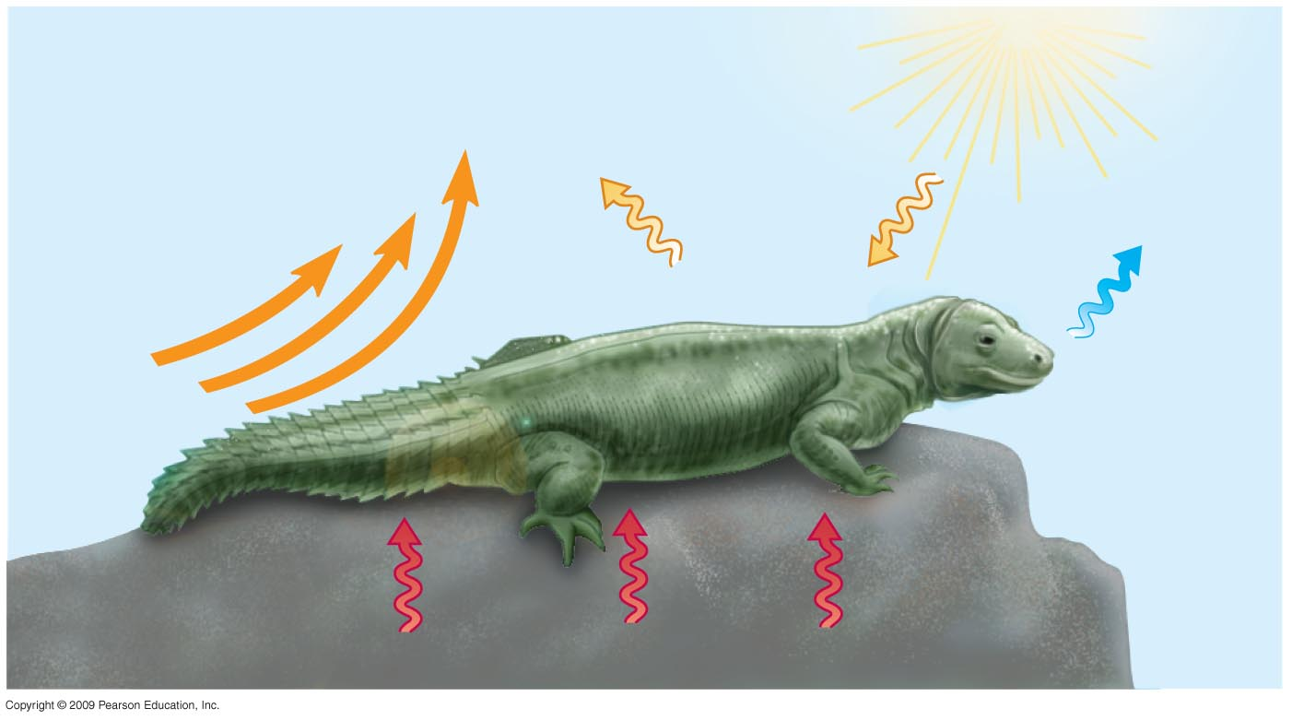
Heat is gained or lost in four ways
Heat exchange with the environment may occur by
Conduction
Convection
Radiation
Evaporation
Radiation
Convection
Evaporation
Mechanisms of heat exchange
Conduction
5

Slide 6
Adaptations that balance heat gain and loss
Five general categories of adaptations promote thermoregulation
1- Increased metabolic heat production
Hormonal changes boost metabolic rate in birds and mammals
Shivering
Increased physical activity
Honeybees cluster and shiver
6
Copyright © 2009 Pearson Education, Inc.
Notes:
Student Misconceptions and Concerns
1. The concept of homeostasis may be new to students, who have never considered how organisms must adjust to subtle changes in environmental conditions. Analogies to other systems that engage in self-regulation, such as the water regulation of a toilet or the temperature regulation of a furnace, may help.
2. One role of the circulatory system rarely discussed is the transport of heat. Blood vessels near the surface of the body expand when we are overheated, releasing some of this excess to the environment. Conversely, during periods of exposure to cold, blood is shunted away from the skin to conserve heat.
Teaching Tips
1. Have students list the many factors that affect heat gain and loss during periods of physical activity, then have them identify which of the four physical processes for exchanging heat are involved. The factors include (a) the person’s physical condition, (b) the level of physical activity, (c) the age of the person (younger people tend to have higher metabolic rates), (d) the person’s level of hydration (which in turn affects the amount of sweating and evaporative cooling), (e) the external level of humidity (higher levels decrease evaporative cooling), (f) the intensity of the wind (greater intensity promotes evaporative cooling), (g) the intensity of sunlight, and (h) the color of the person’s clothing (which affects the amount of light energy the body absorbs).
2. You can extend the exercise above by challenging your class to identify environmental conditions when it would be too hot to play an outdoor sport. That is, when as a parent or coach would you want to prevent practice or a game because it is dangerously hot?
3. As an alternative to the above, challenge students to identify a human example of each of the four physical processes that involve heat exchange with the environment (Module 25.3) and that promote thermoregulation (Module 25.4). Or, to check student comprehension, describe such examples and challenge the class to match the examples to the correct terminology.
4. Some students will be familiar with the type of foam insulation wrap surrounding interior pipes. These forms of insulation are especially necessary when hot- and cold water pipes run parallel and in close proximity to each other. Without the insulation, heat would be easily transferred from hot-water to cold-water pipes, in a situation similar to countercurrent heat exchange systems in animals.

Slide 7
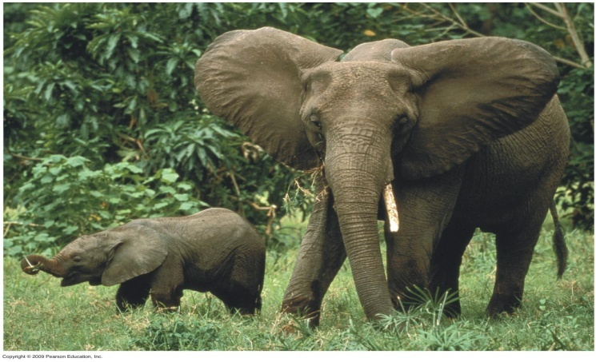
Thermoregulation involves adaptations that balance heat gain and loss
2- Insulation
Hair
Feathers
Fat layers
3- Circulatory adaptations
Increased or decreased blood flow to skin by changing diameter of skin blood vessels
Large ears in elephants
Countercurrent heat exchange
7
Notes:
Student Misconceptions and Concerns
1. The concept of homeostasis may be new to students, who have never considered how organisms must adjust to subtle changes in environmental conditions. Analogies to other systems that engage in self-regulation, such as the water regulation of a toilet or the temperature regulation of a furnace, may help.
2. One role of the circulatory system rarely discussed is the transport of heat. Blood vessels near the surface of the body expand when we are overheated, releasing some of this excess to the environment. Conversely, during periods of exposure to cold, blood is shunted away from the skin to conserve heat.
Teaching Tips
1. Have students list the many factors that affect heat gain and loss during periods of physical activity, then have them identify which of the four physical processes for exchanging heat are involved. The factors include (a) the person’s physical condition, (b) the level of physical activity, (c) the age of the person (younger people tend to have higher metabolic rates), (d) the person’s level of hydration (which in turn affects the amount of sweating and evaporative cooling), (e) the external level of humidity (higher levels decrease evaporative cooling), (f) the intensity of the wind (greater intensity promotes evaporative cooling), (g) the intensity of sunlight, and (h) the color of the person’s clothing (which affects the amount of light energy the body absorbs).
2. You can extend the exercise above by challenging your class to identify environmental conditions when it would be too hot to play an outdoor sport. That is, when as a parent or coach would you want to prevent practice or a game because it is dangerously hot?
3. As an alternative to the above, challenge students to identify a human example of each of the four physical processes that involve heat exchange with the environment (Module 25.3) and that promote thermoregulation (Module 25.4). Or, to check student comprehension, describe such examples and challenge the class to match the examples to the correct terminology.
4. Some students will be familiar with the type of foam insulation wrap surrounding interior pipes. These forms of insulation are especially necessary when hot- and cold water pipes run parallel and in close proximity to each other. Without the insulation, heat would be easily transferred from hot-water to cold-water pipes, in a situation similar to countercurrent heat exchange systems in animals.

Slide 8
Thermoregulation involves adaptations that balance heat gain and loss
4- Evaporative cooling
Sweating
Panting
5- Behavioral responses
Used by endotherms and ectotherms
Examples:
Moving to the sun or shade
Migrating
Bathing
8
Notes:
Student Misconceptions and Concerns
1. The concept of homeostasis may be new to students, who have never considered how organisms must adjust to subtle changes in environmental conditions. Analogies to other systems that engage in self-regulation, such as the water regulation of a toilet or the temperature regulation of a furnace, may help.
2. One role of the circulatory system rarely discussed is the transport of heat. Blood vessels near the surface of the body expand when we are overheated, releasing some of this excess to the environment. Conversely, during periods of exposure to cold, blood is shunted away from the skin to conserve heat.
Teaching Tips
1. Have students list the many factors that affect heat gain and loss during periods of physical activity, then have them identify which of the four physical processes for exchanging heat are involved. The factors include (a) the person’s physical condition, (b) the level of physical activity, (c) the age of the person (younger people tend to have higher metabolic rates), (d) the person’s level of hydration (which in turn affects the amount of sweating and evaporative cooling), (e) the external level of humidity (higher levels decrease evaporative cooling), (f) the intensity of the wind (greater intensity promotes evaporative cooling), (g) the intensity of sunlight, and (h) the color of the person’s clothing (which affects the amount of light energy the body absorbs).
2. You can extend the exercise above by challenging your class to identify environmental conditions when it would be too hot to play an outdoor sport. That is, when as a parent or coach would you want to prevent practice or a game because it is dangerously hot?
3. As an alternative to the above, challenge students to identify a human example of each of the four physical processes that involve heat exchange with the environment (Module 25.3) and that promote thermoregulation (Module 25.4). Or, to check student comprehension, describe such examples and challenge the class to match the examples to the correct terminology.
4. Some students will be familiar with the type of foam insulation wrap surrounding interior pipes. These forms of insulation are especially necessary when hot- and cold water pipes run parallel and in close proximity to each other. Without the insulation, heat would be easily transferred from hot-water to cold-water pipes, in a situation similar to countercurrent heat exchange systems in animals.

Slide 9
Osmoregulation and Excretion
Osmoregulation is the active regulation of the osmotic pressure of an organism’s fluids to maintain the homeostasis of the organism's water content; that is, it keeps the organism's fluids from becoming too diluted or too concentrated.
9

Slide 10
Animals balance the gain and loss of water and solutes through osmoregulation
Osmoconformers
Have the same internal solute concentration as sea water
Many marine invertebrates are osmoconformers
Osmoregulators control their solute concentrations
Freshwater fishes
Gain water by osmosis
Excrete excess water
Uptake salt across their gills
10
Notes:
Student Misconceptions and Concerns
1. The idea that a freshwater fish never drinks can be conceptually challenging, especially for students who have heard the old saying “drinks like a fish”! Consider introducing your discussion of osmoregulation with this remarkable and seemingly counterintuitive fact in order to generate interest.
Teaching Tips
1. Students may better understand the challenges of osmoregulation in freshwater fish if they are reminded of what occurs when humans soak their hands in water. Students will likely recall that this causes the skin on their hands to wrinkle, and some may have noticed that their skin wrinkles even faster in soapy water. Skin absorbs water by osmosis (just as a freshwater fish gains water). Oils on our skin reduce the influx of water. Soapy water, which washes away these oils, speeds up the process. The wrinkling occurs because the skin can expand only in certain areas, creating puckers.

Slide 11
EXCRETION
Excretion is the process by which waste products of metabolism and other non-useful materials are eliminated from an organism.
In vertebrates this is primarily carried out by the kidneys and skin
11

Slide 12
The Mammalian Excretory System
The mammalian excretory system centers on paired kidneys, which are also the principal site of water balance and salt regulation
Urine exits each kidney through a duct called the ureter
Both ureters drain into a common urinary bladder, and urine is expelled through a urethra
12

Slide 13
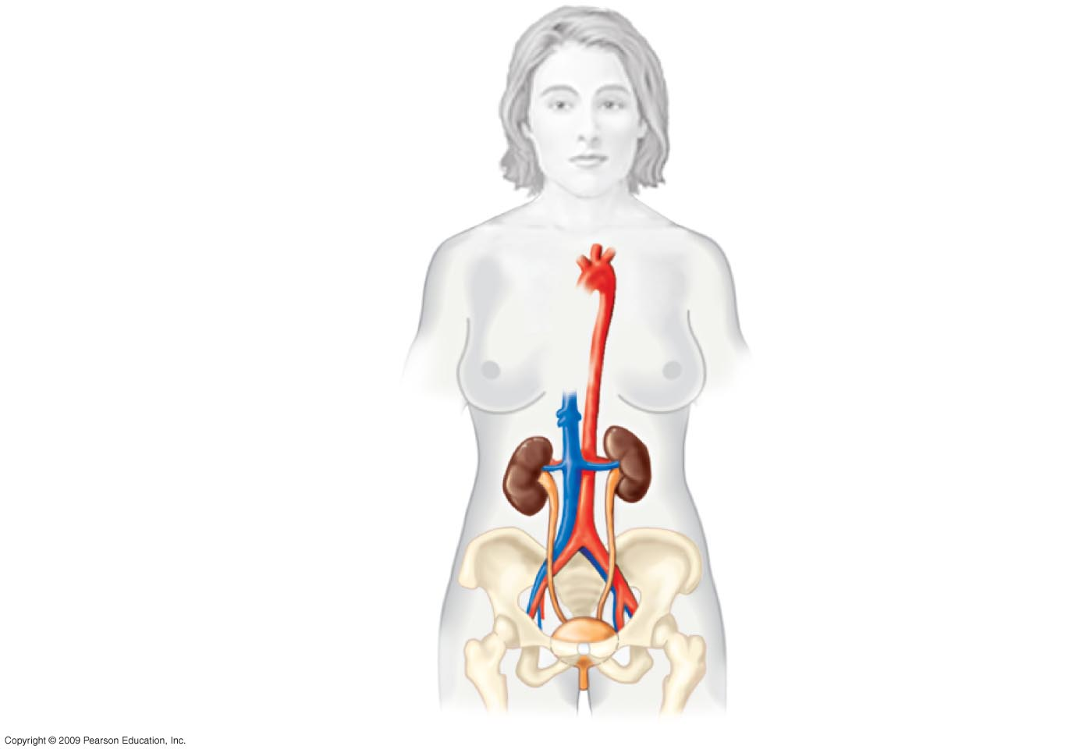
Anatomy of the human excretory system
Aorta
Inferior
vena cava
Renal artery and vein
Kidney
Ureter
Urinary bladder
Urethra
13
Notes:
.

Slide 14
The urinary system plays several major roles in homeostasis
The excretory system
Expels wastes
Regulates water balance
Regulates ion balance
Nephrons
Functional units of the kidneys
Extract a filtrate from the blood
Refine the filtrate to produce urine
14
Notes:
Student Misconceptions and Concerns
1. The kidney’s role in filtration and selective reabsorption may initially be confusing to many students. The process is a bit like cleaning up a closet by removing all the contents and then selectively returning to it what you wish to store.
2. Before addressing the human urinary system, challenge each student in your class to explain how a drink of water may end up as urine. Consider having each students write out their answer on a 3 × 5 card in class. This quick survey will likely reveal misunderstandings that would otherwise be concealed by quiet students’ reluctance to speak up. Students might suggest that some sort of tube transports fluid from the digestive tract to the kidneys or urinary bladder. Such surveys provide a useful means of gauging the initial assumptions of your students as they approach a new subject.
Teaching Tips
1. A moderately full human urinary bladder holds about 500 ml (or 1 pint) of fluid. The bladder’s maximum capacity may be up to double that volume, although if overdistended, it may burst!
2. Students must understand that blood consists of two main components, cells and plasma. If your course has not covered Chapter 23, consider assigning Module 23.12 to ensure that they have this important background knowledge.
3. During the production of urine, blood cells remain within blood vessels, and components of the plasma are filtered out and selectively reabsorbed. Students may appreciate your making this important distinction early on in the discussion of renal functions.

Slide 15
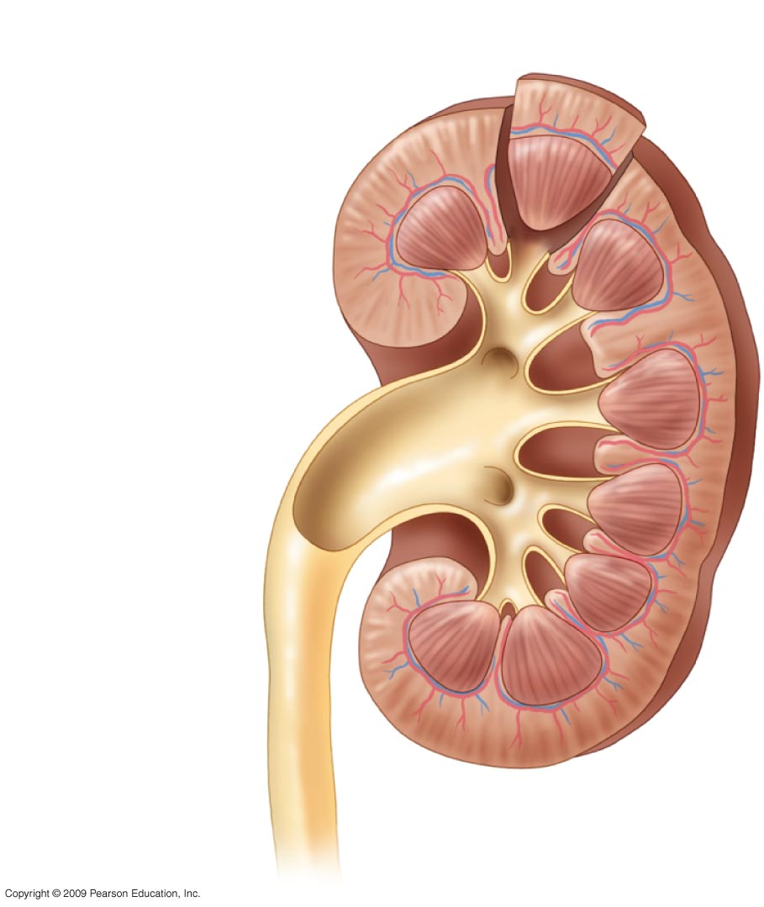
Renal cortex
Renal medulla
Renal pelvis
Ureter
Anatomy of the human excretory system (L.Sec. Kidney)
15

Slide 16
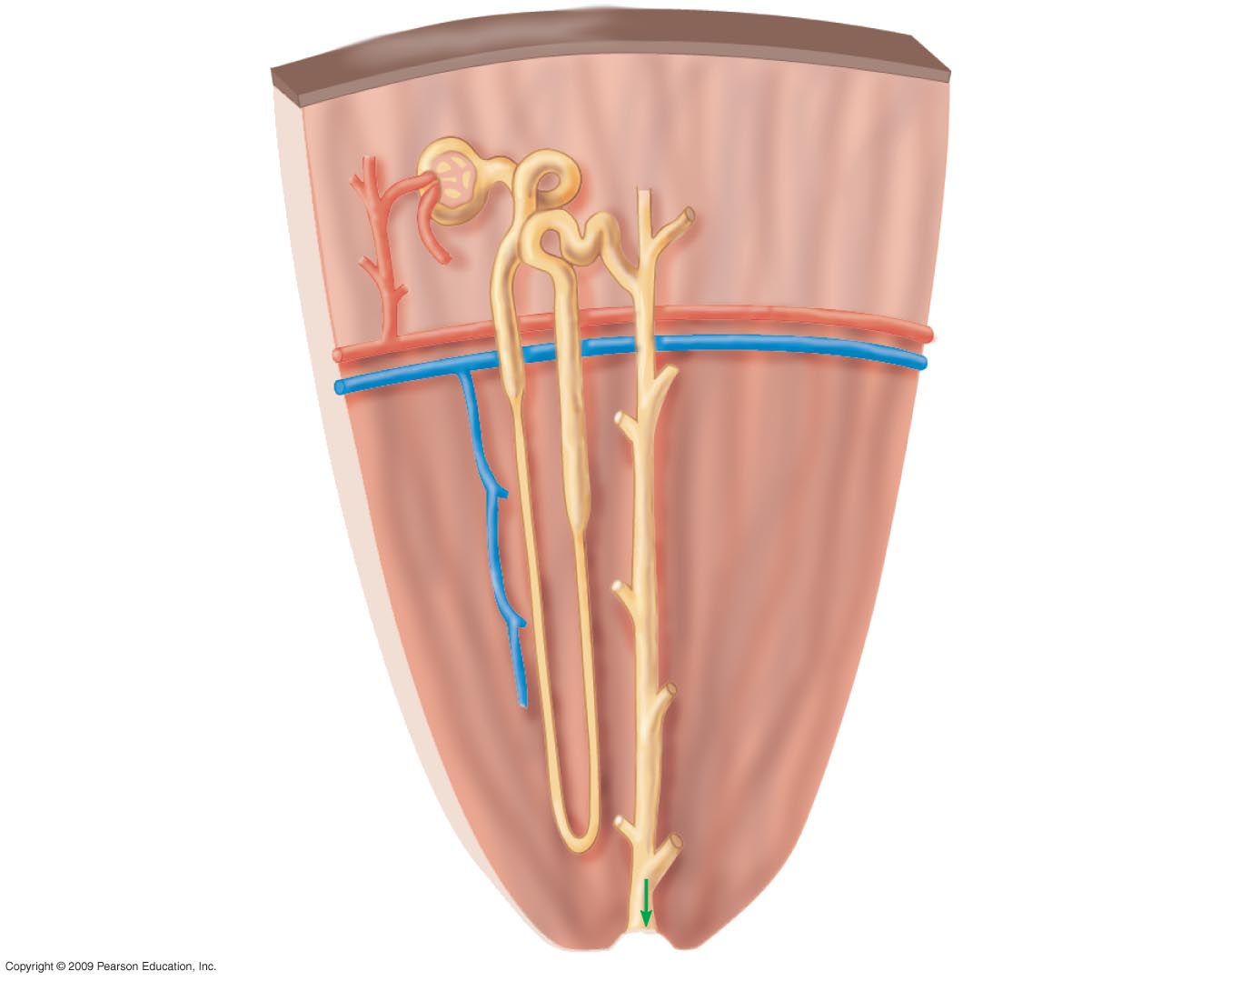
Bowman’s
Capsule
Tubule
Renal cortex
Renal artery
Renal vein
Collecting
Duct
Renal medulla
Anatomy of the human excretory system
(C. Sec. Kidney)
To
renal
Pelvis
16
Notes:
Figure 25.6 Anatomy of the human excretory system. قطاع عرضي في الكلية) ) تشريح الجهاز الاخراجي في الانسان

Slide 17
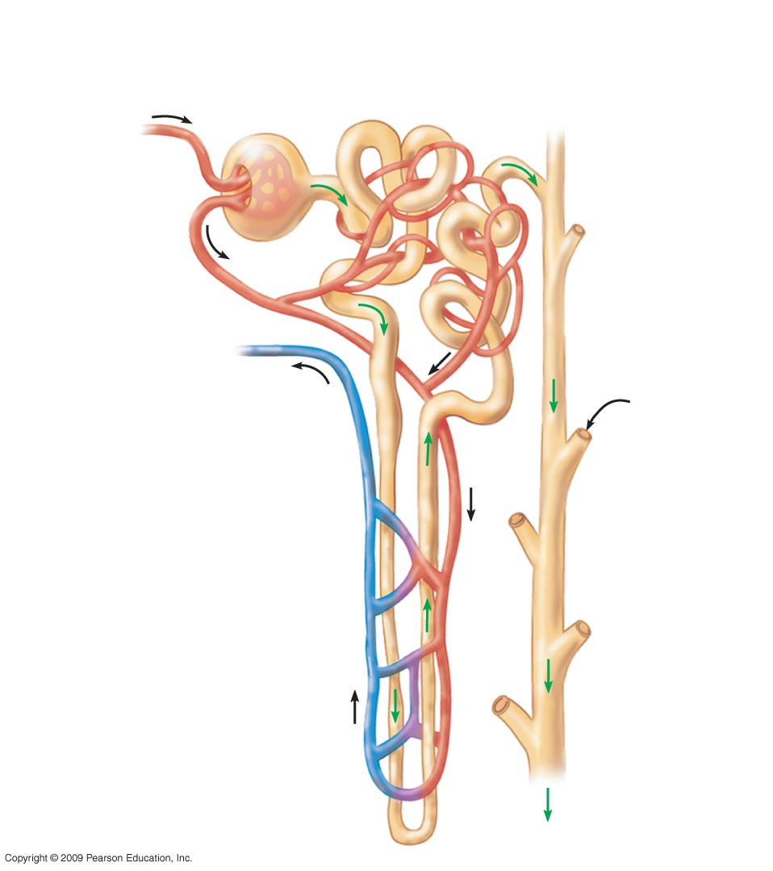
Bowman’s
capsule
Glomerulus
1
Proximal tubule
Capillaries
Arteriole
from renal
artery
Arteriole
from
glomerulus
3
Distal Tubule
From
another
Nephron
Branch of
renal vein
Collecting
Duct
2
Loop of Henle
with capillary
network
Anatomy of the human excretory system (Diagram of a Nephron)
17
Notes:
ا

Slide 18
Excretory Processes The key processes of the urinary system are filtration, reabsorption, secretion and excretion
Filtration
Blood pressure forces water and many small solutes into the nephron
Reabsorption
Valuable solutes are reclaimed from the filtrate
Secretion
Excess toxins and other solutes from the body fluids are added to the filtrate
4) Excretion
The final product, urine, is excreted
18
Notes:
1. The kidney’s role in filtration and selective reabsorption may initially be confusing to many students. The process is a bit like cleaning up a closet by removing all the contents and then selectively returning to it what you wish to store.
Teaching Tips
1. Students must understand that blood consists of two main components, cells and plasma. If your course has not covered Chapter 23, consider assigning Module 23.12 to ensure that they have this important background knowledge.
2. During the production of urine, blood cells remain within blood vessels, and components of the plasma are filtered out and selectively reabsorbed. Students may appreciate your making this important distinction early on in the discussion of renal functions.
3. Some drugs are excreted in urine. This is the basis of drug testing using samples of a person’s urine. Making this simple connection can help generate interest and improve comprehension in your students.

Slide 19
Major Excretory Processes of the urinary system
1
Nephron tubule
2
3
4
Filtration
Reabsorption
Secretion
Excretion
tubule
H₂O, other small molecules
Urine
Capillary
Interstitial fluid
19

Slide 20
Blood filtrate is refined to urine through reabsorption and secretion
Reabsorption in the proximal and distal tubules removes Nutrients, Salt, Water
pH is regulated by
Reabsorption of HCO₃–
Secretion of H⁺
High NaCl concentration in the medulla promotes reabsorption of water.
Antidiuretic hormone (ADH) regulates the amount of water excreted by the kidneys
20
Notes:
Teaching Tips
1. Some drugs are excreted in urine. This is the basis of drug testing using samples of a person’s urine. Making this simple connection can help generate interest and improve comprehension in your students.
2. Students may be particularly interested in the diuretic effects of alcohol and caffeine. The text notes that the diuretic effects of alcohol may contribute to some of the symptoms of a hangover. However, the concentration of alcohol and caffeine are important factors. Higher urine output resulting from the high consumption of low-alcohol (1–5%) beer may largely be the consequence of increased water consumption. Drinks with higher alcohol levels, such as shots of hard liquor (gin, vodka, whiskey) or higher caffeine levels (espresso) and low fluid volume would be expected to better reveal the diuretic effects.

Slide 21
Dispose of nitrogenous wastes in animals
Nitrogenous wastes are toxic breakdown products of protein and nucleic acids (DNA and RNA)
Animals dispose of nitrogenous wastes such as
1) Ammonia (NH₃)
Poisonous
Soluble in water
Easily disposed of by aquatic animals
2) Urea
Less toxic
Easier to store
Some land animals save water by excreting uric acid (dry waste)
3) Urea and uric acid take energy to produce
21
Notes:
Student Misconceptions and Concerns
1. The kidney’s role in filtration and selective reabsorption may initially be confusing to many students. The process is a bit like cleaning up a closet by removing all the contents and then selectively returning to it what you wish to store.
Teaching Tips
1. Student experience with osmoregulation not pertaining to their own bodies may be quite limited. However, many students are familiar with the pasty white color of bird droppings. Consider beginning your discussion of nitrogenous wastes by asking your class to explain why bird droppings are white.

Slide 22
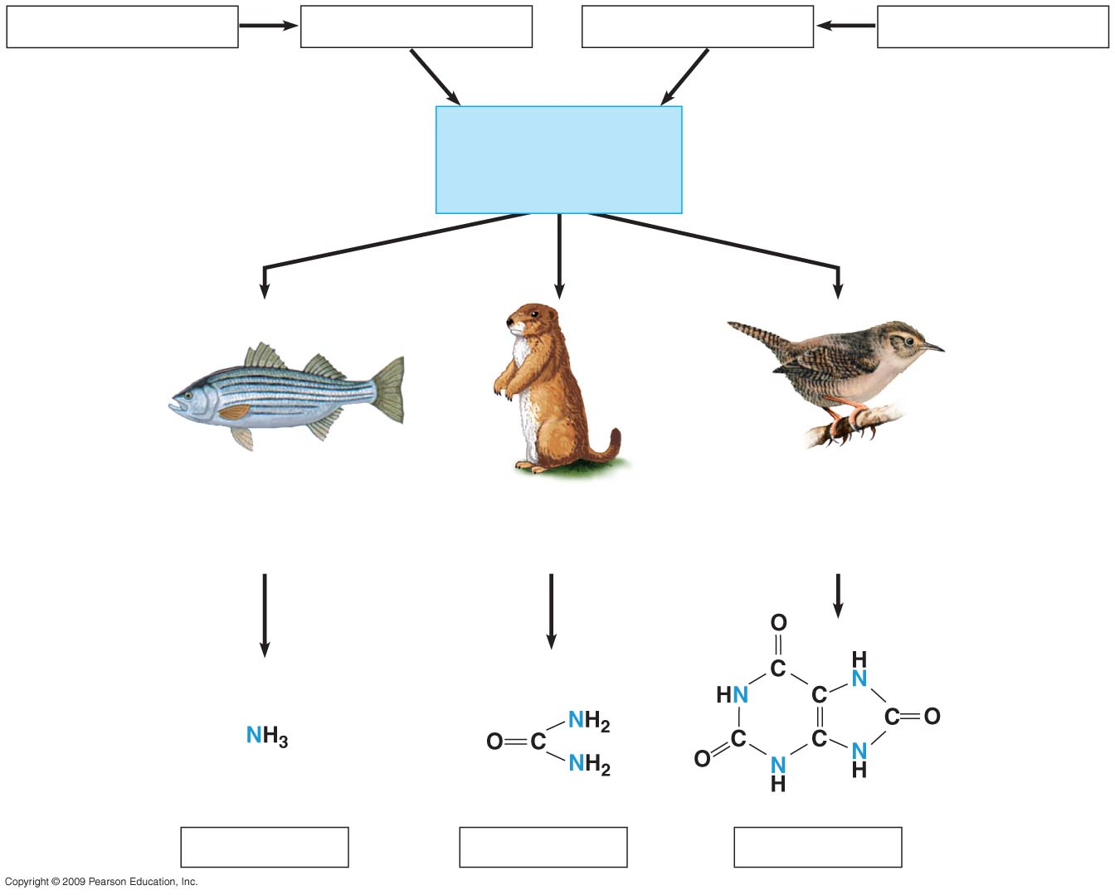
Proteins
Amino acids
Nitrogenous bases
Nucleic acids
Nitrogen-containing metabolic waste products
—NH₂
Amino groups
Most aquatic animals,
including most fishes
Mammals, amphibians,
sharks, some bony
fishes
Birds and many other
reptiles, insects, land
snails
Ammonia
Urea
Uric acid
22
Notes:
Figure 25.5 Nitrogen-containing metabolic waste products.

Slide 23
Kidney dialysis can be a lifesaver
Compensating for kidney failure
A dialysis machine
Removes wastes from the blood
Maintains its solute concentration
23
Notes:
Student Misconceptions and Concerns
1. The kidney’s role in filtration and selective reabsorption may initially be confusing to many students. The process is a bit like cleaning up a closet by removing all the contents and then selectively returning to it what you wish to store.
Teaching Tips
1. It is well established that the loss of one kidney in a human results in enlargement of the remaining kidney, a process known as compensatory hypertrophy. As your time permits, this can provide material for a class discussion or for a special-topic assignment for students with a particular interest.
2. The unfortunate shortage of kidneys and other organs available for transplant is a major health issue. Consider discussing this problem with your class. Many state and federal organ donation organizations can by located by a quick Internet search. The National Kidney Foundation site www.kidney.org/atoz/atozTopic.cfm?topic=11, includes information on kidney donation.

Slide 24
Line from artery
to apparatus
Pump
Tubing made of a
selectively permeable
membrane
Dialyzing
solution
Line from
apparatus
to vein
Fresh dialyzing
solution
Used dialyzing
solution
(with urea and
excess ions)
Kidney dialysis.
24

Slide 25
Excretion in Plants
25
Notes:
25

Slide 26
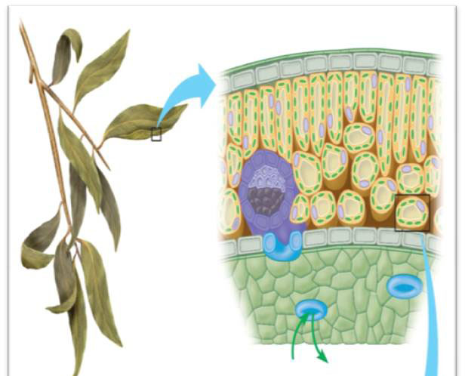
Excretion in Plants
Excretion of Gases
Excess of CO₂ or O₂ in the leaves exit through stomata to the air.
Or they are brought by phloem and xylem from anywhere in the plant body to where there are stomata to exit to the air
They can also penetrate external cell surfaces directly to the air
CO₂
O₂
26

Slide 27
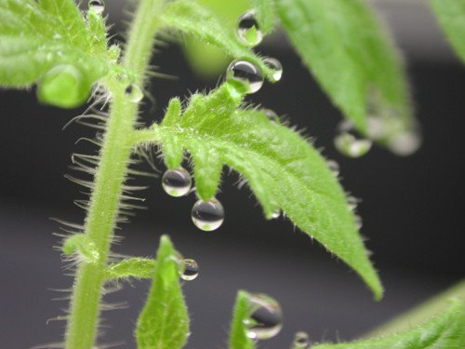
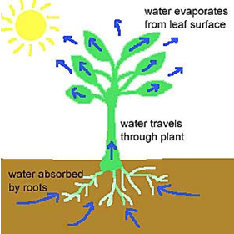
Excretion in Plants
Excretion of water
Guttation
Secretion of water and its solutes by hydathodes found in the leafs epidermis of some plants in hummed environment.
Transpiration
Water evaporates from the surface of leaves through stomata
Water droplets
27

Slide 28
Excretion in Plants
Excretion of Nitrogenous Compounds
Terrestrial plants convert excess amino acids into uric acid and Keto acids by deamination and deposited as crystals in the leafs
In Aquatic plants the excess of amino acids are converted to ammonia and keto acids; ammonia exit outside the plant through stomata
28

Slide 29
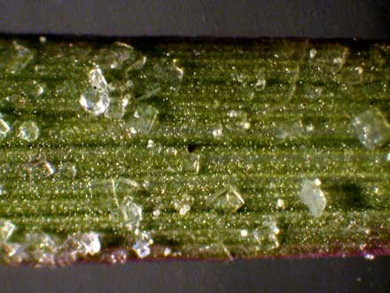
Excretion in Plants
Excretion by Salt glands
Excretion of excess salts outside plant body by special salt glands as in halophytes (plants grow in waters of high salinity).
Salt crystals
29

Slide 30
Control of Body Temperature and Water Balance
التحكم في درجة حرارة الجسم و الاتزان المائي
المصطلـــــــــــــــــــــــــــــــــح | تعريف المصطلــــــــــح
Homeostasis | الاتزان الحيوي
Maintenance Of Steady Internal Conditions | القدرة على الحفاظ على ظروف وأحوال داخلية مستقرة
Fluctuations | التقلبات
Thermoregulation | التنظيم الحراري
Osmoregulation | التنظيم الاسموزي
Excretion | لاخراج
Nitrogen-Containing Wastes | المخلفات المحتوية على النتروجين
Thermoregulation | التنظيم الحراري
Internal Temperature Within A Tolerable Range | المحافظة على درجة حرارة الجسم الداخلية ضمن مدى يمكن تحمله
Ectothermic | خارجية الحرارة
Endothermic | داخلية الحرارة
Conduction | التوصيل
Convection | الحمل الحراري
Radiation | الاشعاع
Evaporation | التبخير

Slide 31
Control of Body Temperature and Water Balance
التحكم في درجة حرارة الجسم و الاتزان المائي
المصطلـــــــــــــــــــــــــــــــــح | تعريف المصطلــــــــــح
Mechanisms Of Heat Exchange | اليات تبادل الحرارة
Adaptations Promote Thermoregulation | التكيفات التي تشجع على التنظيم الحراري
Increased Metabolic Heat Production | زيادة انتاج الحرارة الايضية
Insulation | العزل
Circulatory Adaptations | التكيفات الخاصة بالدورة الدموية
Evaporative Cooling | التبريد بالتبخر
Sweating | التعرق
Panting | للهث
Behavioral Responses | الاستجابات السلوكية
Osmoregulation and Excretion | التنظيم الاسموزي والإخراج
Osmoconformers | الكائنات ذات التوافق الاسموزي
Same Internal Solute Concentration As Seawater | نفس تركيز المواد الذائبة الداخلية كمياه البحر
Marine Invertebrates Are Osmoconformers | اللافقاريات البحرية كائنات ذات توافق اسموزي

Slide 32
Control of Body Temperature and Water Balance
التحكم في درجة حرارة الجسم و الاتزان المائي
المصطلـــــــــــــــــــــــــــــــــح | تعريف المصطلــــــــــح
Osmoregulators Control Their Solute Concentrations | الكائنات ذات التنظيم الاسموزي لها القدرة على التحكم في تراكيز موادها المذابة
Saltwater Fish | اسماك المياه المالحة
Land Animals | حيوانات اليابسة
Nitrogenous Wastes | المخلفات النتروجينية
1-Ammonia (Nh3) | (امونيا (غاز النشادر
Urea | البولينا
Excretory System | الجهاز الاخراجي
Expels Wastes | يطرد المخلفات
Regulates Water Balance | ينظم الاتزان المائي
Regulates Ion Balance | ينظم الاتزان الايوني
Nephrons | (النفرونات) الوحدات البولية
Functional Units Of The Kidneys | الوحدات الوظيفية للكلى
Extract A Filtrate From The Blood | استخلاص المواد الراشحة من الدم
Refine The Filtrate To Produce Urine | تنقية المواد الراشحة لإنتاج البول
Urine | البول

Slide 33
Control of Body Temperature and Water Balance
التحكم في درجة حرارة الجسم و الاتزان المائي
المصطلـــــــــــــــــــــــــــــــــح | تعريف المصطلــــــــــح
Ureters Drain The Kidneys | يفرغ الحالبان الكليتين
Stored In The Urinary Bladder | يخزن في المثانة البولية
Expelled Through The Urethra | يطرح من خلال المجرى البولي
Filtration | الترشيح
Blood Pressure Forces Water And Many Small Solutes Into The Nephron | يدفع ضغط الدم الماء و العديد من المواد المذابة الصغيرة الى الوحدة البولية
Reabsorption | اعادة الامتصاص
Valuable Solutes Are Reclaimed From The Filtrate | يتم استعادة المواد الذائبة النافعة من الراشح
Secretion | الافراز
Excess H⁺ And Toxins Are Added To The Filtrate | يضاف الفائض من ايون الهيدروجين و السموم الى الراشح
Excretion | الاخراج
Final Product, Urine, Is Excreted | اخراج المنتج النهائي وهو البول
Reabsorption In The Proximal And Distal Tubules Removes Nutrients, Salt, Water | يزيح اعادة الامتصاص في الانيببات القريبة والبعيدة المواد المغذية والملح والماء
pH is regulated by | يتم تنظيم الاس الهيدروجيني

Slide 34
Control of Body Temperature and Water Balance
التحكم في درجة حرارة الجسم و الاتزان المائي
المصطلـــــــــــــــــــــــــــــــــح | تعريف المصطلــــــــــح
High Nacl Concentration | تركيز كلوريد الصوديوم العالي
Antidiuretic Hormone (ADH) | الهرمون المضاد للتبول
Regulates The Amount Of Water Excreted By The Kidneys | ينظم كمية الماء التي يتم التخلص منها عن طريق الكليتين
Compensating For Kidney Failure | التعويض عن الفشل الكلوي
A Dialysis Machine | جهاز غسل الكلى
Removes Wastes From The Blood | ازاحة المخلفات من الدم
Solute Concentration | تركيز المواد المذابة
Excretion In Plants | الإخراج فى النبات
Excretion Of Gases | إخراج الغازات
Exit | لخروجه
Penetrate External Cell Surfaces | النفاذ مباشرة عبر سطوح الخلايا الخارجية
Guttation | الإدماع

Slide 35
Control of Body Temperature and Water Balance
التحكم في درجة حرارة الجسم و الاتزان المائي
المصطلـــــــــــــــــــــــــــــــــح | تعريف المصطلــــــــــح
Secretion | إفراز
Hydathodes | الثغور المائية
Humid Environment. | البيئة الرطبة
Terrestrial Plants | النباتات الأرضية
Deamination | بعملية نزع الأمين
Aquatic Plants | النباتات المائية
Converted | تحويل
Salt Glands | بالغدد الملحية
Halophytes | غدد ملحية

