Slide 1
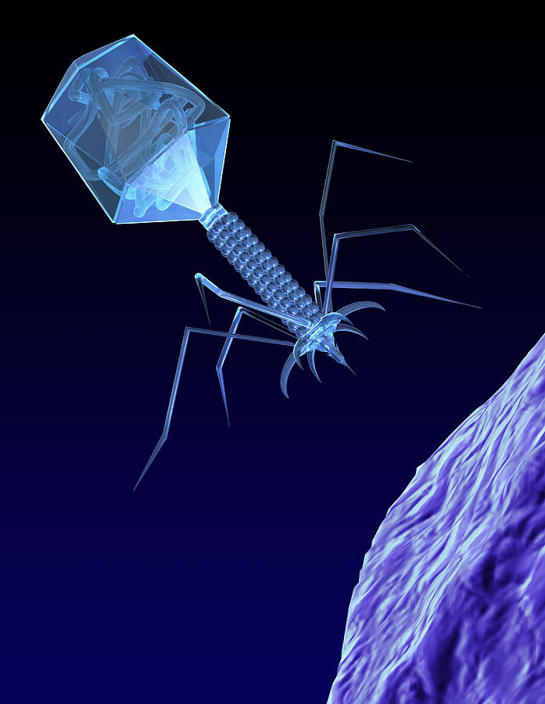
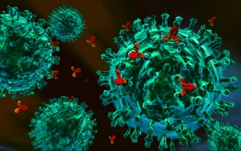
علم الأحياء الدقيقة
Microbiology
Introduction to Virology
& Immunology

Slide 2
What is a virus?
Viruses may be defined as acellular organisms whose genomes consist of nucleic acid (DNA or RNA), and which obligatory replicate inside host cells using host metabolic machinery and ribosomes to form a pool of components.
Components assemble into particles called “VIRIONS”, which serve to protect the genome and to transfer it to other cells.
Acellular forms, most range in size from 5 to 300 nanometers (nm) in diameter with some Paramyxoviruses can be up to 14,000nm long. (n= Nano =10⁻⁹ m ; µ= micro =10⁻⁶ m; m= milli =10⁻³ m).
So small that they readily pass through a very fine porcelain filter.
Two types recognized to belong to this forms :Viruses and Bacteriophages.

Slide 3
What is a virus?
Viruses are obligate intracellular parasitic microorganisms which are smaller than bacteria and so could pass through bacterial filters.
They form a groups which live on other living systems such as humans, animals , insects , plants , fishes and bacteria.
The largest ones coming somewhat closer to the smallest bacterium.
These viruses are highly selective and specific to their hosts.
They are known to be responsible for several diseases of humans, animal, plant, etc.

Slide 4
Viruses
Viruses are infectious agents with both living and nonliving characteristics.
Living characteristics of viruses
They reproduce at an incredible rate, but only in living host cells.
They can mutate.
Non-living characteristics of viruses
They are acellular, that is, they contain no cytoplasm or cellular organelles.
They carry out no metabolism on their own and must replicate using the host cell's metabolic machinery. In other words, viruses don't grow and divide. Instead, new viral components are synthesized and assembled within the infected host cell.
The vast majority of viruses possess either DNA or RNA but not both.

Slide 5
Nature of viruses
Viruses cannot be grown on artificial media.
They can only grow in living organisms or tissue cells which are kept alive in suitable medium.

Slide 6
Morphology of Viruses
According to the shape, viruses can be classified into the following groups :
Spherical. With a size ranging from 18 to 150 nm This includes , as example , the viruses of influenza.
Rod-shaped. They are 300 nm in length and 15 nm in width. It is represented by the tobacco mosaic virus.
Cuboid. With a size ranging from 210 to 305 nm. This form is found in cowpox and canary pox viruses.
Spermatozoid-shaped. The size varies from 10 to 225 nm. This form is a characteristic of phages.

Slide 7
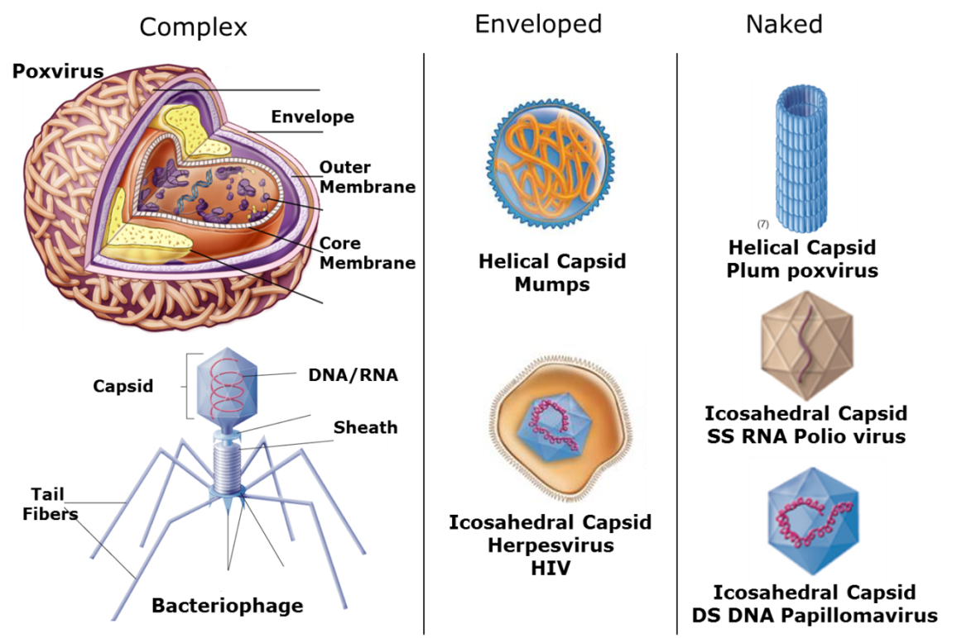

Slide 8
Composition of Viruses
Viruses have the same general chemical characteristics , being composed of molecules of nucleic acid (RNA or DNA) and protein.
The virus unit or particle is called a “VIRIONS”.
This “Virion” is composed of folded strands of nucleic acid inside a coat made of regularly arranged protein subunits (Capsoids).
The simple types of viruses are only nucleoproteins, while the most complex types (as cowpox) contain in addition other compounds such as lipids, carbohydrates and sometimes traces of metals and vitamin-like substances.
The plant viruses mostly contain RNA while the animal viruses may contain either RNA or DNA .
Bacterial viruses or phages usually contain DNA.

Slide 9
Mechanism of Viral infection (Reproduction)
Adsorption: The infective virus has to be bound at first to certain receptors on the outer surface of the host cell.
Penetration: There are two views concerning this phase :
The whole virus consisting of nucleic acid and protein penetrates into the cell , although the protein part has no role on the further steps of infection.
Only the nucleic acid part penetrates into the cell, i.e. the virus has to get rid of its protein coat before penetration
Blocking of cell information:The introduction of viral nucleic acid in the host cell inhibits and blocks the original genetic information in the DNA of the chromosomes, and the nucleus has no longer any control on the cell activity.

Slide 10
Mechanism of Viral infection (Reproduction)
Synthesis of virus components. the viral nucleic acid forces the cell to replicate the virus constituents ( nucleic acid and protein ) . This new synthesis is completed in few hours.
Excretion of the virus: In some viral diseases the excretion or release of the virus is accompanied by the disintegration of the cell, while in others both the nucleus and cytoplasm remain contact.

Slide 11
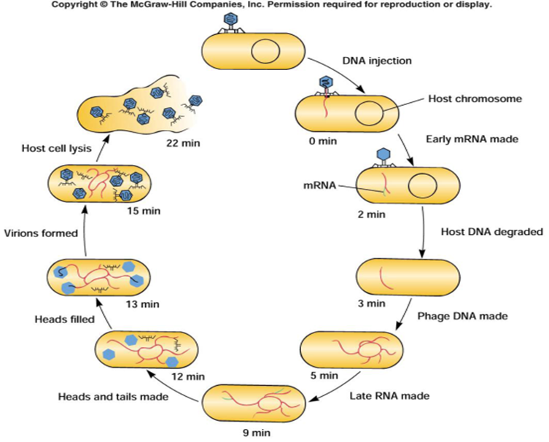

Slide 12
Immunology
Immunology is a branch of biomedical science that covers the study of all aspects of the immune system in all organisms.
It deals with the physiological functioning of the immune system in states of both health and diseases.
Immunity: is a biological term that describes a state of having sufficient biological defenses to avoid infection, disease, or other unwanted biological invasion.
Immunity
Innate immunity
Adaptive immunity

Slide 13
Innate immunity
The innate immune system, also known as non-specific immune system.
It is first line of defense, comprises the cells and mechanisms that defend the host against infections by other organisms.
Innate immune systems provide immediate defense against infection, and are found in all classes of plant and animal life.

Slide 14
Adaptive (acquired) immunity
The adaptive immune system, also known as the specific immune system.
It is composed of highly specialized, systemic cells and processes that eliminate or prevent pathogenic growth.
It is activated by the “non-specific” and evolutionarily older innate immune system.
It is adaptive immunity because the body's immune system prepares itself for future challenges.
The adaptive immune response provides the vertebrate immune system with the ability to recognize and remember specific pathogens (to generate immunity), and to stand stronger against attacks each time the pathogen is encountered.

Slide 15
Types of Immunity
When attacked an organism has several means in which it can prepare to defend itself in event of attack.
Active Immunity (Vaccines ):
Active immunity is acquired from vaccinations or from infection against a pathogen. The next time you encounter the same pathogen your body has built memory against it and will be able to fight it much more efficiently.
Used for health purposes to expose our bodies to a particular antigen. These antigens are usually killed or severely weakened to decrease their potency. After destroying these pathogens, the body stores some T cells as memory cells, due to the fact they code for a particular antigen and can be when needed. This memory in T cells can be a means of artificially acquiring immunity while a genuine attack by a pathogen is a naturally acquired type of immunity.

Slide 16
Types of Immunity
When attacked an organism has several means in which it can prepare to defend itself in event of attack.
Passive Immunity:
Passive immunity is primarily through a mother to a baby or fetus.
Through the placenta the mother transfers her immunity (IgG antibodies) to her fetus.
Also through breast milk she can.
The baby has her/his immunity from the mother but it only lasts a few months because the baby hasn't developed his/her own immunity.

Slide 17
Antigens and antibodies
Antigens
Antigens These are any foreign substance which can stimulate the immune system of our body.
They may be pollen, pathogens, spores, proteins, carbohydrates, nucleic acids or lipids.
In short, antigens are the harmful substances which may disrupt the normal functioning of our body.
In order to stop this disruption, our body produces antibody to protect itself and destroy the antigens.
Antibodies
Antibodies are a protein found in our body, also known as Immunoglobins (Ig).
They are serum proteins, meaning they are usually found in blood and belong to a clan of proteins called gamma globulins.
This protein is produced in response to antigens.
Glycoprotein molecules produced by plasma cells (white blood cells).

Slide 18
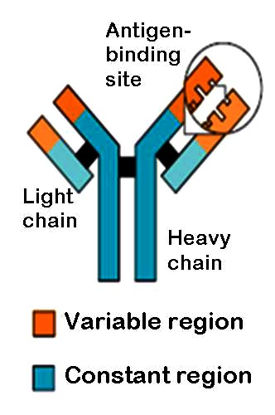
Structure of an Antibody
* Antibodies are Y-shaped proteins with four polypeptide chains.
* The two polypeptide chains are long and identical whereas the other two are also identical but short.
* The long chains are known as Heavy
chains or H chains and the short chains are known as Light chains or L-chains.
* Both the chains are held together by
disulphide bonds like magnets.
* Both chains have a distinct region and a variable region. This variable region is the one where all the action occurs. It acts like a lock and key mechanism, and is used to combine with antigens in a death wrap. This action site is also known as “Paratopes”.

Slide 19
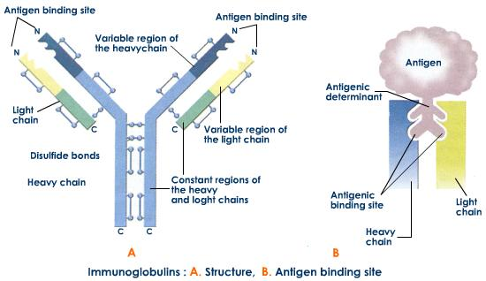
Structure of an Antibody

Slide 20
Types of antibodies
There are five types of antibodies:
IgA- This immunoglobin protects the body against gastro-intestinal and respiratory problems. It is commonly found in milk and saliva.
IgD- This antibody activates the B cell after interacting with any antigen.
IgE- This antibody controls allergic reactions.
IgG- These are extremely important antibodies which stimulate phagocytes. They are the ones that a mother passes on internally to a child for immunity.
IgM- This is the largest antibody. It also helps in the activation of B-cells.

Slide 21
QUESTIONS??

