Slide 1
Copyright © 2012 Pearson Prentice Hall. All rights reserved.

Slide 3
A P P L Y I N G T H E C O N C E P T S
1
How does brand competition within stores affect prices?
Name Brands versus Store Brands
What does it take to enter a market with a franchise?
Opening a Dunkin’ Donuts Shop
What are the effects of market entry?
C3PO and Entry in the Market for Space Flight
What signal does an expensive advertising campaign send to consumers?
Advertising and Movie Buzz
How do firms conspire to fix prices?
Marine Hose Conspirators Go to Prison
2
3
4
5

Slide 4
A P P L Y I N G T H E C O N C E P T S
6
How do patent holders respond to the introduction of generic drugs?
Merck and Pfizer Go Generic
What is the rationale for regulating a natural monopolist?
Public versus Private Waterworks
When does a natural monopoly occur?
Satellite Radio as a Natural Monopoly
Does competition between the second- and third-largest firms matter?
Heinz and Beech-Nut Battle for Second Place
How does a merger affect prices?
Xidex Recovers Its Acquisition Cost in Two Years
7
8
9
10

Slide 5
Market Entry, Monopolistic Competition, and Oligopoly
● monopolistic competition A market served by many firms that sell slightly different products.
The term, monopolistic competition, actually conveys the two key features of the market:
• Each firm in the market produces a good that is slightly different from the goods of other firms, so each firm has a narrowly defined monopoly.
• The products sold by different firms in the market are close substitutes for one another, so there is intense competition between firms for consumers.

Slide 6
THE EFFECTS OF MARKET ENTRY
8.1
M A R G I N A L P R I N C I P L E
Increase the level of an activity as long as its marginal benefit exceeds its marginal cost. Choose the level at which the marginal benefit equals the marginal cost.

Slide 7
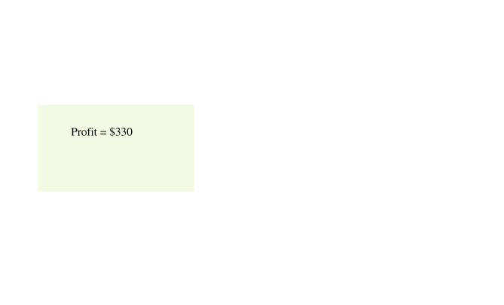
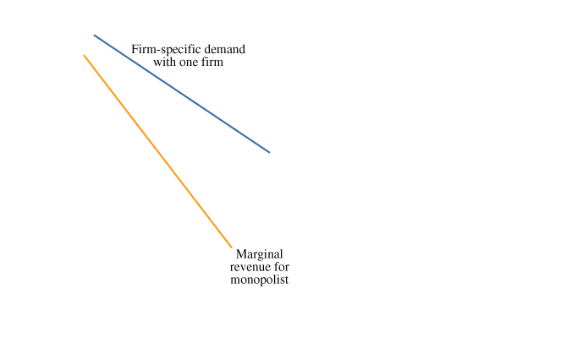
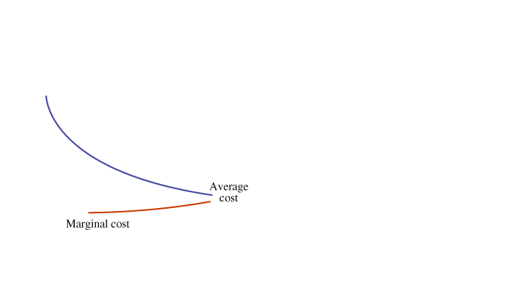
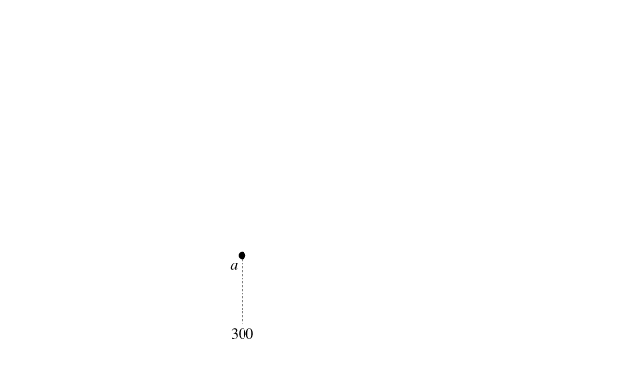
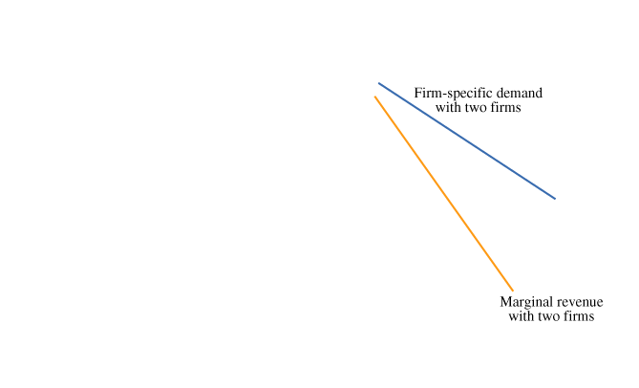
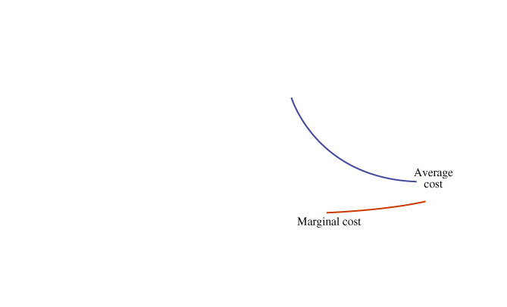
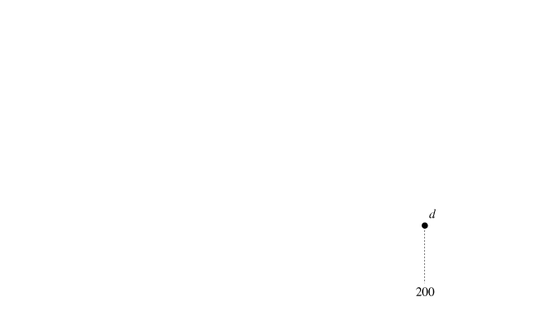
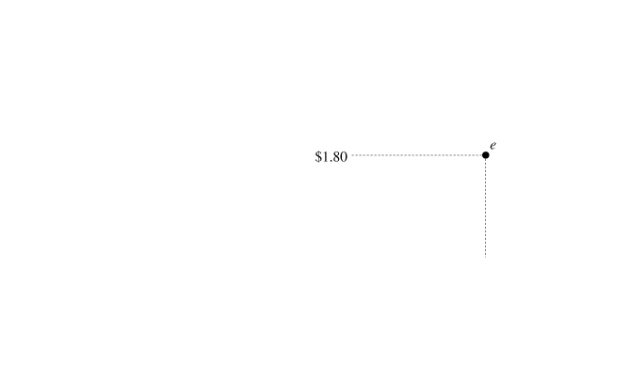
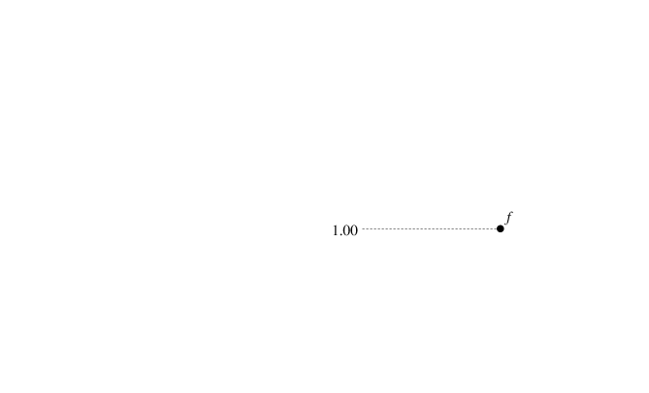
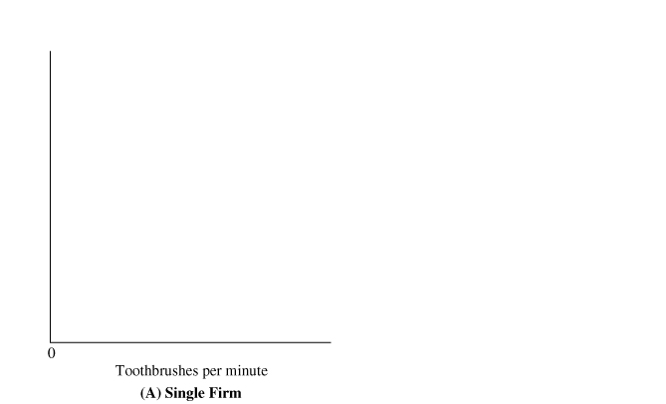
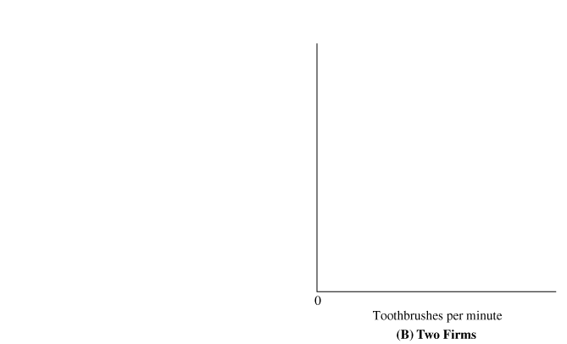
THE EFFECTS OF MARKET ENTRY (cont’d)
8.1
FIGURE 8.1 Market Entry Decreases Price and Squeezes Profit
(A) A monopolist maximizes profit at point a, where marginal revenue equals marginal cost. 300 toothbrushes at a price of $2.00 (point b) and an average cost of $0.90 (point c). Profit of $330 is shown by the shaded rectangle.
(B) Entry of a second firm shifts the firm-specific demand curve for the original firm to the left. The firm produces only 200 toothbrushes (point d) at a lower price ($1.80, shown by point e) and a higher average cost ($1.00, shown by point f). Profit, shown by the shaded rectangle, shrinks to $160.

Slide 8
THE EFFECTS OF MARKET ENTRY (cont’d)
8.1
Entry Squeezes Profits from Three Sides
Entry shrinks the firm’s profit rectangle because it is squeezed from three directions.
The top of the rectangle drops because the price decreases.
The bottom of the rectangle rises because the average cost increases.
The right side of the rectangle moves to the left because the quantity decreases.
Examples of Entry: Stereo Stores, Trucking, and Tires
Empirical studies of other markets provide ample evidence that entry decreases market prices and firms’ profits. In other words, consumers pay less for goods and services, and firms earn lower profits.

Slide 9
A P P L I C A T I O N
1
NAME BRANDS VERSUS STORE BRANDS
APPLYING THE CONCEPTS #1: How does brand competition within stores affect prices?
In many stores, nationally advertised brands share the shelves with store brands. The introduction of a store brand is a form of market entry—a new competitor for a national brand—and usually decreases the price of the national brand.
The classic example of the price effects of store brands occurred in the market for light bulbs:
In the early 1980s, the price of a four-pack of General Electric bulbs was about $3.50.
The introduction of store brands at a price of $1.50 caused General Electric to cut its price to $2.00.
In markets without store brands, the General Electric price remained at $3.50.
For a wide variety of products—laundry detergent, ready-to-eat breakfast cereals, motor oil, and aluminum foil—the entry of store brands decreased the price of national brands.

Slide 10
MONOPOLISTIC COMPETITION
8.2
Under a market structure called monopolistic competition, firms will continue to enter the market until economic profit is zero. Here are the features of monopolistic competition:
• Many firms.
• A differentiated product.
● product differentiation The process used by firms to distinguish their products from the products of competing firms.
• No artificial barriers to entry.

Slide 11
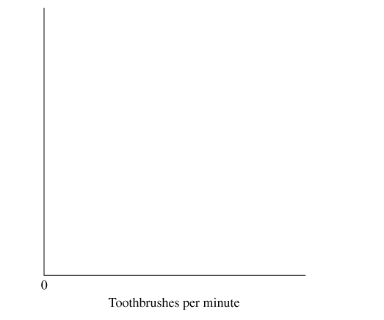
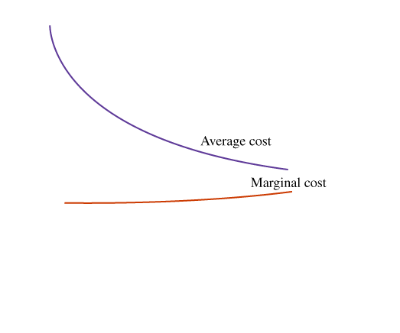
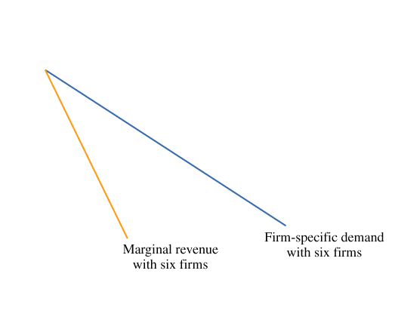
MONOPOLISTIC COMPETITION (cont’d)
8.2
When Entry Stops: Long-Run Equilibrium
FIGURE 8.2 Long-Run Equilibrium with Monopolistic Competition
Under monopolistic competition, firms continue to enter the market until economic profit is zero.
Entry shifts the firm specific demand curve to the left.
The typical firm maximizes profit at point a, where marginal revenue equals marginal cost.
At a quantity of 80 toothbrushes, price equals average cost (shown by point b), so economic profit is zero.

Slide 12
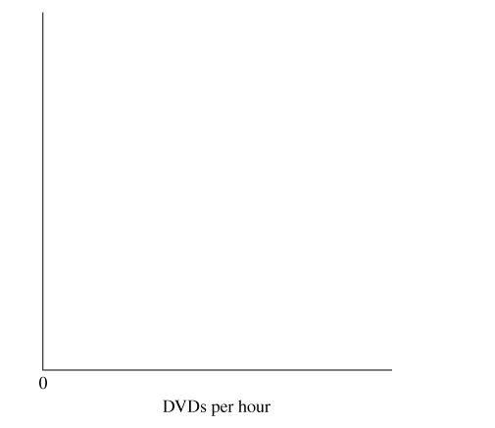
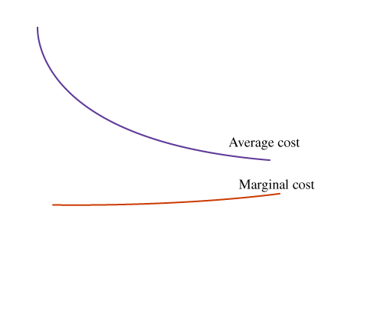
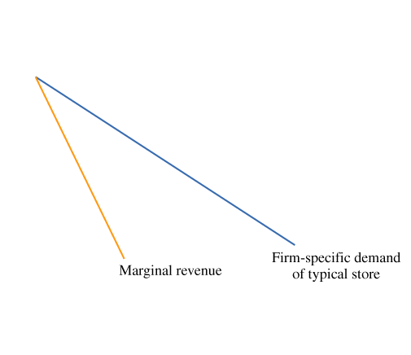
MONOPOLISTIC COMPETITION (cont’d)
8.2
Differentiation by Location
FIGURE 8.3 Long-Run Equilibrium with Spatial Competition
Book stores and other retailers differentiate their products by selling at different locations.
The typical book store chooses the quantity of books at which its marginal revenue equals its marginal cost (point a).
Economic profit is zero because the price equals average cost (point b).

Slide 13
A P P L I C A T I O N
2
OPENING A DUNKIN’ DONUTS SHOP
APPLYING THE CONCEPTS #2: What does it take to enter a market with a franchise?
One way to get into a monopolistically competitive market is to get a franchise for a nationally advertised product.
Table 8.1 shows the franchise fees and royalty rates for several franchising opportunities. The fees indicate how much entrepreneurs are willing to pay for the right to sell a brand-name product.

Slide 14
TRADE-OFFS WITH ENTRY AND MONOPOLISTIC COMPETITION
8.3
Average Cost and Variety
There are some trade-offs associated with monopolistic competition.
Although the average cost of production is higher than the minimum, there is also more product variety.
When firms sell the same product at different locations, the larger the number of firms, the higher the average cost of production.
But when firms are numerous, consumers travel shorter distances to get the product.
Therefore, higher production costs are at least partly offset by lower travel costs.

Slide 15
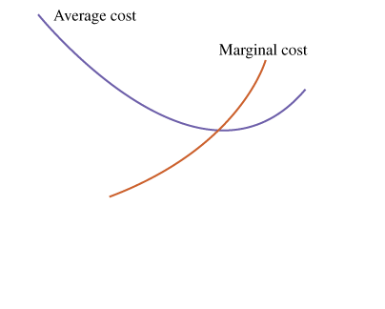
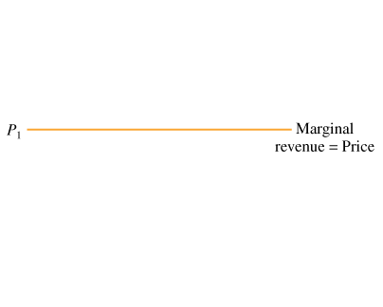
TRADE-OFFS WITH ENTRY AND MONOPOLISTIC COMPETITION (cont’d)
8.3
Monopolistic Competition versus Perfect Competition
FIGURE 8.4 Monopolistic Competition versus Perfect Competition
(A) In a perfectly competitive market, the firm-specific demand curve is horizontal at the market price, and marginal revenue equals price.
In equilibrium, price = marginal cost = average cost.
Equilibrium occurs at the minimum of the average-cost curve.

Slide 16
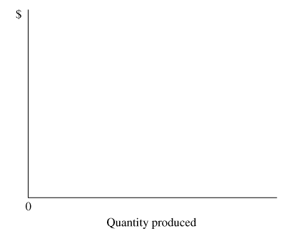
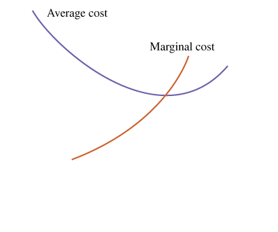
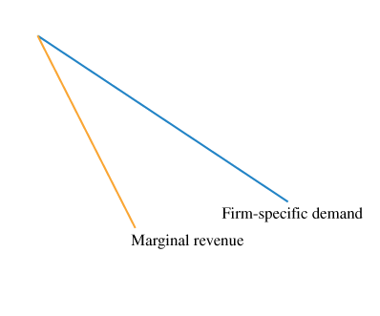
TRADE-OFFS WITH ENTRY AND MONOPOLISTIC COMPETITION (cont’d)
8.3
Monopolistic Competition versus Perfect Competition
FIGURE 8.4 (cont’d.) Monopolistic Competition versus Perfect Competition
(B) In a monopolistically competitive market, the firm- specific demand curve is negatively sloped and marginal revenue is less than price.
In equilibrium, marginal revenue equals marginal cost (point b) and price equals average cost (point c).

Slide 17
A P P L I C A T I O N
3
C3PO AND ENTRY IN THE MARKET FOR SPACE FLIGHT
APPLYING THE CONCEPTS #3: What are the effects of market entry?
Entry into a market increases the competition for consumers, leading to lower prices and profit. Once the shuttle program ends, the Russian Space Agency will charge the monopoly price of $47 million per flight.
The C3PO (Commercial Crew & Cargo Program) should stimulate competition and result in lower prices
NASA expects cheaper more flexible rockets
Price should drop to about $20 million per flight

Slide 18
ADVERTISING FOR PRODUCT DIFFERENTIATION
8.4
Celebrity Endorsements and Signaling
An advertisement that doesn’t provide any product information may actually help consumers make decisions.

Slide 19
A P P L I C A T I O N
4
ADVERTISING AND MOVIE BUZZ
APPLYING THE CONCEPTS #4: What signal does an expensive advertising campaign send to consumers?
For another example of signaling from advertising, consider movies:
A movie distributor may produce several movies each year but advertise just a few of them.
Although there are few repeat consumers for a particular movie, there is word-of-mouth advertising, also known as “buzz”: People who enjoy a movie talk about it and persuade their friends and family members to see it.
An advertisement that gets the buzz started could pay for itself.
In contrast, a distributor won’t expect much buzz from a less-appealing movie, so advertising won’t be sensible.
In general, an expensive advertisement sends a signal that the movie will generate enough word-of-mouth advertising to cover the cost of the advertisement.

Slide 20
WHAT IS AN OLIGOPOLY?
8.5
● concentration ratio The percentage of the market output produced by the largest firms.
An alternative measure of market concentration is the Herfindahl-Hirschman Index (HHI). It is calculated by squaring the market share of each firm in the market and then summing the resulting numbers.
An oligopoly—a market with just a few firms—occurs for three reasons:
1 Government barriers to entry.
2 Economies of scale in production.
3 Advertising campaigns.

Slide 21
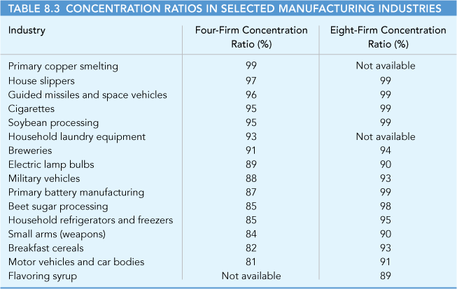
WHAT IS AN OLIGOPOLY?
8.5

Slide 22
CARTEL PRICING AND THE DUOPOLISTS’ DILEMMA
8.6
● duopoly A market with two firms.
● cartel A group of firms that act in unison, coordinating their price and quantity decisions.

Slide 23
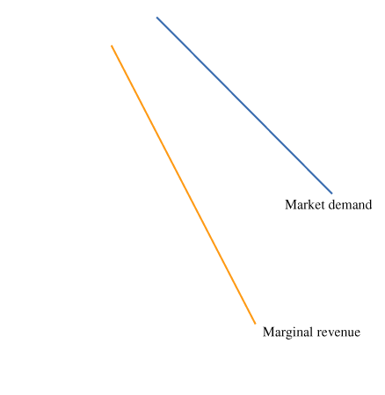
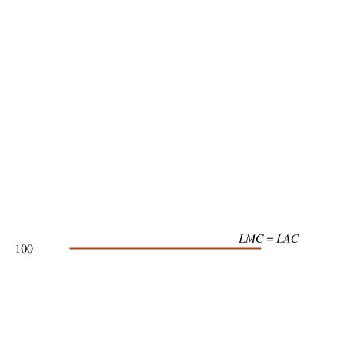
CARTEL PRICING AND THE DUOPOLISTS’ DILEMMA (cont’d)
8.6
profit = (price − average cost) × quantity per firm
FIGURE 8.5 A Cartel Picks the Monopoly Quantity and Price
The monopoly outcome is shown by point a, where marginal revenue equals marginal cost.
The monopoly quantity is 60 passengers and the price is $400.
If the firms form a cartel, the price is $400 and each firm has 30 passengers (half the monopoly quantity).
The profit per passenger is $300 (equal to the $400 price minus the $100 average cost), so the profit per firm is $9,000.
● price-fixing An arrangement in which firms conspire to fix prices.

Slide 24
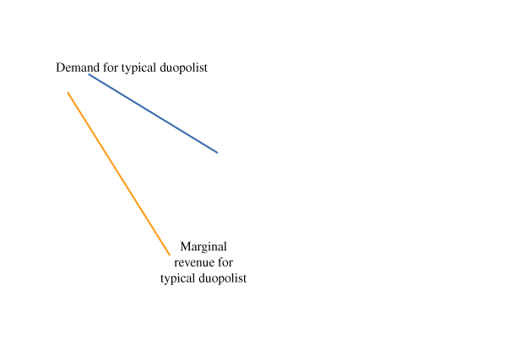
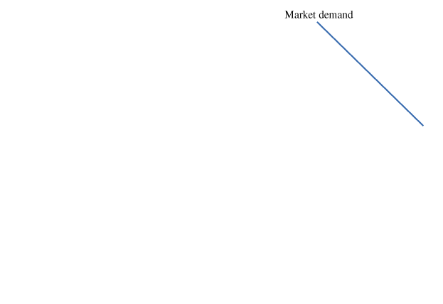
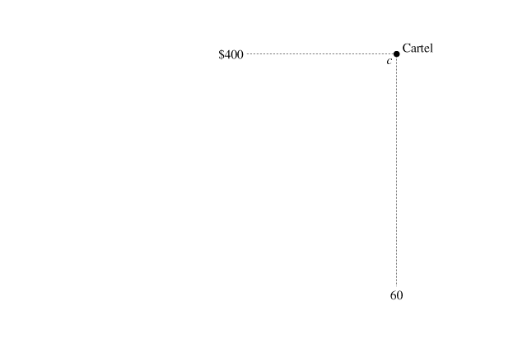
CARTEL PRICING AND THE DUOPOLISTS’ DILEMMA (cont’d)
8.6
FIGURE 8.6 Competing Duopolists Pick a Lower Price
(A) The typical firm maximizes profit at point a, where marginal revenue equals marginal cost. The firm has 40 passengers.
(B) At the market level, the duopoly outcome is shown by point d, with a price of $300 and 80 passengers.
The cartel outcome, shown by point c, has a higher price and a smaller total quantity.

Slide 25
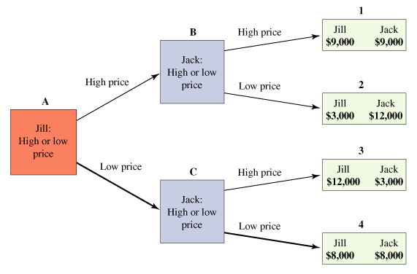
CARTEL PRICING AND THE DUOPOLISTS’ DILEMMA (cont’d)
8.6
Price-Fixing and the Game Tree
● game tree A graphical representation of the consequences of different actions in a strategic setting.
 FIGURE 8.7 Game Tree for the Price-Fixing Game
The equilibrium path of the game is square A to square C to rectangle 4: Each firm picks the low price and earns a profit of $8,000.
The duopolists’ dilemma is that each firm would make more profit if both picked the high price, but both firms pick the low price.

Slide 26
CARTEL PRICING AND THE DUOPOLISTS’ DILEMMA (cont’d)
8.6
Price-Fixing and the Game Tree (pickup)

Slide 27
CARTEL PRICING AND THE DUOPOLISTS’ DILEMMA (cont’d)
8.6
Equilibrium of the Price-Fixing Game
● dominant strategy An action that is the best choice for a player, no matter what the other player does.
● duopolists’ dilemma A situation in which both firms in a market would be better off if both chose the high price, but each chooses the low price.

Slide 28
CARTEL PRICING AND THE DUOPOLISTS’ DILEMMA (cont’d)
8.6
Nash Equilibrium
● Nash equilibrium An outcome of a game in which each player is doing the best he or she can, given the action of the other players.

Slide 29
OVERCOMING THE DUOPOLISTS’ DILEMMA
8.7
Low-Price Guarantees
● low-price guarantee A promise to match a lower price of a competitor.

Slide 30
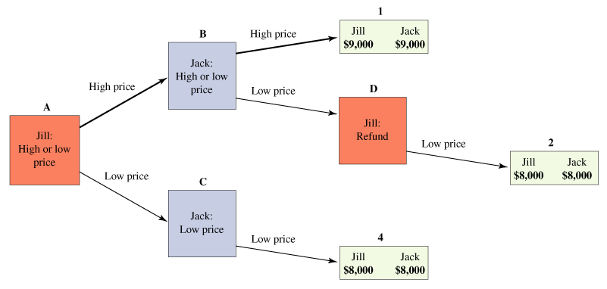
OVERCOMING THE DUOPOLISTS’ DILEMMA (cont’d)
8.7
Low-Price Guarantees
FIGURE 8.8 Low-Price Guarantees Increase Prices
When both firms have a low-price guarantee, it is impossible for one firm to underprice the other. The only possible outcomes are a pair of high prices (rectangle 1) or a pair of low prices (rectangles 2 or 4).
The equilibrium path of the game is square A to square B to rectangle 1. Each firm picks the high price and earns a profit of $9,000.

Slide 31
OVERCOMING THE DUOPOLISTS’ DILEMMA (cont’d)
8.7
Repeated Pricing Games with Retaliation for Underpricing
Repetition makes price-fixing more likely because firms can punish a firm that cheats on a price-fixing agreement, whether it’s formal or informal:
1 A duopoly pricing strategy.
Choosing the lower price for life.
2 A grim-trigger strategy.
● grim-trigger strategy A strategy where a firm responds to underpricing by choosing a price so low that each firm makes zero economic profit.
3 A tit-for-tat strategy.
● tit-for-tat A strategy where one firm chooses whatever price the other firm chose in the preceding period.

Slide 32
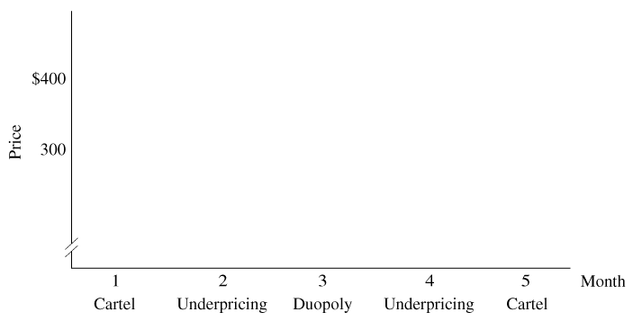
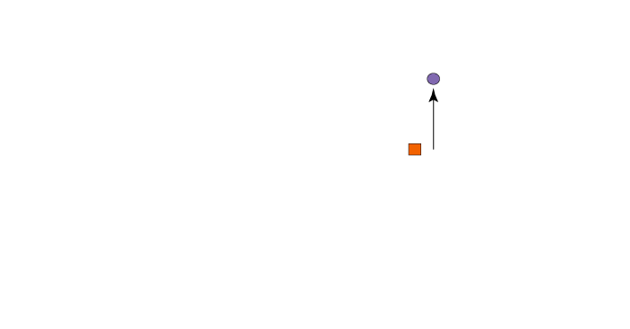
OVERCOMING THE DUOPOLISTS’ DILEMMA (cont’d)
8.7
Repeated Pricing Games with Retaliation for Underpricing
FIGURE 8.9 A Tit-for-Tat Pricing Strategy (cont’d)
Under tit-for-tat retaliation, the first firm (Jill, the square) chooses whatever price the second firm (Jack, the circle) chose the preceding month.

Slide 33
OVERCOMING THE DUOPOLISTS’ DILEMMA (cont’d)
8.7
Price-Fixing and the Law
Under the Sherman Antitrust Act of 1890 and subsequent legislation, explicit price-fixing is illegal.
It is illegal for firms to discuss pricing strategies or methods of punishing a firm that underprices other firms.

Slide 34
A P P L I C A T I O N
5
MARINE HOSE CONSPIRATORS GO TO PRISON
APPLYING THE CONCEPTS #5: How do firms conspire to fix prices?
In 2007, the U.S. government discovered a seven-year conspiracy to fix the price of marine hose, which is used to transfer oil from tankers to onshore storage facilities.
The case ultimately led to fines and prison sentences for the employees of several marine-hose firms and for a person paid by the firms to coordinate the price-fixing scheme.
The executives were arrested after a meeting in Houston in which they allocated customers to different members of the cartel and fixed prices.
Each firm in the cartel agreed to submit artificially high bids for customers allocated to other firms, a practice known as bid rigging.
There is some evidence that prison sentences are more effective than fines in deterring business crimes such as price fixing.
In the United States, people convicted of price fixing regularly offer to pay bigger fines to avoid prison.

Slide 35
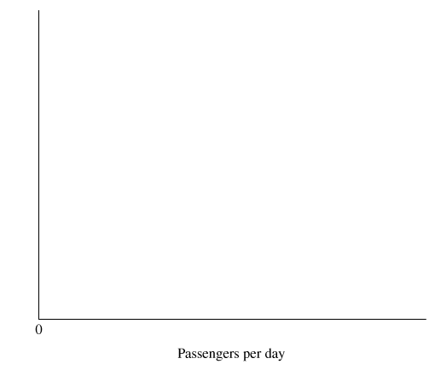
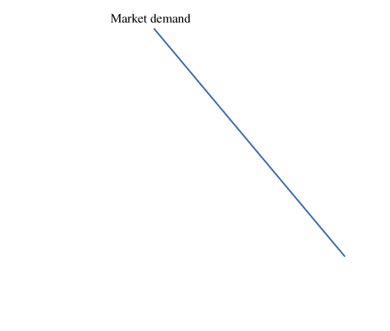
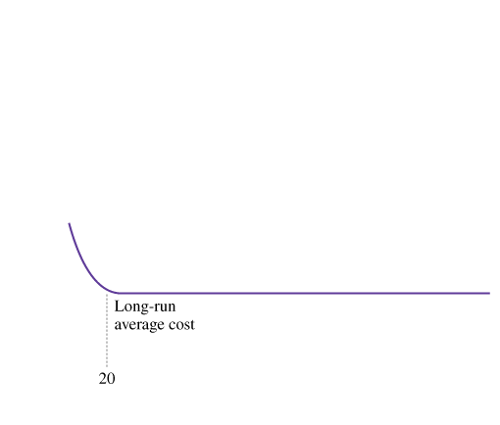
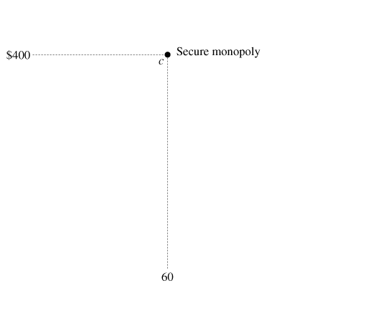
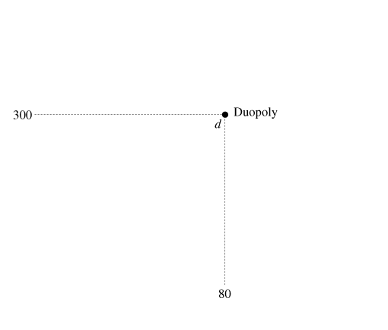
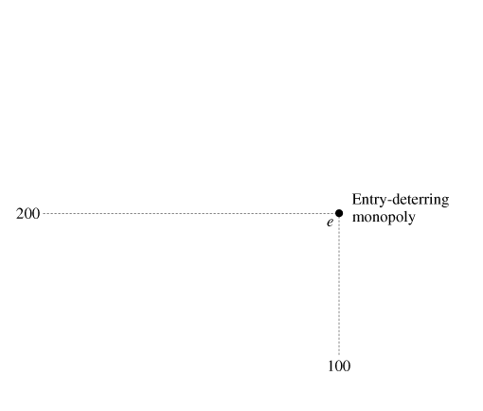
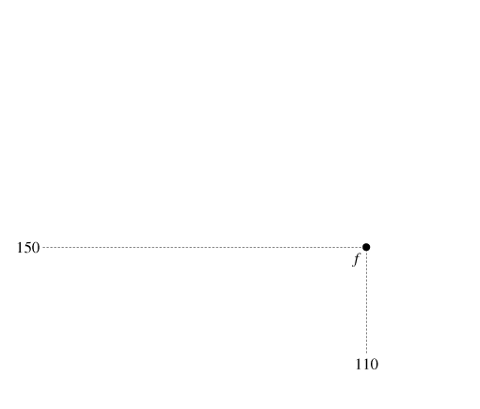
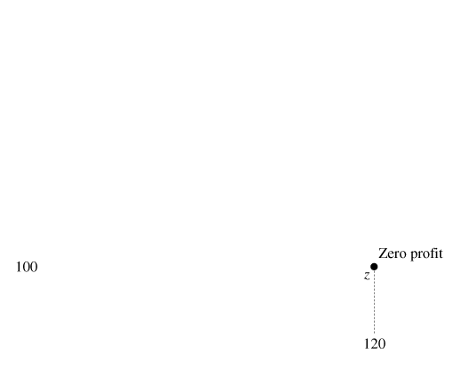
THE INSECURE MONOPOLIST AND ENTRY DETERRENCE
8.8
The Passive Approach
FIGURE 8.10 Deterring Entry with Limit Pricing
Point c shows a secure monopoly, point d shows a duopoly, and point z shows the zero-profit outcome.
The minimum entry quantity is 20 passengers, so the entry- deterring quantity is 100 (equal to 120 – 20), as shown by point e. The limit price is $200.

Slide 36
THE INSECURE MONOPOLIST AND ENTRY DETERRENCE (cont’d)
8.8
Entry Deterrence and Limit Pricing
The quantity required to prevent the entry of the second firm is computed as follows:
deterring quantity = zero profit quantity − minimum entry quantity

Slide 37
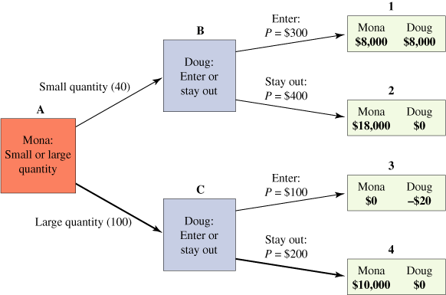
THE INSECURE MONOPOLIST AND ENTRY DETERRENCE (cont’d)
8.8
Entry Deterrence and Limit Pricing
 FIGURE 8.11 Game Tree for the Entry-Deterrence Game
The path of the game is square A to square C to rectangle 4. Mona commits to the entry-deterring quantity of 100, so Doug stays out of the market.
Mona’s profit of $10,000 is less than the monopoly profit but more than the duopoly profit of $8,000.

Slide 38
THE INSECURE MONOPOLIST AND ENTRY DETERRENCE (cont’d)
8.8
Entry Deterrence and Limit Pricing
● limit pricing The strategy of reducing the price to deter entry.
● limit price The price that is just low enough to deter entry.

Slide 39
A P P L I C A T I O N
6
MERCK AND PFIZER GO GENERIC?
APPLYING THE CONCEPTS #6: How do patent holders respond to the introduction of generic drugs?
Between 2006 and 2011 many top-selling branded drugs will lose their patent protection. Producers of generic versions will enter markets with hundreds of billions of dollars in annual sales.
There are two way companies are responding to this increased competition.
Companies are producing their own versions of generic drugs
They are cutting the prices of branded drugs to compete with the generic versions.

Slide 40
THE INSECURE MONOPOLIST AND ENTRY DETERRENCE (cont’d)
8.8
Examples: Microsoft Windows and Campus Bookstores
Microsoft picks a lower price to discourage entry and preserve its monopoly. If your campus bookstore suddenly feels insecure about its monopoly position, it could cut its prices to prevent online booksellers from capturing too many of its customers.
Entry Deterrence and Contestable Markets
● contestable market A market with low entry and exit costs.
When Is the Passive Approach Better?
Entry deterrence is not the best strategy for all insecure monopolists.
Sharing a duopoly can be more profitable than increasing output and cutting the price to keep the other firm out.

Slide 41
NATURAL MONOPOLY
8.9
Picking an Output Level
M A R G I N A L P R I N C I P L E
Increase the level of an activity as long as its marginal benefit exceeds its marginal cost. Choose the level at which the marginal benefit equals the marginal cost.

Slide 42
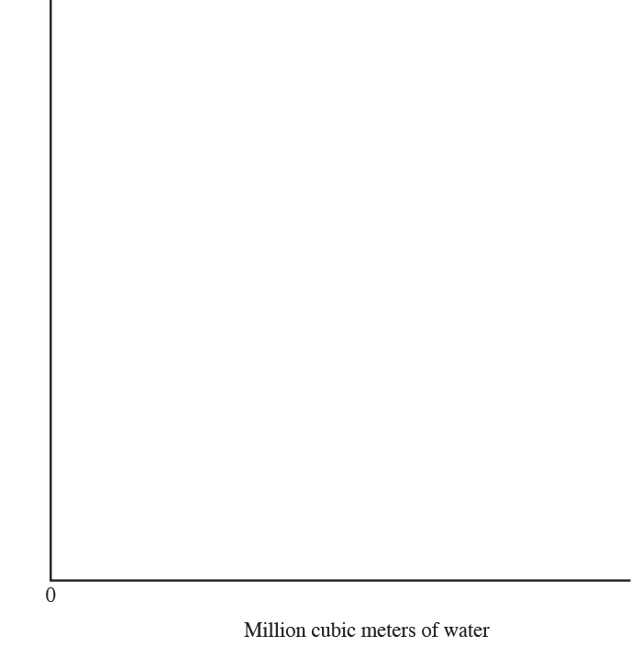
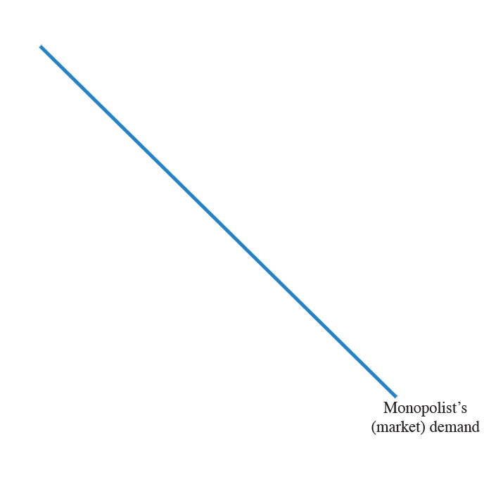
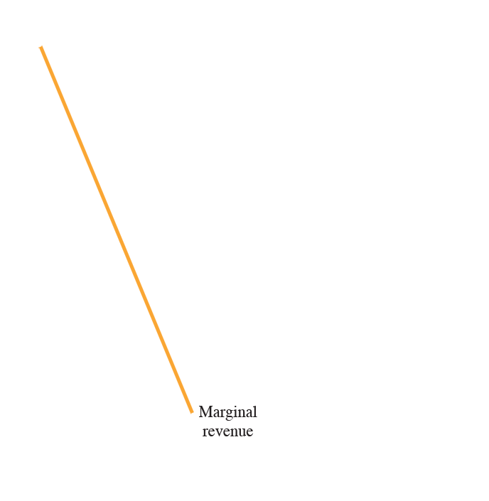
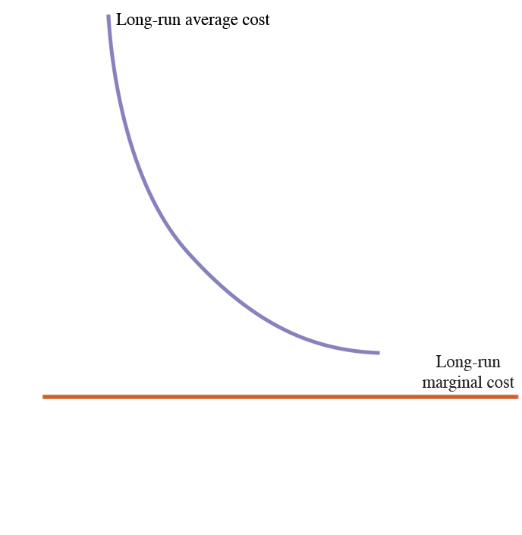
NATURAL MONOPOLY (cont’d)
8.9
Picking an Output Level
FIGURE 8.12
A Natural Monopoly Uses the Marginal Principle to Pick Quantity and Price
Because of the indivisible input of cable service (the cable system), the long-run average-cost curve is negatively sloped.
The monopolist chooses point a, where marginal revenue equals marginal cost.
The firm serves 70,000 subscribers at a price of $27 each (point b) and an average cost of $21 (point c). The profit per subscriber is $6 ($27 – $21).

Slide 43
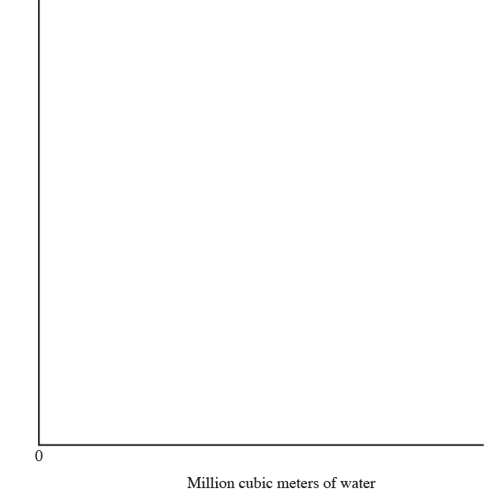
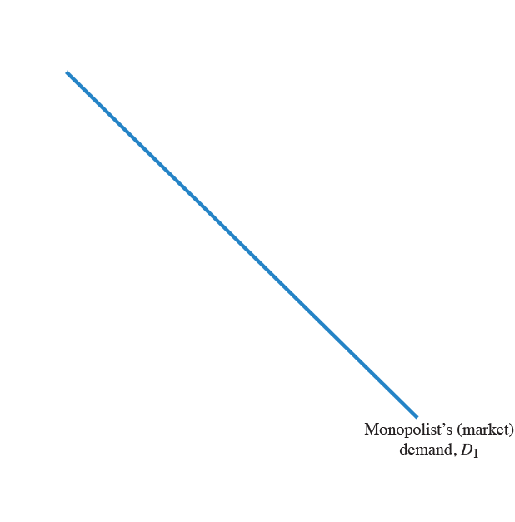
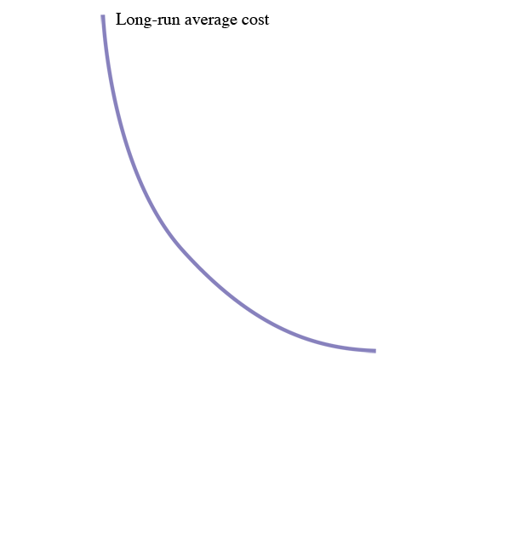
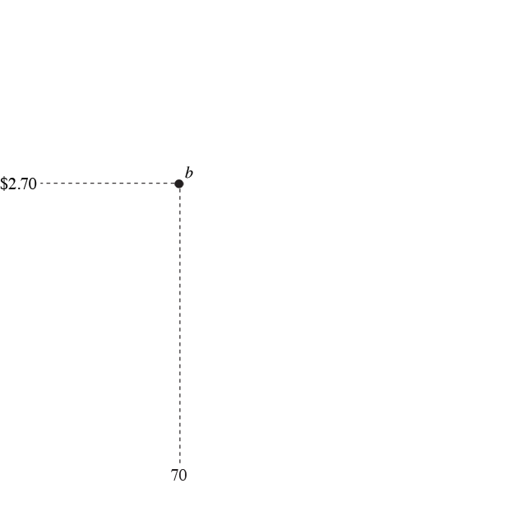
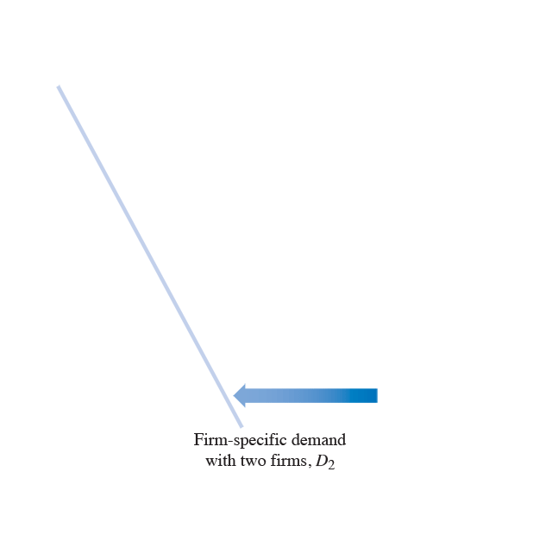
NATURAL MONOPOLY (cont’d)
8.9
Will a Second Firm Enter?
FIGURE 8.13 Will a Second Firm Enter the Market?
The entry of a second cable firm would shift the demand curve of the typical firm to the left.
After entry, the firm’s demand curve lies entirely below the long-run average-cost curve.
No matter what price the firm charges, it will lose money. Therefore, a second firm will not enter the market.

Slide 44
NATURAL MONOPOLY (cont’d)
8.9
Price Controls for a Natural Monopoly
 FIGURE 8.14 Regulators Use Average-Cost Pricing to Pick a Monopoly’s Quantity and Price
Under an average-cost pricing policy, the government chooses the price at which the demand curve intersects the long-run average-cost curve—$12 per subscriber.
Regulation decreases the price and increases the quantity.

Slide 45
A P P L I C A T I O N
7
PUBLIC VERSUS PRIVATE WATERWORKS
APPLYING THE CONCEPTS #7: What is the rationale for regulating a natural monopoly?
In the early part of the nineteenth century, public water works could not keep up with rapidly growing demand, so cities allowed private companies to provide water.
However, problems with competing private wager providers caused cities to switch back to public systems
The British determined that water distribution is a natural monopoly and allowing competition hurts rather than helps public access to water.

Slide 46
A P P L I C A T I O N
8
SATELLITE RADIO AS A NATURAL MONOPOLY
APPLYING THE CONCEPTS #8: When does a natural monopoly occur?
In 2008, the nation’s only two satellite radio providers, Sirius Satellite Radio and XM Satellite Radio, merged into a single firm. Together the two firms had 14 million subscribers, each paying $13 per month for dozens of channels, most of which are free of advertisements. Both firms were losing money as they struggled to get enough subscribers to cover their substantial fixed costs.
The proposed merger needed to be approved by the U.S. Department of Justice and the Federal Communication Commission.
Two years later, the new firm, Sirius XM, earned its first quarterly profit of $14.2 million, compared to a loss one year earlier of $245.8 million.
The merger transformed two unprofitable firms into a single profitable firm.

Slide 47
ANTITRUST POLICY
8.10
● trust An arrangement under which the owners of several companies transfer their decision-making powers to a small group of trustees.
Breaking Up Monopolies
One form of antitrust policy is to break up a monopoly into several smaller firms. The label “antitrust” comes from the names of the early conglomerates that the government broke up.

Slide 48
ANTITRUST POLICY (cont’d)
8.10
Blocking Mergers
● merger A process in which two or more firms combine their operations.
A horizontal merger involves two firms producing a similar product, for example, two producers of pet food.
A vertical merger involves two firms at different stages of the production process, for example, a sugar refiner and a candy producer..

Slide 49
ANTITRUST POLICY (cont’d)
8.10
Blocking Mergers
FIGURE 8.15 Pricing by Staples in Cities with and without Competition
Using the marginal principle, Staples picks the quantity at which marginal revenue equals marginal cost.
In a city without a competing firm, Staples picks the monopoly price of $14.
In a city where Staples competes with Office Depot, the demand facing Staples is lower, so the profit- maximizing price is only $12.

Slide 50
ANTITRUST POLICY (cont’d)
8.10
Merger Remedy for Wonder Bread
In some cases, the government allows a merger to happen but imposes restrictions on the new company.

Slide 51
ANTITRUST POLICY (cont’d)
8.10
Regulating Business Practices: Price-Fixing, Tying, and Cooperative Agreements
● tie-in sales A business practice under which a business requires a consumer of one product to purchase another product.
● predatory pricing A firm sells a product at a price below its production cost to drive a rival out of business and then increases the price.

Slide 52
ANTITRUST POLICY (cont’d)
8.10
The Microsoft Cases
In recent years, the most widely reported antitrust actions have involved Microsoft Corporation, the software giant.
In the case of United States v. Microsoft Corporation, the judge concluded that Microsoft stifled competition in the software industry.

Slide 53
ANTITRUST POLICY (cont’d)
8.10
A Brief History of U.S. Antitrust Policy

Slide 54
A P P L I C A T I O N
9
HEINZ AND BEECH-NUT BATTLE FOR SECOND PLACE
APPLYING THE CONCEPTS #9: Does competition between the second- and third-largest firms matter?
In 2001, H.J. Heinz Company announced plans to buy Milnot Holding Company’s Beech-Nut for $185 million. The merger would combine the nation’s second- and third-largest sellers of baby food, with a combined market share of 28 percent. The combined company would still be less than half the size of the market leader, Gerber, with its 70 percent market share.
The FTC successfully blocked the merger, based on two observations:
Most retailers stock only two brands of baby food, Gerber and either Heinz or Beech-Nut. After the merger, the Heinz brand would disappear, leaving Beech-Nut as a secure second brand on the shelves next to Gerber. The elimination of competition for second place would lead to higher prices.
The smaller the number of firms in an oligopoly, the easier it is to coordinate pricing. In a market with two firms instead of three, it would be easier for the baby-food manufacturers to fix prices.

Slide 55
A P P L I C A T I O N
10
XIDEX RECOVERS ITS ACQUISITION COST IN TWO YEARS
APPLYING THE CONCEPTS #10: How does a merger affect prices?
In 1981 the FTC brought an antitrust suit against Xidex Corporation for its earlier acquisition of two rivals in the microfilm market.
Xidex increased its market share from 46 percent to 71 percent.
Price on one type of microfilm increased by 11 percent.
Price on the other type increased by 23 percent.
Xidex recovered it acquisition cost in two years.
Xidex agreed to license its microfilm at bargain prices to other firms

Slide 56
K E Y T E R M S
cartel
concentration ratio
contestable market
dominant strategy
duopolists’ dilemma
duopoly
game theory
game tree
grim-trigger strategy
low-price guarantee
limit price
limit pricing
merger
monopolistic competition
Nash equilibrium
oligopoly
predatory pricing
price-fixing
product differentiation
tie-in sales
tit-for-tat
trust

