Slide 1
Copyright © 2012 Pearson Prentice Hall. All rights reserved.

Slide 3
A P P L Y I N G T H E C O N C E P T S
1
When the wage increases, will the typical person work more hours or fewer hours?
Cabbies Respond to an Increase in the Wage
Who benefits from the immigration of low-skilled workers?
Trade-Offs from Immigration
What explains differences in wages?
The Beauty Premium
How does racial discrimination affect the labor market?
Lakisha Washington versus Emily Walsh
2
3
4

Slide 4
10.1
THE DEMAND FOR LABOR
Labor Demand by an Individual Firm in the Short Run
M A R G I N A L P R I N C I P L E
Increase the level of an activity as long as its marginal benefit exceeds its marginal cost. Choose the level at which the marginal benefit equals the marginal cost.
The firm will pick the quantity of labor at which the marginal benefit of labor equals the marginal cost of labor.

Slide 5
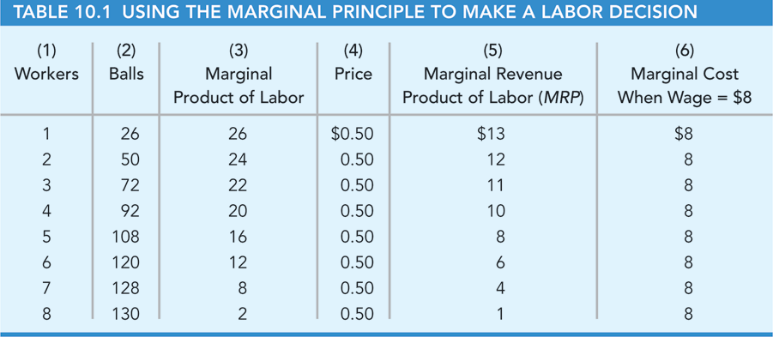
10.1
THE DEMAND FOR LABOR (cont’d)
Labor Demand by an Individual Firm in the Short Run
P R I N C I P L E O F D I M I N I S H I N G R E T U R N S
Suppose output is produced with two or more inputs and we increase one input while holding the other input or inputs fixed. Beyond some point—called the point of diminishing returns —output will increase at a decreasing rate.

Slide 6
10.1
THE DEMAND FOR LABOR (cont’d)
Labor Demand by an Individual Firm in the Short Run
● marginal product of labor The change in output from one additional unit of labor.
● marginal-revenue product of labor (MRP) The extra revenue generated from one additional unit of labor; MRP is equal to the price of output times the marginal product of labor.

Slide 7
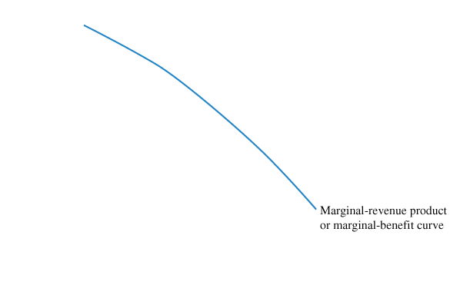
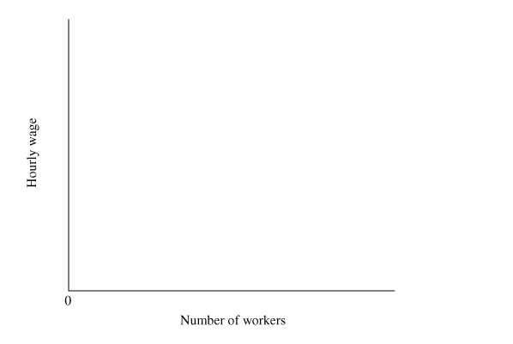
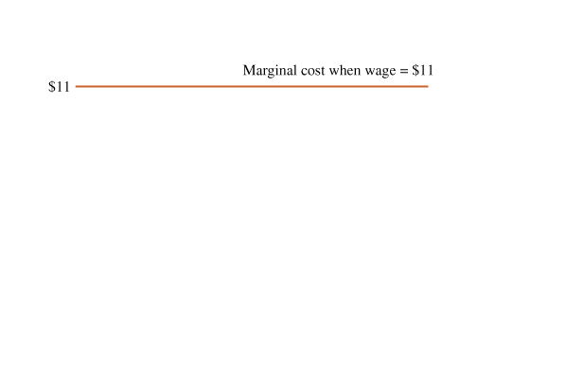
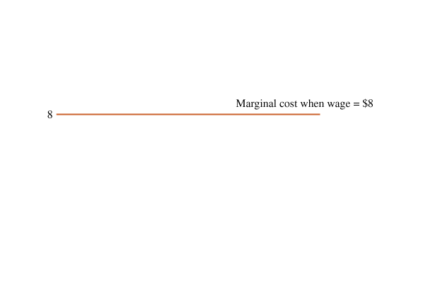
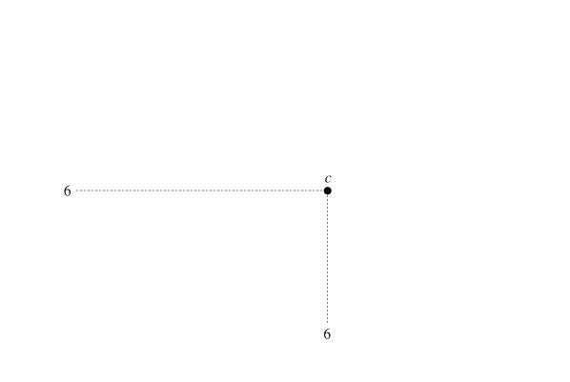
10.1
THE DEMAND FOR LABOR (cont’d)
Labor Demand by an Individual Firm in the Short Run
FIGURE 10.1 The Marginal Principle and the Firm’s Demand for Labor
Using the marginal principle, the firm picks the quantity of workers at which the marginal benefit (the marginal revenue product of labor) equals the marginal cost (the wage).
The firm’s short-run demand curve for labor is the marginal revenue product curve.
● short-run demand curve for labor A curve showing the relationship between the wage and the quantity of labor demanded over the short run, when the firm cannot change its production facility.

Slide 8
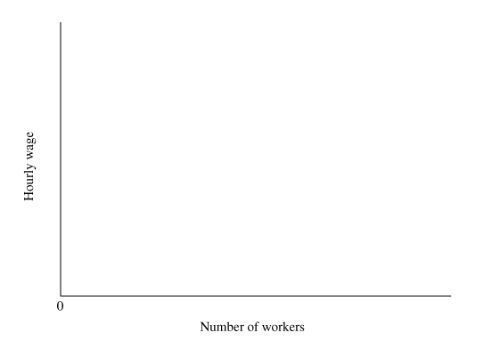
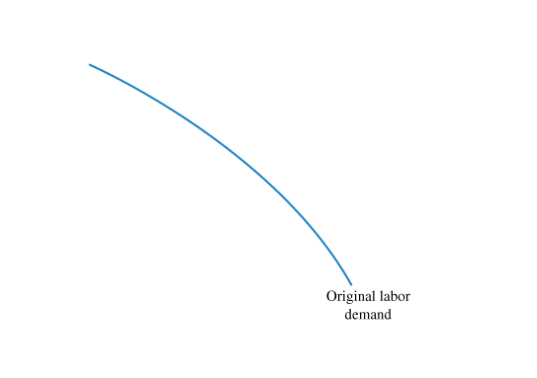
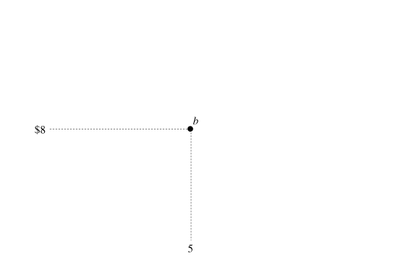
10.1
THE DEMAND FOR LABOR (cont’d)
Labor Demand by an Individual Firm in the Short Run
FIGURE 10.2 An Increase in the Price of Output Shifts the Labor-Demand Curve
An increase in the price of the good produced by workers increases the marginal revenue product at each quantity of workers, shifting the demand curve to the right.
At each wage, the firm will demand more workers. For example, at a wage of $8, the demand for labor increases from five workers (point b) to seven workers (point d).

Slide 9
10.1
THE DEMAND FOR LABOR (cont’d)
Market Demand for Labor in the Short Run
To draw the short-run market demand curve for labor, we add the labor demands of all the firms that use a particular type of labor.
If there were 100 firms and each hired 5 workers at a wage of $8, the market demand for labor would be 500 workers.
Similarly, if the typical firm hired 3 workers at a wage of $11, the market demand would be 300 workers.

Slide 10
10.1
THE DEMAND FOR LABOR (cont’d)
Labor Demand in the Long Run
● long-run demand curve for labor A curve showing the relationship between the wage and the quantity of labor demanded over the long run, when the number of firms in the market can change and firms can modify their production facilities.
● output effect The change in the quantity of labor demanded resulting from a change in the quantity of output produced.
● input-substitution effect The change in the quantity of labor demanded resulting from an increase in the price of labor relative to the price of other inputs.

Slide 11
10.1
THE DEMAND FOR LABOR (cont’d)
Labor Demand in the Long Run
In less-developed countries, labor is less costly relative to machinery and equipment, so labor is substituted for these other inputs.
Examples:
Mining. Firms in some less-developed countries use thousands of workers digging by hand.
Furniture. Firms in some less-developed countries make furniture by hand.
Accounting. Some accountants in less-developed countries use simple calculators and ledger paper.
Short-Run versus Long-Run Demand
There is less flexibility in the short run because firms cannot enter or leave the market and they cannot modify their production facilities. As a result, the demand for labor is less elastic in the short run. That means the short-run demand curve is steeper than the long-run demand curve.

Slide 12
10.2
THE SUPPLY OF LABOR
The Individual Labor-Supply Decision: How Many Hours?
● substitution effect for leisure demand The change in leisure time resulting from a change in the wage (the price of leisure) relative to the price of other goods.
● income effect for leisure demand The change in leisure time resulting from a change in real income caused by a change in the wage.

Slide 13
10.2
THE SUPPLY OF LABOR (cont’d)
The Market Supply Curve for Labor
An increase in the wage affects the quantity of nursing supplied in three ways:
1 Hours worked per employee. When the wage increases, some nurses will work more hours, some will work fewer hours, and some will work the same number of hours.
2 Occupational choice. An increase in the nursing wage will cause some workers to switch from other occupations to nursing and motivate more new workers to pick nursing over other occupations.
3 Migration. Some nurses in other cities will move to Florence to earn the higher wages offered there.
● market supply curve for labor A curve showing the relationship between the wage and the quantity of labor supplied.

Slide 14
A P P L I C A T I O N
1
CABBIES RESPOND TO AN INCREASE IN THE WAGE
APPLYING THE CONCEPTS #1: When the wage increases, will the typical person work more hours or fewer hours?
Taxi drivers have a lot of flexibility in choosing their work hours.
An increase in the taxi fare represents an increase in the wage earned by taxi drivers.
In a 2004 study in New York, a 19 percent increase in the regulated fare decreased the miles driven per cabbie by 5.6 percent.
▪ The elasticity of miles driven was -0.22.
▪ A 10 percent increase in the wage decreases labor supplied by 2.2 percent.

Slide 15
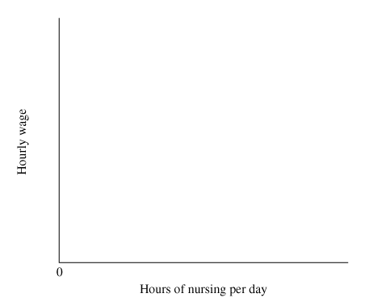
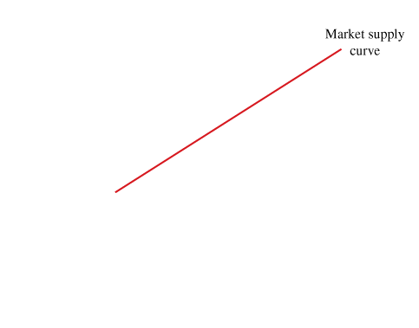
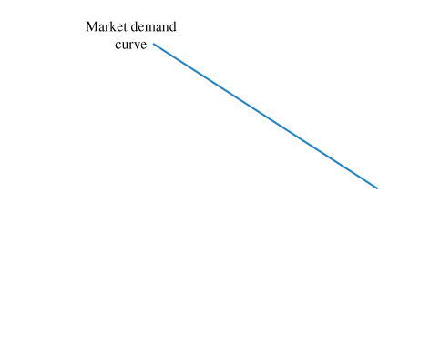
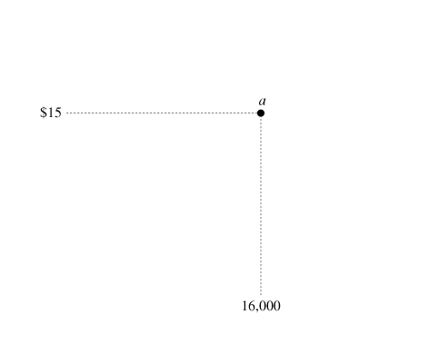
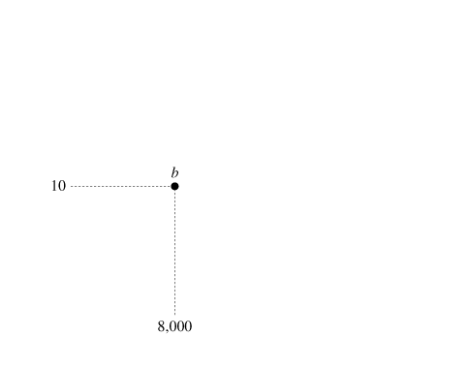
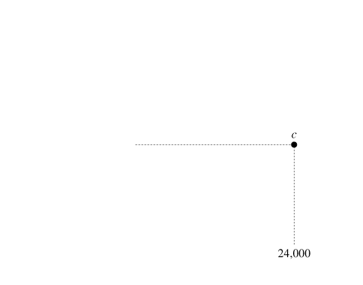
10.3
LABOR MARKET EQUILIBRIUM
FIGURE 10.3 Supply, Demand, and Labor Market Equilibrium
At the market equilibrium shown by point a, the wage is $15 per hour and the quantity of labor is 16,000 hours.
The quantity supplied equals the quantity demanded, so there is neither excess demand for labor nor excess supply of labor.

Slide 16
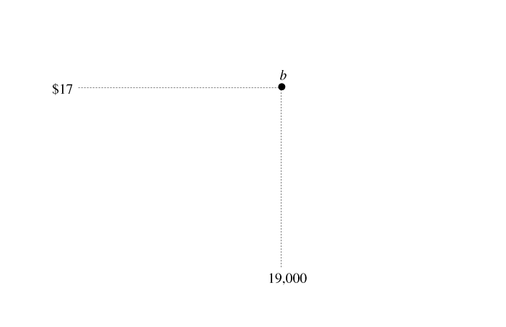
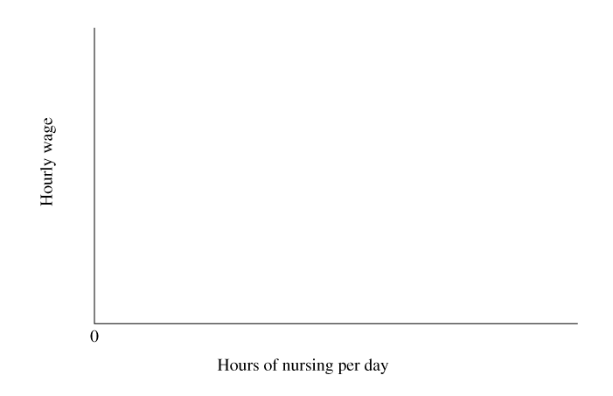
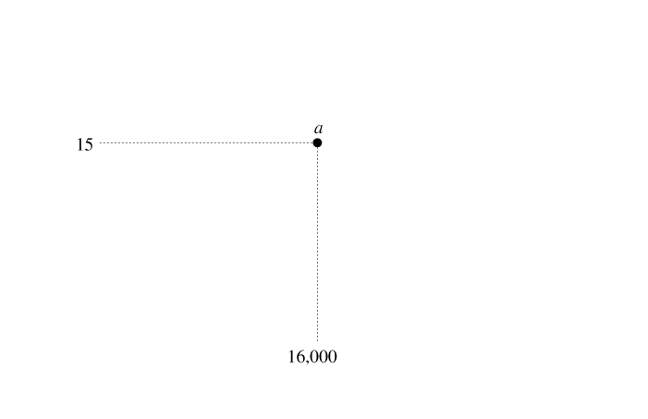
10.3
LABOR MARKET EQUILIBRIUM (cont’d)
Changes in Demand and Supply
FIGURE 10.4 The Market Effect of an Increase in Demand for Labor
An increase in the demand for nursing services shifts the demand curve to the right, moving the equilibrium from point a to point b.
The equilibrium wage increases from $15 to $17 per hour, and the equilibrium quantity increases from 16,000 hours to 19,000 hours.

Slide 17
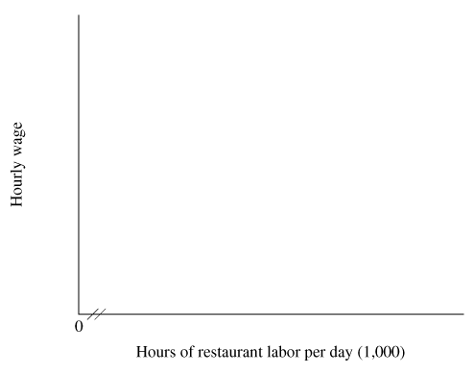
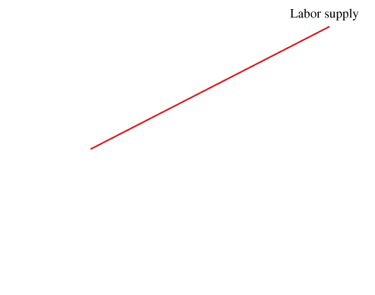
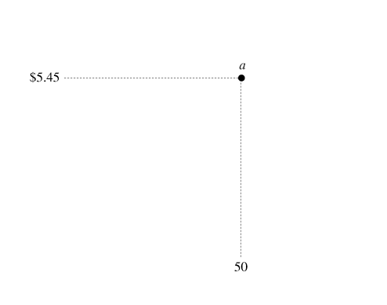
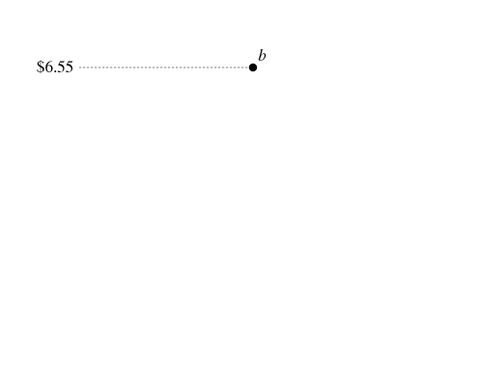
10.3
LABOR MARKET EQUILIBRIUM (cont’d)
The Market Effects of the Minimum Wage
FIGURE 10.5 The Market Effects of a Minimum Wage
The market equilibrium is shown by point a: The wage is $5.45 per hour, and the quantity of labor is 50,000 hours.
A minimum wage of $6.55 decreases the quantity of labor demanded to 49,000 hours per day (point b).
Although some workers receive a higher wage, others lose their jobs or work fewer hours.

Slide 18
A P P L I C A T I O N
2
TRADE-OFFS FROM IMMIGRATION
APPLYING THE CONCEPTS #2: Who benefits from the immigration of low-skilled workers?
Since about 1850, immigration has played an important role in the labor market. The first wave of immigration was from 1850 to 1913. The second began in 1945, and the most recent began in 1990.
Immigration creates winners and losers within the economy.
▪ The increase in labor supply decreases wage for workers with the same skill level as the immigrants.
▪ Immigrants primarily compete with low-skill natives, decreasing their wage.
▪ However, low cost labor lowers consumer prices
George Borjas shows that immigration has a net positive effect with the loss in wages more than offset by gains to consumers and firms in lower prices.

Slide 19
10.4
EXPLAINING DIFFERENCES IN WAGES AND INCOME
Why Do Wages Differ Across Occupations?
The supply of workers in a particular occupation could be small for four reasons:
1 Few people with the required skills.
2 High training costs.
Undesirable working conditions.
Danger
5 Artificial barriers to entry.

Slide 20
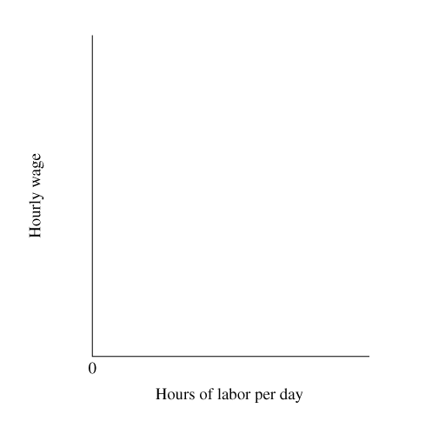
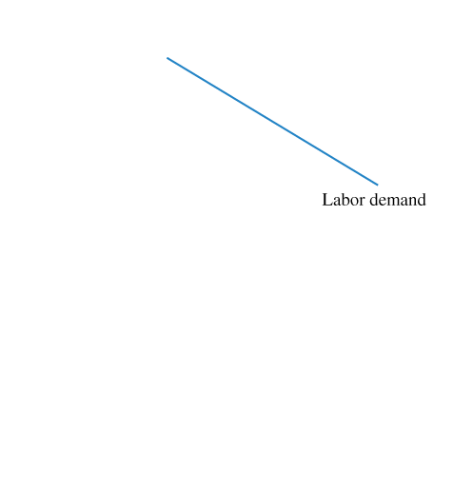
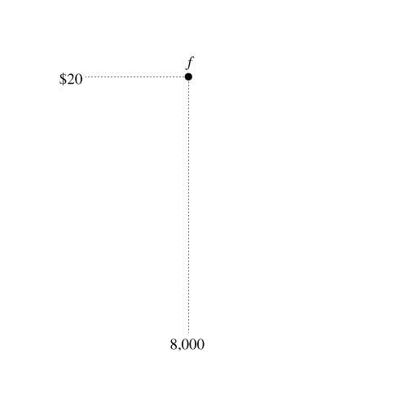
10.4
EXPLAINING DIFFERENCES IN WAGES AND INCOME (cont’d)
Why Do Wages Differ Across Occupations?
FIGURE 10.6 The Equilibrium Wage When Labor Supply Is Low Relative to Demand
If supply is low relative to demand—because few people have the skills, training costs are high, or the job is undesirable—the equilibrium wage will be high.

Slide 21
10.4
EXPLAINING DIFFERENCES IN WAGES AND INCOME (cont’d)
The Gender Pay Gap
A recent study explored several factors that contribute to the gender pay gap. The study observed a gap of about 20 percent among workers aged 26 to 34, and identified four factors that contribute to the gender gap:
Difference in worker skills and productivity.
Differences in occupational preferences.
Occupational discrimination.
Wage discrimination.

Slide 22
10.4
EXPLAINING DIFFERENCES IN WAGES AND INCOME (cont’d)
Racial Discrimination
In 2008, African American males who worked full time earned 73 percent as much as their white counterparts earned, while African American females earned 85 percent as much as their white counterparts.
Hispanic males earned 65 percent as much as white males, while Hispanic females earned 78 percent as much as white females.
For both males and females, part of the earnings gap is caused by differences in productivity:
On average, whites have more education and work experience, so they are paid higher wages. However, part of the wage gap is caused by racial discrimination.
Earnings differences have decreased over the last few decades.

Slide 23
10.4
EXPLAINING DIFFERENCES IN WAGES AND INCOME (cont’d)
Why Do College Graduates Earn Higher Wages?
● learning effect
The increase in a person’s wage resulting from the learning of skills required for certain occupations.
● signaling effect The information about a person’s work skills conveyed by completing college.

Slide 24
A P P L I C A T I O N
3
THE BEAUTY PREMIUM
APPLYING THE CONCEPTS #3: What explains differences in wages?
How does physical attractiveness affect earnings? Studies of the U.S. labor market show that beautiful people earn more than people of average books, and unattractive people earn less.
The beauty premium is 5 percent for the 33 percent of workers who are considered beautiful or handsome, and the beauty premium is larger for men than for women. The penalty for bad looks is about 8 percent for the 10 percent of workers who are considered plain or unattractive.
Why do beautiful people earn more income? According to biologists, beauty is a marker for underlying characteristics such as health and intelligence, and beautiful people start with a slight edge in the labor market. Beautiful people get more opportunities to learn through experience, and they also acquire better professional contacts. Because of these wider opportunities, a small difference in innate characteristics can be amplified into a large difference in earnings.
Another factor in the beauty premium is that some workers and consumers simply like dealing with attractive people, so there is a higher demand for beautiful workers, resulting in higher wages.

Slide 25
10.5
THE DISTRIBUTION OF INCOME
Income Distribution Facts
To compute the numbers in the second column of the table (Percent of Market Income), we take four steps:
1 Rank the nation’s households according to market income.
2 Divide the households into five groups, or “quintiles.”
3 Compute each group’s income.
4 Compute each group’s percentage of total income.

Slide 26
10.5
THE DISTRIBUTION OF INCOME (cont’d)
Income Distribution Facts
Three key factors explain these substantial differences in market income:
1 Differences in labor skills and effort.
2 Luck and misfortune.
3 Discrimination.

Slide 27
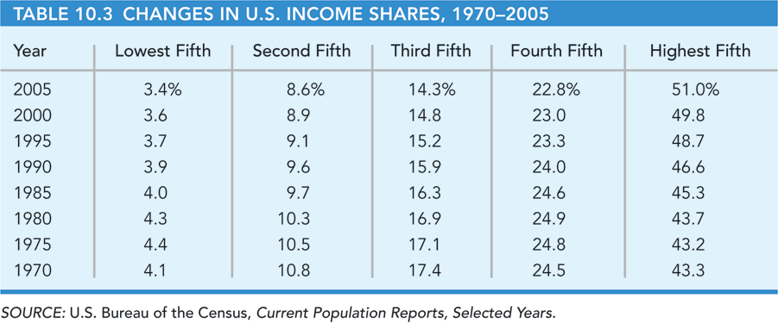
10.5
THE DISTRIBUTION OF INCOME (cont’d)
Recent Changes in the Distribution of Income
Why did the demand for skill increase over the last three decades?
Technological change.
Increased international trade.

Slide 28
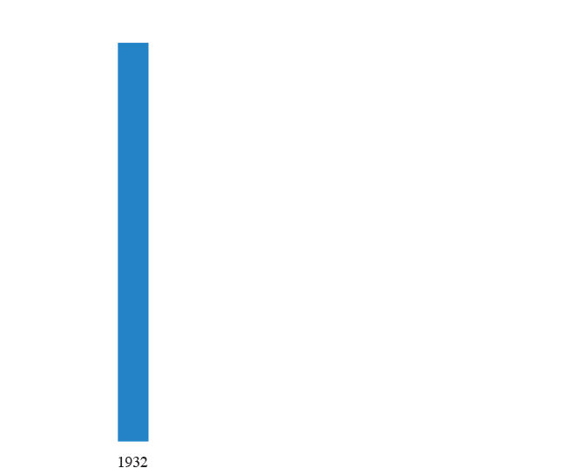
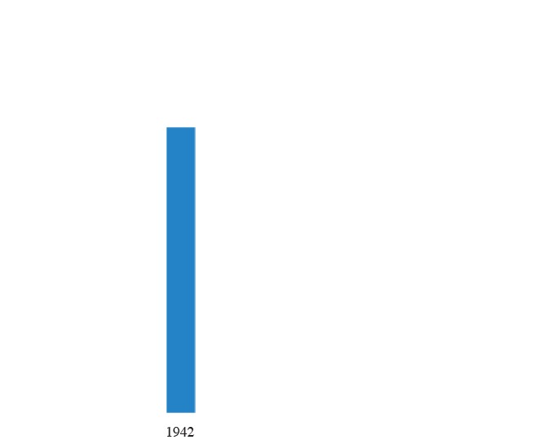
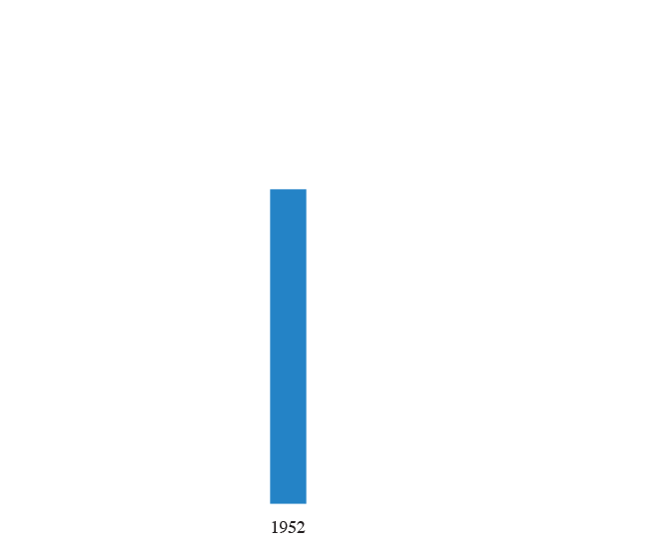
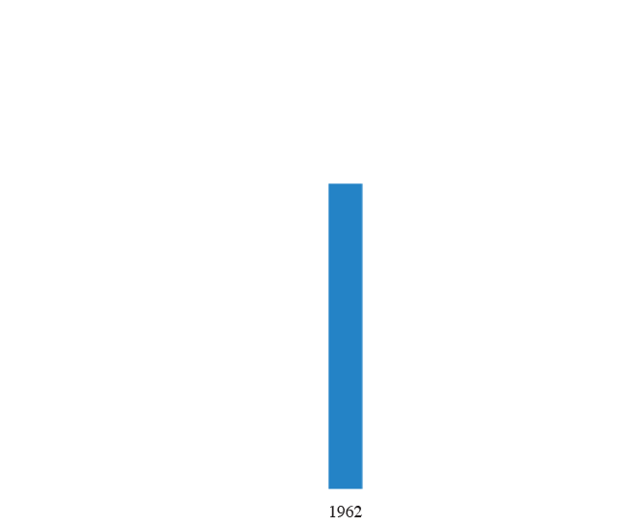
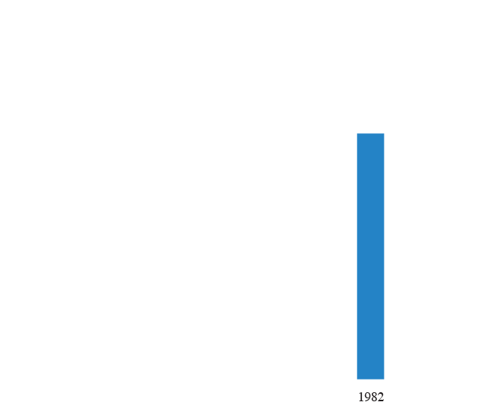
10.5
THE DISTRIBUTION OF INCOME (cont’d)
Changes in the Top End of Income Distribution:1920–2002
FIGURE 10.7 Share of U.S. Income Earned by Top 10 Percent

Slide 29
10.5
THE DISTRIBUTION OF INCOME (cont’d)
Changes in the Top End of Income Distribution: 1920–2002
What caused the patterns?
1 During World War II, the income share of the top decile decreased because government wage controls compressed wages.
The stability of the income share in the period 1945–1970 is puzzling because one would expect wages to rebound after wage controls ended following World War II.
The increase in the income shares since 1970 has been caused by rapid increases in the compensation of the highest-wage workers.

Slide 30
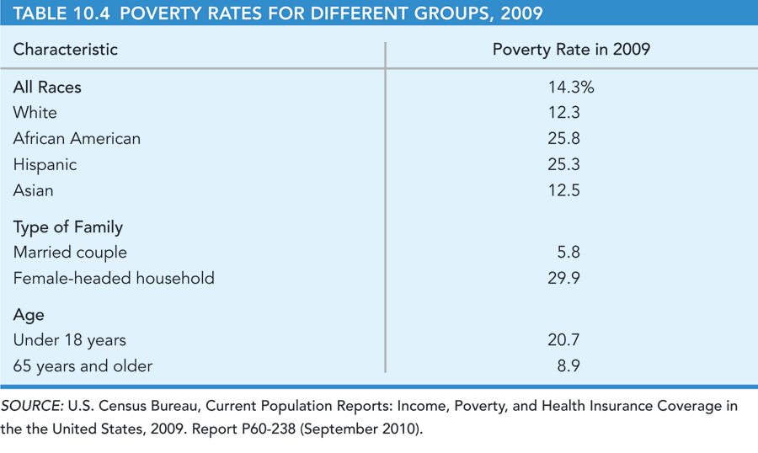
10.6
POVERTY AND PUBLIC POLICY
Poverty Rates for Different Groups
Poverty rates vary by:
1 Race.
2 Type of family.
3 Age.

Slide 31
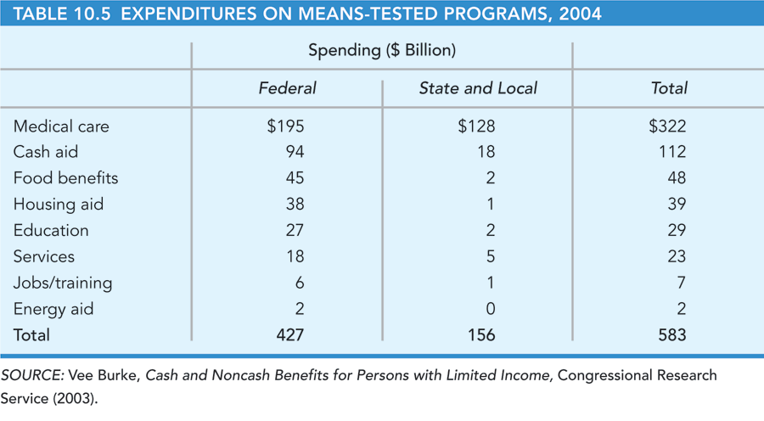
10.6
POVERTY AND PUBLIC POLICY (cont’d)
Redistribution Programs for the Poor
● means-tested program A government spending program that provides assistance to those whose income falls below a certain level.

Slide 32
10.6
POVERTY AND PUBLIC POLICY (cont’d)
Welfare Reform and TANF
The federal government now provides block grants to states to provide Temporary Aid to Needy Families (TANF), with restrictions on what recipients must do to qualify for assistance and limits on how long they can receive assistance:
• A recipient must participate in work activities, defined as employment, on-the-job training, work experience, community service, or vocational training.
• After a total of 60 months of cash assistance (consecutive or nonconsecutive), assistance stops. States can allow exceptions to the 60- month rule for up to 20 percent of recipients.

Slide 33
10.6
POVERTY AND PUBLIC POLICY (cont’d)
Welfare and Work Incentives
Two features of an assistance program affect work incentives.
The first feature is the base cash payment. The larger the amount provided as a base—the payment to someone who earns no market income—the lower the incentive to work to supplement the base income.
The second feature that affects work incentives is the benefit reduction rate for market income. When a recipient earns market income, the welfare payment decreases.
There is evidence that in states with relatively large work incentives welfare recipients work more hours and earn more market income.

Slide 34
A P P L I C A T I O N
4
LAKISHA WASHINGTON VERSUS EMILY WALSH
APPLYING THE CONCEPTS #4: How does racial discrimination affect the labor market?
An experiment in Milwaukee revealed substantial racial discrimination in hiring for low-skill jobs:
The white applicant with a criminal record was called back 17 percent of the time, while the crime-free African American applicant was called back only 14 percent of the time.
The study implies that the disadvantage of being African American is roughly equivalent to the disadvantage of spending 18 months in prison.
In another experiment, economists responded in writing to help-wanted ads in Chicago and in Boston, using hypothetical names that were likely to be identified by employers as either white or African American:
Applicants named Greg Kelly or Emily Walsh were 50 percent more likely to be called for interviews than those named Jamal Jackson or Lakisha Washington.
Adding work experience and computer skills increased the likelihood of interviews by 30 percent for white-sounding applicants but only 9 percent for those whose names suggested an African American background.

Slide 35
K E Y T E R M S
income effect for leisure demand
input-substitution effect
learning effect
long-run demand curve for labor
marginal product of labor
marginal-revenue product of labor (MRP)
market supply curve for labor
means-tested programs
output effect
short-run demand curve for labor
signaling effect
substitution effect for leisure demand

