Slide 1

General Chemistry
CHEM 101
(3+1+0)
Dr. Mohamed El-Newehy
http://fac.ksu.edu.sa/melnewehy

Slide 2
Introduction

Slide 3
What is Chemistry?
It's easy to say chemistry is important because everything is made from chemicals.
Chemistry is the study of matter and the changes it undergoes.
Chemistry sometimes is called the "central science" because it connects other sciences to each others, such as biology, physics, geology and environmental science.
Chemistry is the science that deals with the materials of the universe and the changes these materials undergo
Notes:
3

Slide 4
Why is Chemistry Important?
1) Chemistry helps you to understand the world around you.
Why does leaves change color in the fall? Why are plants green? What is in soap and how does it clean?
2) A command of chemistry can help keep you safe!
You'll know which household chemicals are dangerous to keep together or mix and which can be used safely.
3) Chemistry teaches useful skills.
Because it is a science, learning chemistry means learning how to be objective and how to reason and solve problems.
4) Chemistry opens up career options.
There are many careers in chemistry, but even if you're looking for a job in another field, the analytical skills you gained in chemistry are helpful. Chemistry applies to the food industry, retail sales, transportation, art, homemaking... really any type of work you can name.
5) Chemistry is fun!
They can glow in the dark, change colors, produces bubbles and change states.
Notes:
3

Slide 5
Chapter 1
Chemistry: The Study of Change Matter & Measurements

Slide 6
Matter

Slide 7
Chemistry is the study of matter and the changes it undergoes.
Matter is anything that occupies space and has mass.
A substance is a form of matter that has a definite composition and distinct properties.

Slide 8
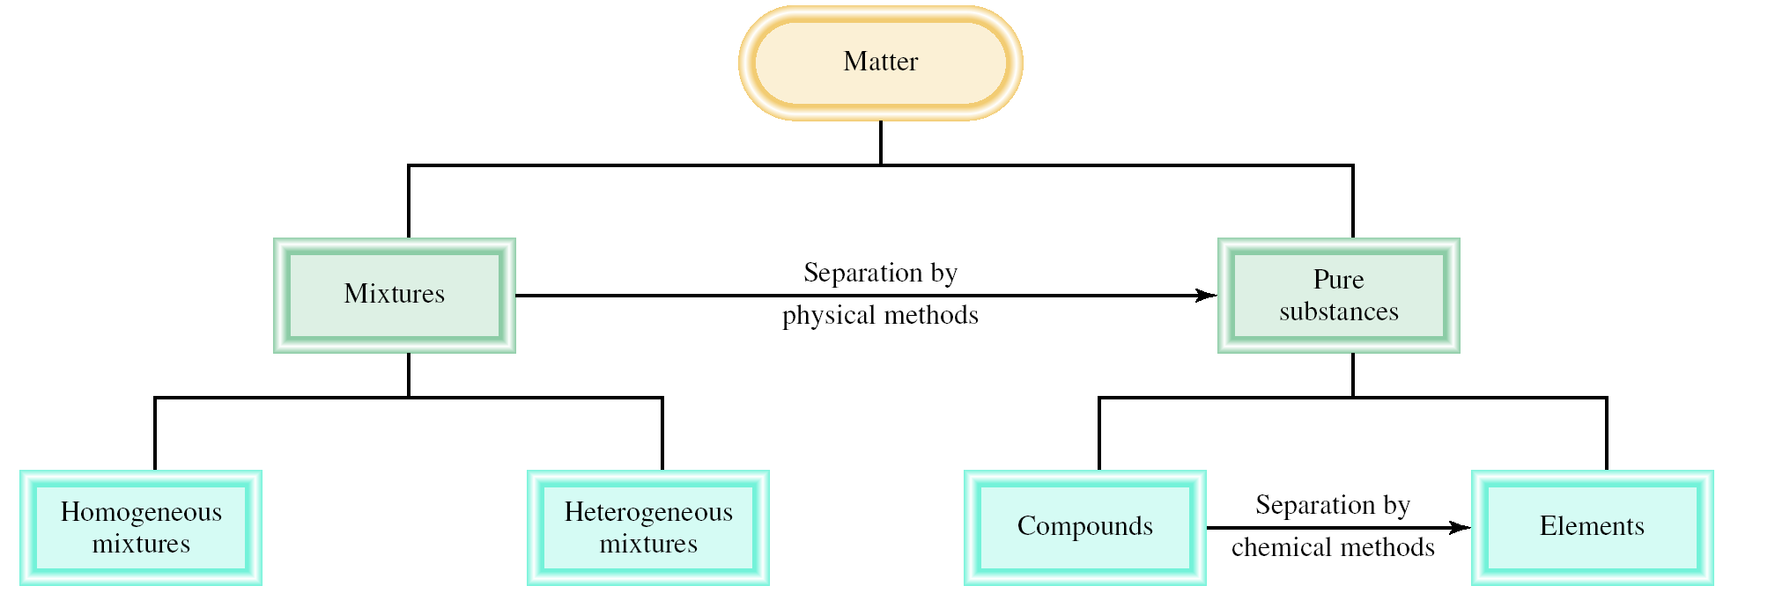
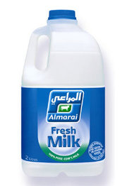
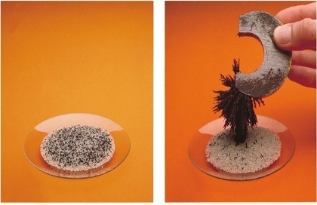
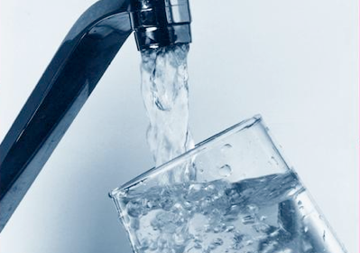
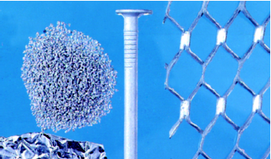
Classifications of Matter
is a combination of two or more substances in which the substances retain their distinct identities.
Example: Air, soft drink, and pizza
is a form of matter that has a definite composition and distinct properties.
Example: water , sugar and gold
The composition is the same throughout.
Example: sugar in water, soft drink, milk
The composition is not uniform throughout.
Example: fruit salad, iron filings in sand
is a substance composed of atoms of two or more elements chemically united in fixed proportions.
Example: water, ammonia
is a substance that cannot be separated into simpler substances by chemical means.
Example: aluminum

Slide 9
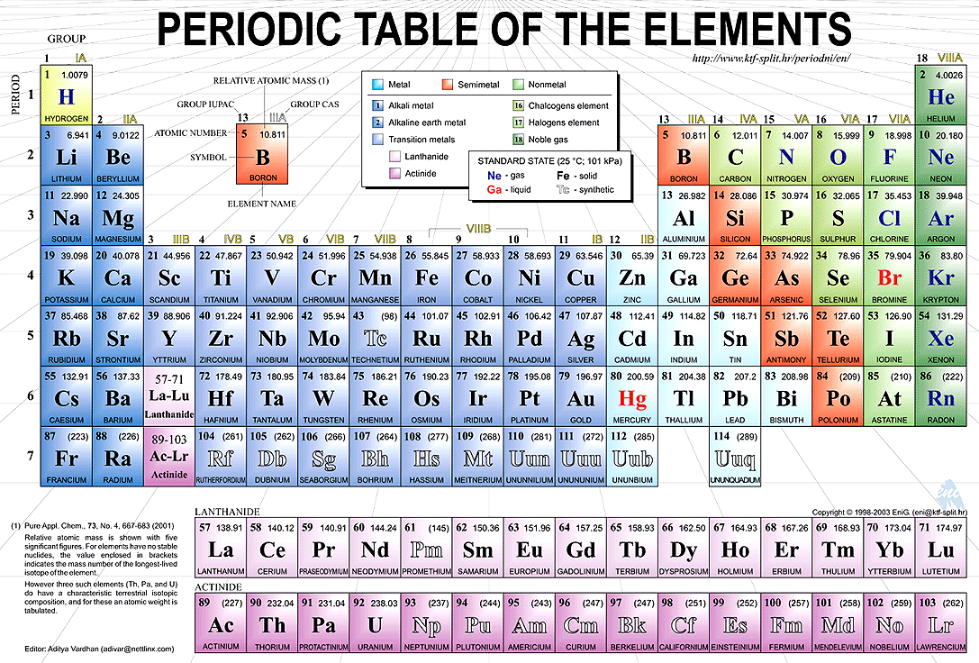
Classifications of Matter

Slide 10
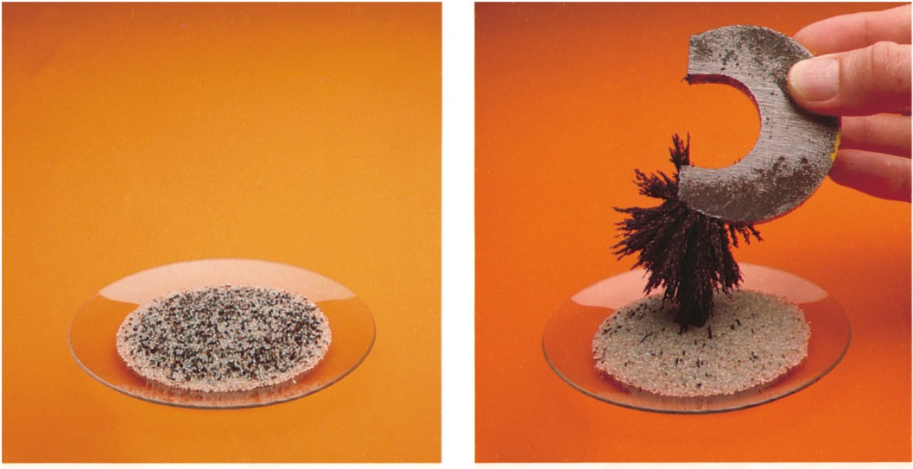
Classifications of Matter
Physical means can be used to separate a mixture into its pure components.
magnet
Compounds can only be separated into their pure components (elements) by chemical means.

Slide 11
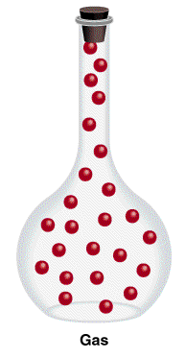
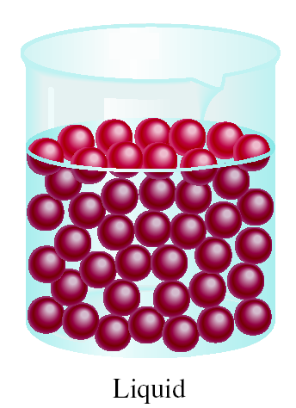
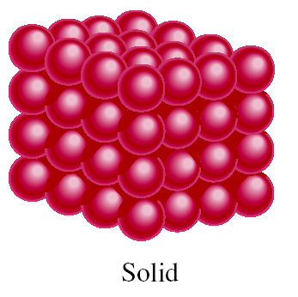
The Three States of Matter
States of matter
Gas
Liquid
Solid
Molecules are separated by distance.
Have no definite shape.
Have no definite volume
Molecules are close together but not held so rigidly in position and can move past on another.
Have no definite shape.
Have a definite volume
Molecules are held close together in orderly fashion with little freedom of motion.
Have a definite shape.
Have a definite volume

Slide 12
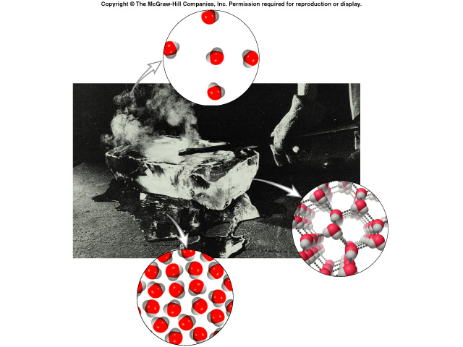
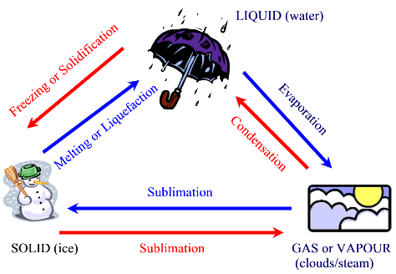
The Three States of Matter
gas
liquid
solid

Slide 13
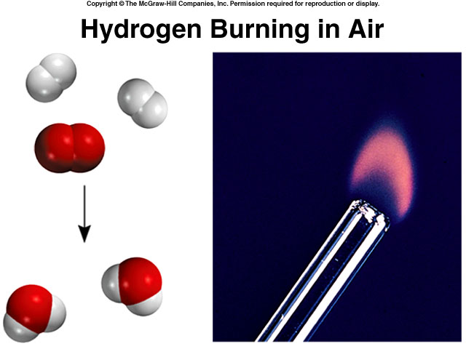
Changes of Matter: Physical and Chemical Changes
Color, melting point, and boiling point are physical properties.
A physical change does not alter the composition or identity of a substance.
ice melting
sugar dissolving in water
A chemical change alters the composition or identity of the substance(s) involved.
hydrogen burns in air to form water

Slide 14
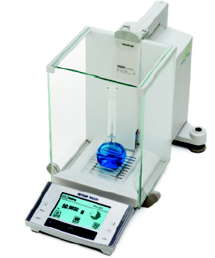
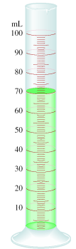

Properties of Matter
Extensive and Intensive Properties
An extensive property of a material depends upon how much matter is being considered.
mass
length
volume
An intensive property of a material does not depend upon how much matter is being considered.
density
temperature
color

Slide 15
Measurements

Slide 16
International System of Units (SI)
A measured quantity is usually written as a number with an appropriate unit.
The same is true in chemistry; units are essential to stating measurements correctly.
For many years, scientists recorded measurements in metric units, which are related decimally, that is, by powers of 10.
Metric system called the International System of Units (abbreviated SI).
Measurements that we will utilize frequently in our study of chemistry include time, mass, volume, density, and temperature.

Slide 17
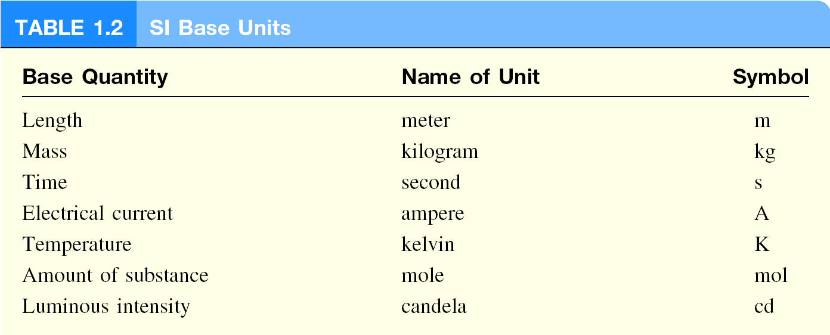
International System of Units (SI)

Slide 18
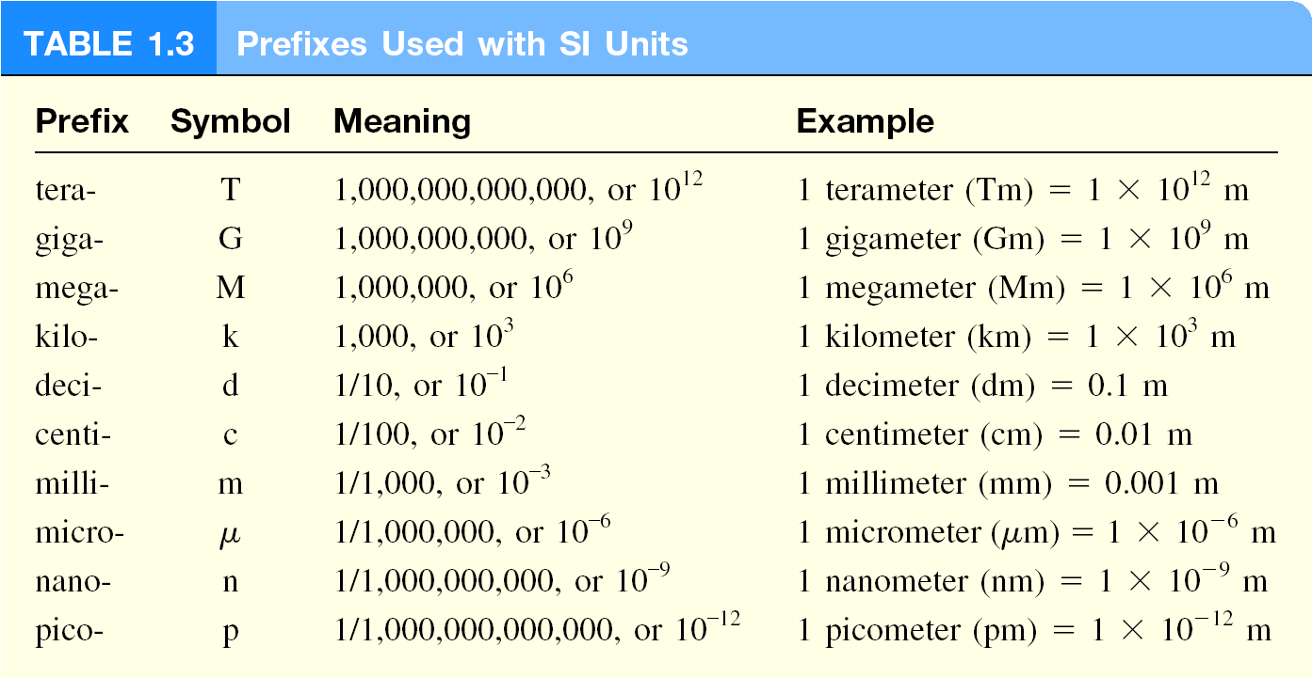
International System of Units (SI)

Slide 19
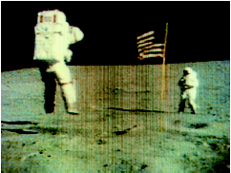
International System of Units (SI)
Mass and Weight
Matter - anything that occupies space and has mass.
mass – measure of the quantity of matter
  SI unit of mass is the kilogram (kg)
  1 kg = 1000 g = 1 x 10³ g
weight – force that gravity exerts on an object
weight = c x mass
A 1 kg bar will weigh
on earth, c = 1.0
1 kg on earth
on moon, c ~ 0.1
0.1 kg on moon

Slide 20
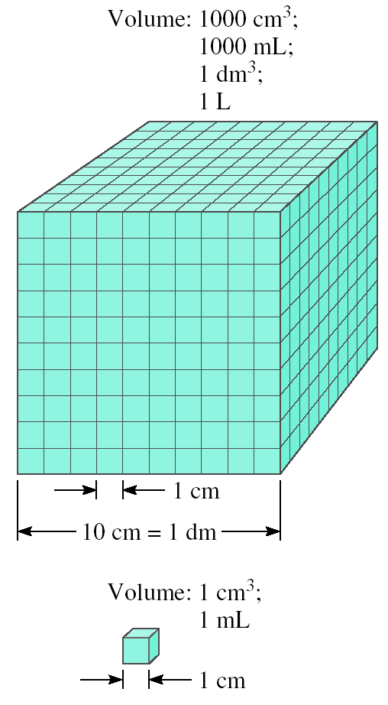
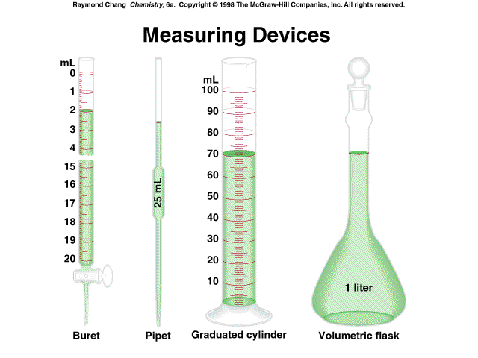
International System of Units (SI)
Volume
Volume – SI derived unit for volume is cubic meter (m³)
1 cm³ = (1 x 10⁻² m)³ = 1 x 10⁻⁶ m³
1 dm³ = (1 x 10⁻¹ m)³ = 1 x 10⁻³ m³
1 L = 1000 mL = 1000 cm³ = 1 dm³
1 mL = 1 cm³

Slide 21
International System of Units (SI)
Density
Density – SI derived unit for density is kg/m³
1 g/cm³ = 1 g/mL = 1000 kg/m³
1 g/L = 0.001 g/mL
mass
m
density =
d =
volume
V
A piece of platinum metal with a density of 21.5 g/cm³ has a volume of 4.49 cm³. What is its mass?
m
d =
V
m = d x V
= 21.5 g/cm³ x 4.49 cm³ = 96.5 g

Slide 22
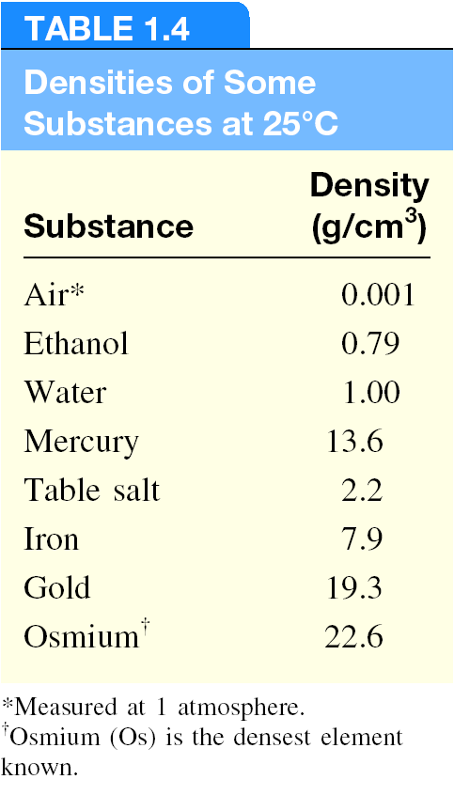
International System of Units (SI)
Density
Density usually decreases with temperature.

Slide 23
International System of Units (SI)

Slide 24
International System of Units (SI)

Slide 25
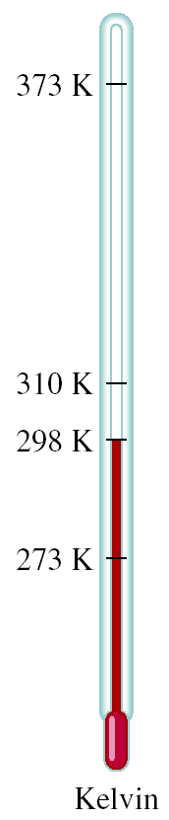
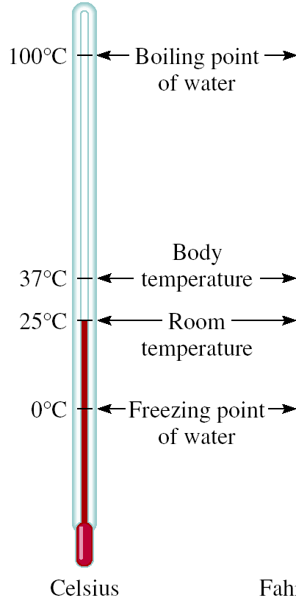
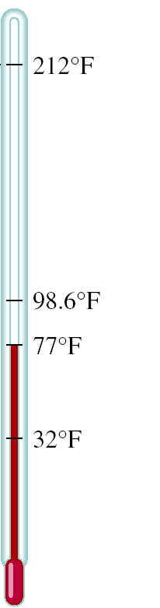


International System of Units (SI)
Temperature Scales
K = ⁰C + 273.15
273 K = 0 ⁰C
373 K = 100 ⁰C
9
⁰F = x ⁰C + 32
5
32 ⁰F = 0 ⁰C
212 ⁰F = 100 ⁰C
The kelvin (K) is the SI base unit of temperature: it is the absolute temperature scale.

Slide 26
International System of Units (SI)
Temperature Scales
Convert 172.9 ⁰F to degrees Celsius.
9
⁰F = x ⁰C + 32
5
9
⁰F – 32 = x ⁰C
5
5
x (⁰F – 32) = ⁰C
9
5
⁰C = x (⁰F – 32)
9
5
⁰C = x (172.9 – 32) = 78.3
9

Slide 27
Handling Numbers
Scientific Notation
The number of atoms in 12 g of carbon:
602,200,000,000,000,000,000,000
6.022 x 10²³
The mass of a single carbon atom in grams:
0.0000000000000000000000199
1.99 x 10⁻²³
N x 10^{n}
N is a number
between 1 and 10
n is a positive or
negative integer
Any number expressed in this way is said to be written in scientific notation.

Slide 28
Handling Numbers
Scientific Notation
568.762
0.00000772
move decimal left
move decimal right
n > 0
n < 0
568.762 = 5.68762 x 10²
0.00000772 = 7.72 x 10⁻⁶
Addition or Subtraction
Write each quantity with the same exponent n
Combine N₁ and N₂
The exponent, n, remains the same
4.31 x 10⁴ + 3.9 x 10³ =
4.31 x 10⁴ + 0.39 x 10⁴ =
4.70 x 10⁴

Slide 29
Handling Numbers
Scientific Notation
Multiplication
(4.0 x 10⁻⁵) x (7.0 x 10³) =
(4.0 x 7.0) x (10⁻⁵⁺³) =
28 x 10⁻² =
2.8 x 10⁻¹
Multiply N₁ and N₂
Add exponents n₁ and n₂
Division
8.5 x 10⁴ ÷ 5.0 x 10⁹ =
(8.5 ÷ 5.0) x 10⁴⁻⁹ =
1.7 x 10⁻⁵
Divide N₁ and N₂
Subtract exponents n₁ and n₂

Slide 30
Handling Numbers
Significant Figures
Significant figures - are the meaningful digits in a measured or calculated quantity.
Guidelines for Using Significant Figures

Slide 31
Handling Numbers
Significant Figures
Any digit that is not zero is significant
  1.234 kg 4 significant figures
Zeros between nonzero digits are significant
  606 m 3 significant figures
Zeros to the left of the first nonzero digit are not significant
  0.08 L 1 significant figure
If a number is greater than 1, then all zeros to the right of the decimal point are significant
  2.0 mg 2 significant figures
If a number is less than 1, then only the zeros that are at the end and in the middle of the number are significant
  0.00420 g 3 significant figures

Slide 32
Handling Numbers
Significant Figures
For numbers that do not contain decimal points, the trailing zeros (that is, zeros after the last nonzero digit) may or may not be significant.
Thus, 400 cm may have
one significant figure (the digit 4),
two significant figures (40),
or three significant figures (400).
Which is correct? …. we can express the number 400 as
4 X 10² for one significant figure,
4.0 X 10² for two significant figures,
or 4.00 X 10² for three significant figures.

Slide 33
Handling Numbers
Significant Figures
How many significant figures are in each of the following measurements?
24 mL
2 significant figures
3001 g
4 significant figures
0.0320 m³
3 significant figures
6.4 x 10⁴ molecules
2 significant figures
560 kg
2 significant figures

Slide 34
Handling Numbers
Significant Figures
Addition or Subtraction
The answer cannot have more digits to the right of the decimal
point than any of the original numbers.
89.332
+
1.1
one significant figure after decimal point
90.432
round off to 90.4
3.70
two significant figures after decimal point
-2.9133
0.7867
round off to 0.79

Slide 35
Handling Numbers
Significant Figures
Multiplication or Division
The number of significant figures in the result is set by the original number that has the smallest number of significant figures
4.51 x 3.6666 = 16.536366
= 16.5
3 sig figs
round to
3 sig figs
6.8 ÷ 112.04 = 0.0606926
= 0.061
2 sig figs
round to
2 sig figs

Slide 36
Handling Numbers
Significant Figures
Exact Numbers
Numbers from definitions or numbers of objects are considered
to have an infinite number of significant figures
The average of three measured lengths; 6.64, 6.68 and 6.70?
6.64 + 6.68 + 6.70
= 6.67333 = 6.67
= 7
3
Because 3 is an exact number

Slide 37
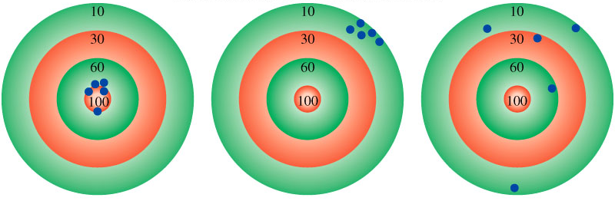
Handling Numbers
Significant Figures
Accuracy and Precision
Accuracy – how close a measurement is to the true value
Precision – how close a set of measurements are to each other
accurate
&
precise
precise
but
not accurate
not accurate
&
not precise

Slide 38
Handling Numbers
Significant Figures
Accuracy and Precision
Three students are asked to determine the mass of a piece of copper wire. (The true mass of the wire is 2.000 g)
The results of two successive weighing's by each student are
not accurate
&
not precise
precise
but
not accurate
accurate
&
precise

Slide 39
Dimensional Analysis in Solving Problems
Dimensional analysis - The procedure we use to convert between units in solving chemistry problems.
Dimensional analysis is based on the relationship between different units that express the same physical quantity.
Determine which unit conversion factor(s) are needed
Carry units through calculation
If all units cancel except for the desired unit(s), then the problem was solved correctly.
given quantity x conversion factor = desired quantity
desired unit
given unit x
= desired unit
given unit

Slide 40
Dimensional Analysis in Solving Problems
How many mL are in 1.63 L?
Conversion Unit 1 L = 1000 mL
1000 mL
1.63 L x
= 1630 mL
1L
1L
L²
1.63 L x
= 0.001630
1000 mL
mL

Slide 41
Dimensional Analysis in Solving Problems
The speed of sound in air is about 343 m/s. What is this speed in miles per hour?
conversion units
meters to miles
seconds to hours
1 mi = 1609 m
1 min = 60 s
1 hour = 60 min
m
1 mi
60 s
60 min
mi
343
x
x
x
= 767
s
1609 m
1 min
1 hour
hour

