Slide 1
Copyright © 2012 Pearson Prentice Hall. All rights reserved.

Slide 3
A P P L Y I N G T H E C O N C E P T S
1
How does the elasticity of demand vary over time?
A Closer Look at the Elasticity of Demand for Gasoline
How does an increase in price affect total expenditures?
Vanity Plates and Elasticity of Demand
Where do I find estimates of elasticities of demand?
I Can Find that Elasticity in Four Clicks!
How does a change in demand affect the equilibrium price in the short run and long run?
Milk Prices in the Short Run and Long Run
2
3
4

Slide 4
THE PRICE ELASTICITY OF DEMAND
4.1
● price elasticity of demand (E_{d}) A measure of the responsiveness of the quantity demanded to changes in price; equal to the absolute value of the percentage change in quantity demanded divided by the percentage change in price.

Slide 5
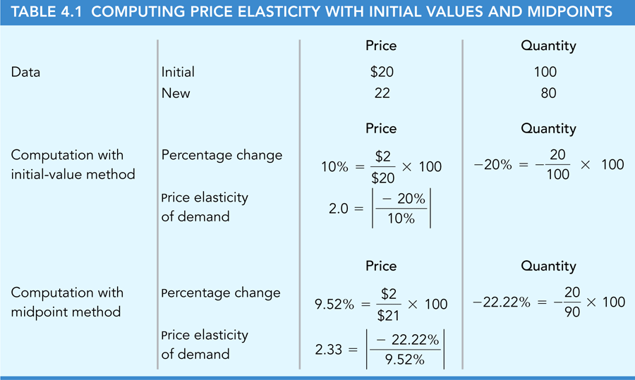
THE PRICE ELASTICITY OF DEMAND (cont’d)
4.1
Computing Percentage Changes and Elasticities

Slide 6
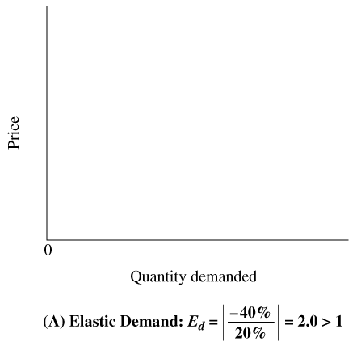
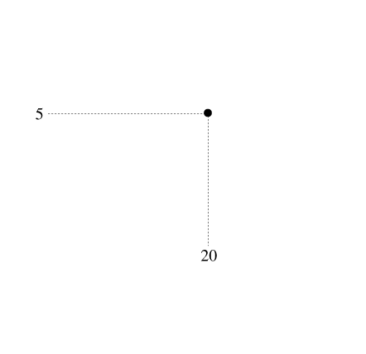
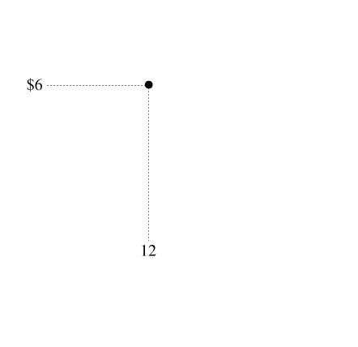
4.1
THE PRICE ELASTICITY OF DEMAND (cont’d)
Price Elasticity and the Demand Curve
● elastic demand The price elasticity of demand is greater than one, so the percentage change in quantity exceeds the percentage change in price.
► FIGURE 4.1 Elasticity and Demand Curves

Slide 7
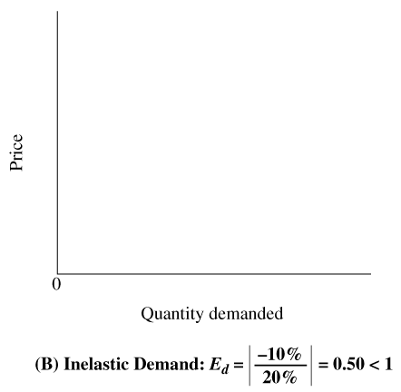
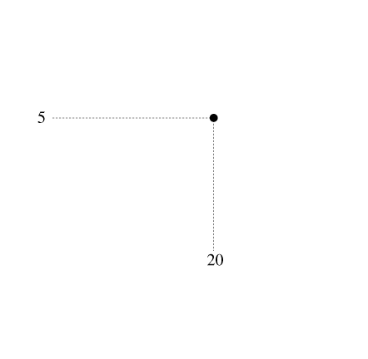
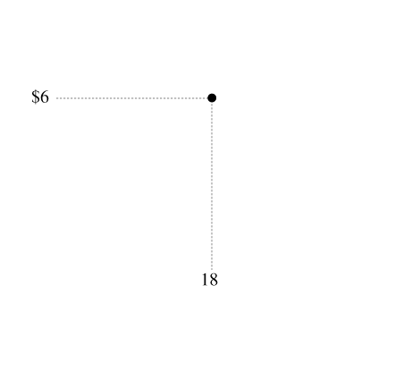
4.1
THE PRICE ELASTICITY OF DEMAND (cont’d)
Price Elasticity and the Demand Curve
● inelastic demand The price elasticity of demand is less than one, so the percentage change in quantity is less than the percentage change in price.
► FIGURE 4.1 (cont’d.) Elasticity and Demand Curves

Slide 8
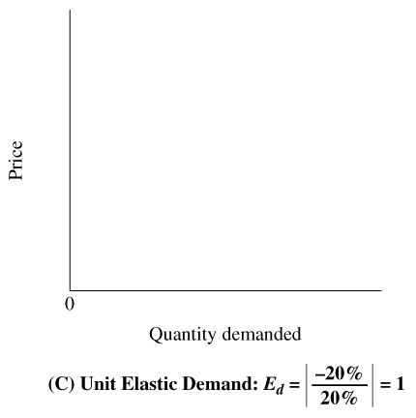
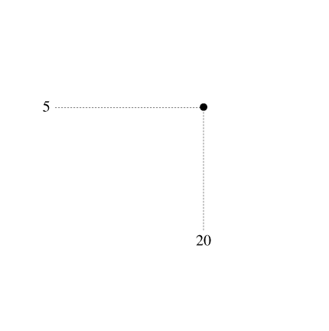
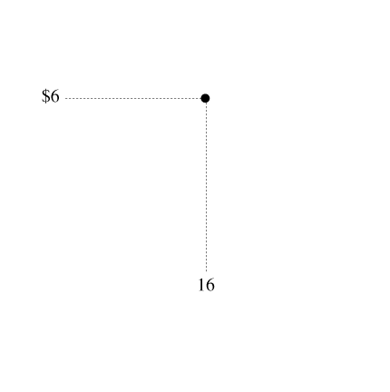
4.1
THE PRICE ELASTICITY OF DEMAND (cont’d)
Price Elasticity and the Demand Curve
● unit elastic demand The price elasticity of demand is one, so the percentage change in quantity equals the percentage change in price.
► FIGURE 4.1 (cont’d.) Elasticity and Demand Curves

Slide 9
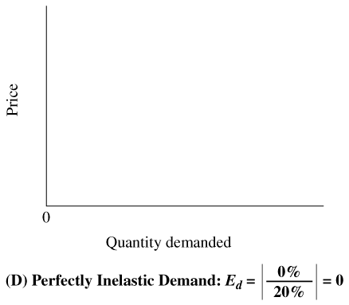
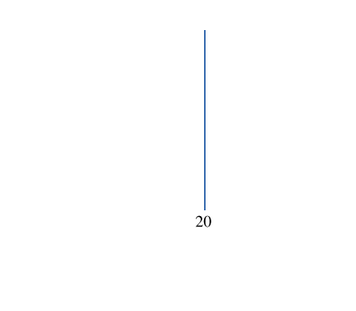
4.1
THE PRICE ELASTICITY OF DEMAND (cont’d)
Price Elasticity and the Demand Curve
● perfectly inelastic demand The price elasticity of demand is zero.
► FIGURE 4.1 (cont’d.) Elasticity and Demand Curves

Slide 10
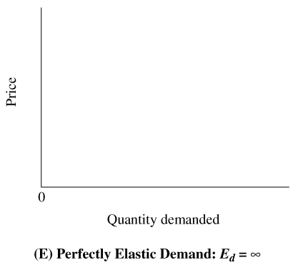
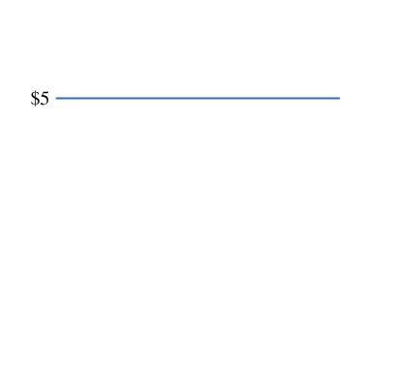
4.1
THE PRICE ELASTICITY OF DEMAND (cont’d)
Price Elasticity and the Demand Curve
● perfectly elastic demand The price elasticity of demand is infinite.
► FIGURE 4.1 (cont’d.) Elasticity and Demand Curves

Slide 11
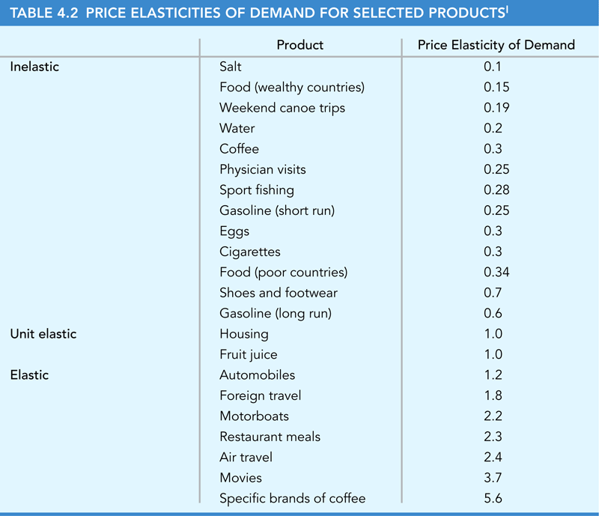
4.1
THE PRICE ELASTICITY OF DEMAND (cont’d)
Elasticity and the Availability of Substitutes

Slide 12
4.1
THE PRICE ELASTICITY OF DEMAND (cont’d)
Other Determinants of the Price Elasticity of Demand

Slide 13
A P P L I C A T I O N
1
A CLOSER LOOK AT THE ELASTICITY OF DEMAND
FOR GASOLINE
APPLYING THE CONCEPTS #1: How does the elasticity of demand vary over time?
We’ve seen that the demand for gasoline is more elastic in the long run, when consumers have more opportunity to respond to changes in price. A recent study explores two sorts of response to higher gasoline prices.
First, when the price increases, people drive fewer miles, so there are fewer cars on the road.
A second response to higher prices is to switch to more fuel-efficient cars.

Slide 14
USING PRICE ELASTICITY TO PREDICT CHANGES IN QUANTITY
4.2
If we have values for two of the three variables in the elasticity formula, we can compute the value of the third. The three variables are:
the price elasticity of demand itself,
the percentage change in quantity, and
the percentage change in price.
Specifically, we can rearrange the elasticity formula:
percentage change in quantity demanded = percentage change in price × E_{d}

Slide 15
4.2
USING PRICE ELASTICITY TO PREDICT CHANGES IN QUANTITY (cont’d)
Beer Prices and Highway Deaths
We can use the concept of price elasticity to predict the effects of a change in the price of beer on drinking and highway deaths among young adults.
The price elasticity of demand for beer among young adults is about 1.30.
If a state imposes a beer tax that increases the price of beer by 10 percent, we would predict that beer consumption will decrease by 13 percent:
%change in quantity demanded = %change in price*Ed =10% * 1.30=13%
The number of highway deaths among young adults is roughly proportional to their beer consumption, so the number of deaths will also decrease by 13 percent.

Slide 16
4.2
USING PRICE ELASTICITY TO PREDICT CHANGES IN QUANTITY (cont’d)
Cigarette Prices and Teenagers
Another ongoing policy objective is to reduce smoking by teenagers.
Under the 1997 federal tobacco settlement, cigarette prices increased by about 62 cents per pack, a percentage increase of about 25 percent.
The demand for cigarettes by teenagers is elastic, with an elasticity of 1.3
Therefore, a 25 percent price hike will reduce teen smoking by 32.5%
%change in quantity demanded = 25%*1.30 = 32.5%
About half the decrease in consumption occurs because fewer teenagers will become smokers, and the other half occurs because each teenage smoker will smoke fewer cigarettes.

Slide 17
PRICE ELASTICITY AND TOTAL REVENUE
4.3
● total revenue The money a firm generates from selling its product.
total revenue = price per unit × quantity sold
What happens to Total Revenue if price goes up?
Good News: You get more for each unit sold
Bad News: You sell fewer units
Effect on TR depends on which effect is bigger, i.e. whether the price elasticity is less than or greater than one.

Slide 18
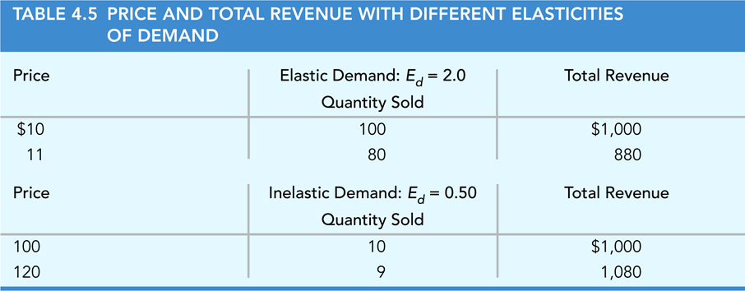
PRICE ELASTICITY AND TOTAL REVENUE (cont’d)
4.3
Elastic versus Inelastic Demand

Slide 19
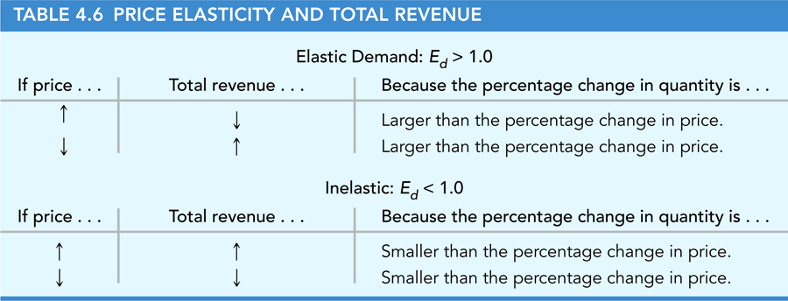
4.3
PRICE ELASTICITY AND TOTAL REVENUE (cont’d)
Elastic versus Inelastic Demand

Slide 20
4.3
PRICE ELASTICITY AND TOTAL REVENUE (cont’d)
Market versus Brand Elasticity
Recall the chapter opener about the coffee producer.
The question is whether a price cut will increase or decrease the firm’s total revenue.
Although general demand for coffee is inelastic (price elasticity of demand = 0.3) the demand for specific brands is elastic (price elasticity of demand = 5.6)
Therefore, a price cut on a specific brand of coffee will increase a firm’s total revenue.

Slide 21
4.3
PRICE ELASTICITY AND TOTAL REVENUE (cont’d)
Bus Fares and Deficits
In every large city in the United States, the public bus system runs a deficit Here is the exchange between two city officials:
Buster: “A fare increase is a great idea. We’ll collect more money from bus riders, so revenue will increase, and the deficit will shrink.”
Bessie: “Wait a minute, Buster. Haven’t you heard about the law of demand? The increase in the bus fare will decrease the number of passengers taking buses, so we’ll collect less money, not more, and the deficit will grow.”
Who’s right? It depends on the price elasticity of demand for bus ridership.
The price elasticity of demand for bus ridership in the typical city is 0.33, meaning that a 10 percent increase in fares will decrease ridership by only about 3.3 percent.
Because demand for bus travel is inelastic, the good news associated with a fare hike (10 percent more revenue per rider) will dominate the bad news (3.3 percent fewer riders), and total fare revenue will increase.
In other words, an increase in fares will reduce the transit deficit, so Buster is right.

Slide 22
4.3
PRICE ELASTICITY AND TOTAL REVENUE (cont’d)
Why Are Bumper Crops Bad News for Farmers?
Suppose favorable weather generates a “bumper crop” for soybeans that is 30 percent larger than last year’s harvest.
The bumper crop brings good news and bad news for farmers.
The good news is that they will sell more bushels of soybeans.
The bad news is that the increase in supply will decrease the equilibrium price of soybeans, so farmers will get less money per bushel.
Unfortunately for farmers, the demand for soybeans and many other agricultural products is inelastic.
With inelastic demand, consumers need a large price reduction to buy more of the product. Therefore, to increase the quantity demanded of soybeans by 30 percent to meet the higher supply, the price must decrease by more than 30 percent.

Slide 23
4.3
PRICE ELASTICITY AND TOTAL REVENUE (cont’d)
Antidrug Policies and Property Crime
What is the connection between antidrug policies and property crimes
The government uses various policies to restrict the supply of illegal drugs, and the decrease in supply increases the equilibrium price.
Because the demand for illegal drugs is inelastic, the increase in price will increase total spending on illegal drugs.
A drug addict supports his or her habit by stealing, will commit more property crimes to pay for the drugs.
There is a trade off. A policy that increases drug prices, will reduce consumption, but will also increase the amount of crime committed by drug addicts who continue to abuse drugs.

Slide 24
A P P L I C A T I O N
2
VANITY PLATES AND THE ELASTICITY OF DEMAND
APPLYING THE CONCEPTS #2: How does an increase in price affect total expenditures?
The radio quiz show Wait Wait . . . Don’t Tell Me! recently asked the following question: Which state has the highest number of vanity license plates?
The correct answer is Virginia, where over 10 percent of cars have vanity license plates such as 10SNE1 and GLBLWRMR.
An economist might have extended the question to ask why there are so many vanity plates in Virginia.
Although Virginians may be unusually vain, a more plausible explanation is that the price of vanity plates is only $10, or about one-third of the average price in the United States.
According to a recent study, the demand for vanity plates in Virginia is inelastic, with a price elasticity of demand equal to 0.26.
If the state increased the price, the total revenue from vanity plates would increase.

Slide 25
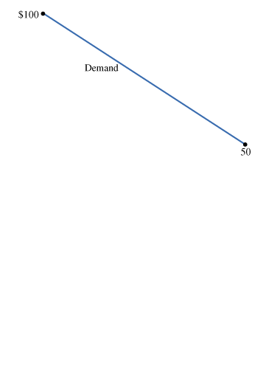
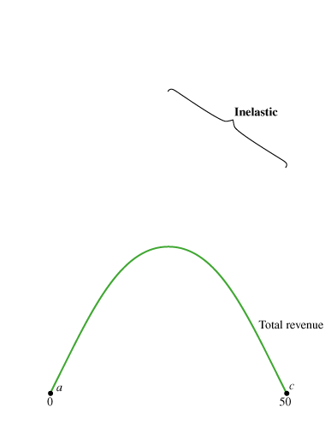
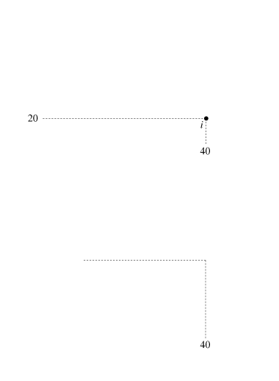
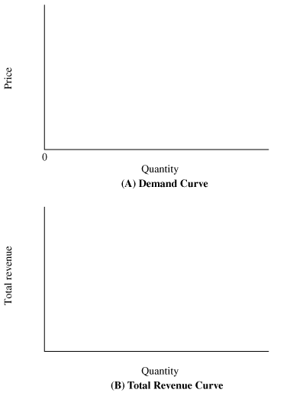
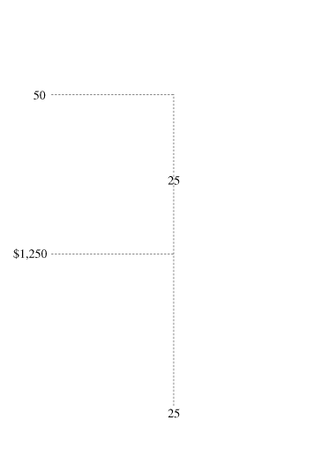
ELASTICITY AND TOTAL REVENUE FOR A LINEAR DEMAND CURVE
4.4
Price Elasticity along a Linear Demand Curve
► FIGURE 4.2 Elasticity and Total Revenue along a Linear Demand Curve
Demand is elastic along the upper half of a linear demand curve (between points a and b on the total- revenue curve).
Demand is inelastic along the lower half of a linear demand curve (between points b and c).
Total revenue is maximized at the midpoint of a linear demand curve (point u), where demand is unit elastic.

Slide 26
ELASTICITY AND TOTAL REVENUE FOR A LINEAR DEMAND CURVE (cont’d)
4.4
Elasticity and Total Revenue for a Linear Demand Curve
Panel B of Figure 4.2 shows the relationship between total revenue and the quantity sold for the linear demand curve.
Demand is elastic along the upper half of a linear demand curve, which means that a decrease in price will increase the quantity sold by a larger percentage amount. As a result, total revenue will increase, as shown by the positively sloped total-revenue curve between points a and b.
In contrast, demand is inelastic along the lower half of a linear demand curve, which means that a decrease in price will increase the quantity sold by a smaller percentage amount. As a result, total revenue will decrease, as shown by the negatively sloped total-revenue curve between points b and c.
The total-revenue curve reaches its maximum at the midpoint of the linear demand curve, where demand is unit elastic. In Figure 4.2, demand is unit elastic at point u on the demand curve, so total revenue reaches its maximum at $1,250 at point b on the total-revenue curve.

Slide 27
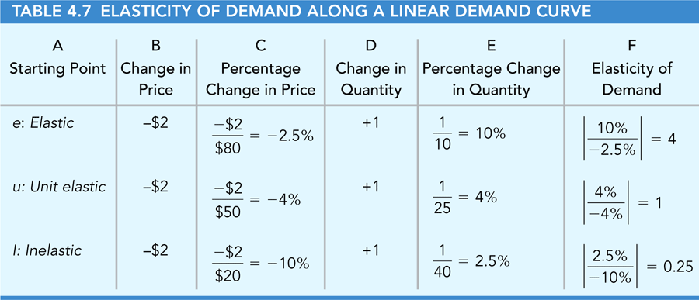
ELASTICITY AND TOTAL REVENUE FOR A LINEAR DEMAND CURVE (cont’d)
4.4
Price Elasticity along a Linear Demand Curve

Slide 28
OTHER ELASTICITIES OF DEMAND
4.5
Income Elasticity of Demand
● income elasticity of demand A measure of the responsiveness of demand to changes in consumer income; equal to the percentage change in the quantity demanded divided by the percentage change in income.

Slide 29
OTHER ELASTICITIES OF DEMAND (cont’d)
4.5
Cross-Price Elasticity of Demand
● cross-price elasticity of demand A measure of the responsiveness of demand to changes in the price of another good; equal to the percentage change in the quantity demanded of one good (X) divided by the percentage change in the price of another good (Y).

Slide 30
A P P L I C A T I O N
3
I CAN FIND THAT ELASTICITY IN FOUR CLICKS!
APPLYING THE CONCEPTS #3: Where do I find estimates of elasticities of demand?
The U.S. Department of Agriculture has a Web site that provides estimates of demand elasticities for hundreds of food products in dozens of countries: http://www.ers.usda.gov/Data/Elasticities/
Clicks (1) Demand Elasticities from Literature; (2) Choose Country; Choose Commodity; (3) Cross Commodity; (4) Submit.
It is important to note two things about the reported elasticities. First, the regular price elasticity is reported as a negative number and labeled “own price elasticity” for “Marshallian Demand.” Second, the reported “expenditure elasticity” is similar to the income elasticity, with the denominator of the elasticity equal to the percentage change in total consumer expenditure (versus percentage change in income)

Slide 31
THE PRICE ELASTICITY OF SUPPLY
4.6
● price elasticity of supply A measure of the responsiveness of the quantity supplied to changes in price; equal to the percentage change in quantity supplied divided by the percentage change in price.

Slide 32
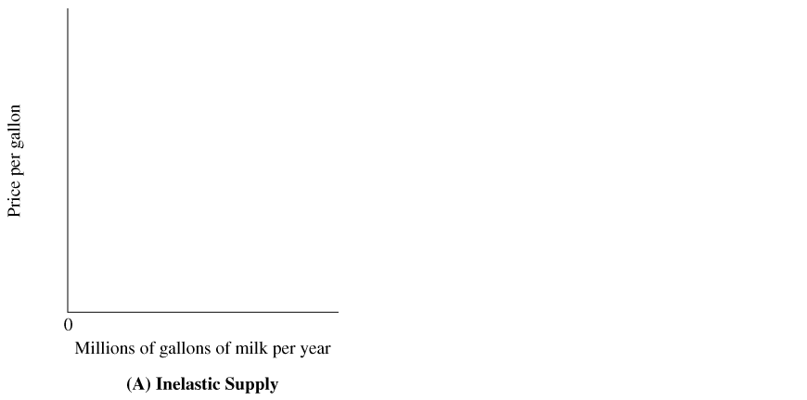
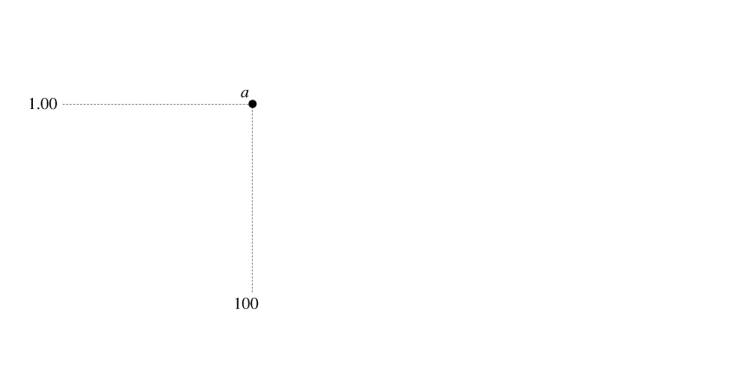
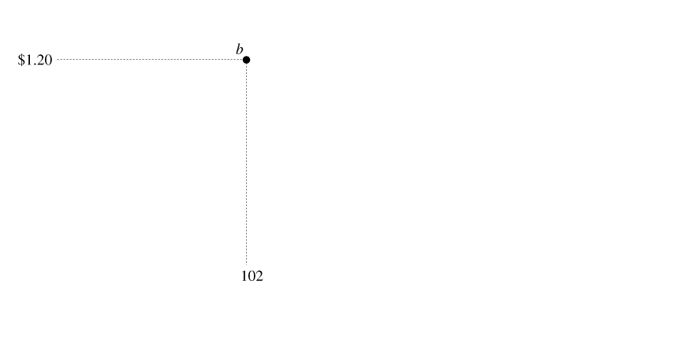
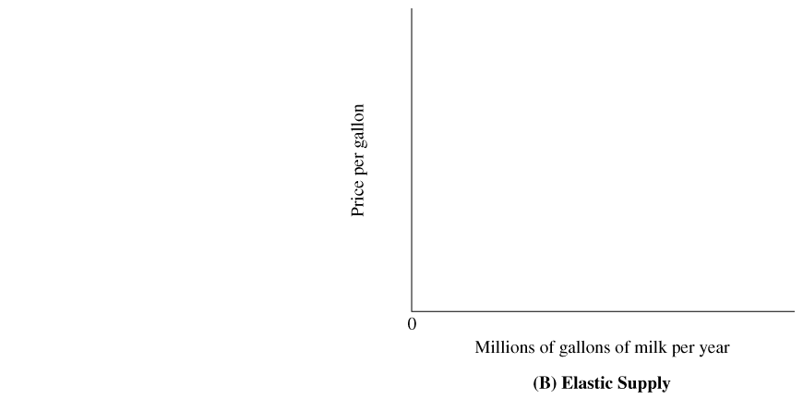
4.6
THE PRICE ELASTICITY OF SUPPLY
▼ FIGURE 4.3 The Slope of the Supply Curve and Supply Elasticity
(A) The supply curve is relatively steep. A 20 percent increase in price increases the quantity supplied by 2 percent, implying a supply elasticity of 0.10.
(B) The supply curve is relatively flat. A 20 percent increase in price increases the quantity supplied by 50 percent, implying a supply elasticity of 2.5.

Slide 33
THE PRICE ELASTICITY OF SUPPLY (cont’d)
4.6
What Determines the Price Elasticity of Supply?
The price elasticity of supply is determined by how rapidly production costs increase as the total output of the industry increases. If the marginal cost increases rapidly, the supply curve is relatively steep and the price elasticity is relatively low.

Slide 34
4.6
THE PRICE ELASTICITY OF SUPPLY (cont’d)
The Role of Time: Short-Run versus Long-Run Supply Elasticity
Time is an important factor in determining the price elasticity of supply for a product. The market supply curve is positively sloped because of two responses to an increase in price:
• Short run. A higher price encourages existing firms to increase their output by purchasing more materials and hiring more workers.
• Long run. New firms enter the market and existing firms expand their production facilities to produce more output.
The short-run response is limited because of the principle of diminishing returns.
P R I N C I P L E O F D I M I N I S H I N G R E T U R N S
Suppose output is produced with two or more inputs, and we increase one input while holding the other input or inputs fixed. Beyond some point—called the point of diminishing returns—output will increase at a decreasing rate.

Slide 35
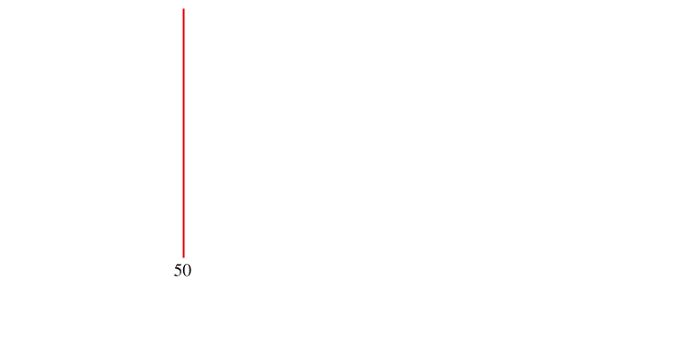
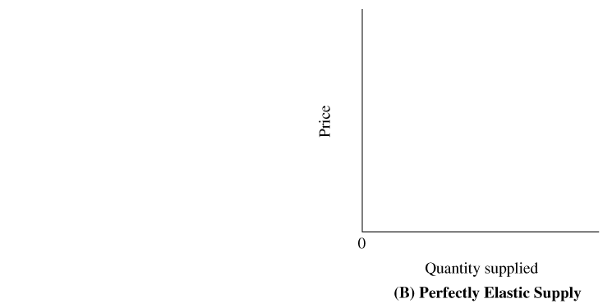
4.6
THE PRICE ELASTICITY OF SUPPLY (cont’d)
Extreme Cases: Perfectly Inelastic Supply and Perfectly Elastic Supply
▼ FIGURE 4.4 Perfectly Inelastic Supply and Perfectly Elastic Supply
In Panel A, the quantity supplied is the same at every price, so the price elasticity of supply is zero.
In Panel B, the quantity supplied is infinitely responsive to changes in price, so the price elasticity of supply is infinite.

Slide 36
4.6
THE PRICE ELASTICITY OF SUPPLY (cont’d)
Extreme Cases: Perfectly Inelastic Supply and Perfectly Elastic Supply
● perfectly inelastic supply The price elasticity of supply equals zero.
● perfectly elastic supply The price elasticity of supply is equal to infinity.
Predicting Changes in Quantity Supplied

Slide 37
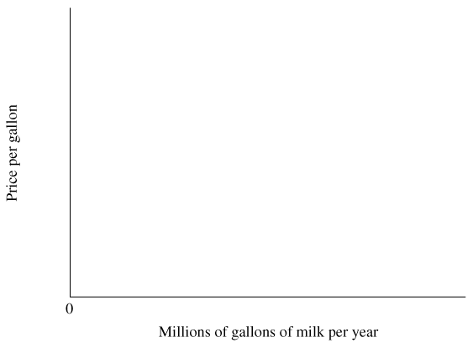
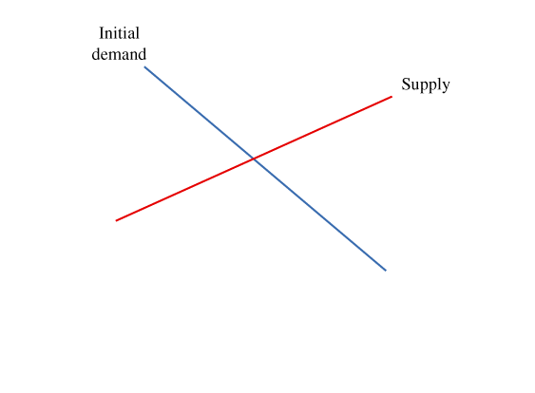
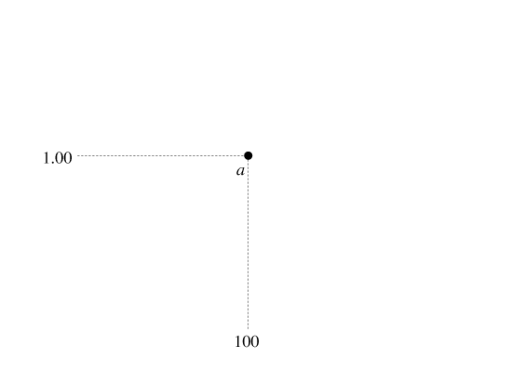
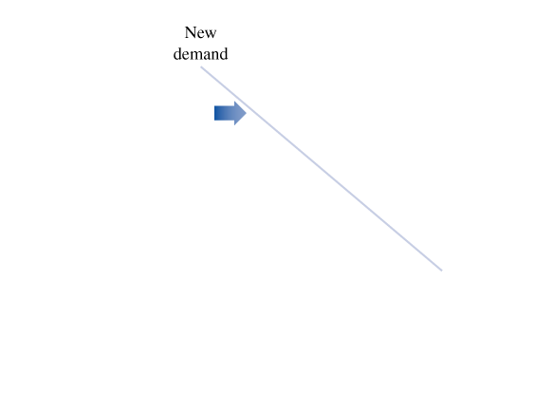
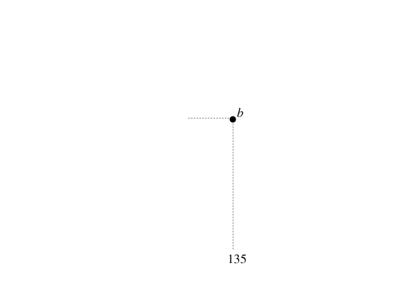
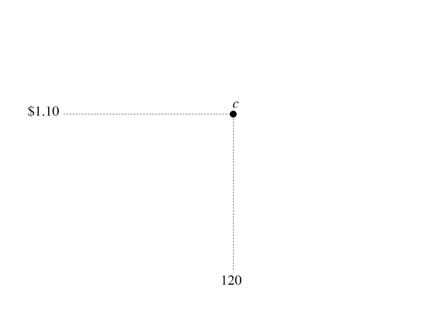
USING ELASTICITIES TO PREDICT CHANGES IN EQUILIBRIUM PRICE
4.7
The Price Effects of a Change in Demand
► FIGURE 4.5 An Increase in Demand Increases the Equilibrium Price
An increase in demand shifts the demand curve to the right, increasing the equilibrium price.
In this case, a 35 percent increase in demand increases the equilibrium price by 10 percent. Using the price-change formula, 10% = 35% / (2.5 + 1.0).

Slide 38
4.7
USING ELASTICITIES TO PREDICT CHANGES IN EQUILIBRIUM PRICE (cont’d)
The Price Effects of a Change in Demand
Under what conditions will an increase in demand cause a relatively small increase in price?
• Small increase in demand.
• Highly elastic demand.
Highly elastic supply.

Slide 39
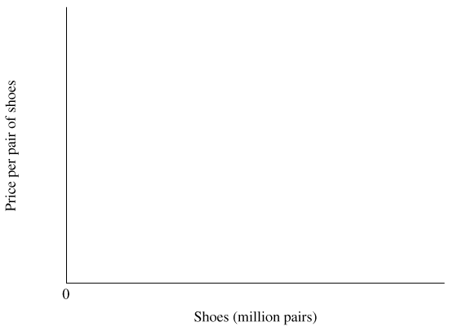
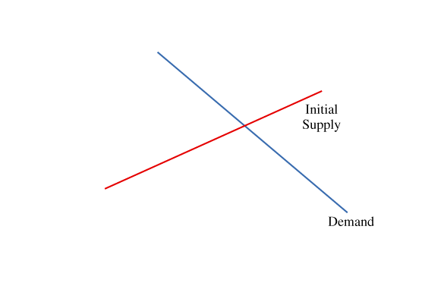
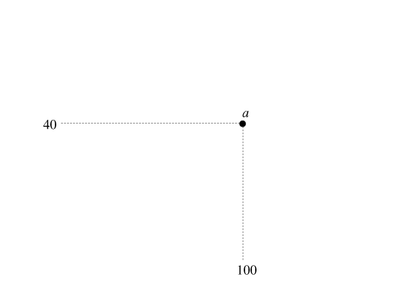
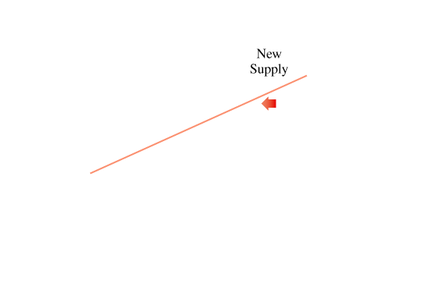
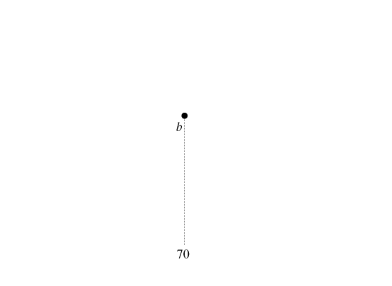
4.7
USING ELASTICITIES TO PREDICT CHANGES IN EQUILIBRIUM PRICE (cont’d)
The Price Effects of a Change in Supply
► FIGURE 4.6 A Decrease in Supply Increases the Equilibrium Price
An import restriction on shoes decreases the supply of shoes, shifting the market supply curve to the left and increasing the equilibrium price from $40 to $44.
In this case, a 30 percent reduction in supply increases the equilibrium price by 10 percent. Using the price-change formula, 10% =
–(–30% / (2.3 + 0.70)).

Slide 40
4.7
USING ELASTICITIES TO PREDICT CHANGES IN EQUILIBRIUM PRICE (cont’d)
The Price Effects of a Change in Supply
Under what conditions will a decrease in supply cause a relatively small increase in price?
• Small decrease in supply.
• Highly elastic demand.
Highly elastic supply.

Slide 41
A P P L I C A T I O N
4
MILK PRICES IN THE SHORT RUN AND LONG RUN
APPLYING THE CONCEPTS #4: How does a change in demand affect the equilibrium price in the short run and long run?
We can use the supply version of the price-change formula to predict the effects of a change in demand on equilibrium prices in the short run and the long run.
Suppose a national advertising campaign increases the demand for milk by 3 percent.
Price elasticity of demand for milk is -0.20 and the short-run price elasticity of supply is 0.10. Therefore, in the short-run, the equilibrium price of milk will increase by 10 percent.
Percentage change in equilibrium price = 3% / (0.10+0.20)= 3% / 0.30 = 10%
In the long run, the price elasticity of supply is 2.50 and the equilibrium price of milk will only be 1.1 percent higher.
Percentage change in equilibrium price = 3% / (2.50+0.20)= 3% / 2.70 = 1.1%

Slide 42
K E Y T E R M S
cross-price elasticity of demand
elastic demand
income elasticity of demand
inelastic demand
perfectly elastic demand
perfectly elastic supply
perfectly inelastic demand (E_{d})
perfectly inelastic supply
price elasticity of demand
price elasticity of supply
total revenue
unit elastic demand

