Slide 1
بسم الله توكلنا على الله ولا حول ولا قوة الا بالله

Slide 2
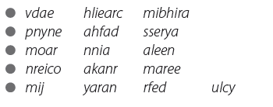

Slide 4
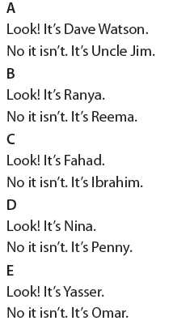

Slide 5
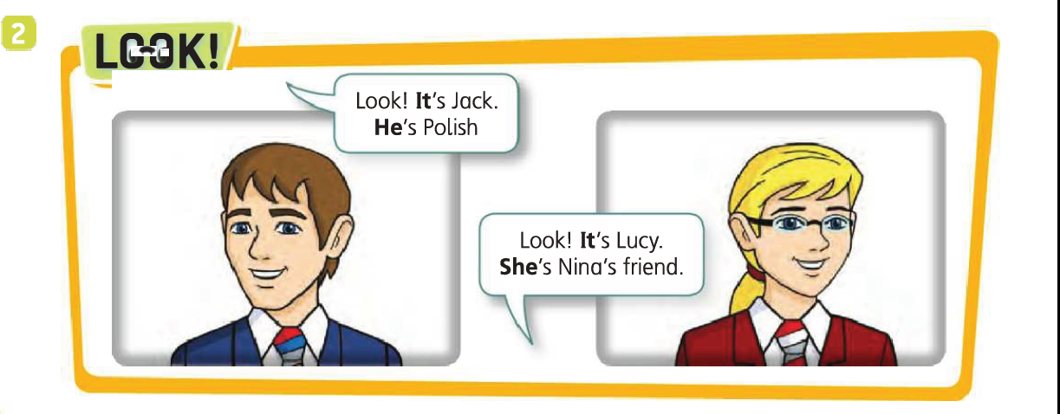

Slide 6
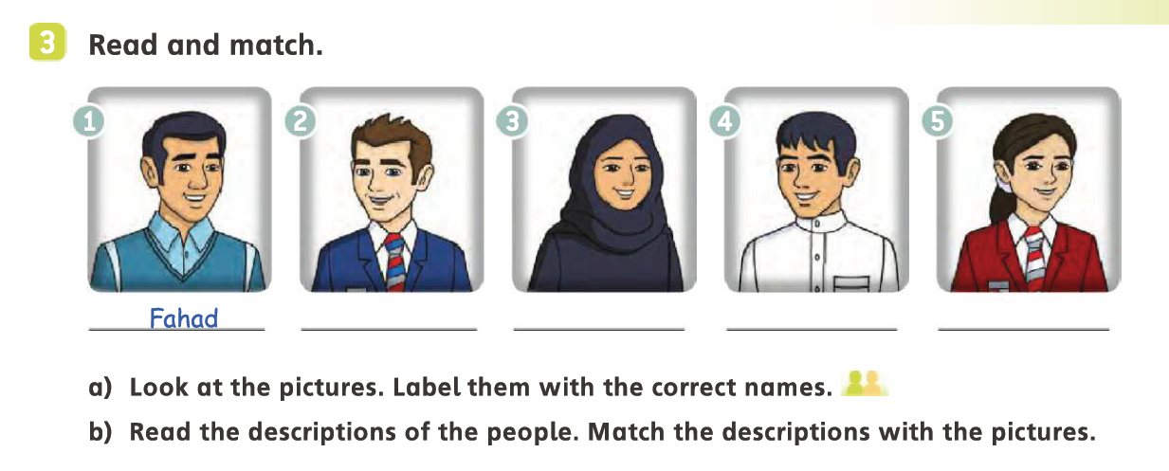
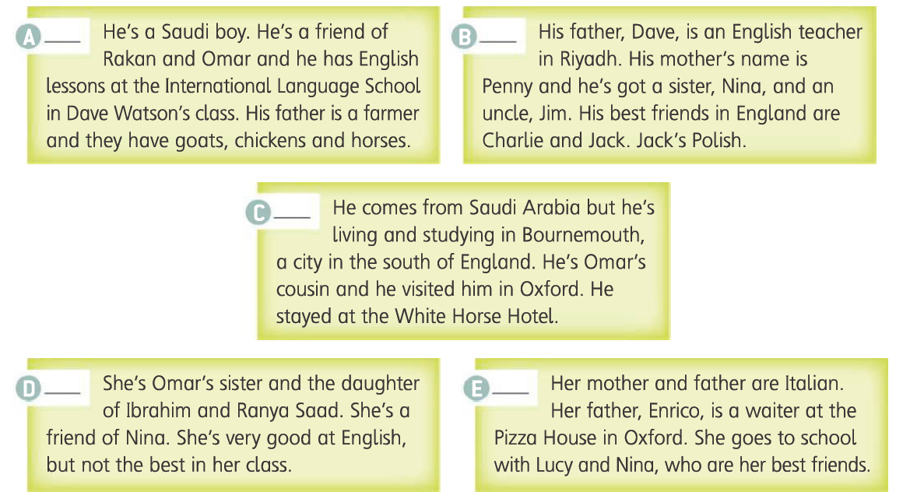
Fred
Reema
Yasser
Elina
4
2
1
3
5

Slide 7
Answer the questions:
1- What is Yasser‘s father’s job?
2-What is Elina’s father’s job ?
3-Where does he work?
farmer
His job is at pizza house
In Oxford

