Slide 1

General Physics
(104 Phys)
Dr Nargis Bano

Slide 2
Chapter 25 Electric Potential
Chapter Outline
25.1 Potential Difference and Electric Potential
25.2 Potential Differences in a Uniform Electric Field
25.3 Electric Potential and Potential Energy Due to Point Charges

Slide 3
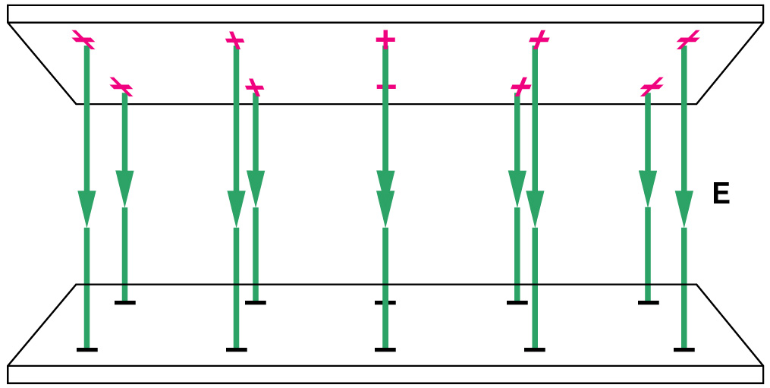
25.1 Potential Difference and Electric Potential
Moving an electric charge through space where electric fields are present can require work, since forces associated with the fields act on the charge.
This work can be described as a change in potential energy. We introduce the new concept of “electric potential” to describe the amount of work needed to move a charge through a region with electric fields.
If we suppose we have two parallel metal plates containing equal but opposite-sign charges produce a uniform electric field in the region between the plates.

Slide 4
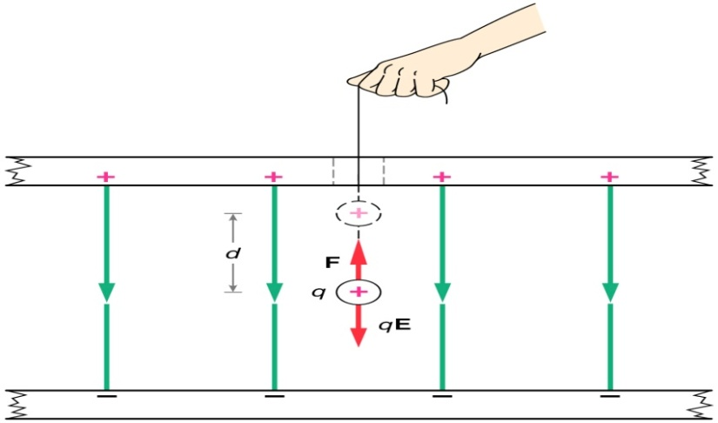
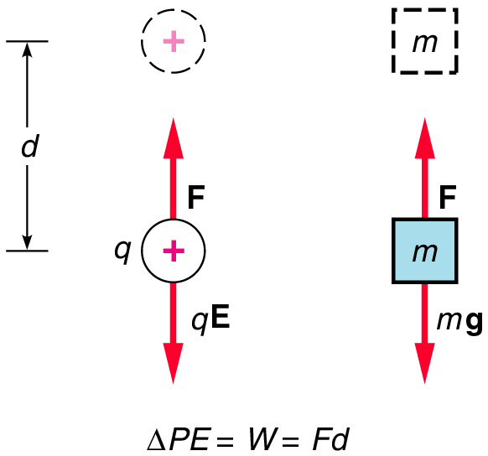
An external force F, equal in magnitude to the electrostatic force F = qE, is used to move the charge q a distance d in a uniform field.
The increase in potential energy when a charge q is moved against the electrostatic force is analogous to what happens when a mass m is lifted against the gravitational force.

Slide 5
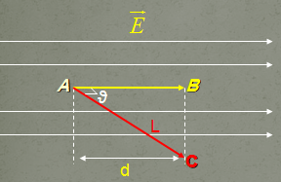
The electrostatic force is conservative (is conservative means the work (W) done by the force is independent of path)
As in mechanics, work is
Work done on the positive charge by moving it from A to B:
Work done on the positive charge by moving it from A to C:

Slide 6
The work done by a conservative force equals the negative of the change in potential energy, ΔU
This equation
  is valid only for the case of a uniform electric field
  allows to introduce the concept of electric potential
Electric potential
The potential difference between points A and B, V_{B}-V_{A}, is defined as the change in potential energy (final minus initial value) of a charge, q, moved from A to B, divided by the test charge

Slide 7

Electric potential is a scalar quantity.
Electric potential is a measure of electric energy per unit charge (V=U/q)
The SI unit of the electric potential is energy per unit charge and potential difference is joules per coulomb, which is defined as a volt (V):
The electron volt is related to the joule as follows:

Slide 8
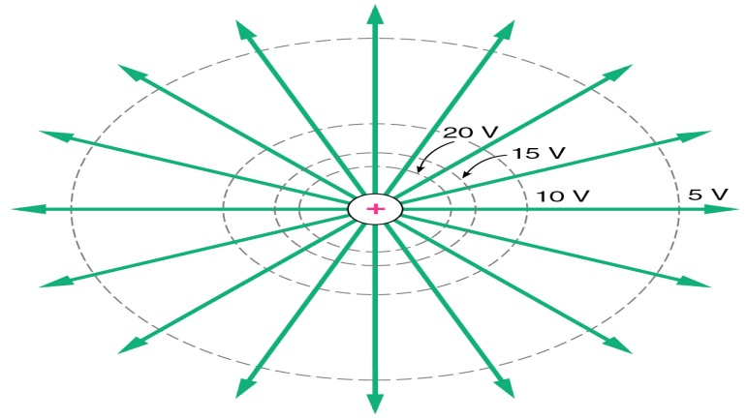
25.2 Potential Differences in a Uniform Electric Field
If one returns to the case of uniform electric field the potential difference in the direction of the field will be:
The negative sign indicates to VB < VA
The electric field lines always point in the direction of decreasing the electric potential.

Slide 9
(a) When the electric field is directed downward, point B
is at a lower electric potential than point A. As a positive test charge moves from A to B, the electric potential energy decreases.
(b) An object of mass m moves in the direction of the gravitational field , the gravitational potential energy decreases.

Slide 10
Now suppose that a test charge q0 moves from A to B. We can calculate the change in the potential energy of the charge field system:
From this equation:
If q0 is positive, then ΔU is negative.
This means system consisting of a positive charge and an electric field loses electric potential energy when the charge moves in the direction of the field.
If q0 is negative, then ΔU is positive.
This means system consisting of a negative charge and an electric field gains electric potential energy when the charge moves in the direction of the field.

Slide 11
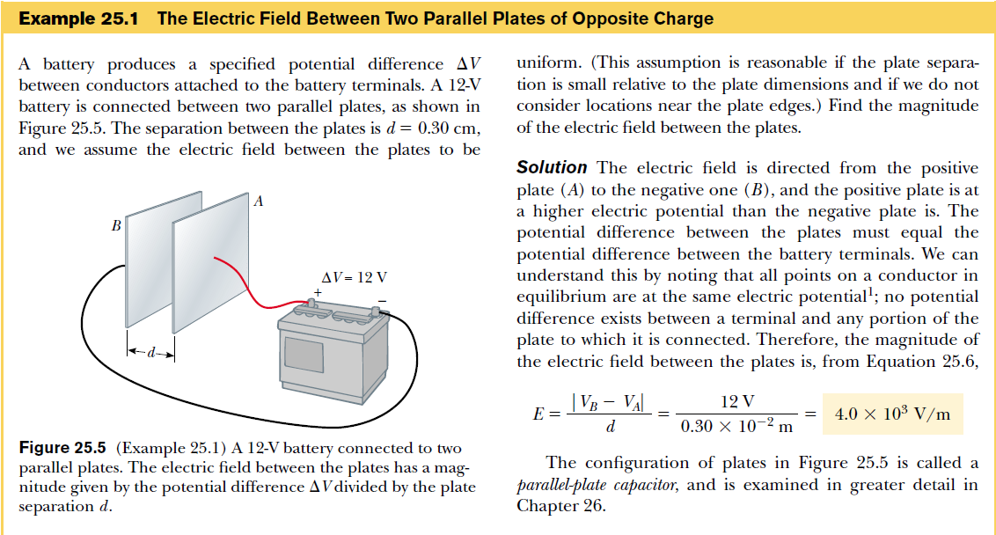

Slide 12
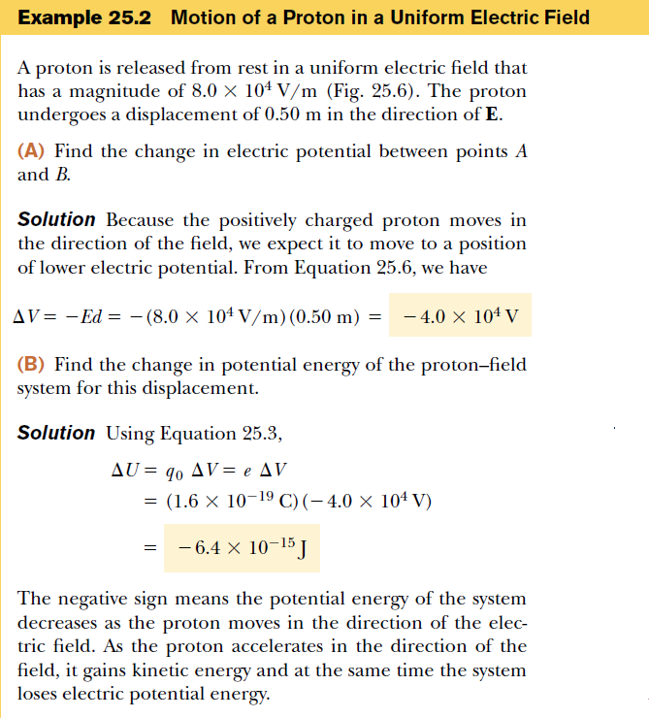

Slide 13

25.3 Electric Potential and Potential Energy Due to Point Charges
Electric Potential due to point charges given as

Slide 14
point of zero potential is taken at an infinite distance from the charge: V_{infinity} = 0
With this choice, the electric potential created by a point charge q at any distance r from q is given by
The total electric potential at some point P due to several point charges is algebraic sum of the potentials due to the individual charges
Remember that potentials are scalar quantities!

Slide 15

Consider a system of two particles , If V₁ is the electric potential due to charge q₁ at a point P, then work required to bring the charge q₂ from infinity to P without acceleration is q₂V₁.
If the distance between P and q₁ is r, then by definition
Potential energy is positive if charges are of the same sign and vice versa.
The total potential energy of the system of three charges is

Slide 16
Problem Solving Strategy
Remember that potential is a scalar quantity.
Superposition principle is an algebraic sum of potentials due to a system of charges.
    Signs are important.

Slide 17
