Slide 1
Chapter 5
Discrete Probability Distributions

Slide 2
Chapter 5 Overview
Introduction
5-1 Probability Distributions
5-2 Mean, Variance, Standard Deviation , and Expectation
5-3 The Binomial Distribution

Slide 3
5.1 Probability Distributions
A random variable is a variable whose values are determined by chance.
Classify as discrete and continuous
A discrete probability distribution consists of the values a random variable can assume and the corresponding probabilities of the values.

Slide 4

For example: tossed a coin S={T,H}
X= number of heads
X= 0 , 1
P(x=0) = P(T) =
P(x=1) = P(H)=
X | 0 | 1
P(X)

Slide 5
discrete probability distribution
Two Requirements For a Probability Distribution
The Sum of the probabilities of all the events in the sample space must be equal 1
Σ P (X) = 1
2. The probability of each event in the sample space must be between or equal to 0 and 1.
0 ≤ P (X) ≤ 1.

Slide 6
Determine whether each distribution is a probability distribution.
Example 5-4:
X | 0 | 5 | 10 | 15 | 20
P(X)
√
X | 0 | 2 | 4 | 6
P(X) | -1 | 1.5 | 0.3 | 0.2
×
X | 1 | 2 | 3 | 4
P(X)
√
X | 2 | 3 | 7
P(X) | 0.5 | 0.3 | 0.4
×

Slide 7
Example 5-2: Tossing Coins
Represent graphically the probability distribution for the sample space for tossing three coins.
.
S={TTT , TTH , THT , HTT , HHT , HTH , THH , HHH}
X= number of heads
X= 0 , 1, 2 , 3
P(x=0) = P({TTT}) =
P(x=1) = P({TTH ,THT,HTT}) =
P(x=2) = P({HHT,HTH,THH}) =
P(x=3) = P(HHH) =

Slide 8
Probability Distribution Table
Number of heads (X) | 0 | 1 | 2 | 3
Probability P(X)
0
1
2
3

Slide 9
Example 5-3:
The baseball World Series is played by the winner of the National League and the American League. The first team to win four games, wins the world sreies.In other words ,the series will consist of four to seven games, depending on the individual victories. The data shown consist of the number of games played in the world series from 1965 through 2005.The number of games (X) .Find the probability P(X) for each X ,construct a probability distribution, and draw a graph for the data.
x | Number of games played
4 | 8
5 | 7
6 | 9
7 | 16
Note: This PowerPoint is only a summary and your main source should be the book.

Slide 10
For 4 games = = 0.200
For 5 games = = 0.175
For 6 games = = 0.225
For 7 games = = 0.400
Probability Distribution Table
X | 4 | 5 | 6 | 7
P(X) | 0.200 | 0.175 | 0.225 | 0.400
Note: This PowerPoint is only a summary and your main source should be the book.

Slide 11
P(X)
0.40
0.30
0.20
0.10
4
5
6
7
X
Note: This PowerPoint is only a summary and your main source should be the book.

Slide 12
Mean, Variance, Standard Deviation, and Expectation

Slide 13
Mean, Variance, Standard Deviation, and Expectation
Mean
The mean of a random variable with a discrete probability distribution .
Where X₁, X₂ , X₃ ,…, X_{n} are the outcomes and P(X₁), P(X₂), P(X₃), …, P(X_{n}) are the corresponding probabilities.
µ = X₁ . P(X₁) + X₂ . P(X₂) + X₃ . P(X₃)+ … + X_{n} . P(X_{n})
µ = ∑ X . P(X)

Slide 14



Variance and Standard Deviation
The formula for the variance of a probability distribution is
Variance:
Standard Deviation:

Slide 15
Example 5-6: Children in Family
In a family with two children ,find the mean of the number of children who will be girls.
=
X | 0 | 1 | 2
P(X)
Solution:
µ= ∑X . P(X)=

Slide 16

Example 5-9:
Rolling a Die
Compute the variance and standard deviation for the probability distribution in Example 5–5.
Solution :
Variance
standard deviation

Slide 17
Example 5-10:
Selecting Numbered Balls
A box contains 5 balls .Two are numbered 3 , one is numbered 4 ,and two are numbered 5. The balls are mixed and one is selected at random . After a ball is selected , its number is recorded . Then it is replaced . If the experiment is repeated many times , find the variance and standard deviation of the numbers on the balls.
Solution :
Number on each ball (X) | 3 | 4 | 5
Probability P(X)

Slide 18



Number on each ball (X) | 3 | 4 | 5
Probability P(X)
^{Step 1 :}
µ= ∑X . P(X)=
^{Step 2 :}

Slide 19
Expectation
The expected value, or expectation, of a discrete random variable of a probability distribution is the theoretical average of the variable.
The expected value is, by definition, the mean of the probability distribution.

Slide 20




Example 5-12: Winning Tickets
One thousand tickets are sold at $1 each for a color television valued at $350. What is the expected value of the gain if you purchase one ticket?
Solution :
 | Win | Lose
Gain(X) | $349 | -$1
Probability P(X)
An alternate solution :

Slide 21
Example 5-13: Winning Tickets
One thousand tickets are sold at $1 each for four prizes of $100, $50, $25, and $10. After each prize drawing, the winning ticket is then returned to the pool of tickets. What is the expected value if you purchase two tickets?
Gain
X
$98
$48
$23
$8
-$2
Probability
P(X)

Slide 22
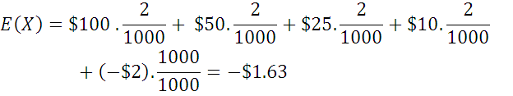
An alternate solution :

Slide 23
The Binomial Distribution

Slide 24
5-3 The Binomial Distribution
Many types of probability problems have only two possible outcomes or they can be reduced to two outcomes.
Examples include: when a coin is tossed it can land on heads or tails, when a baby is born it is either a boy or girl, etc.

Slide 25
The Binomial Distribution
The binomial experiment is a probability experiment that satisfies these requirements:
  Each trial can have only two possible outcomes—success or failure.
  There must be a fixed number of trials.
  The outcomes of each trial must be independent of each other.
  The probability of success must remain the same for each trial.

Slide 26
Notation for the Binomial Distribution
P(S)
P(F)
p
q
P(S) = p
n
X
Note that X = 0, 1, 2, 3,...,n
The symbol for the probability of success
The symbol for the probability of failure
The numerical probability of success
The numerical probability of failure
and P(F) = 1 – p = q
The number of trials
The number of successes

Slide 27
The Binomial Distribution
In a binomial experiment, the probability of exactly X successes in n trials is

Slide 28



Example 5-15: Tossing Coins
A coin is tossed 3 times. Find the probability of getting exactly two heads.
n = 3
Solution :
x= 2
p=

Slide 29

Example 5-16: Survey on Doctor Visits
A survey found that one out of five Americans say he or she has visited a doctor in any given month. If 10 people are selected at random, find the probability that exactly 3 will have visited a doctor last month.
n = 10
x= 3
p=

Slide 30
Example 5-17: Survey on Employment
A survey from Teenage Research Unlimited (Northbrook, Illinois) found that 30% of teenage consumers receive their spending money from part-time jobs. If 5 teenagers are selected at random, find the probability that at least 3 of them will have part-time jobs.
n = 5
Solution :
x= 3,4,5
p=0.30
q=1-0.30 =0.70

Slide 31
Mean, Variance and Standard deviation for the binomial

Slide 32
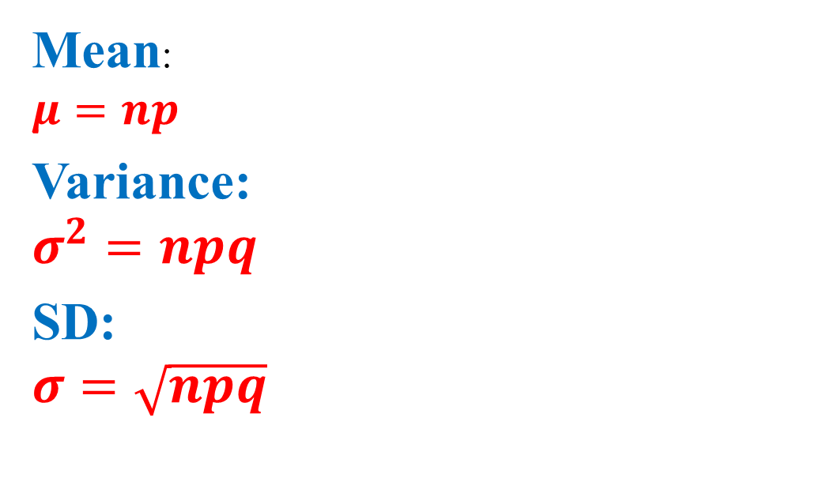
The mean , variance and SD of a variable that the binomial distribution can be found by using the following formulas:

Slide 33



Example 5-21: tossing a coin
A coin is tossed 4 times
Find the mean, variance and standard deviation of number of heads that will be obtained.
n = 4
p=

Slide 34




Example 5-22: Rolling a die
A die is rolled 360 times , find the mean , variance and slandered deviation of the number of 4s that will be rolled .
n = 360
p=

