Slide 1
CHAPTET 3
Data Description

Slide 2
Outline:
Introduction.
3-1 Measures of Central Tendency.
3-2 Measures of Variation.
3-3 Measures of Position.
3-4 Exploratory Data Analysis

Slide 3
A statistic:
Is a characteristic or measure obtained by using all the data values from a sample.
A parameter:
Is a characteristic or measure obtained by using all the data values from a specific population.

Slide 4
Measures of Central Tendency
Mode
Weighted Mean
Midrange
Mean
Median

Slide 5
The Mean:
The mean is the sum of the values, divided by the total number of values.
The symbol for the sample mean: | The symbol for the population mean: (mu)
n represent the total number of values in the sample | N represent the total number of values in the population .

Slide 6
Example 3-1: Days Off per Year
The data represent the number of days off per year for a sample of individuals selected from nine different countries. Find the mean.
20, 26, 40, 36, 23, 42, 35, 24, 30
The mean number of days off is 30.7 years.

Slide 7
Example 3-1P(106):Area Boat Registrations.
The data is:
3782 6367 9002 4208 6843 11008
Find the mean?
Solution:
If the mean of 5 values equals 64, then
∑ ᵡ = ?

Slide 8
Properties of the Mean
Uses all data values.
Unique, usually not one of the data values
Affected by extremely high or low values, called outliers
Have a look to page no. 116

Slide 9
The Median
The median is the midpoint of the data array. The symbol of the Median is MD.
where the data array is the ordered of the data set.
The median is the halfway point in a data set
The median will be one of the data values if there is an odd number of values.
The median will be the average of two data values if there is an even number of values.

Slide 10
Steps in computing the median of a data array.
Step 1: Arrange the data in order.
Step 2: Select the middle point .
Note: This PowerPoint is only a summary and your main source should be the book.

Slide 11
Example 3-4: Hotel Rooms
The number of rooms in the seven hotels in downtown Pittsburgh is
713, 300, 618, 595, 311, 401, 292..
Find the median?
Sort in ascending order.
292, 300, 311, 401, 596, 618, 713
Select the middle point
MD = 401
Odd number of values in data set

Slide 12
Example 3-6 :
The number of tornadoes that have occurred in the United States over an 8-year period follows
684, 764, 656, 702, 856, 1133 , 1132 , 1303.
Find the median?
Even number of values in data set
Solution :
Step 1: Arrange the data in order
656 , 684 , 702 , 764 , 856 , 1132 , 1133 , 1303
Median
Note: This PowerPoint is only a summary and your main source should be the book.

Slide 13
Example 3-8 P(111):Magazines Purchased.
Even number of values in data set
The data is:
1 7 3 2 3 4
Find the median?
Solution :
Step 1: Arrange the data in order.
1 , 2 , 3 , 3 , 4 , 7
Median

Slide 14
Properties of the Median
Affected less than the mean by extremely high or extremely low values.
Have a look to page no. 116

Slide 15
The Mode:
The value that occurs most often in a data set is called the mode.
unimodal | A data set that has only one value that occurs with the greatest frequency .
bimodal | A data set has two values that occur with the same greatest frequency ,both values are considered to be the mode and the data set.
multimodal | A data set has more than two values that occur with the same greatest frequency ,each value is used as the mode, and the data set.
No mode | Each value occurs only once . *Same

Slide 16
Example 3-9 :
Find the mode of the signing bonuses of eight NFL players for a specific year. The bonuses in millions of dollars are
18.0 , 14.0 , 34.5 , 10 , 11.3 , 10 , 12.4 , 10
Solution :
10 , 10 , 10 , 11.3 , 12.4 , 14.0 , 18.0 , 34.5
Since $10 million occurred 3 times
The mode is $10 million .
Then the data set is said
to be unimodal.
Example 3-10 :
110 , 731 , 1031 , 84 , 20 , 118 , 1162 , 1977 , 103 , 752
Each value occurs only once so there is no mode

Slide 17
Example 3-11 :
104 | 104 | 104 | 104 | 104
107 | 109 | 109 | 109 | 110
109 | 111 | 112 | 111 | 109
The values 104 and 109 both occur 5 time
The modes are 104 and 109 .
Then the data set is said
to be bimodal .

Slide 18
Properties of the Mode
Can be used with nominal data
Not always unique or may not exist
Have a look to page no. 116

Slide 19
The Midrange:
The midrange is defined as the sum of the lowest and highest values in the data set, divided by 2.The symbol of midrange is MR.

Slide 20
For example 3-15:
Find the midrange.
2, 3, 6, 8, 4, 1
For example 3-16:
18.0 , 14.0 , 34.5 ,10 , 11.3 , 10 , 12.4 10
. Find the midrange ?

Slide 21
Properties of the Midrange
Affected by extremely high or low values in a data set
Have a look to page no. 116

Slide 22
The Weighted Mean:
Find the Weighted Mean of a variable X by multiplying each value by its corresponding weight and dividing the sum of the products by the sum of the weights.
(not all values are equally represented)
Where w1 ,w2 , …., wn are the weights
And x1 , x2 , ….., xn are the values.
The type of mean that considers an additional factor is called the weighted mean.

Slide 23
Example 3-17:
A student received an A in English Composition I (3 credits), a C in Introduction to Psychology (3 credits), a B in Biology I (4 credits),and a D in physical Education (2credits).Assuming A= 4 grade points , B= 3 grade points , C = 2 grade points , D= 1 grade points and F = 0 grade points , find the student’s grade points average.
Course | Credits (w) | Grade (x)
English Composition I Introduction to Psychology Biology I physical Education | 3 3 4 2 | A(4 point) B(2 point) C(3 point) D(1 point)
Note: This PowerPoint is only a summary and your main source should be the book.

Slide 24
Summary of Measures of Central Tendency.
Measure | Definition | Symbol
Mean | Sum of values, divided by total no. of values | ,
Median | Middle point in data array | MD
Mode | Most frequent data value | None
Midrange | L.V plus H.V ,divided by 2 | MR

Slide 25
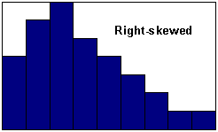
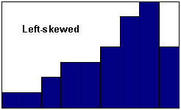
Distribution Shapes
Positively skewed
Negatively skewed
y
y
Mode
Median
Mean
x
Mean
Mode
Median
x
Mean > MD> Mode
Mean < MD< Mode
the mean is the largest statistic, while the mode is the smallest
the mean is less than the median and they are both less than the mode.

Slide 26
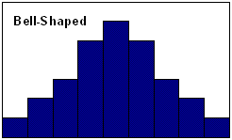
Symmetric distribution
Mode
Median
Mean
= MD = D

Slide 27
3-2 Measures of Variation

Slide 28
How Can We Measure Variability?
Range
Variance
Standard Deviation
Coefficient of Variation

Slide 29
Measures of Variation: Range
The range is the difference between the highest and lowest values in a data set.

Slide 30
Example 3-18/19: Outdoor Paint
Two experimental brands of outdoor paint are tested to see how long each will last before fading. Six cans of each brand constitute a small population. The results (in months) are shown. Find the mean and range of each group.
Brand A | Brand B
10 | 35
60 | 45
50 | 30
30 | 35
40 | 40
20 | 25

Slide 31
Example 3-18/19: Outdoor Paint
Brand A | Brand B
10 | 35
60 | 45
50 | 30
30 | 35
40 | 40
20 | 25
The average for both brands is the same, but the range
for Brand A is much greater than the range for Brand B.
Which brand would you buy?

Slide 32
Measures of Variation: Variance & Standard Deviation
The variance is the average of the squares of the distance each value is from the mean.
The standard deviation is the square root of the variance.
The standard deviation is a measure of how spread out your data are.

Slide 33
Uses of the Variance and Standard Deviation
To determine the spread of the data.
To determine the consistency of a variable.
To determine the number of data values that fall within a specified interval in a distribution (Chebyshev’s Theorem).
Used in inferential statistics.

Slide 34
Example 3-21: Outdoor Paint
Find the variance and standard deviation for the data set for Brand A paint. 10, 60, 50, 30, 40, 20
Months, X | µ | X - µ | (X - µ)²
10 60 50 30 40 20
35
35
35
35
35
35
-25
25
15
-5
5
-15
625
625
225
25
25
225
1750

Slide 35
Variance & Standard Deviation (Sample Theoretical Model)
The sample variance denoted by s² is
Where x= individual
= sample mean
n = sample size
The sample standard deviation denoted by s is

Slide 36
Variance & Standard Deviation (Sample Computational Model)
The sample variance is
The sample standard deviation is
is not the same as .
T he notation means to square the values first then sum .
means to sum the values first then square the sum .

Slide 37
Example 3-23: European Auto Sales
Find the variance and standard deviation for the amount of European auto sales for a sample of 6 years. The data are in millions of dollars.
11.2, 11.9, 12.0, 12.8, 13.4, 14.3
X | X ²
11.2 11.9 12.0 12.8 13.4 14.3
125.44
141.61
144.00
163.84
179.56
204.49
variance
standard deviation
75.6
958.94

Slide 38
Coefficient of Variation
The coefficient of variation denoted by Cvar is the standard deviation divided by the mean, expressed as a percentage.
For sample For populations,
Use CVAR to compare standard deviations when the units are different.

Slide 39
Example 3-25: Sales of Automobiles
The mean of the number of sales of cars over a 3-month period is 87, and the standard deviation is 5. The mean of the commissions is $5225, and the standard deviation is $773. Compare the variations of the two.
Commissions are more variable than sales.

Slide 40
Solution :
Example 3-25:
The mean for the number of pages of sample of women’s fitness magazines is 132 with a variance of 23.The mean for the number of advertisements of sample of women’s fitness magazines is 182 with a variance of 62. Compare the variations.
The coefficients of variation are
Since the coefficients of variation is larger for advertisements.
The number of advertisements are more variable than number of pages.
Note: This PowerPoint is only a summary and your main source should be the book.

Slide 41
Summary
 | Sample | populations
Variance
Standard Deviation
Cvar

Slide 42
The empirical(Normal)Rule
For any bell shaped distribution.
Approximately 68% of the data values will fall within one standard deviation of the mean .
Approximately 95% of the data values will fall within two standard deviation of the mean .
Approximately 99.7% of the data values will fall within three standard deviation of the mean .

Slide 43
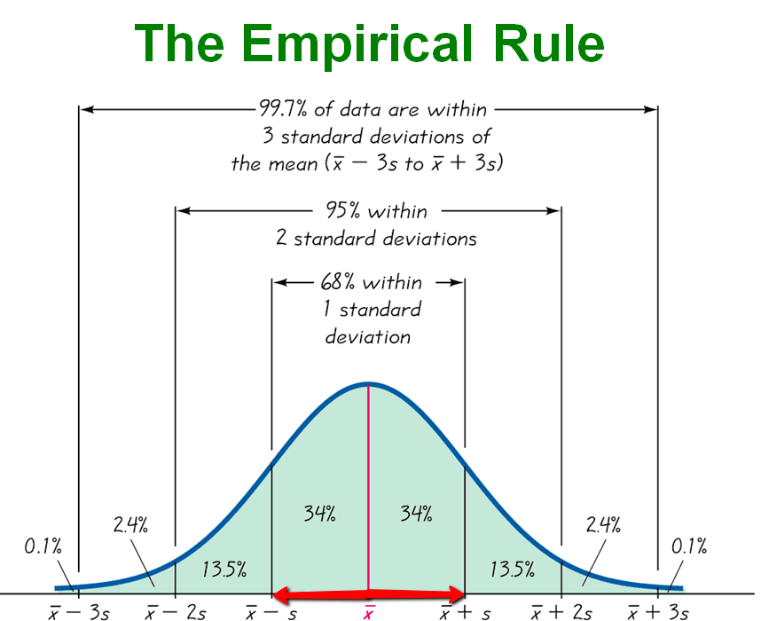

Slide 44
For example :
= 480 , S = 90 , approximately 68%
= 480 –1(90)= 390
Then the data fall between 570 and 390
= 480 + 1(90)= 570
= 480 , S = 90 , approximately 95%
= 480 - 2(90) = 300
Then the data fall between 660 and 300
= 480 + 2(90) = 660
= 480 , S = 90 , approximately 99.7%
=480 + 3(90) = 750
Then the data fall between 750 and 210
=480 - 3(90) = 210

Slide 45
Measure of position

Slide 46
Standard score or z score
Quartile
Outlier

Slide 47
A z score or standard score for a value is obtained by subtracting the mean from the value and dividing the result by the standard deviation . The symbol for a standard score is z . The formula is
For samples , the formula is
For populations , the formula is
The z score represents the number of standard deviations
that a data value falls above or below the mean .

Slide 48
Example 3-29 :
A student scored 65on a calculus test that had a mean of 50 and a standard deviation of 10 ; she scored 30 on a history test with a mean of 25 and a standard deviation of 5 .
Compare her relative position on the two tests.
Solution:

Slide 49
Example 3-29 :
Solution:
The z scores. For calculus is
The z scores. For history is
Her relative position in the calculus class is higher than
her relative position in history class.

Slide 50
Example 3-30 :
Find the z score for each test , and state which is higher .
Test A | X=38 | = 40 | S=5
Test B | X=94 | = 100 | S=10
Solution:

Slide 51
Example 3-30 :
Find the z score for each test , and state which is higher .
Solution:
The z scores. For lest A,
The z scores. For lest B,
The score for test A is relatively higher than the score for test B.

Slide 52
Quartiles
Quartiles divide the data set into 4 equal groups .
Deciles are denoted Q₁ , Q₂ and Q₃ with the corresponding percentiles being P₂₅ , P₅₀ and P₇₅ .
The median is the same as P₅₀ or Q₂ .
Smallest
data value
largest
data value
Q₁
Q₂
Q₃
25%
25%
25%
25%
25%
50%
75%

Slide 53
Procedure Table
Finding Data Values Corresponding to Q₁,Q₂and Q_{3 .}
Step 1: Arrange the data in order from lowest to highest .
Step 2: Find the median of the data values .This is the value
for Q₂ .
Step 3: Find the median of the data values that fall below Q₂.This is the value for Q₁ .
Step 4: Find the median of the data values that fall above Q2.This is the value for Q3.

Slide 54
Example 3-36 :
Find Q1 ,Q2 and Q3 for the data set
15 , 13 , 6 , 5 , 12 , 50 , 22 , 18 .
Solution:
Step 1: Arrange the data in order from lowest to highest .
5 , 6 , 12 , 13 , 15 , 18 , 22 , 50
Step 2: Find the median (Q₂).
5 , 6 , 12 , 13 , 15 , 18 , 22 , 50
MD
Q₂

Slide 55
Step 3: Find the median of the data values less than 14 .
5 , 6 , 12 , 13
Q₁
Step 4: Find the median of the data values greater than 14 .
15 , 18 , 22 , 50
Q₃

Slide 56
Example:
Find Q1 ,Q2 and Q3 for the data set
16 , 13 , 6 , 5 , 12 , 23, 19 .
Solution:
5 , 6 , 12 , 13 , 16 , 19 , 23
Q2
5 , 6 , 12 , 13 , 16 , 19 , 23
Q1
Q3

Slide 57
Outliers

Slide 58
Procedure Table
An outlier is an extremely high or an extremely low
data value when compare with the rest of the data values .
Procedure for Identifying Outliers
Step 1: Arrange the data in order and find Q₁ and Q₃.
Step 2: Find the interquartile range IQR= Q₃ - Q₁
Step 3: Multiply the IQR by 1.5 .
Step 4: Subtract the value obtained in step 3 form Q₁ and add the value to Q₃.
Step 5: Check the data set for any data value that is smaller than
Q₁-1.5(IQR) or larger than Q₃+1.5(IQR).

Slide 59
Example 3-36 :
Check the following data set for outliers
15 , 13 , 6 , 5 , 12 , 50 , 22 , 18 .
Solution:
Step 1: Arrange the data in order and find Q₁ and Q₃.
This was done in example 3-36 ; Q₁= 9 and Q₃=20
Step 2: Find the interquartile range IQR= Q₃ - Q₁
IQR= Q₃ - Q₁ = 20 – 9 = 11

Slide 60
Step 3: Multiply the IQR by 1.5 .
1.5(11) = 16.5
Step 4: Subtract the value obtained in step 3 form Q₁ and add the value to Q₃.
9-16.5 = -7.5
20 + 16.5 = 36.5
Step 5: Check the data set for any data value that fall outside the interval from -7.5 to 36.5 .
Such as the value 50 is outside this interval so it can be considered an outlier.

Slide 61
Exploratory Data Analysis (EDA)
The five –Number Summary :
1-lowest value of the data set .
2-Q1.
3-the median(MD) Q2.
4-Q3.
5-the highest value of the data set .
A Box plot can be used to graphically represent the data set .

Slide 62
Procedure for constructing a boxplot
Find five -Number summary .
Draw a horizontal axis with a scale such that it includes the maximum and minimum data value .
Draw a box whose vertical sides go through Q₁ and Q₃,and draw a vertical line though the median .
Draw a line from the minimum data value to the left side of the box and line from the maximum data value to the right side of the box.
Q₁
Q₂
Q₃
maximum
minimum

Slide 63
Example 3-39 :
Cheese substitute |  |  |  | Real cheese
290 | 250 | 180 | 270 | 40 | 45 | 420 | 310
310 | 340 | 260 | 130 | 90 | 180 | 240 | 220
Compare the distributions using Box Plot s?
Solution:
Step1: Find Q₁,MD,Q₃ for the Real cheese data
40 , 45 , 90 , 180 , 220 , 240 , 310 , 420
Q1 MD Q3

Slide 64
,
,
Step2:Find Q₁ , MD and Q₃ for the cheese substitute data.
130 , 180 , 250 , 260 , 270 , 290 , 310 , 340
Q1 MD Q3
=265
,
,

Slide 65
67.5 200 275
40 420
215 265 300
130 340
0 100 200 300 400 500

Slide 66
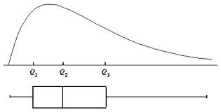
Right skewed
(+ve skewed)
Left skewed
(-ve skewed)

Slide 67
Information obtained from a Box plot
The median(MD) is near the center. | The distribution is symmetric.
The median falls to left of the center . | The distribution is positively skewed (Left skewed).
The median falls to right of the center . | The distribution is negatively skewed (Right skewed).
The lines are the same length. | The distribution is symmetric.
The right line is larger than the left line . | The distribution is positively skewed (Right skewed). .
The left line is larger than the right line . | The distribution is negatively skewed (Left skewed).

