Slide 1
Chapter 3
Stoichiometry: calculations with chemical formulas and equations

Slide 2
Chapter 3
Stoichiometry: calculations with chemical formulas and equations
Page:54-64
Representing compounds.
An atomic level view of elements and compounds
Ionic compounds
Molecular compounds
Writing and balancing chemical equation.

Slide 3
Chapter 3/Stoichiometry
3.2. Representing compounds:
A compound is represented with its chemical formula.
Chemical formula indicates the elements present in the compound and the relative number of atoms or ions of each.
Example:
Water is represented as H₂O.
Carbon dioxide is represented as CO₂.
Sodium Chloride is represented as NaCl.
Carbon tetrachloride is represented as CCl₄.

Slide 4
Chapter 3/Stoichiometry
3.2. Representing compounds:
Types of Chemical Formulas
1- Molecular formula الصيغة الجزيئية) (:
give the actual number of atoms of each element in compound.
e.g. hydrogen peroxide H₂O₂
2- Empirical formula (الصيغة الأولية):
give the relative number of atoms of each element in compound.
e.g. hydrogen peroxide
HO
3- Structural formal (الصيغة البنائية):
use lines to represent covalent bonds.
e.g. hydrogen peroxide
H−O−O−H
Notes:
الصيغة الأولية: أبسط صورة للجزئ تعطي نسب وجود الذرات المكونة للجزئ بأصغر نسبة وليس من الضروري أن تعطي العدد الصحيح للذرات
الصيغة الجزيئية: تحتوي على العدد الصحيح من ذرات كل عنصر يدخل في تركيب أصغر وحده في المادة (الجزي).
(من الصيغة الجزيئية نستطيع إيجاد الصيغة الأولية والعكس غير صحيح)

Slide 5
Chapter 3/Stoichiometry
3.2. Representing compounds:
Example:
1- What the Empirical Formula of H₂O, C₆H₁₂O₆ , O₃ and N₂H₄?
The empirical formula of H₂O is H₂O
The empirical formula of C₆H₁₂O₆ is CH₂O (divide the numbers 6, 12 and 6 by the smallest common devisor 6)
The empirical formula of N₂H₄ is NH₂
2- Write the empirical formulas for the following molecules:
Acetylene (C₂H₂)
CH
Nitrous oxide (N₂O)
N₂O
3. Caffeine C₈H₁₀N₄O₂
C₄H₅N₂O
Divide all the numbers by the smallest common devisor.

Slide 6
Chapter 3/Stoichiometry
3.2. Representing compounds:
Example 3.1 p55:
Write the empirical formulas for the following molecules:
C₄H_{8,}
the greatest common factor is 4 → The empirical formula is therefore CH₂.
(b) B₂H₆
the greatest common factor is 2 → The empirical formula is therefore BH₃.
(c) CCl₄
the only common factor is 1, → The empirical formula and the molecular formula are identical.

Slide 7
Chapter 3/Stoichiometry
3.3. An atomic level view of elements and compounds

Slide 8
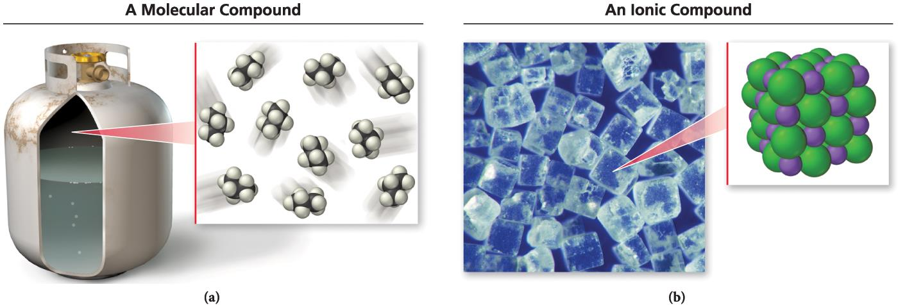
Chapter 3/Stoichiometry
3.3. An atomic level view of elements and compounds
Atomic element: Are elements that exist in nature with single atoms as their unite.
Molecular element: Are elements that exist as molecule two or more atoms bonded together.
1- diatomic molecule: H₂, N₂, O₂, F₂, Cl₂, Br₂, and I₂.
2- polyatomic molecule e.g. P₄ and S₈
Ionic compound: Are composed of cation (metal) and anion (nonmetal) bound together by ionic bond.
1- Binary ionic compounds e.g. NaCl
2- polyatomic ions compound e.g. NaNO₃
Molecular compound: Are composed of two or more atoms covalently bonded nonmetal.

Slide 9
Chapter 3/Stoichiometry
3.4. Ionic Compounds: formal and Naming
Ionic Compounds
consist of a combination of cations and an anions, e.g.: Na⁺ and Cl⁻ → NaCl
The sum of the charges on the cation/s and anion/s in each formula unit must equal zero.
The formula of the ionic compound must be neutral.
1- Binary compounds are compounds formed from just two elements.
2- polyatomic ions: are ionic compounds contain ions that are themselves composed of a group of covalently bonded atoms with an overall charge.
Example:
NaNO₃ contains Na⁺ and NO^{3–.}
CaCO₃ contains Ca²⁺ and CO3^{2–.}
KClO Contains K⁺ and ClO–
Cation
Anion
Notes:
المركبات الأيونية
صيغتها الجزيئية مطابقة للصيغة الأولية
مجموع شحنة الكاتيونات + شحنة الأنيونات = صفر
the formula is always the same as the empirical formula
the sum of the charges on the cation(s) and anion(s) in each formula unit must equal zero

Slide 10
Chapter 3/Stoichiometry
3.4. Ionic Compounds: formal and Naming
How to make the formula neutral?
Potassium Bromide
Zinc Chloride
K⁺ Br⁻
Zn²⁺ Cl⁻
قاعدة تبادل التكافؤات
The subscript of the cation is numerically equal to the charge on the anion, and the subscript on the anion is numerically equal to the charge on the cation.
KBr
ZnCl₂

Slide 11
Chapter 3/Stoichiometry
3.4. Ionic Compounds: formal and Naming
How to make the formula neutral?
2 x (+3) = +6
3 x (-2) = -6
Al₂O₃
Al³⁺
O²⁻
قاعدة تبادل التكافؤات
The subscript of the cation is numerically equal to the charge on the anion, and the subscript on the anion is numerically equal to the charge on the cation.
1 x (+2) = +2
2 x (-1) = -2
CaBr₂
Ca²⁺
Br⁻
1 x (+2) = +2
1 x (-2) = -2
Na₂CO₃
Na⁺
CO₃²⁻

Slide 12
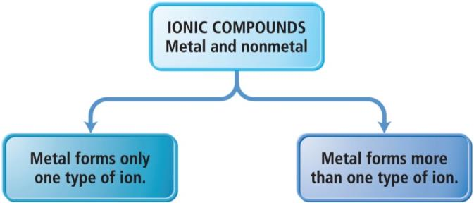
Chapter 3/Stoichiometry
3.4. Ionic Compounds: formal and Naming
1- Ionic Binary compounds can be categorized into two types,
depending on the metal in the compound.
The ion always has the same charge.
The ion has the different charge.

Slide 13
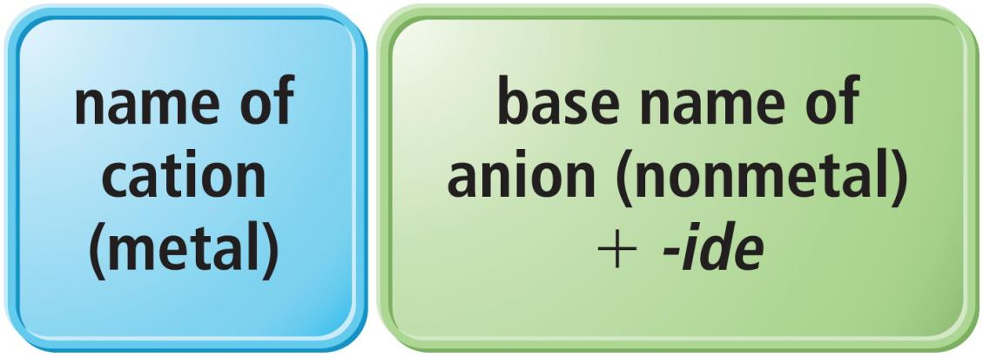
Chapter 3/Stoichiometry
3.4. Ionic Compounds: formal and Naming
1.1 Naming Binary Ionic Compounds of Type I Cations
The names of binary ionic compounds take the following form:
Example:
1- The name for KCl consists of the name of the cation, potassium, followed by the base name of the anion, chlor, with the ending -ide.
KCl → potassium chloride.
2- The name for CaO consists of the name of the cation, calcium, followed by the base name of the anion, ox, with the ending -ide.
CaO → calcium oxide.

Slide 14
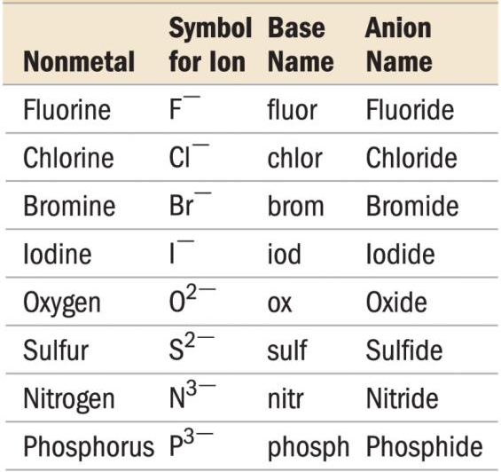
Chapter 3/Stoichiometry
3.4. Ionic Compounds: formal and Naming
1.1 Naming Binary Ionic Compounds of Type I Cations
Table 3.2.Base Names of some common Anions

Slide 15
Chapter 3/Stoichiometry
3.4. Ionic Compounds: formal and Naming
1.2 Naming Binary Ionic Compounds of Type II Cations
Metals of this type are often transition metals.
Some main group metals, such as Pb, Tl, and Sn, form more than one type of cation.
Example:
FeSO₄ → iron is +2 cation (Fe²⁺).
Fe₂(SO₄)₃ → iron is +3 cation (Fe³⁺).
Cu₂O → copper is +1 cation (Cu⁺).
CuO → copper is +2 cation (Cu²⁺).

Slide 16
Chapter 3/Stoichiometry
3.4. Ionic Compounds: formal and Naming
1.2 Naming Binary Ionic Compounds of Type II Cations
we distinguish between Fe²⁺ and Fe³⁺ as follows:
Fe²⁺ Iron(II)
Fe³⁺ Iron(III)
Example:
FeCl₂ → Iron (II) chloride
FeCl₃ → Iron (III) chloride
Cr₂S₃ → chromium(III) sulfide
Roman numerals
I | One
II | two
III | Three
IIII | Four
IV | Five

Slide 17
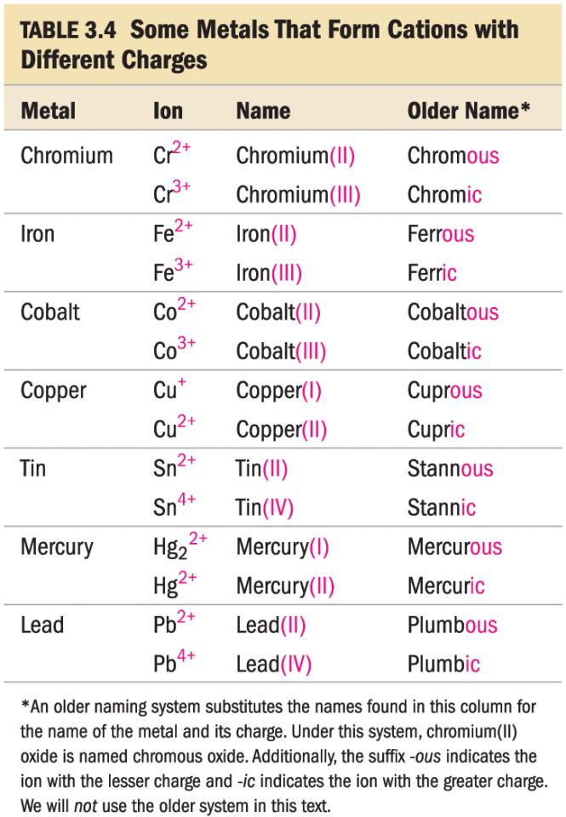
Chapter 3/Stoichiometry
3.4. Ionic Compounds: formal and Naming
1.2 Naming Binary Ionic Compounds of Type II Cations
Table 3.3

Slide 18
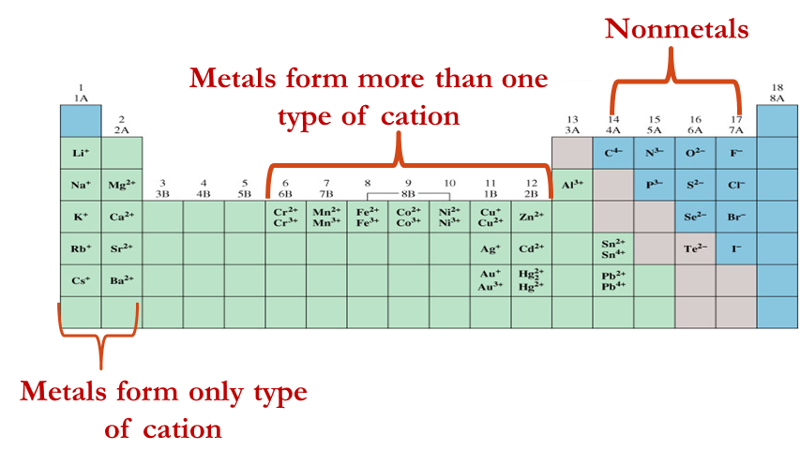
Chapter 3/Stoichiometry
3.4. Ionic Compounds: formal and Naming
Ionic Binary compounds
1- Metals form only one type of cation:
Alkali metals.
Alkali earth metals.
Ag⁺, Al³⁺, Cd²⁺, Zn²⁺
2- Metals form more than one type of cation:
Transition Metals.
other metal cations.

Slide 19
Chapter 3/Stoichiometry
3.4. Ionic Compounds: formal and Naming
2. Naming Ionic Compounds Containing Polyatomic Ions
Ionic compounds that contain a polyatomic ion is name in the same way as other ionic compounds, except that we use the name of the polyatomic ion whenever it occurs.
Example:
NaNO₂ is named according to
its cation, Na⁺ → sodium
its polyatomic anion, NO₂– → nitrite
NaNO₂ → sodium nitrite

Slide 20
Chapter 3/Stoichiometry
3.4. Ionic Compounds: formal and Naming
2. Naming Ionic Compounds Containing Polyatomic Ions
Most polyatomic ions are oxyanions anions containing oxygen and another element.
1-If there are two ions in the series,
The one with more O₂ atoms has the ending -ate,
e.g. NO^{3–} → nitrate
2- If there are more than two ions in the series
The one with fewer has the ending -ite.
e.g. NO^{2–} → nitrite
the prefixes hypo-, meaning less than,
the prefixes per-, meaning more than,
ClO– → hypochlorite
ClO₂– → chlorite
ClO₃– → chlorate
ClO₄– → perchlorate
→

Slide 21
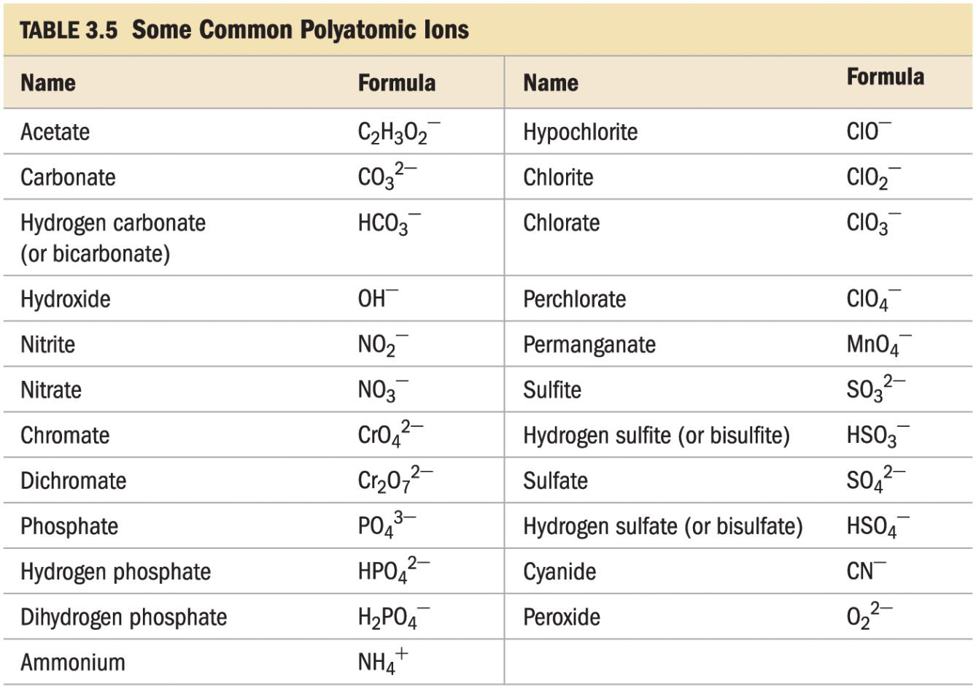
Chapter 3/Stoichiometry
3.4. Ionic Compounds: formal and Naming
2. Naming Ionic Compounds Containing Polyatomic Ions
Table 3.4

Slide 22
Chapter 3/Stoichiometry
3.4. Ionic Compounds: formal and Naming
2. Naming Ionic Compounds Containing Polyatomic Ions
Example:
Name the following compounds:
(a) Cu(NO₃)₂
1. Cation: Copper cation (can form two types of cation) → Copper (II)
2. Anion: NO₃⁻ anion has a common name Nitrate
Thus: the name of the compound is: Copper (II) nitrate
(b) KH₂PO₄
1. Cation: K form only one type of cation→ Potassium Note: not potassium (I)
2. Anion: H₂PO⁴⁻ has a common name dihydrogen phosphate
Thus: the name of the compound is: Potasium dihydrogen phosphate

Slide 23
Chapter 3/Stoichiometry
3.4. Ionic Compounds: formal and Naming
Example 3.7 p62:
Determine the name for the compound Li₂Cr₂O₇ ?
Notes:
Lithium dichromate

Slide 24
Chapter 3/Stoichiometry
H.W
4, 12, p73

Slide 25
Chapter 3/Stoichiometry
3.5. Molecular Compounds: Formulas and Names
Molecular compounds are composed of two or more nonmetals.
The formula for a molecular compound cannot readily be determined from its constituent elements (why?)
because the same combination of elements may form many different molecular compounds, each with a different formula.
Example: Nitrogen and oxygen form all of the following unique molecular compounds: NO
NO₂
N₂O
N₂O₃
N₂O₄
N₂O₅
Notes:
المركبات الجزيئية
تتكون من أشباه فلزات + لا فلزات
لا فلزات + لا فلزات
معظم المركبات الجزيئية تكون ثنائية العنصر (تتكون من عنصرين فقط)
بعضها له أسماء شائعه مثل
H₂O, NH₃, CH₄
العنصر الأخير يضاف لنهايته ide
تكتب العناصر الموجوده يسار الجدول الدوري أو الأقرب لليسار أولا.
المركبات المحتوية على أكثر من ذرة من نفس العنصر يعبر عن عدد الذرات للعنصر لها باستخدام البادئات اليونانية

Slide 26
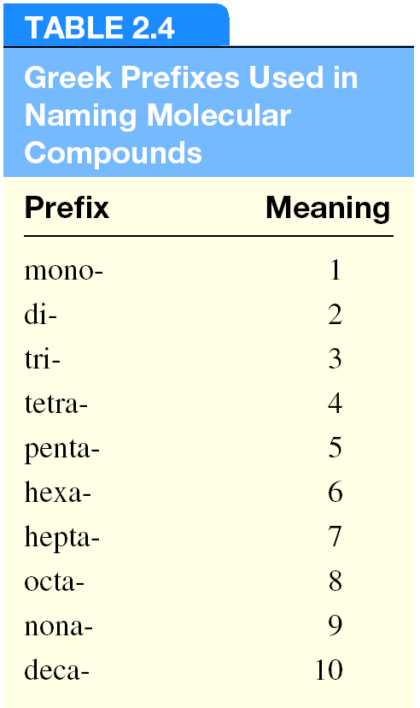
Chapter 3/Stoichiometry
3.5. Molecular Compounds: Formulas and Names
How to write the name of Molecular Compounds?
1- write the name of the element with the smallest group number first.
e.g. HCl → hydrogen chloride
If the two elements lie in the same group, then write the element with the greatest row number first.
e.g. SO₂ → sulphur dioxide
2- The prefixes given to each element indicate the number of atoms present.
If there is only one atom of the first element in the formula, the prefix mono- is normally omitted.

Slide 27
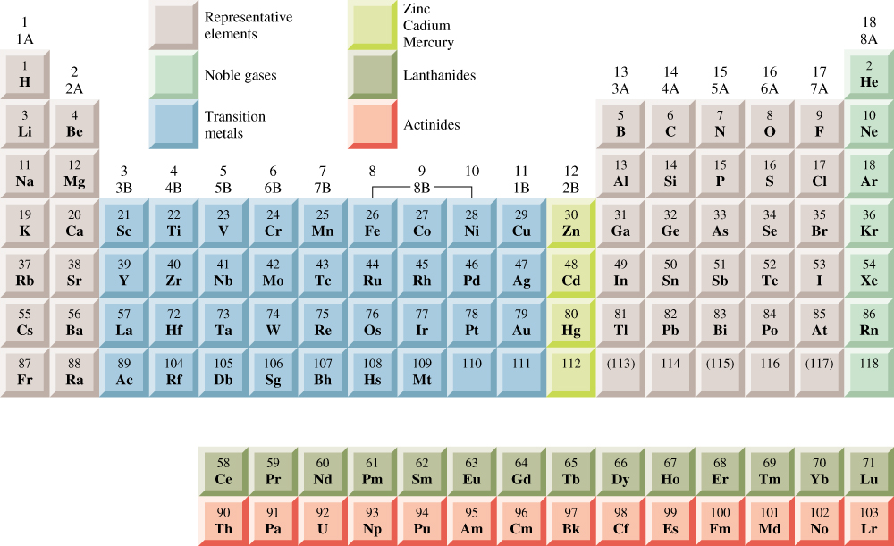
Chapter 3/Stoichiometry
3.5. Molecular Compounds: Formulas and Names

Slide 28
Chapter 3/Stoichiometry
3.5. Molecular Compounds: Formulas and Names
Mono- is omitted if its in the first element.
e.g. Monocarbon monoxide
→ Carbon monoxide
Example:
HCl | Hydrogen chloride
SiC | Silicone carbide
CO | Carbon monoxide
CO₂ | Carbon dioxide
SO₂ | Sulphur dioxide
SO₃ | Sulphur trioxide
NO₂ | Nitrogen dioxide
N₂O₄ | Dinitrogen tetroxide
monooxide → monoxide
the o is omitted
tetraoxide → tetroxide the a is omitted

Slide 29
Chapter 3/Stoichiometry
3.5. Molecular Compounds: Formulas and Names
Example:
Name the following molecular compounds:
(a) SiCl₄
One silicon atom & four chlorine atoms
Thus: Silicon tetrachloride
(b) P₄O₁₀
Four phosphourus atoms & ten oxygen atoms
Thus: Tetraphosphourus decoxide
decaoxide the a is omitted

Slide 30
Chapter 3/Stoichiometry
3.5. Molecular Compounds: Formulas and Names
Example:
Write chemical formulas for the following molecular compounds:
(a) carbon disulphide
There is one carbon atom & two sulphur
Atoms, Thus: CS₂
(b) Disilicon hexabromide
There is two silicon atoms & six bromine
Atoms, Thus: S₂Br₆

Slide 31
Chapter 3/Stoichiometry
3.5. Molecular Compounds: Formulas and Names
Acids: are molecular compounds that form H⁺ when dissolved in water.
To indicate the compound is dissolved in water (aq) is written after the formula.
e.g. HCl → dissolved in water, → H⁺_{(aq)} and Cl–_{(aq)} ions
A compound is not considered an acid if it does not dissolve in water.
Characters of acids:
Sour taste
Dissolve many metals
such as Zn, Fe, Mg; but not Au, Ag, Pt
Formula generally starts with H
e.g., HCl, H₂SO₄

Slide 32
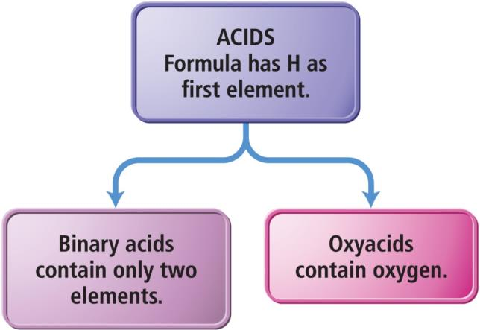
Chapter 3/Stoichiometry
3.5. Molecular Compounds: Formulas and Names
Acids can be categorized into two types
have H⁺¹ cation and nonmetal anion.
have H⁺ cation and polyatomic anion.

Slide 33
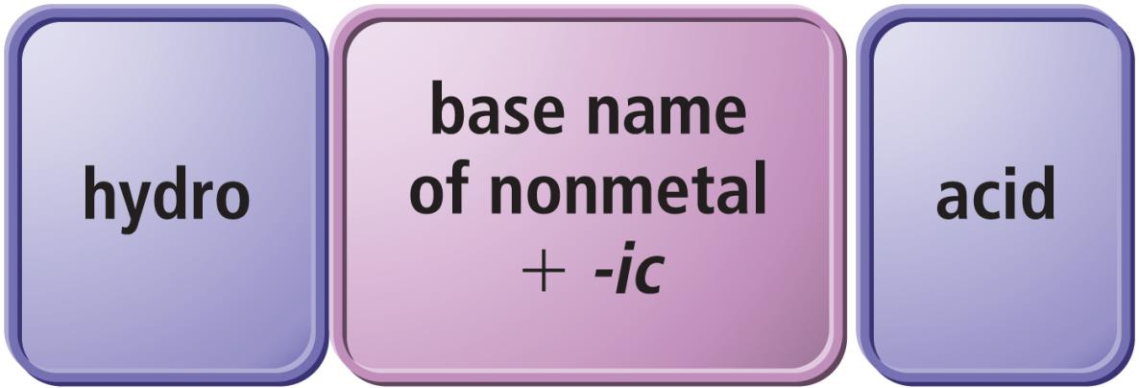
Chapter 3/Stoichiometry
3.5. Molecular Compounds: Formulas and Names
How to Naming Binary Acids?
Write a hydro- prefix.
Follow with the nonmetal name.
Change ending on nonmetal name to –ic.
Write the word acid at the end of the name.
Example: HCl → Hydrochloric acid
HBr → Hydrobromic acid

Slide 34
Chapter 3/Stoichiometry
3.5. Molecular Compounds: Formulas and Names
Example 3.9 p64
1- Determine the name for the compound HI(aq) ?
2-Determine the name for the compound HF(aq) ?
Notes:
Hydroiodic acid
Hydrofluoric acid

Slide 35
Chapter 3/Stoichiometry
H.W
14, 15,
p73
35

