Slide 1
Chapter 3
Stoichiometry: calculations with chemical formulas and equations

Slide 2
Chapter 3
Stoichiometry: calculations with chemical formulas and equations
Page:54-64
Representing compounds.
An atomic level view of elements and compounds
Ionic compounds
Molecular compounds
Writing and balancing chemical equation.

Slide 3
Chapter 3/Stoichiometry
3.6. Composition of Compounds
Percent Composition by Mass: is the percent by mass of each element in a compound
percent composition of an element in a compound =
أو بتعبير أخر
Where n is the number of moles of the element in 1 mole of the compound
n x molar mass of element
percent composition of an element in a compound =
x 100%
molar mass of compound

Slide 4
Chapter 3/Stoichiometry
3.6. Composition of Compounds
Example:
Calculate the mass percent of carbon in ethane (C₂H₆)?
(2)x(molar mass of C)
Mass percent of C in C₂H₆ =
× 100
molar moss of C₂H₆
Molar moss of C₂H₆ =
(2 x (molar mass of C)) + (6 x molar mass of H)
= (2 x12.011g/mol) + (6 x 1.007g/mol) = 30.070 g/mol
2 x (12.011g/mol)
%C =
× 100
30.070 g/mol
= 79.887%

Slide 5
Chapter 3/Stoichiometry
3.6. Composition of Compounds
Example:
Calculate the mass percent of Cl in CCl₂F₂?

Slide 6
Chapter 3/Stoichiometry
3.7. Determining a Chemical Formula from Experimental Data
Can be determined chemical formal from elemental analysis (experimentalمعمليا ) by:
Masses of elements formed
Or Percent composition
How ?

Slide 7
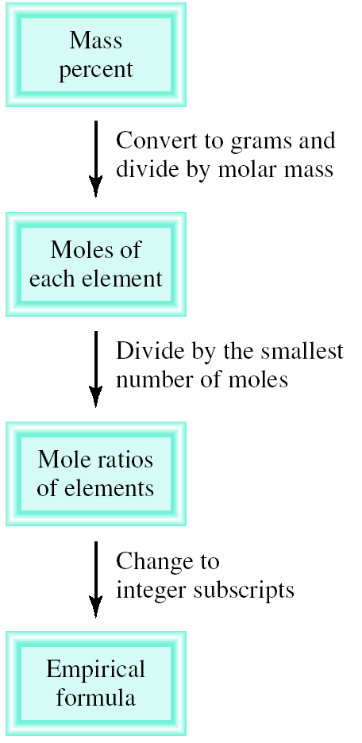
Chapter 3/Stoichiometry
3.7. Determining a Chemical Formula from Experimental Data
How ?
1. Convert the percentages to grams.
a) Assume you start with 100 g of the compound.
b) Skip if already grams.
2. Convert grams to moles.
a) Use molar mass of each element.
Write a pseudo formula using moles as subscripts.
4. Divide all by smallest number of moles.
a) If the result is within 0.1 of a whole number, round to the whole number.
5. Multiply all mole ratios by a number to make all whole numbers.
If ratio 0.5, multiply all by 2.
if ratio 0.33 or 0.66, multiply all by 3.
If ratio 0.25 or 0.75, multiply all by 4.
If ratio 0.20 or 0.40 or 0.80 multiply all by 5
d) Skip if already whole numbers.

Slide 8
Chapter 3/Stoichiometry
3.7. Determining a Chemical Formula from Experimental Data
Q: Determine the empirical formula of a compound that has the following percent composition by mass: K 24.75, Mn 34.77, O 40.51 percent.
 | K | Mn | O
% →100g | 24.75g | 34.77g | 40.51g
n=m/M | 24.75/39.10 =0.633mol | 34.77/54.94 =0.6329mol | 40.51/16.00 = 2.532mol
÷ on smallest no. of mole | 0.633/0.632 =1 | 0.6329/0.632 = 1 | 2.532/0.632 =4
The empirical formula is | K₁ | Mn₁ | O₄
 | KMnO₄
خطوات الحل
ننشأ جدول نضع فيه العناصر المذكورة في السؤال
نعتبر أن النسبة المئوية معبر عنها بالجرام فلو كان عندنا 100 جرام من المركب فهذه ال 100 جرام موزعة على العناصر حسب نسبتها.
نوجد عدد المولات n لكل عنصر باستخدام القانون n=m/M .
نقسم عدد المولات على أصغر مول من العناصر.
الأرقام التي نحصل عليها تمثل empirical formula بشرط أن تكون أعداد صحيحة كما في المثال السابق.
في حالة ظهور أعداد عشرية نقوم بضرب الأرقام التي في الأسفل الموجودة في الصيغة بأعداد بدأ من 2، 3....... حتى نحصل على أعداد صحيحة .
Courtesy of Dr. Fawzia Albelwi

Slide 9
Chapter 3/Stoichiometry
3.7. Determining a Chemical Formula from Experimental Data
Q/ Ascorbic acid composed of 40.92% C, 4.58% H, and 54.50% O by mass. Determine its empirical formula.
 | C | H | O
% →100g
n=m/M
÷ on smallest no. of mole
Convert into integer x 3
The empirical formula is

Slide 10
Determining Molecular Formulas For Compounds
Chapter 3/Stoichiometry
3.7. Determining a Chemical Formula from Experimental Data
The molecular formula is a multiple of the empirical formula.
To determine the molecular formula you need to know the empirical formula and the molar mass of the compound.
Molecular formula = (empirical formula)n,
where n is a positive integer.
The molar mass is a whole-number multiple of the empirical formula molar mass, the sum of the masses of all the atoms in the empirical formula:
molar mass
empirical formula molar mass
n =

Slide 11
Chapter 3/Stoichiometry
3.7. Determining a Chemical Formula from Experimental Data
Determining Molecular Formulas For Compounds
Example:
A sample compound contains 1.52g of N and 3.47g of O. The molar mass of this compound is between 90g/mol and 95g/mol. Determine the molecular formula.
Solution:
2.
3.
Thus the empirical formula is: NO₂
Present Composition by Mass
↓
Empirical Formula
↓
Molecular Formula

Slide 12
Chapter 3/Stoichiometry
3.7. Determining a Chemical Formula from Experimental Data
Determining Molecular Formulas For Compounds
4. The molar mass of the empirical formula NO₂ = 14.01 + (2x16.00) = 46.01g
5. The ratio between the empirical formula and the molecular formula:
6. The molecular formula is (NO₂)₂ = N₂O₄

Slide 13
Chapter 3/Stoichiometry
3.7. Determining a Chemical Formula from Experimental Data
H.W
18 (b and c) p73
25, (b), 26(a), 28 p74

Slide 14
Chapter 3/Stoichiometry
3.8 Writing and Balancing Chemical Equations
Chemical Reactions
Reactions involve chemical changes in matter resulting in new substances.
Reactions involve rearrangement and exchange of atoms to produce new molecules.
Elements are not transmuted during a reaction.
Reactants → Products

Slide 15
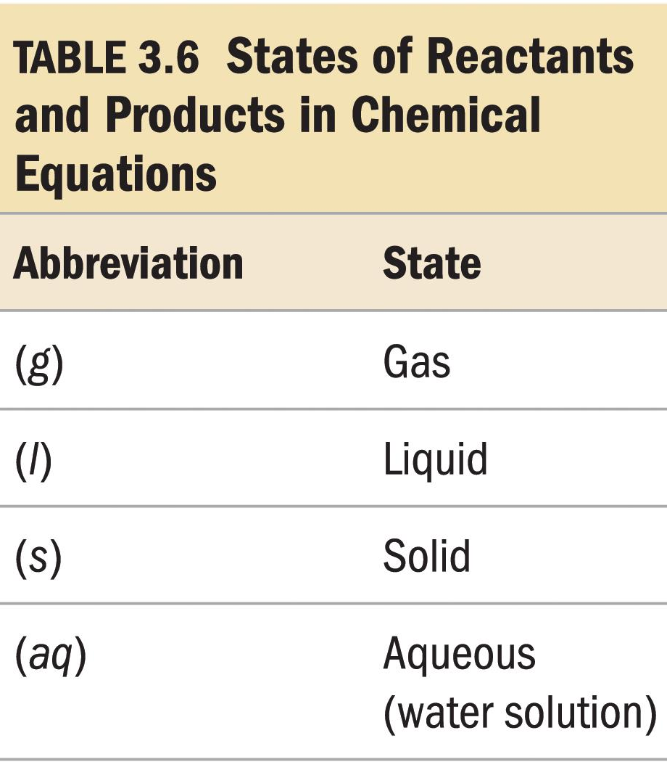
Chemical equations: it shorthand way of describing a reaction 1. provide information about the reaction 2. formulas of reactants and products 3. states of reactants and products 4. relative numbers of reactant and product molecules that are required 5. can be used to determine weights of reactants used and products that can be made
Chapter 3/Stoichiometry
3.8 Writing and Balancing Chemical Equations

Slide 16
Chapter 3/Stoichiometry
3.8 Writing and Balancing Chemical Equations
Combustion of Methane
Methane gas (CH₄(g) )burns to produce carbon dioxide gas (CO₂(g)) and gaseous water (H₂O(g)).
Whenever something burns it combines with O₂(g).
CH₄(g) + O₂(g) → CO₂(g) + H₂O(g)
If you look closely, you should immediately spot a problem.
4 H atoms
2 H atoms

Slide 17
Chapter 3/Stoichiometry
3.8 Writing and Balancing Chemical Equations
Combustion of Methane
Reactants appear on the left side of the equation.
Products appear on the right side of the equation.
The states (g, aq, s and l) of the reactants and products are written in parentheses to the right of each compound.
Coefficients are inserted to balance the equation.

Slide 18
Chapter 3/Stoichiometry
3.8 Writing and Balancing Chemical Equations
Subscripts and Coefficients Give Different Information
Subscripts (الرمز السفلي) tell the number of atoms of each element in a molecule.
Coefficients (المعاملات) tell the number of molecules.

Slide 19
Chapter 3/Stoichiometry
3.8 Writing and Balancing Chemical Equations
Balancing Chemical Equations
The principle that lies at the heart of the balancing process is that atoms are conserved in a chemical reaction.
Atoms are neither created nor destroyed.
The same number of each type of atom is found among the reactants and among the products.
The identities (formulas) of the compounds must never be changed in balancing a chemical equation.

Slide 20
How to write and balance equations?
Chapter 3/Stoichiometry
3.8 Writing and Balancing Chemical Equations
Read the description of the chemical reaction. What are the reactants, the products, and their states? Write the appropriate formulas.
Hydrogen gas (H₂) and oxygen gas (O₂) combine to form liquid water (H₂O).
Write the unbalanced equation that summarizes the information from step 1.
H₂(g) + O₂(g) → H₂O(l)

Slide 21
How to write and balance equations?
Chapter 3/Stoichiometry
3.8 Writing and Balancing Chemical Equations
Balance the equation by inspection, starting with the most complicated molecule.
We must balance the equation by adding more molecules of reactants and/or products.

Slide 22
Chapter 3/Stoichiometry
3.8 Writing and Balancing Chemical Equations
How to write and balance equations?
Check to see that the coefficients used give the same number of each type of atom on both sides of the arrow.
Also check to see that the coefficients used are the smallest integers that give the balanced equation.
The balanced equation is:
2H₂(g) + O₂(g) → 2H₂O(l)

Slide 23
Example 3.14 p71:
Chapter 3/Stoichiometry
3.8 Writing and Balancing Chemical Equations
Balance the following equation in standard form (lowest multiple integers) and determine the sum of the coefficients?
Co₂O₃(s) + C(s) → Co(s)+CO₂(g)
Notes:
2 Co₂O₃(s) + 3C(s) → 4Co(s)+ 3 CO₂(g)

Slide 24
Example 3.15 p71:
Chapter 3/Stoichiometry
3.8 Writing and Balancing Chemical Equations
Balance the following equation in standard form (lowest multiple integers) and determine the sum of the coefficients?
C₄H₁₀(s) + O₂(s) → CO₂(s)+H₂O(g)
Notes:
2 C₄H₁₀(s) + 13 O₂(s) → 8 CO₂(s)+ 10 H₂O(g)

Slide 25
Example:
Chapter 3/Stoichiometry
3.8 Writing and Balancing Chemical Equations
Balance the following equation in standard form and determine the sum of the coefficients?
FeO(s) + O₂(g) → Fe₂O₃(s)
Notes:
The answer is c. The balanced equation is:
4FeO(s) + O₂(g) → 2Fe₂O₃(s). The sum of the coefficients is therefore 4 + 1 + 2 = 7.

Slide 26
Chapter 3/Stoichiometry
3.7. Determining a Chemical Formula from Experimental Data
H.W
18 (b and c) p73
25, (b), 26(a), 28 p74

