Slide 1
Unit 6 review P. 61
Family and Friends 2
Grade 2
A new friend!

Slide 2
Objectives
1- Revise unit’s words.
2- Revise using ‘s – hasn’t got – ‘ve got.
____________________________________________________________________________________________________________________________________
Ministry of Education-2020

Slide 3
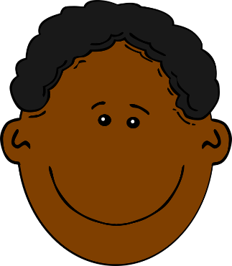
Let’s practice
Look at the pictures, read about their hair and put :
Blond | Brown | Black | curly | straight | Short | long
Blond | Brown | Black | curly | straight | Short | long
Blond | Brown | Black | curly | straight | Short | long
____________________________________________________________________________________________________________________________________
Ministry of Education-2020

Slide 4
Let’s practice
Look at the pictures, read about their hair and put :
Blond | Brown | Black | curly | straight | Short | long
Blond | Brown | Black | curly | straight | Short | long
Blond | Brown | Black | curly | straight | Short | long
____________________________________________________________________________________________________________________________________
Ministry of Education-2020

Slide 5
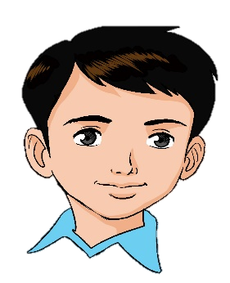
Let’s practice
Look at the pictures and write (has got – hasn’t got)
She has got…….. . She hasn’t got…… .
He has got……...…… ……………..… .
……………….……..…… …………………… .
____________________________________________________________________________________________________________________________________
Ministry of Education-2020

Slide 6
Let’s practice
Look at the pictures and write (has got – hasn’t got)
She has got straight hair. She hasn’t got curly hair.
He has got black hair. He hasn’t got blond hair.
She has got long hair. She hasn’t got short hair.
____________________________________________________________________________________________________________________________________
Ministry of Education-2020

Slide 7
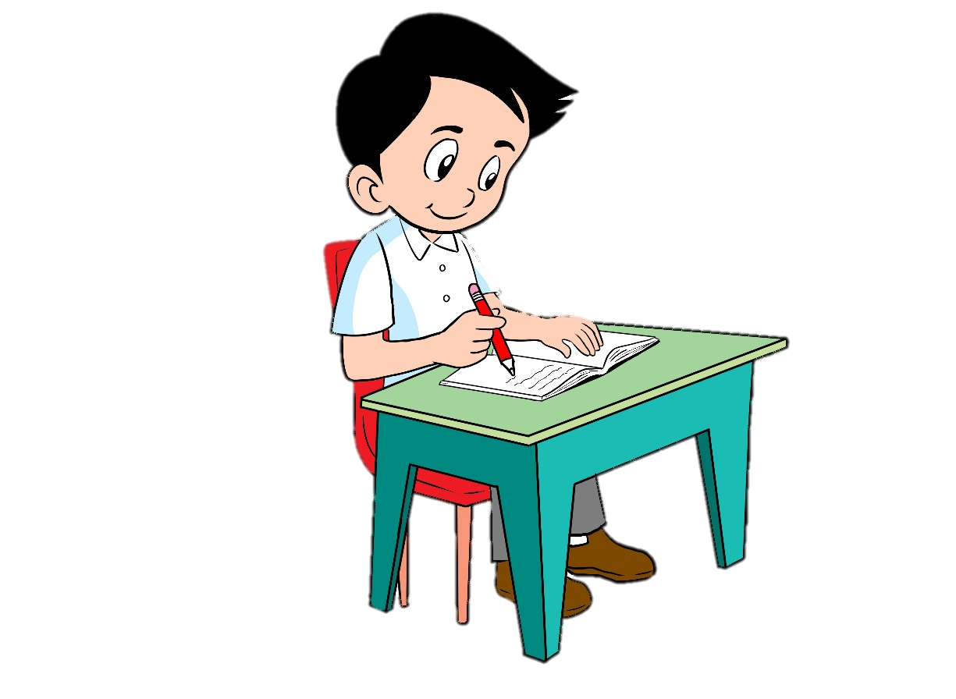
Let’s practice
Answer the activities (Q2 – Q3)
in your workbook page 59.
____________________________________________________________________________________________________________________________________
Ministry of Education-2020

Slide 8
Q2 - Model Answers
’s got
Hasn’t got
Hasn’t got
’s got
’s got
Hasn’t got
____________________________________________________________________________________________________________________________________
Ministry of Education-2020

Slide 9
Q3 - Model Answers
He’s got blond curly hair.
She’s got long straight hair.
He hasn’t got short curly hair.
____________________________________________________________________________________________________________________________________
Ministry of Education-2020

Slide 10
End of unit 6
Good job dear !
____________________________________________________________________________________________________________________________________
Ministry of Education-2020

