Slide 1
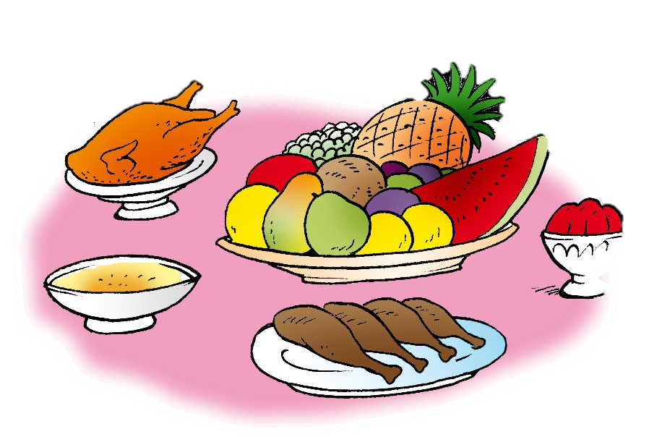
Unit 7- Lesson 4 P 67
Dinnertime!
Family and Friend 2
Grade 2

Slide 2
Objectives
1- Identify the words bin, tin, fig, and six.
2- Recognise the sound /i/ in the middle of words.
____________________________________________________________________________________________________________________________________
Ministry of Education-2020

Slide 3
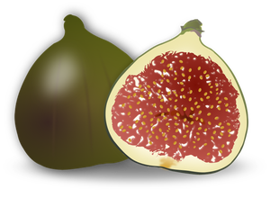
Listen, point and repeat.
six
bin
fig
tin
____________________________________________________________________________________________________________________________________
Ministry of Education-2020

Slide 4
Read, point and repeat.
Six
____________________________________________________________________________________________________________________________________
Ministry of Education-2020

Slide 5
Read, point and repeat.
bin
____________________________________________________________________________________________________________________________________
Ministry of Education-2020

Slide 6
Read, point and repeat.
fig
____________________________________________________________________________________________________________________________________
Ministry of Education-2020

Slide 7
Read, point and repeat.
tin
____________________________________________________________________________________________________________________________________
Ministry of Education-2020

Slide 8
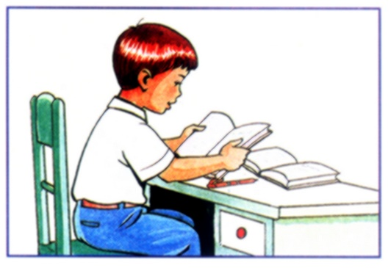
Open page 67 in your Class Book.
Read and point to the letter “i”.
____________________________________________________________________________________________________________________________________
Ministry of Education-2020

Slide 9
Guess the letter and write the word on your mini board.
1
2
bin
B
tin
T
____________________________________________________________________________________________________________________________________
Ministry of Education-2020

Slide 10
Guess the letter and write the word on your mini board.
1
2
fig
F
six
S
____________________________________________________________________________________________________________________________________
Ministry of Education-2020

Slide 11
Re-order the letters to spell the words correctly. Use your mini-board.
1
2
gif
itn
fig
tin
____________________________________________________________________________________________________________________________________
Ministry of Education-2020

Slide 12
Re-order the letters to spell the words correctly. Use your mini-board.
1
2
nib
isx
bin
six
____________________________________________________________________________________________________________________________________
Ministry of Education-2020

Slide 13
Look and write.
1
3
b
bin
f
fig
in
ig
t
2
b
4
tin
big
____________________________________________________________________________________________________________________________________
Ministry of Education-2020

Slide 14
Answer the questions in your Workbook page 65.
____________________________________________________________________________________________________________________________________
Ministry of Education-2020

Slide 15
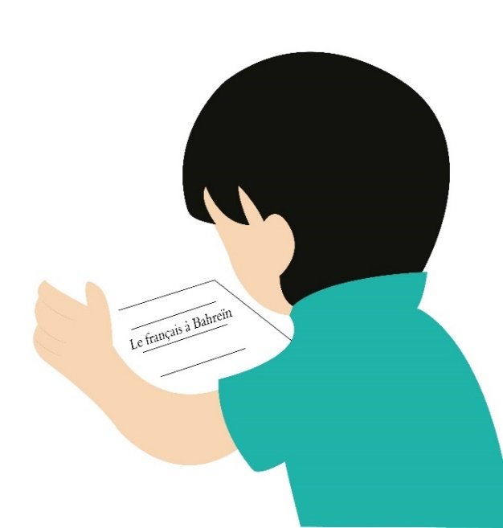
Don’t forget to answer the questions
in the practice PPT for L4.
____________________________________________________________________________________________________________________________________
Ministry of Education-2020

Slide 16
End of the lesson
Good job dear !
____________________________________________________________________________________________________________________________________
Ministry of Education-2020

