Slide 3
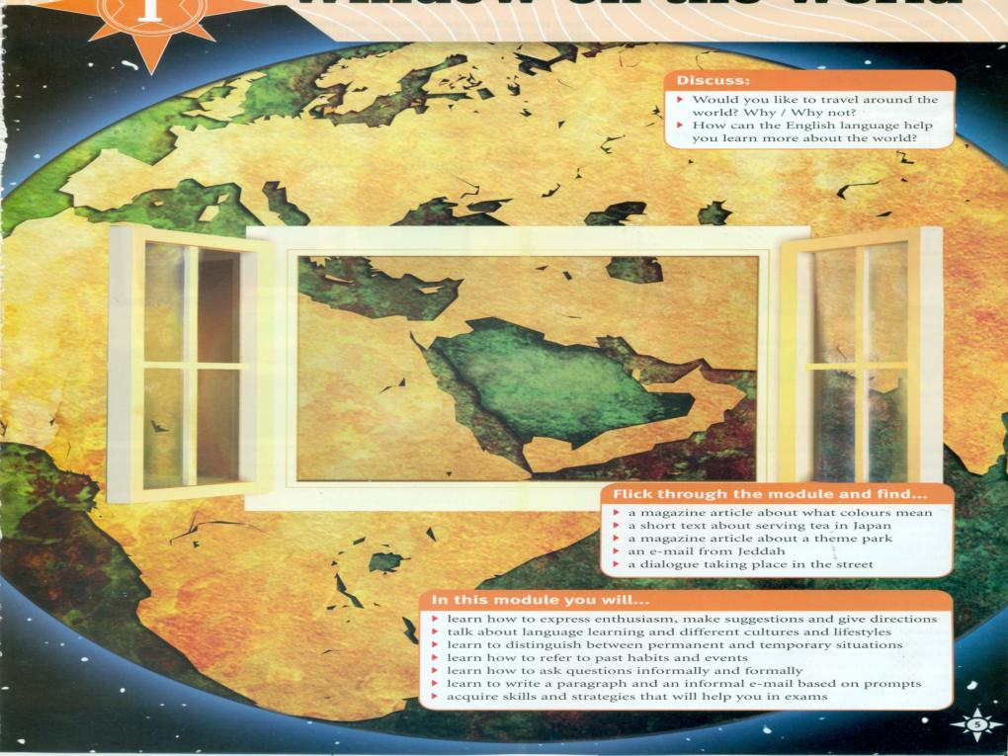

Slide 4
Unit 1
Window on the World

Slide 6
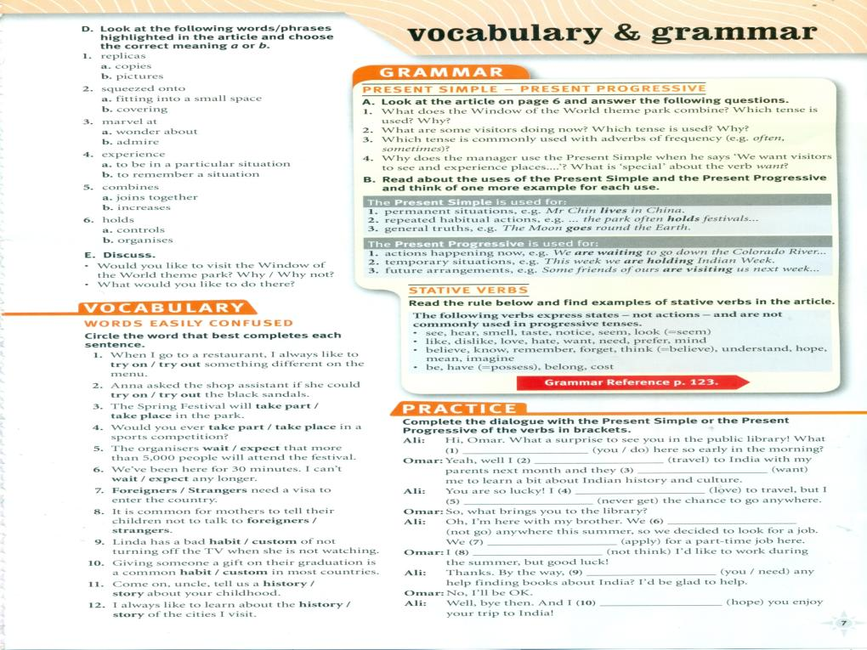
are you doing
m travelling
want
love
never get
aren’t going
are applying
don’t think
do you need
hope

Slide 8
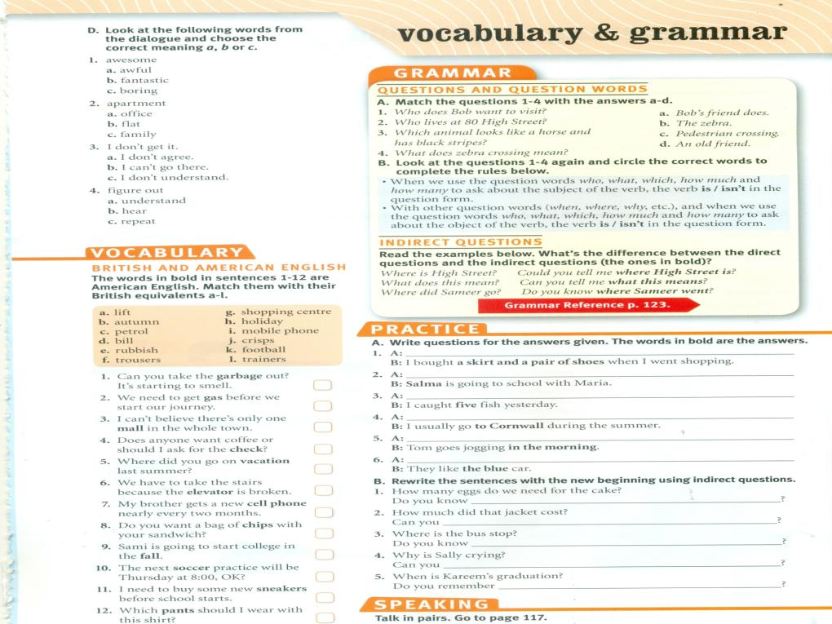
e
What did you buy
Who is going to school with Maria
c
How many fish did you catch
g
Where do you usually go during the summer
d
h
When does Tom go jogging
Which car do they like
j
i
a
b
how many eggs we need for the cake?
tell me how much that jacket cost?
k
where is the bus stop is?
l
tell me why Is Sally crying?
f
when Kareem’s graduation is?

Slide 10
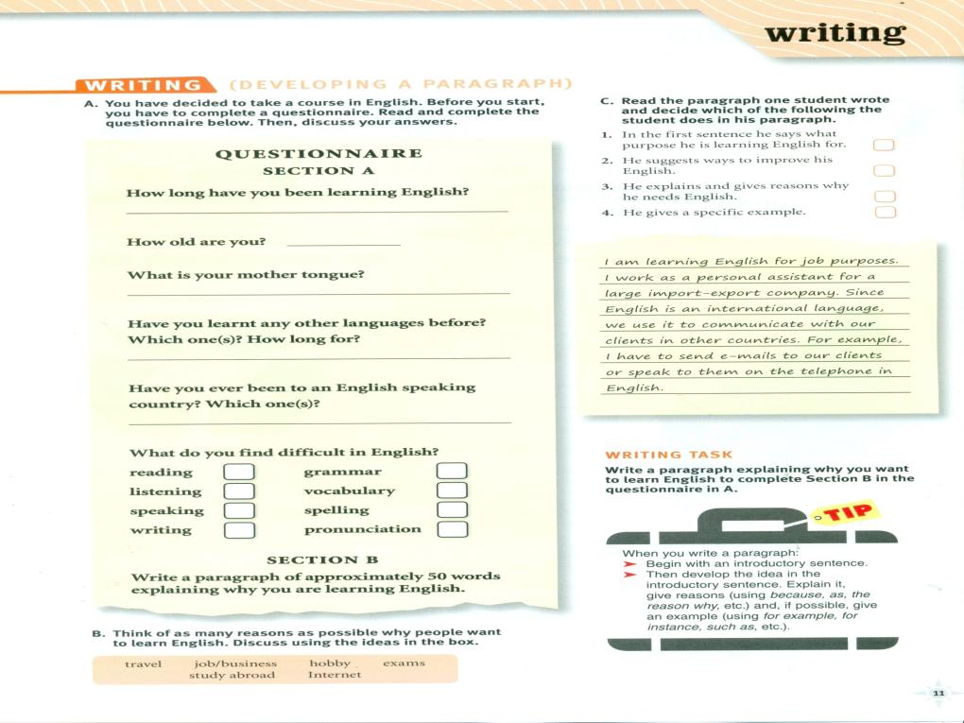

Slide 11
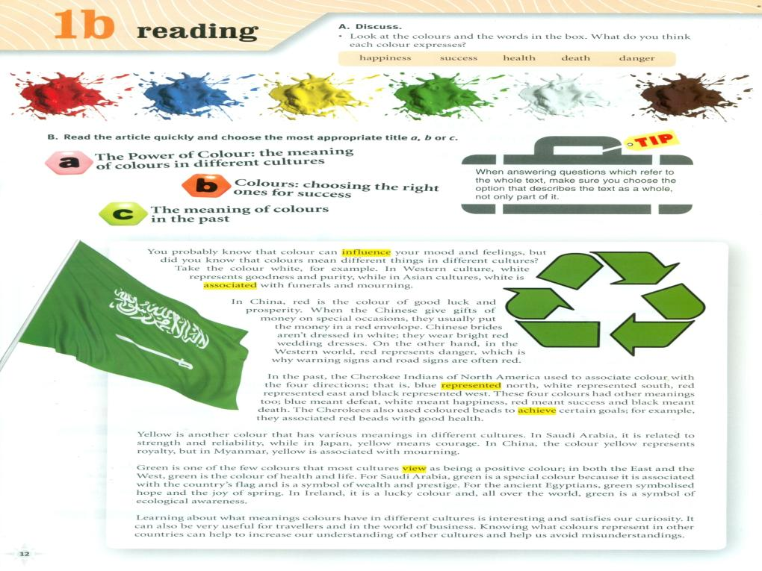

Slide 12
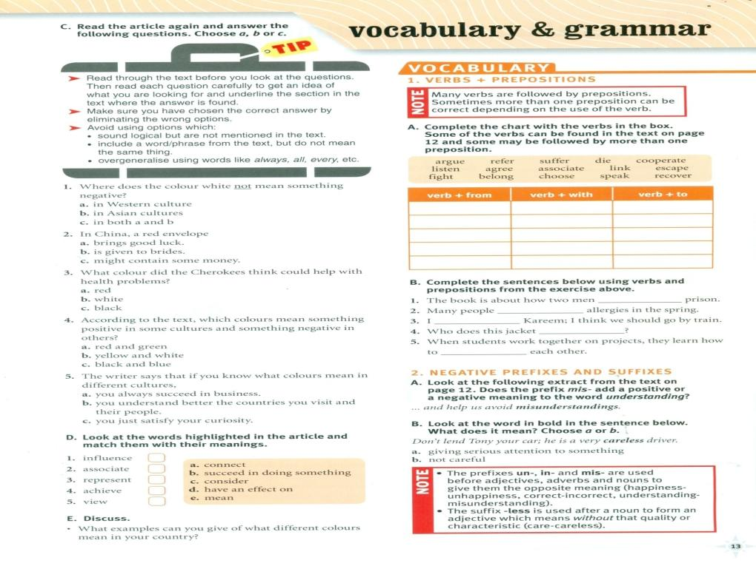

Slide 13
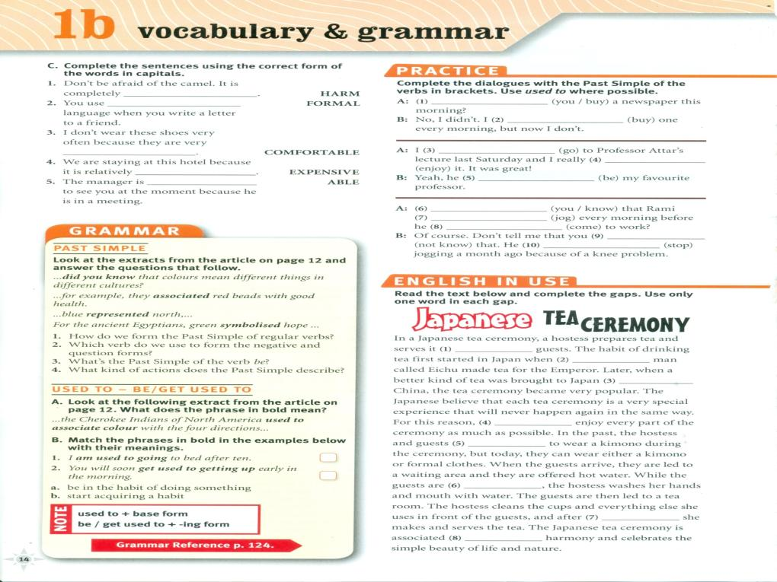
harmless
Didyou buy
informal
Used to buy
uncomfortable
went
enjoyed
inexpensive
was
unable
Did you know
Used to jog
came
didn’t know
stopped

Slide 15
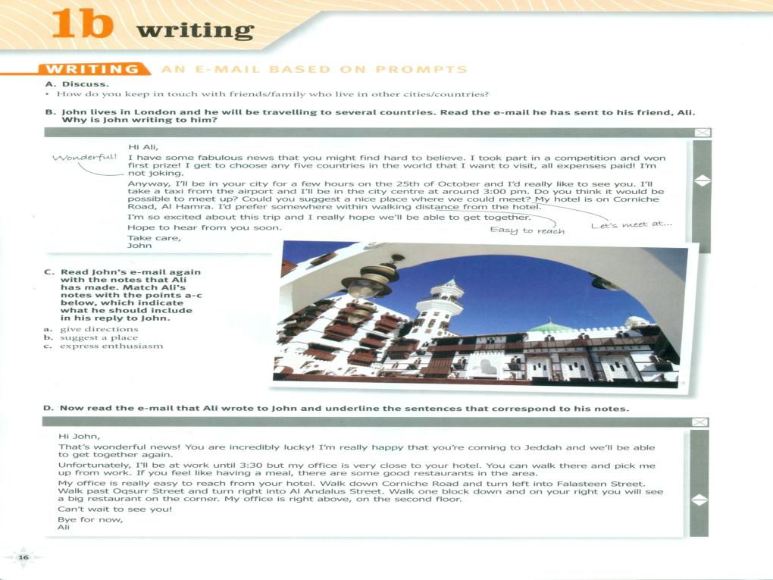

Slide 18
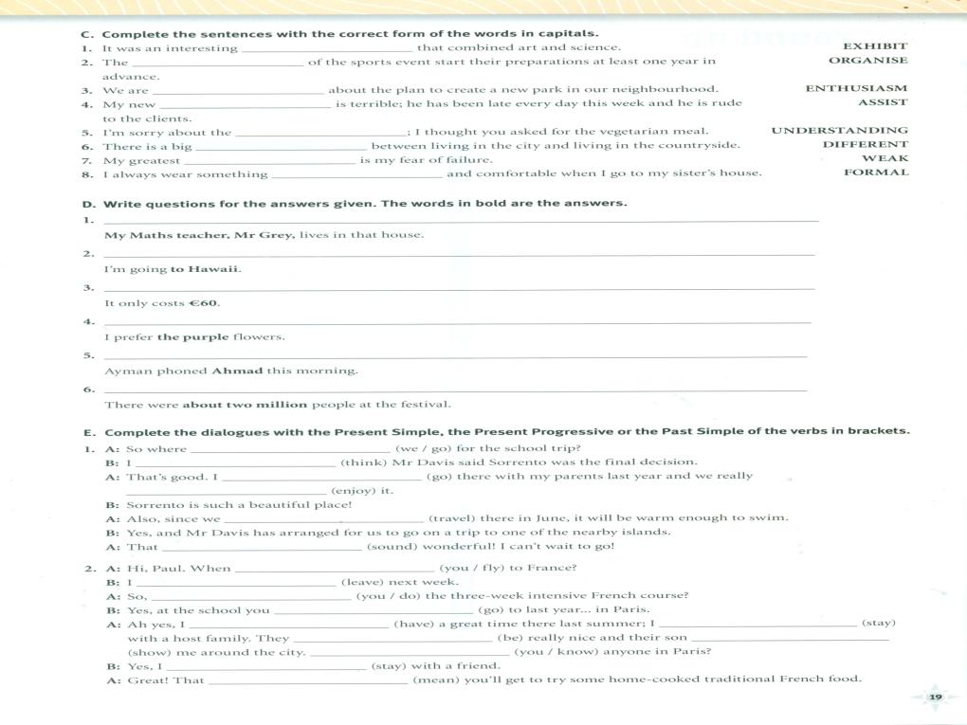
organisers
exhibition
Enthusiastic
assistant
misunderstanding
difference
weakness
informal
Who lives in that house?
Where are you going?
How much does it cost?
Which flowers do you prefer?
Who did Ayman phoned this morning?
How many people were there at the festival
are we going
think
went
enjoyed
are travelling
sounds
am leaving
are you flying
are you doing
went
had
stayed
were
showed
Am staying
Do you know
means

