Slide 1
3D Printing Techniques
Powder Bed Fusion

Slide 2
Selective Laser Melting (SLM)
SLM, works based on the layering process similar to SLS.
A wide range of materials in powder form can be used.
SLM is able to produce solid and porous parts based on the laser energy density.
This technique is free of binders and fluxing agents, so there is no need for a post-processing step .
Notes:
SLM يستخدم نفس آلية ال SLS والمعتمدة على التصنيع التراكمي لطبقات المادة ، ومجموعة واسعة من مساحيق المواد يمكن استخدامها. وعلاوة على ذلك، حركة SLM قادرة على إنتاج أجزاء صلبة وأخرى ذات كثافة متبانة عن طريق التحكم بكثافة طاقة الليزر. أيضا، وهذه التقنية ليست بحاجة لإضافة أي مواد مساعدة للباودر للمساعدة في لصق ذرات الباودر مثل ال SLS وبالتالي ليس هناك حاجة لعمليات أخرى بعد الطباعة لإزالة المواد الوسيطة. هذه التقنية تستخدم نوع معين من الليزر يطلق عليه الإيتربيوم الليزر 200 واط ويستخدم غار أو النيتروجين او الارجون في حجرة البناء بنى الذي قد يزيد من التوصيل الحراري والحفاظ على التبريد السريع المنتظم في منطقة الطباعة. ومع ذلك، فإن تكلفة الإنتاج عالية، ووقت تلفيق طويلة، وصعوبة في إزالة مسحوق المحاصرين هي القيود الرئيسية لهذا التقنية.
وعلاوة على ذلك، فإن ظاهرة التبخر هي واحدة من عيوب هذه التقنية. يتم إنشاء هذه الظاهرة نظرا لارتفاع درجة حرارة حمام السباحة المنصهر الناجمة عن شعاع الليزر تبخير جزيئات. وهذا يؤدي إلى الضغط الزائد في تجمع المنصهر، والذي ينتج في يقذف من بعض المعادن المنصهرة من تجمع 56. اليوم، وتستخدم هذه التقنية في صناعة الطيران، الاصطناعية العظام، وزراعة الأسنان.
SLM, works based on the layering process similar to SLS.A wide range of materials in powder form can be used. Moreover, SLM is able to produce solid and porous parts based on the laser energy density. Also, this technique is free of binders and fluxing agents, so there is no need for a postprocessing step . Unlike EBM, SLM uses an ytterbium fiber laser 200 W power and uses Ar or N in the building chamber, which may increase the thermal conductivity and maintain a consistent rapid cooling of the printed zone more than EBM. However, high production cost, lengthy fabrication time, and difficulty in removing the trapped powder are the major limitations of this technique. Furthermore, the vaporization phenomenon is one of the drawbacks of this technique. This phenomenon is generated due to the high temperature of the molten pool caused by the laser beam evaporating the particles. This leads to an overpressure in the molten pool, which results in spewing of some molten metals out of the pool 56. Today, this technique is utilized in the aerospace industry, orthopedics prostheses, and dental implants

Slide 3
Selective Laser Melting (SLM)
SLM machines uses fiber lasers in processing the powder.
SLM uses Ar or N in the building chamber, which may increase the thermal conductivity and maintain a consistent rapid cooling of the printed zone more than EBM.
The major disadvantages of this technique are:
High production cost.
Lengthy fabrication time.
Difficulty in removing the trapped powder.
Today, this technique is utilized in the aerospace industry, orthopedics prostheses, and dental implants fabrication.

Slide 4
Electron Beam Melting (EBM)
EBM uses a high-energy electron beam to induce fusion between metal powder particles.
Electron beams are inherently different from laser beams, as electron beams are made up of a stream of electrons moving near the speed of light, whereas, laser beams are made up of photons moving at the speed of light.
When an electron beam is passed through a gas at atmospheric pressure, the electrons interact with the atoms in the gas and are deflected. In contrast, a laser beam can pass through a gas unaffected as long as the gas is transparent at the laser wavelength.
Thus, EBM is practiced in a low-partial-pressure vacuum environment, whereas SLM is practiced in an inert gas atmosphere at atmospheric pressure.
Electrons have a negative charge and are focused and deflected magnetically, whereas photons are optically focused and deflected using mirrors attached to motors.
Notes:
EBM تستخدم نفس آلية عمل تقنية ال SLM. EBM ولكن يختلف عن ال SLM في استخدامه لشعاع الالكترون بدلا من الليزر لتلبيد المسحوق، هذا الاليكترون يتم توليده في من خلال اسلاك التنغستن ويسرع ويسيطر عليه بالمجال المغناطيسي. وبناء العينات يتم في منطقة مفرغة من الهواء. هذه تقنية في التصنيع سريعة نسبيا، و تتميز هذه التقنية من حيث إمكانيتها طباعة أجزاء صلبة وأجزاء متدرجة في كثافتها بسبب وجود العديد من المعلمات الممكن التحكم بها مثل قوة ال Beam، ومعدل المسح الضوئي، سماكة الطبقة. في هذه التقنية، ليس هناك حاجة لإضافة أي موادمساعدة للباودر للمساعدة في رفع درجة حرارة الباودر لدرجة الذوبان نظراً لقوة عامود الالكترونات الكافية للوصول لدرجة الذوبان للمادة. ومع ذلك، لا تزال هناك بعض القيود في استخدام هذه الطريقة التكلفة العالية لاستخدأمها وايضاً الحاجة الماسة للتقني المؤهل لاستخدأمها حيث ان إزالة الباودر الزائد بعد عملية الطباعة عملية ليست باليسيرة خصوصاً عند طباعة أجزاء بتفاصيل دقيقة جداً. هناك عدة مواد معدنية يمكن طباعتها بهذه التقنية مثل ، مثل CP-تي، تي-6AL-4V، وشركة / الكرووتستخدم تجارياً بإنتاج الأجزاء التعويضية للعظام مثل مفاصل الركبة والفخذ إضافة الى زرع أجزاء تستخدم في جراحة الوجه والفكين.
EBM utilizes the same mechanism of the SLM. EBM differs from SLM in its use of an electron beam rather than a laser to sinter the powders, which is generated in a tungsten filament and is accelerated and controlled with a magnetic field. This manufacturing technique is relatively fast and the building of samples takes place under vacuum. It offers an attractive opportunity in the fabrication of fully dense or porous parts due to several controllable parameters such as beam current, scan rate, and sequence variations. In this technique, an additive or fluxing agent is not required to fulfill the melting process because the electron beam is powerful enough to raise the temperature of the particles to the melting point. However, there are still some limitations in this method such as the low dimensional accuracy and surface quality due to shrinkage. Additionally, this technique is costly, and removing the excess material inside the structure can prove difficult. Different metals have been fabricated using EBM, such as Cp-Ti, Ti-6Al-4V, and Co/Cr for orthopedic implant and maxillofacial surgery

Slide 5
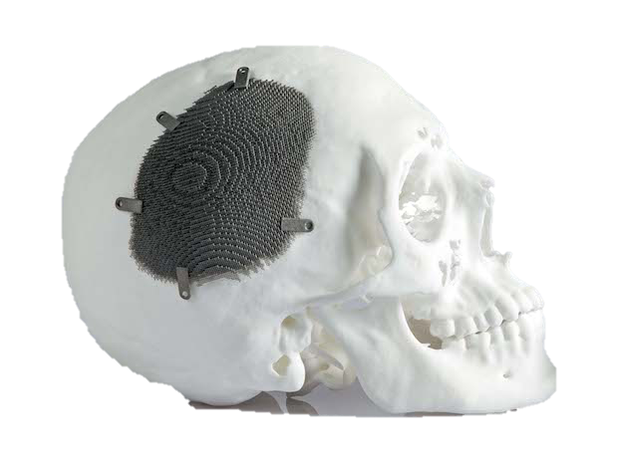
Electron Beam Melting (EBM)
EBM can only be used to process conductive materials because the powder bed must be conductive (e.g., metals)
whereas, lasers can be used with any material that absorbs energy at the laser wavelength (e.g., metals, polymers and ceramics).
Lasers with beam energies above 1 kW are typically much more expensive than comparable electron beams with similar energies.
Thus, electron beams are a less costly high energy source than laser beams.

Slide 6
SLM Vs EBM

Slide 7
Powder Bed Fusion(PBF) Capabilities and Limitations
In PBF, the loose powder bed is a sufficient support material for printed part.
Internal cooling channels and other complex features that would be impossible to machine are possible with PBF.
Finer particle sizes produce smoother, more accurate parts but are difficult to spread and handle.
Larger particle sizes facilitate easier powder processing and delivery, but hurt surface finish, minimum feature size and minimum layer thickness.
With PBF processes, total part construction time can take longer than other additive manufacturing processes because of the pre-heat and cool-down cycles involved.

Slide 8
3D Printing Techniques
Extrusion-Based Systems

Slide 9
Extrusion-Based Systems Introduction
These technologies can be visualized as similar to cake icing, in that material contained in a reservoir is forced out through a nozzle when pressure is applied.
If the pressure remains constant, then the resulting extruded material will flow at a constant rate and will remain a constant cross-sectional diameter.
This diameter will remain constant if the travel of the nozzle across a depositing surface is also kept at a constant speed that corresponds to the flow rate.
The material that is being extruded must be in a semi-solid state when it comes out of the nozzle.
There are two primary approaches when using an extrusion process.
Using temperature as a way of controlling the material state: Molten material is liquefied inside a reservoir so that it can flow out through the nozzle.
Using a chemical change to cause solidification: a curing agent, residual solvent, reaction with air, or drying of a “wet” material permits bonding to occur.

Slide 10
Basic Principles
There are a number of key features that are common to any extrusion-based system:
– Loading of material
– Liquification of the material
– Application of pressure to move the material through the nozzle
– Extrusion
– Plotting according to a predefined path and in a controlled manner
– Bonding of the material to itself or secondary build materials to form a coherent solid structure.
– Inclusion of support structures to enable complex geometrical features.

Slide 11
Basic Principles Material Loading
If the material is in a liquid form, then the ideal approach is to pump this material.
Most bulk material is supplied as a solid and the most suitable methods of supply are in pellet or powder form, or where the material is fed in as a continuous filament.
The chamber itself is therefore the main location for the liquification process.
Pellets, granules, or powders are fed through the chamber under gravity or with the aid of a screw.

Slide 12
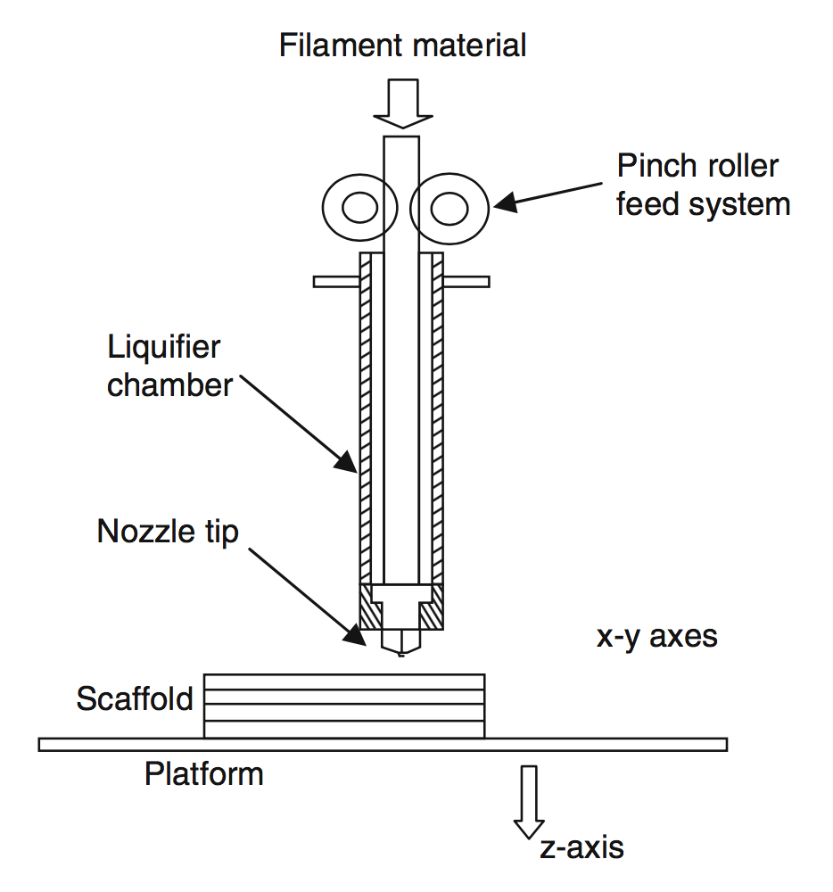
Basic Principles Liquification
The extrusion method works on the principle that what is held in the chamber will become a liquid that can eventually be pushed through the die or nozzle.
Material could be in the form of a solution that will quickly solidify following the extrusion, but more likely this material will be liquid because of heat applied to the chamber.
Such heat would normally be applied by heater coils wrapped around the chamber and ideally this heat should be applied to maintain a constant temperature in the melt.

Slide 13
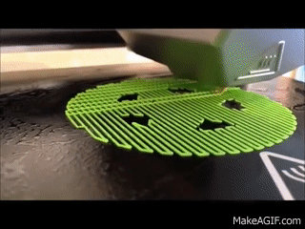
Basic Principles Extrusion
The extrusion nozzle determines the shape and size of the extruded filament.
A larger nozzle diameter will enable material to flow more rapidly but would result in a part with lower precision compared with the original CAD drawing.
The diameter of the nozzle also determines the minimum feature size that can be created.

Slide 14
Basic Principles Solidification
Once the material is extruded, it should ideally remain the same shape and size.
Gravity and surface tension, however, may cause the material to change shape, while size may vary according to cooling and drying effects.
The cooling is also very likely to be nonlinear. If this nonlinear effect is significant, then it is possible the resulting part will distort upon cooling.
This can be minimized by ensuring the temperature differential between the chamber and the surrounding atmosphere is kept to a minimum (i.e., use of a controlled environmental chamber when building the part) and also by ensuring the cooling process is controlled with a gradual and slow profile.
It is reasonable to assume that an extrusion-based AM system will extrude from a large chamber to a small nozzle through the use of a conical interface.

