Slide 1
Unit 3 My house
Lesson 2

Slide 3
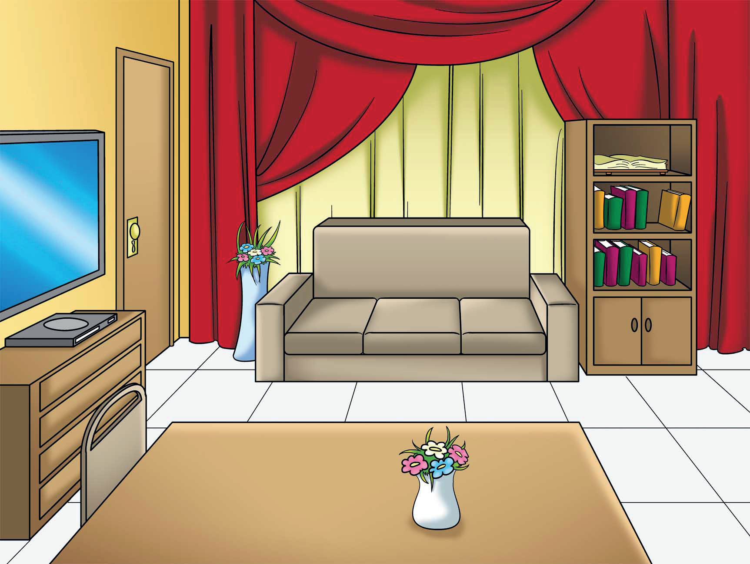
living room

Slide 4
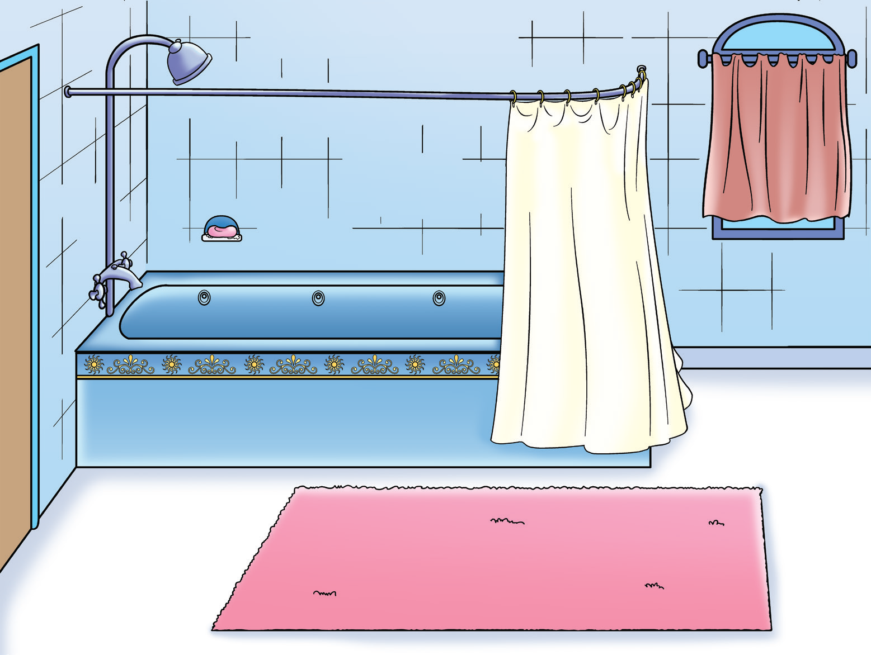
bathroom

Slide 5
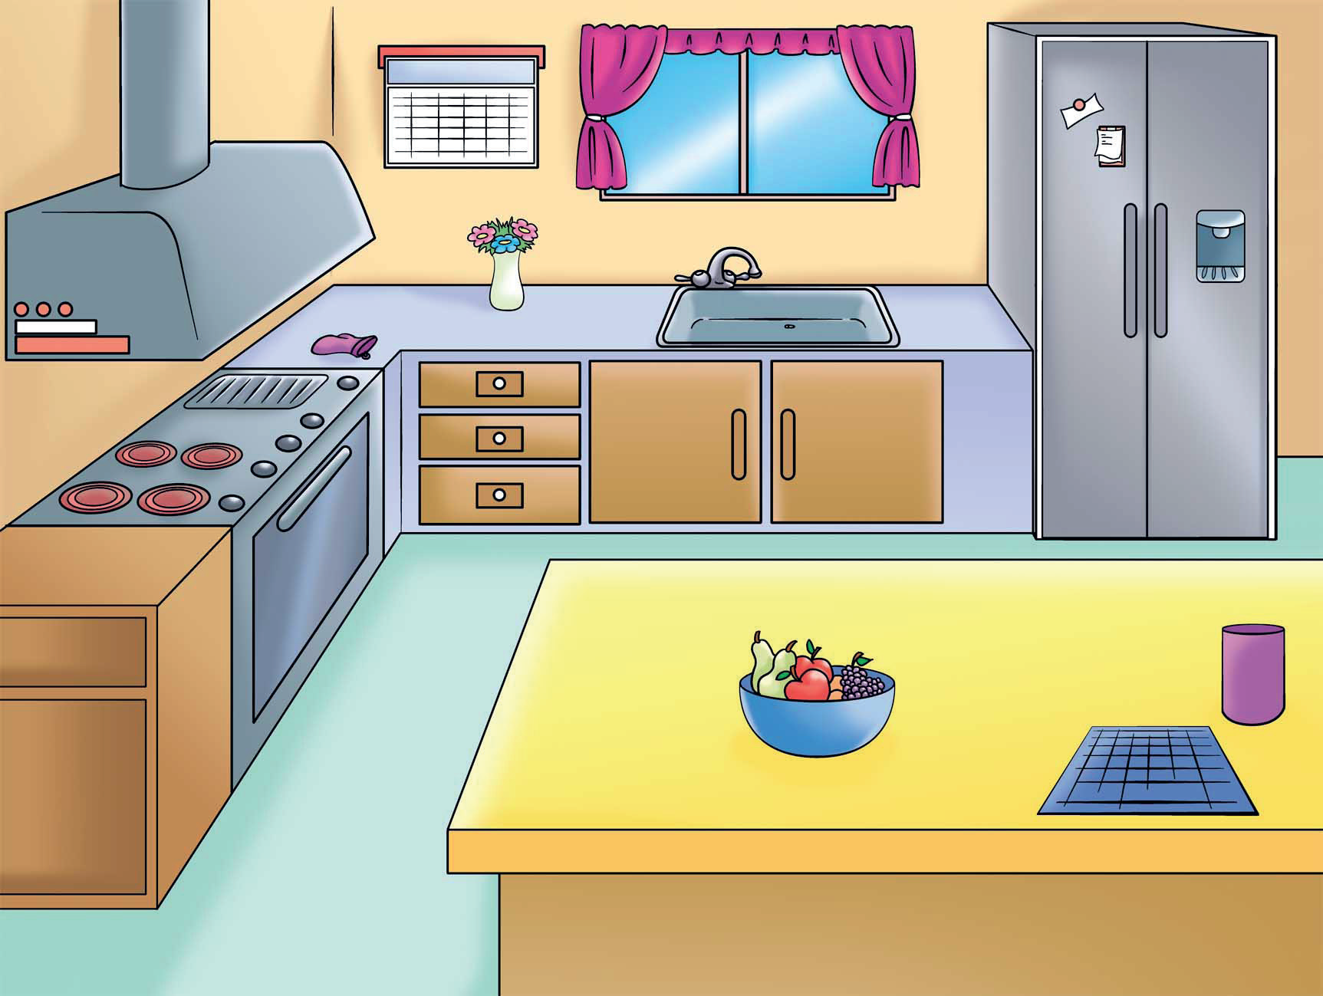
kitchen

Slide 6
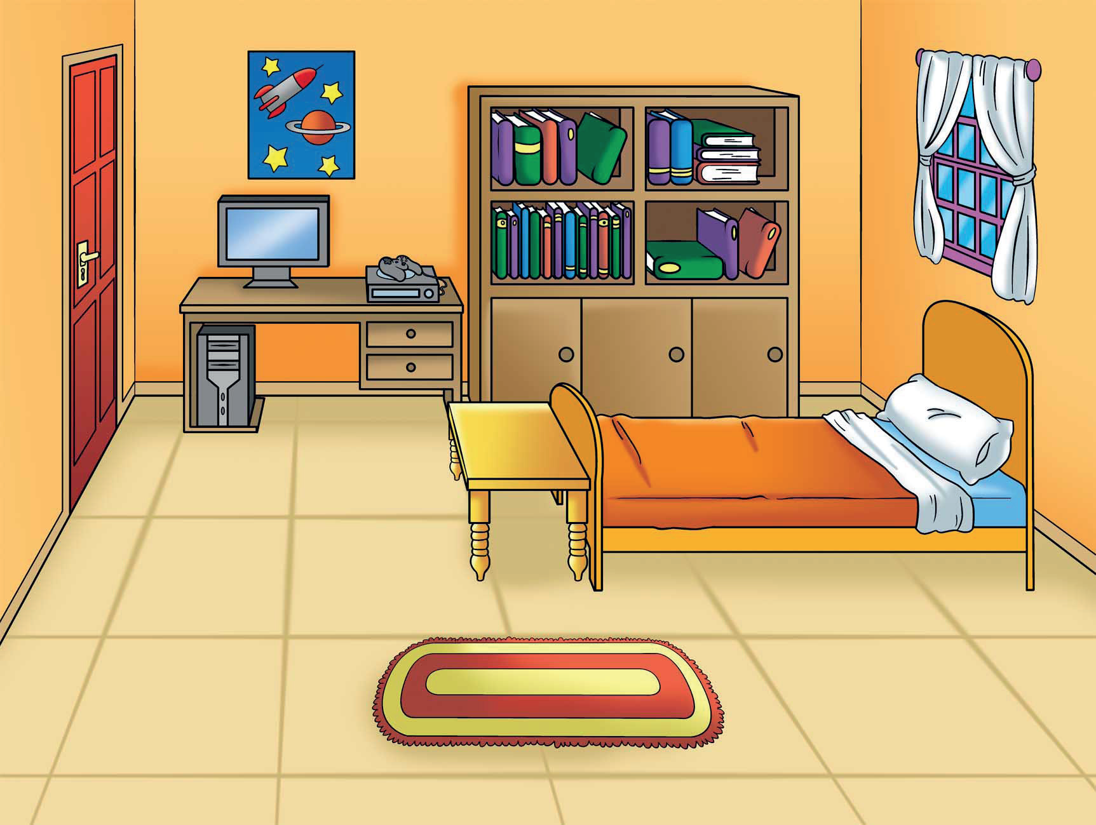
bedroom

Slide 7
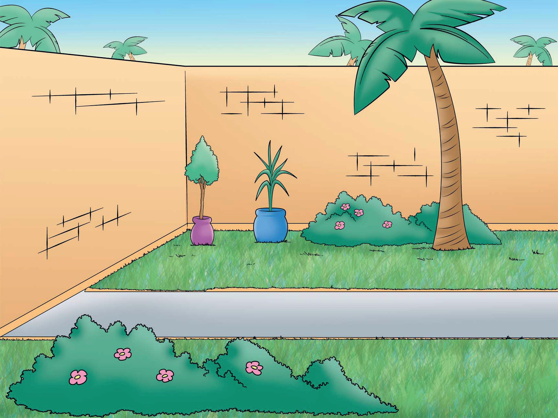
garden

Slide 8
key

Slide 9
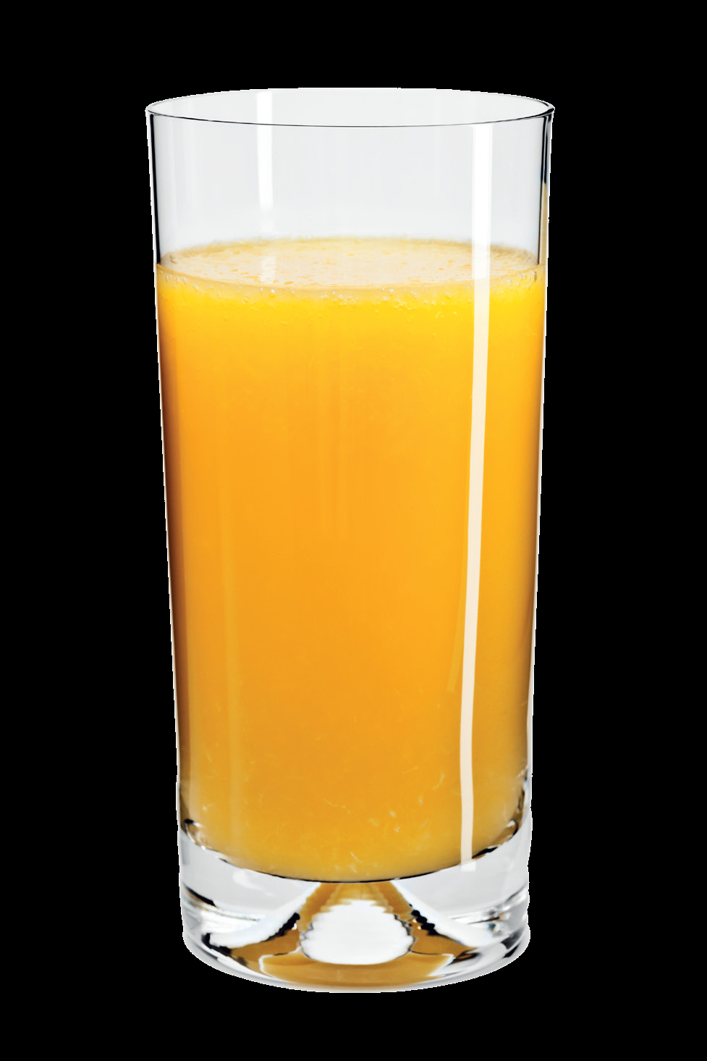
J j
juice

Slide 10
U u
umbrella

Slide 11
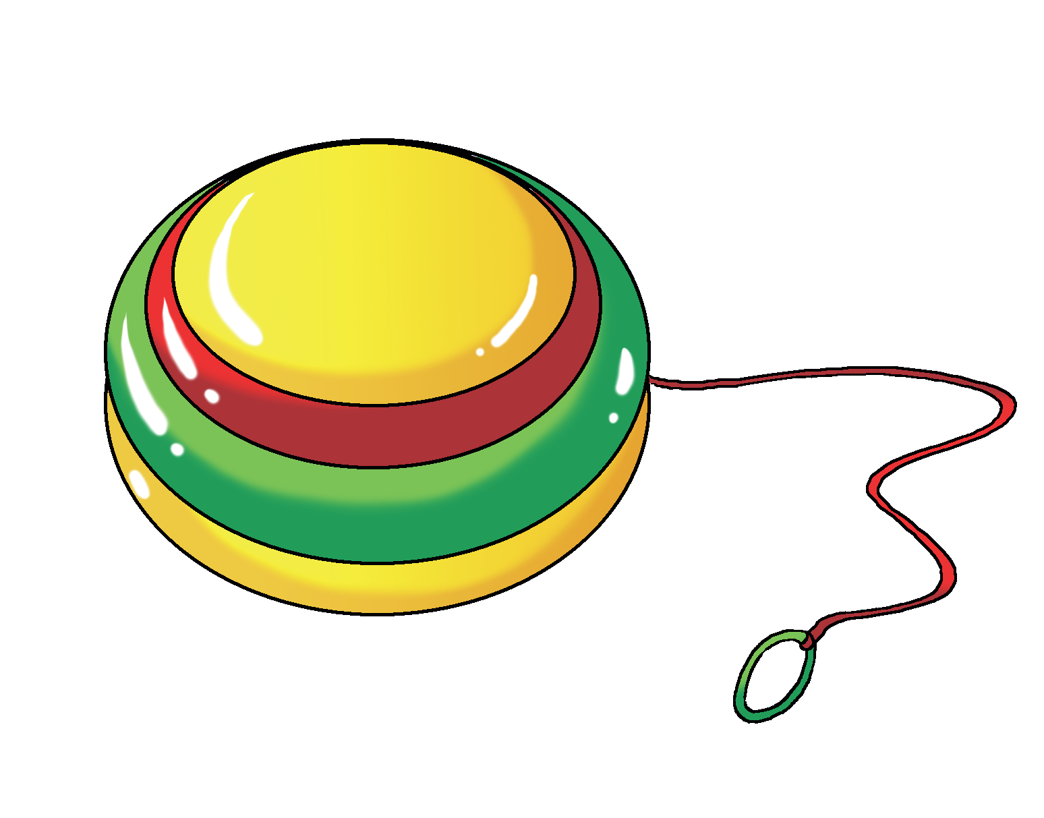
Y y
yo – yo

Slide 12
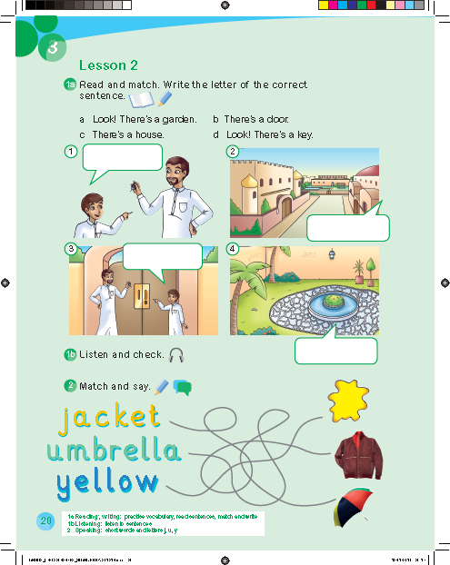
d
c
b
a

Slide 15
5
1
4
2
3

Slide 16
Work book p. 67

Slide 17
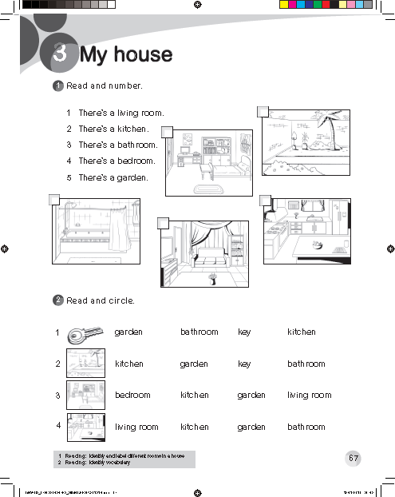
5
4
3
2
1

