Slide 1
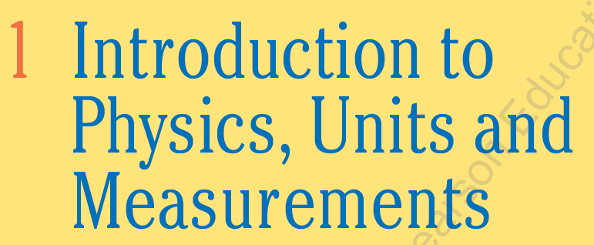

Slide 2
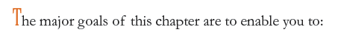
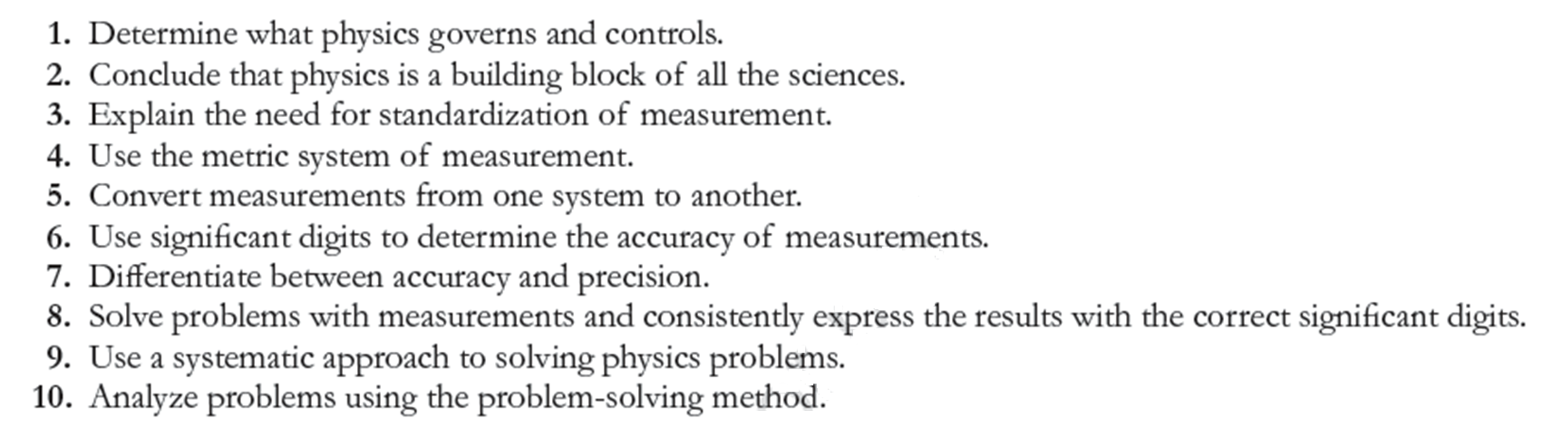

Slide 3
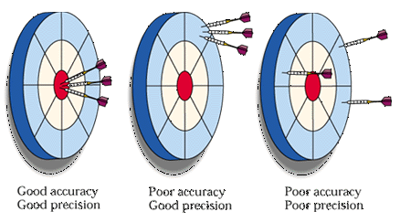
NO measurement is absolutely precise OR accurate
When giving the result of a measurement , it is important to state the estimated uncertainty in measurement
Good accuracy
Good precision
Poor accuracy
Good precision
Poor accuracy
Poor precision

Slide 4
Accuracy vs. Precision
Accuracy is how close a measurement comes to the true value.
Precision is the repeatability of the measurement using the same instrument. That is, Precision is how close the measured values are to each other
It is possible to be accurate without being precise and to be precise without being accurate!
Good accuracy
Good precision
Poor accuracy
Good precision
Poor accuracy
Poor precision
Notes:
kloʊs

Slide 5
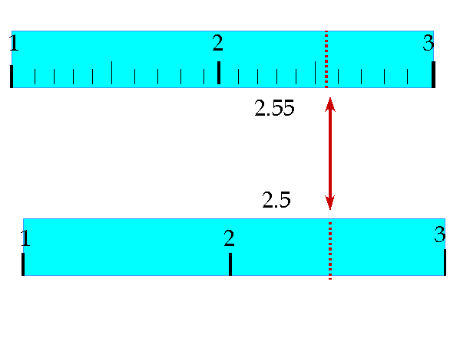
Main sources of uncertainty (errors):
        Human errors: (difficulty reading results Between the smallest divisions )
        Limited Instrument accuracy (systematic error)
Relatively accurate ruler with least reading ~ 0.05 unit
Less accurate ruler. Its least reading ~ 0.5 unit
The result could be claimed to be precise to the smallest division shown

Slide 6
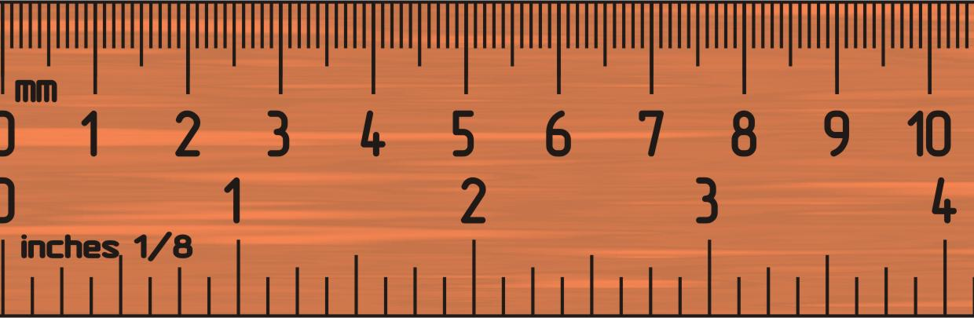
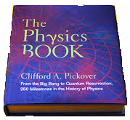

Smallest division = 1 mm = 0.1 cm
The ruler is precise to within 0.1 cm,
⇒ estimated uncertainty (error) = ± 0.1 cm
The tiny book is 3.7 ± 0.1 cm wide
⇒ its true width likely lies between 3.8 and 3.6 cm
Width of thumbnail = 1.3 ± 0.1 cm
⇒ it lies between 1.4 and 1.2 cm
Therefore measurement result is expressed as:
(Result ± Error) unit
Notes:
ˈθʌm.neɪl

Slide 7
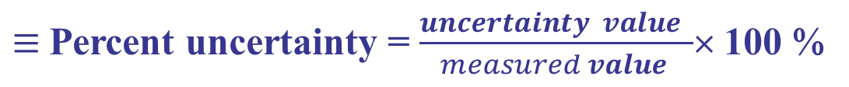
Measurement result is expressed as:
(Result ± Error) unit
The percent uncertainty
$≡$Percent uncertainty = $\frac{uncertainty value }{measured value }$× 100 %
Example:
Notes:
Percent uncertainty = $\frac{uncertainty value }{measured value }$× 100 %

Slide 8
The uncertainty is generally assumed to be one or a few units in the last digit specified.
Example:
Result = 2.03 m² (with two decimal places)
In this case the error is taken as the smallest number with two decimal places.
Error = 0.01 m²

Slide 9
8.17 – 0.05 = 8.12 g
8.17 + 0.05 = 8.22 g
8.09 – 0.05 = 8.04 g
8.09 + 0.05 = 8.14 g
Results from day one (blue) and day two (red) overlap ⇒ The two measurements agree
Notes:
ˈpreʃ.əs

Slide 10
Significant figure
The number of reliably known digits in a number
For example: 2 cm, 2.0 cm, & 2.00 cm are mathematically the same but experimentally different: They have different significant figures.
Counting rules
Rule 1:
All nonzero digits (1, 2, 3, …, 7, 8, 9) are significant figures
Q. determine the number of significant figures in:
11 and 235.68
Ans.
Has two significant figures
Has five significant figures

Slide 11
Rule 2:
Zeros
Trailing zeros (to the right of a number)
Zeros in-between digits
⇒ Count
Leading zeros (to the left of a number)
⇒ Don’t count
Number with decimal point
⇒ Count
Number without decimal point
⇒ Don’t count

Slide 12
Trailing zeros: special case
A whole number (without decimal point) preceded by the word about (approximately, etc … ) ⇒ don’t count zeros
Implying ±10 cm uncertainty
Implying ±100 km uncertainty
A whole number (without decimal point) preceded by the word precisely (accurately, etc …) ⇒ Count zeros
Implying ±1 cm uncertainty
Implying ±1 km uncertainty

Slide 13
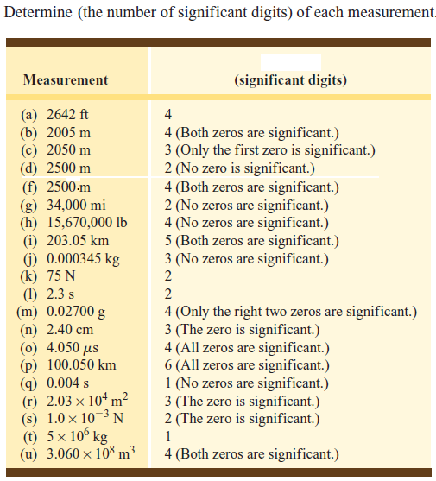

Slide 14
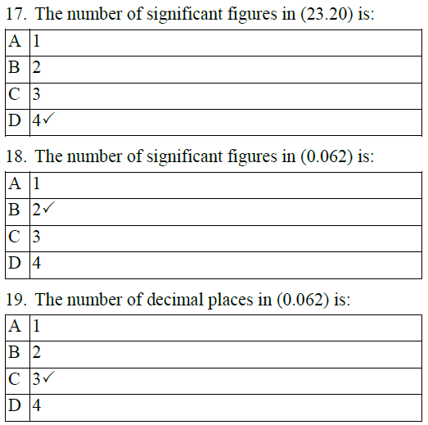
Check your understanding

Slide 15
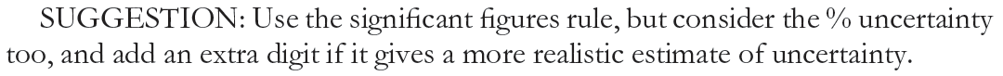
Significant figure: mathematical operations
Carry out intermediate calculations without rounding. Only round the final answer (outcome) according to the following rules:
1. Multiplications and divisions
Final result presented with significant figures similar to that for the number with least significant figure used in the operation.
See page 6 in your book for more details
2. Addition and subtraction
Final result presented with decimal places similar to that for the number with least decimal places used in the operation.
The final result is no more accurate than the least accurate number used.

Slide 16

1-4 Measurement and Uncertainty; Significant Figures
Calculators will not give you the right number of significant figures; they usually give too many but sometimes give too few (especially if there are trailing zeroes after a decimal point).
The top calculator shows the result of 2.0 / 3.0.
The bottom calculator shows the result of 2.5 x 3.2.
Examples:
3.6 – 0.57 = 3 .03 = 3.0 ( Rounding off to one place )
4.83 +2.1 = 6.93 = 6.9
6.53+ 2 = 8.53 = 9
8.42 x 3.0 = 25.26 = 25
6.00 / 2.0 = 3.0

Slide 17
Exercises
The area of a rectangle 4.5 cm by 3.25 cm is correctly given by (a) 14.625 cm²; (b) 14.63 cm²; (c) 14.6 cm²; (d) 15 cm².
Do 0.00324 and 0.00056 have the same number of significant figures.
For each of the following numbers, state the number of significant figures and number of decimal places:
(a) 1.23; (b) 0.123; (c) 0.0123.

Slide 18
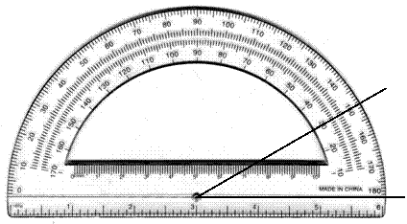
Conceptual example
Using a protractor you measure an angle to be 30°.
How many significant figures should you quote in this measurements?
Use a calculator to find the cosine of the angle you measured.

Slide 19
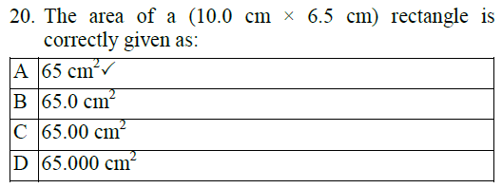
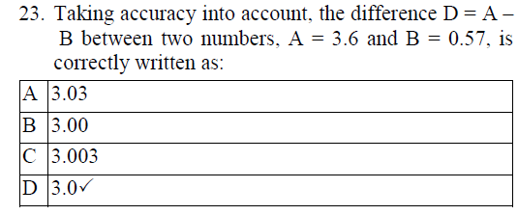
Check your understanding

Slide 20
Scientific Notation(Powers of 10)
Common to express very large or very small numbers using powers of 10 notation.
A number greater than 10 positive power of 10
39,600 = 3.96 × 10⁴
(moved decimal 4 places to left)
A number between 0 and 1 negative power of 10
0.0021 = 2.1 × 10⁻³
(moved decimal 3 places to right)
A number between 1 and 10 zero power of 10
7.33 = 7.33 × 10⁰
Useful for controlling significant figures:

Slide 21
Scientific Notation
Write the following numbers in full with the correct number of zeros :
8.69 x 10⁴ → 86900
3.62 x 10⁻⁵→ 0.0000362
The positive (+) power of ten require moving the decimal point to the right .
The negative (-) power of ten require moving the decimal point to the left .
EXAMPLE Write 7.62 × 10² in decimal form.
7.62 × 10² = 762 (Move the decimal point two places to the right).
EXAMPLE Write 6.15 × 10 ⁻⁴ in decimal form.
6.15 ×10 ⁻⁴ = 0.000615 (Move the decimal point four places to the left
and insert three zeros).

Slide 22
PROBLEMS
Write each number in scientific notation.
1) 326 2) 798 3) 2650
4) 14,500 5) 826.4 6) 24.97
7) 0.00413 8) 0.00053 9) 6.43
Write each number in decimal form.
1) 8.62 × 10⁴ 2) 8.67 × 10² 3) 6.31 × 10⁻⁴
4) 5.41 × 10³ 5) 7.68 × 10⁻¹ 6) 9.94 × 10¹
7) 7.77 × 10⁸ 8) 4.19 × 10⁻⁶ 9) 4.05 × 10⁰
The number 0.00123×10⁻³ can be expressed in scientific notation as……..

Slide 23
Units, Standards, SI System
The measurement of any quantity is made relative to a particular standard or unit .
All measured physical quantities have units.
Units are VITAL in physics!!
The SI system of units:
SI = “Systéme International” (French)
More commonly called the “MKS system” (meter-kilogram-second) or more simply, “the metric system”
For any unit we use, we need to define a standard. It is important that standards are readily reproducible
Notes:
ˈred.ɪ.li

Slide 24
SI or MKS System
Defined in terms of standards (a standard ≡ one unit of a physical quantity) for length, mass, time, … .
Length :
The standard unit of length is Meter (m) (kilometer = km = 1000 m)
  Standard meter.
  The standard meter was originally chosen to be one ten-millionth of the distance from the Earth’s equator to either pole [a platinum rod to represent length was made].
  Newest definition in terms of speed of light ≡ Length of path traveled by light in vacuum in (1/299,792,458) of a second!

Slide 25
Time
The standard unit of time is the second (s).
  Standard second.
  The second was defined as 1/86,400 of a mean solar day.
  Newest definition ≡ time required for 9,192,631,770 oscillations of radiation emitted by cesium atoms!
Mass
The standard unit of mass is the Kilogram (kg) (kilogram = kg = 1000 g)
  Standard kg.
  A particular platinum-iridium cylinder whose mass is defined as exactly 1 kg
  When dealing with atoms and molecules, we usually use the unified atomic mass unit (u).
1 u = 1.6605 × 10⁻²⁷ kg.

Slide 26
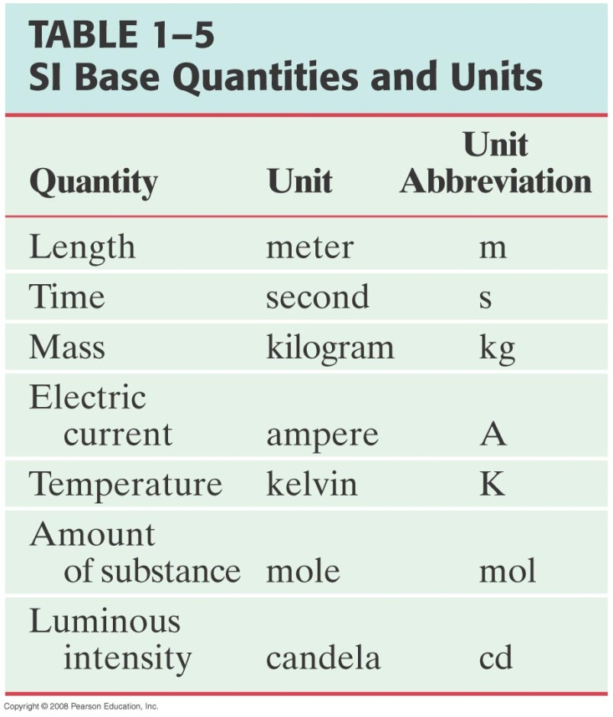
Base versus Derived Quantities
Physical quantities can be divided into:
  Base quantities
  It is the seven quantities in the SI system and must be define in terms of standard
Notes:
ˈluː.mɪ.nəs

Slide 27
SI Derived Quantities and Units
All physical quantities are defined in terms of the base quantities
  Both the quantity and its unit are derived from a combination of base units, using a defining equation.
Example: Derived units for speed, acceleration and force:
Notes:
ˌkɒm.bɪˈneɪ.ʃən , ɪˈkweɪ.ʒən/

Slide 28
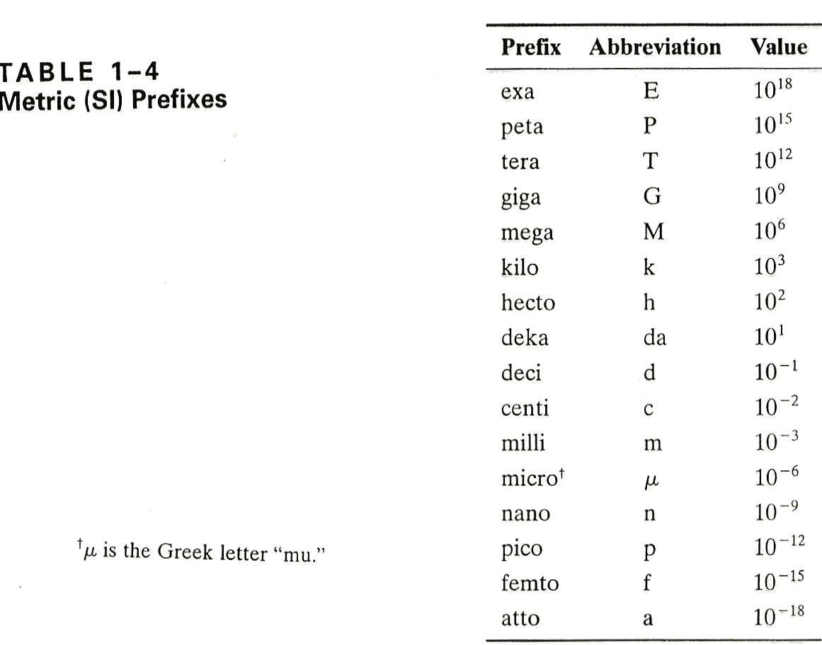
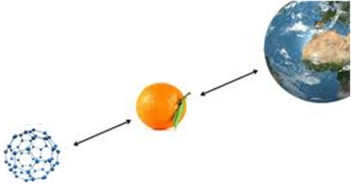
Larger & smaller units defined from SI standards by powers of 10 & Greek prefixes
Fullerene molecule
The number 4.436 × 10⁴ km can be written as:
A. 4.436 Mm B. 4436 km
C. 4436 Mm D. 44.36 Mm
Notes:
Ans. D

Slide 29
Other Systems of Units
CGS (centimeter-gram-second) system
  Centimeter = 0.01 meter
  Gram = 0.001 kilogram
British (foot-pound-second) system
  Our “everyday life” system of units
  Still used in some countries like USA
  British engineering system has force instead of mass as one of its basic quantities

Slide 30
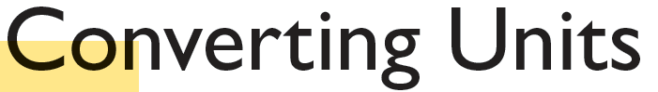
Unit conversions always involve a conversion factor.
Suppose you are to convert 15 US Dollar ($) into Saudi Ryal (SR) :
1st Find conversion factor: 1 $ = 3.75 SR
2nd
3rd
Likewise convert 21.5 inches (in) into cm :
1st Conversion factor: 1 in = 2.54 cm
2nd
3rd

Slide 31
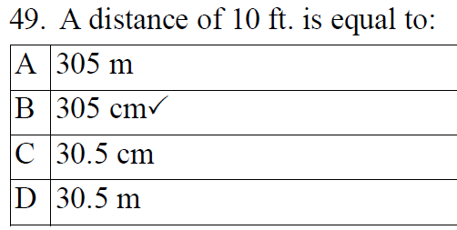
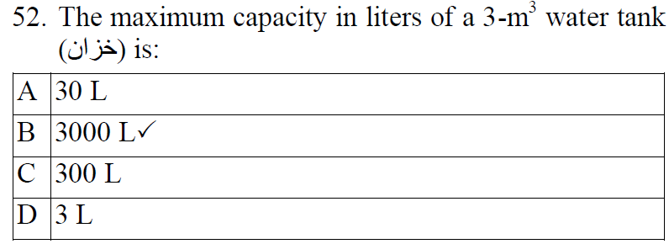
Hint:
1 ft = 12 in
and
1 in = 2.54 cm
Hint:
1 m³ = 1000 L

Slide 32
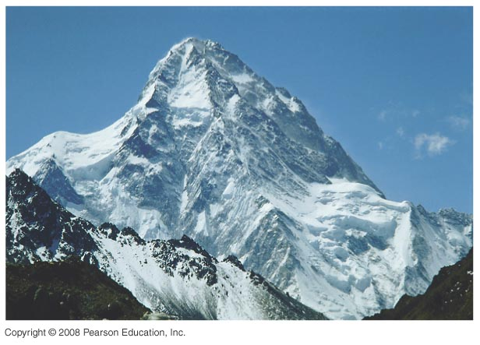
Working Examples
1. What is the elevation, in feet, of an elevation of 8000 m?(1ft=12in.)
Notes:
1m= 3.28 ft
Figure 1-6. Caption: The world’s second highest peak, K2, whose summit is considered the most difficult of the “8000-ers.” K2 is seen here from the north (China).
Answer: An elevation of 8000 m is 26,247 ft above sea level.

Slide 33
2. A silicon chip has an area of 1.25 square inches. Express this in square centimeters.

Slide 34
3. Posted speed limit is 55 miles per hour, what is this speed in kilometer per hour? (1 mile = 5280 ft)
Notes:
1 mile=1609 m

Slide 35
4. Would a driver travelling at 15 m/s in a 35 mi/h zone be exceeding the speed limit?
Notes:
No

Slide 36
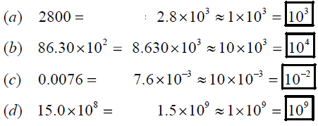
Order of Magnitude; Rapid Estimating
Sometimes, we are interested in only an approximate value for a quantity. We are interested in obtaining rough or order of magnitude estimates.
Order of magnitude estimates: Made by rounding off all numbers in a calculation to 1 significant figure, along with power of 10.
  Can be accurate to within a factor of 10 (often better)
Which means determining the power of 10 that is closest to the actual numerical value of the quantity.
The order of magnitude of
Notes:
Which means determining the power of 10 that is closest to the actual numerical value of the quantity.

Slide 37
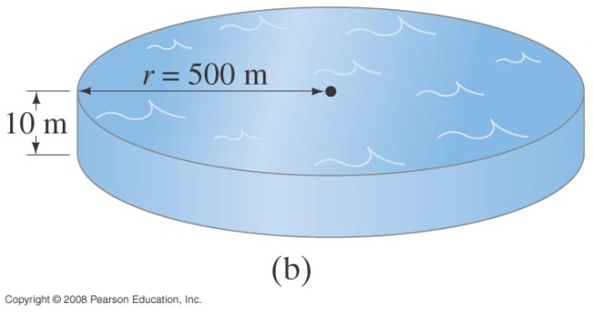
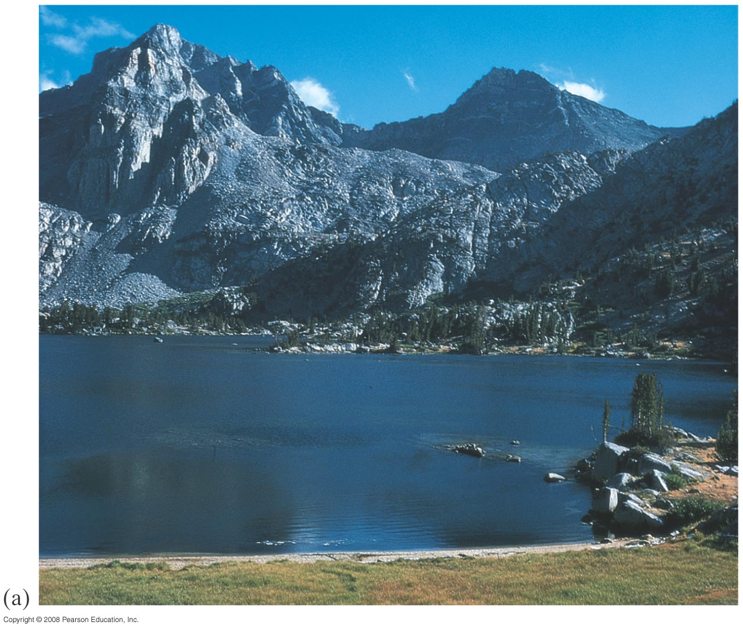
1-7 Order of Magnitude: Rapid Estimating
Example 1-5: Volume of a lake.
Estimate how much water there is in a particular lake, which is roughly circular, about 1 km across, and you guess it has an average depth of about 10 m.
Notes:
Figure 1-7. Caption: Example 1–5. (a) How much water is in this lake? (Photo is of one of the Rae Lakes in the Sierra Nevada of California.) (b) Model of the lake as a cylinder. [We could go one step further and estimate the mass or weight of this lake. We will see later that water has a density 1000 kg/m³, of so this lake has a mass of about (10³ kg/m³)(10⁷ m³) ≈ 10¹⁰ kg, which is about 10 billion kg or 10 million metric tons. (A metric ton is 1000 kg, about 2200 lbs, slightly larger than a British ton, 2000 lbs.)]
Answer: The volume of the lake is about 10⁷ m³.

Slide 38
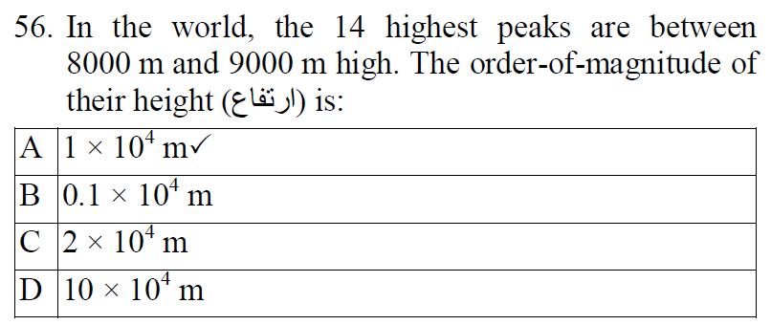
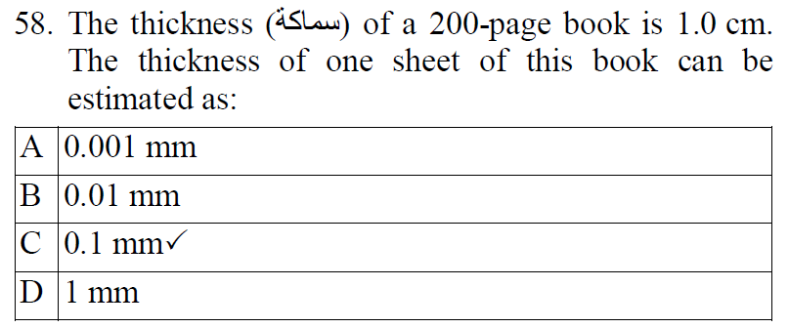
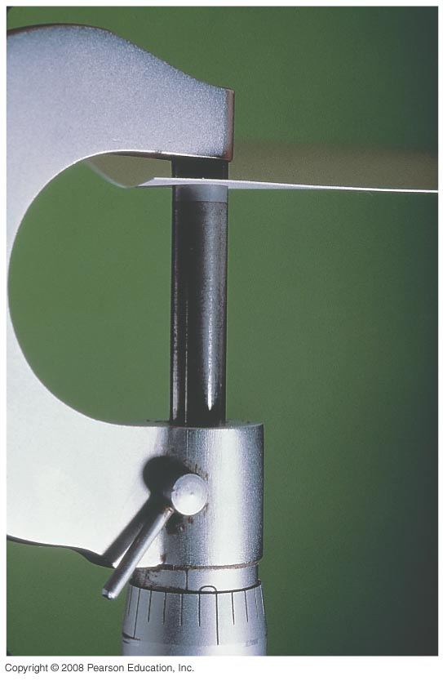
Explanation:
You measure that a book with 300 sheets of paper is 3-cm thick. This means that the thickness of one sheet of this book is…………μm
Notes:
Ans. = 100 μιχρο m

Slide 39
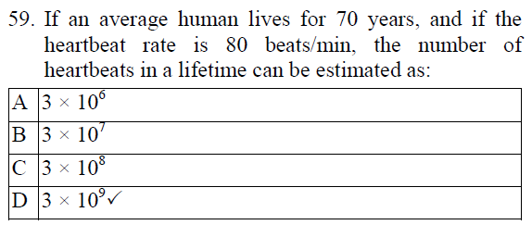

Slide 40
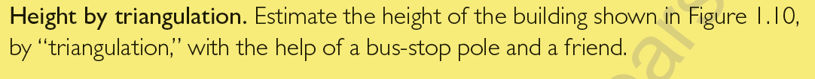
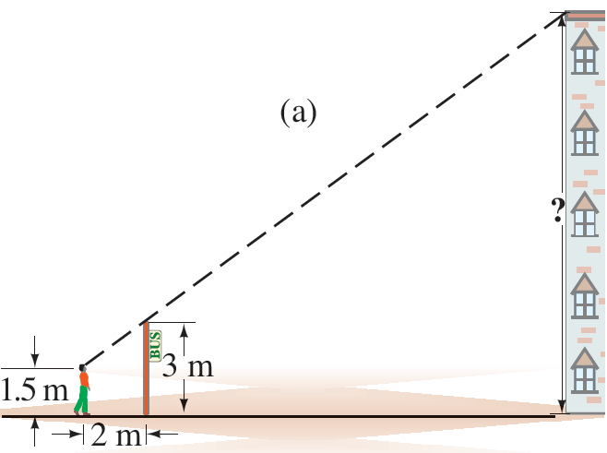
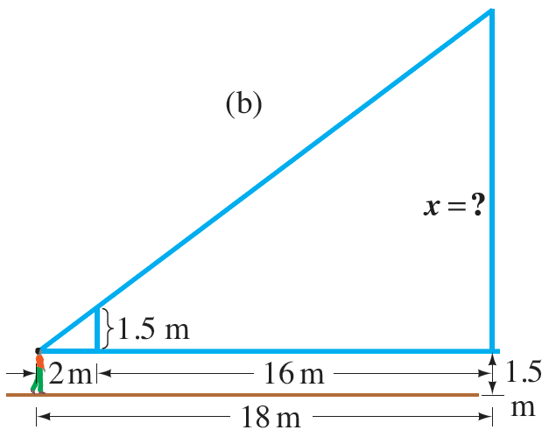

Slide 41
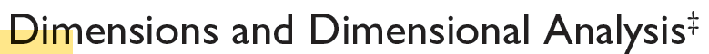
The dimension of a physical quantity is the type of units or base quantities that make it up.
Base quantity Dimension abbreviation
Length [L]
Time [T]
Mass [M]
… …
Dimension of the velocity & speed =
Dimension of the acceleration =
Dimensional analysis is the checking of dimensions of all quantities in an equation to ensure that those which are added, subtracted, or equated have the same dimensions.

Slide 42
Dimensional analysis:
Example:
Left Hand Side (LHS)
Right Hand Side (RHS)
The equation is incorrect
⇒ The equation is dimensionally correct (But could be physically incorrect)

Slide 43
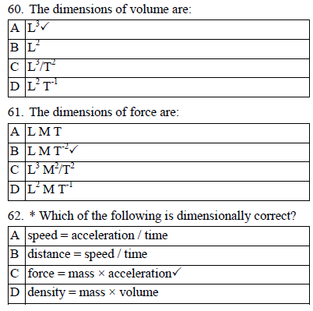
The equation: speed = (acceleration × time^{n}) is dimensionally correct if n equals…….
Notes:
Ans. = 1

Slide 44
Remember
The approach to rounding off is summarized as follows
If the digit is smaller than 5, drop this digit and leave the remaining number unchanged.
Thus, 1.684 becomes 1.68. (underestimating )
If the digit is 5 or larger, drop this digit and add 1 to the preceding digit. Thus, 1.247 becomes 1.25. (overestimating )

Slide 45
Students can also access the material via:
Site: http://equella2emea.pearson.com/taibah-pri/logon.do
User Name: viewer
Password: viewer

