Slide 1
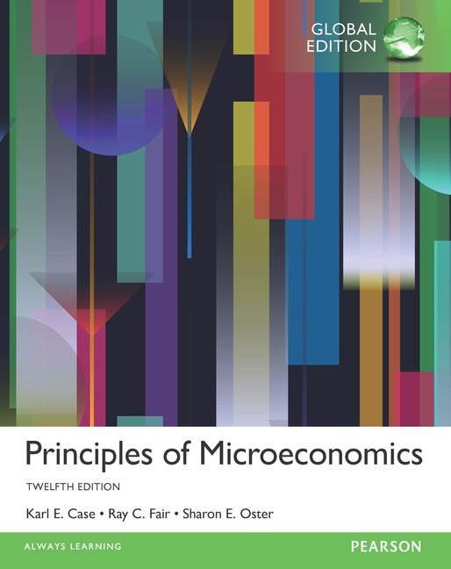
Principles of Microeconomics
Twelfth Edition, Global Edition
Chapter 7
The Production Process: The Behavior of Profit-Maximizing Firms

Slide 2
Chapter Outline and Learning Objectives
7.1 The Behavior of Profit-Maximizing Firms
Understand the importance of opportunity costs to economic profits and how these profits feed into firm decision making.
7.2 The Production Process
Be able to describe how total, marginal, and average products relate to one another.
7.3 Choice of Technology
Discuss the factors that firms consider when choosing among production techniques.
Looking Ahead: Cost and Supply
Appendix: Isoquants and Isocosts
Derive a cost curve from isoquants and isocost lines.

Slide 3
Chapter 7 The Production Process: The Behavior of Profit-Maximizing Firms
All firms demand inputs, engage in production, and produce output.
Firms also have an incentive to maximize profits and minimize costs.
production The process by which inputs are combined, transformed, and turned into outputs.
firm An organization that comes into being when a person or a group of people decides to produce a good or service to meet a perceived demand.

Slide 4
The Behavior of Profit-Maximizing Firms
All firms must make several basic decisions to achieve what we assume to be their primary objective—maximum profits.
FIGURE 7.1 The Three Decisions That All Firms Must Make

Slide 5
Profits and Economics Costs (1 of 3)
profit The difference between total revenue and total cost.
profit = total revenue $−$total cost
total revenue The amount received from the sale of the product (q × P).
total cost The total of (1) out-of-pocket costs and (2) opportunity cost of all factors of production.

Slide 6
Profits and Economics Costs (2 of 3)
The term profit will from here on refer to economic profit.
So whenever we say profit = total revenue $−$ total cost, what we really mean is:
economic profit = total revenue $−$ total economic cost
economic profit Profit that accounts for both explicit and opportunity costs.

Slide 7
Profits and Economics Costs (3 of 3)
Normal Rate of Return
The way we treat the opportunity cost of capital is to add a normal rate of return to capital as part of economic cost.
normal rate of return A rate of return on capital that is just sufficient to keep owners and investors satisfied. For relatively risk-free firms, it should be nearly the same as the interest rate on risk-free government bonds.

Slide 8
TABLE 7.1 Calculating Total Revenue, Total Cost, and Profit
Initial Investment: Market Interest Rate Available: | $20,000 0.10, or 10%
Total revenue (3,000 belts × $10 each) | $30,000
Costs
Belts from Supplier | $15,000
Labor cost | 14,000
Normal return/opportunity cost of capital ($20,000 × 0.10) | 2,000
Total Cost | $31,000
Profit = total revenue − total cost | −$1,000ª
ª There is a loss of $1,000.

Slide 9
Short-Run versus Long-Run Decisions
short run The period of time for which two conditions hold: The firm is operating under a fixed scale (fixed factor) of production, and firms can neither enter nor exit an industry.
long run That period of time for which there are no fixed factors of production: Firms can increase or decrease the scale of operation, and new firms can enter and existing firms can exit the industry.

Slide 10
The Bases of Decisions: Market Price of Outputs, Available Technology, and Input Prices
A firm needs to know three things:
Market price of output: potential revenues
Production techniques that are available: how much input needed
Input prices: costs
optimal method of production The production method that minimizes cost for a given level of output.

Slide 11
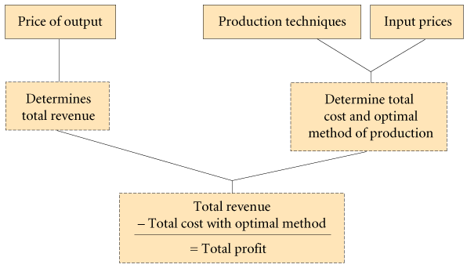
FIGURE 7.2 Determining the Optimal Method of Production

Slide 12
The Production Process
production technology The quantitative relationship between inputs and outputs.
labor-intensive technology Technology that relies heavily on human labor instead of capital.
capital-intensive technology Technology that relies heavily on capital instead of human labor.

Slide 13
Production Functions: Total Product, Marginal Product, and Average Product (1 of 3)
production function or total product function A numerical or mathematical expression of a relationship between inputs and outputs. It shows units of total product as a function of units of inputs.

Slide 14
TABLE 7.2 Production Function
(1) Labor Units (Employees) | (2) Total Product (Sandwiches per Hour) | (3) Marginal Product of Labor | (4) Average Product of Labor (Total Product ÷ Labor Units)
0 1 2 3 4 5 6 | 0 10 25 35 40 42 42 | — 10 15 10 5 2 0 | — 10.0 12.5 11.7 10.0 8.4 7.0

Slide 15
Production Functions: Total Product, Marginal Product, and Average Product (2 of 3)
Marginal Product and the Law of Diminishing Returns
marginal product The additional output that can be produced by adding one more unit of a specific input, ceteris paribus.
law of diminishing returns When additional units of a variable input are added to fixed inputs, after a certain point, the marginal product of the variable input declines.
Every firm faces diminishing returns, which always apply in the short run.

Slide 16
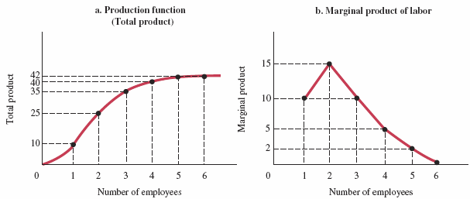
FIGURE 7.3 Production Function for Sandwiches
A production function is a numerical representation of the relationship between inputs and outputs.
In panel (a), total product (sandwiches) is graphed as a function of labor inputs.
The marginal product of labor is the additional output that one additional unit of labor produces.
Panel (b) shows that the marginal product of the second unit of labor at the sandwich shop is 15 units of output; the marginal product of the fourth unit of labor is 5 units of output.

Slide 17
Production Functions: Total Product, Marginal Product, and Average Product (3 of 3)
Marginal Product versus Average Product
average product The average amount produced by each unit of a variable factor of production.
If marginal product is above average product, the average rises; if marginal product is below average product, the average falls.

Slide 18
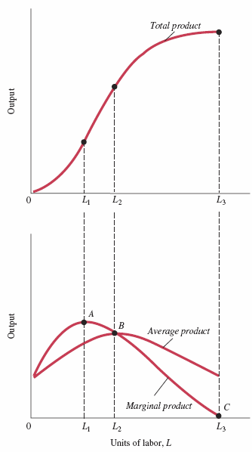
FIGURE 7.4 Total Average and Marginal Product
Marginal and average product curves can be derived from total product curves.
Average product is at its maximum at the point of intersection with marginal product.

Slide 19
Production Functions with Two Variable Factors of Production (1 of 2)
Inputs work together in production. Capital and labor are complementary inputs.
Additional capital increases the productivity of labor—that is, the amount of output produced per worker per hour.
This simple relationship lies at the heart of worries about productivity at the national and international levels. Building new, modern plants and equipment enhances a nation’s productivity.

Slide 20
Production Functions with Two Variable Factors of Production (2 of 2)
In the past decade, China has accumulated capital (that is, built plants and equipment) at a very high rate. The result has been growth in the average quantity of output per worker in China.

Slide 21
ECONOMICS IN PRACTICE
Learning about Growing Pineapples in Ghana
In the 1990s, an area of Ghana changed from an exclusive reliance on maize as the agricultural crop to the development of pineapple farms.
The choice of how much fertilizer to use was highly dependent on how much fertilizer more successful neighbor farmers used.
Social learning plays a role in the diffusion of technology.
THINKING PRACTICALLY
1. In many high-tech firms, executives must sign non-compete agreements, preventing them from working for a competitor after they stop working for their current firm. These agreements are much less common in mature manufacturing firms. Why?

Slide 22
Choice of Technology
TABLE 7.3 Inputs Required to Produce 100 Diapers Using Alternative Technologies
Technology | Units of Capital (K) | Units of Labor (L)
A B C D E | 2 3 4 6 10 | 10 6 4 3 2
TABLE 7.4 Cost-Minimizing Choice among Alternative Technologies (100 Diapers)
(1) Technology | (2) Units of Capital (K) | (3) Units of Labor (L) | Cost = (L × P_{L}) + (K × P_{K})
 |  |  | (4) | (5)
 |  |  | P_{L} = $1 P_{K} = $1 | P_{L} = $5 P_{K} = $1
A B C D E | 2 3 4 6 10 | 10 6 4 3 2 | $12 9 8 9 12 | $52 33 24 21 20
Two things determine the cost of production: (1) technologies that are available and (2) input prices. Profit-maximizing firms choose the technology that minimizes the cost of production, given current market input prices.

Slide 23
ECONOMICS IN PRACTICE How Soon Should Preventive Maintenance Be Employed?
For a large-scale, plant-based industry the most important aspect is how gains can be realized in a competitive environment. One crucial measure is to have better maintenance practices.
With more than one input, the optimal “technology” to use in manufacturing depends on costs and productivity of maintenance services. Modern technology allows a modern manufacturing firm to observe and recognize the benefits of maintenance services within a production department.
THINKING PRACTICALLY
1. Apart from those mentioned in this case, what other inputs and technological decisions do manufacturing firms have to make to minimize its costs and, therefore, maximizes profits?

Slide 24
REVIEW TERMS AND CONCEPTS
average product
capital-intensive technology
economic profit
firm
labor-intensive technology
law of diminishing returns
long run
marginal product
normal rate of return
optimal method of production
Production
production function or total product function
production technology
profit
short run
total cost (total economic cost)
total revenue
Equations:
profit = total revenue – total cost

Slide 25
CHAPTER 7 APPENDIX: Isoquants and Isocosts
New Look at Technology: Isoquants
This chapter has shown that the cost structure facing a firm depends on two key pieces of information: (1) input (factor) prices and (2) technology.
This appendix presents a more formal analysis of technology and factor prices and their relationship to cost.
isoquant A graph that shows all the combinations of capital and labor that can be used to produce a given amount of output.

Slide 26
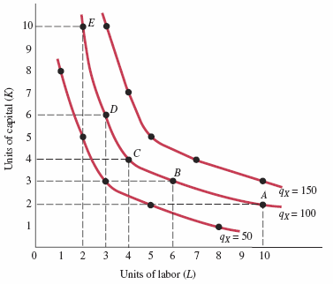
TABLE 7A.1 Alternative Combinations of Capital (K) and Labor (L) Required to Produce 50, 100, and 150 Units of Output
FIGURE 7A.1 Isoquants Showing All Combinations of Capital and Labor That Can Be Used to Produce 50, 100, 150 Units of Output
 | Q_{X} = 50 |  | Q_{X} = 100 |  | Q_{X} = 150
 | K | L | K | L | K | L
A B C D E | 1 2 3 5 8 | 8 5 3 2 1 | 2 3 4 6 10 | 10 6 4 3 2 | 3 4 5 7 10 | 10 7 5 4 3

Slide 27
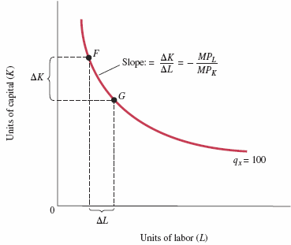
FIGURE 7A.2 The Slope of an Isoquant Is Equal to the Ratio of MP_{L} to MP_{K}

Slide 28
New Look at Technology: Isoquants
For output to remain constant, the loss of output from using less capital must be matched by the added output produced by using more labor.
marginal rate of technical substitution The rate at which a firm can substitute capital for labor and hold output constant.

Slide 29
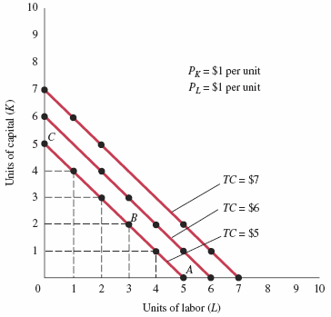
FIGURE 7A.3 Isocost Lines Showing the Combinations of Capital and Labor Available for $5, $6, and $7
An isocost line shows all the combinations of capital and labor that are available for a given total cost.

Slide 30
Factor Prices and Input Combinations: Isocosts
The equation of the straight line in Figure 7A.3:
Substituting our data for the lowest isocost line into this general equation, we get:
isocost line A graph that shows all the combinations of capital and labor available for a given total cost.

Slide 31
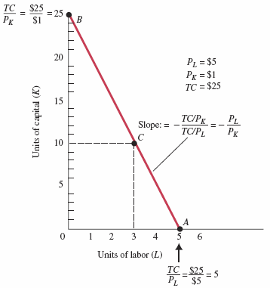
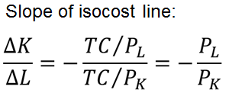
FIGURE 7A.4 Isocost Line Showing All Combinations of Capital and Labor Available for $25
One way to draw an isocost line is to determine the endpoints of that line and draw a line connecting them.

Slide 32
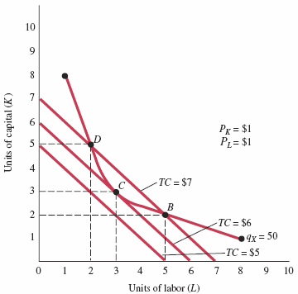
Finding the Least-Cost Technology with Isoquants and Isocosts
FIGURE 7A.5 Finding the Least-Cost Combination of Capital and Labor to Produce 50 Units of Output
Profit-maximizing firms will minimize costs by producing their chosen level of output with the technology represented by the point at which the isoquant is tangent to an isocost line.
Here the cost-minimizing technology—3 units of capital and 3 units of labor—is represented by point C.

Slide 33
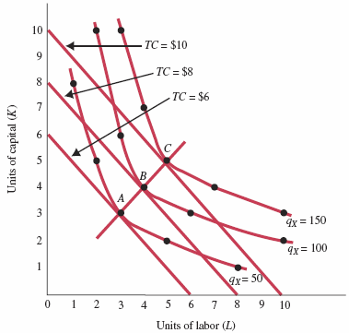
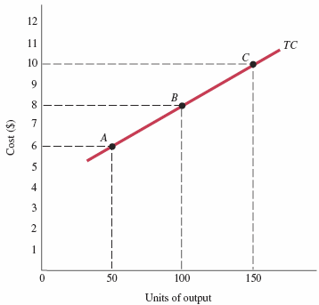
FIGURE 7A.6 Minimizing Cost of Production for q_{X} = 50, q_{X} = 100, and q_{X} = 150
FIGURE 7A.7 A Cost Curve Shows the Minimum Cost of Producing Each Level of Output
Plotting a series of cost-minimizing combinations of inputs—shown in Figure 7A.6 as points A, B, and C—on a separate graph results in a cost curve like the one shown in Figure 7A.7.

Slide 34
The Cost-Minimizing Equilibrium Condition
At the point where a line is just tangent to a curve, the two have the same slope. At each point of tangency, the following must be true:
Thus,
We divide both sides by PL and multiply both sides by MPK:

Slide 35
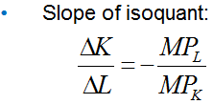
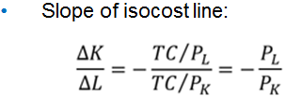
APPENDIX REVIEW TERMS AND CONCEPTS
isocost line
isoquant
marginal rate of technical substitution
Equations:

